Slide 1
Leveraging Data and Apprenticeships to Strengthen the Educator Workforce
September 24, 2026

Slide 2
Housekeeping
Please add your organization to your Zoom name:
In the Participants list, click the “More“ button by your name
Select “Rename” from the drop-down menu
Add a short version of your organization name after your name, then click “OK”
Today’s session is being recorded.
Please remain on mute when not speaking to minimize noise.
Share questions and comments in the chat box.
If you have any technical issues, please contact Micayla Tomkins at MicaylaRKinder@ufl.edu.

Slide 3
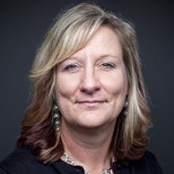


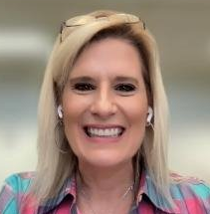
CEEDAR Apprenticeship Team
Lynn Holdheide
Cheryl Krohn, PhD
Meghan Wills
Lisa White, EdD
Content Expert,
CEEDAR
Managing TA Consultant, American Institutes for
Research (AIR)
Content Expert,
CEEDAR
Senior TA Consultant, American Institutes for
Research (AIR)
Content Expert,
CEEDAR
Senior TA Consultant, American Institutes for
Research (AIR)
Apprenticeship Team
Coordinator
CEEDAR Center

Slide 4
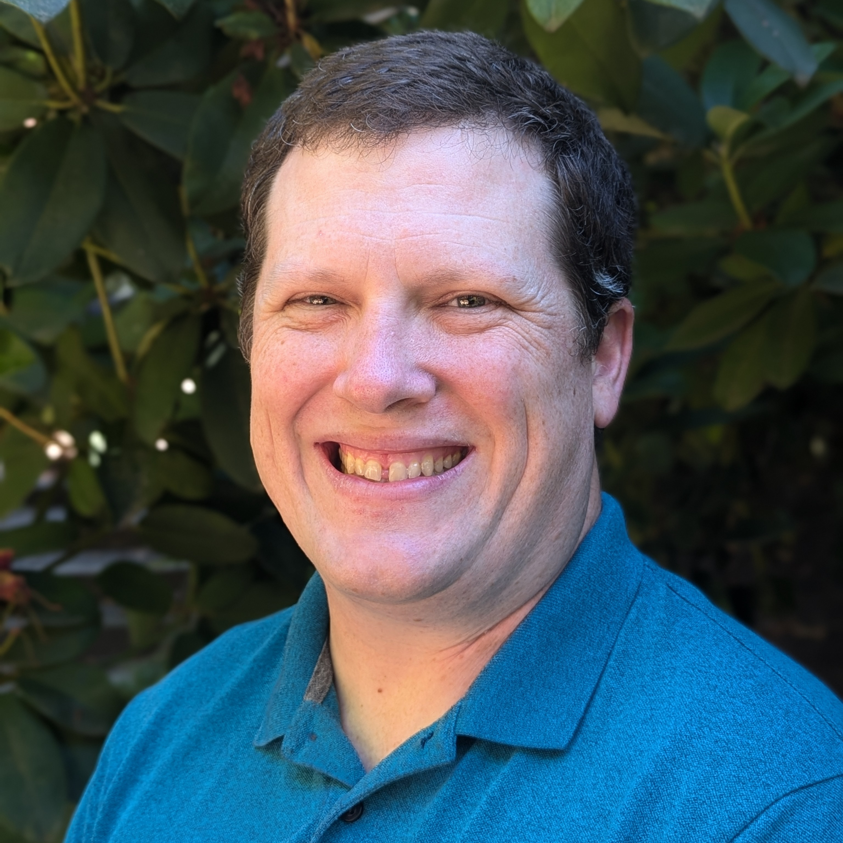
Presenters
Roddy Theobald, PhD
James (Jim) Meadows, PhD
Co-Director, SPARC Center
Senior Policy Researcher, RAND
Founding Dean and Director
Washington Education Association Apprenticeship Residency in Teaching
Notes:
James (Jim) Meadows, Ph.D. is the founding Dean and Director of the Washington Education Association Apprenticeship Residency in Teaching Program (WEA-ART), a union-run, educator-led preparation program credentialing special education teachers in Washington state. WEA-ART is built for aspiring, diverse educators who have a passion for equity and find joy in working with students with disabilities. WEA-ART is Washington state’s only teaching apprenticeship, run in partnership with school district and local association partners to address the state’s persistent shortage of special educators. Most of Jim's career has focused on educator quality and elevating the education professions. He led WEA's National Board Certification efforts over two decades, contributing to significant growth in the state's National Board Certification movement. In 2026 he received the prestigious James Kelly Award from the National Board for Professional Teaching Standards (NBPTS) for his national leadership. Jim is a first-generation college student and earned Ph.D. work at the University of Washington focused on the intersection of policy and practice, which remains at the forefront of his work today.
Roddy Theobald is a Senior Policy Researcher at RAND and director of the SPARC Center. His ongoing projects investigate teacher education and licensing, career and technical education, and special education in Hawaii, Massachusetts, Pennsylvania, and Washington. Roddy received his PhD in Statistics from the University of Washington in 2015, and he previously worked as a Managing Researcher at American Institutes for Research, as a Research Assistant at the Center for Education Data and Research at the University of Washington, and as a 7th-grade math teacher at Westlake Middle School in the Oakland (CA) Unified School District as a Teach For America corps member.

Slide 5
CEEDAR’s Mission

Slide 6
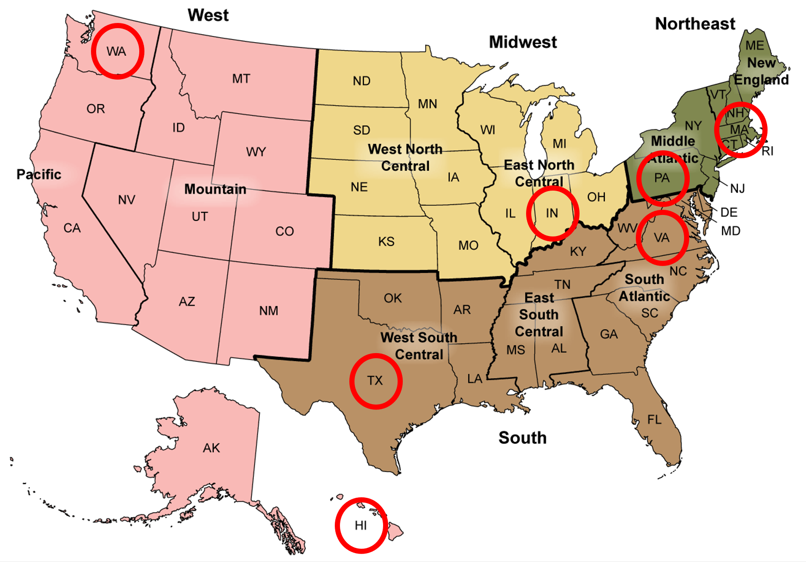
The Special Educator Workforce: A Research Collaborative
IES NCSER-Funded National Research Center
The SPARC Center aims to address challenges related to the special education teacher (SET) workforce, including composition, distribution, stability, and effectiveness. It is a five-year $5 million IES NCSER grant covering research in partnership with seven states (Hawai`i, Indiana, Massachusetts, Pennsylvania, Texas, Virginia, and Washington).

Slide 7
Poll – What is your role in RTAPs?

Slide 8
Agenda
Welcome & Introductions
Using Data to Understand Workforce Needs: Washington State Spotlight
Washington's Approach to Addressing Teacher Shortages
Registered Teacher Apprenticeship as a Strategy for Strengthening the Special Education Teacher Workforce
Helpful Registered Teacher Apprenticeship Program Resources
Looking Ahead: Building the Evidence Base

Slide 9
Using Data to Understand Workforce Needs
SPARC Data Explorer: Washington State Spotlight

Slide 10
Washington's Approach to Addressing Teacher Shortages

Slide 11
Washington Education Association
Apprenticeship Residency in Teaching (WEA-ART)
September 24, 2026

Slide 12
Initial Design Framework
Designed, developed and run by practicing educators: “By educators, for educators”
Innovation Question: “If you could design the special education preparation program you wish you would have had, what would it look like?”
Intent: Build a program model different from other Washington EPPs; encourage innovation
How do we build a program that has a shot at sustainability post ESSER grant?
  WEA: Provides high-quality preparation program
  School Districts: Fund apprentice salary/benefits; create bridge to employment

Slide 13
WEA-ART Innovations
Educator Led
Union Run
300+ educators have shaped the program (curriculum designers, course faculty, graders, mentors, coaches, field supervisors, etc.)
Brings the power of collective bargaining and labor/ management collaboration to workforce development
All apprentices are under collective bargaining agreements
  Barrier removal
  Rights, workplace supports

Slide 14
WEA-ART Innovations (2)
WEA-ART Innovations
Artificial Intelligence (AI)
Competency-Based Transition
WEA-ART build parallelled emergence of AI
Strong integration of AI throughout the program
  AI-based products (ColleagueAI, Mursion, Iris Connect)
  Curriculum redesign integrating AI
Rebuilding 351 program standards into 14 competencies
  Formative assessments
  Summative assessments
Will allow apprentices to “show what they know” and have some coursework and field requirements waived
Could become a pathway for an endorsement-only program for existing WA certified teachers (retooling)

Slide 15
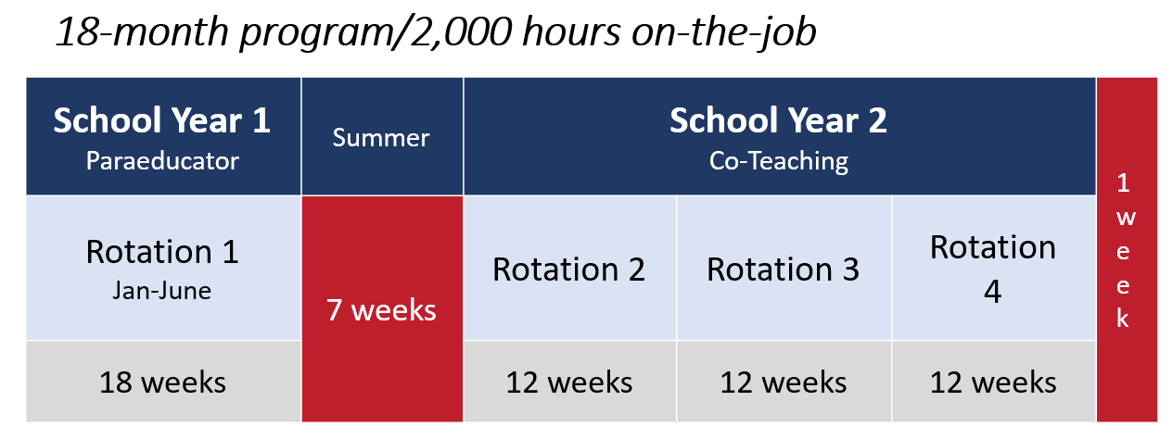
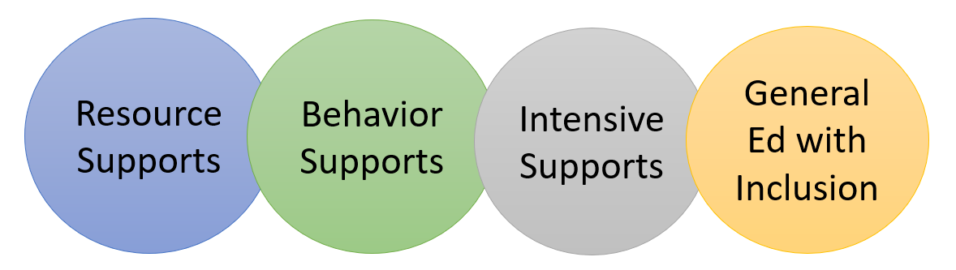
WEA-ART Innovations (3)
WEA-ART Innovations
2,000 Hour Model
Medical Rounds Model
WA EPPs required to have 540 student teaching hours
Embraces a clinical rounds rotation model to ensure in-depth, multi-level training experience

Slide 16
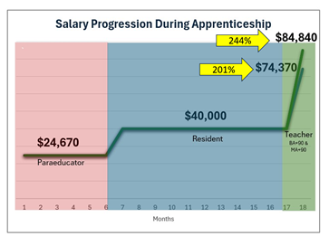
WEA-ART Innovations (4)
WEA-ART Innovations
ESP Career Pathway via Wage Progression
80-90% are/were ESP
Intense barrier removal shatters glass ceilings. Economic justice.
Collective Bargaining
Apprentices under collective bargaining agreements
Labor/management collaboration ensures:
  1-1 preparation: vacancy → staffing
  Effective, intentional school/job placements
  Shared responsibility for apprentice success
  Higher starting salaries

Slide 17
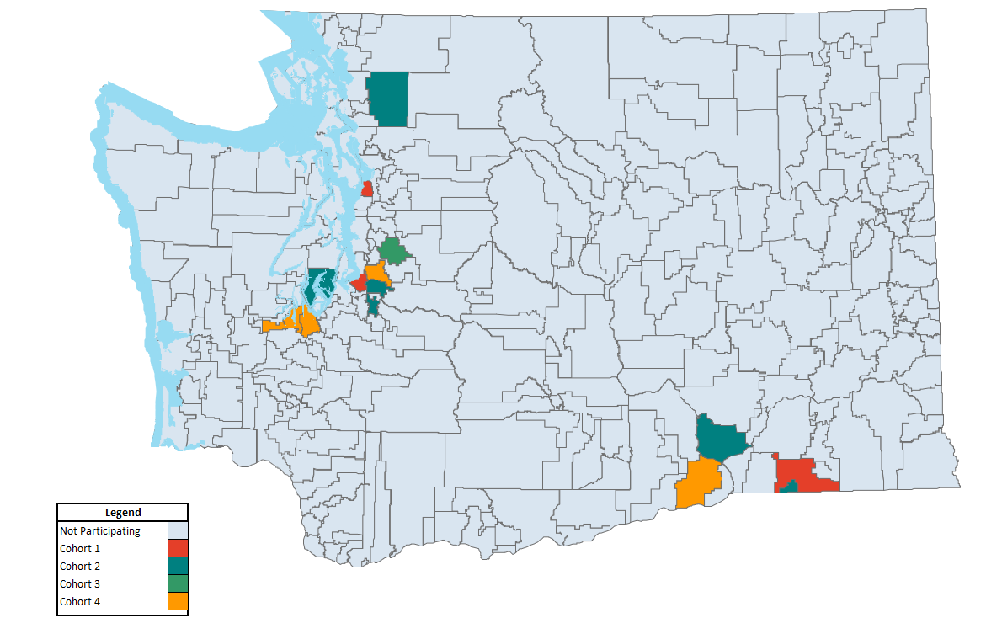
Partner School Districts
Cohort 1:
Federal Way
Mukilteo
Walla Walla
Cohort 2 added:
Auburn
Sumner/Bonney Lake
Peninsula
Pasco
College Place
Sedro-Woolley
Cohort 3 added:
Issaquah
Cohort 4 added:
Kennewick
Kent
Olympia
North Thurston
Notes:
i

Slide 18
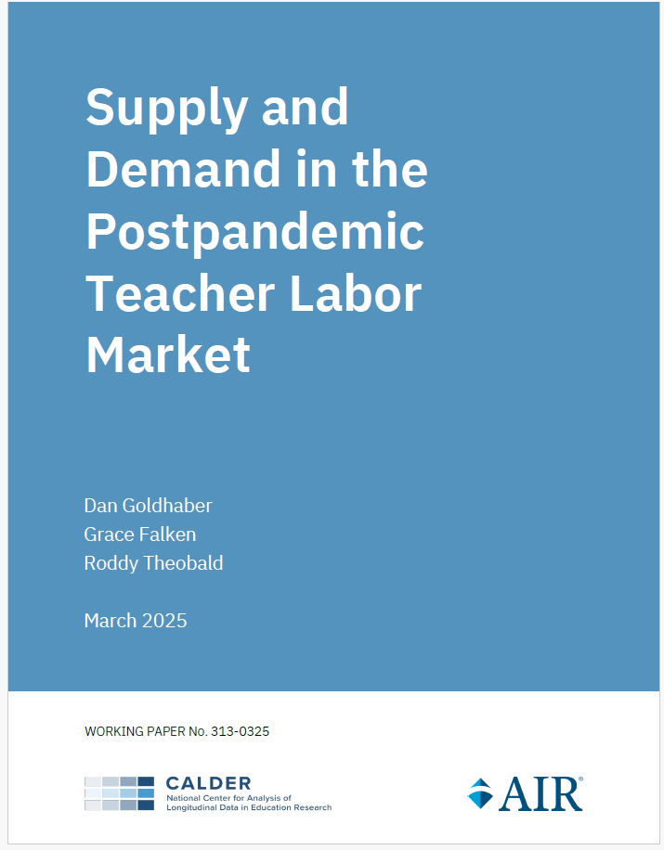
Supply and Demand: Special Educators
2024 Professional Educator Standards Board (PESB) Shortage Report: Special Education is the #1 shortage area - persistent shortage for years.
WA teacher preparation programs only produce 10 new candidates for every 16 new special education job postings: 62% of job market needs (Calder/AIR, 2025)
Notes:
WEA-ART
Aligns program recruitment efforts with state workforce initiatives
Creates a certification pathway
Recruits educators who more closely represent their communities
Reduces financial barriers.

Slide 19

Our WEA-ART Resident Apprentices
Cohort 1 | 13 Completers
Cohort 2 | 29 Completers
Cohort 3 | 19 Completers
Cohort 4
All applicants | 98
Eligible, complete | 79
Offered admission | 34
Currently Enrolled | 28
Tori Castro
Cohort 2
Mark Twain Elementary
Federal Way

Slide 20
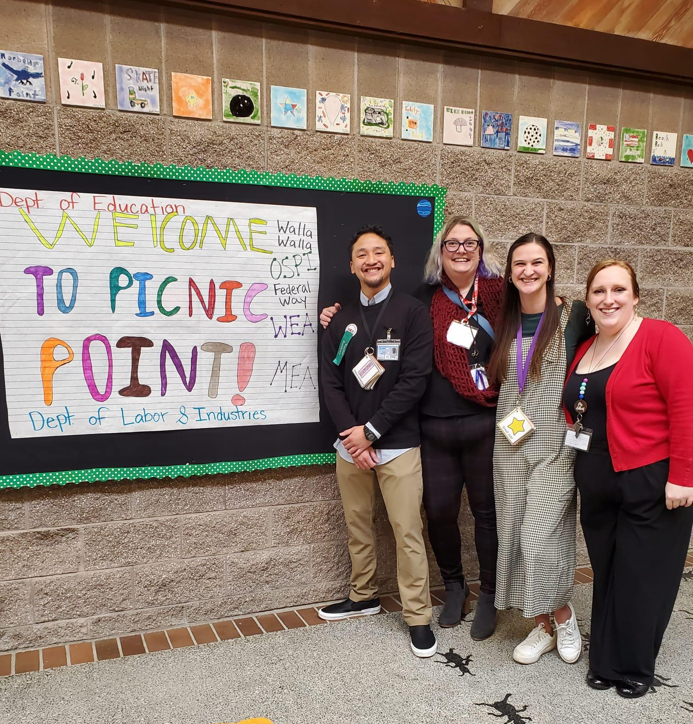
Cohort 4: Disability
Voluntary Disability Disclosure | Applied | Eligible | Admitted
Yes, I have or previously had a disability | 21% | 22% | 28%
No, I do not have a disability | 70% | 73% | 63%
Prefer not to answer | 8% | 5% | 9%
In Washington state, 16% of students are identified as having disabilities (OSPI Report Card, 2025)

Slide 21
Enrollment and Completion in Washington State Teacher Preparation Programs (TPPs)
 | 2023-24 | 2022-23 | 2021-22 | 2020-21 | 2019-20 | 2018-19
Enrollees | 7,062 | 7,079 | 8,358 | 10,654 | 11,275 | 10,059
Completers | 2,828 | 2,949 | 3,106 | 3,320 | 3,057 | 2,994
Number of completers is relatively steady with slight declines, while the number of enrollees has declined more significantly.
Note: Many programs last more than one year, which is why the number of enrollees is so much greater than the number of completers. A person is a completer only one year, but may be enrolled several years.
Source: Title II Reports, accessed 3/29/26. Numbers may not total 100% due to rounding.

Slide 22
WEA-ART and Washington State
Washington state Data
WEA-ART Data
Washington state data from OSPI Report Card (Feb. 2026). Cohorts 1 and 2 is completer data. Cohorts 3 and 4 is current enrollee data.

Slide 23
Teacher Residency retention rates surpass traditional programs.
Prepared to Teach finds that, “Studies show new teachers who complete high-quality teacher residency programs, where they spend a full year in clinical placements alongside accomplished teachers before being hired as teachers of record, have retention rates after four years as high as 93% in programs that were specifically designed to recruit, prepare, and support new teachers for district hiring needs.” (2023)
Multiple research reports collected by the Learning Policy Institute show that teachers inducted using a teacher residency model stay in the profession between 75% and 90% past their commitment period and five years. (2024)

Slide 24
Dynamic Cost Impacts of Residency Apprenticeship
Potential cost savings by hiring and retaining highly qualified special education teachers:
Lower costs related to recruitment and retention
  Teacher resident candidates joining this program have already worked in schools and shown a passion for educating children and a desire to create a career from this work. Keeping teachers in the profession reduces teacher churn on schools saving money.
  The cost of hiring a new teacher to a district ranges from $7K in remote/rural schools to $30K in urban districts.
Potential for lower costs related to compliance requirements –
  Well-prepared special education teachers better understand federal and state compliance requirements for special education which will lead to less founded complaints and lost due process hearings.
  The cost avoidance of staff time related to complaints, legal fees for the district and awarded by the courts, awarded compensatory services, public disclosure requests and the broken trust of families should be considered.

Slide 25
Jim Meadows contact
Jim Meadows, Ph.D.
Dean & Director, Educator Career Pathways Center
WEA Apprenticeship Residency in Teaching (WEA-ART)
WEA Phone: 253-765-7102
CELL: 253-508-9810
EMAIL: jmeadows@washingtonea.org

Slide 26
Registered Teacher Apprenticeship as a Strategy to Strengthen the Special Education Teacher Workforce

Slide 27
Registered Apprenticeship – Earn and Learn
Paid Job​
On-The-Job Learning​
Mentorship​
Related Coursework​
Industry-​
Recognized and U.S. DOL- Endorsed Credentials
Notes:
This is most likely not new information to anyone here... So just briefly, we will introduce Registered Apprenticeship with the 5 main components of an RA: It is a paid job with an on-the-job learning or training component, mentorship, related coursework we sometimes call supplemental education or related technical instruction, and an industry-recognized and US. DOL-endorsed credential. These requirements apply to RA in general, including educator RAs.

Slide 28
National Registered Teacher Apprenticeship Landscape
All 50 states in the U.S., the District of Columbia, and several U.S. territories have approved Registered Teacher Apprenticeship Programs (RTAPs)
  In 2021, New York became the first state to recognize “teacher” as an apprenticeable occupation. Later that year, the U.S. Department of Labor’s Office of Apprenticeship similarly approved “K-12 teacher” as an apprenticeable occupation as well as the first federally approved RTAP in Tennessee.
Over half of the states in the U.S. have RTAPs preparing special education teachers

Slide 29
Special Education RTAPs
Variety of Program Models (listed by recruit type)
  Paraprofessionals/Noncertified staff
    Usually resulting in bachelor's degree and full licensure
    Sometimes certification-only (if para already has earned a bachelor's degree)
    Several dual-certification programs
      Often elementary education and special education
      Sometimes a combination of licensure areas within the field of special education (e.g., ASD/EBD)
  Career changers
    Typically post-baccalaureate programs, either resulting in certification only or full licensure and a graduate degree
  High school students
Notes:
Local context is key—What do the data show related to needs and available recruits? The inherent flexibility of the model allows RTAP developers to design programs to meet local needs. Sometimes we see models recruiting paraprofessionals or other non-certified staff.

Slide 30
Special Education RTAPs – Variety of Sponsor Types
Sponsor Type | Examples
State Education Agency | Georgia, Idaho, Kansas, North Dakota, Florida
Education Preparation Program (EPP) | Missouri State University, UNLV, Dakota State University, University of South Carolina
Local Education Agency/School District | Dougherty County School System (GA), Minneapolis Public Schools (MN), Bucks County Intermediate Unit (PA), Laramie County School District #1(WY)
Cooperative/Education Service Center | Brightworks (MN), Educational Service Center of Central Ohio, Region 4 Inspire Texas,
Other | NCDE (NH), Teacher Apprenticeship Network (NJ), Washington Education Association Apprenticeship Residency in Teaching (WEA-ART)

Slide 31
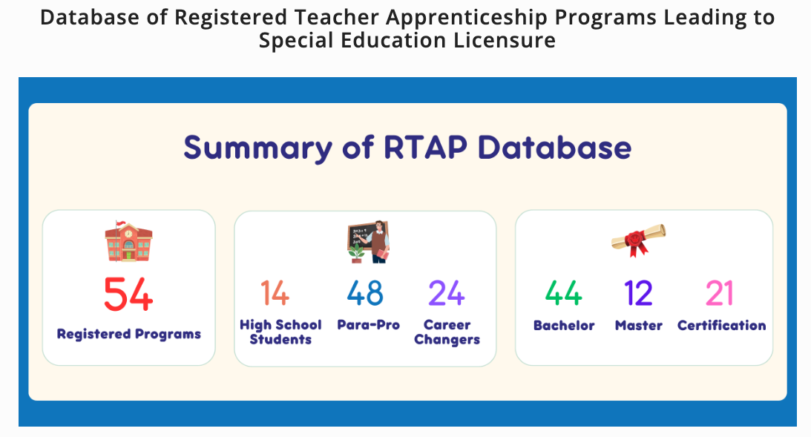
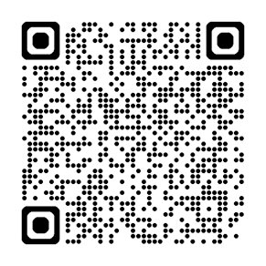
CEEDAR Special Education RTAP Database
The CEEDAR Apprenticeship Team is actively searching for RTAPs leading to special education licensure to add to the database.
Notes:
https://ceedar.education.ufl.edu/teacher-apprenticeship-resources/#toggle-id-1

Slide 32
Comparison of Teacher Prep Models
 | Grow Your Own | NCTR Teacher Residency | Registered Apprenticeship
Year-long mentored experience | X | X | X
Includes financial supports | X | X | X
Students earn a wage or stipend | X | X | X
Targeted recruitment | X | X | X
Requires strong partnerships with multiple partners | X | X | X
Must adhere to Equal Employment Opportunity law |  |  | X
Registered with USDOL or appropriate state agency |  |  | X
Participants complete college degree prior to entry | varies | X | varies
Participants complete coursework while in the program | X | X | X
Commitment to stay at the school district post-program for a specified time period |  | X
Source: New America and GYO Educators National Network, A Starter Guide to Grow Your Own Educator Programs, https://d1y8sb8igg2f8e.cloudfront.net/documents/GYO_A_Starter_Guide_to_Programs-FINAL.pdf; National Center for Teacher Residencies, Our Residency Model, https://nctresidencies.org/our-residency-model/ ​
Notes:
Although GYO, teacher residencies, and Registered Teacher Apprenticeship can be separate models, they are not mutually exclusive.

Slide 33
Teacher Residency and RTAP Evidence of Effectiveness
Teacher Residencies (Established Evidence Base) | RTAPs (Emerging Evidence Base) *
Strong positive impact on Recruitment ^{1,2} Composition of the workforce ^{1,2, 3, 4, 5, 6, 7, 8} Teacher preparedness 4, 5, 9, 10, 11, 12, 13, 14, 15, 16, 17 Teacher retention ^{1, 15, 17, 18, 19, 20} | Key strengths Accessibility and affordability ^{22, 23, 24} Addresses immediate workforce shortages
Mixed impact on student achievement; some studies report positive effects found in high-need schools and student populations ^{10, 21} | Apprentices value Earn-while-you learn wages Mentorship Extensive early classroom experience
 | *mainly informed by perception data, as limited long-term data exist

Slide 34
Teacher Residency and RTAP Evidence of Effectiveness
Shared success factors of Teacher Residencies and RTAPs
High-quality mentoring
Extended immersive clinical practice
Strong, collaborative district-EPP partnerships
Notes:
While teacher residencies have a stronger proven track record in positively impacting retention and student achievement (in some studies), both models rely on strong clinical practice, mentoring, and local partnerships to succeed.

Slide 35
References
Guha, R., Hyler, M. E., & Darling-Hammond, L. (2016). The teacher residency: An innovative model for preparing teachers. Learning Policy Institute. https://learningpolicyinstitute.org/media/182/download?inline&file=Teacher_Residency_Innovative_Model_Preparing_Teachers_REPORT.pdf
Silva, T., McKie, A., Knechtel, V., Gleason, P., & Makowsky, L. (2014). Teaching residency programs: A multisite look at a new model to prepare teachers for high-need schools (NCEE 2015-4002). U.S. Department of Education, Institute of Education Sciences, National Center for Education Evaluation and Regional Assistance. https://files.eric.ed.gov/fulltext/ED548234.pdf
Burstein, N., Sears, S., & Wilcoxen, A. (2023). Examining the effectiveness of a special education residency program in increasing the recruitment and retention of teachers in urban schools. Teacher Education Quarterly, 50(1), 28–52. https://eric.ed.gov/?id=EJ1375612
Fitz, J., & Yun, C. (2025, March). Successful teacher residencies: What matters and what works. Learning Policy Institute. https://eric.ed.gov/?id=ED674821
Learning Policy Institute. (2016, January 19). Teacher residencies in California. Learning Policy Institute. https://learningpolicyinstitute.org/product/teacher-residencies-california
Papay, J. P., West, M. R., Fullerton, J. B., & Kane, T. J. (2012). Does an urban teacher residency increase student achievement? Early evidence from Boston. Educational Evaluation and Policy Analysis, 34(4), 413–434. https://eric.ed.gov/?id=EJ985263
Patrick, S. K., Darling-Hammond, L., & Kini, T. (2023, May 9). Educating teachers in California: What matters for teacher preparedness? Learning Policy Institute. https://doi.org/10.54300/956.678
Podolsky, A., Kini, T., Bishop, J., & Darling-Hammond, L. (2016, September). Solving the teacher shortage: How to attract and retain excellent educators. https://learningpolicyinstitute.org/media/180/download?inline&file=Solving_Teacher_Shortage_Attract_Retain_Educators_REPORT.pdf
Abrego, M., Diaz, Z., Chamberlain, S., Rodriguez, A., Cavazos, J., Garcia, T., & Gonzalez, K. (2025). Crafting a sustainable teacher residency program (version 1). VeriXiv, 2, Article 266. https://doi.org/10.12688/verixiv.1969.1
American Institutes for Research. (2015, February). Beyond evaluation: Improving a teacher residency program to increase student achievement. https://www.air.org/sites/default/files/Denver-Recruit-and-Retain-Effective-Teachers-Feb2015.pdf

Slide 36
References (2)
References
11. Eisner, R., Fulbeck, E., Green, G., Hallberg, K., Manzeske, D., Zhu, B., & Citkowicz, M. (2017). Lessons from AIR’s ongoing evaluation of the Denver Teacher Residency. American Institutes for Research. https://static.chalkbeat.org/uploads/chorus_asset/file/19931453/Lessons_from_DTR.pdf
12. Garrison, A. W. (2022). Memphis Teacher Residency: Teacher effectiveness in 2021–2022. Memphis-Shelby County Schools. https://static1.squarespace.com/static/64270cff85ef0f530f03e109/t/6491fd864949b80c6e29abc0/1687289222244/Memphis-Teacher-Residency-2021-22-Evaluation-Report.pdf
13. Memphis Teacher Residency. (n.d.). Results. https://memphistr.org/results/
14, National Center for Teacher Residencies. (2017). 2016–17 network partner report. https://nctresidencies.org/wp-content/uploads/2021/02/Network-Partner-Report-2017.pdf
15. National Center for Teacher Residencies. (2023). NCTR annual report 2022–2023. https://nctresidencies.org/resource/nctr-annual-report-2022-2023/
16. Perlstein, L., Jerald, C., & Duffrin, E. (2014, November). Building effective teacher residencies. National Center for Teacher Residencies. https://nctresidencies.org/wp-content/uploads/2021/01/NCTR-BETR-v2-Final-1.pdf
17. Regional Educational Laboratory Northwest. (2024). Characteristics of teacher apprenticeship programs and outcomes of teacher residency programs. U.S. Department of Education, Institute of Education Sciences. https://ies.ed.gov/sites/default/files/migrated/rel/regions/northwest/pdf/RELNW_ID_Apprenticeship-Programs_BRIEF.pdf
18. Ray, T. (2023). Teacher preparation matters: Long-term outcomes outpacing teacher retention and career trends through a year-long teacher residency design. Texas Educator Preparation, 7(1). https://txep.csotte.com/index.php/txep/article/view/2
19. Valente, R., Tejwani, J., Pedroza, V., & Cartznes, S. (2022). Increasing rural teacher preparedness through a teacher residency. The Rural Educator, 43(4), 58–61. https://doi.org/10.55533/2643-9662.1333
20. Wan, Y., Nguyen, T., Lazarev, V., Zacamy, J., & Gerdeman, D. (2021, May). Outcomes for early career teachers prepared through a pilot residency program in Louisiana (REL 2021–079). U.S. Department of Education, Institute of Education Sciences, National Center for Education Evaluation and Regional Assistance, Regional Educational Laboratory Southwest. https://eric.ed.gov/?id=ED612482
21. Sloan, K., Allen, A., Blazevski, J., Carson, F., & Rockman, S. (2018). New visions for public schools: Hunter College Urban Teacher Residency Project: A different, more durable model. https://eric.ed.gov/?id=ED593903

Slide 37
References (3)
References
22. Gallup, A. (2024). What we know about registered apprenticeship: A systematic review and synthesis of 30 years of empirical research. Economic Development Quarterly, 38(1), 25–39. https://journals.sagepub.com/doi/10.1177/08912424231196792
23. Pufall Jones, E., Knight, J., Hess, H., & Copeman Petig, A. (2025). Empowering early educators: An evaluation of the Alameda County Early Educator Apprentice Program. https://eric.ed.gov/?id=ED678645
24. Kriha, N., George, D., Feinstein, J., & Skubel, A. (2025, October). Building futures: Strengthening the educator workforce through teacher apprenticeships. Education Trust. https://edtrust.org/wp-content/uploads/2025/10/RTAP-National-Report-Final.pdf

Slide 38

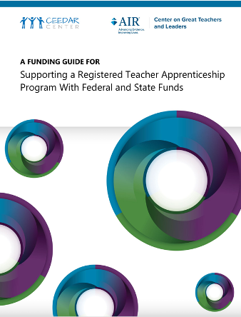
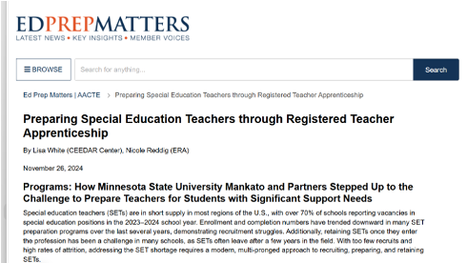

Helpful RTAP Resources
Notes:
CEEDAR RTAP Resources: https://ceedar.education.ufl.edu/teacher-apprenticeship-resources/

Slide 39

Educator Shortages In Special Education
Notes:
https://ceedar.education.ufl.edu/gtl-landing/
The Educator Shortages in Special Education Toolkit is organized around the guiding principle that short-term strategies to meet immediate demand must be intentionally paired with long-term, systemic strategies to attract, prepare, and retain effective special education teachers to create comprehensive shortage solutions.
The Toolkit is organized around a Facilitator’s Guide and three supporting sets of tools. If this is your first visit, we recommend starting with the Facilitator’s Guide.

Slide 40
Looking Ahead: Building the Evidence Base

Slide 41
Key Considerations
As you design/implement/refine/scale your RTAP, consider
Why implementation, evaluation, and continuous improvement matter
Emerging questions for states, education preparation providers, and researchers
Opportunities to learn from and contribute to the growing RTAP knowledge base

Slide 42
Questions and Discussion

Slide 43
Thank you for your attendance and participation!

Slide 44
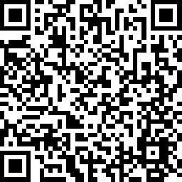
We value your feedback!
https://www.research.net/r/RTAP-Sept26

Slide 45
Disclaimer

