Slide 1
Thursday, September 24th, 2026
3:00-4:00 Eastern Time
Welcome to
CEEDAR’s Leadership
Topical Action Group (TAG)
Welcome to our TAG!
Participants: please change your Zoom name to
your state and name
Ex: Florida, Agatha Trunchbull
CEEDAR staff: please change your Zoom name to
CEEDAR, Your name
Notes:
Abby: Make everyone co-hosts
Speaker: Abby
3:00-3:02

Slide 2

Check in:
Notes:
Speaker: Abby Please change your name to Your state abbreviation and your first and last name
3:00-3:02

Slide 3
Virtual Meeting Recording Notice
This meeting is scheduled to be recorded by CEEDAR. Your consent to the recording is requested. Participation in the meeting without expressing an objection to recording will be treated as consent. Any participant who prefers to participate via audio only should disable their video camera so only their audio will be captured. External AI bots are prohibited unless specifically authorized.
Notes:
Speaker: Abby
3:02-303

Slide 4
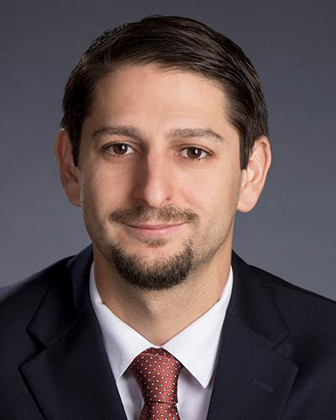
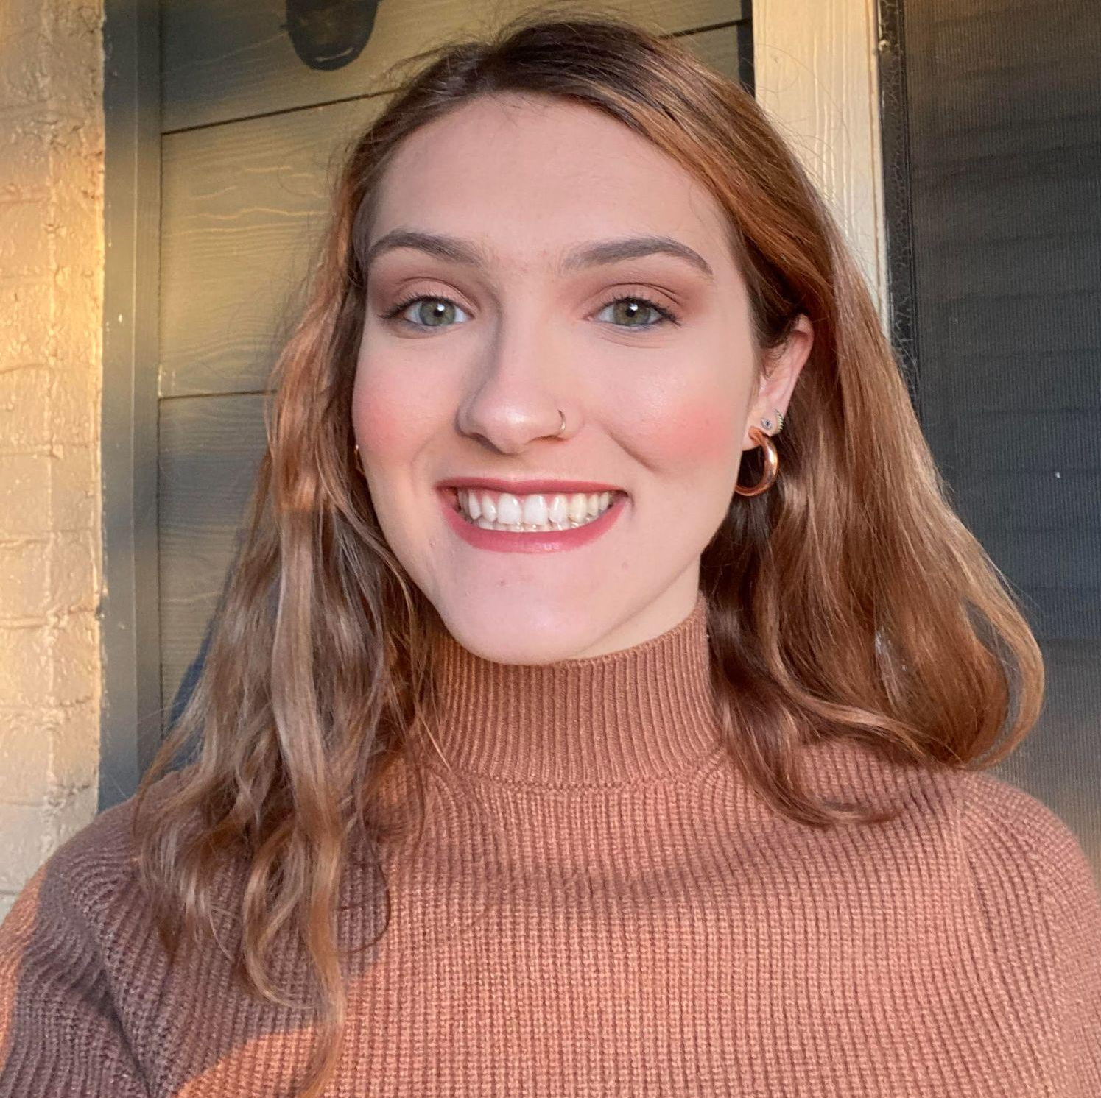
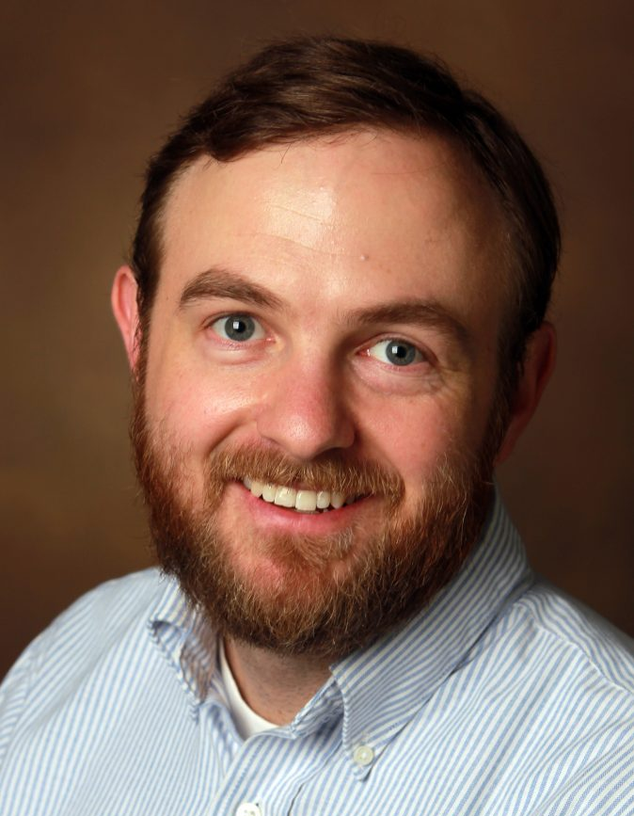
Welcome & Introductions
Dr. David DeMatthews
Professor, Department of Education Leadership and Policy,
The University of Texas at Austin
Abby Berner
Engagement Specialist, CEEDAR, Research Assistant, American Institute for Research (AIR)
Dr. Chris Redding
Associate Professor, Department of Educational Leadership and Policy, University of Florida
Notes:
Speaker: Abby
3:02-3:03
If you have joined us for the Leadership TAG before welcome back, and if this is your first time welcome, we’re glad to have you with us

Slide 5





Our Partners
Notes:
Speaker: Abby
A warm thank you to our partners, they are our liaisons and will share resources, they can provide additional perspectives. If you are here from one of these partner organizations, thank you for joining us.
3:03-05

Slide 6
Lead IDEA Resource Share
Some resources have been shared with your work groups related to MTSS, scheduling, budgeting.
Lead IDEA has curated a wide assortment of resources (relevant for preparation programs, school districts, leaders) that could support your TAG work this year.
Leader Assessment, IDEA Leadership Essentials: https://lead-idea.org/idea-essential
Notes:
Speaker: Shelby
3:03-05
https://lead-idea.org/idea-essential

Slide 7
The purpose of the TAG is to…
elevate the importance of effective leadership in our work,
focus on effective practices in our programs, coursework, clinical experiences, and policies,
engage in authentic conversations on effective leadership efforts,
and share expertise, successes and challenges, and discuss how to use resources to support scaling and sustainability.
Notes:
Speaker: Abby
Recognize that we have different roles as members of our TAG (SEA, IHE, professional associations,school district) but we are all here to learn more about practices of effective leaders and how to support students with disabilities
3:05-07

Slide 8
Leadership TAG
Potential Topics for Discussion
Date | Topic
Sept 24th | MTSS
Oct 22nd | Budgeting
Dec 3rd | Science of Reading
January 28th | HLP
February 25th | SDI
March 25th | IEP Meetings
April 22nd | School Discipline
May 27th | Hiring, Induction, and Retention
Notes:
speaker: Abby
3:05-07
If you have a connection to one of these topics, let us know! we are still looking for presenters.

Slide 9
Today’s Agenda
Welcome and Introductions
Leadership Standards Overview
Cross State Padlet
Spotlight on UM: Farmington
Post Presentation Q&A
State Team Breakout time
Final Thoughts and Invitations
Notes:
Speaker: Abby
3:05-07

Slide 10
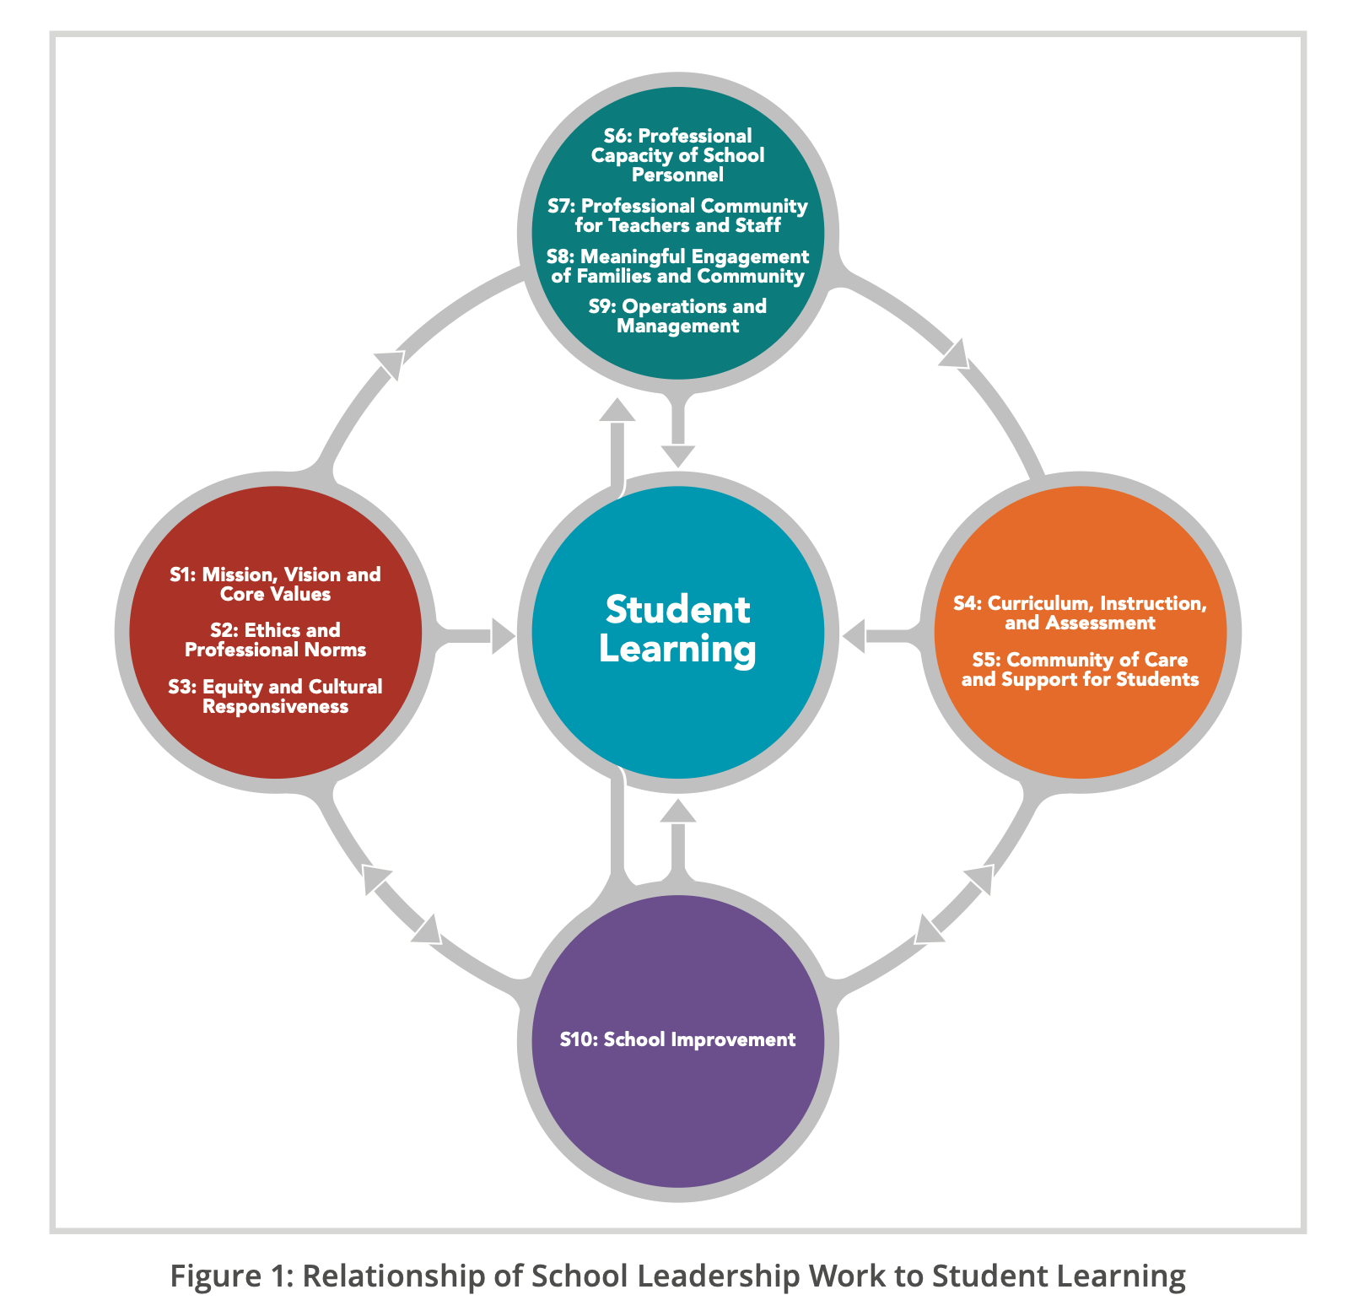
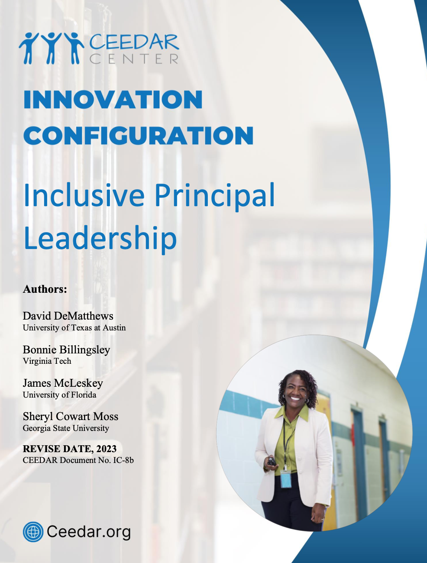
Effective Principal Leadership and PSEL
Notes:
Educational leadership programs often prepare principals to manage schools but less frequently to lead systems of prevention, intervention, and continuous improvement.
Speaker: David
3:07-12

Slide 11
MTSS as a Leadership Framework
MTSS is a prevention-oriented framework integrating data and instruction to support ALL students. With four core components:
  Screening
  Multi-level prevention system
  Progress monitoring
  Data-informed decision-making
Implementation depends on leadership – communication, organizational structures, collaboration, and professional capacity.
Research suggests that MTSS can improve achievement, reduce exclusionary discipline, and other issues when implementing effectively.
Notes:
Educational leadership programs often prepare principals to manage schools but less frequently to lead systems of prevention, intervention, and continuous improvement.
Speaker: David
3:07-12

Slide 12
Leadership Beyond Compliance
Leadership Responsibilities:
Establish a vision that all students can learn with appropriate supports.
Build collaborative teams and share responsibility.
Use data to inform all important organizational and instructional decisions.
Align staffing, schedules, and resources to student needs.
Support implementation of EVPs and HLPs.
Monitor implementation fidelity AND outcomes.
Notes:
This is fundamentally principal leadership work
Speaker: David
3:07-12

Slide 13
Takeaways from the Principal Leadership IC
Vision and Values: Develops a shared mission supporting all learners.
Curriculum, Instruction, and Assessment: (a) promote high expectations; (b) ensure MTSS, HLPs, and EBPs are implemented; (c) support progress monitoring systems.
Professional Capacity: (a) build teacher expertise; (b) providing ongoing professional development.
Professional community: Create collaborative problem-solving cultures.
School Improvement: Use regular improvement cycles focus on student needs, outcomes, and other credible information.
MTSS | IC Leadership Practice
Data Teams | PSEL 4&7
Tiered Supports | PSEL 4
Professional Learning | PSEL 6
Continuous Improvement | PSEL 10
Notes:
Speaker: David
3:07-12

Slide 14
Implications for Preparation
Current Challenge: If MTSS is taught, it is likely addressed either indirectly in several classes or only part of special education law.
Potential Revisions:
  Target Class Revisions: Data-Based Decision-Making; School Improvement; Instructional Leadership; Finance/Budgeting/HR
  Clinical Experiences: Participate in MTSS meetings; Conduct intervention audits; Analyze screening and progress monitoring data; Facilitate improvement cycles
  Performance Assessments: Resource mapping; MTSS implementation plans; Fidelity reviews
Notes:
Speaker: David
3:07-12

Slide 15
Moving Forward
Faculty can start by doing the following:
Partnering with special education faculty and/or with districts/schools effectively implementing MTSS.
Recruit mentor principals with MTSS expertise
Embed IC competencies across courses
Align internships with district efforts to implement MTSS
Notes:
Speaker: David
3:07-12

Slide 16
Final Point of Emphasis
MTSS is not another topical area to insert into leadership preparation, but rather a model through which all aspiring principals can learn about key concepts and practices in the field, such as:
Instructional leadership
Data use
Collaboration
School improvement
Supporting struggling learners
Notes:
Speaker: David
3:07-12

Slide 17
Cross State Padlet
Share an example on Padlet of how your SEA/EPP is strengthening program implementation of MTSS for aspiring and current school leaders.
How are you teaching this topic in your program or context?
Where does MTSS show up in coursework or clinical experience?
What partnerships do you utilize to build the content knowledge of this topic?
Notes:
https://padlet.com/aberner2424/9-24-26-tag-cross-state-notes-s023vr01blv7ifjbswfw
Speaker: Abby
3:12-17
reflect on what David just shared and your knowledge related to preparing teachers and leaders to implement MTSS and add a post under any question you’d like to reply to. We will do this for 5 minutes.

Slide 18
CEEDAR
Effective Leadership TAG
Structures & Resources for Integrated MTSS
Notes:
Speaker: Jessica
3:17-32

Slide 19
The Upstream Parable & MTSS
MTSS =
Prevention
Mindset & Action
A group of teachers and their principal gather for a picnic-retreat by a river.
Not long after they arrive, a child comes floating downstream calling for help. One teacher dives in and pulls the child out.
Minutes later, another child appears, then another, and soon more are coming. The teachers and principal leap into action - diving in, dragging children to shore and jumping back in to save more.
In the midst of this life-saving effort, the principal starts walking away. Her colleagues call out “where are you going? We have so many children to save!”
She replies, “I’m going upstream to find out why kids are falling into the river”
She finds out that the children had been crossing a rotted wooden bridge with missing boards. Unable to jump across the gaps, they fell into the river.
McSheehan (2025)
Notes:
Speaker: Jessica
3:17-32

Slide 20
Fix the Bridge! Leading an Effective MTSS
Commit to a vision that centers meaningful opportunities for all students to learn and belong
Use systems-thinking and data literacy
Provide support for educators and staff to:
  ensure clear system processes and protocols
  prioritize schedules that protect core instruction, provide intentional planning time and allow for aligned, embedded and supplemental interventions and supports
  set clear expectations for instructional practices that are universally designed and accessible for a wide range of learners
  create a culture that values feedback and responding to staff professional development needs in authentic ways
  communicate and collaborate with families and community members
Notes:
Speaker: Jessica
3:17-32

Slide 21
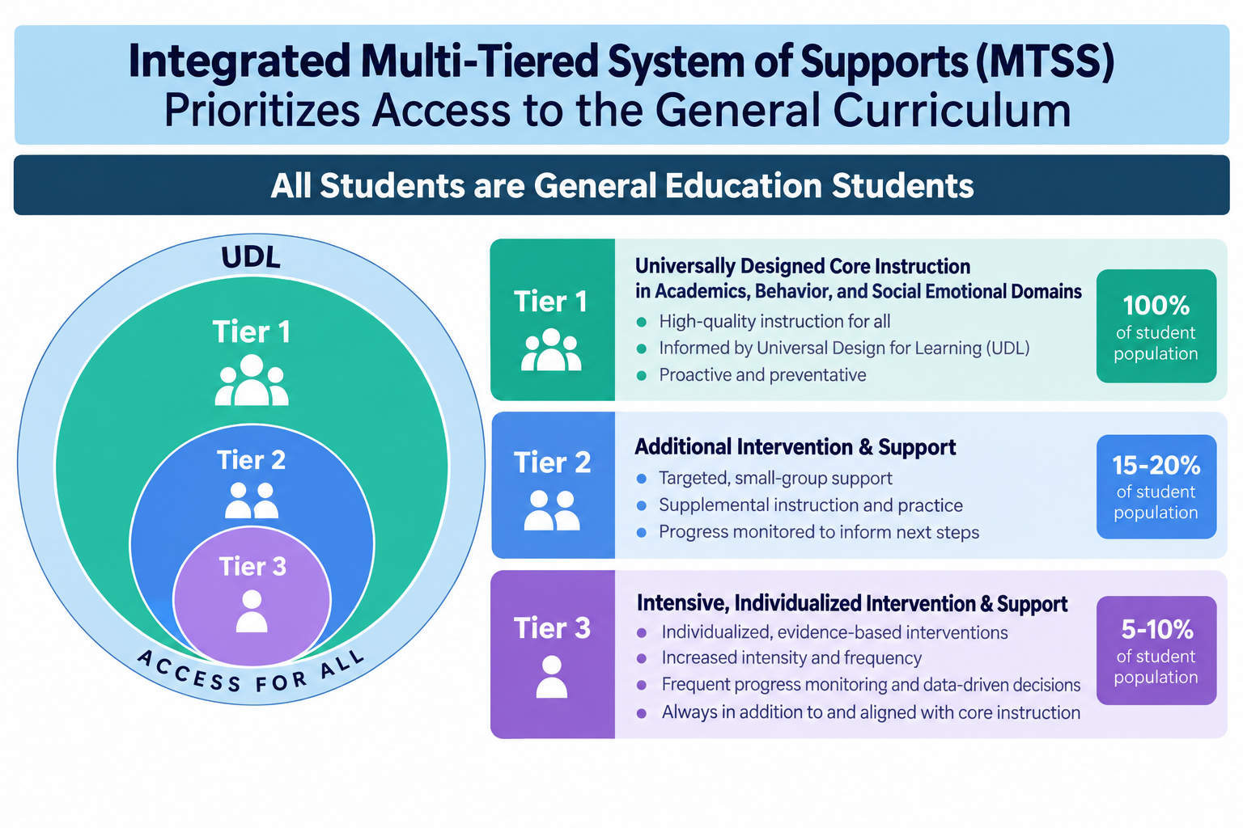
Original graphic created by Apgar & MacLeod (2025) - graphic design updated by ChatGPT
Notes:
Speaker: Jessica
3:17-32

Slide 22
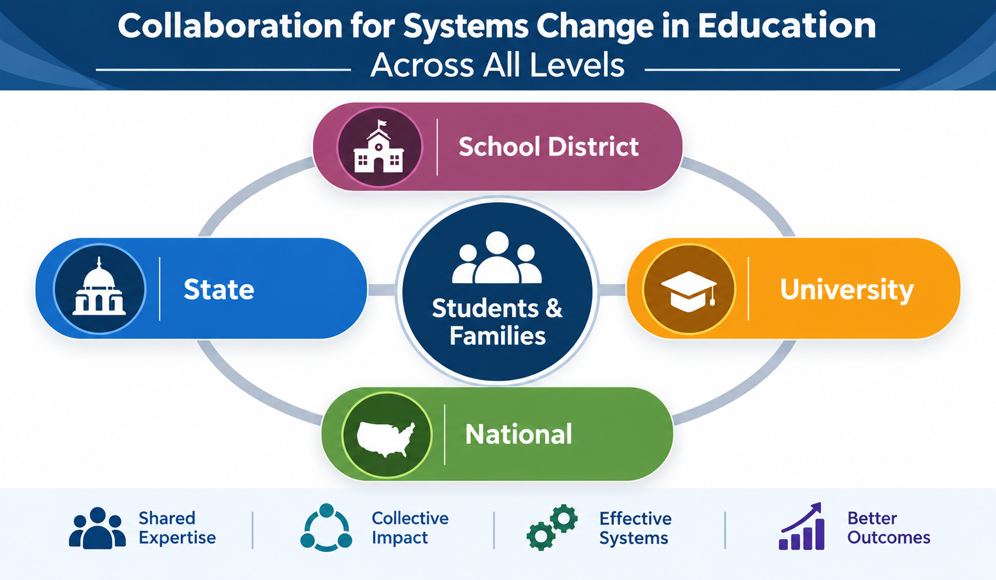
Leaders build relationships and leverage expertise and resources across the system
Notes:
Speaker: Jessica
3:17-32

Slide 23
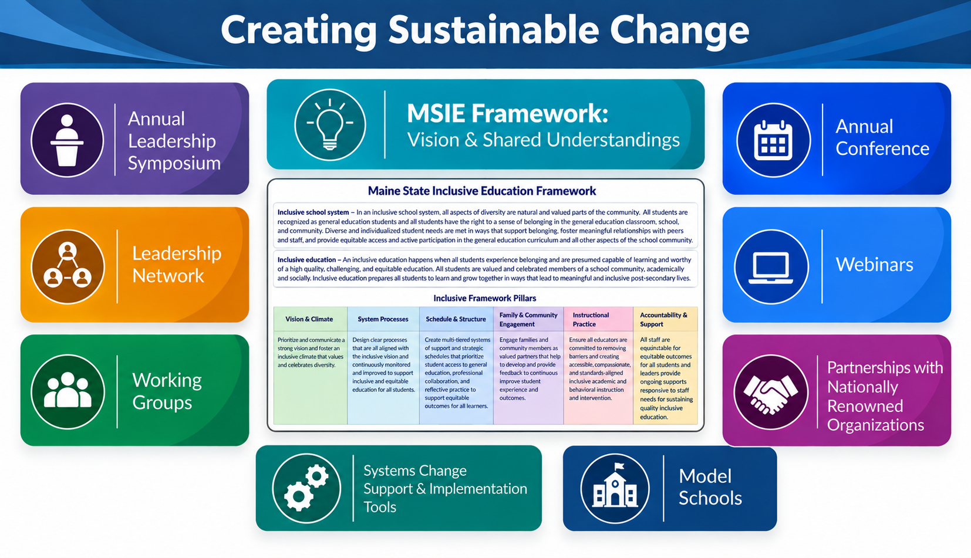
An Example from Maine
Notes:
Speaker: Jessica
3:17-32

Slide 24
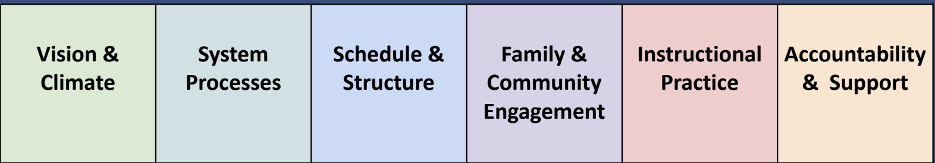
Align Everything with Vision & Shared Understandings
Common language & definitions provide clarity
MSIE Framework & Tools include indicators and “look-fors”
  Used to assess systems, schools and classrooms
  Provide clear expectations
  Identify areas of need for restructuring, redesign and professional development
  Built into syllabi, field experience handbooks, applied assignments in coursework
Notes:
Speaker: Jessica
3:17-32

Slide 25
Prepare Future Leaders by Creating Cohesive Learning Experiences
UMF EDU 579 - Implementing an Integrated MTSS
MSIE Pillars:
Vision & Climate,
System Processes,
Scheduling & Structure,
Family & Community Engagement and
Accountability & Support
Students develop an understanding of systems change by examining their school (or a case study), analyzing data and developing a data-driven action plan for school improvement.
UMF SED 598 - Inclusive Education Reform (for Students with Disabilities)
MSIE Pillars:
Vision & Climate,
Schedules & Structures,
Accountability & Support
Students develop an understanding of systems change by examining their school (or a case study), analyzing data and developing a data-driven action plan for school improvement.
UMF SED 551 - Advanced Intervention Methods
MSIE Pillars
Vision & Climate,
System Processes,
Instructional Practices for Academics and Social-Emotional Behavioral Domains,
Family & Community Engagement
Students develop the skills needed to design strong, grade-aligned core instruction, embedded supports and accommodations, integrated specially designed instruction and relevant, aligned interventions
UMF SED 599 - Coaching for Inclusion
MSIE Pillars:
Vision & Climate,
Schedule & Structure, Instructional Practices,
Accountability & Support
Students engage in assessing the needs of educators who work with all students and develop plans for supporting their development of knowledge and skills that create sustainable improvements in instructional practices.
Notes:
Speaker: Jessica
3:17-32

Slide 26
Key Assignments for the Integrating MTSS Course
iMTSS System Review (100 points) - For this assignment, you will create a plan for collecting information about a district or school (ideally, yours) that will help inform you of the status in relation to the implementation of an iMTSS. This system review will include a snapshot of the district or school (choices of templates will be provided - if you have taken SED 598, you may use or update/expand the review you completed for that course), an overview of key structures, processes, and practices, and a summary of findings with key recommendations for becoming an iMTSS. Specific assignment guidelines and a rubric will be provided, and you will have a chance to submit drafts for feedback (to me and your peers).
UDL Action Plan (100 points) - A robust, well-implemented iMTSS requires the creation of a system that prioritizes high expectations and learning for all students while also centering a strong sense of belonging in the school community. Using the system review as justification, you will identify key areas of needed improvement (ideally from your recommendations) that you can build out into a plan for strengthening the accessibility of structures, supports, and practices through the use of Universal Design for Learning. Without strong core instruction and supports for academics, behavior, and social-emotional learning, tiered interventions are not effective. This plan will help you to focus on that Tier 1 core so you can build or improve a responsive system from that foundation.
A similar process is used for the Annual Leadership Symposium and with Model School Leadership Teams
Notes:
Speaker: Jessica
3:17-32

Slide 27
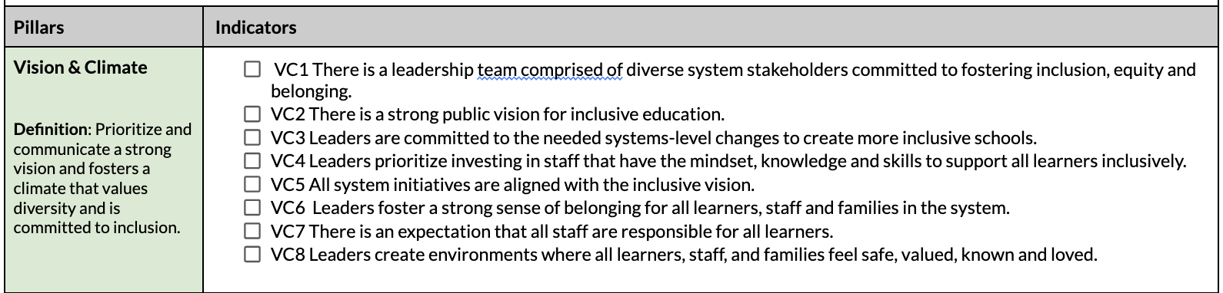
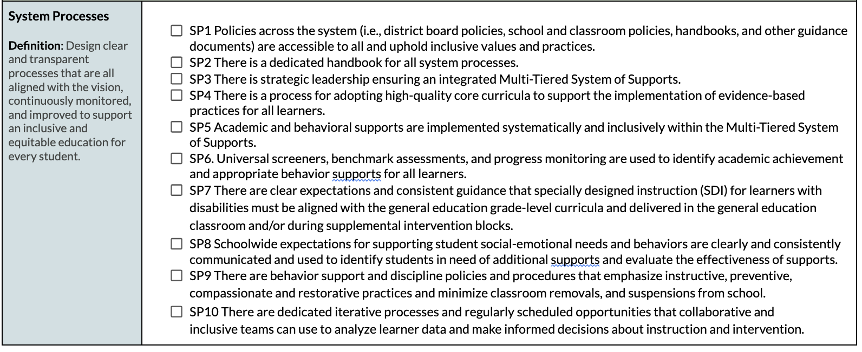
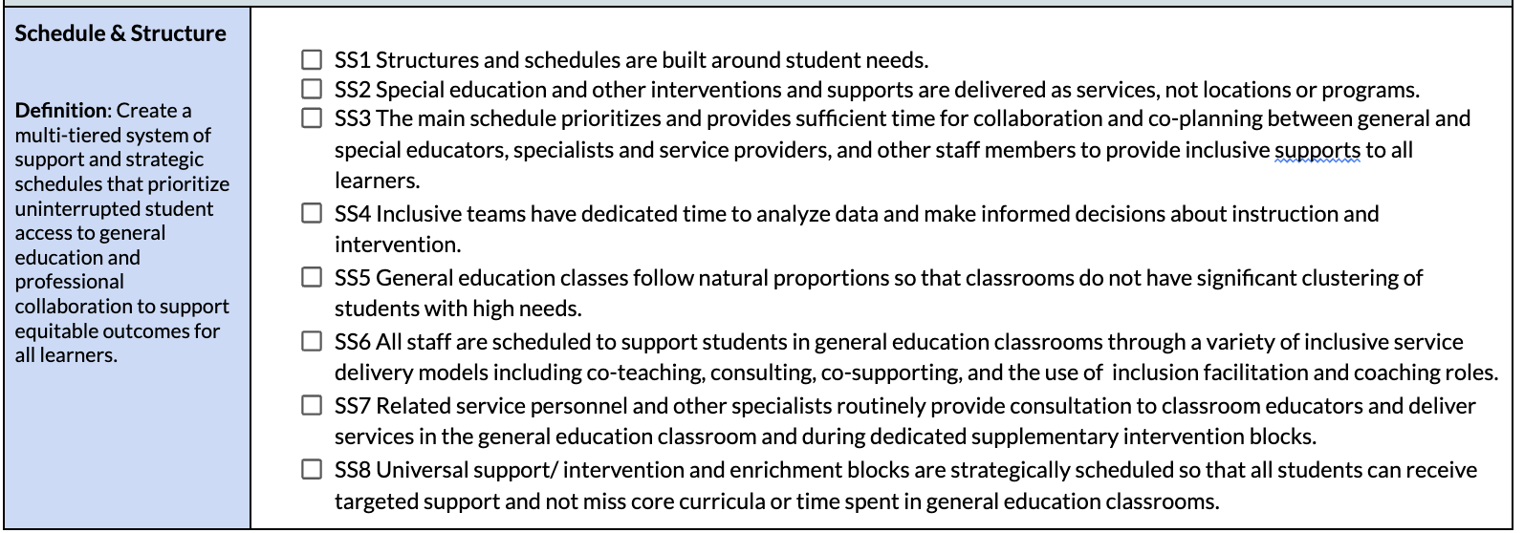
Application of the MSIE Framework & Indicators
Notes:
Speaker: Jessica
3:17-32

Slide 28
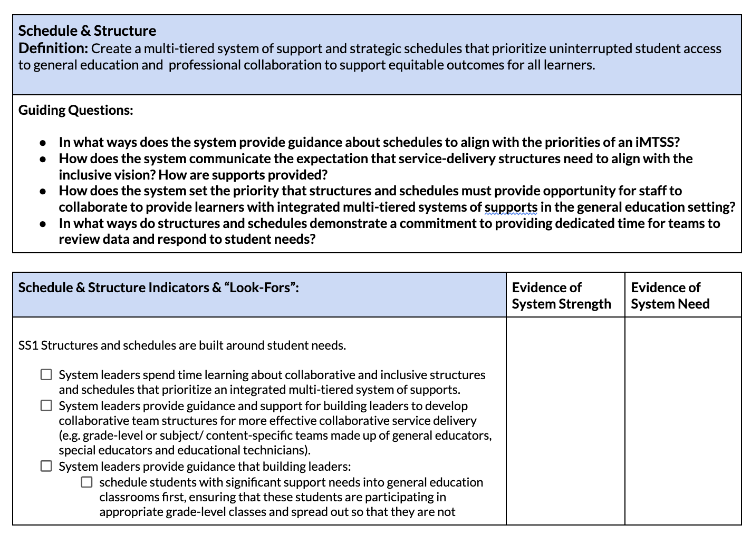
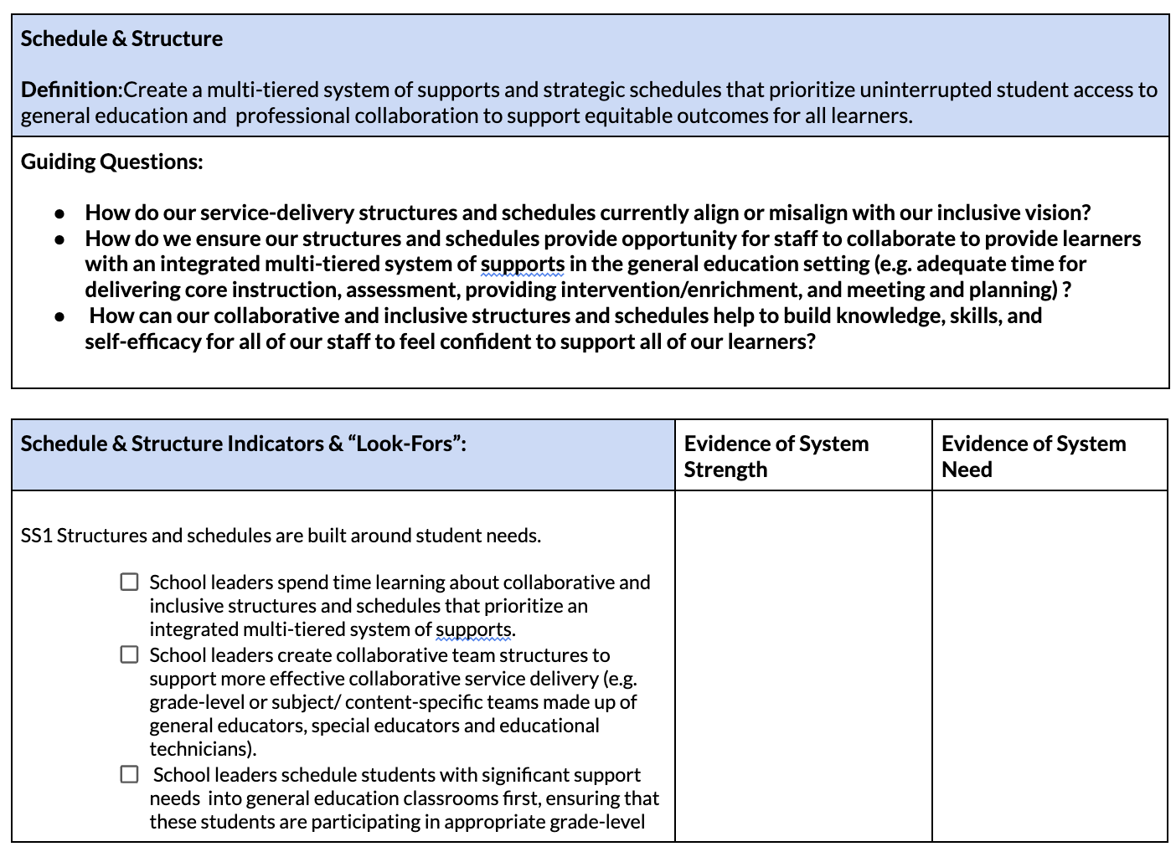
Look-Fors Provide Additional Context
System Level
School Level
Notes:
Speaker: Jessica
3:17-32

Slide 29
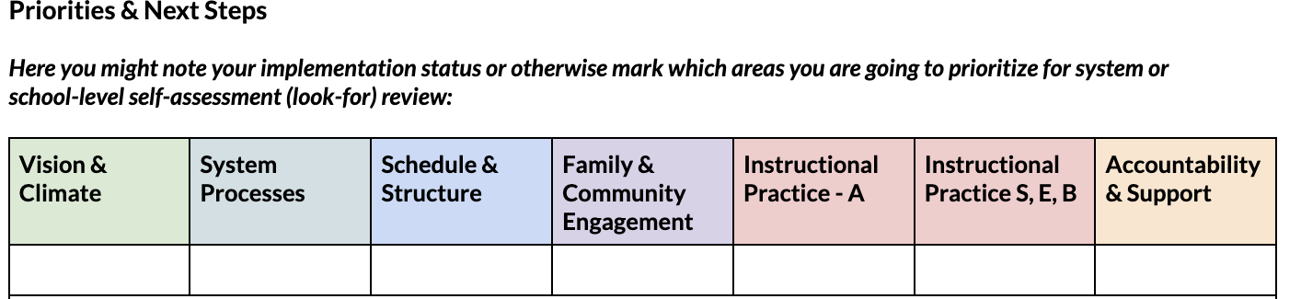
District & School Leadership Applications
Use a framework and shared definitions to communicate a clear vision and set expectations and goals for school improvement.
Build leadership teams with all roles represented (General educators, special educators, family representatives, related service providers, interventionists, coaches, district and building administrators)
“See the system” by collecting, reviewing and analyzing data (district/school)
Use the framework indicators & look-fors to create action plans
Connect all work in the district/school to the shared goal of an integrated MTSS.
Notes:
Speaker: Jessica
3:17-32

Slide 30
Next Steps to Consider for Systems Change
Connect with people across levels of your state’s education system
Identify tools and resources to anchor shared vision and goals
Use those tools and resources in courses, in your districts & schools
Lean on your networks (like this) to sustain the work!
Use CEEDAR’s Innovation Configurations to support
Partner across the system to develop responsive resources and supports (e.g., webinars, microcredentials, coaching structures, etc.)
Notes:
Speaker: Jessica
3:17-32

Slide 31
MTSS Resources & Frameworks
MSIE Framework
TIES Center - RISE
MA MTSS Blueprint
Florida State Resources (BPIE)
Washington MTSS Resources
NIRN-SISEP District Capacity Assessment
Reimagining MTSS through UDL
MTSS Brief - Emphasizing Prevention
Notes:
Speaker: Jessica
3:17-32

Slide 32
Thank you!
Feel free to reach out with questions or to chat and brainstorm!
Jessica Apgar, PhD
Assistant Professor of Special Education
Associate Director - UMF/Maine DOE Inclusive Education Project
University of Maine at Farmington
jessica.apgar@maine.edu
Notes:
Speaker: Jessica
3:17-32
jessica.apgar@maine.edu

Slide 33
Q and A with our Presenter
Notes:
Speaker: Jessica and Chris
3:32-40
thank you for sharing about your work in Maine to create and use structures for integrated MTSS

Slide 34
State Team Reflection
  What ideas did you hear today that resonated with you?
  How might what you learned today impact your state plan or the work in your organization?
Notes:
speaker: Abby
Now with your state team in breakout rooms, please reflect on presentation and how it relates to your state’s work.
3:40-55
Questions to Consider:
What ideas did you hear today that resonated with you?
How might what you learned today impact your state plan or the work in your organization?

Slide 35
Invitations
Join us on October 22nd for a discussion on budgeting. An Assistant Superintendent from Illinois will share how her understanding of budgeting evolved from her leadership preparation program to campus leadership and now her role as a district-level decision-maker.
We are looking for state to highlight in upcoming meetings.
  If you have a connection within your state work that connects to the topics we shared at the beginning, please reach out to aberner@air.org
Next IC training: tomorrow, September 25th, 1-2:30 pm ET, sign up here
Notes:
speaker: Abby
3:55-4:00
https://docs.google.com/forms/d/e/1FAIpQLSdMFYUHSfGdE-ED6YvObvUCKy4rZjfvibQGjo-rR9JrvAWI8w/viewform

