Slide 1


Supporting Educators, Strengthening Leaders
Insights from NCLD’s National Survey
Notes:
Title Card

Slide 2

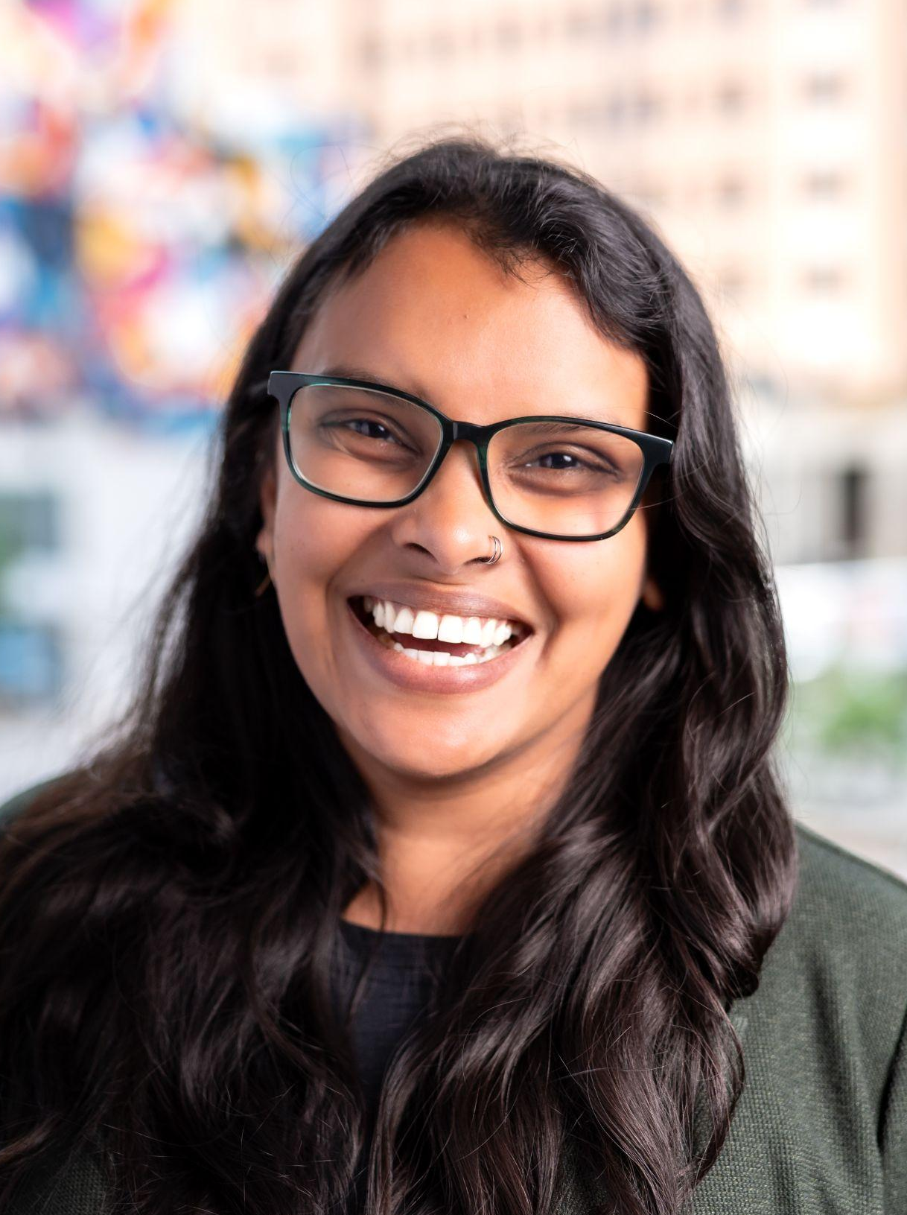
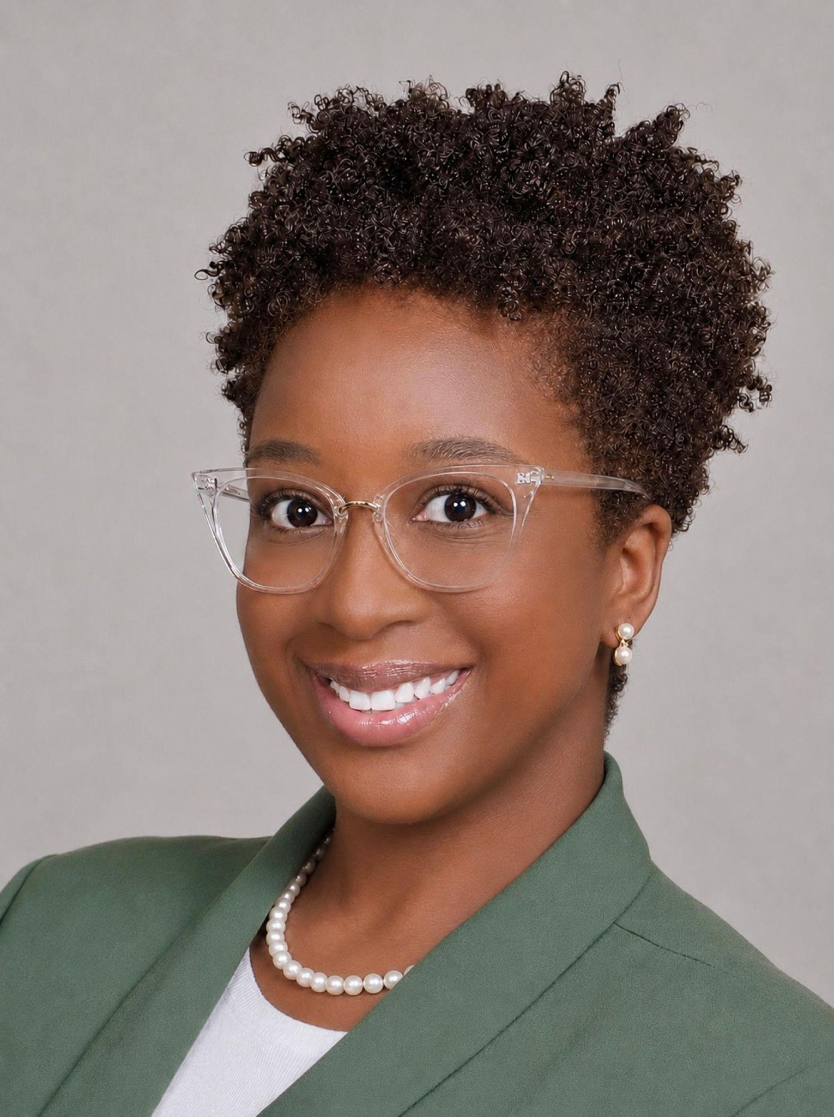

Welcome!
Saashya Rodrigo, Ph.D.
Alexis McCoy-Pickett, Ph.D.
Notes:
Quote Card

Slide 3

Welcome! 1
Welcome!
Who’s in the room? Put in the chat:
Your organization/affiliation
Where you’re based
Notes:
Quote Card

Slide 4

Overview of the State of LD
Educator Survey
Notes:
Quote Card

Slide 5
Overview
A national survey of general and special educators
Explored school-level factors that shape educators’ experiences in supporting students with LD
Notes:
Quote Card

Slide 6
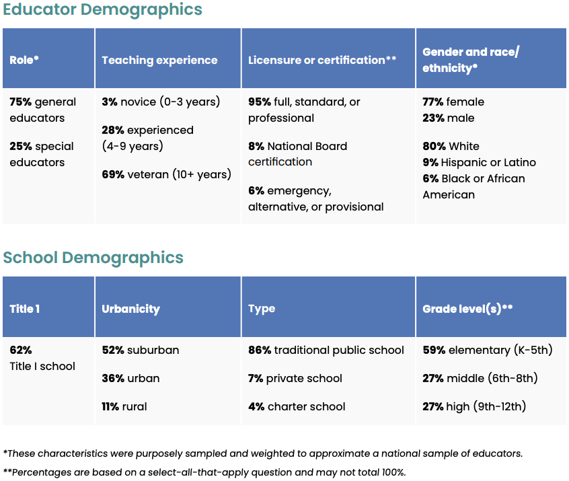
Educator Demographics
Notes:
Quote Card

Slide 7
Key Findings
Notes:
Quote Card

Slide 8
RQ 1: To what extent do educators feel confident adapting instruction for students with LD?
Most general educators are not fully confident in their ability to teach students with LD.
Only 17% of novice general educators are completely confident in adapting instruction for students with LD, compared to 60% of special educators.
Notes:
Quote Card

Slide 9
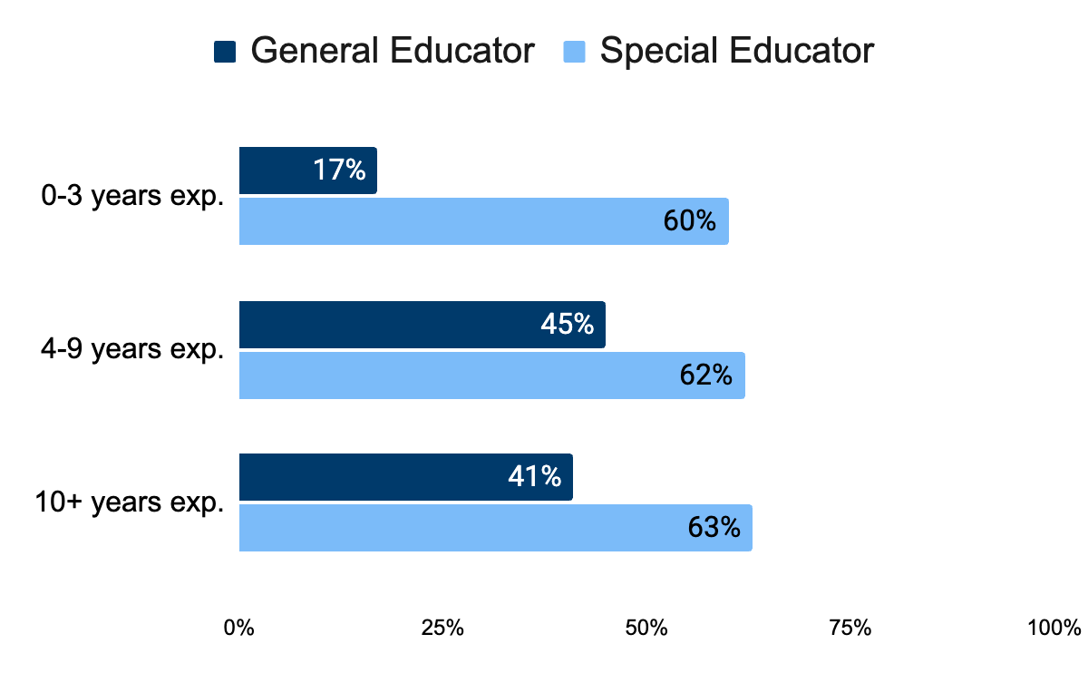
Percentage of teachers who feel completely confident adapting instruction for students with LD
Notes:
Quote Card

Slide 10
RQ 2: What school-level factors support or hinder educator confidence in adapting instruction for students with LD?
Leadership Support
Time & Resources
Instructional Decision-Making
Collegial Expertise
Collaboration
Student Support Dialogue
Notes:
Quote Card

Slide 11
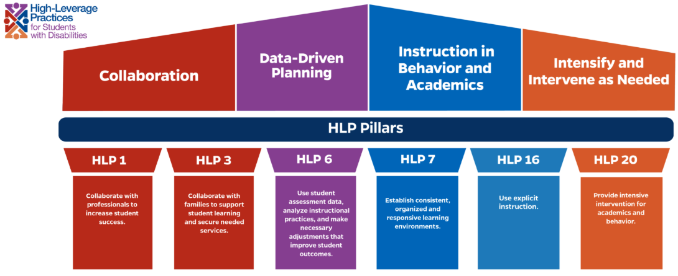
HLP Pillars
Leadership Support
Time & Resources
Instructional Decision-Making
Collegial Expertise
Collaboration
Student Support Dialogue
Notes:
Quote Card

Slide 12
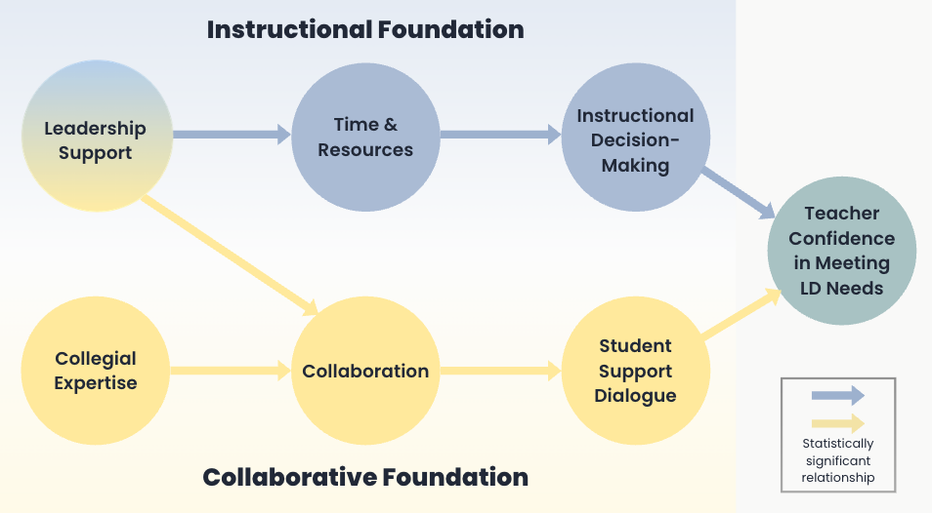
Framework for Supporting Teachers of Students with LD 1
Framework for Supporting Teachers of Students with LD
Notes:
Quote Card

Slide 13
Deep Dive into Findings
Notes:
Quote Card

Slide 14
Framework for Supporting Teachers of Students with LD 2
Framework for Supporting Teachers of Students with LD
Notes:
Quote Card

Slide 15
Leadership Support
Educators identified three key areas of leadership growth:
Strengthen knowledge and training on LD
Consistently follow through supports for students with LD
Respond effectively when teachers ask for support
Notes:
Quote Card

Slide 16
Framework for Supporting Teachers of Students with LD 3
Framework for Supporting Teachers of Students with LD
Notes:
Quote Card

Slide 17
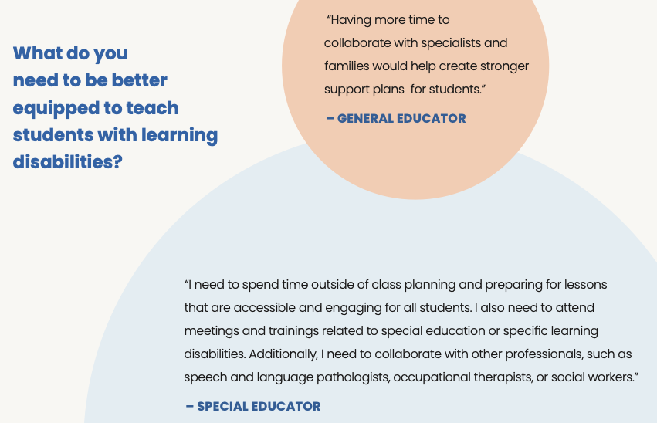
“What do you need to be better equipped to teach students with learning disabilities?”
Notes:
Quote Card

Slide 18
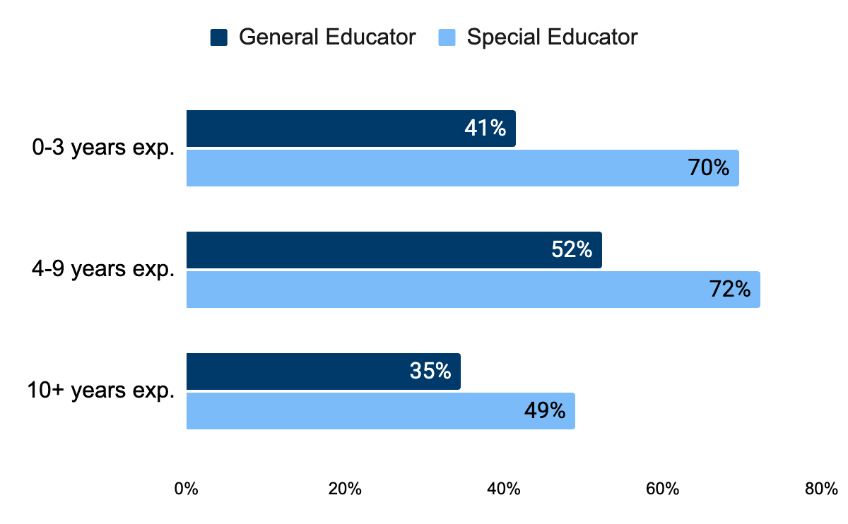
Percentage of teachers who reported having adequate time by role & experience
Notes:
Quote Card

Slide 19
Framework for Supporting Teachers of Students with LD 4
Framework for Supporting Teachers of Students with LD
Notes:
Quote Card

Slide 20
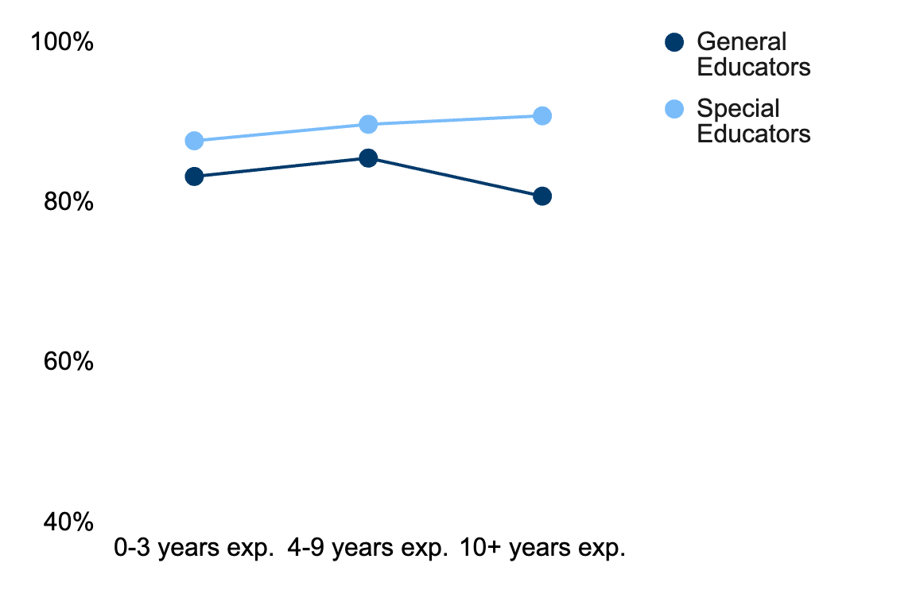
Percentage of teachers comfortable choosing academic interventions to address skill gaps
Notes:
Biggest gap: 10% for 10+ years

Slide 21
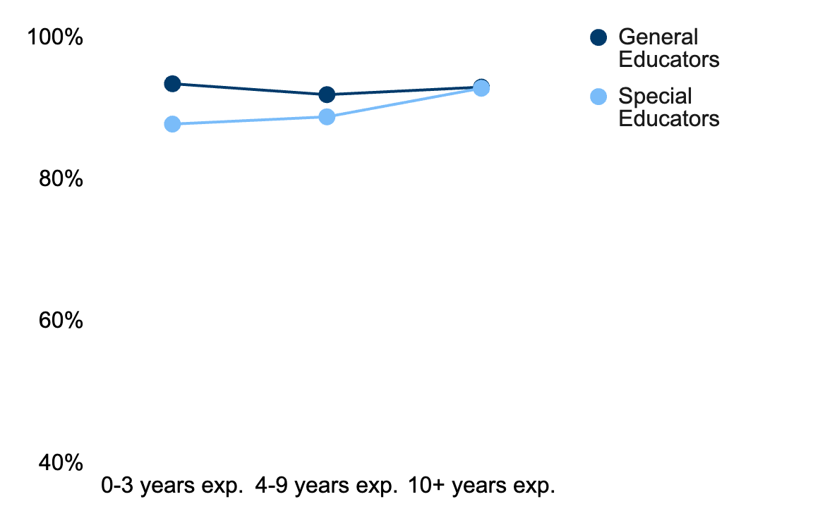
Percentage of teachers comfortable implementing accommodations & modifications
Notes:
Biggest gap: 6% at 0-3 years

Slide 22
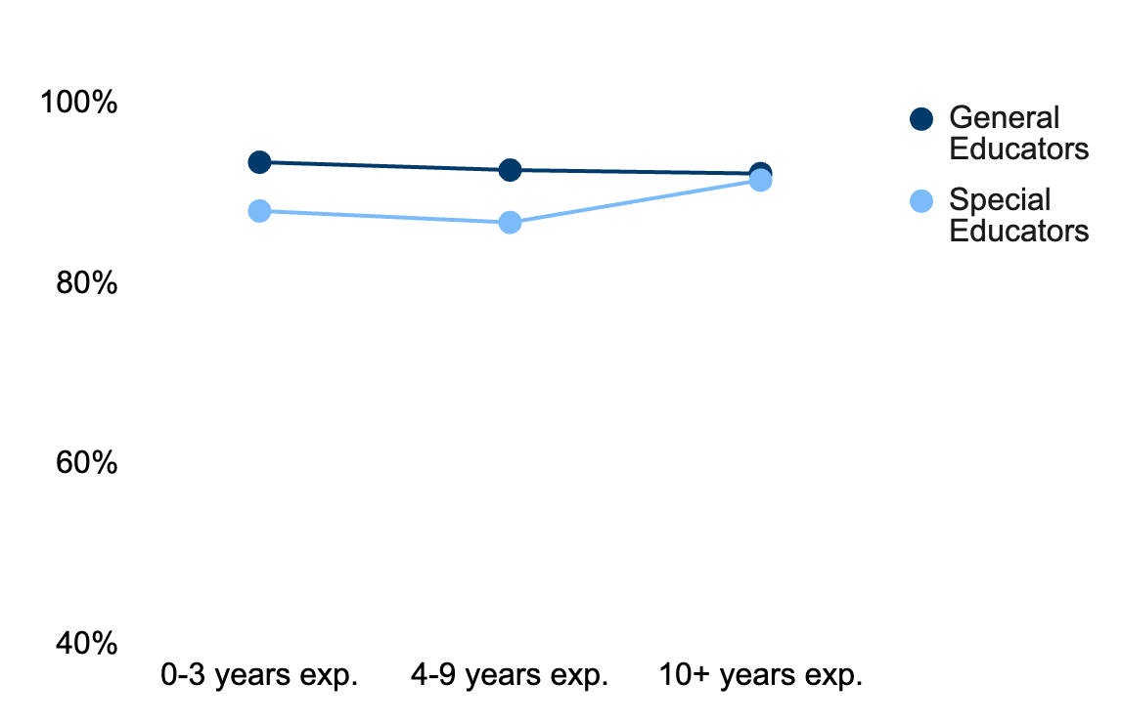
Percentage of teachers comfortable differentiating instruction
Notes:
Biggest gap: 6% for 0-3 and 4-9

Slide 23
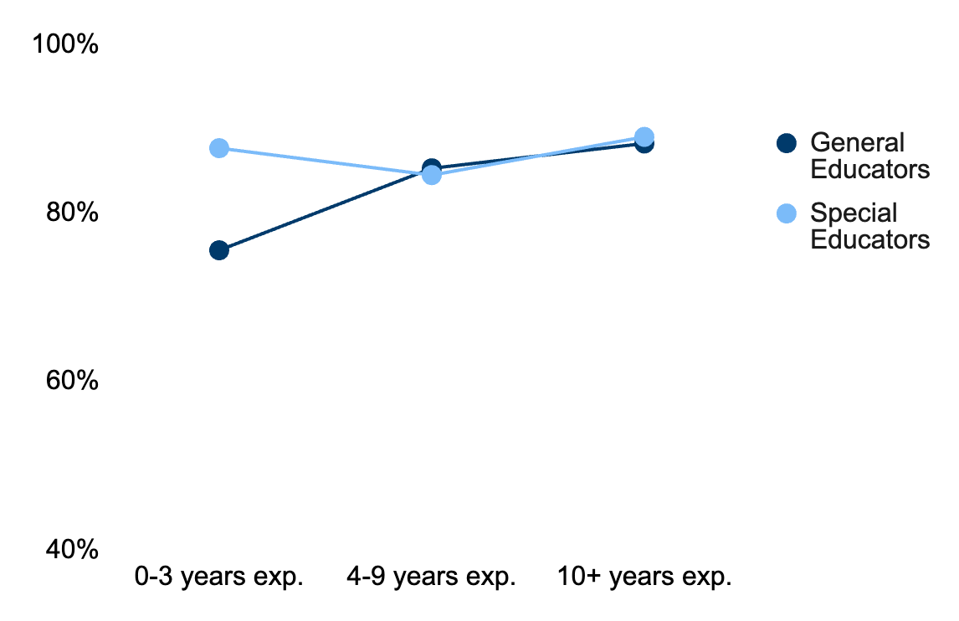
Percentage of teachers comfortable using student data to identify skill gaps
Notes:
Biggest gap: 12% at 0-3 years

Slide 24
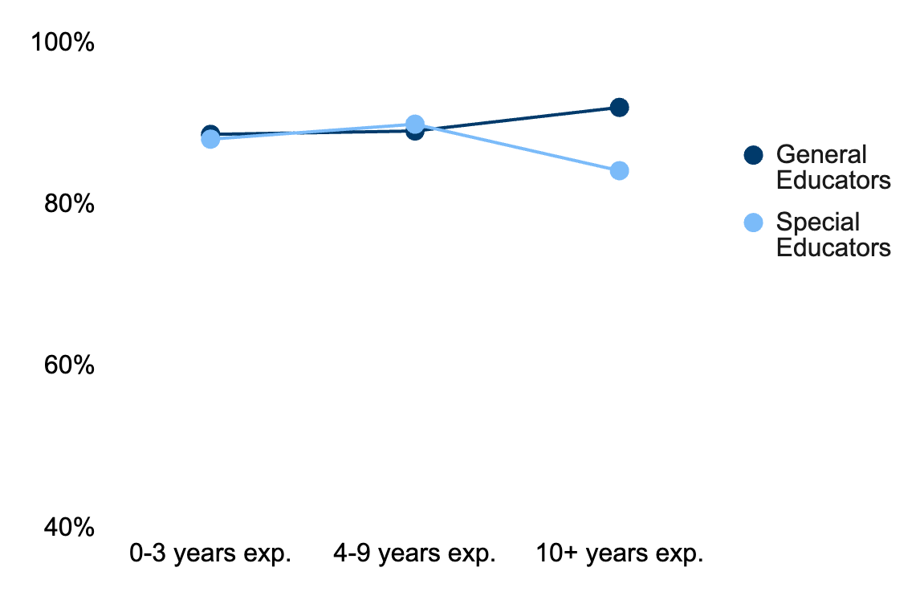
Percentage of teachers comfortable implementing academic interventions
Notes:
Biggest gap: 8% at 10+ years

Slide 25
Framework for Supporting Teachers of Students with LD 5
Framework for Supporting Teachers of Students with LD
Notes:
Here's our framework again, and now we're moving into the Collaborative Foundation — starting with Collegial Expertise. This is where we shift from "how confident am I in my own instruction" to "how much do I trust and lean on my colleagues."

Slide 26
Collegial Expertise
Educators reported limited confidence in their colleagues’ ability to address the learning and behavioral needs of all students.
Educators with 10+ years of experience reported greater concerns with their colleagues’ consistency of practice– particularly in meeting academic and behavioral needs.
Notes:
Educators reported limited confidence in their colleagues' ability to address the full range of learning and behavioral needs in their classrooms. And notably, it's the most experienced educators — 10+ years — who reported the greatest concern about their colleagues' consistency, particularly around academic and behavioral needs.
That's a bit counterintuitive — you'd expect veteran teachers to be the most reassured about their colleagues. Instead, they're the most skeptical.

Slide 27
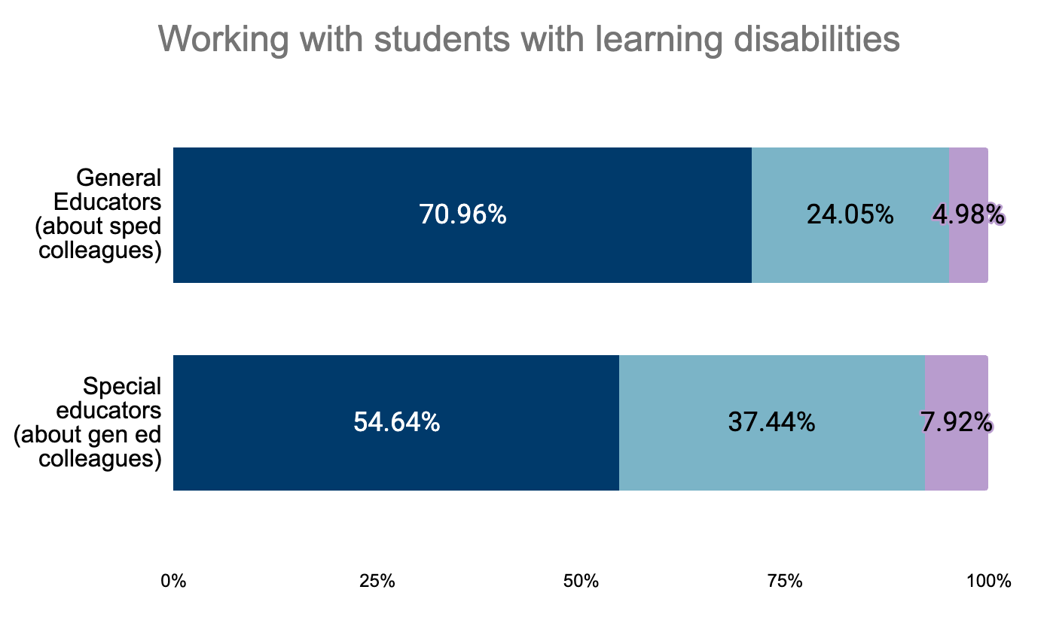
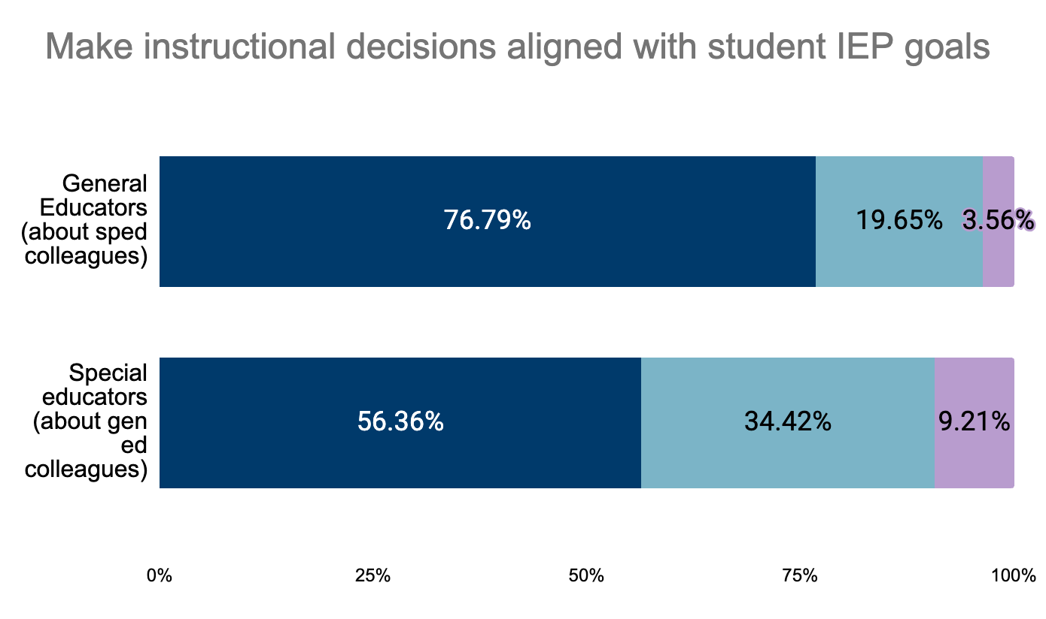
When asked about their general educator colleagues, special educators reported somewhat lower consistency in two specific areas.
Notes:
Let's put some numbers on that. When general educators talk about their special education colleagues, 71% report high consistency in working with students with learning disabilities, and 77% report high consistency making instructional decisions aligned with IEP goals.
Flip it around — when special educators talk about their general education colleagues — those numbers drop to 55% and 56%. So general educators are actually somewhat more confident in their special ed colleagues than the reverse.

Slide 28
Framework for Supporting Teachers of Students with LD 6
Framework for Supporting Teachers of Students with LD
Notes:
That takes us to Collaboration itself — the node that connects Collegial Expertise to Student Support Dialogue.

Slide 29
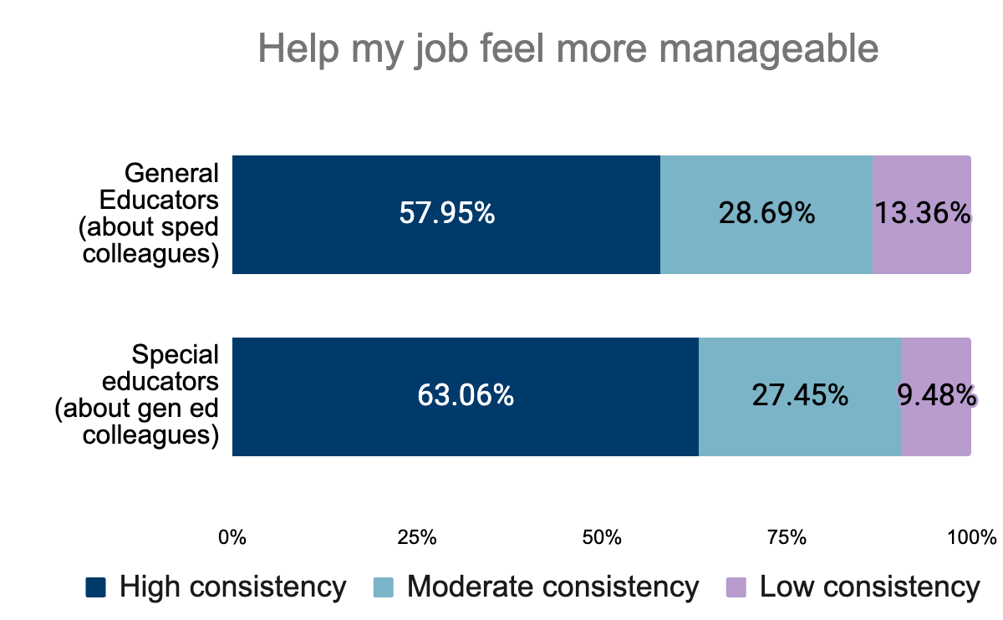
Educators reported the greatest concerns about their colleagues’ consistency in making their job feel more manageable.
Notes:
Here's where it gets personal — not just "are my colleagues consistent," but "does that consistency actually make my job feel manageable." General educators: 58% high consistency. Special educators: 63%. Both meaningful majorities, but that still leaves a lot of teachers — roughly 1 in 3 to 2 in 5 — who aren't feeling that support.

Slide 30
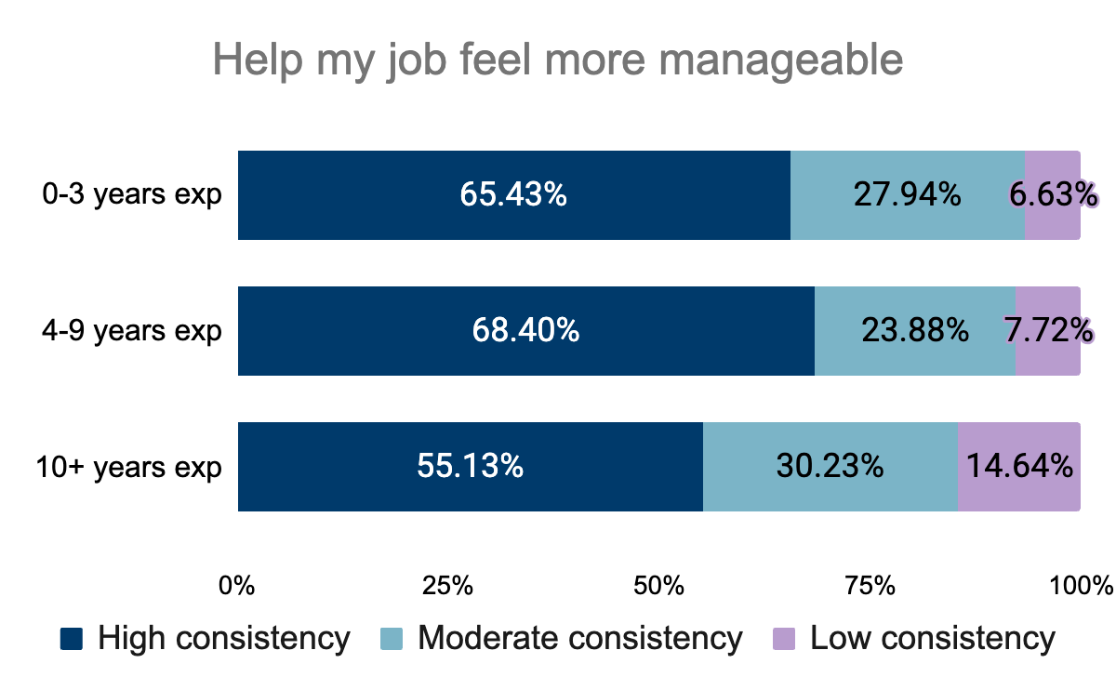
These concerns were particularly heightened among educators with 10+ years of experience, and were evident across all collaborative items, compared to that of those who were less experienced.
Notes:
And again, experience matters — but not the way we'd hope. Teachers with 10+ years report the lowest sense of consistency helping their job feel manageable, at 55%, compared to 65–68% for less experienced teachers. Low-consistency responses also climb from under 7% among newer teachers to nearly 15% among veterans.
This is the same pattern we saw in slides 20–22 — veteran educators are not automatically the most confident or the most reassured. If anything, experience seems to sharpen their awareness of where the gaps are.

Slide 31
Framework for Supporting Teachers of Students with LD
Notes:
Which brings us to the last node before Teacher Confidence: Student Support Dialogue — actually talking with colleagues about individual students.

Slide 32
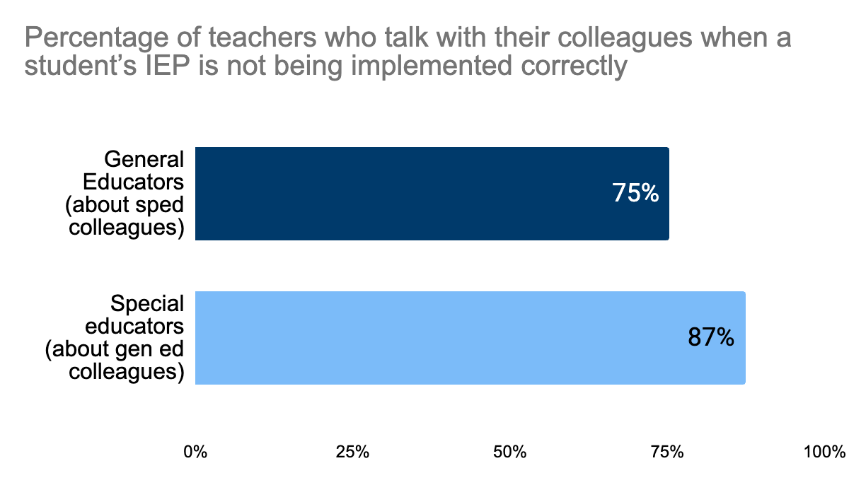
Special educators reported greater engagement with general educator colleagues around topics related to special education and IEP implementation.
Notes:
Good news here. When a student's IEP isn't being implemented correctly, 75% of general educators say they'd talk to their colleague about it — and 87% of special educators say the same. This is the strongest collaborative behavior we've seen in this section.

Slide 33
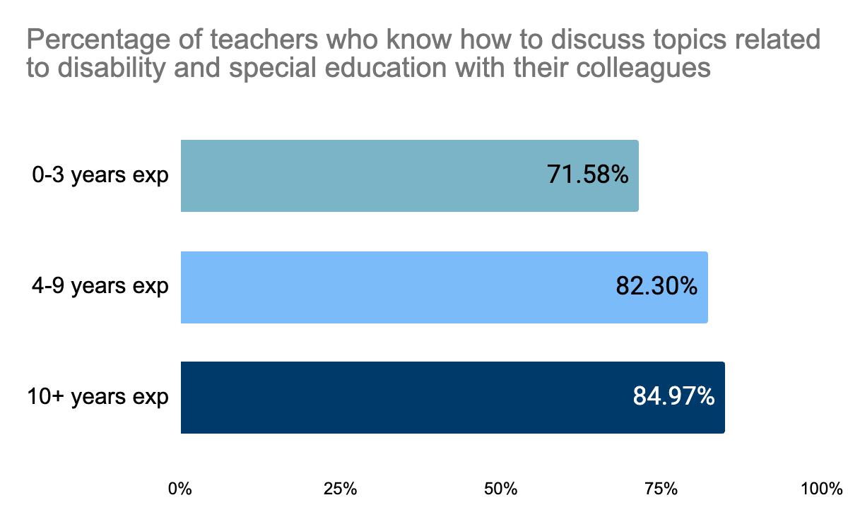
Knowledge around how to engage in student support dialogue with colleagues may grow with teaching experience.
Notes:
And unlike the earlier dips, knowing how to have these conversations does grow steadily with experience — from 72% for newer teachers up to 85% for veterans. So the skill is there and it builds over time; the confidence and consistency around colleagues just doesn't always keep pace with it.
So that's the full walk through both foundations — Instructional and Collaborative. Let's zoom out and pull this together.

Slide 34
Wrapping Up
Notes:
Let's wrap up what we've found."

Slide 35
Key Takeaways
Educator confidence in meeting LD needs is reliant on two foundations:
  Instructional
  Collaborative
Leadership support can either make or break these foundations.
General educators in particular feel less prepared to meet the needs of students with LD.
Notes:
Three things to leave with:
Teacher confidence in meeting the needs of students with LD rests on two foundations — instructional and collaborative — and we just walked through the data behind both.
Leadership support is the hinge. It's the one factor connecting both foundations, and it can make or break whether any of this translates into real classroom practice.
And despite spending a lot of this presentation on special educators' confidence, it's worth restating: general educators in particular feel less prepared to meet the needs of students with LD. The instructional comfort we saw in slides 20–22 is about general teaching skills — differentiation, data use, interventions — not necessarily about LD-specific need. Confidence in a skill isn't the same as confidence in applying it to this population.

Slide 36
Call to Action
State Education Agencies: Embed high-leverage practices and collaboration standards into certification and licensure requirements.
Educator Preparation Programs: Build instructional decision-making and student support dialogue into coursework and clinical placements.
Districts and School Leaders: Protect time for collaborative planning and follow through consistently when teachers ask for support.
Notes:
Here's what that looks like concretely at each level:
SEAs — embed High-Leverage Practices and collaboration standards directly into certification and licensure requirements, so this isn't optional professional development, it's baked into how teachers get credentialed in the first place.
EPPs — build instructional decision-making and student support dialogue into coursework and clinical placements, so new teachers are practicing these collaborative conversations before they ever have their own classroom.
Districts and school leaders — protect time for collaborative planning, and follow through consistently when teachers ask for support. That second part matters as much as the first — the data we just saw shows consistency, not just presence, is what teachers are responding to.

Slide 37

Q&A Time!
Notes:
Quote Card

Slide 38
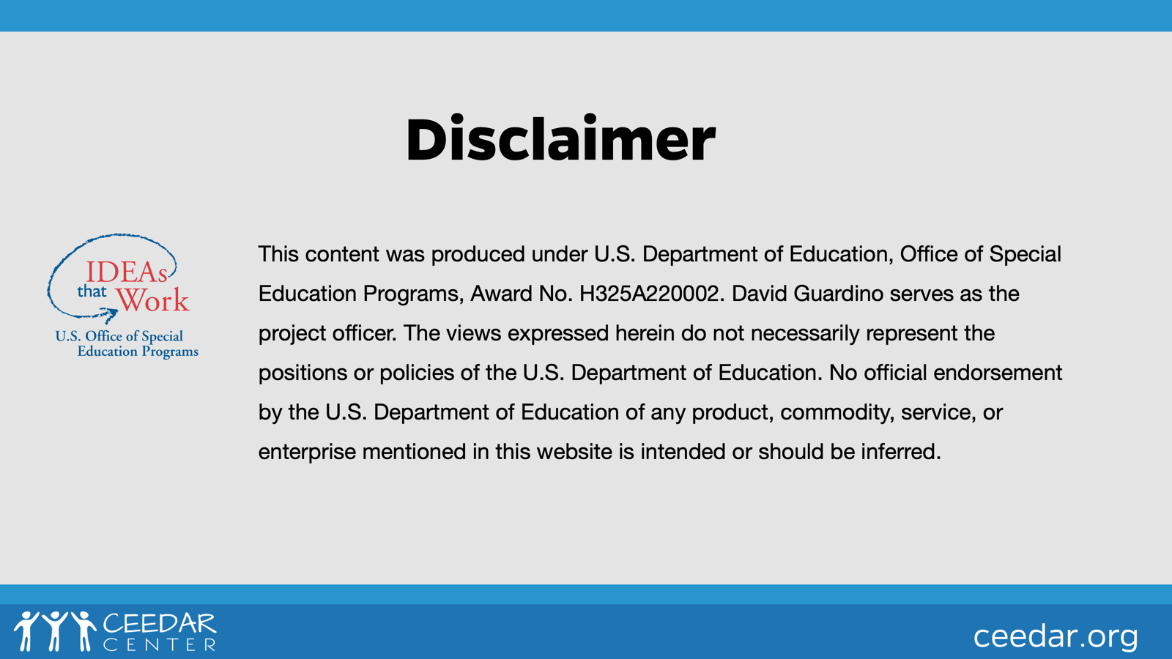
Disclaimer

Slide 39

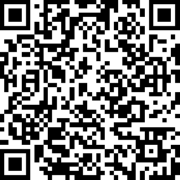
Feedback
We Value Your Feedback!
www.research.net/r/CEEDAR-NCLD-Aug26

