Slide 1

Insight to Action: Using AI to Enhance Teaching and Learning
CEEDAR/CIDDL AI Lunch & Learn Webinar
Monday, May 11, 2026
James D. Basham, Ph.D.
Professor, Department of Special Education
Director, CIDDL
University of Kansas
Disclaimer: The contents of this presentation were developed by the presenters under award #H327F200008, #H327F250003. They do not represent the policy of the Department of Education. Do not assume endorsement by the Federal Government.

Slide 2

Quick Introductions
James D. Basham, Ph.D.,
Professor of Special Education
Director, CIDDL
University Of Kansas
Learn more at CIDDL.org

Slide 3

Learn more at https://ciddl.org/
The Center for Innovation, Design, and Digital Learning (CIDDL) serves as the National Center to Improve Faculty Capacity to use Educational Technology in Special Education Personnel and Leadership Preparation Programs.
Disclaimer: The contents of this presentation were developed by the presenters under award #H327F200008, #H327F250003. They do not represent the policy of the Department of Education. Do not assume endorsement by the Federal Government.
Learn more at CIDDL.org

Slide 4
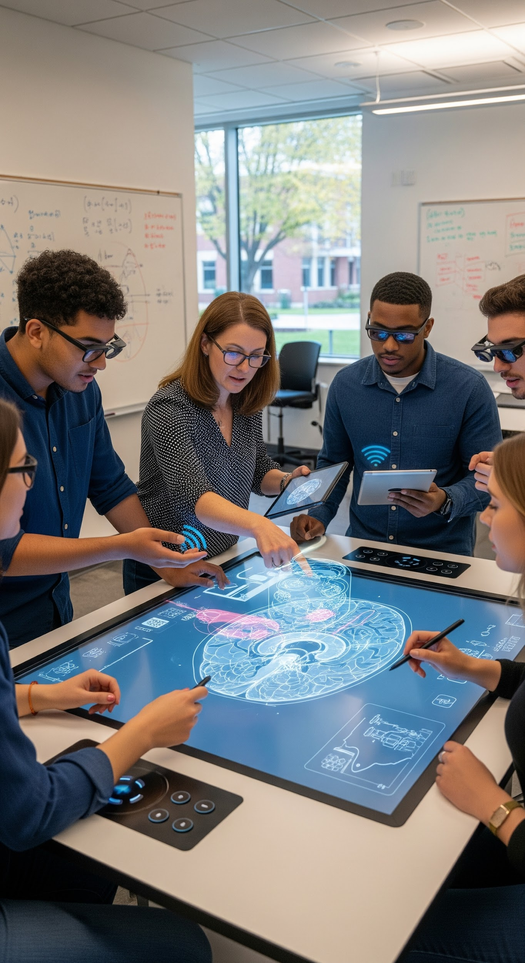
CIDDL is Focused on…
Increasing knowledge, capacity, adoption, and integration of innovative technologies (including educational, assistive, and artificial intelligence) within special education personnel and leadership preparation programs;
Increasing the number of faculty who keep up with technological innovations and research;
Increasing the number of special education and leadership personnel graduates well-prepared to integrate technologies and innovative technology practices.
Learn more at CIDDL.org

Slide 5
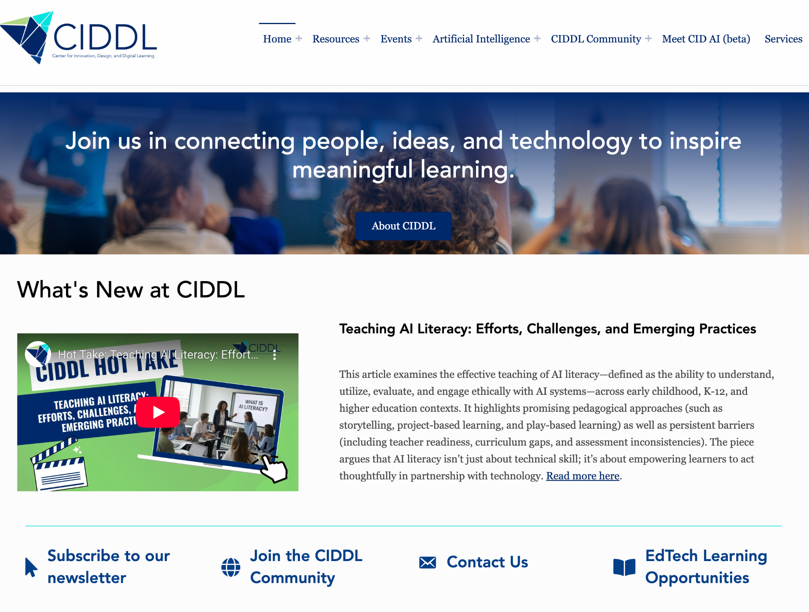
Learn more at CIDDL.org

Slide 6

Why AI Matters in Education
AI is already influencing how students learn and educators teach.
Supporting teachers in reducing their workload.
Opens new pathways for personalization, access, and engagement.
Understanding both capabilities and responsible use is critical.

Slide 7

Reality in Today’s Schools…
87% of teachers are using AI
57% of IEPs and 504 plans in 2025 were written with AI (an 18% increase for 2024)
Fewer than half the teachers have reported receiving “official” professional development on AI.
(Center for Democracy and Technology, 2025)

Slide 8

What is AI?
Notes:
Trey -

Slide 9

Artificial Intelligence (AI)
Basic: The simulation of human intelligence processes by machines.
A bit more… Artificial Intelligence (AI) as a machine-based system capable of making predictions, recommendations, or decisions that impact real or virtual environments, based on human-defined objectives. 15 U.S. Code § 9401(3)

Slide 10













Khan Academy

Slide 11
Human or AI?
Demystifying the Invisible Logic in Education

Slide 12
How to Play
Examine: Look closely at the four artifacts on the next slide.
Vote: Decide if each was created by a Human or AI.
Reflect: Think about what cues or "feelings" informed your decision.

Slide 13
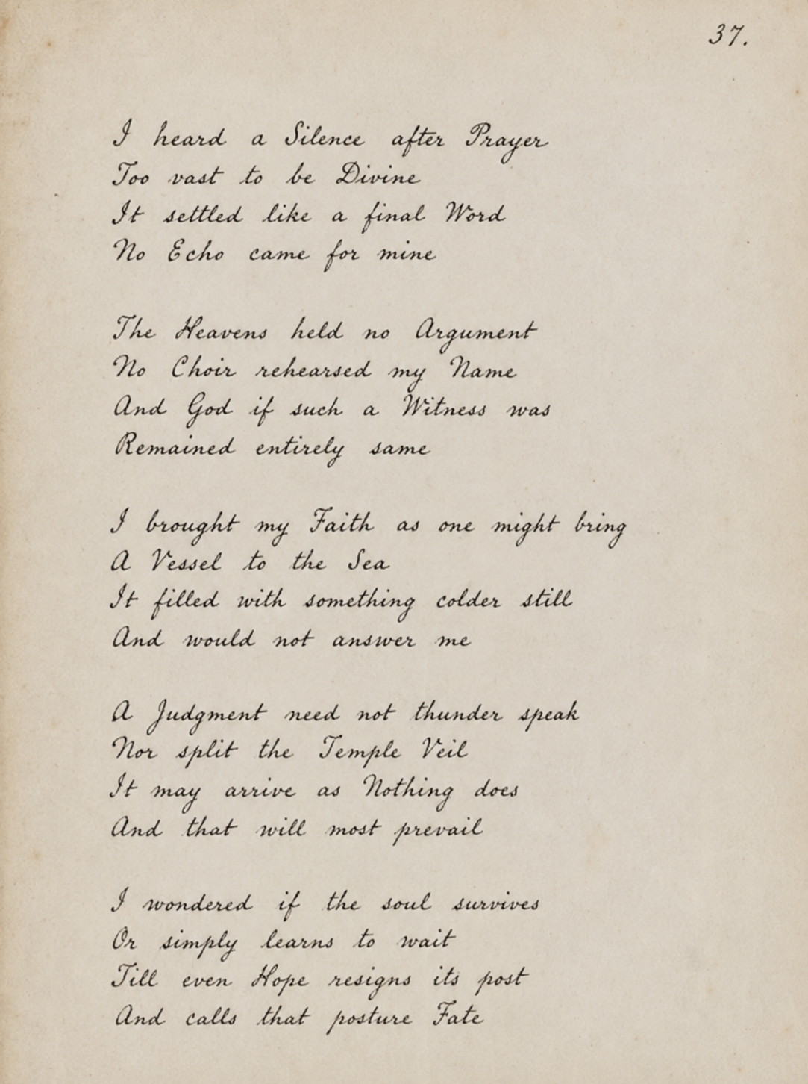
Artifact: A Poem

Slide 14
2. Artifact: Case Study Activity
Team Challenge:
As a team use the case study to consider:
How can the lesson be redesigned to support independent communication and participation, particularly for students using AAC?
What structures or strategies could ensure equitable roles and engagement within group work?
How might the team better capture evidence of understanding beyond verbal or written responses?
How can rigor be maintained while increasing access for students with significant support needs?
Case Study: Designing for Inclusion in a STEM Classroom
Ms. Alvarez, a 7th-grade science teacher, is preparing a unit on photosynthesis for a diverse classroom that includes English learners, students with varying academic backgrounds, and two students with significant support needs who use AAC devices. She is committed to ensuring that all students engage with grade-level science content, not through separate or simplified tasks, but through shared learning experiences.
During a recent lesson, students participated in a hands-on activity modeling photosynthesis. While most students actively engaged, Ms. Alvarez noticed uneven participation. One student using AAC relied heavily on a paraprofessional to respond, with limited independent interaction. Another student participated physically but showed little evidence of conceptual understanding. Meanwhile, some peers dominated group roles, unintentionally limiting access for others.

Slide 15

3. Artifact: Art/Photography

Slide 16
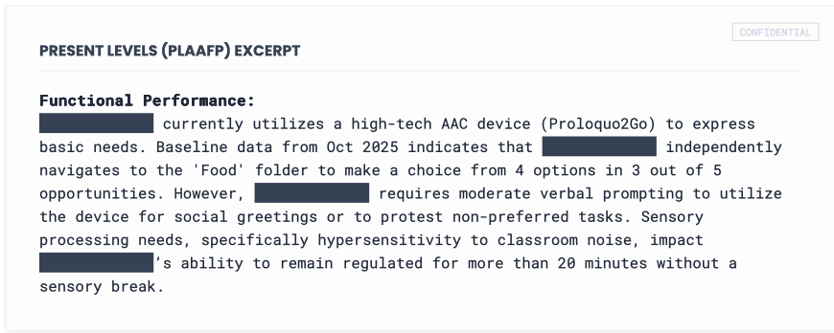
4. Artifact: IEP PLAAFP Statement
(Present Levels of Academic Achievement and Functional Performance)

Slide 17
Let’s Decide: Human or AI?

Slide 18
What can AI do for you?
Personalize instruction & feedback
Help brainstorm ideas
Write text
Level text
Translate across languages
Create podcasts
Create and manipulate images
Solve word problems
Provide step-by-step directions
Write Code
…

Slide 19

For Many People November 30, 2022…
Marked the start of modern AI with the launch of Open AI’s ChatGPT 3.5
But in reality…“AI” has been around for decades.

Slide 20

Scope of Large Language Models (LLM)
Parameters - Think of as individual neurons or connections between the neurons.
Human Brain = 86 billion
Chat GPT 3 = 175 billion
Training data: 500 billion words
Wooldridge, M. (2023). What's the future for generative AI? The Royal Institution.

Slide 21
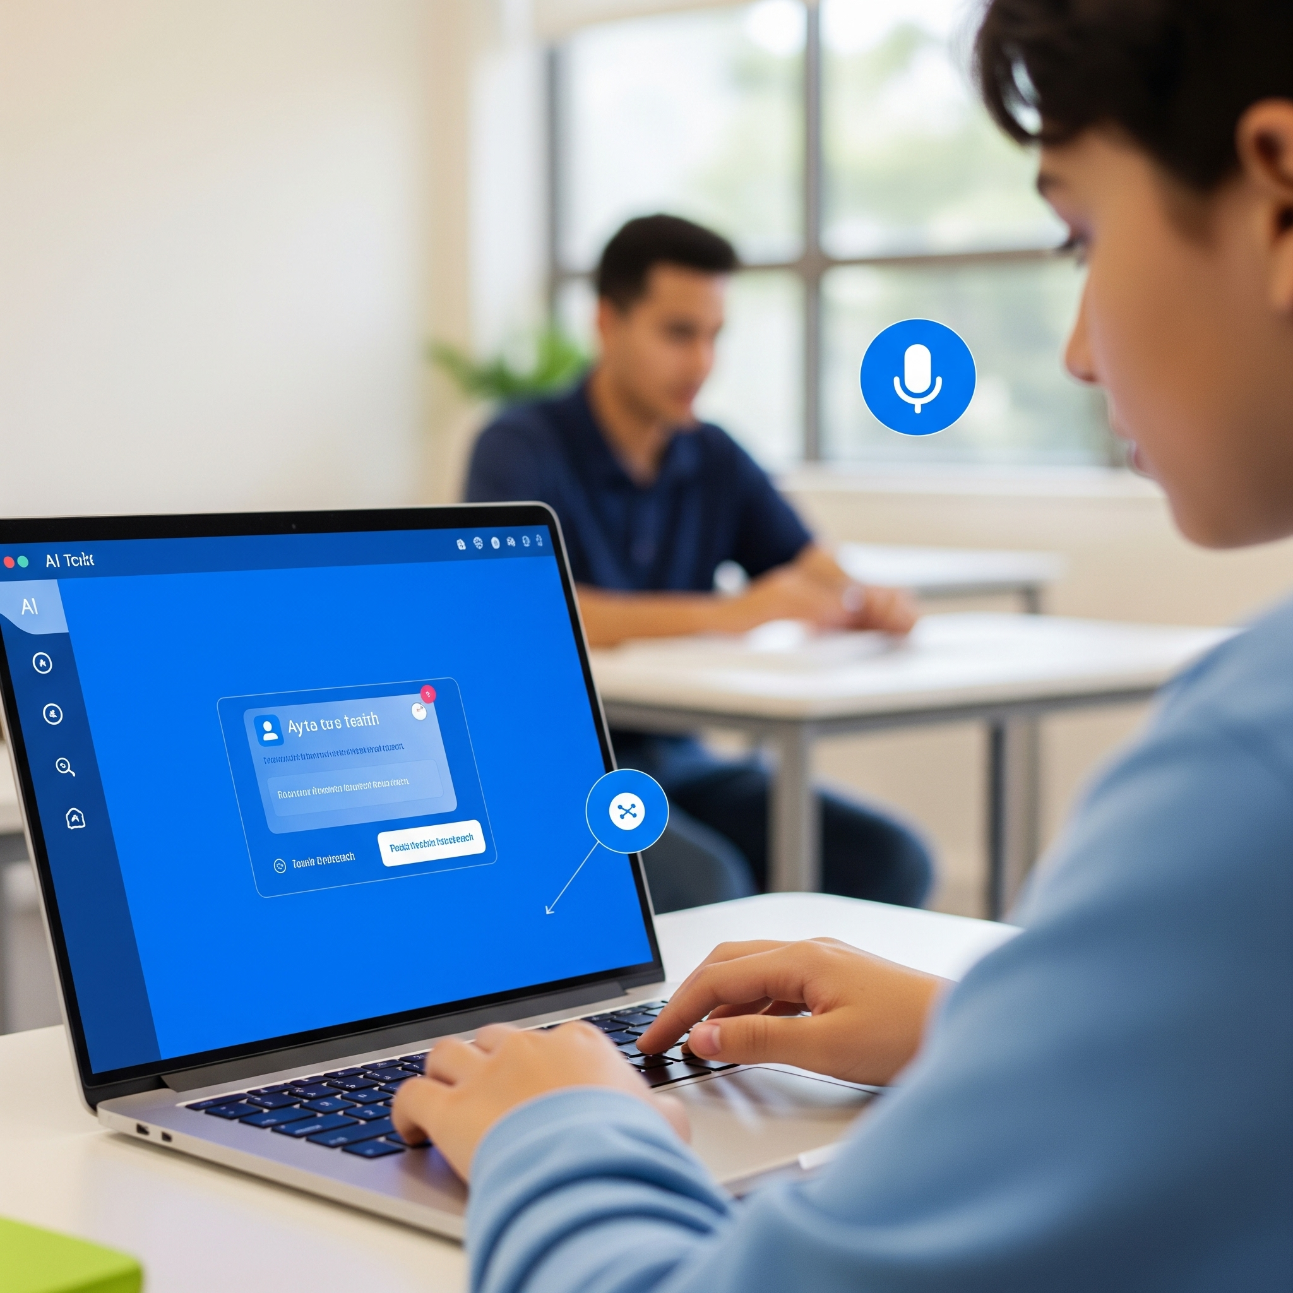
AI’s Potential Impact in Supporting ALL Students
Improved and easier accessibility of educational materials
Greater personalization (individualization) across education, for all students
Increased and novel measurement (e.g., multimodal learning analytics)
Increased just-in-time, support based on student need
More efficient workflows for professionals serving students
Continuous home and school support (e.g., intelligent agents)

Slide 22

Ethics and Professional Use
Data Privacy and Security: AI collects sensitive student data. Follow FERPA for privacy compliance.
Bias and Fairness: AI can reflect biases, potentially leading to unfair treatment of students with disabilities or from marginalized groups.
Ensuring Access: Ensure AI tools are accessible to all students, supporting diverse needs.
Transparency and Explainability: Use AI tools that make decision-making clear, enabling informed use.
Maintaining Professional Judgment: AI should aid, not replace, your judgment; human oversight is essential.
Avoiding Misinformation: Ensure AI-generated materials are accurate and align with learning goals.

Slide 23
Let’s look at a quick example…

Slide 24

AI Accessible Technology

Slide 25
Where to get started…

Slide 26

High-Leverage Practices (HLPs)
Created by CEEDAR Center and Council for Exceptional Children (CEC)
HLPs are used across all levels, content areas, and settings to improve learning outcomes for all students
Four Domains:
  Collaboration,
  Data-Driven Planning,
  Instruction in Behavior
  Academics, and Intensify and Intervene as Needed

Slide 27


HLP webpage

Slide 28
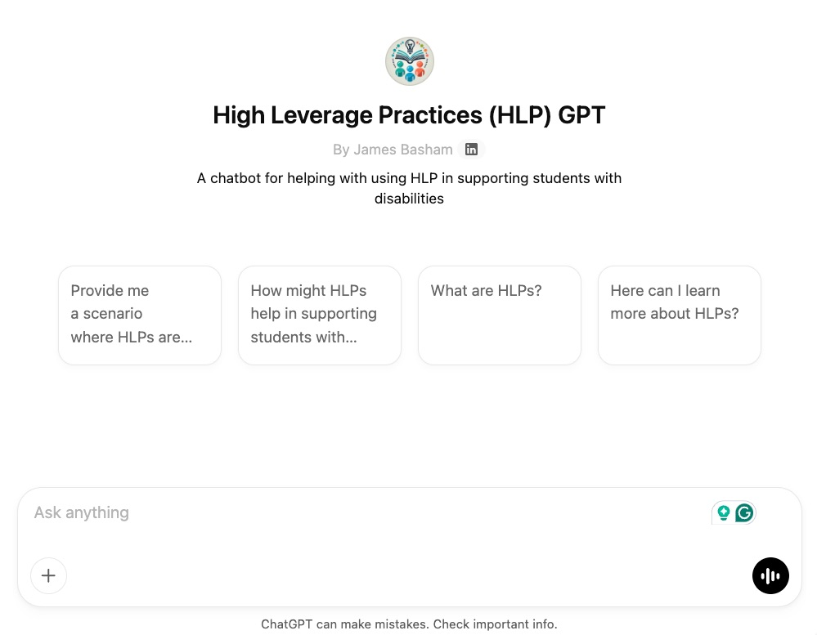

https://tinyurl.com/HLPGPT

Slide 29
HLP Activity: Think. Pair. Share.
Think. What questions might be appropriate.
Pair with an AI….
  What are HLPs and how might I use them?
  How might I use HLPs in my classroom?
  I have X situation how might HLPs help me?
  How might my district encourage the use of HLPs, as X leader, what are steps I might take?
Share with an AI, what did the AI say?
Prepare to share with Humans in the Chat
https://tinyurl.com/HLPGPT

Slide 30
Basics of Effective Prompting
Notes:
Details for prompting are important How to make a PBJ video https://www.youtube.com/shorts/KR25vZJEKeo

Slide 31
Six Components of Prompt Engineering
More important
Less important
Tasks
Contexts
Exemplars
Persona
Format
Tone
Start with an action verb to ask what you want
User’s background/
environment,
what success look like
Examples;
not necessary but improve the quality of output
Who do you want the AI to be?
Visualize the exact format you want the end result to be
Add feelings you are going for in the output
Generate
Develop
Give
Write
Analyze
Suggest
Second grade student struggling with decoding
Objectives
Resource room/ general education classroom with 25 students
Rewrite this using this structure:
For example,
Special education teacher
Cartoon characters
Emails
Bullet points
Paragraphs
Table
Markdowns
Code blocks
Casual tone
Formal tone
Witty output
Show enthusiasm
Clear and concise language

Slide 32
Weak and Strong Example Prompts
“Create a lesson plan on photosynthesis for middle school students. Include some activities and make it engaging.”
“Create a 45-minute lesson plan on photosynthesis for 7th-grade students. I am a middle school science teacher designing an inclusive lesson for a class with diverse learning needs, including students with disabilities, English learners, and students with varying background knowledge. The lesson should include opportunities for engagement, representation, and action/expression. Structure the lesson plan with these parts: learning objective, materials, opening activity, mini-lesson, guided practice, independent or collaborative activity, formative assessment, and closure. Include at least one support for learner variability in each section. You are an expert instructional designer with knowledge of UDL, differentiated instruction, and middle school science teaching. Present the response as a clearly labeled lesson plan with headings and bullet points for each section. Use a practical, clear, supportive, and ready-for-classroom-use tone.”

Slide 33
Building AI Literacy, Fluency, and Collaboration
Notes:
Trey

Slide 34

AI Literacy Foundations
Critical evaluation: Students and teachers need to ask, How accurate is this? What’s missing? Whose perspective is represented?
Ethics & bias: AI reflects human biases in data. Educators should model how to spot and question inequities.
Transparency: Be able to explain where AI “gets its answers” (e.g., data sources, probabilities, limitations).
Privacy & security: Understand what data goes into an AI tool and who owns/controls it.

Slide 35

AI in Education Practice
AI as a partner, not a replacement: Use AI to support teaching (lesson ideas, accessibility tools, differentiation), not replace educators.
Accessibility benefits: Text-to-speech, speech-to-text, summarizers, translation, AI can expand access for learners with disabilities and multilingual learners.
Limitations to respect: Fabricated info (hallucinations), overreliance, reduced creativity if used passively.
Classroom use: Teach students to use AI for brainstorming, feedback, and scaffolding while still developing independent thinking.

Slide 36
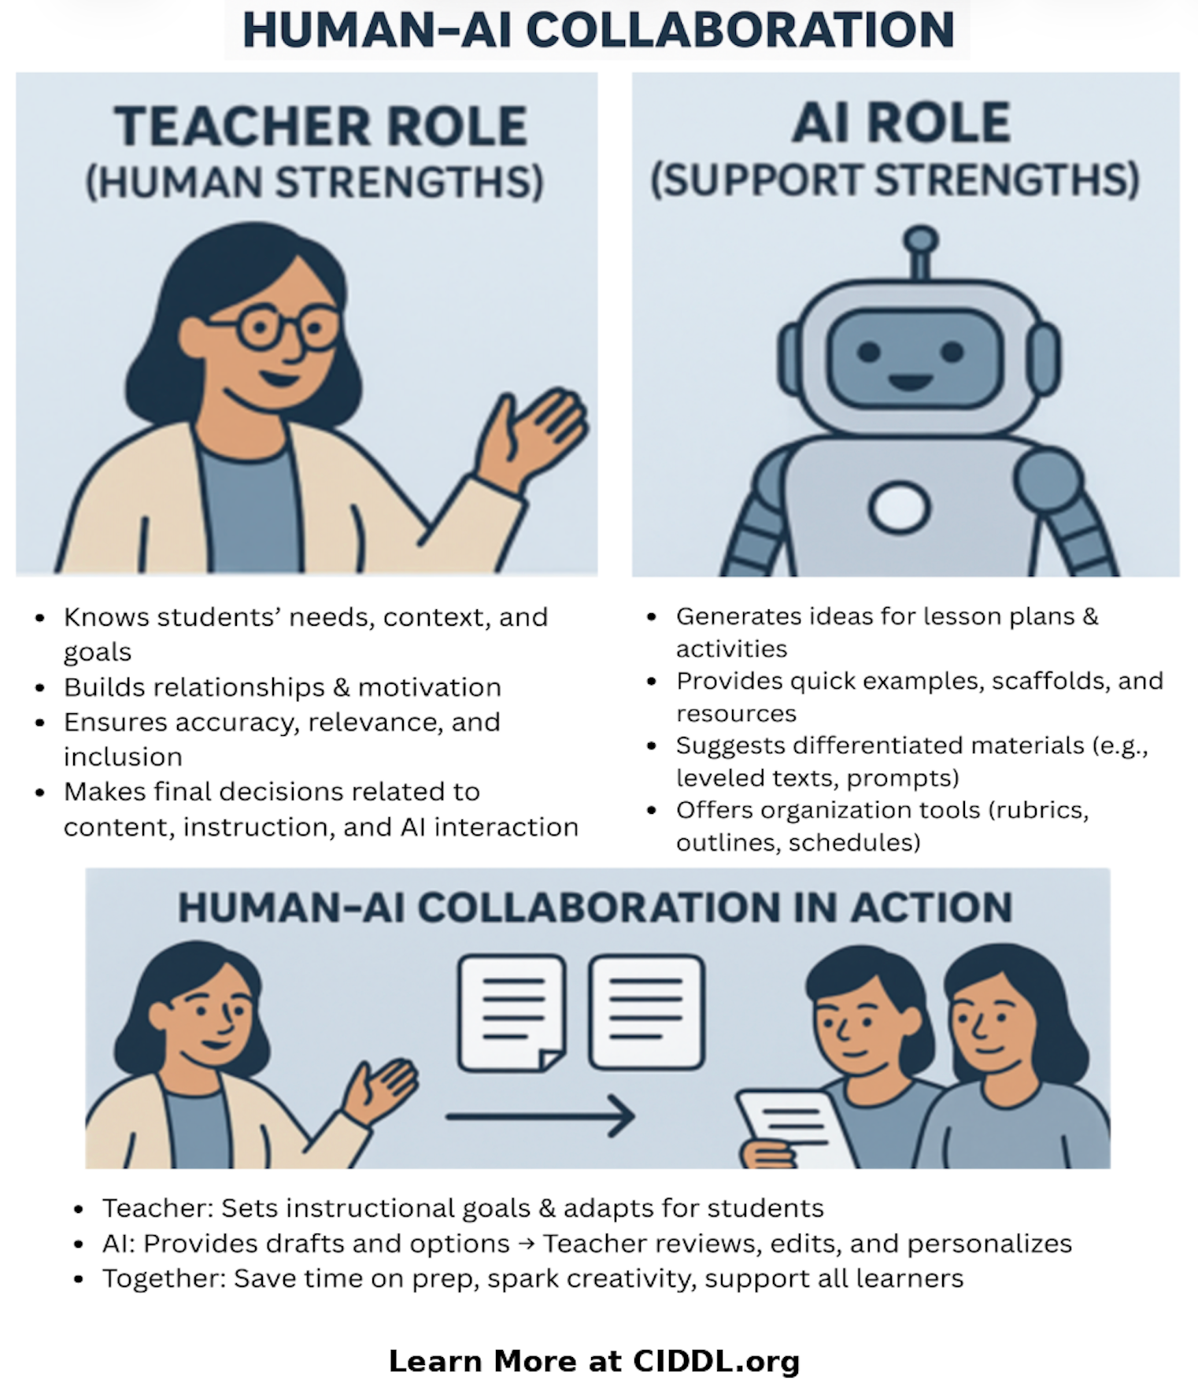
Human-AI Collaboration
Building knowledge and skills to support Human-AI Collaboration
Identified roles for humans & AI
Supporting practice in the process of doing this with students in K-12
Notes:
Trey End

Slide 37

Reflect on the AI Output
What do you like about the revised AI output?
How can it still be improved with better prompting?

Slide 38

Guardrails and Guidelines..

Slide 39

Three Core Guardrail Lenses
Safety & Privacy – Protect people and data.
Opportunity & Access for All– Focus on all students, staff, families; avoid amplifying bias; expand future horizons.
Transparency & Accountability – Be clear when AI is used and who is responsible.

Slide 40



Educators "Do" List:
Lesson Scaffolding
Generate level-appropriate readings, simplify complex concepts, or create guided notes for varied learners.
Admin & Parent Comms
Draft class newsletters, permission slips, or initial responses to general parent inquiries to save time.
EL & ESL Support
Instantly translate assignments or instructions to support students and families in their home language.

Slide 41
The "Don't" List: Keep Humans in the Loop
Verify Everything
AI systems can support humans, but do not rely on AI for final decisions in:
Final Grading: Evaluating summative learning require human professional judgment.
Disciplinary Decisions: AI lacks context and empathy to judge human behavior, humans are necessary to make final decisions.
Special Education Decisions: Disability status, PLAAFP Statements, IEP goals, require humans in the loop, especially credentialed experts.

Slide 42
Guardrails: Safety & Privacy
Protect student and staff sensitive data.
Use age-appropriate tools and content filters.
Avoid over-reliance on AI for high-stakes decisions (placement, discipline, etc.).
Align AI use with existing data privacy and security policies.

Slide 43
Guardrails: Opportunity & Access for All
Audit AI use for potential bias and unequal impacts.
Ensure AI supports all students, including students with disabilities and multilingual learners.
Provide non-AI options where needed/required.
Avoid using AI as the sole basis for grading, placement, or eligibility decisions.

Slide 44


Guardrails: Transparency & Accountability
Be clear when and how AI is being used with students/staff.
Keep humans-in-the-loop for instructional and high-stakes decisions.
Document tool choices: purpose, data used, decision processes.
Provide ways for students, families, and staff to ask questions or challenge AI-informed decisions.

Slide 45

IDEA and FERPA Guidance
Foundational laws like IDEA and FERPA must guide AI use.
Use of AI must ensure IDEA compliance and student rights.
FERPA protects student personally identifiable information and data.
Educators must evaluate AI tools for compliance with these laws.
Legal frameworks support ethical AI decision-making in special education.

Slide 46
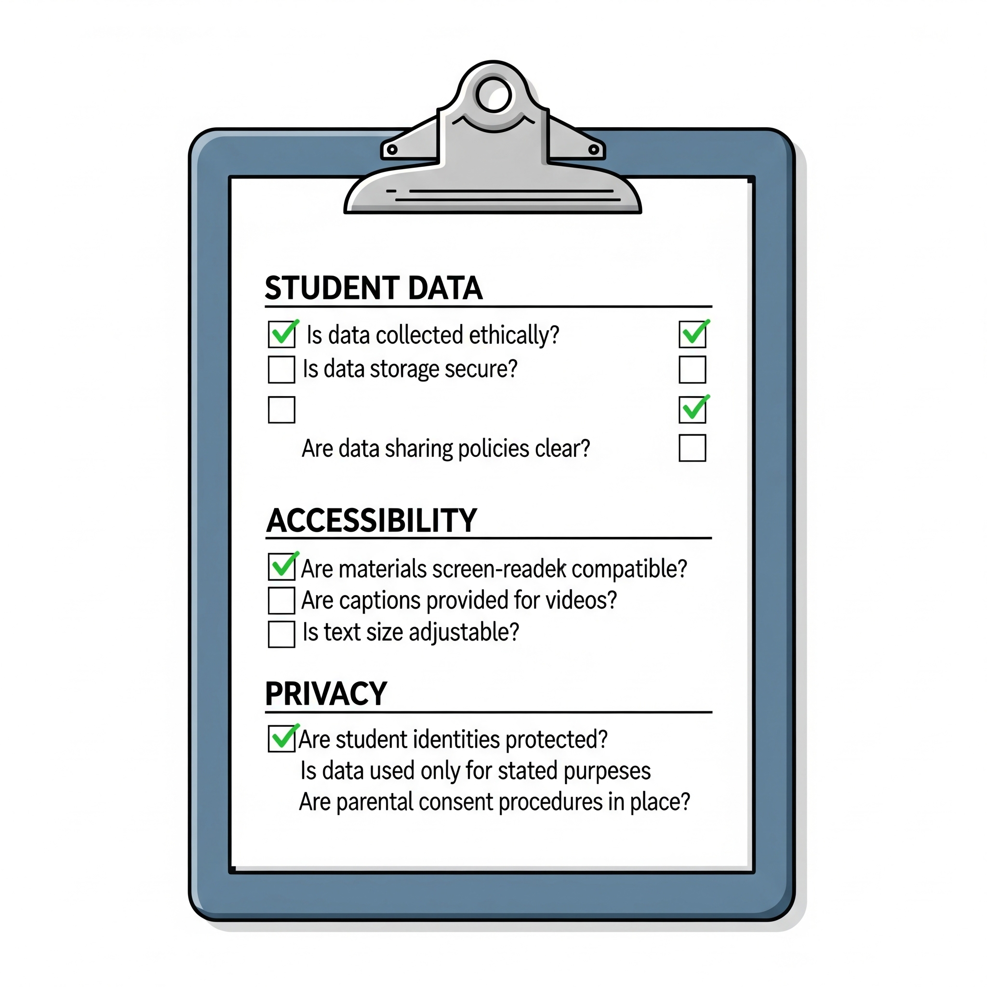
Some Guiding AI Use Questions
What student data does this tool collect, store, and share?
Does it meet accessibility standards for students with disabilities?
Can the tool accommodate necessary IEP requirements and modifications?
What are the vendor's policies for data retention and deletion?
Is there a clear and compliant data privacy agreement in place?

Slide 47
Final Reflection
Learn more at CIDDL.org

Slide 48

Reflect on AI Use…
The Opportunity
“AI is most useful to me when…”
(Think: Differentiating for learners, developing lesson ideas, or clearing administrative hurdles)
The Professional Limit
“I will stay cautious about…”
(Think: Student PII, hidden biases, or maintaining human empathy)

Slide 49
Some CIDDL Resources…
Learn more at CIDDL.org
CIDDL.org

Slide 50
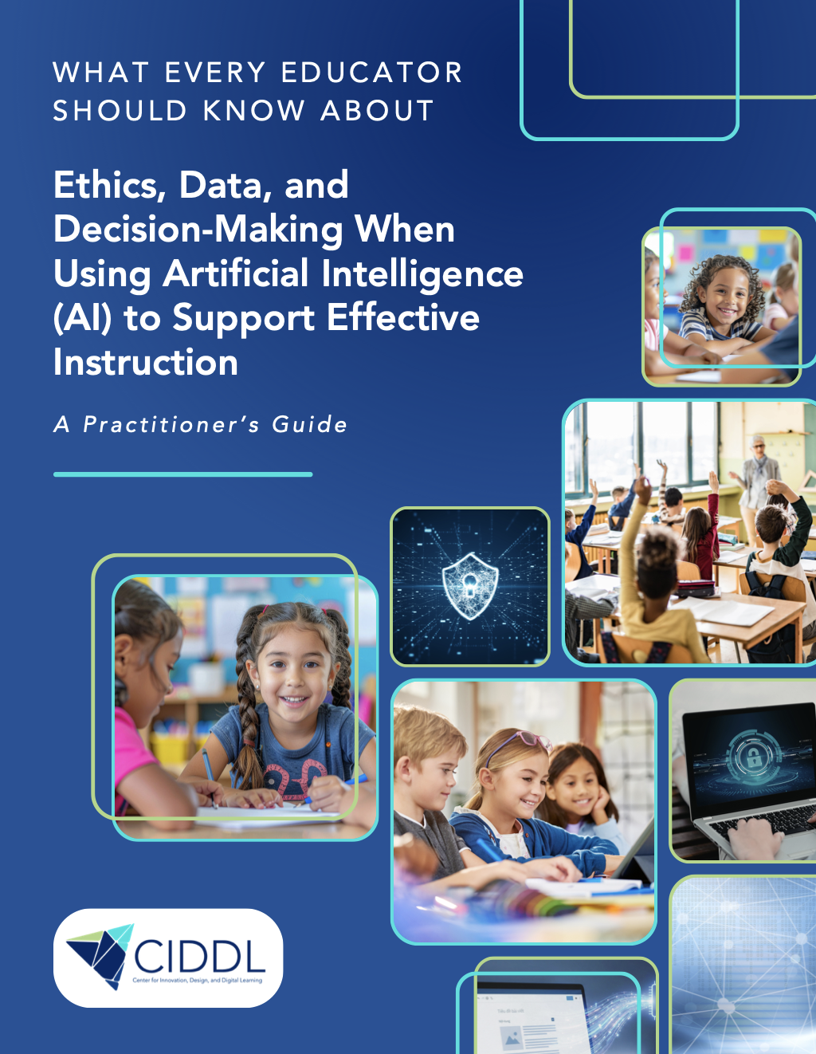

A Free Practitioner's Guide from CIDDL
AI is already shaping your students' learning experiences, whether you've chosen it or not. Adaptive platforms, assessment systems, writing tools, and IEP workflows are increasingly powered by artificial intelligence, often operating quietly in the background without formal review. This free guide gives educators, school leaders, and teacher educators a practical, research-grounded framework for making ethical, data-informed decisions about AI in education.
CIDDL.org

Slide 51
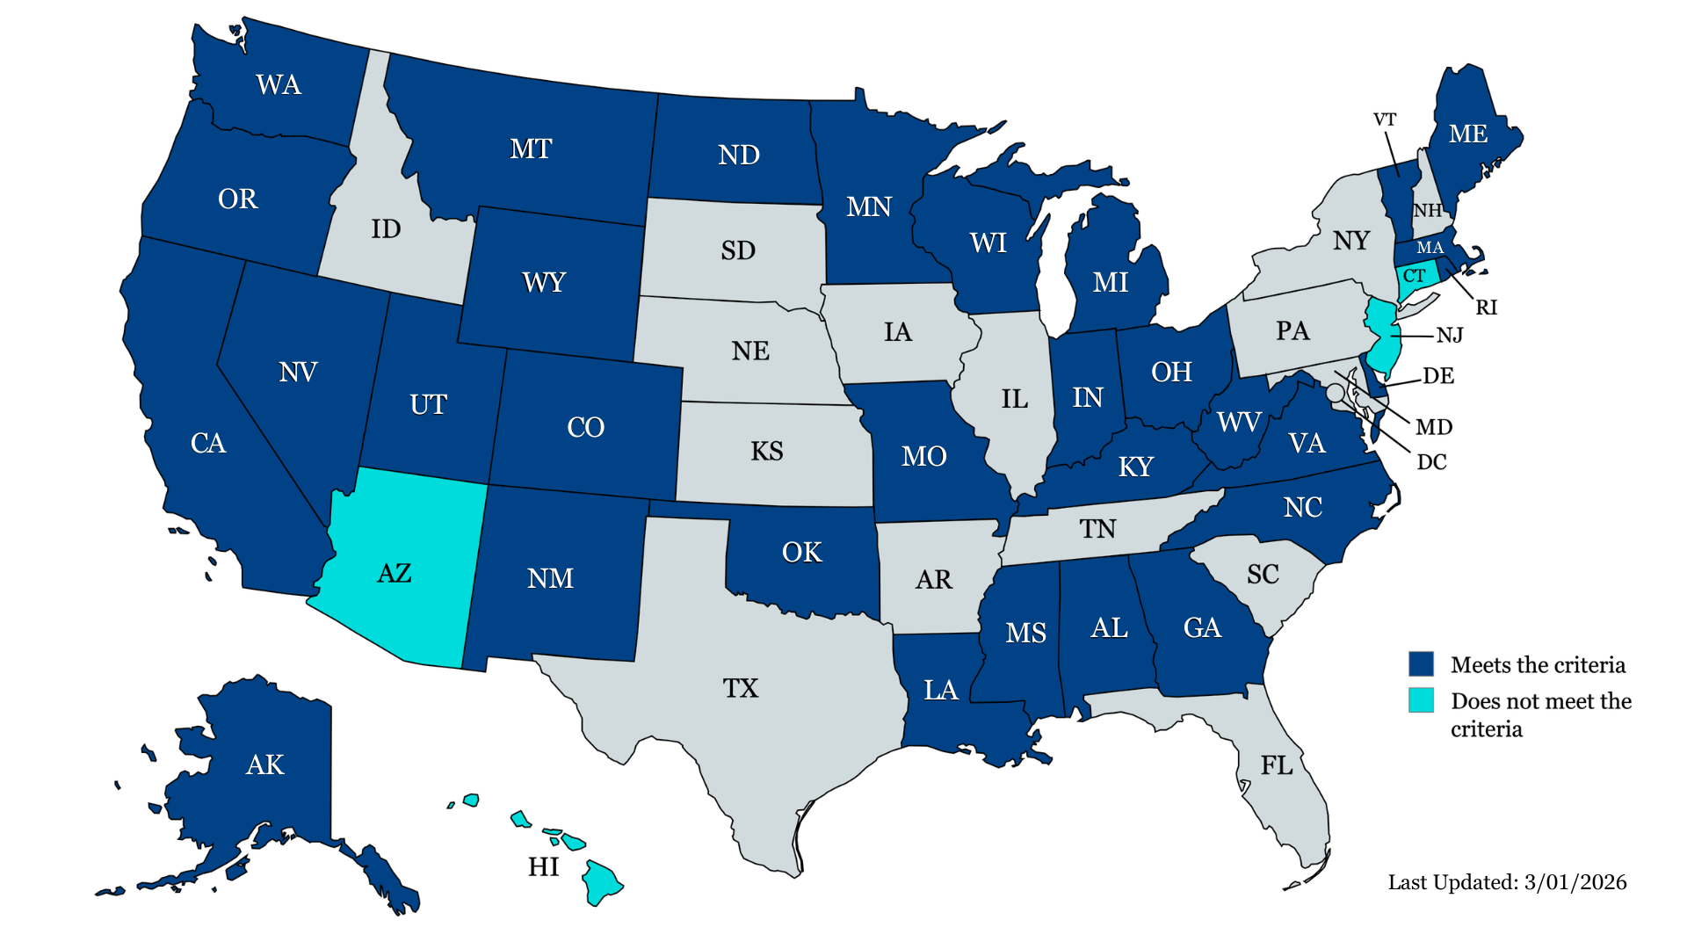

AI State Guidance for K-12 Education
Monitoring of “official” K-12 state AI guidance.
Thirty-one state guidance documents met our criteria: AK, AL, CA, CO, DE, GA, IN, KY, LA, MA, ME, MI, MN, MO, MS, MT, NC, ND, NM, NV, OH, OK, OR, RI, UT, VA, VT, WA, WI, WV, and WY.
Only include students with disabilities (22 of 31 states).
A single state, Maryland has actual policy on AI use and procurement
CIDDL.org

Slide 52


Artificial Intelligence:
The Impact of AI on Education for All Learners
Introduction
Chapter 1: Considering Artificial Intelligence in Higher Education
Chapter 2: Teacher Practices and AI Assessment
Chapter 3: Using AI in the Classroom: Considerations for Educators
Chapter 4: Envisioning AI's Impact on Special Education Research
Chapter 5: Enhancing the School-Home Connection: Empowering Parents with AI
Chapter 6: Policy and Guidance Considerations for AI in Supporting SWDs
Chapter 7: Industry Collaboration for Educators and AI
Chapter 8: Ethical Considerations for Educators Leveraging AI
CIDDL.org
Notes:
Matt

Slide 53
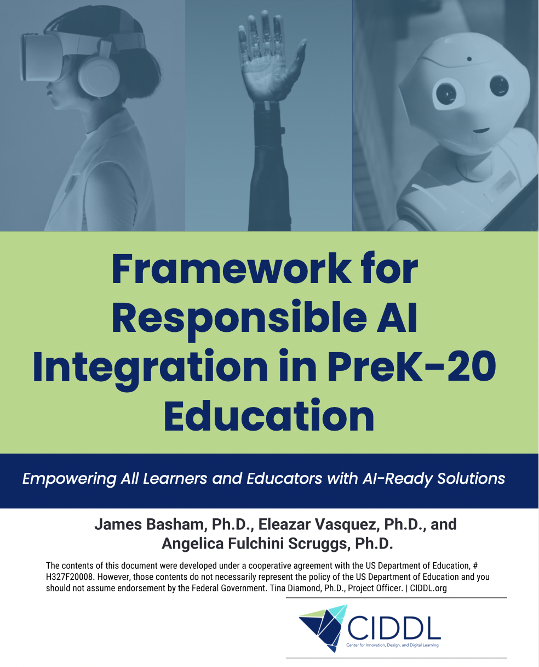

CIDDL.org
Strategic AI Use: AI in education requires careful planning to avoid risks and maximize benefits.
CIDDL Framework: Provides practical guidance for AI integration in PreK–20 settings.
Supports All Learners: Designed to meet the needs of students, including those with disabilities.
Future-Focused: Prepares students for postsecondary, career, and lifelong learning.
Evolving Resource: Framework will adapt with new technologies and insights.

Slide 54


CIDDL.org
Join CIDDL Early Career
Higher Education Faculty
Writing Collaborative
https://tinyurl.com/CIDDLearly

Slide 55

CEEDAR Webinar Evaluation
https://www.research.net/r/CEEDAR_AI_5-26

Slide 56


Questions?
Ask questions and share your thoughts
Connect with us via email at info@CIDDL.org
If interested in learning more about CIDDL or requesting products and services…

