Slide 1

Innovative Models for Strengthening Educator Preparation: State Initiatives to Meet Local Needs

Slide 2


Tennessee Registered Teacher Apprenticeship Programs (RTAP)

Slide 3




Teacher Shortage
A challenge in Tennessee & across the nation
Certain academic areas are more affected:
Math
Special Populations
ESL
Science
Notes:
- While staffing has improved, high-need areas remain persistent:
- Special Education
- ESL
- Secondary Math
- RTAP has been successful in building new educator pipelines, but we continue to hear from districts that apprenticeships alone do not solve every human capital challenge.
- Many LEAs still need support with:
- Recruitment in hard-to-staff areas
- Retention of current educators
- Mentorship and induction systems
- This is what drove the evolution from RTAP alone to the broader TEACHReadyTN human capital strategy—so districts have tools and support beyond just one pathway.

Slide 4
Utilizing Teacher Apprenticeships in Tennessee
Addressing three core principles:
Establish sustainable talent pipelines to address vacancies
Support districts in navigating and responding to local workforce needs
Design a program model that intentionally blends a strong high-quality preparation with meaningful, practical experience

Slide 5
Why Apprenticeship?
A pathway into the profession, not a clinical experience.
Provides structure and a second phase of high-quality “grow your own“ programs.
Customizations based on local needs.
Support for non-teachers to move into careers as a teacher.
Financial sustainability or expansion of what already works or could be working in your local context.
Built to reflect the dynamic, evolving partnership between EPPs (RTI Providers) and LEAs (Employers).

Slide 6
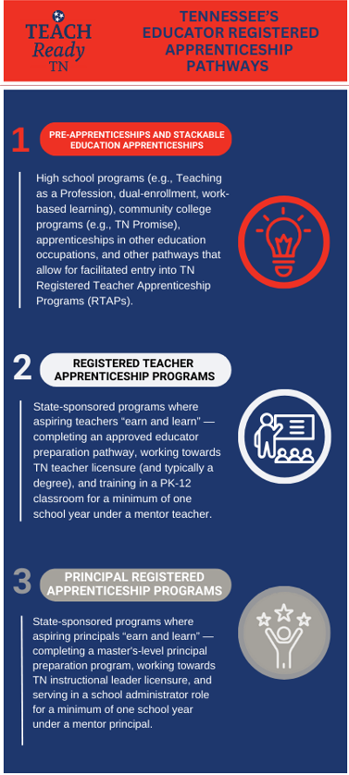
Tennessee’s Educator Registered Apprenticeship Pathways
Occupation: Teacher Aide I
Sponsor: Nashville State Community College, Volunteer State Community College, Northeast State Community College
Occupation: K-12 Teacher
Sponsor: Tennessee Department of Education
State Apprenticeship Agency: Department of Labor & Workforce Development

Slide 7
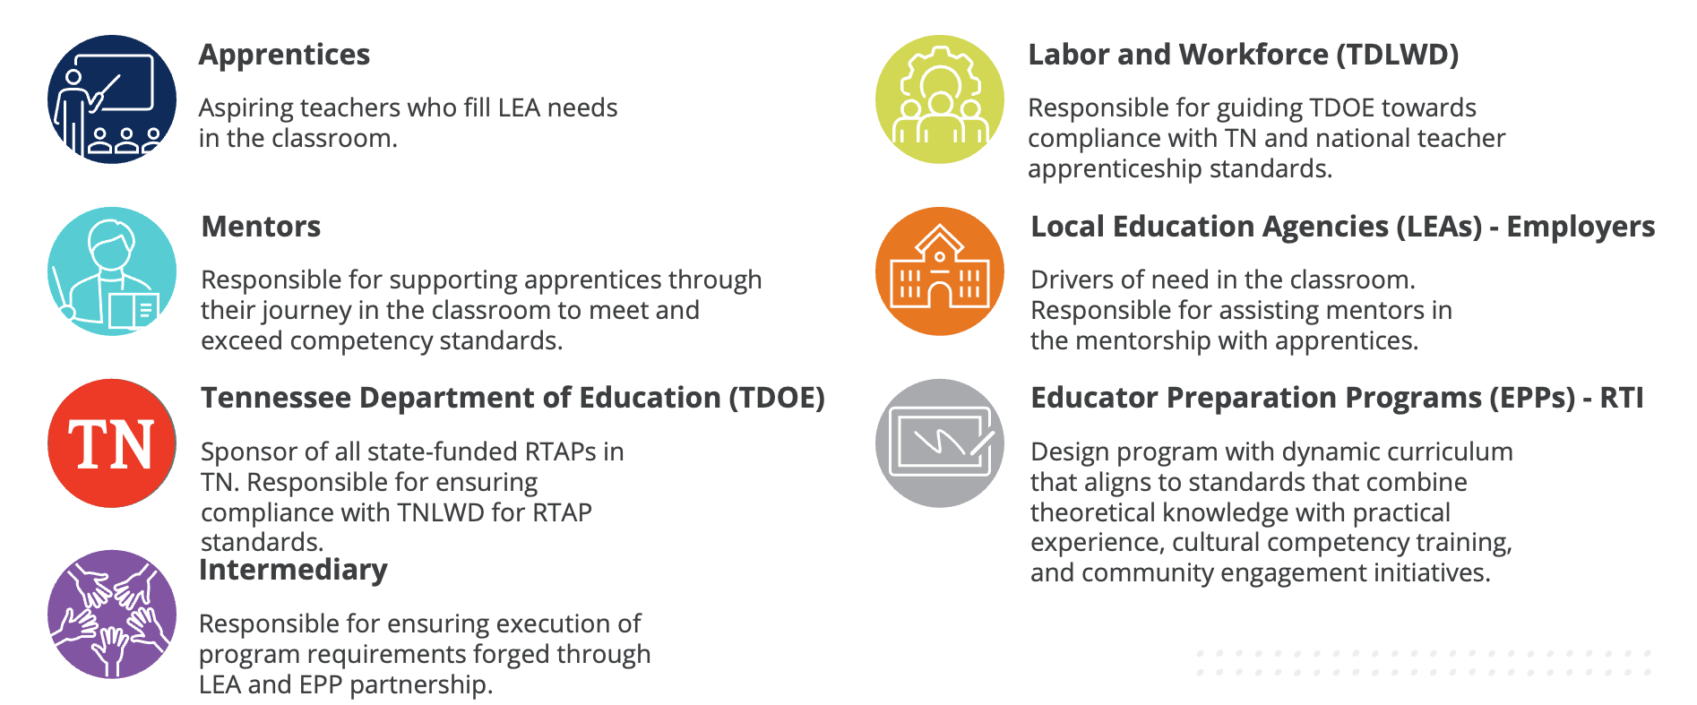
Key Stakeholders for RTAP
Notes:
Tennessee’s Registered Teacher Apprenticeship Program operates through a shared partnership model with clearly defined roles.
This structure ensures compliance, quality, and scalability, while keeping district workforce needs at the center.

Slide 8
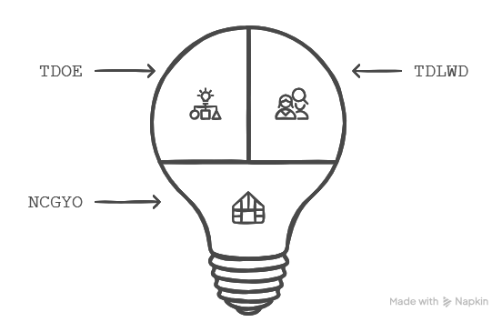
Partnerships
  Sponsor (Tennessee Department of Education/TDOE): Oversees the administration
  and management of the Teacher Registered Apprenticeship Program, including
  registering apprenticeships in RAPIDS, ensuring the program complies with federal
  apprenticeship regulations according to national and Tennessee standards of
  apprenticeship, aligning strategy with intermediary, and supporting the work of the
  intermediary.
  State Apprenticeship Agency (Tennessee Department of Labor and Workforce
  Development/TDLWD): Recognized by Office of Apprenticeship to act on behalf of the
  federal U.S. Department of Labor to register and oversee apprenticeship programs in the state, including responsibility for ensuring compliance with the Code of Federal Regulations.
  Intermediary (National Center for Grow Your Own Center/NCGYO): Supports TDOE (as sponsor) in developing a resource hub
  with regional focus comprised of various entities (e.g., no affiliation with one individual EPP or LEA). Intermediary carries out mission of sponsor while working to resolve local needs via partnerships with LEAs.
Notes:
The evolution of our RTAP program led us to where we are today with the NCGYO and their involvement in our Human Capital pursuits as our intermediary in this work.

Slide 9
Current State of Apprenticeships
434
124
14
Active RTAP Apprentices
Active PRAP Apprentices
Approved RTI Partners
24
310
105
Community College
Pipeline
RTAP Completers
Approved RTAP and PRAP
School District Partners

Slide 10

Tennessee’s Needs & Opportunities
Build on existing momentum and best practices at the local level in Tennessee
Expansion of high-quality, low-cost, state-sponsored RTAP models co-designed by LEAs to meet regional needs and support quality preparation outcomes
  Emphasis on high-need regions and endorsements
Increase access to high-quality preparation statewide by leveraging scalable and flexible preparation models
Notes:
Learning Policy Institute. (2024, September 18). 2024 update: What’s the cost of teacher turnover? [Fact sheet]. Learning Policy Institute.

Slide 11


Do Grow your Own Programs Work?
Data analysis from our first five years
Amelia Brown, PhD
David Cihak, PhD

Slide 12

UT timeline
2020
Launch of second approved “Grow Your Own” program in Tennessee - graduate students serving as TAs
2021
Expansion of this program to recruit existing TAs into graduate programs to earn teacher licensure and degree. Launch of non-degree additional endorsement programs for teachers.
2022
Transition to “Sustainable Funding Model” prompted by impending end of ESSER, examinations of success and challenge
2023
Data-based decision to decouple degree from licensure and marry Apprenticeship/ “Grow Your Own” programs with non-degree additional endorsement program
2024+
Launch of Apprenticeship/ “Grow Your Own” programs in non-credit, competency-based format & continuation of additional endorsement programs.

Slide 13
2020
2020
Launch of second approved “Grow Your Own” program in Tennessee - graduate students serving as TAs
 | edTPA Average | GPA Average | Graduation Rate | Licensure Rate | Active Educators
2020-2021 | 44 | 3.85 | 100% | 100% | 80%
2021-2022 | 47 | 3.98 | 100% | 100% | 71%
2022-2023 | 45 | 3.77 | 100% | 100% | 50%
2023-2024 | 44.25 | 3.88 | 100% | 100% | 67%
2024-2025 | N/A | 3.37 | 100% | 67% | N/A

Slide 14
2021
2021
Expansion of this program to recruit existing TAs into graduate programs to earn teacher licensure and degree. Launch of non-degree additional endorsement programs for teachers.
 | edTPA Average | GPA Average | Graduation Rate | Licensure Rate | Active Educators
2022-2023 | 44 | 3.97 | 50% | 10% | 0
2023-2024 | 43.5 | 3.87 | 75% | 58% | 48%
2024-2025 | 44 | 3.94 | 93% | 56% | 75%
2025-2026 | 45 | N/A | 0% | 0% | 50%

Slide 15
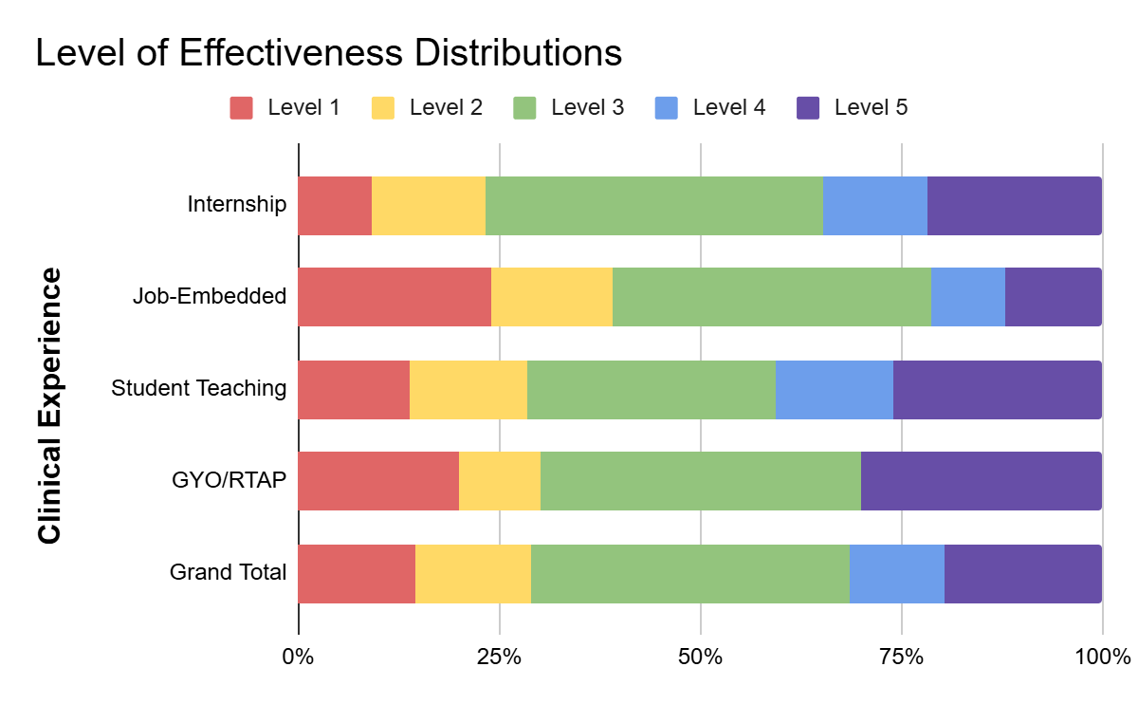
2021 graph
2021
Expansion of this program to recruit existing TAs into graduate programs to earn teacher licensure and degree. Launch of non-degree additional endorsement programs for teachers.

Slide 16

2022-2023
2022
Transition to “Sustainable Funding Model” prompted by impending end of ESSER, examinations of success and challenge
2023
Data-based decision to decouple degree from licensure and marry Apprenticeship/ “Grow Your Own” programs with non-degree additional endorsement program
TA to Teacher programs successful when students complete them, but low completion rates
Challenges in TA to Teacher programs centered around programs not designed for adult, working learners with valuable experience including durable and transferable skills
Student to TA programs highly successful - keep and expand.
Loss of ESSER means funding becomes a real, pressing barrier for TAs to become teachers

Slide 17
2024+
2024+
Launch of Apprenticeship/ “Grow Your Own” programs in non-credit, competency-based format & continuation of additional endorsement programs.
UT-PLAYS | Special Education | Mathematics | Total
Current Apprentice Teachers | 79 | 7 | 86
Current Job-Embedded Teachers | 76 | 16 | 92
Current/pending Applicants | 71 | 36 | 107
Current Teachers getting additional credentials | 224 | 25 | 251
Total initial teacher licensure issued to date | 63 | 12 | 75
Current Additional Endorsements issued to date | 1123 | 72 | 1195

Slide 18
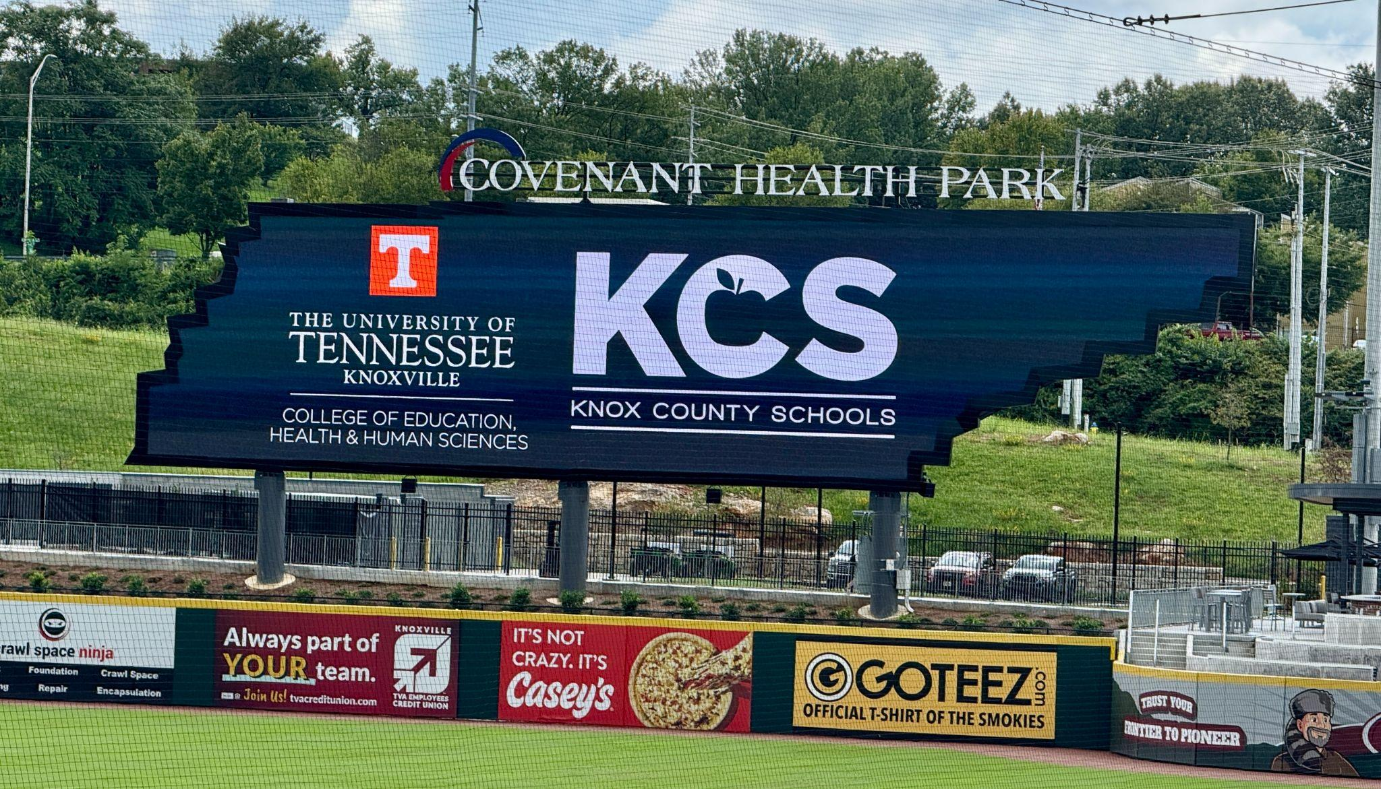
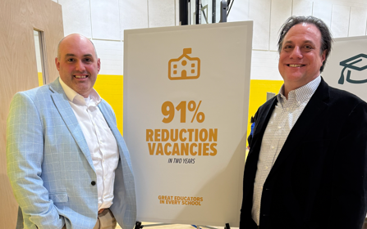
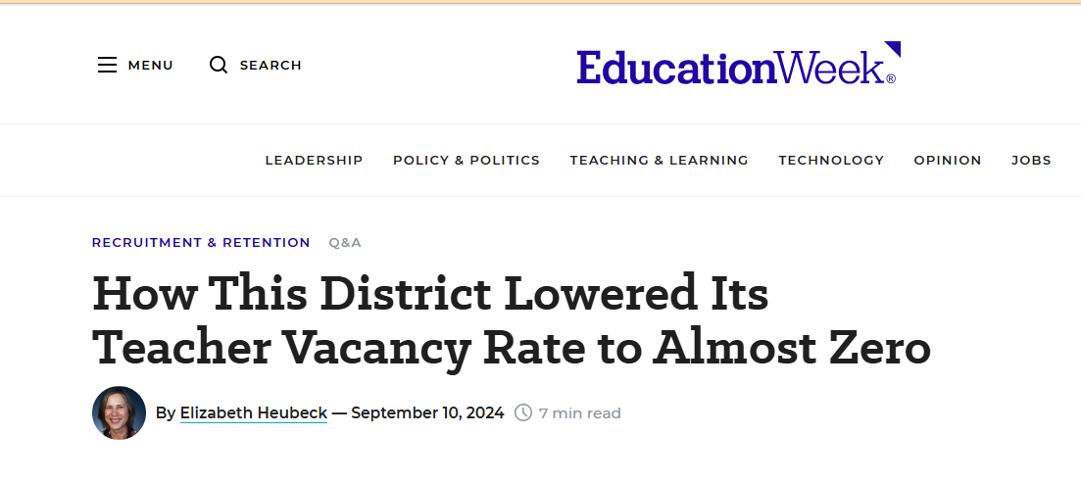
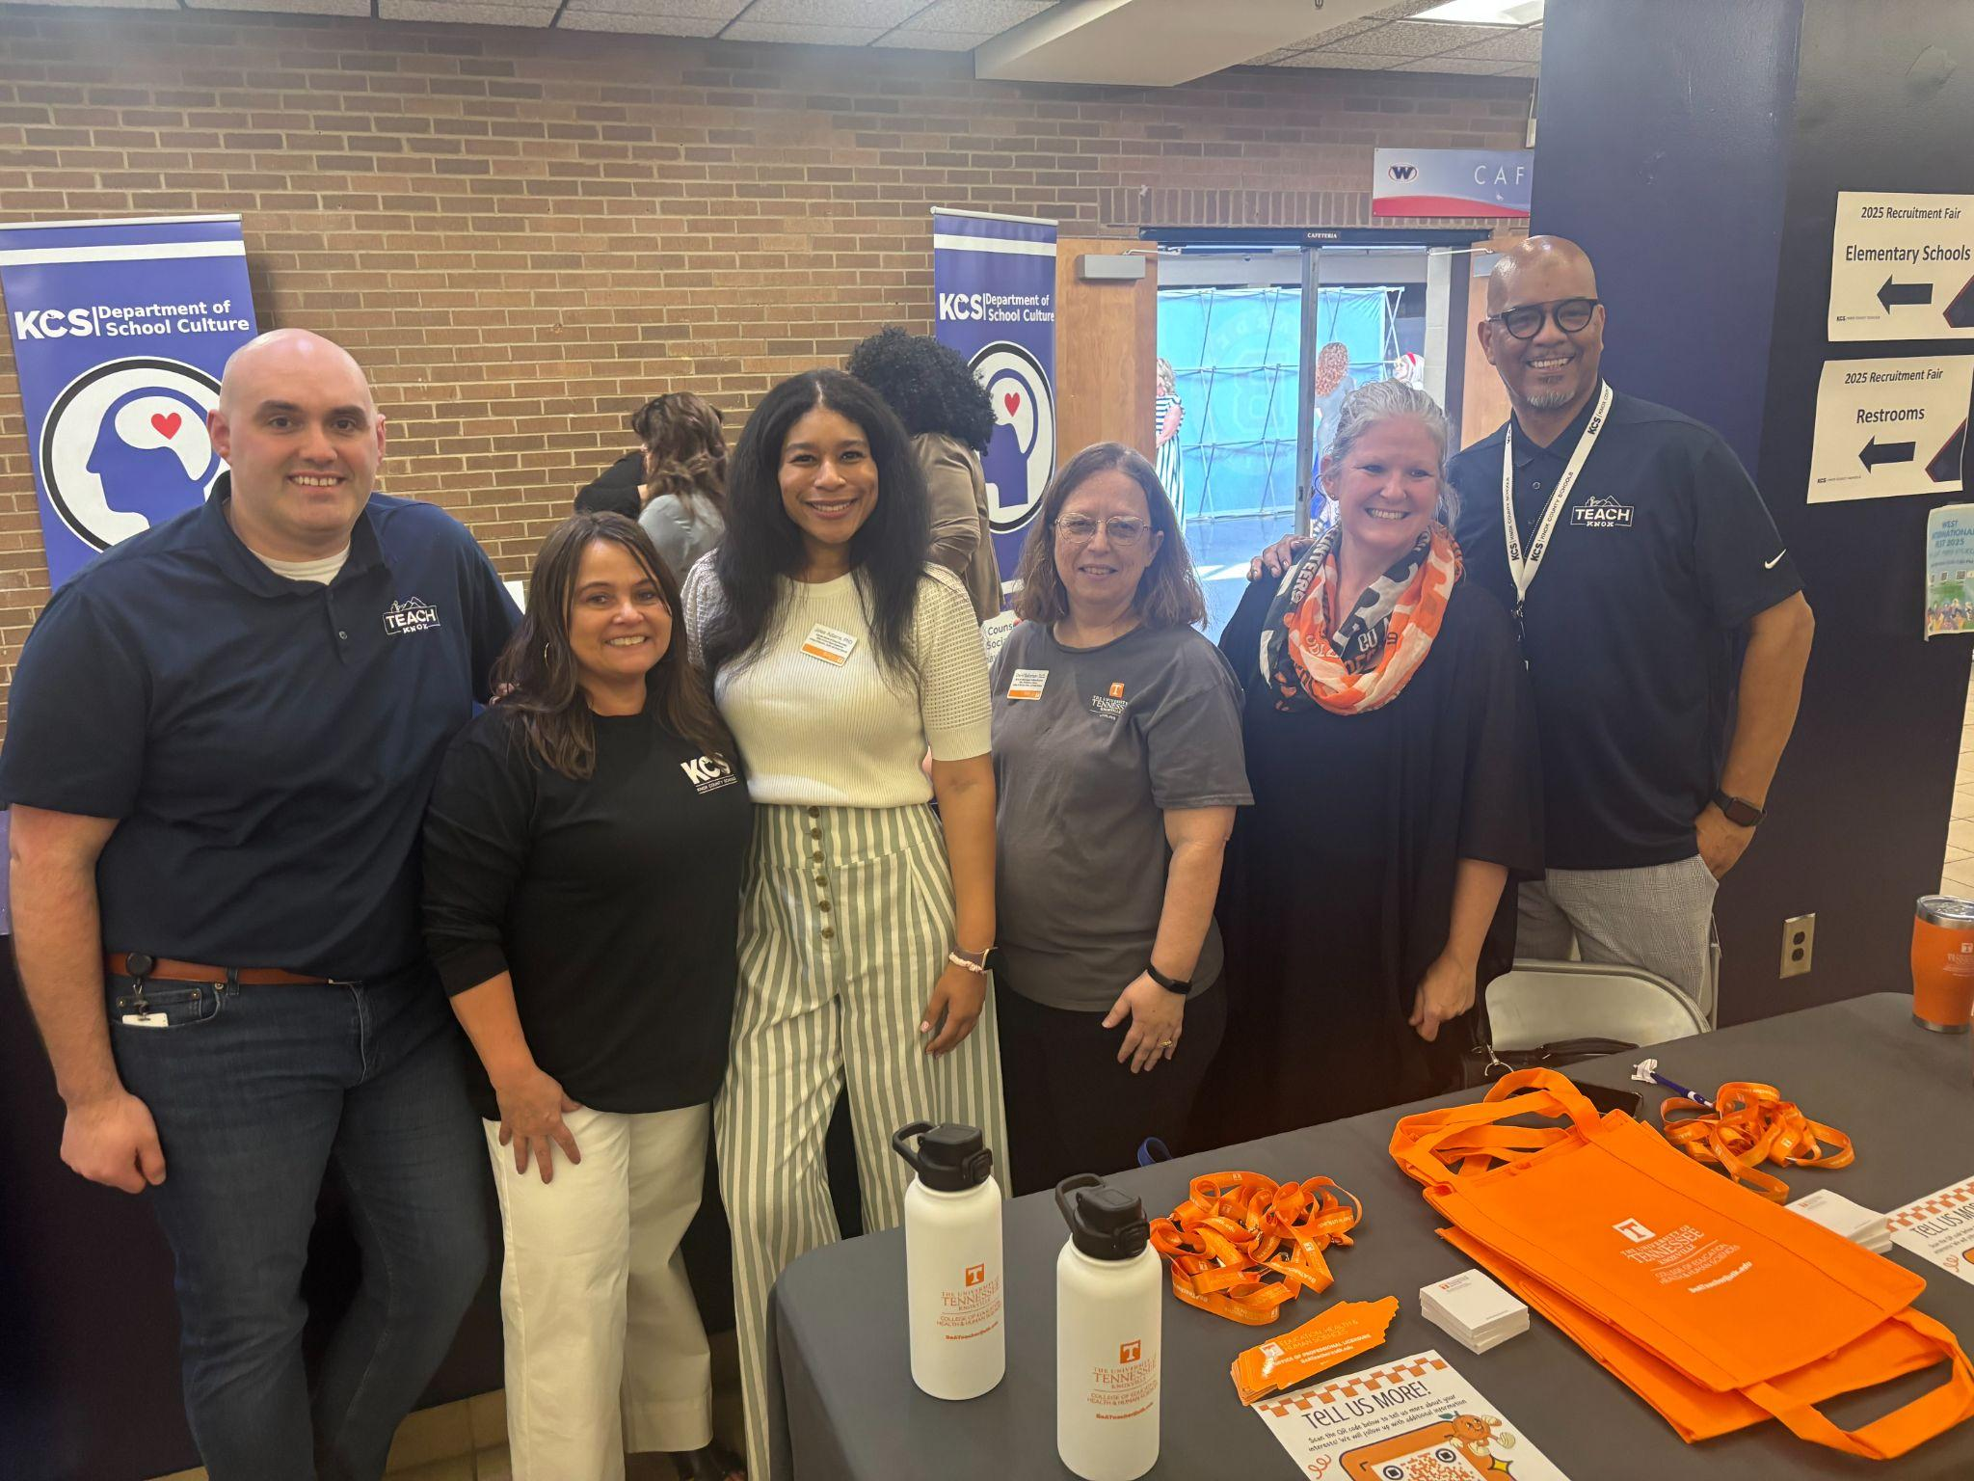
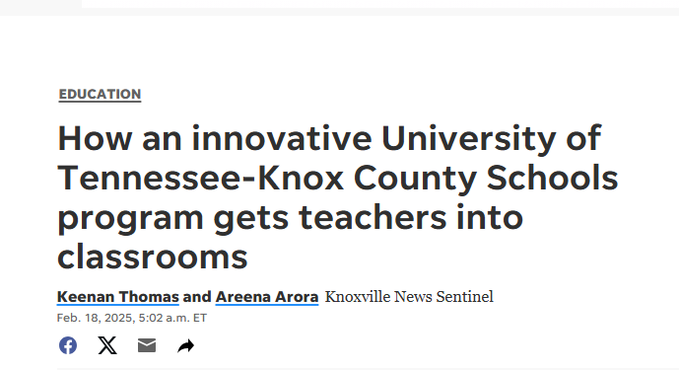
Examples
Notes:
Welcome - Meghan and Meagan

Slide 19

CEEDAR Center

Slide 20

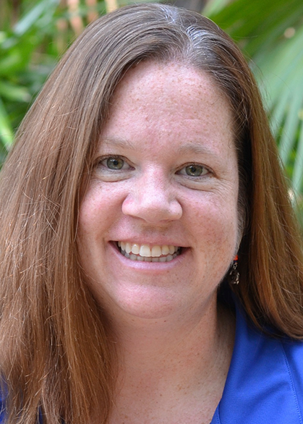





Leadership Team
Meg Kamman
Erica McCray
Co-Director (UF)
Executive-Director (UF)
Activity 1: TA Incubator
Activity 3: Targeted Prep
Activity 6: Cross-State Collaboration
Activity 5: Coordination and Alignment
Melinda Leko
Lindsey Hayes
Co-Director (UF)
Co-Director (AIR)
Activity 2: Universal TA
Evaluation
Activity 4: Intensive TA
Shari Ostovar
Project Coordinator (UF)
Dr. Jocelyn Cooledge
External Evaluator (Center Street Consulting)

Slide 21
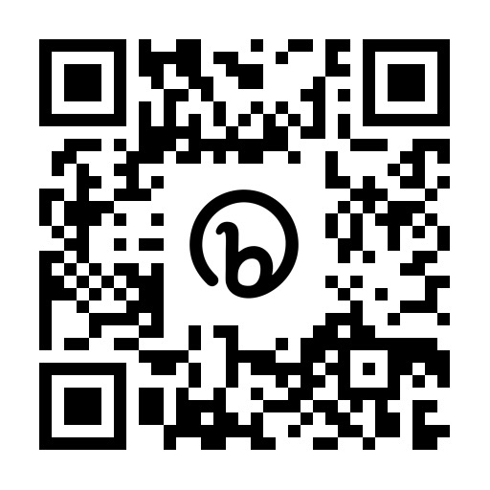

CEEDAR Overview
Collaborative for Effective Educator Development, Accountability, and Reform (CEEDAR) Center at the University of Florida, with American Institutes for Research (AIR) as a partner
National Technical Assistance Center, currently partnering with 21 states
Provides assistance to collaborating teams of state departments of education, institutes of higher education, and local education agencies to ensure effective teachers and leaders for each student
Resources available at CEEDAR.org

Slide 22
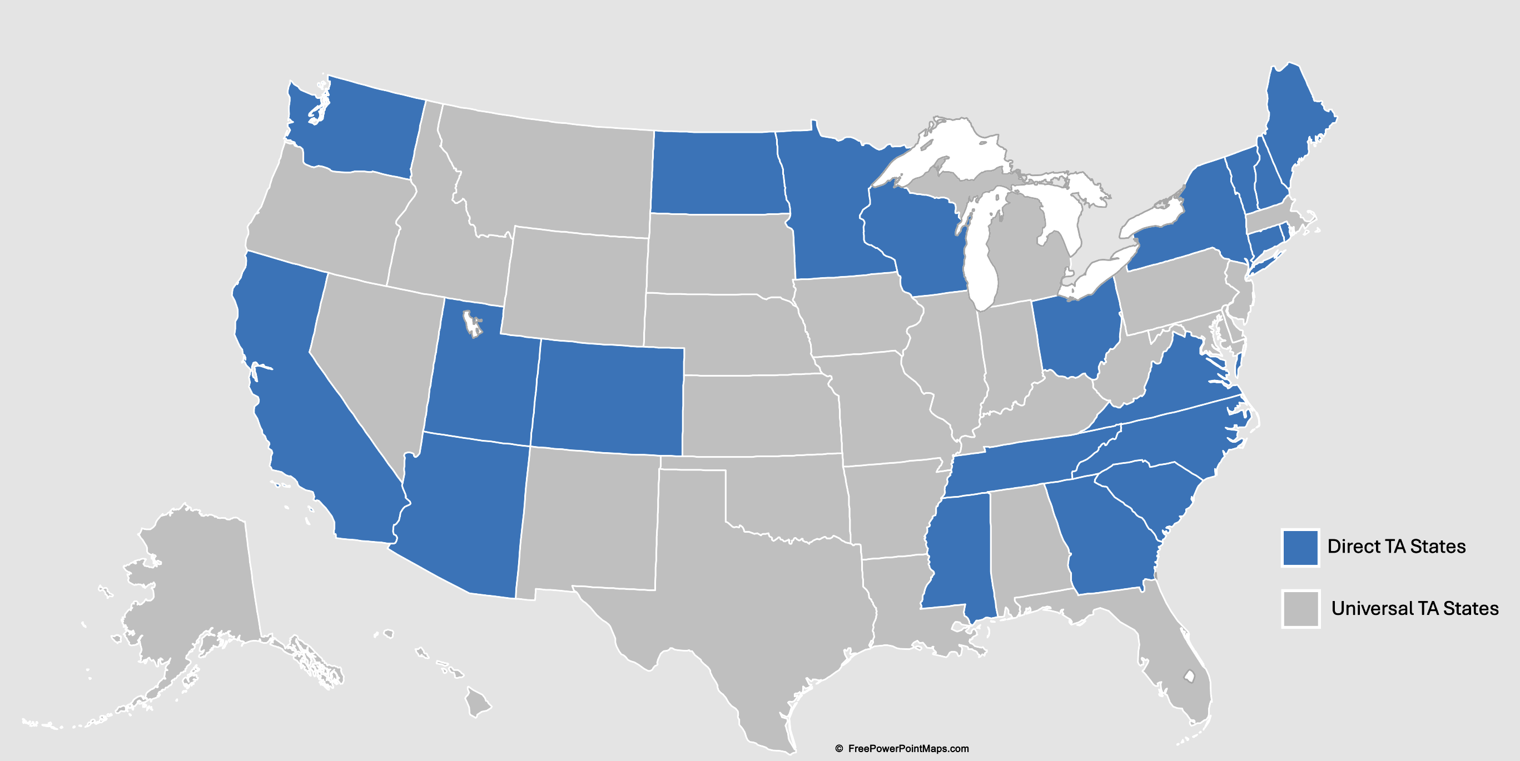
CEEDAR States

Slide 23

CEEDAR’s Mission
To support students with disabilities (SWDs) in achieving college- and career-ready standards by building the capacity of state personnel preparation systems to prepare teachers and leaders to implement evidence-based practices (EBPs) within multi-tiered systems of support (MTSS).​
“Every student deserves an opportunity to achieve.”

Slide 24
CEEDAR 3.0 Priorities/Goals
Increased EPP capacity, in collaboration with SEA and LEAs, to off­er high-quality instruction for teacher and leader candidates.
Improved SEA capacity, in collaboration with EPPs and LEAs, to track and evaluate the impact of policy on the ability to attract, prepare and sustain teachers and leaders, and change policy when appropriate.
Increased SEA, EPP, and LEA capacity to use multiple data sources to inform continuous improvement of personnel preparation systems to attract, prepare, and retain teachers and leaders.
Increased capacity of SEAs, EPPs, and LEAs, and other state organizations to collaborate and implement plans that sustain and scale up reform efforts.

Slide 25



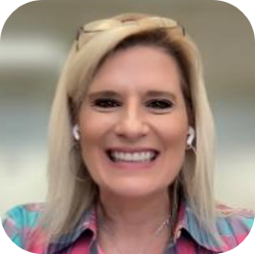
CEEDAR Apprenticeship Team
Lynn Holdheide
Content Expert, CEEDAR
Managing TA Consultant, American Institutes for Research (AIR)
Cheryl Krohn
Content Expert, CEEDAR
Senior TA Consultant, American Institutes for Research (AIR)
Meghan Wills
Content Expert, CEEDAR
Senior TA Consultant, American Institutes for Research (AIR)
Lisa White
Facilitator and RTAP Coordinator,
CEEDAR

Slide 26
Technical Assistance (TA) Provided to States
Universal TA
  Free resources to support development, implementation, and scaling of Registered Teacher Apprenticeship Programs (RTAPs) that are available to everyone
Targeted and Intensive TA
  TA tailored to meet the specific needs of state agencies, educator preparation programs, and/or local school districts, including support developing and navigating partnerships, designing and implementing RTAPs, and scaling RTAPs​
Cross-State Collaboration
  Knowledge-sharing between comparable states, educator preparation programs, and/or local school districts related to development, implementation, and scaling of RTAPs

Slide 27

Helpful Resources
Special Education RTAP Database​
CEEDAR RTAP Affinity Group​
Online Resource--Credit for Prior Learning in Teacher Apprenticeships: Considerations for Sponsors and Partners​
Webinar--Credit for Prior Learning in Teacher Apprenticeships ​
Other Resources

Slide 28
Disclaimer
This content was produced under U.S. Department of Education, Office of Special Education Programs, Award No. H325A220002. David Guardino serves as the project officer. The views expressed herein do not necessarily represent the positions or policies of the U.S. Department of Education. No official endorsement by the U.S. Department of Education of any product, commodity, service, or enterprise mentioned in this website is intended or should be inferred.

