Slide 1
Alternative Pathways for Special Educators: Changes & Developments Nationwide
Presentation for the Association of Education, Finance, & Policy Conference
Thursday, March 19th
Tashnuva Shaheen, PhD, Binghamton University
Kelly Acosta, PhD, Rhode Island College & CEEDAR Center
Cametreus Clardy, MEd, University of Florida
Jamie Day, PhD University of Missouri
Kathlyn Kale-Mokake, EdS Cherokee County Schools, Georgia
Garrett Stevens, MEd University of Florida
Notes:
“Today I’ll discuss how states are using alternative certification pathways to address shortages in special education—and what’s changed since 2018.”

Slide 2
Agenda
Purpose
Research Questions
Definitions
Why
Framework
Method
Findings
Implications
Future Research

Slide 3
Purpose
Expand on prior work (Sindelar et al., 2019; Myers et al., 2020) comparing alternative route (AR) pathways for special education teachers pre- and post-COVID-19 by conducting an analysis of changes in AR pathways.

Slide 4
Research Questions
How have alternative certification pathways for special education teachers changed in 2023 compared to 2018?
  What are the differences in eligibility criteria?
  What are the differences in training requirements?
  What are the differences in state exam requirements?

Slide 5
Teacher Shortages Defined
Teacher shortage is defined (USDOE, 2017) whether teaching positions
  Go unfilled
  Are filled with teachers who lack credentials
  Are filled by teachers who have credentials but are teaching outside of their specific credential

Slide 6

AR Pathways & Programs Defined
Alternative Route Pathway = State Policy
Alternative Route Program = Plan at Educator Preparation Program
Notes:
Alternative Route Pathway – established and governed by state’s educational policies, which outline specific program requirements that individuals must meet to be credentialed.
Alternative Route Program (AR) – nontraditional and accelerated preparation routes to obtain a teaching license (Day et al., 2023) housed within pathways.

Slide 7
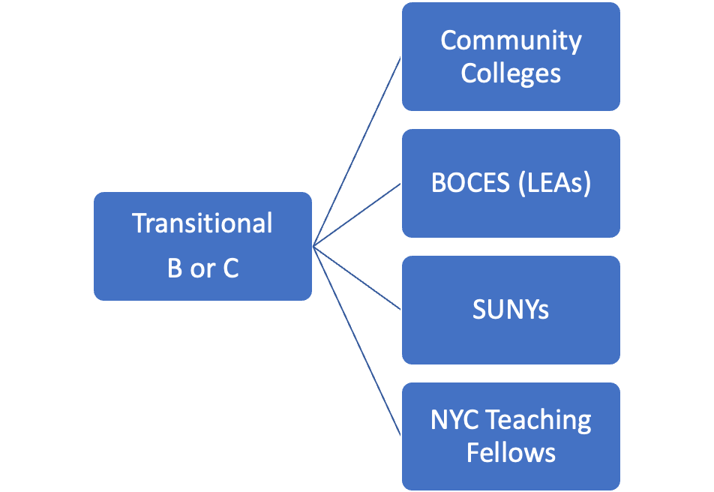
Example: New York State Alternative Pathways
2 Pathways with over 37 Programs
NYS ED, n.d.
Notes:
NY has over 37 different alternative programs within each of these pathways

Slide 8


Why
Notes:
“Special education teacher shortages remain persistent across the country, with high turnover and unfilled positions.”
“Alternative pathways are designed to increase supply, particularly in high needs areas like special education—but the question is whether they actually reduce barriers to entry and if they do reduce barriers, does it lower the quality of teacher preparation? (Darling-Hammond, 2010; King & Yin, 2022).
Additionally, while there is research out there on the quality of alternative route programs, teacher preparation, and links to student achievement, there is little research on the specific state policy pathways with specific elements, such as entry or training requirements, within these pathways

Slide 9

Framework
2018 CEEDAR Alternate Licensure Database
Sindelar et al. (2019) & Myers et al. (2020) on alternative route special education licensure
Image
Notes:
To conduct our study we used The framework we used to support our research was a national database, developed by staff at the CEEDAR Center, to track the individual pathways to teacher certification in general and special education
We used the information from this database and extended previous research conducted by Sindelar and Myers and colleagues, and examined any changes in SPED AP pathways up through 2023

Slide 10
Methods

Slide 11
Data Collection
Used CEEDAR 2018 Alternative Licensure Database
SEA websites for all 50 states
Other websites such as TFA
Google search (alternative route pathways or programs)

Slide 12

Method: Codes for Pathway Types
Pathway Type | Definition
Internship | Candidate is hired as teacher of record while pursuing full certification.
Residency | Candidate with at least a bachelor’s degree is immersed in teacher training for a certain amount of time (usually six months to a year) before they enter the classroom as teacher of record.
Credential/competency review | Candidates with at least a bachelor’s degree undergo a review of their academic transcript to demonstrate competency in their desired endorsement area.
IHE faculty/doctoral | Granting candidates who are former or current university faculty, or doctoral degree holders in the content area of endorsement authorization to be the teacher of record.
Test only | Test only programs require candidates to meet state examination requirement or complete the benchmarks to be eligible for the appropriate credential (e.g., ABCTE).
Emergency | Programs where candidates are granted limited certification in an area where there is a critical shortage of suitably qualified teachers.
Other | Programs that do not fit into the categories previously described.
Notes:
we also labeled the type of pathway

Slide 13
Codes for Pathway Requirements
Used same codes from (CEEDAR Center, 2018; Myers et al., 2020; & Sindelar et al., 2019) to identify key variables:
Eligibility:
Require BA or BS
Minimum GPA
Previous work experience
Employment offer
Passing a test
Training:
Require coursework
Mentoring required
State Examination:
State exam required
Lead to full time licensure

Slide 14
Coding Procedures
Team collaboratively coded 5 states
Coders split into pairs & coded for eligibility, training, or state exam
Each pair independently coded & reviewed independent codes until consensus
Weekly, pairs reviewed codes with entire team & reviewed questionable data
Pairs switched coding categories & reviewed data
Data was vetted via email to SEA contacts
  33 out of 48 respondents
Created binary codes for categories (1 = yes, 0 = no)
Added codes for each category
Post-hoc IRR (k 0.71)

Slide 15
Findings

Slide 16
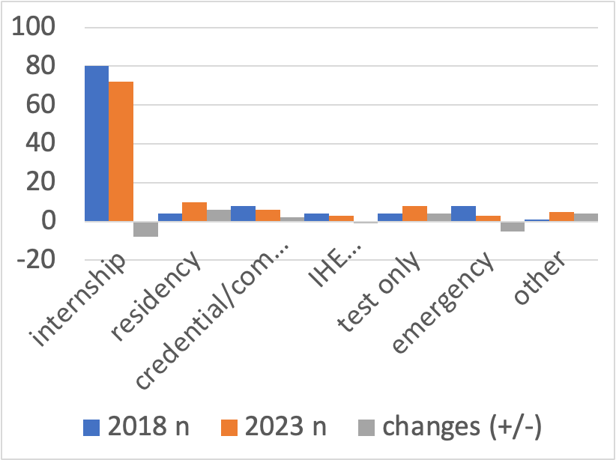
Type, Frequency, & Changes in Pathways

Slide 17
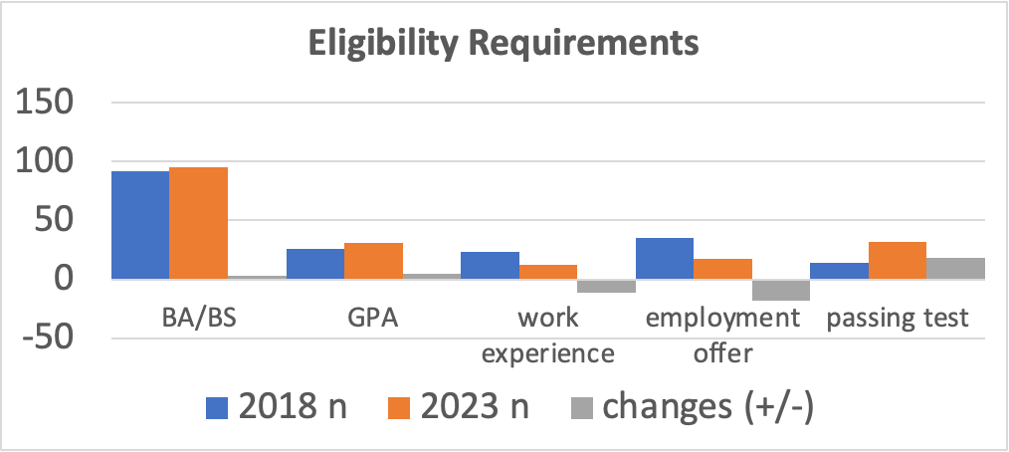
Eligibility Requirements

Slide 18
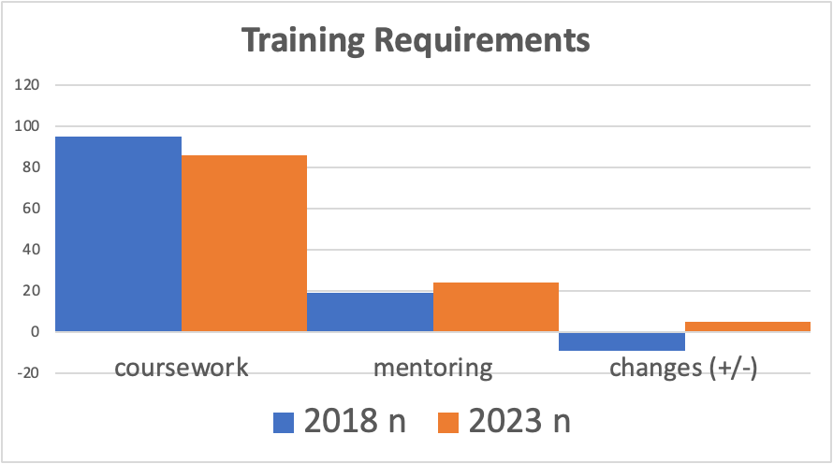
Training Requirements

Slide 19
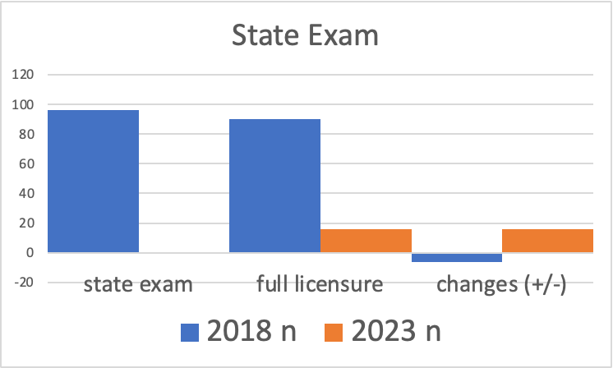
State Exam Requirements

Slide 20
Regional Changes
 | Total Pathways |  | Credential Review |  | Emergency |  | Faculty |  | Internship |  | Residency |  | Test Only |  | Other
Region | 2018 | 2023 | 2018 | 2023 | 2018 | 2023 | 2018 | 2023 | 2018 | 2023 | 2018 | 2023 | 2018 | 2023 | 2018 | 2023
NE | 23 | 21 | 3 | 2 | 2 | 1 | 0 | 0 | 17 | 12 | 0 | 4 | 0 | 0 | 0 | 0
SE | 37 | 36 | 4 | 2 | 3 | 2 | 2 | 2 | 27 | 23 | 1 | 4 | 0 | 0 | 0 | 4
MW | 26 | 23 | 1 | 2 | 3 | 0 | 2 | 0 | 15 | 15 | 2 | 2 | 2 | 4 | 0 | 0
SW | 6 | 8 | 0 | 0 | 0 | 0 | 0 | 1 | 5 | 7 | 0 | 0 | 1 | 0 | 0 | 0
W | 17 | 19 | 0 | 0 | 0 | 0 | 0 | 0 | 15 | 14 | 1 | 1 | 1 | 4 | 0 | 0
Total | 109 | 107 | 8 | 8 | 8 | 3 | 4 | 3 | 79 | 71 | 4 | 11 | 4 | 8 | 0 | 4

Slide 21
Implications
Stability in findings
  Missed opportunities to redesign teacher pathways
Potentially due to IDEA requirements
Increased testing requirements can pose a problem for access
There’s research showing that alternatively prepared teachers are more likely to turnover than traditionally prepared teachers (Redding & Smith, 2016)
BA in content area; what does this mean for special ed
Increased mentoring requirements could help with retention
Notes:
While there are benefits to reducing barriers, turnover rates become an equity issue, especially in low SES schools where alternatively prepared teachers are more likely to teach

Slide 22
Limitations
Unclear language and complicated state websites creates an information barrier
  “Be of good moral standing & character”
Conflicting information from state certification directors
2024 updates/changes were not included in this analysis

Slide 23
Future Research
Examine effectiveness of qualitative features
  length of mentorship
  supports provided in mentorship
Continue to compare effectiveness in programs related to eligibility, training, and exam requirements between AR and traditional pathways
Case study analysis of a one state and their policies and changes over time with implications on teacher shortages

Slide 24
Questions?
Tashnuva Shaheen, tshaheen@binghamton.edu
Kelly Acosta, kacosta@ric.edu

Slide 25

Disclaimer
This content was produced under U.S. Department of Education, Office of Special Education Programs, Award No. H325A220002. David Guardino serves as the project officer. The views expressed herein do not necessarily represent the positions or policies of the U.S. Department of Education. No official endorsement by the U.S. Department of Education of any product, commodity, service, or enterprise mentioned in this website is intended or should be inferred.

