Slide 1

Lunch & Learn: Fostering Cross-Department Collaboration

Slide 2
Lunch & Learn:
Fostering Cross-Department Collaboration

Slide 3


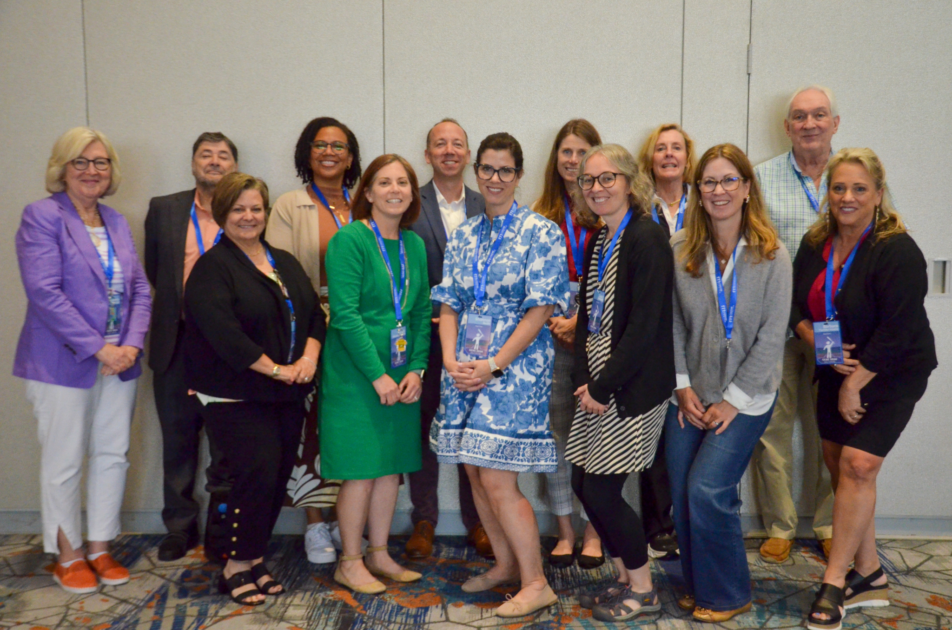

Who we are….
Dr. DaShaunda Patterson
Associate Dean for Faculty Affairs
Georgia State University
CEEDAR Center
Dr. Nakia Gray-Nicolas
Associate Professor
Educational Leadership
Queens College School of Education

Slide 4
Today’s Objectives
Shares strategies for fostering cross-department collaboration through interdisciplinary committees and course alignment to ensure all candidates are prepared to meet the needs of students with disabilities.

Slide 5

CEEDAR Overview
The Collaboration for Effective Educator Development, Accountability, and Reform (CEEDAR) Center is a national technical assistance center funded by the U.S. Department of Education Office of Special Education Programs (OSEP)
CEEDAR provides technical assistance (since 2013) to collaborating teams of state education agencies, institutes of higher education, and local education agencies to ensure effective teachers and leaders for each student

Slide 6


Our Mission
To support students with disabilities (SWDs) in achieving college- and career-ready standards by building the capacity of state personnel preparation systems to prepare teachers and leaders to implement evidence-based practices (EBPs) within multi-tiered systems of support (MTSS).
“Every student with a disability has an opportunity to achieve.”

Slide 7
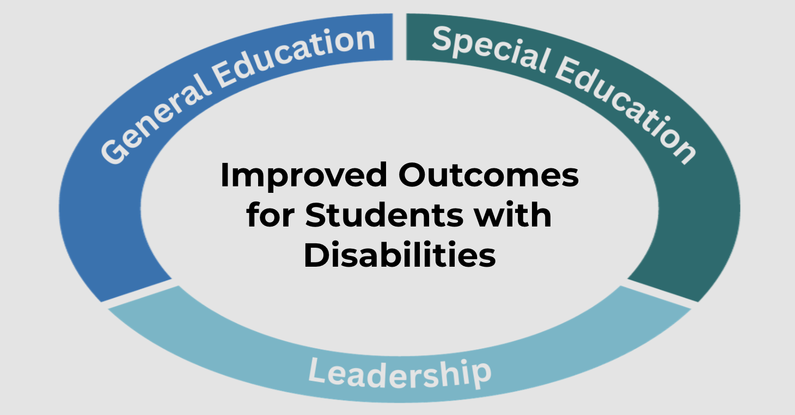
Improved Outcomes for Students with Disabilities

Slide 8
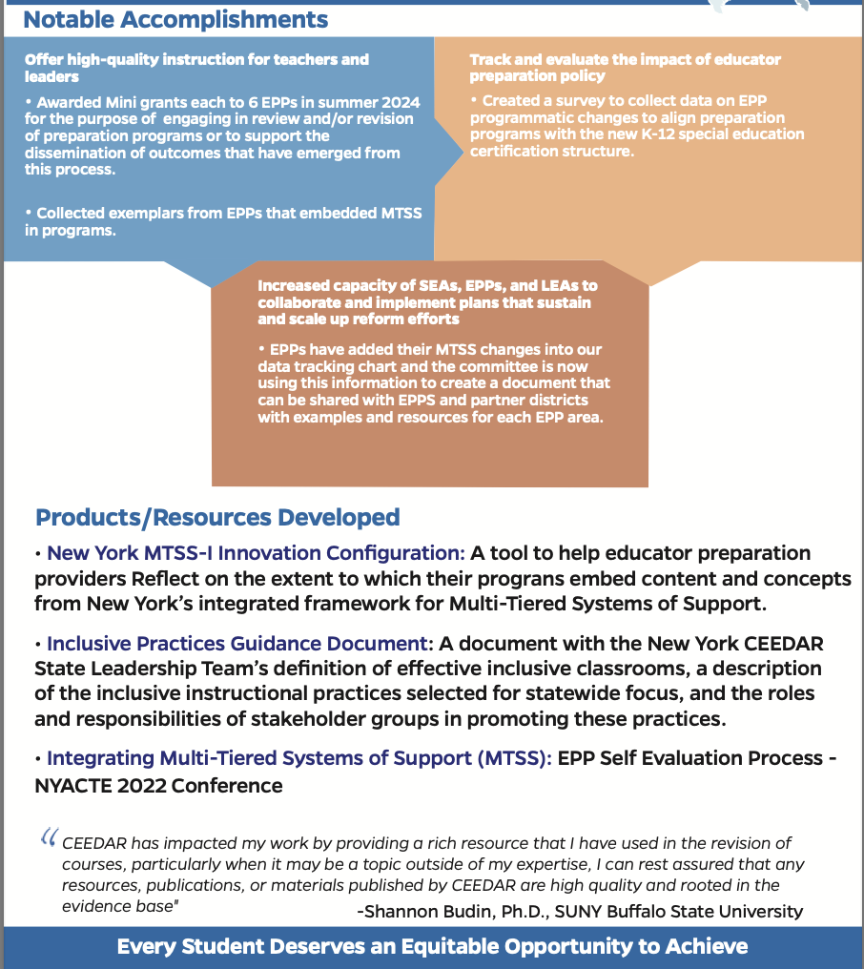
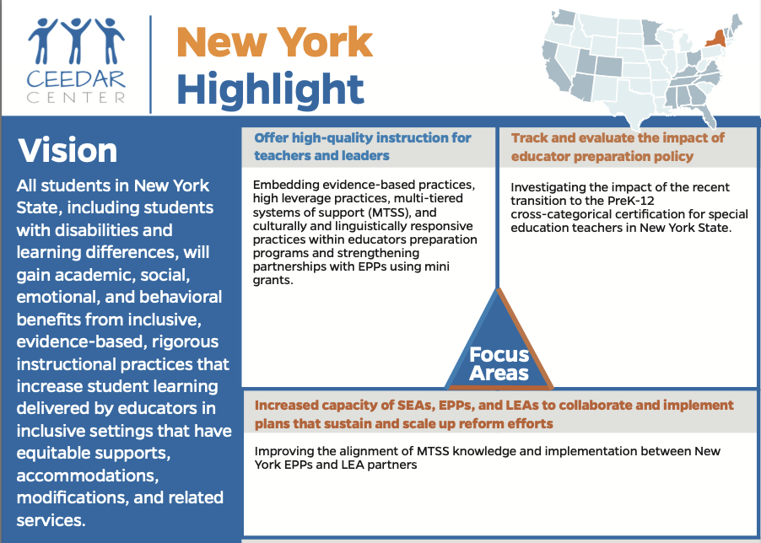
New York Highlight

Slide 9
Fostering Cross-Department Collaboration

Slide 10

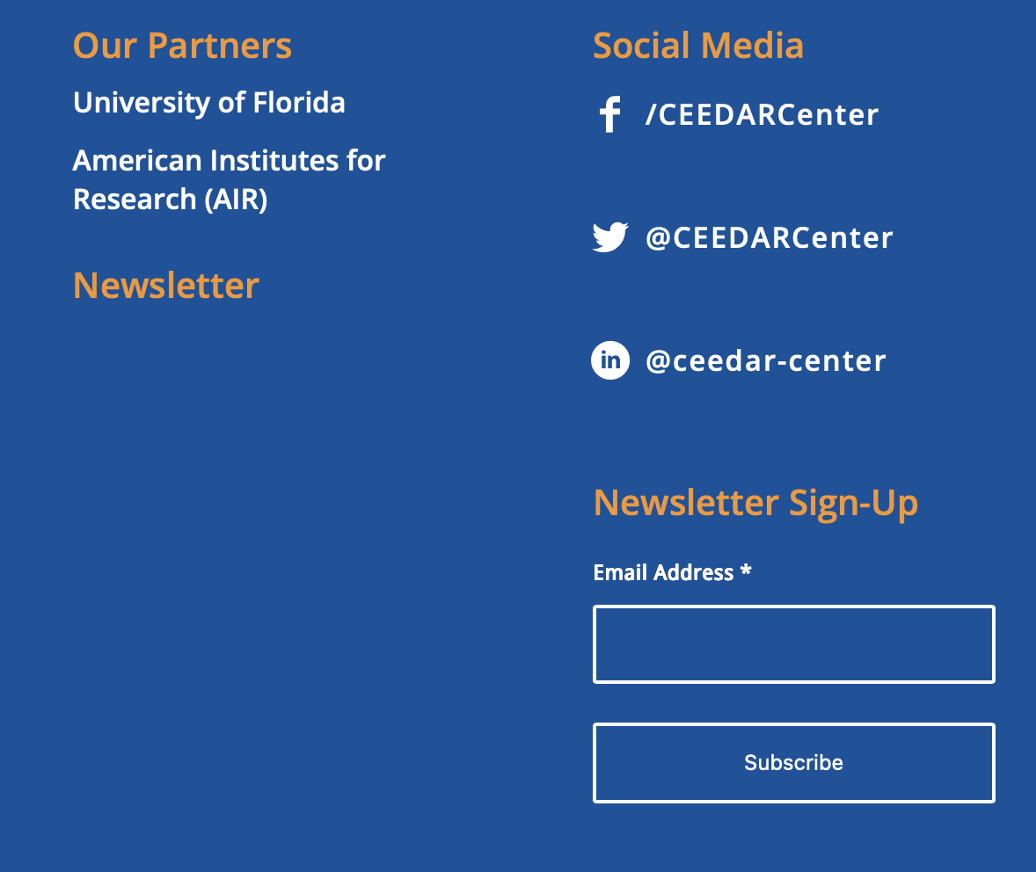
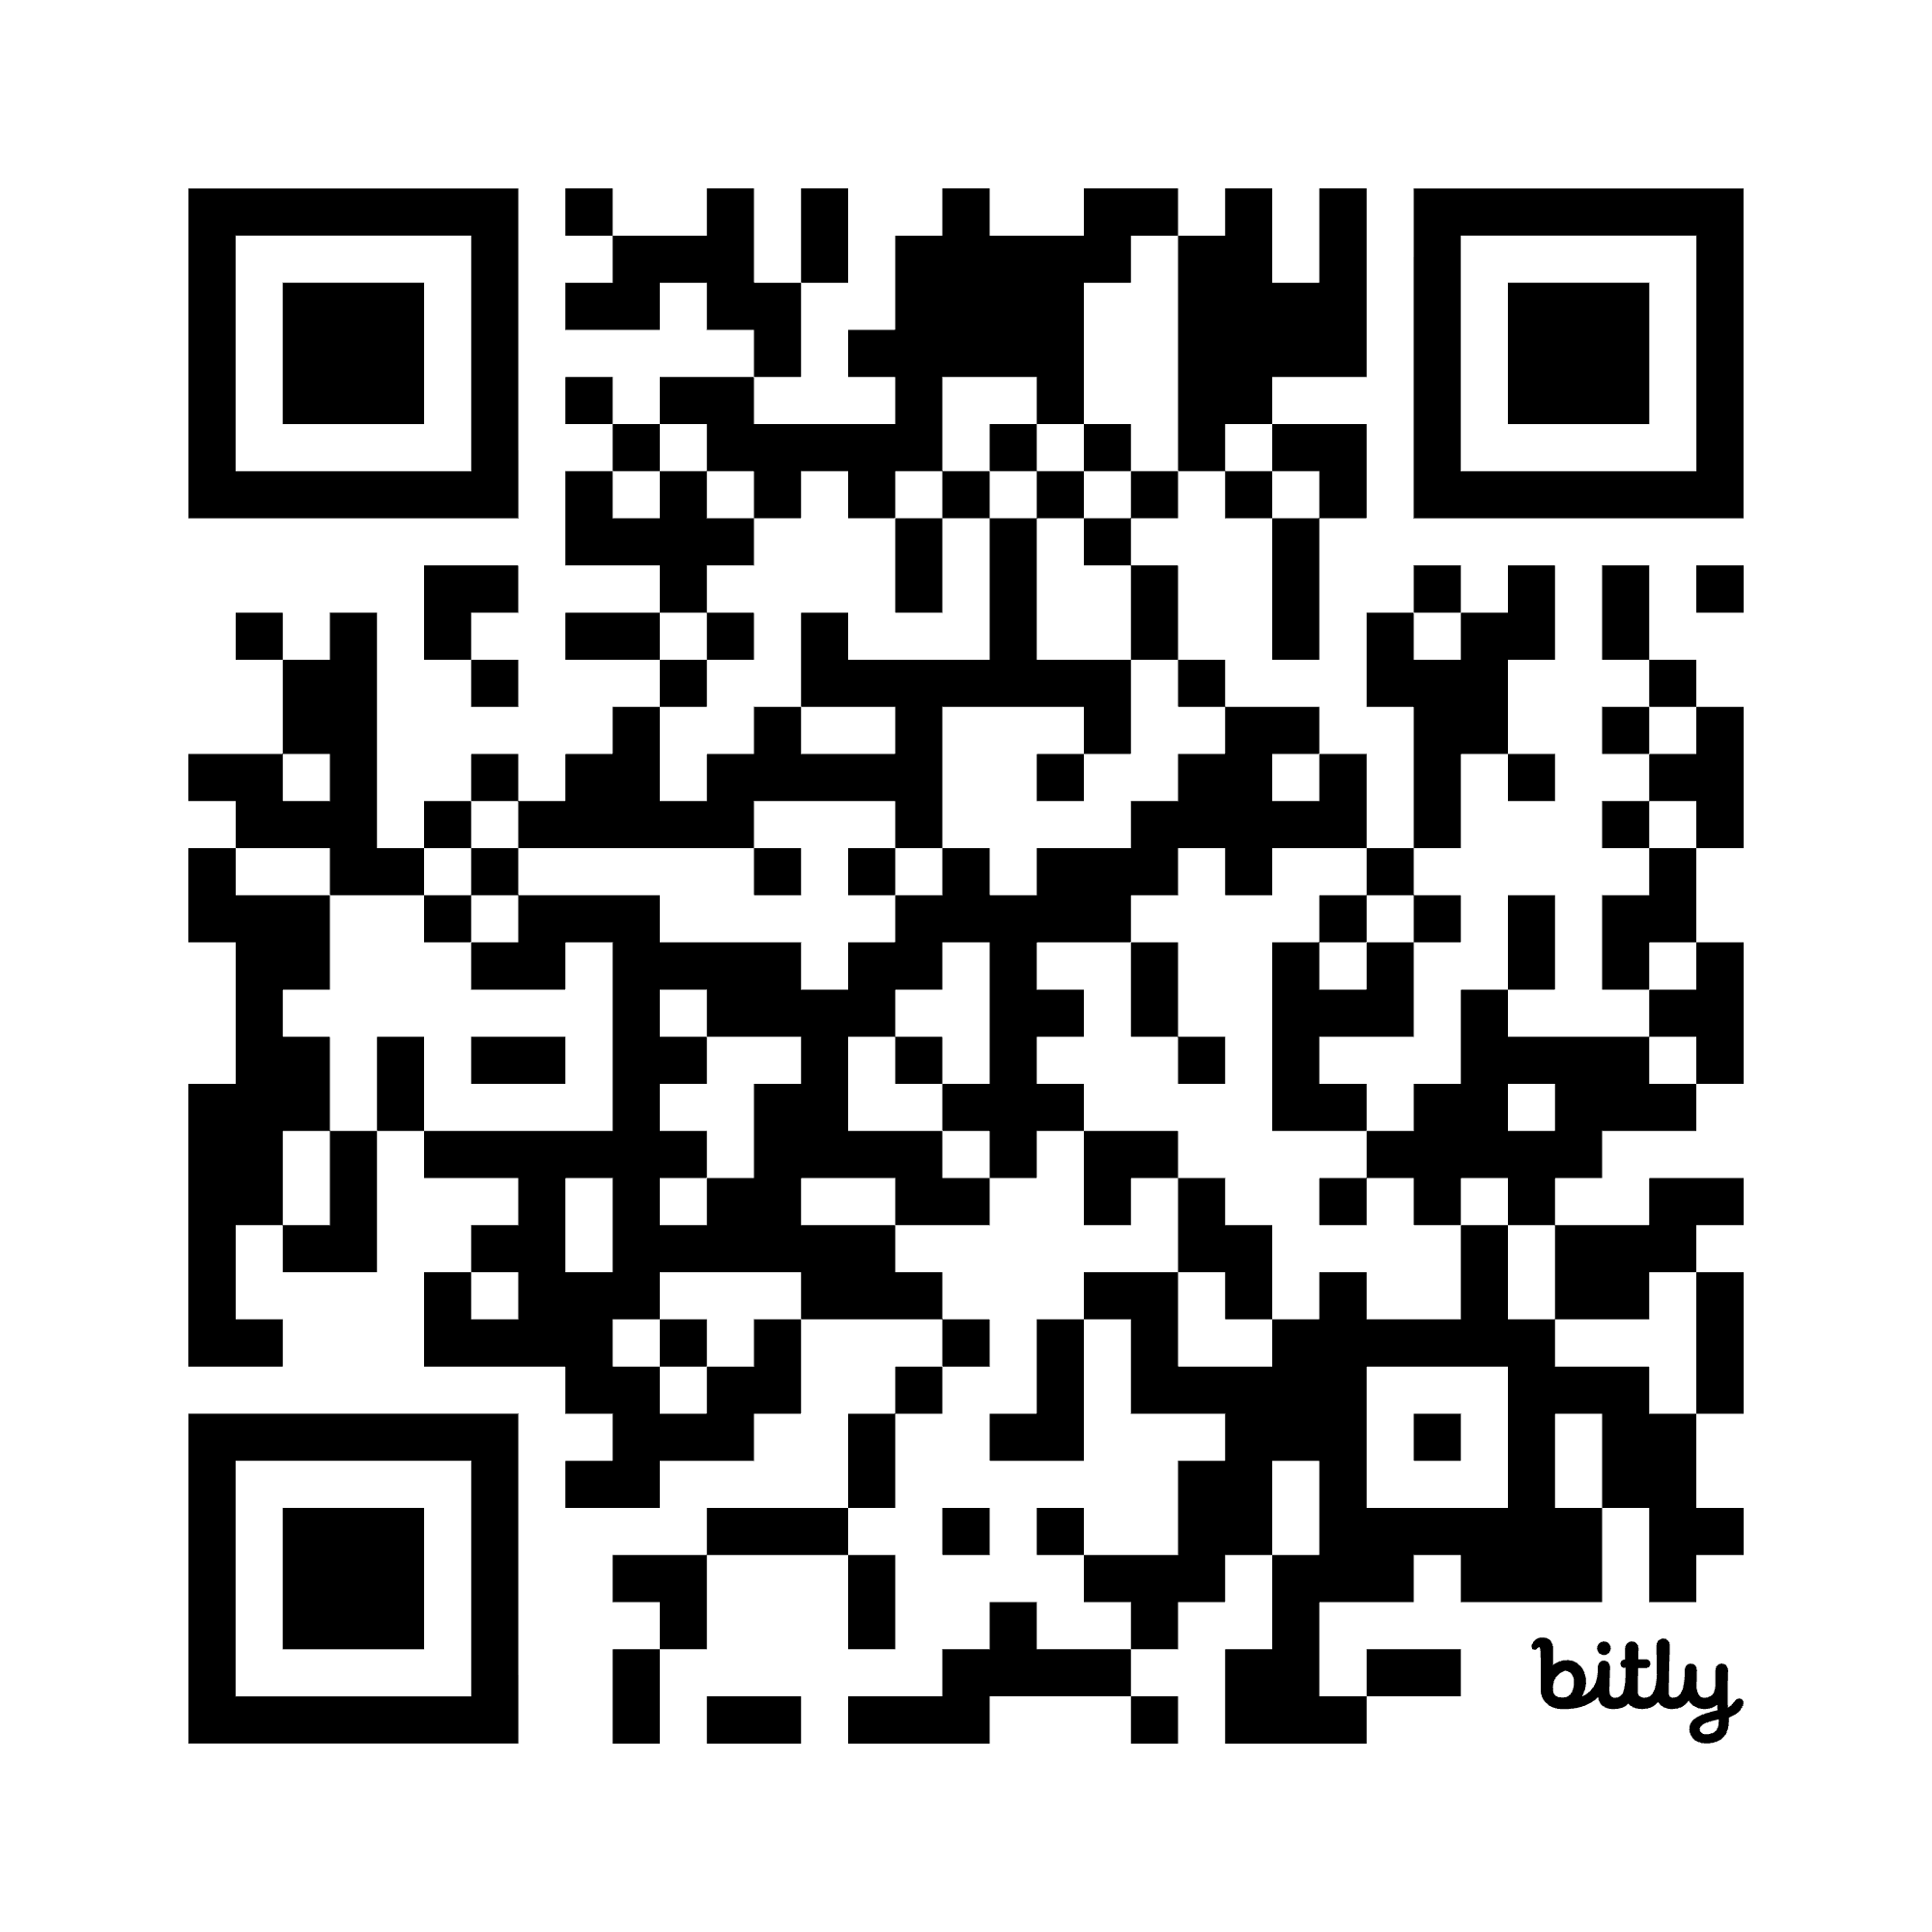
Questions?
Day Patterson
CEEDAR Center
dspatterson@gsu.edu
Nakia Gray-Nicolas
Queens College
nakia.graynicolas@qc.cuny.edu
Notes:
Let me know who we want on this slide for the recording, we can add/change as needed

Slide 11

Disclaimer
This content was produced under U.S. Department of Education, Office of Special Education Programs, Award No. H325A220002. David Guardino serves as the project officer. The views expressed herein do not necessarily represent the positions or policies of the U.S. Department of Education. No official endorsement by the U.S. Department of Education of any product, commodity, service, or enterprise mentioned in this website is intended or should be inferred.

