Slide 1
Lunch & Learn:
How Artificial Intelligence can be used to Incorporate UDL and HLPs

Slide 2

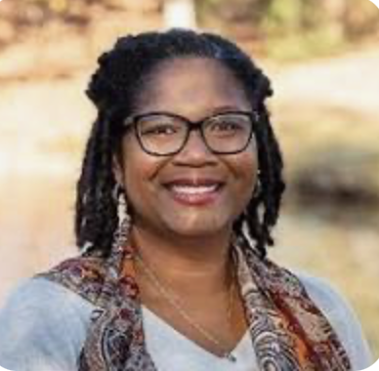
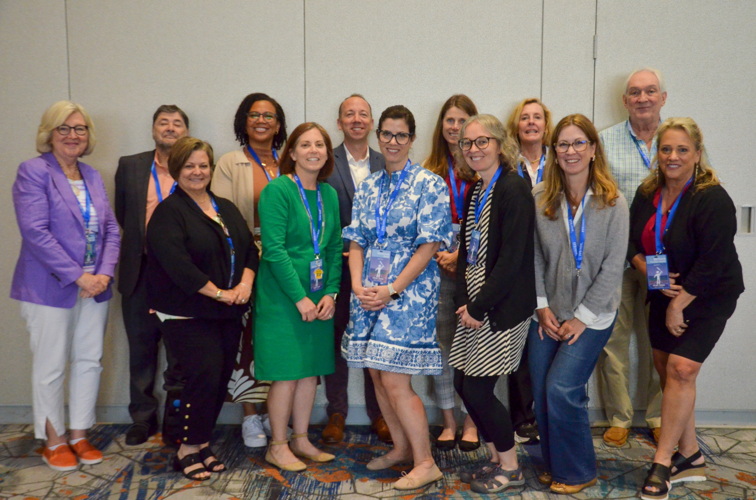
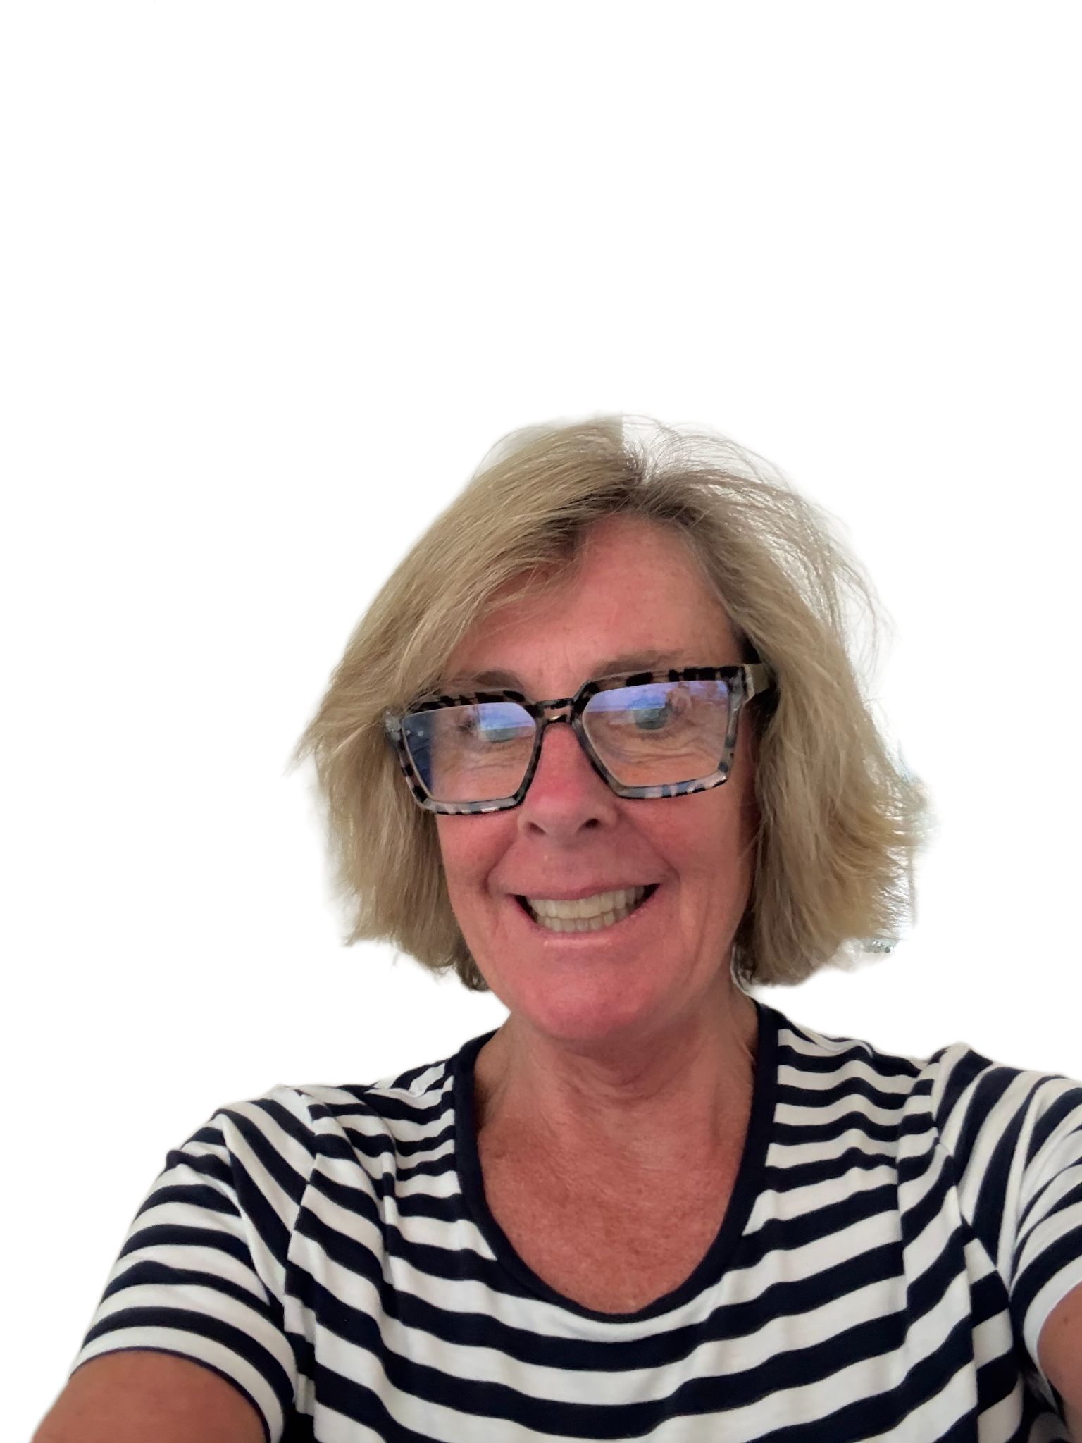
Who we are….
Dr. DaShaunda Patterson
Associate Dean for Faculty Affairs
Georgia State University
CEEDAR Center
Dr. Susan Courey
Associate Professor
General and Special Education
Touro University Graduate School of Education

Slide 3


Today’s Objectives
Facilitate the understanding and implementation of Evidence-Based Practices (Universal Design for Learning and High-Leverage Practices) through AI
Develop AI Literacy Among Pre-Service Teachers
Prepare Teachers for Ethical Use of AI

Slide 4

CEEDAR Overview
The Collaboration for Effective Educator Development, Accountability, and Reform (CEEDAR) Center is a national technical assistance center funded by the U.S. Department of Education Office of Special Education Programs (OSEP)
CEEDAR provides technical assistance (since 2013) to collaborating teams of state education agencies, institutes of higher education, and local education agencies to ensure effective teachers and leaders for each student

Slide 5


Our Mission
To support students with disabilities (SWDs) in achieving college- and career-ready standards by building the capacity of state personnel preparation systems to prepare teachers and leaders to implement evidence-based practices (EBPs) within multi-tiered systems of support (MTSS).
“Every student with a disability has an opportunity to achieve.”

Slide 6
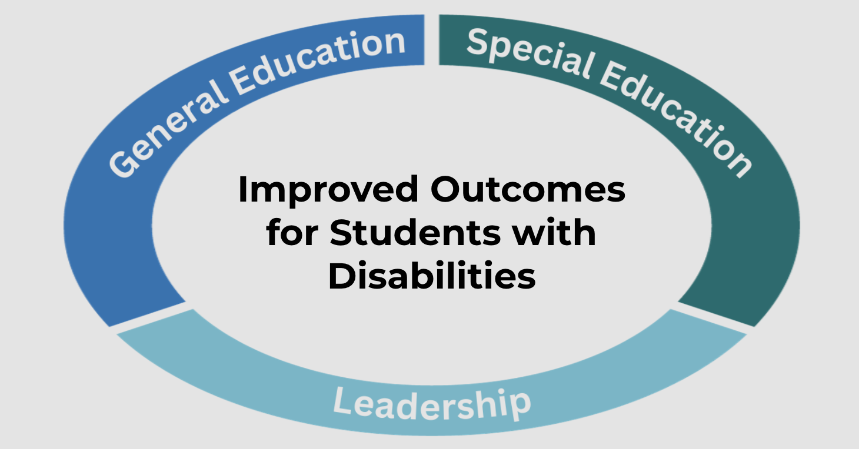
Improved Outcomes for Students with Disabilities

Slide 7
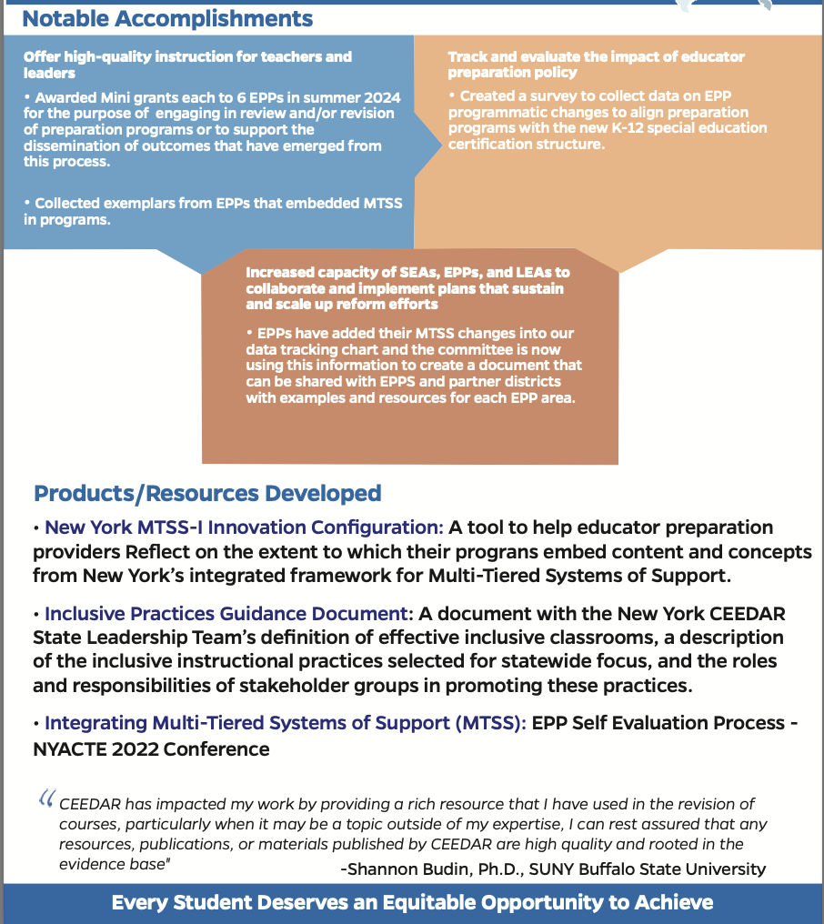
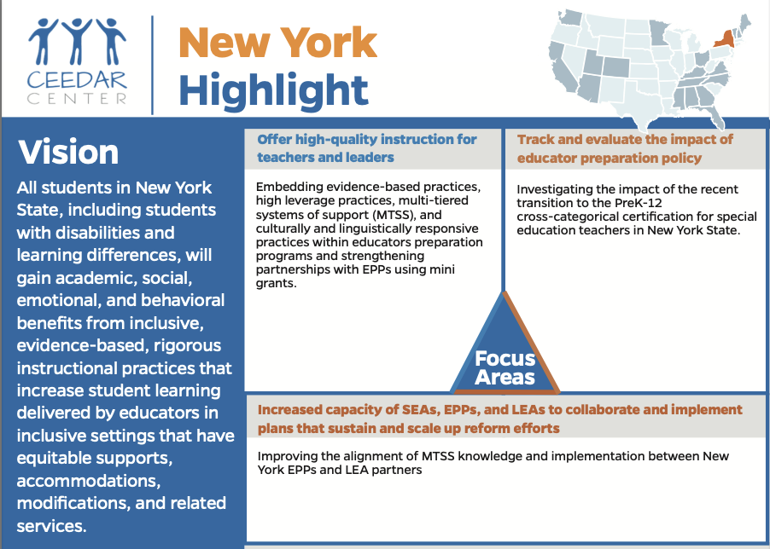
New York Highlight

Slide 8
Develop AI Literacy Among Pre-Service Teachers
Understanding AI concepts and recognizing its applications within general and special education contexts.

Slide 9
Facilitate the understanding and implementation of Evidence-Based Practices through AI
By utilizing AI platforms that support adaptive learning and provide tailored feedback, pre-service teachers can learn to implement personalized education plans more effectively

Slide 10
Prepare Teachers for Ethical Use of AI
. Understanding the ethical implications of AI use in education is crucial, especially considering the diverse needs of ALL students; mitigating bias and ensuring equitable access to learning resources

Slide 11
AI to Incorporate UDL and HLPs
UDL reminds us that variability is the norm.
HLPs give us the tools to teach responsively across that variability.
Disability is not fixed—it’s shaped by context + environment.
Our role: Design with diversity in mind, not for the “average” student.

Slide 12
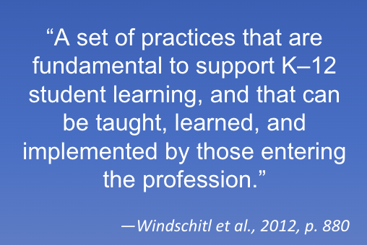
What Are HLPs?
HLPs are practices that can be woven into core instruction in the general education setting to intentionally design, deliver, and assess instruction that leads to equitable learning outcomes for all students, including students with diverse learning needs.

Slide 13
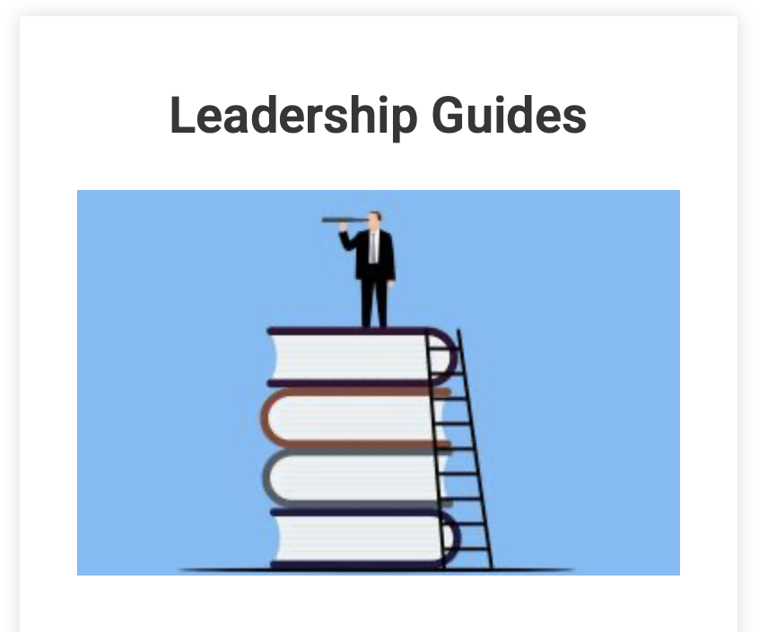
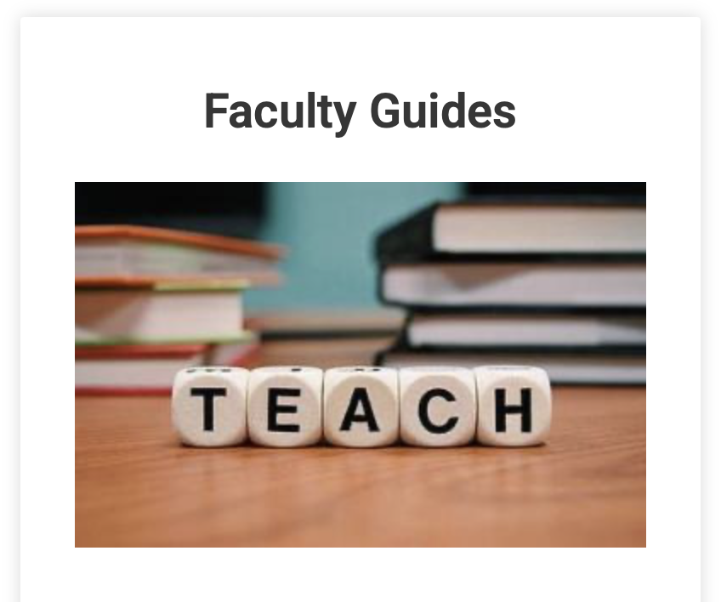
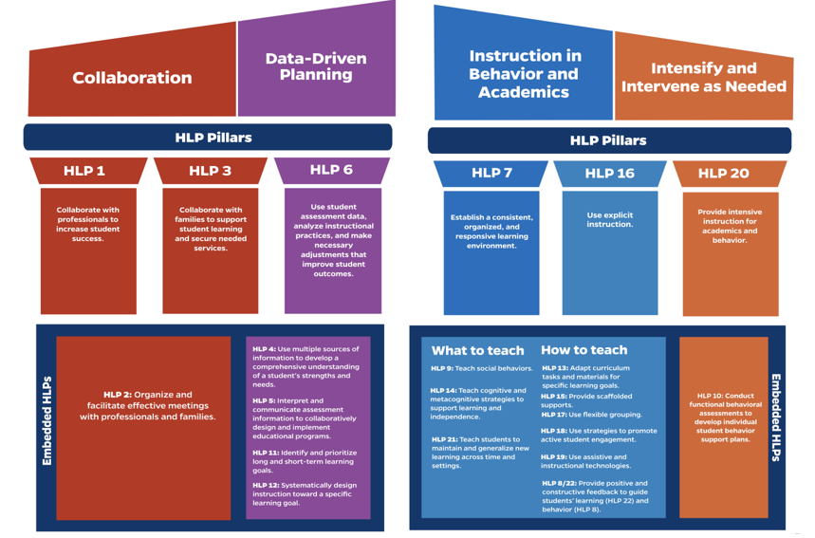
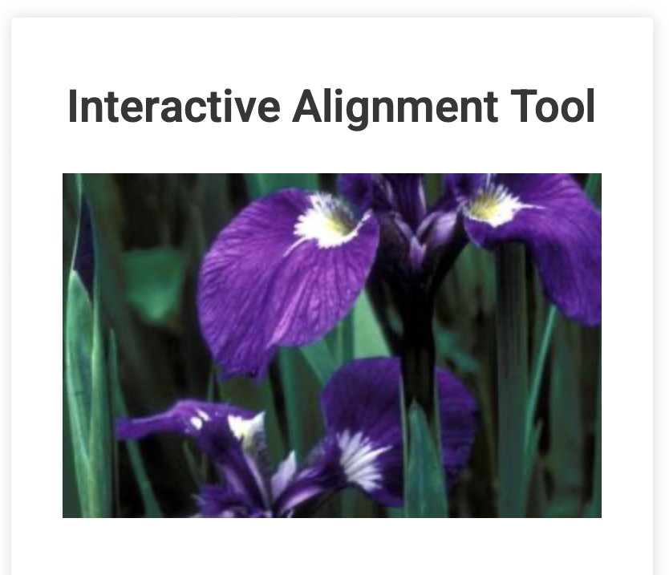
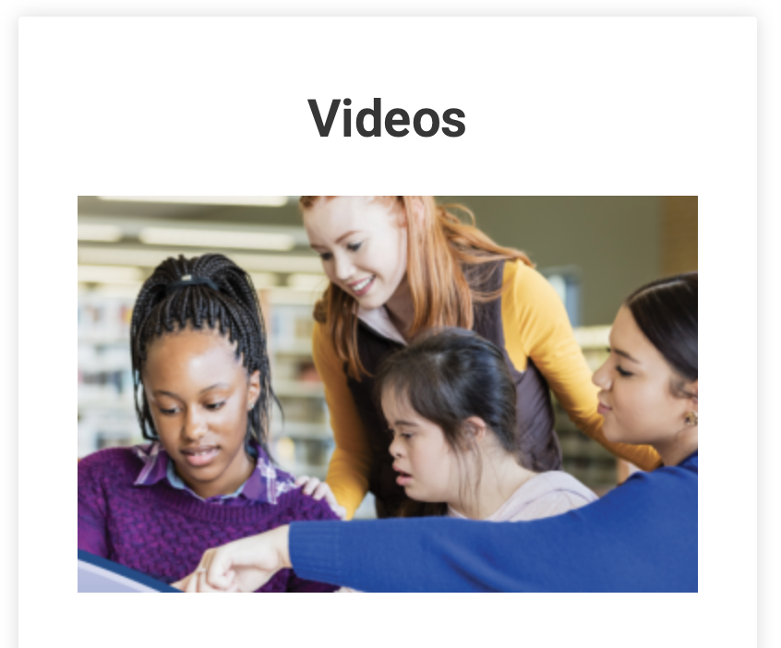
High Leverage Practices
Purpose: Offers a framework for what educators should know and be able to do to supports SWDs
Notes:
High Leverage Practices for Students with Disabilities (Revised and Updated 2024): https://ceedar.education.ufl.edu/wp-content/uploads/2024/03/High-Leverage-Practices-for-Students-with-Disabilties-updated.pdf
High Leverage Practices Implementation Resources: https://highleveragepractices.org/implementation-resources

Slide 14
Features of HLPs
Focus directly on instructional practice
Occur with high frequency in teaching
Research based and known to foster student engagement and learning
Broadly applicable and usable in any content area or approach to teaching
Fundamental to effective teaching when skillfully executed
Address cultural and linguistic needs of diverse students
McLeskey et al., 2017
Notes:
Explanation of Slide
HLPs are appealing for both general education and special education teachers because these practices are applicable to and can be used in any content area or grade level. Some might consider HLPs to be common-sense practices that are used widely—which is true.
That said, it is the intentionality with which HLPs are used to respond to specific learning tasks and student needs that makes them powerful. Although HLPs can enhance all students’ learning with increased intensity and intentionality, students with disabilities (SWDs), English learners (ELs), and students who struggle are provided better access to the curriculum through HLPs.

Slide 15




Why Should We Focus on HLPs?
We can define effective practice for teachers, assess it, and then improve it!
We can create a seamless system of support for teachers throughout their career.
HLPs are content agnostic and can be used across
all grades.
HLPs have been identified as practices that all novice teachers should know and be able to do.
Notes:
Explanation of Slide
Focusing on HLPs provides an opportunity to assess and improve specific practices. Understanding what we know about adult learning, teachers need practice with consistent feedback to implement instructional practices with fidelity, and we cannot expect teachers to master all instructional practices at one time. Targeting a consistent set of HLPs increases the likelihood of mastery among novice teachers.

Slide 16
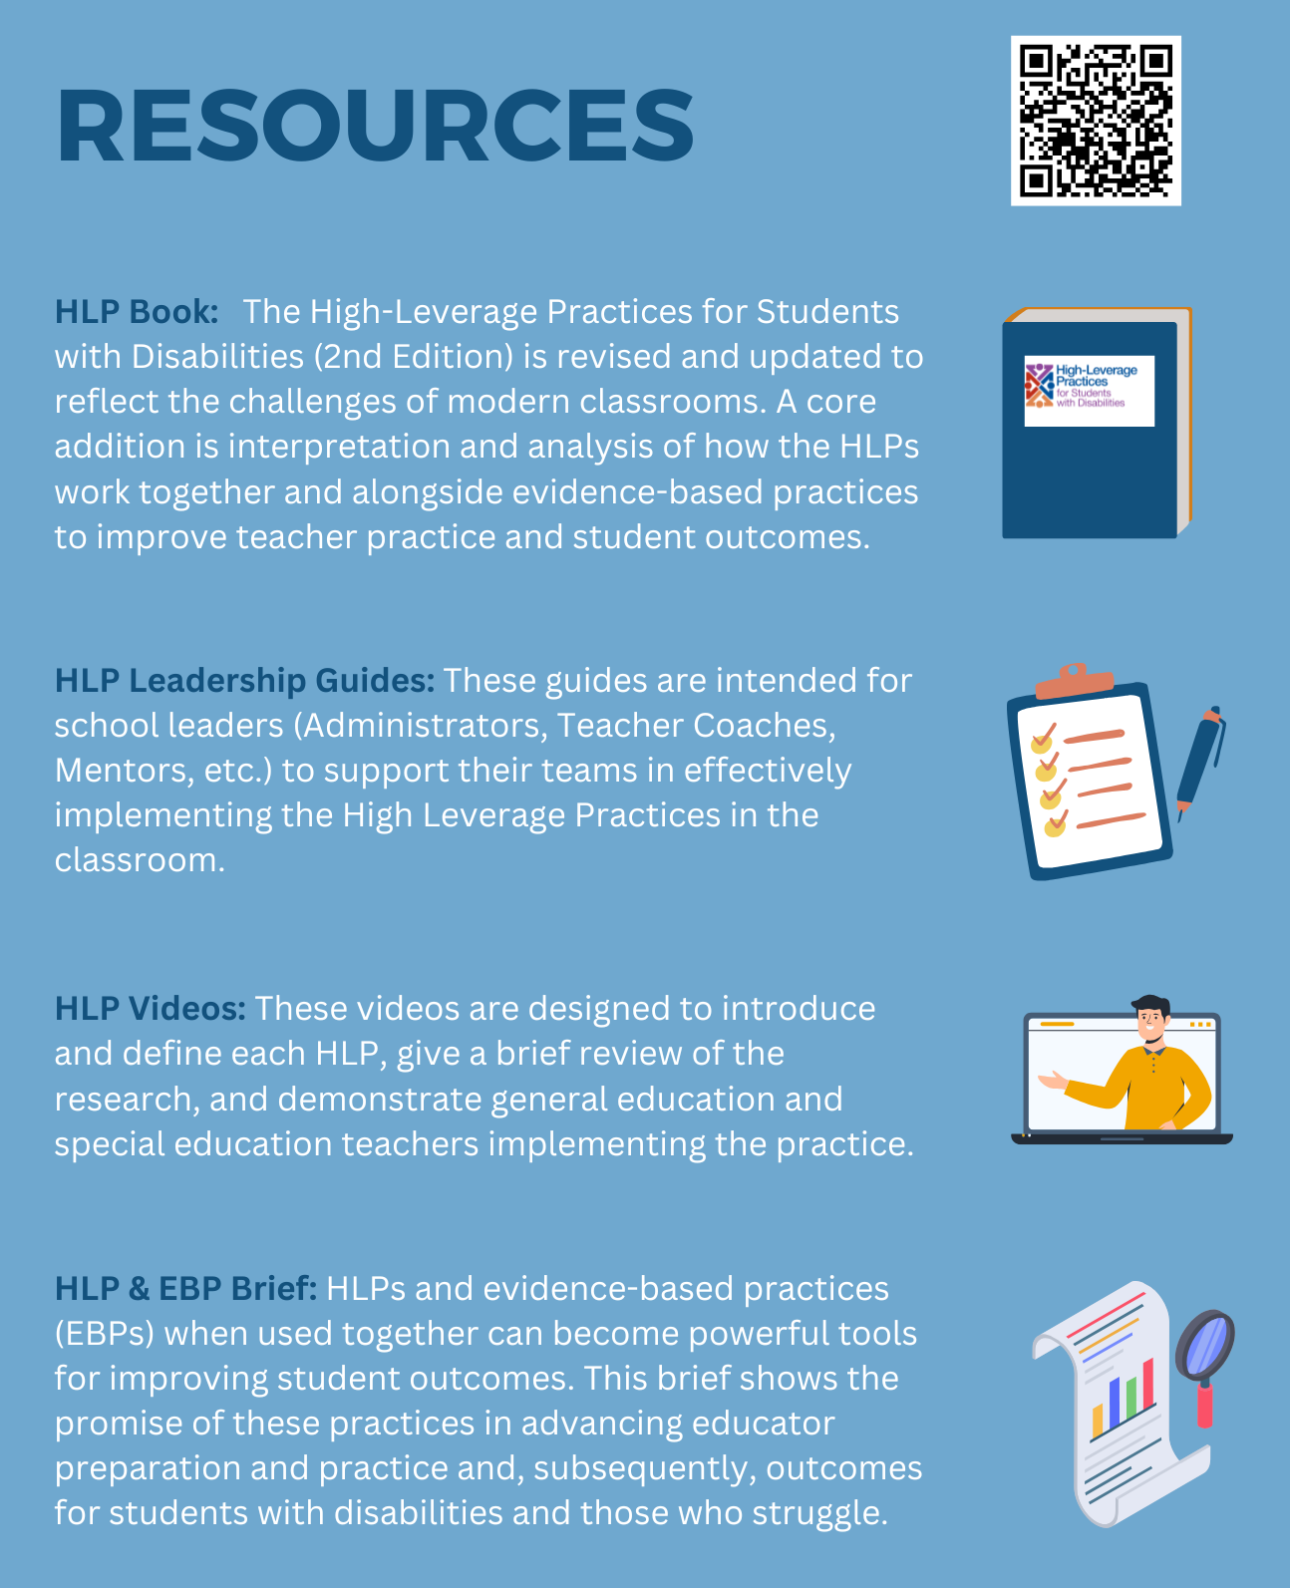
Flyer - Resources

Slide 17
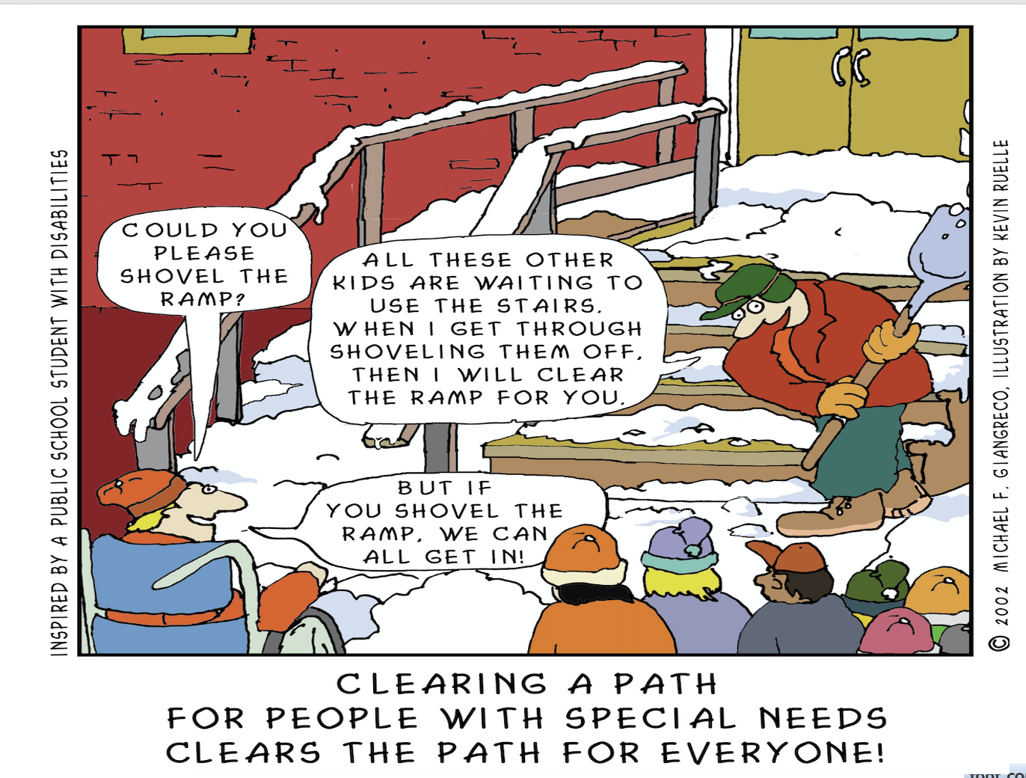
There is No “average” Brain
“When a flower doesn’t bloom, you fix the environment in which it grows, not the flower.”—
Alexander den Heijer

Slide 18
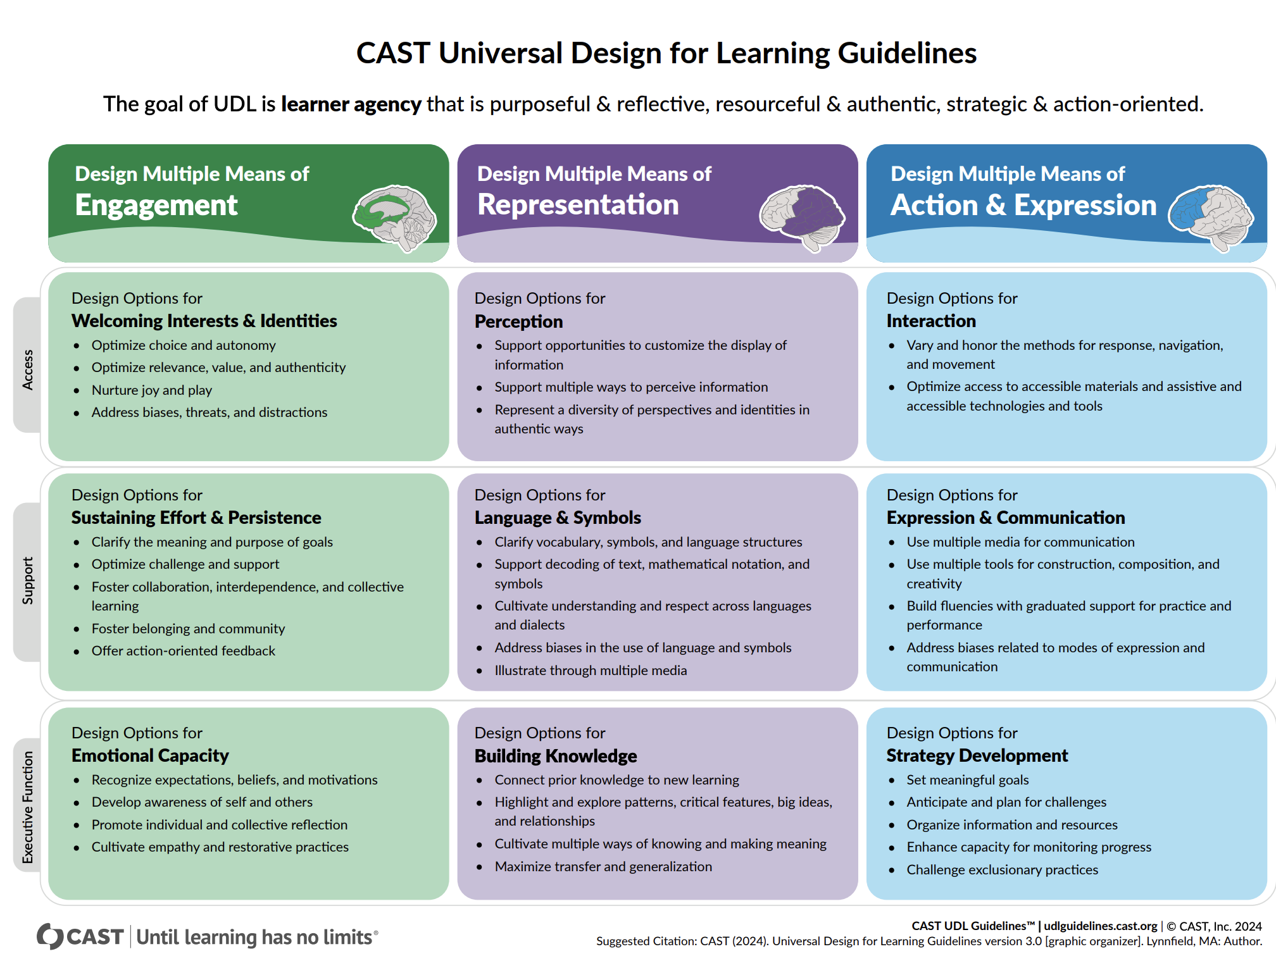
UDL Guidelines

Slide 19

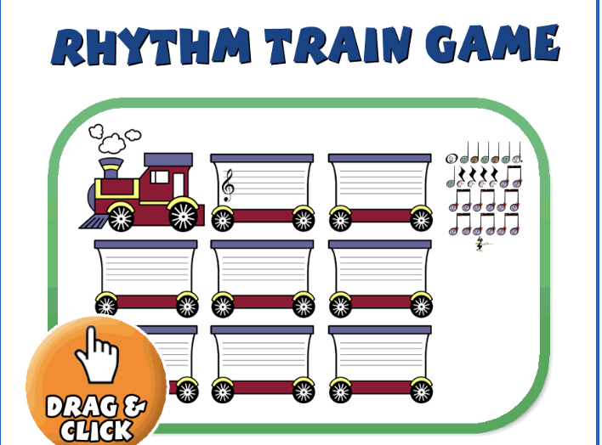

Breakdown of UDL Guidelines and HLPs
Engagement
YAM Song and Videos
Representation
Visual Symbols and Movement
Action/Expression
Movement, Clapping, Cards, Drawing
HLPs: Representation
Beat blocks, .Expression
Students build rhythms,\Engagement
Problem solving.

Slide 20
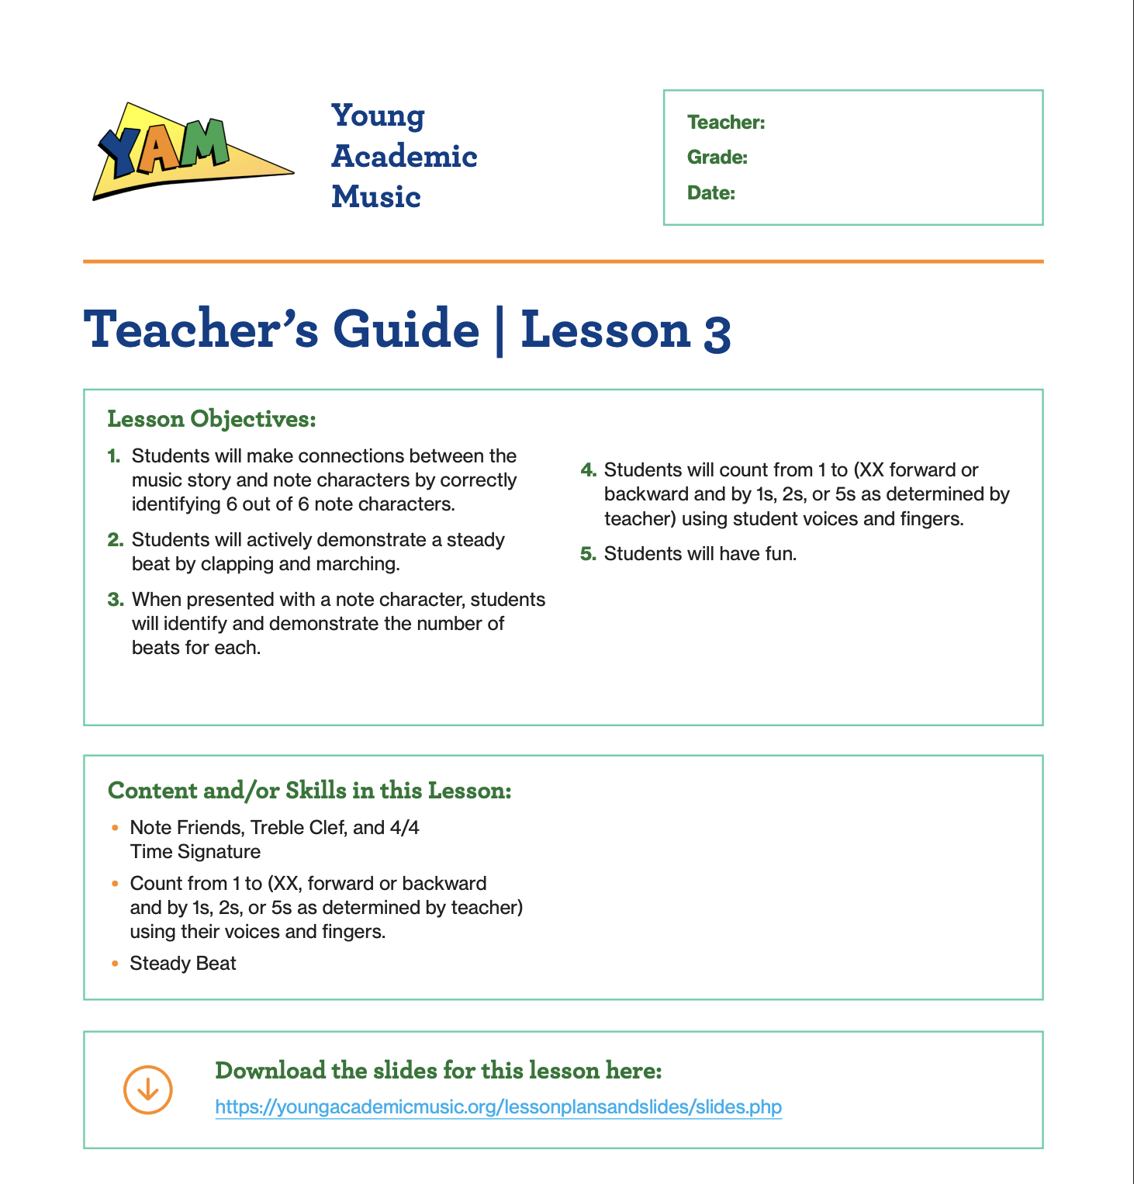
Lesson Planning: Key Components of a Standards-Based UDL Lesson Plan
Scope and Sequence
Standards-Aligned Learning Objectives
Student Data and Learner Profile
UDL: Multiple Means of Engagement
Explicit Instruction and Scaffolding
Differentiation and Flexible Grouping
Positive and Inclusive Learning Environment
Formative Assessment and Feedback

Slide 21
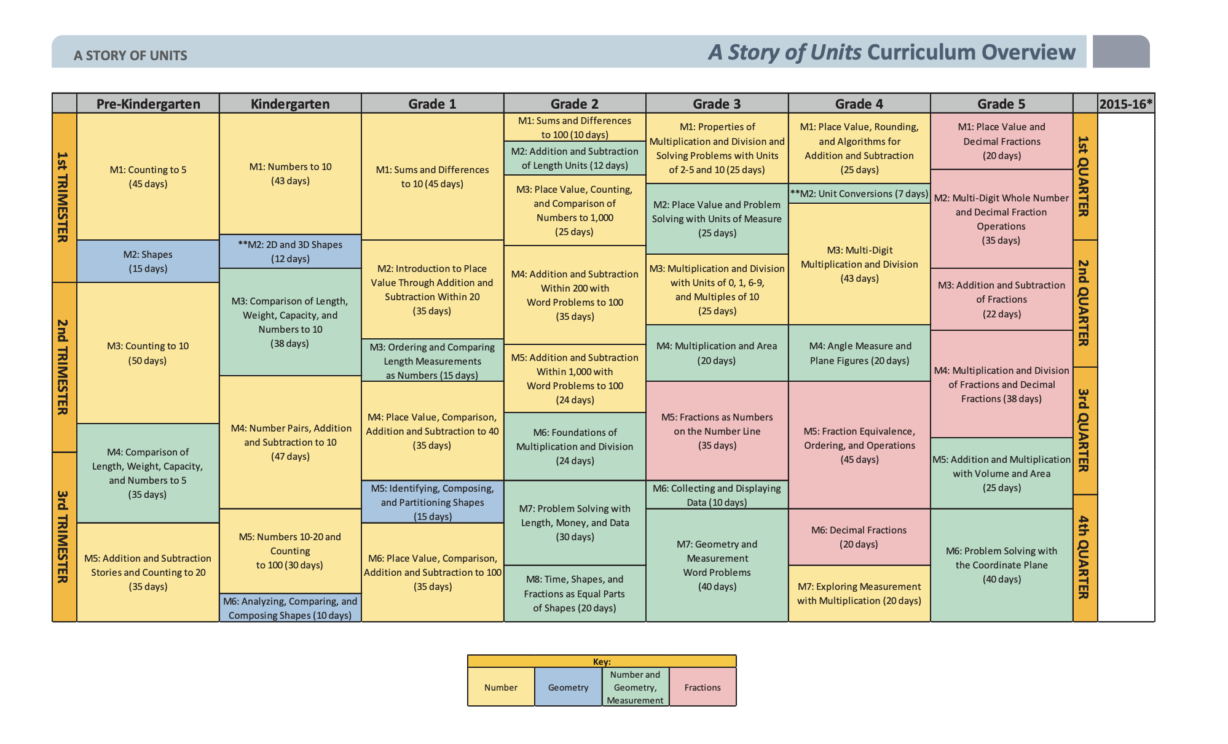
Scope and Sequence

Slide 22
Artificial Intelligence: Friend or Foe
Using AI To Reduce Teacher Workload
  Teachers reported feeling comfortable using AI as a planning assistant to generate lesson outlines, example activities, differentiated questions, or alternative explanations, while retaining full control over final decisions.
Avoid Early Implementation Errors
  An early pitfall for teachers without much AI experience is treating the technology as a replacement for professional judgment rather than as a tool to help make routine tasks easier.
Safeguard Student Data
  As AI becomes more deeply embedded in educational technology, establishing guardrails is essential to protect student data and ensure regulatory compliance.
Jones, C. (2026).

Slide 23

If Your Teacher Candidates Don’t know What Their Students Need to Know, AI Could be your Foe
We Have to Teach our Candidates How to Use AI responsibly

Slide 24
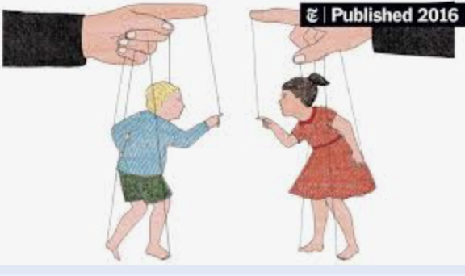
Ethical Use and Professional Judgment: AI should Support Candidate Teaching, Not Replace Their Judgment
Mitigate Bias
Protect Privacy
Always review AI-generated content for cultural bias. AI can sometimes reflect stereotypes present in its training data; it is your candidates’ role to ensure materials are culturally responsive and inclusive of all races, ethnicities, and gender identities.
Never enter personally identifiable information (PII) about students into an AI platform.

Slide 25
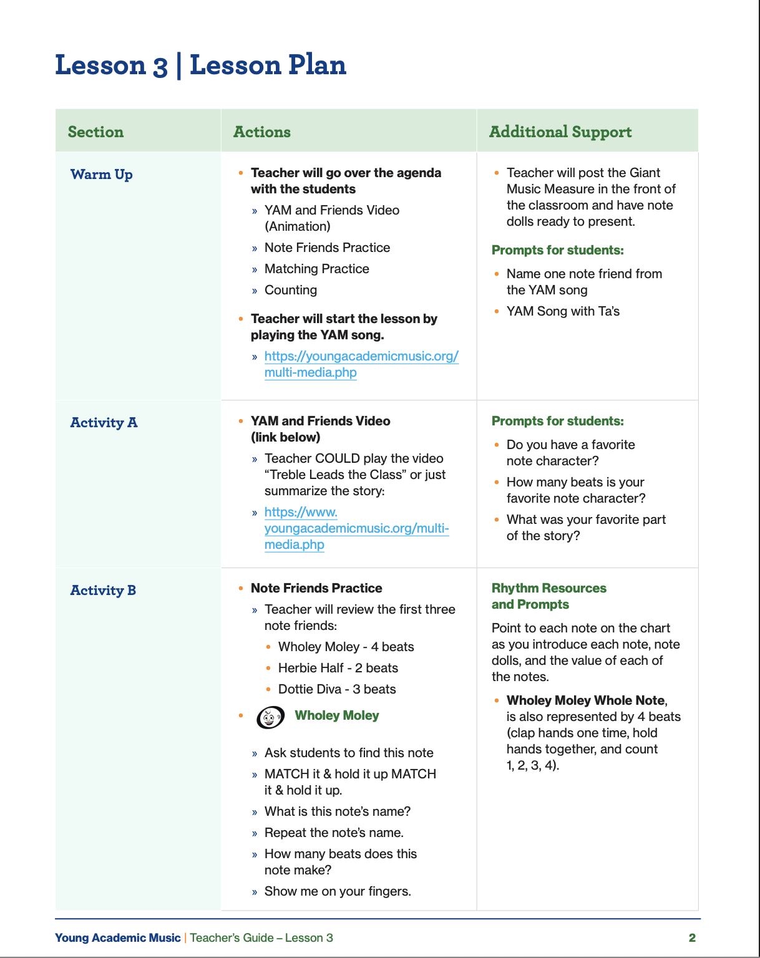
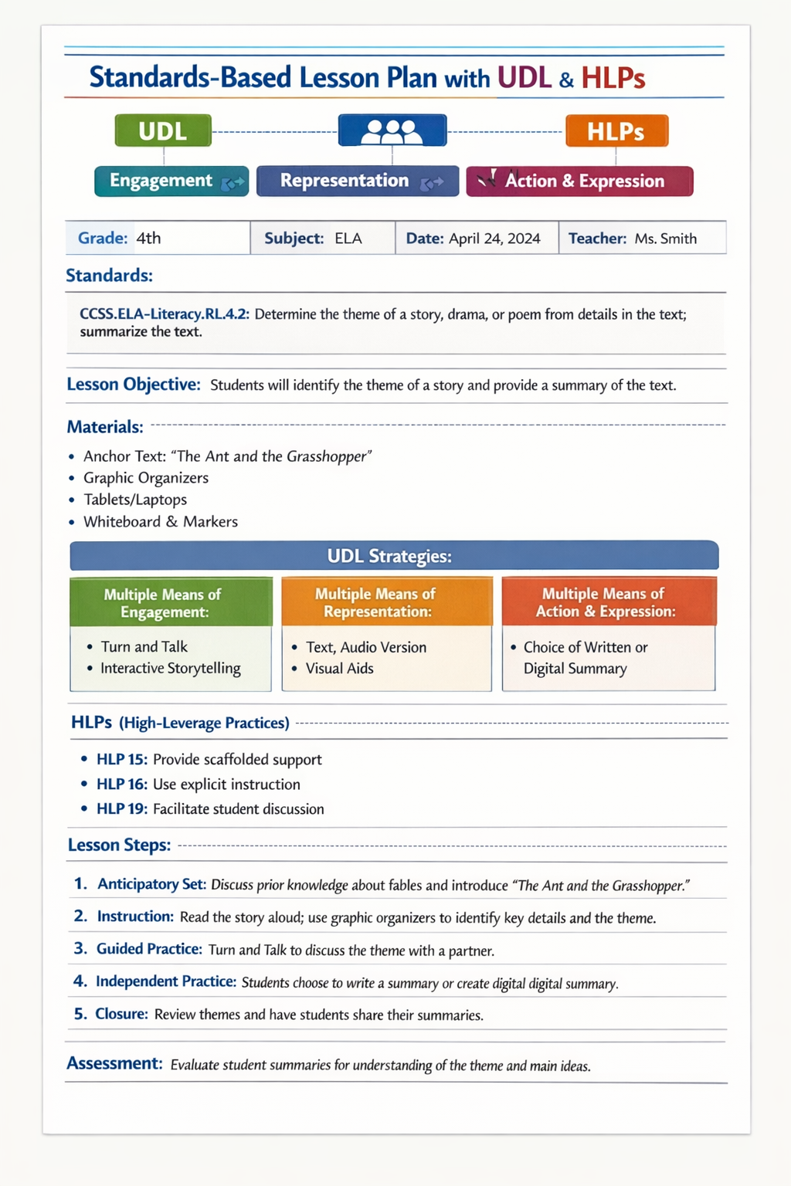
Using CEEDAR GPT to Create a Lesson Plan
Enhancing a Lesson Plan
Creating a Lesson Plan

Slide 26
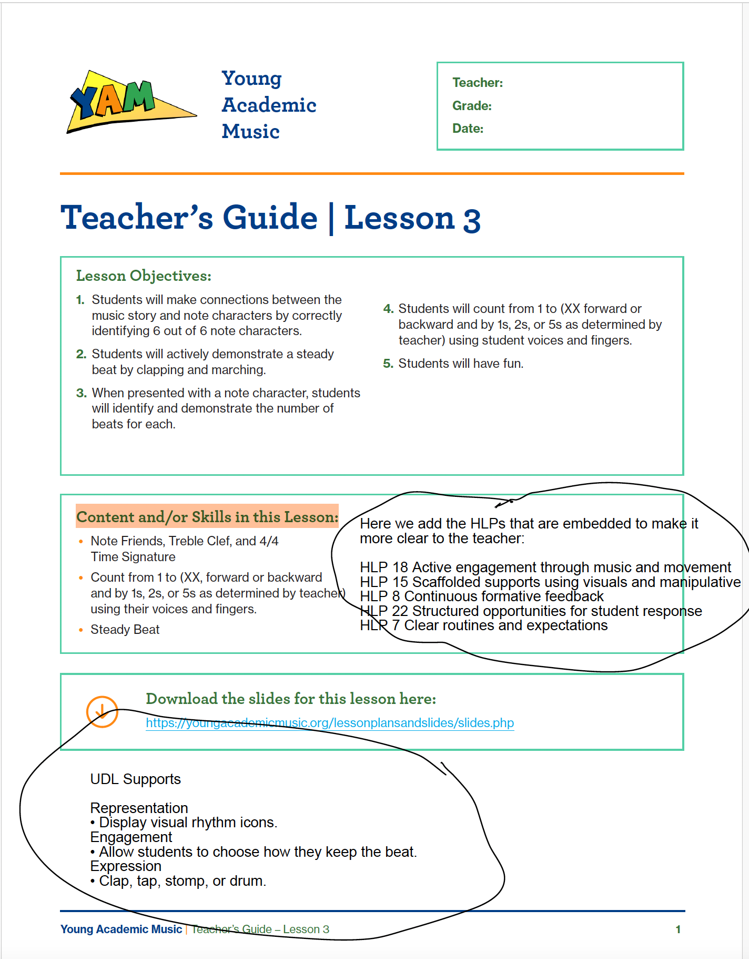
Using CEEDAR GPT to Create a Lesson Plan (2)
Using CEEDAR GPT to Create a Lesson Plan
Enhancing a Lesson Plan
Creating a Lesson Plan

Slide 27
CEEDAR GPT to Create a Lesson Plan
Your Lesson Plan
Student Characteristics
You are a preservice teacher completing your clinical preparation in an inclusive classroom. Your goal is to design a standards-based lesson plan that integrates Universal Design for Learning (UDL), High-Leverage Practices (HLPs), appropriately using AI tools (CEEDAR GPT) to support diverse learners.
Student Characteristic
3 students with IEPs
  One student with a Specific Learning Disability in reading
  One student with ADHD
  One student with Autism Spectrum Disorder
2 multilingual learners (MLLs) who are developing academic English
Several students with different learning preferences
  Some students learn best through visual supports
  Others benefit from movement and hands-on learning
  Some students prefer technology-based learning tools
CEEDAR GPT
Notes:
https://chatgpt.com/g/g-67b53457ec208191b9c82aa7e6bcf1a9-high-leverage-practices-hlp-gpt?utm_source=CEEDAR+Center+Newsletter&utm_campaign=207a51a350-EMAIL_CAMPAIGN_2023_05_23_03_15_COPY_01&utm_medium=email&utm_term=0_-a23a86e187-107663557

Slide 28

High Leverage Practices (HLP) GPT
This is how it works:
I am taking you to CEEDAR HLP GPT to demonstrate how to create a lesson plan.

Slide 29
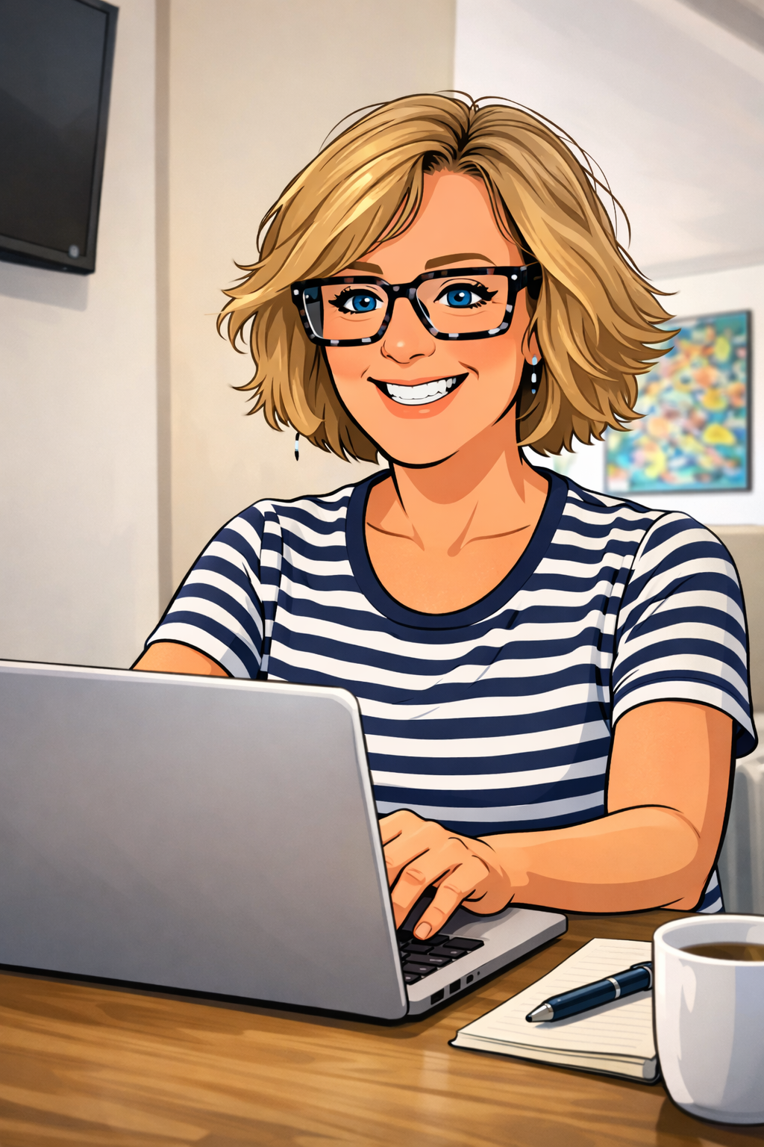
High Leverage Practices (HLP) GPT 2
High Leverage Practices (HLP) GPT
Now it is your turn:
  Review the following 3 case studies and choose one to work on in your break-out room.
  Read the ‘Think About’ questions before you start the exercise

Slide 30
Think About
Grade Level & Subject: Which of these three levels (Pre-K, Elementary, or Middle) do you feel most drawn to, and which specific New York State standard are you currently targeting for your clinical practice?
HLP Application: Looking at Case Study 2, how might HLP 16 (Use explicit instruction) help the student with ASD understand the specific steps of the decomposition model?
Ethical AI Use: When using AI to differentiate texts for your MLLs (as in Case Study 3), what steps will you take to ensure the AI has not introduced cultural bias or stripped away the rigor of the original standard?

Slide 31
CEEDAR GPT to Create a Lesson Plan: Case Study 1
Setting: A diverse Pre-K "3-K for All" classroom in Brooklyn.
Student Profile: 18 students; 4 students with IEPs (including Speech/Language Impairment and Developmental Delay); 6 MLLs (Spanish and Bengali home languages).
NY Standard: PK.SEL.2. Identifies self as being part of a family and identifies being connected to at least one significant adult.
The Challenge: Design a lesson on "My Community Helpers" where students must recognize and name individuals who support them.
AI Goal Suggestions: Use AI to help you address all the important components of a comprehensive lesson plan.
CEEDAR GPT

Slide 32
CEEDAR GPT to Create a Lesson Plan: Case Study 2
Setting: A semi-urban 5th-grade inclusive classroom
Student Profile: 24 students; 1 student with Autism Spectrum Disorder (ASD); 2 students with Specific Learning Disabilities (SLD) in Reading; 50% of the class is from low-income households
NY Standard (NGSS): 5-LS2-1. Develop a model to describe the movement of matter among plants, animals, decomposers, and the environment
The Challenge: Students struggle to visualize the invisible process of decomposition and matter cycling
AI Goal Suggestions: Use AI to differentiate the "Independent Work" phase of your lesson. Ask the AI to create three tiered versions of a "Matter Cycle" diagram: one with a word bank, one with sentence starters, and one that is a digital drag-and-drop. This incorporates HLP 15 (Provide scaffolded supports) and UDL: Multiple Means of Action & Expression.
CEEDAR GPT

Slide 33
CEEDAR GPT to Create a Lesson Plan: Case Study 3
Case Study 3: Middle School (8th Grade) – ELA
Setting: A large middle school in an English Language Learner-heavy district.
Student Profile: 28 students; 4 students with ADHD; 8 MLLs (varying proficiency levels); 1 student with a hearing impairment.
NY Standard: 8R8: Trace and evaluate an argument and specific claims in a text, assessing whether the reasoning is valid and the evidence is relevant.
The Challenge: The class is analyzing a complex article about renewable energy, but reading levels vary from 3rd to 10th grade.
AI Goal Suggestions: Use AI to summarize the core text into three different Lexile levels. Then, ask the AI to generate "Evidence Trackers" using HLP 12 (Systematically design instruction toward a specific learning goal). Apply UDL: Multiple Means of Engagement by having AI suggest three different debate topics based on the text to spark student interest.
CEEDAR GPT

Slide 34
Reflection Questions
After creating your lesson plan, reflect on the following:
How did UDL help you design instruction for learner variability?
Which HLPs were most important in your lesson?
How can AI support inclusive teaching without replacing teacher judgment?
What challenges might arise when implementing this lesson?

Slide 35

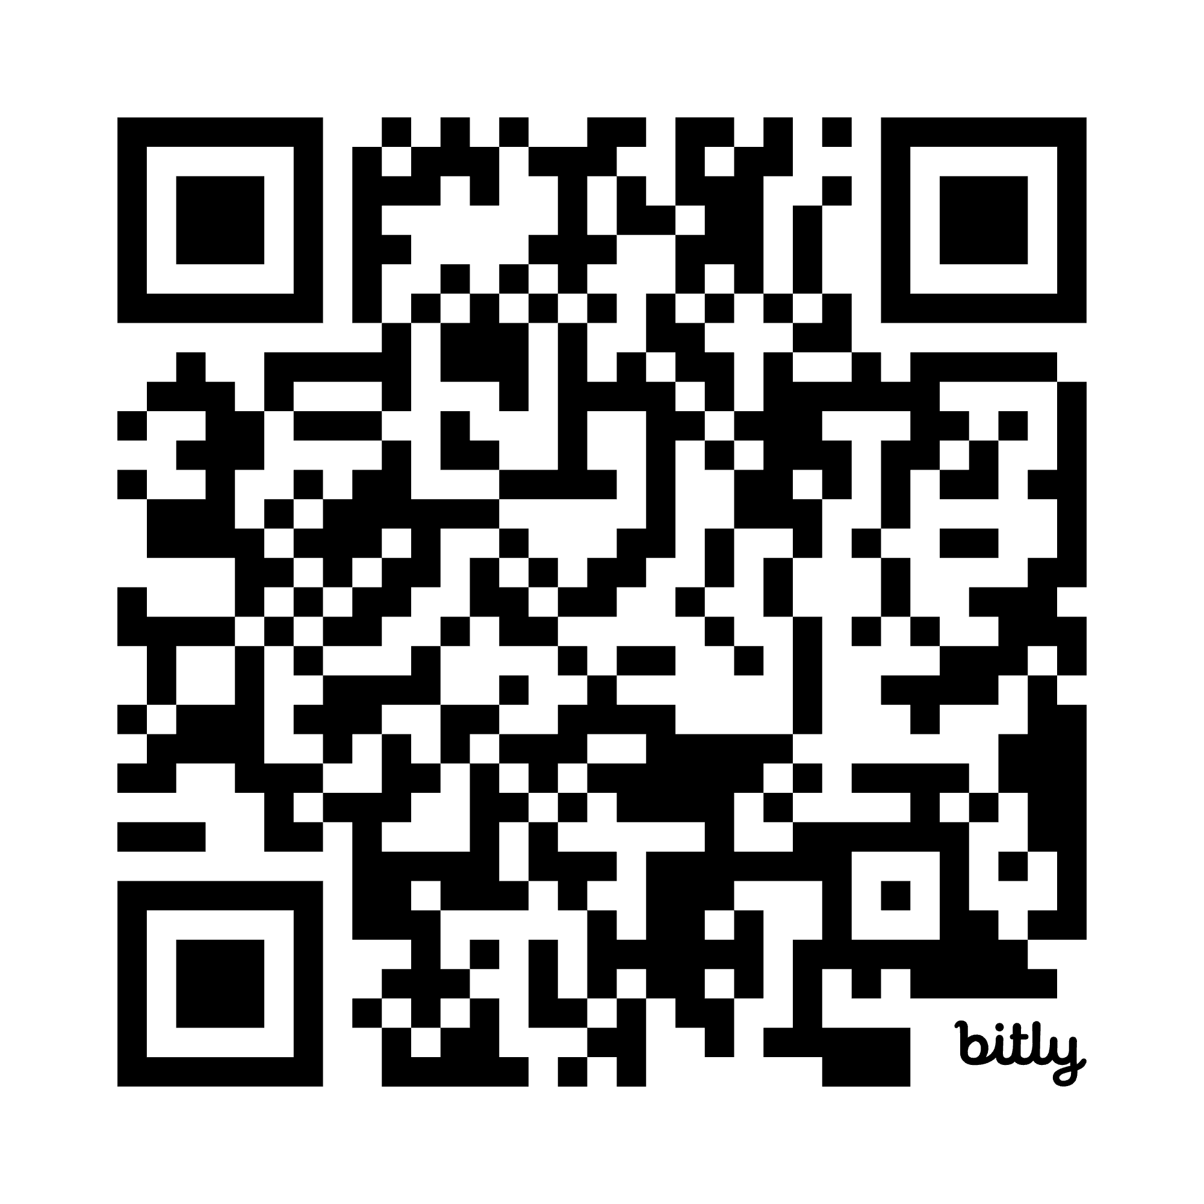
Questions?
Day Patterson
CEEDAR Center
dspatterson@gsu.edu
Previous NY CEEDAR
Lunch and Learns
Susan Corey
Touro University
Graduate School of Education
susan.courey@touro.edu
Notes:
Let me know who we want on this slide for the recording, we can add/change as needed

Slide 36
References
CAST. (2018). Universal Design for Learning guidelines version 2.2. https://udlguidelines.cast.org
Council for Exceptional Children. (2024). High-leverage practices for students with disabilities. High-Leverage Practices. https://highleveragepractices.org
IRIS Center. (2025). High-leverage practices. Vanderbilt University. https://iriscenterdev.wpengine.com/resources/high-leverage-practices/
Jones, C. (2026). AI Tips for Teachers New to Technology. The Learning Agency. (https://the-learning-agency.com/the-cutting-ed/article/ai-tips-for-teachers-new-to-the-technology/). March 12, 2026
McLeskey, J., Barringer, M., Billingsley, B., Brownell, M., Jackson, D., Kennedy, M., Lewis, T., Maheady, L., Rodriguez, J., Scheeler, M., Winn, J., & Ziegler, D. (2017). High-leverage practices in special education. Council for Exceptional Children & CEEDAR Center.
New York State Education Department. (2017). New York State Next Generation Mathematics Learning Standards. https://www.nysed.gov/curriculum-instruction/new-york-state-next-generation-mathematics-learning-standards

Slide 37
There is No “average” Brain (2)
There is No “average” Brain
“When a flower doesn’t bloom, you fix the environment in which it grows, not the flower.”—
Alexander den Heijer

Slide 38
Artificial Intelligence: Friend or Foe (2)
Artificial Intelligence: Friend or Foe
Subject
Fractions
Grade Level
First
HLPs
?
UDL
?

Slide 39
Scope and Sequence (2)
Scope and Sequence
Grade Levels
Classroom Context and Culture

Slide 40
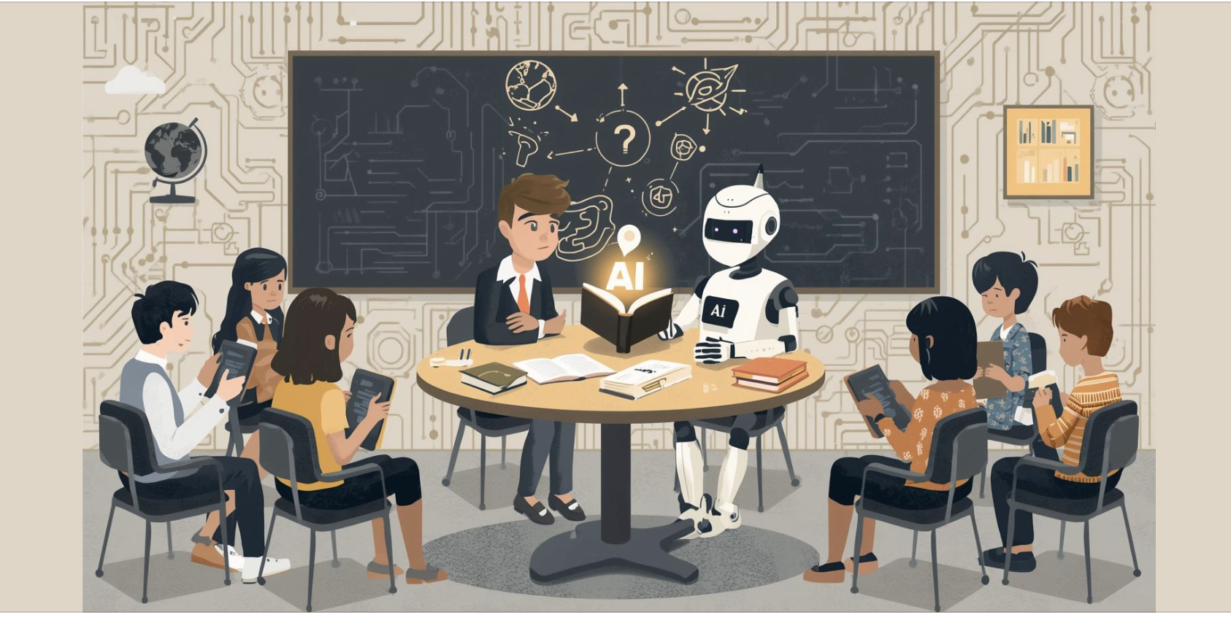
CEEDAR
High Leverage Practices (HLP) GPT
CEEDAR GPT

Slide 41

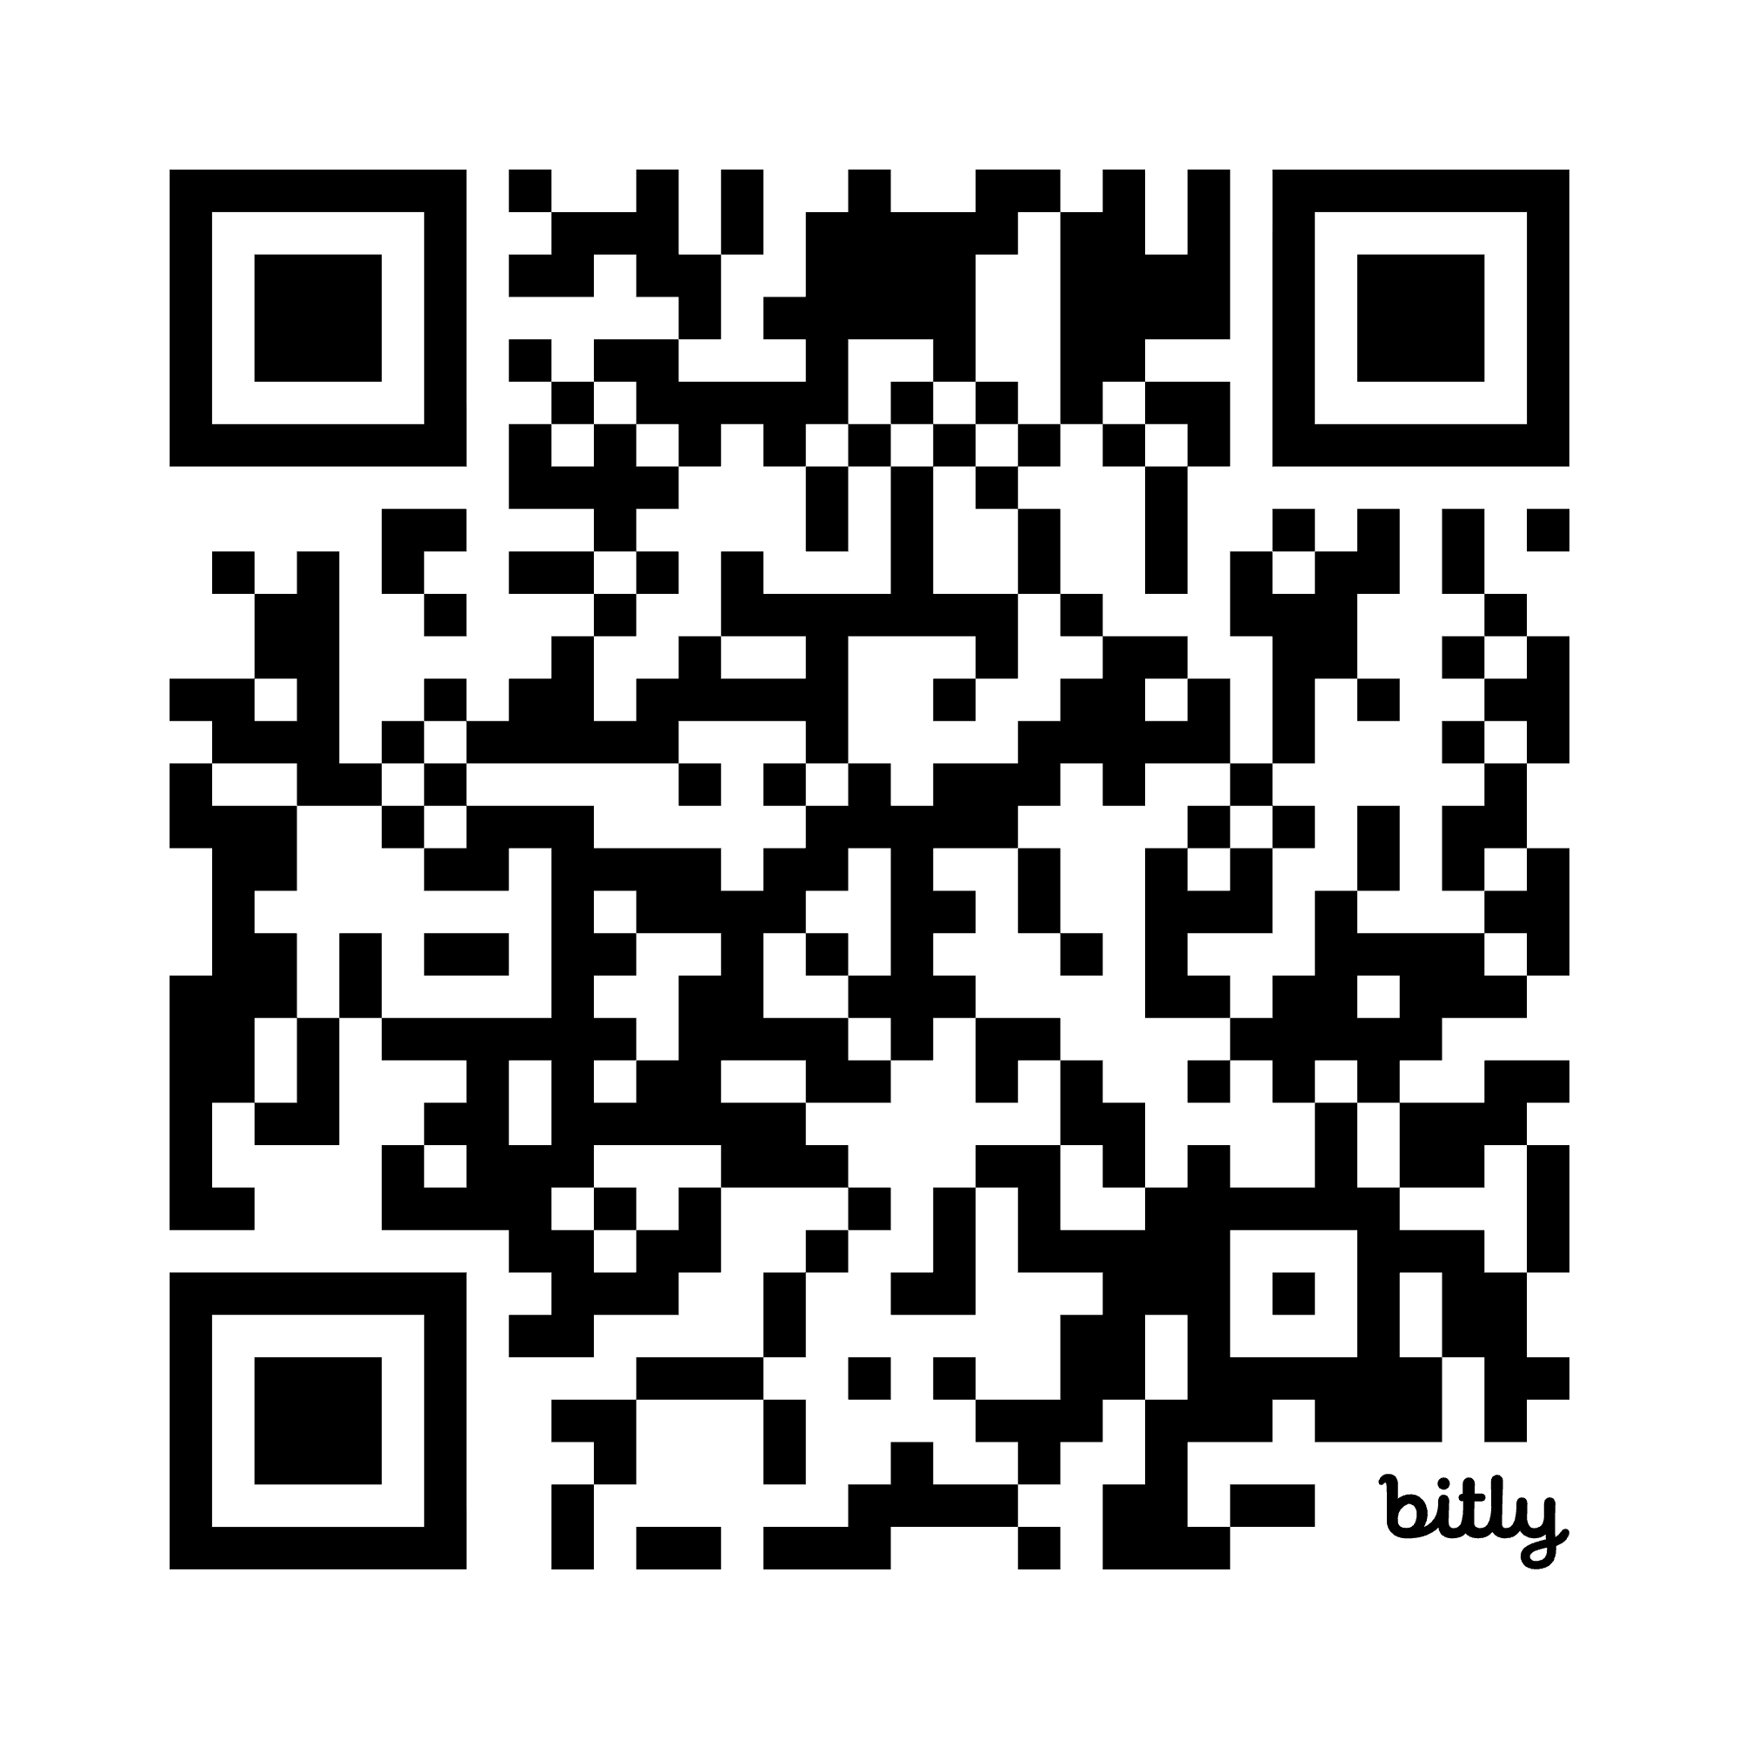
Questions? (2)
Questions?
Day Patterson
CEEDAR Center
dspatterson@gsu.edu
Susan Courey
Touro University
Graduate School of Education
susan.courey@touro.edu
Notes:
Let me know who we want on this slide for the recording, we can add/change as needed

Slide 42

Disclaimer
This content was produced under U.S. Department of Education, Office of Special Education Programs, Award No. H325A220002. David Guardino serves as the project officer. The views expressed herein do not necessarily represent the positions or policies of the U.S. Department of Education. No official endorsement by the U.S. Department of Education of any product, commodity, service, or enterprise mentioned in this website is intended or should be inferred.

