Slide 1
Lunch & Learn:
How the IC can Support Program Development

Slide 2
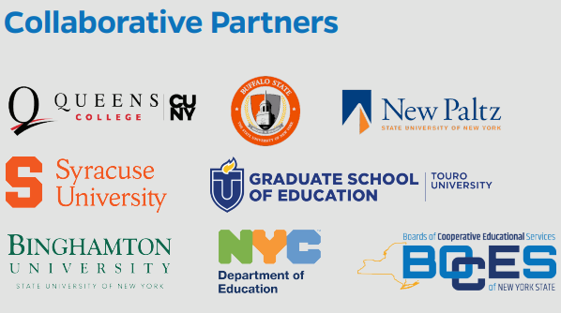

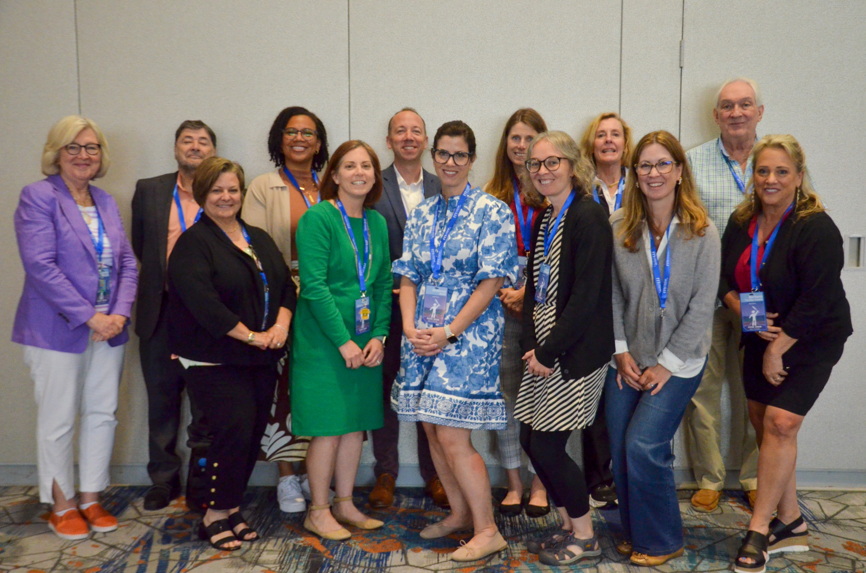

Who we are….
Dr. DaShaunda Patterson
Associate Dean for Faculty Affairs
Georgia State University
CEEDAR Center
Dr. Shannon Budin
Horace Mann Endowed Chair
Professor of Exceptional Education
SUNY Buffalo State University

Slide 3
Today’s Objectives
Demonstrate how Innovation Configurations can be used to support program review, revision, and / or development around the Science of Reading.
Explore the organization and outputs provided by Innovation Configurations to assist in this effort.

Slide 4
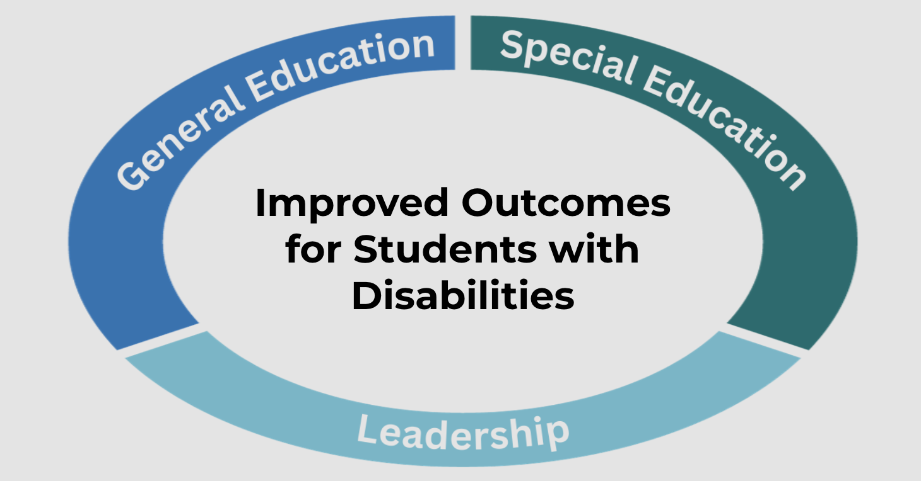
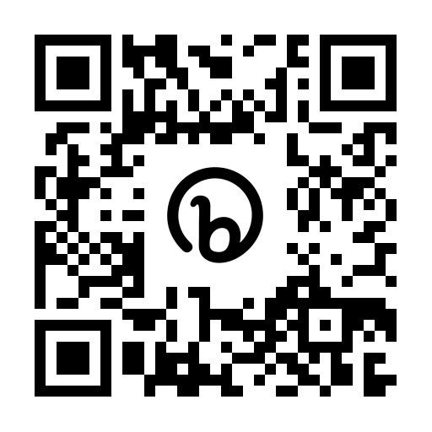
CEEDAR Overview
The Collaboration for Effective Educator Development, Accountability, and Reform (CEEDAR) Center is a national technical assistance center funded by the U.S. Department of Education Office of Special Education Programs (OSEP)
CEEDAR provides technical assistance (since 2013) to collaborating teams of state education agencies, institutes of higher education, and local education agencies to ensure effective teachers and leaders for each student

Slide 5


Our Mission
To support students with disabilities (SWDs) in achieving college- and career-ready standards by building the capacity of state personnel preparation systems to prepare teachers and leaders to implement evidence-based practices (EBPs) within multi-tiered systems of support (MTSS).
“Every student with a disability has an opportunity to achieve.”

Slide 6
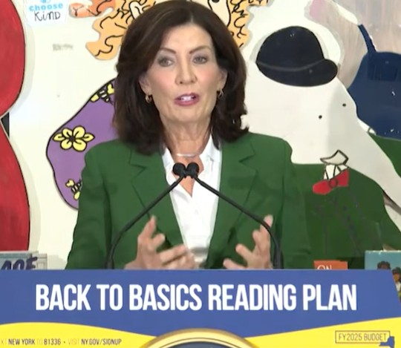
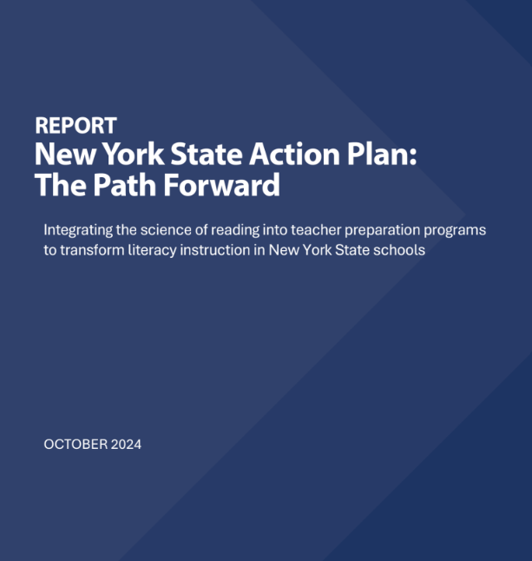
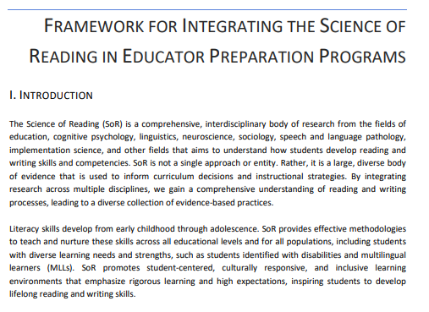

Timeline
Jan 2024
Oct 2024
Mar 2025
Jan 2026

Slide 7


Baseline analysis to desired state
Baseline Analysis
Desired State
Notes:
image from vecteezy.com

Slide 8
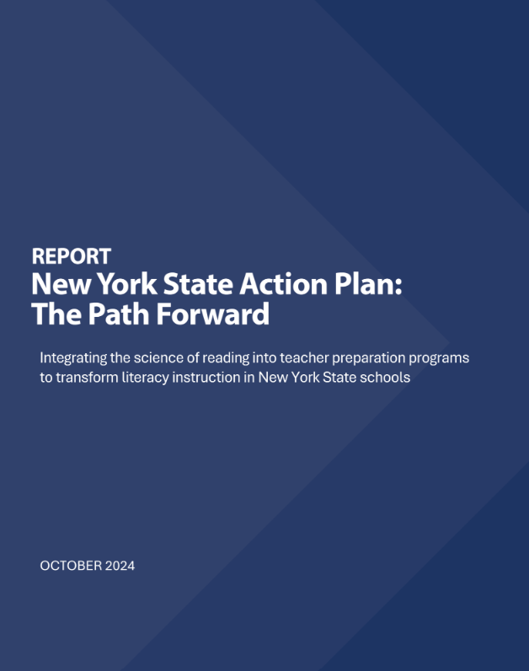
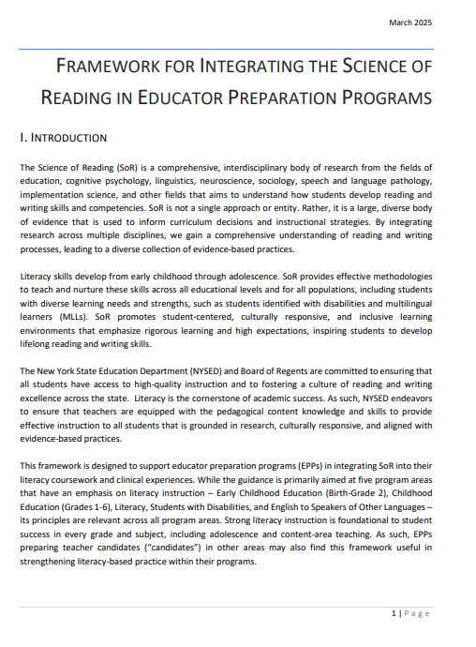

New York State Action Plan

Slide 9
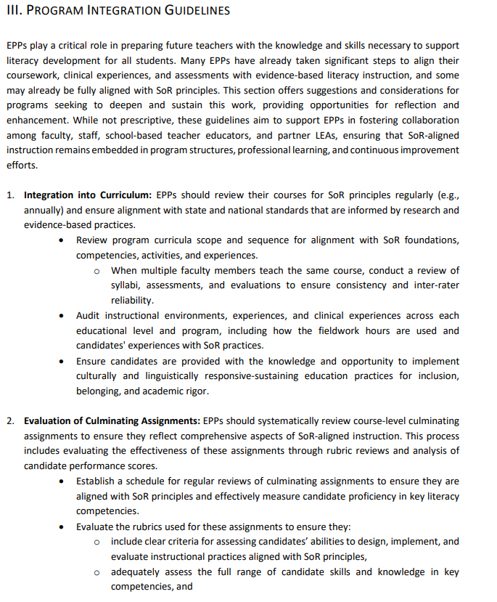
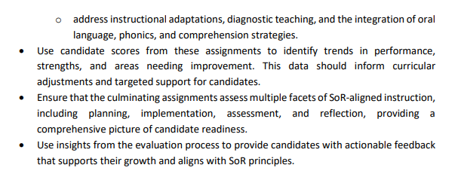
Program Integration Guidelines
Program Integration Guidelines:
I. Integration into the Curriculum
II. Evaluation of Culminating Assignments

Slide 10

What we can and cannot do today:
Cannot:
Can:
Answer questions or details about NYSED or SUNY requirements related to Path Forward, the Framework, or specific program review or development processes
Teach about the content or pedagogy of the SoR
Share/describe all of the NYS related resources for SoR technical assistance or professional development
Share CEEDAR tools & resources that may help you…
    Evaluate the status of your current program’s SoR content
    Identify areas of strength, gaps, and / or redundancies in program
    Reflect on & take action to align program content & assessments to SoR

Slide 11
Quick “Share” …
To date, what has your EPP done to explore, deepen, and/or and sustain this work in order to move closer to that “desired state”?

Slide 12


What are Innovation Configurations?
ICs focus on evidence-based content and instructional practices that increase student achievement.
They are both a process and a tool to guide the self-assessment of programs and to facilitate the course enhancement process.
ICs consider a program or set of courses to identify strengths, gaps and redundancies in programs.
Notes:
Intro about ICs

Slide 13
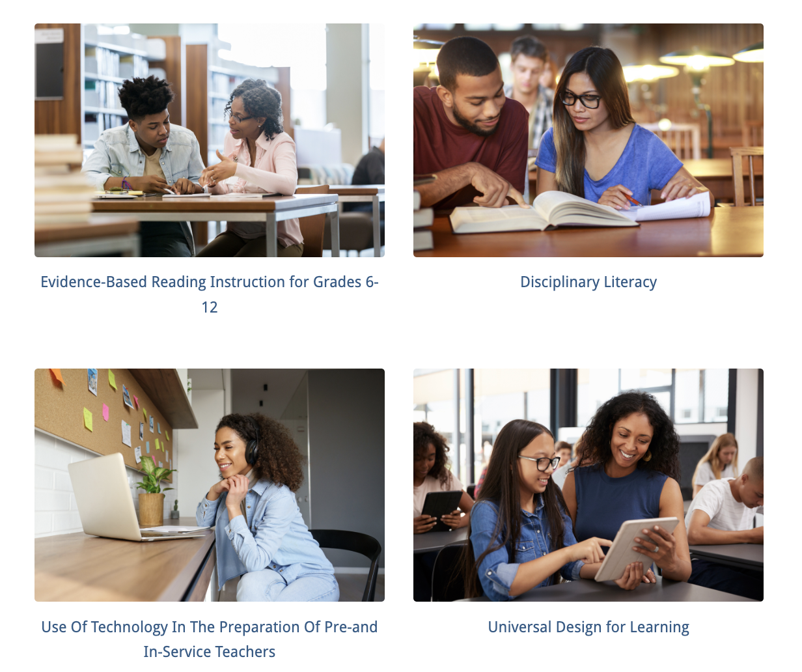
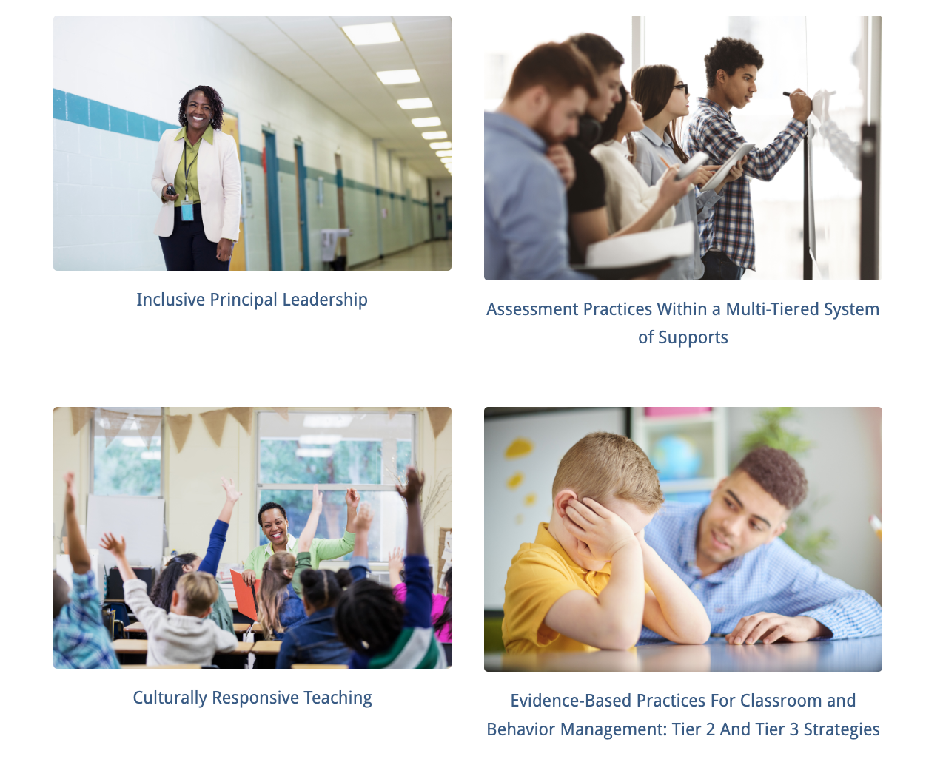


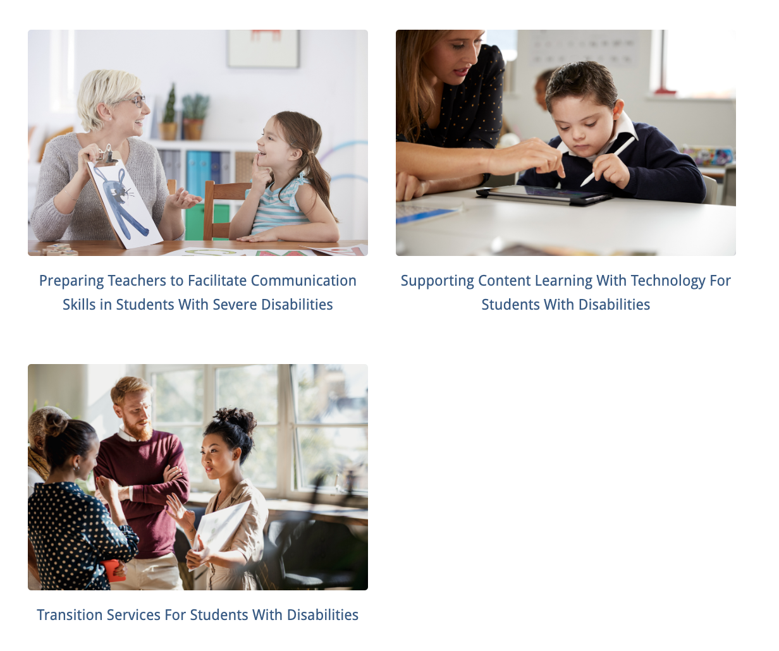
Innovation Configurations (ICs)
Help to you to….
Evaluate current teacher preparation by determining the extent to which EBPs are taught, observed, and applied within the program.

Slide 14





Relevant ICs for SoR

Slide 15
ICs Help you Systematically Answer…
What types of instruction and experiences do teachers receive throughout their preparation that promote the use of evidence-based instructional practices?
The number and depth of practice opportunities candidates have to deliberately apply these strategies with explicit feedback and sustained implementation to ensure fidelity.

Slide 16
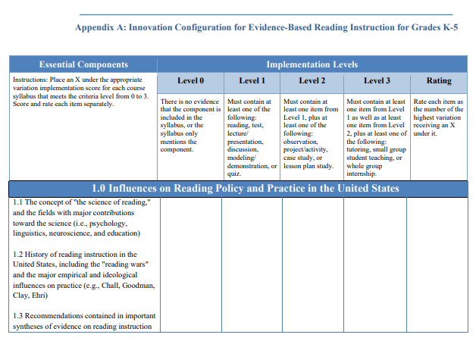

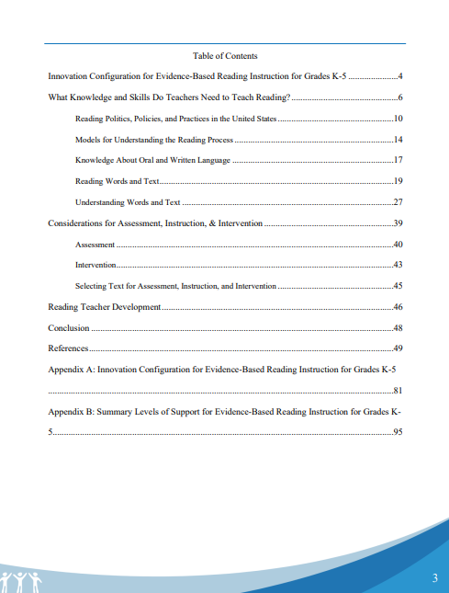
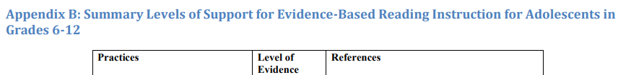
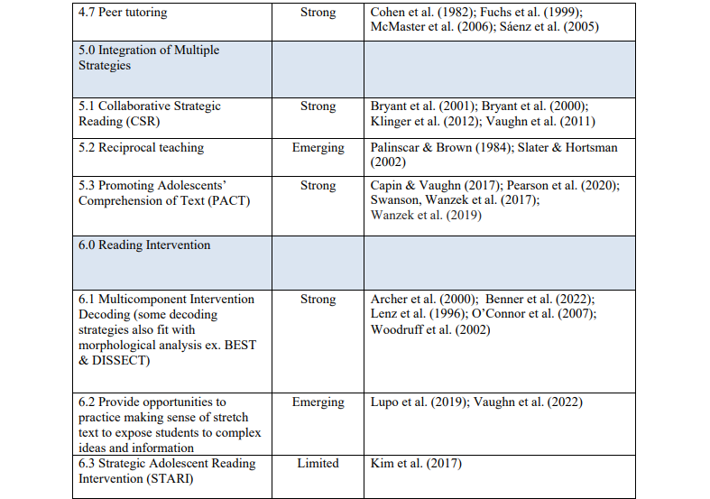
Innovation Configuration
Every IC includes a chart distilling the essential components related to the topic that are supported by research.
Every IC begins with an extensive review of the literature in the topic area

Slide 17
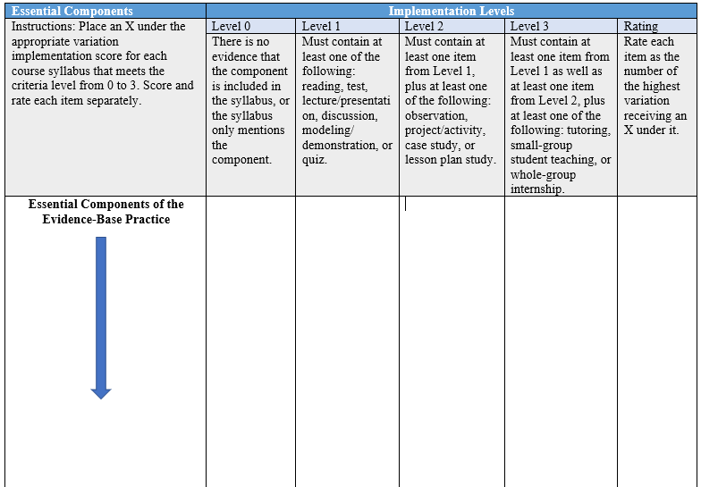
Innovation Configuration Structure
4 levels (increase in complexity for each criterion)- depth of instruction or opportunity to learn
ICs are organized around two dimensions:
Essential components—Key concepts and skills that candidates need related to the content area
Degrees of implementation—The extent to which these concepts and skills are taught, applied, and practiced within the program

Slide 18
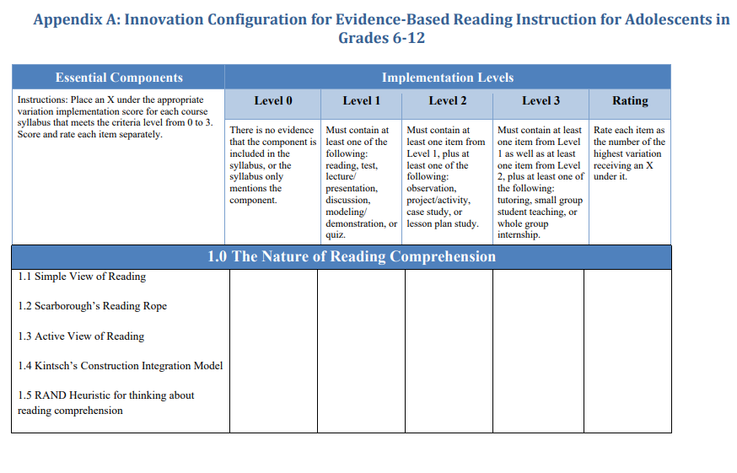
Appendix A

Slide 19
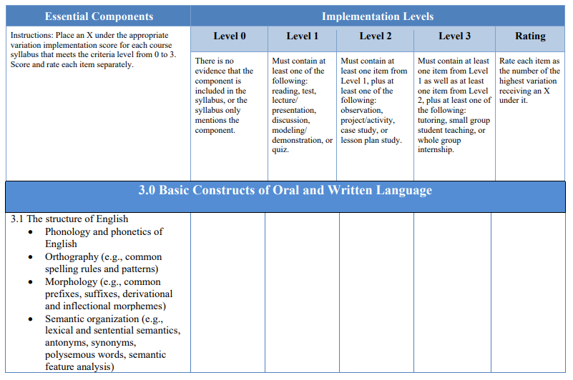
Essential Components and Implementation levels

Slide 20
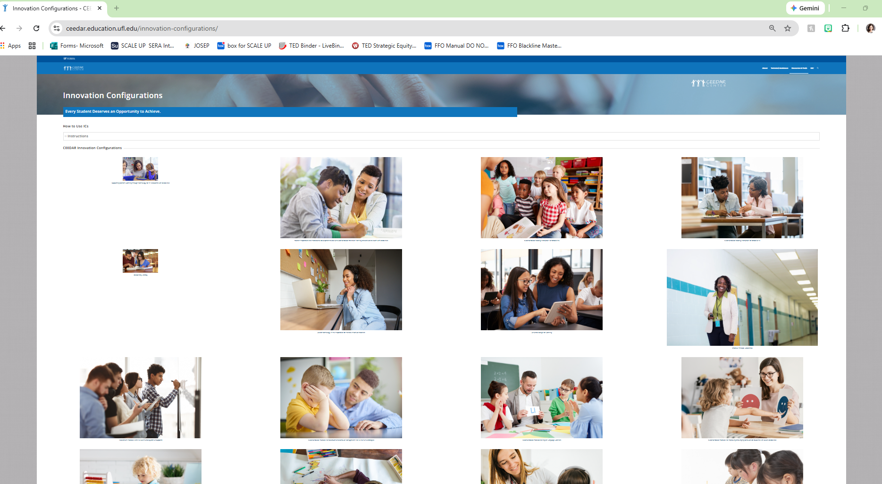
Let’s Explore an IC
Explore:
Spend 4 minutes exploring an IC.
As you do, think about one way this could be used in your program and one question or challenge you anticipate
To Access:
Go to ceedar.org
Click Resources/Tools
Click Innovation Configurations
Select SoR related IC
Notes:
https://ceedar.education.ufl.edu/innovation-configurations/
After and spend a few quiet minutes exploring and then we will enter breakout room to have a brief discussion about
What stood out to you?
How could this support Science of Reading alignment in your program?
What questions or barriers do you see?

Slide 21

The Networked Improvement Community (NIC)
Moved the process online
Faculty can complete in 20-30 minutes per syllabus
Creates reports that can be used for making decisions about programs
Reports can be used for program review

Slide 22
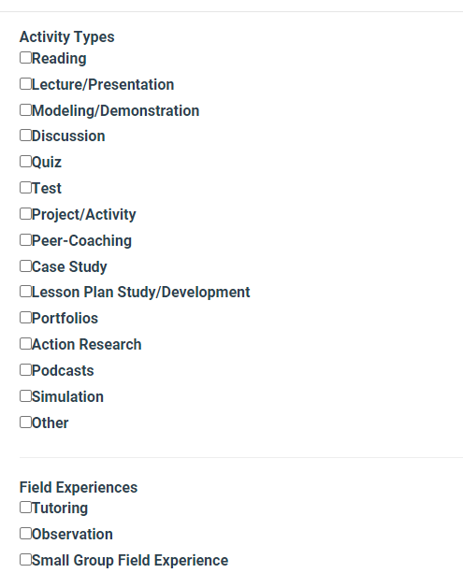
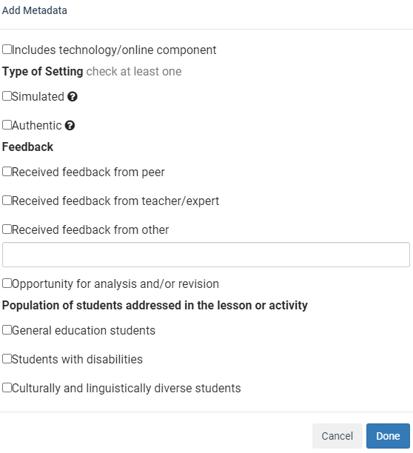
What gets entered into the IC tool?
Programs → Courses → ACTIVITIES
Activities can be variety of “things” student does in the course.
Then provide details about that activity.

Slide 23
Sample outputs-
Reports Available
-Can be used as a one time “snapshot”
-Can be compared over time (growth/change)

Slide 24
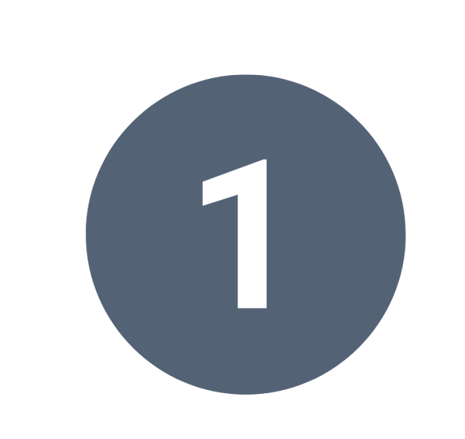
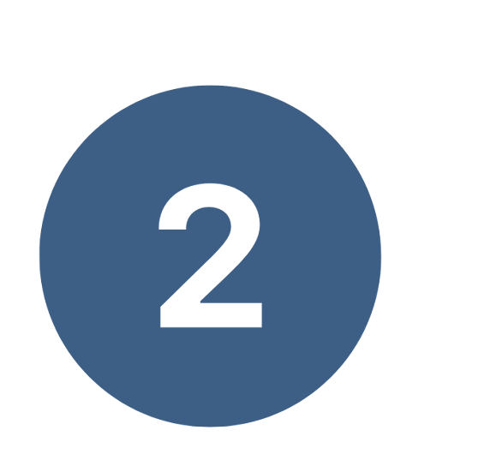
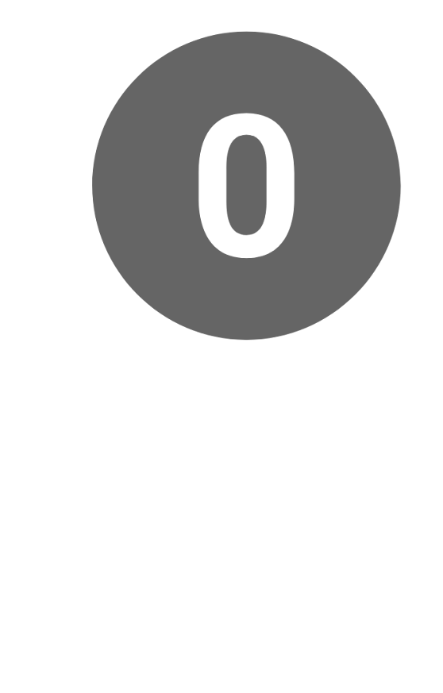
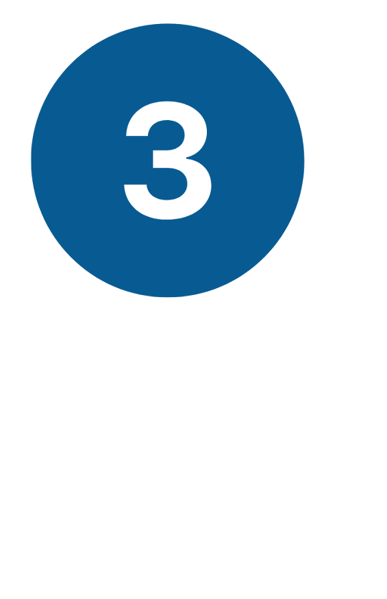
Implementation Level Language
Level 0 | Level 1 | Level 2 | Level 3
There is no evidence that the component is included in the syllabus, or the syllabus only mentions the component. | Must contain at least one of the following: reading, test, lecture/presentation, discussion, modeling/ demonstration, or quiz. | Must contain at least one item from Level 1, plus at least one of the following: observation, project/activity, case study, or lesson plan study. | Must contain at least one item from Level 1 as well as at least one item from Level 2, plus at least one of the following: tutoring, small group student teaching, or whole group internship.

Slide 25
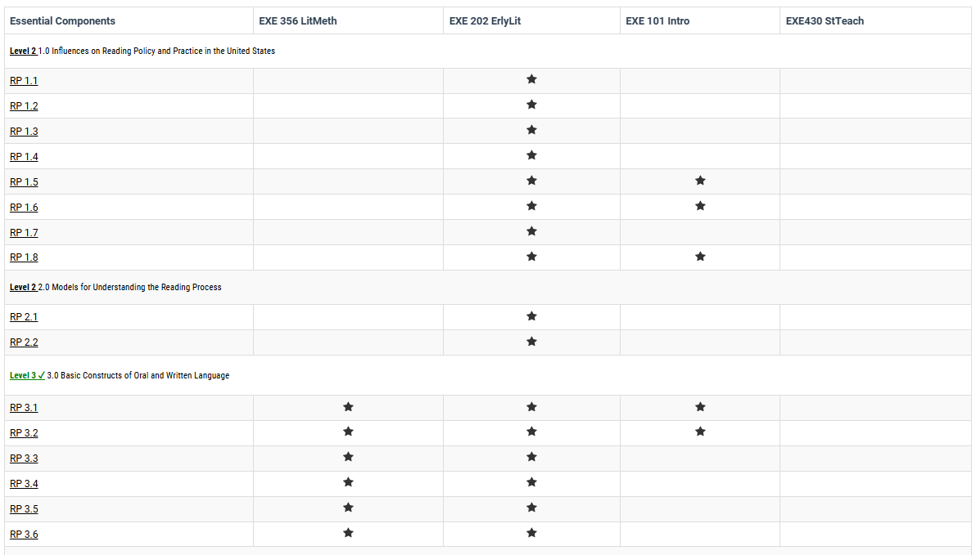
Sample Report:
Matrix from the IC

Slide 26
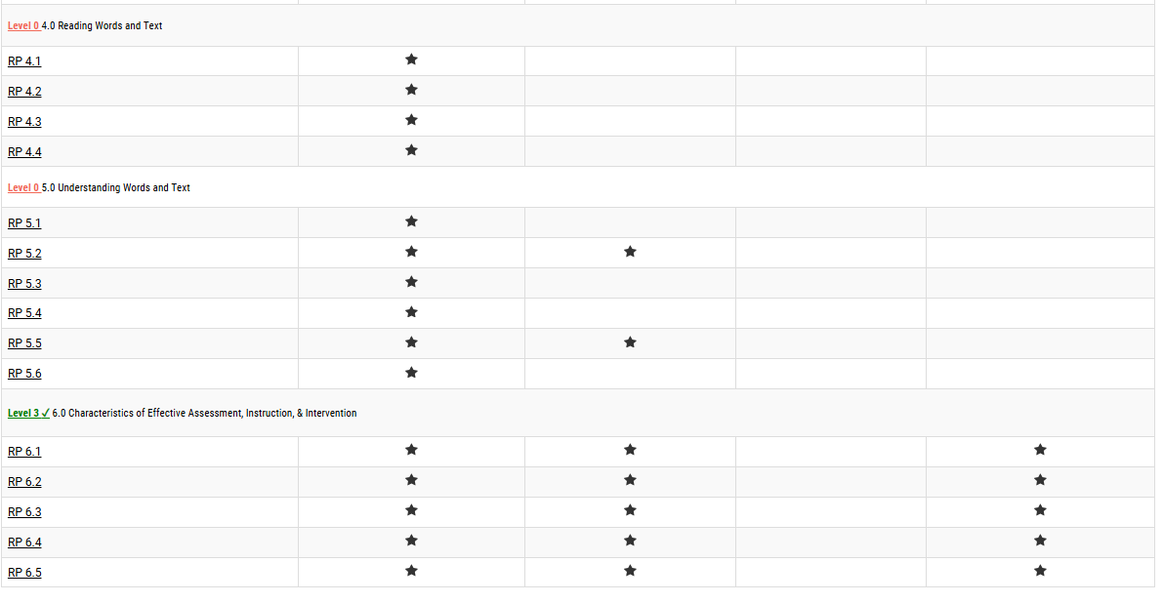
Sample Report

Slide 27
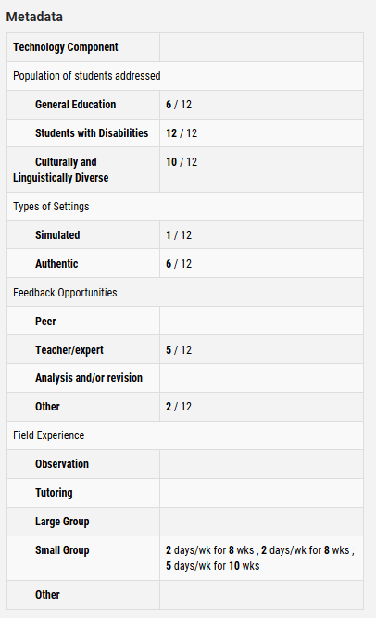
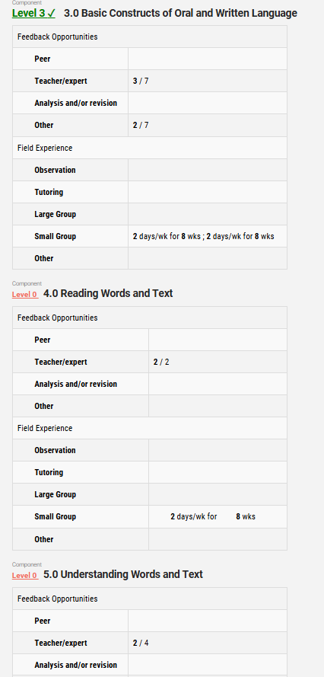
Additional Sample reports
Additional Sample Reports:
Metadata
Analysis of Feedback Opportunities
Field Experience/Practice Opportunities

Slide 28
Getting Started and
Suggestions for Success
(based on 2 EPPs experience!)
In Person collaborative activity vs. independent use (or virtual)
Expectations & “norms” surrounding identifying “activities”
Keep it “non-evaluative” or judgemental
Resist the “say and pray” model of content coverage
Consider using ICs as a professional development tool & resource for course development/ revision
IC Training Session with CEEDAR (NIC access)
Next up: March 19th @ 11am

Slide 29
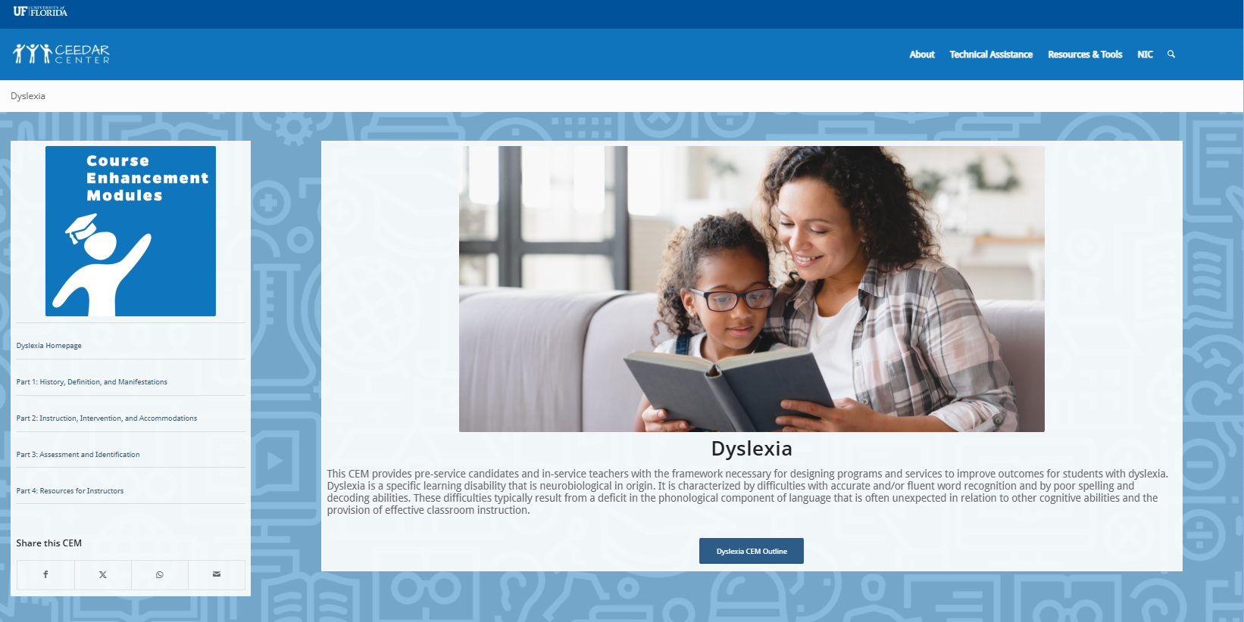
Additional Resources:
Course Enhancement Modules

Slide 30
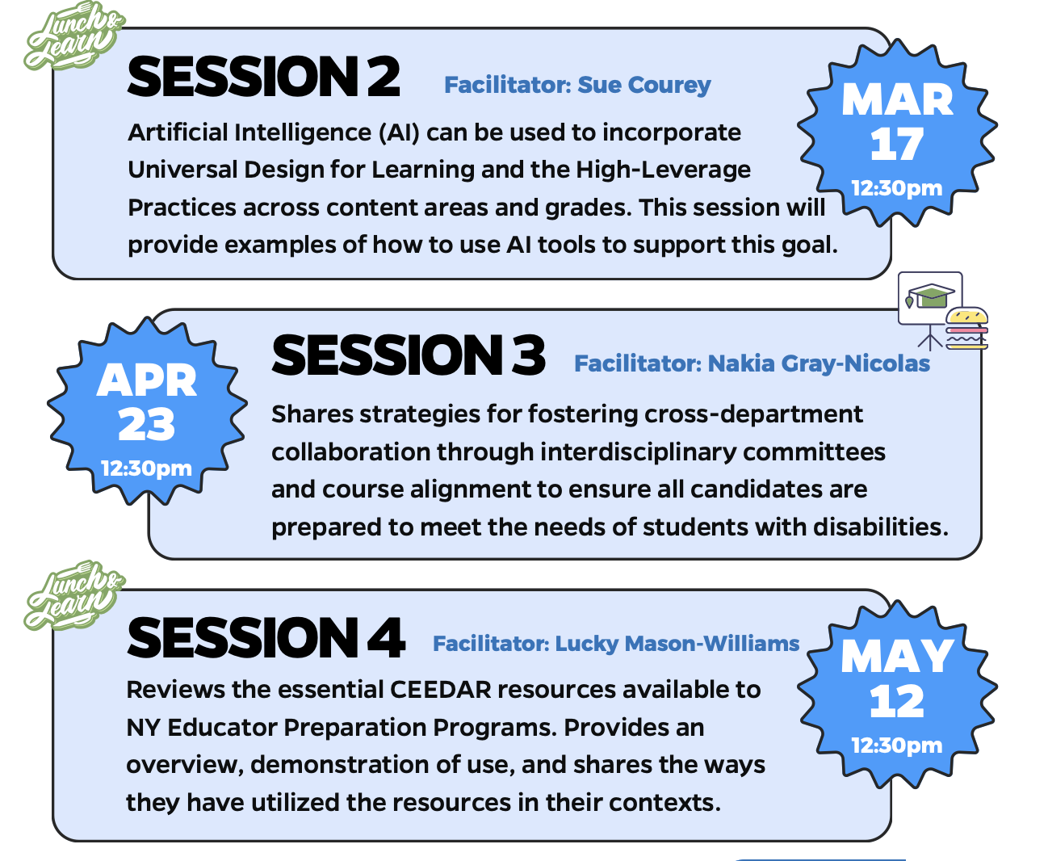
Upcoming Lunch & Learns

Slide 31

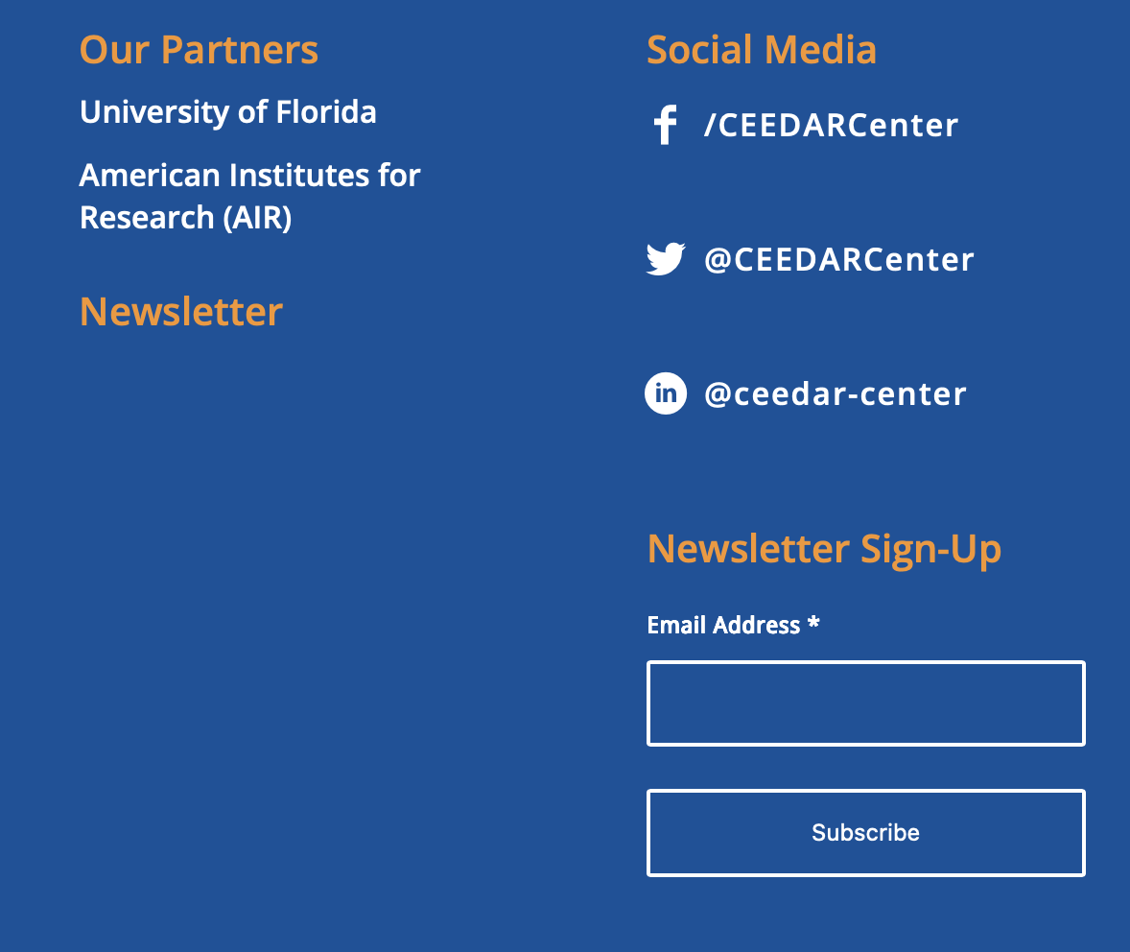
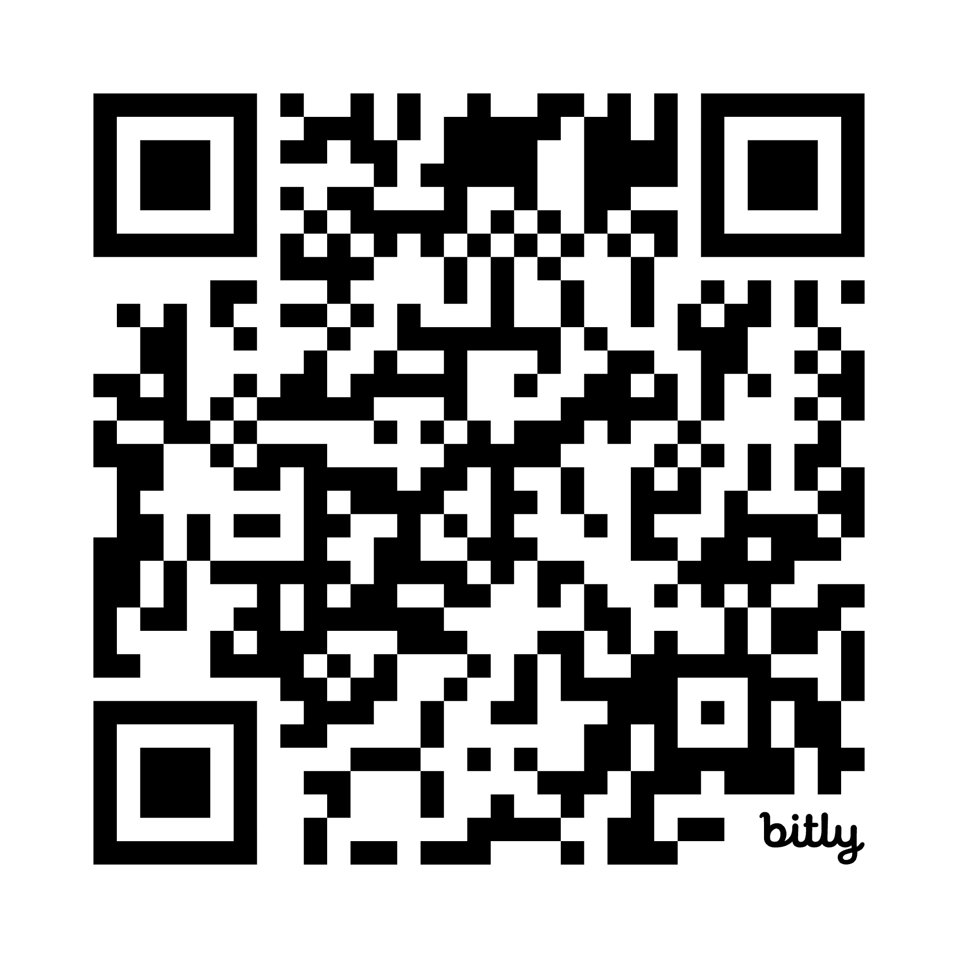
Questions?
Day Patterson
CEEDAR Center
dspatterson@gsu.edu
Shannon Budin
SUNY Buffalo State University
gormlese@buffalostate.edu
Notes:
Let me know who we want on this slide for the recording, we can add/change as needed

Slide 32

Disclaimer
This content was produced under U.S. Department of Education, Office of Special Education Programs, Award No. H325A220002. David Guardino serves as the project officer. The views expressed herein do not necessarily represent the positions or policies of the U.S. Department of Education. No official endorsement by the U.S. Department of Education of any product, commodity, service, or enterprise mentioned in this website is intended or should be inferred.

