Slide 1
Teacher Preparation
Family Engagement is a Curriculum Objective

Slide 2

Disclaimer
This content was produced under U.S. Department of Education, Office of Special Education Programs, Award No. H325A120003. Bonnie Jones and David Guardino serve as the project officers. The views expressed herein do not necessarily represent the positions or polices of the U.S. Department of Education. No official endorsement by the U.S. Department of Education of any product, commodity, service, or enterprise mentioned in this website is intended or should be inferred.

Slide 3
Presented and developed by:
Helene Fallon
Long Island Parent Center; CCI; LIU Long Island Advocacy Center - Helene.Fallon@liu.edu
Susan Barlow
Parent Network of WNY - srb@parentnetworkwny.org
Kathy McCarthy-Proulx
Starbridge Inc. - kmccarthy-proulx@starbridgeinc.org

Slide 4
Many working definitions
Variety of terms
  Parent Engagement
  Parent Involvement
  School Family Engagement
  School-Family-Community Partnerships
Key Qualities
  Effective Communication
  Meaningful, Positive, Long-term Relationships
  3 Rs: Responsive, Respectful, Rewarding

Slide 5
Research & Evidence
Based Best School Practices
  Improved Academic Performance (Joyce Epstein, Center on School, Family and Community Partnerships)
  Improvements in Student Achievement, Attendance and Behavior (Henderson and Mapp, NYU, 2002)
  Dual Capacity Framework on Family Engagement; A SEDL and US Department of Education Publication (Mapp and Kutner, 2013)
  National PTA Standards (http://www.pta.org/nationalstandards)

Slide 6

Benefits of Parent-Teacher Partnerships
  Research has proven when parents engage in their child’s education, it promotes higher student achievement (Henderson & Berla, 1995).
  Parental involvement supports their child’s well being and helps them to value their learning.
  Teachers interact with families to communicate their values, unique knowledge and skills, which makes them feel more welcomed in the classroom.

Slide 7
“Family-school partnership is really a very immature field of study compared to other aspects of education. People talk about 30 years of research and that’s very young in terms of a research enterprise. There must be an investment for research over the next 10 years, and how to develop this infrastructure in colleges and universities will be an interesting and challenging task”
**Joyce Epstein, Director
Center on School, Family and Community
Partnerships, John Hopkins University

Slide 8
Why Family Engagement??
LAWS mandate that schools work to engage families…BUT it’s the RESEARCH that tells us why!
100% of students in seminar classes stated that the sessions on family engagement increased their knowledge and would be helpful in their work.
*88% of pre-service educators surveyed stated they did not have ANY training in engaging families in the educational process.
*NYS HESC 2009

Slide 9

Knowledge is Power!
“Thank you so much for an excellent semester! I learned so much, and this class was extremely beneficial in so many ways. There are so many things from this class that I will carry with me throughout my whole career”. M.P. 2015
“I will be writing to the dean to let her know that this class is necessary for ALL education majors, it is by far the most comprehensive and practical class I have taken in my entire 6 years”. G.M. 2015

Slide 10
*Karen Mapp, Dual Capacity Framework on Family Engagement, Harvard University’s Graduate School of Education
“When families are given skills about how to question their kids – about reading, about school work – that’s what makes a huge difference.
“Without any extra money, teachers can adopt new habits: More good news phone calls, more in-class lessons that involve family concepts, more homework that’s interactive, that’s designed for kids and families to do together”

Slide 11
Family Engagement…
My vision for family engagement is ambitious… I want to have too many parents demanding excellence in their schools. I want all parents to be real partners in education with their children’s teachers, from cradle to career. In this partnership, students and parents should feel connected—and teachers should feel supported. When parents demand change and better options for their children, they become the real accountability backstop for the educational system. —
*Arne Duncan, U.S. Secretary of Education, 2010

Slide 12
Dual Capacity Building Framework for Family-School Partnerships
Family and Staff Capacity Outcomes
The Challenge
Conditions
for Success
Policy &
Program Focus
Lack of opportunities for school/program staff to build the capacity for partnership
Organizational Conditions
Systemic: across the organization
Integrated: embedded in all programs
Sustained: with resources and infrastructure
Process Conditions
Linked to Learning
Relational
Developmental vs service orientation
Collaborative
Interactive
To build and enhance the capacity of staff/families in the “4 C” areas:
Capabilities (skills and knowledge)
Connections (networks)
Cognition (beliefs, values)
Confidence (self-efficacy)
School & Program Staff Who Can:
Honor and Recognize Families’ Funds of Knowledge
Connect Family Engagement to Student Learning
Create Welcoming, Inviting Cultures
Ineffective
Family/School Partnerships
Effective
Family/School Partnerships
Supporting Student Achievement & School Improvement
Lack of opportunities for families to build the capacity for partnership
Families Who Can Negotiate
Multiple Roles:
Supporters
Encouragers
Monitors
Advocates
Decision Makers
Collaborators

Slide 13

National Standards for Family-School Partnerships
http://www.pta.org/nationalstandards

Slide 14
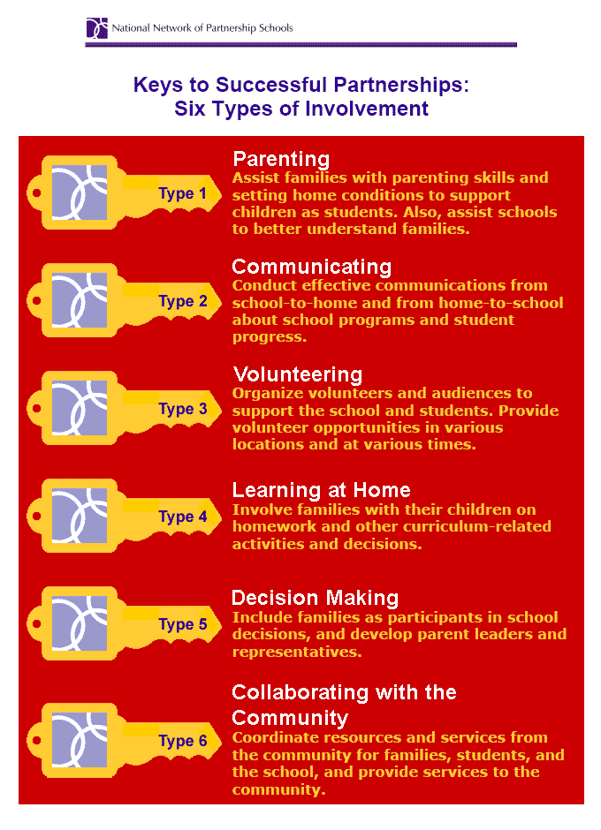
Keys to Successful Partnerships: Six Types of Involvement

Slide 15


Fundamental Values
The student/young adult should be present and participate as much as possible in any meeting regarding their services.
“Nothing about me without me”
School and family relationships must be built on trust and positive interaction.
“Your child did a great job today”
*These statements are often new concepts for
pre-service teachers.

Slide 16
Public Policy and Legislation
State Performance Indicators….
    Dispute Resolution
    Parent Engagement
    Effective Transition
    Early Intervention
    Post Secondary Options
IDEA – Individuals with Disabilities Education Act
ESSA - Every Student Succeeds Act

Slide 17
Administrators and School Leaders
Funding Requirements
  Title #1
  IDEA
Creative Funding
  Title # 3
  State Improvement Grants
School Based Decision Making Teams
Board of Education
Collaborative Partnerships

Slide 18
Key College Curriculum Topics
Effective Communication and Engagement Strategies
  Beyond the Teacher-Parent Conference
  Calling during the good times
Attitude, Disability Awareness and Sensitivity
  Parents as Speakers
  Disability Advocacy Presentations
  Special Populations
Community Supports and Services
  Tutoring
  Community Service
  Parent Centers
  Community Based and Disability Advocacy Services
Use of Technology
  E-mail/Text
  Organization
  Data gathering Practicum
Practicum
Partial - Full Semester Course Working with Families
YOU CAN DO THIS!!!

Slide 19
Challenges
Curriculum is filled – Where will it fit?
Ensure Consistency, Quality and Rigor in Practicum/ Community Based Courses.
How do we measure student success?
How do we attribute course work to long term impact?

Slide 20
Wide Range of Approaches
Family and Community Engagement incorporated throughout education curriculum
Special Topics incorporated throughout the curriculum
Course targeted only to special/general or early education majors
Required course or only an elective.
Courses on families and schools; undergraduate or graduate courses.
Elements of working with diverse populations, including parents are incorporated throughout the curriculum

Slide 21
Examples
LIU Consultation and Collaboration
Hofstra University – Collaborative Partnerships With Families of Children with Disabilities
St. John Fisher College – Presenters for a New Attitude – 4 or 5 students to each family
Canisius College – Families as Faculty
SUNY Stonybrook – Building Effective Educational Teams

Slide 22
Key Questions to ask on Family Involvement in Teacher Curriculum
What is the philosophy of your university?
  Management or Engagement
  Required or Collaborative
  Problem solving or Partnership
Where does parent engagement fit?
  Special Education or General Education
  Early Childhood, Elementary…..
A Requirement or an Elective
  Undergraduate or Graduate level
  Theory or Practice
What type of instruction makes a lasting, positive impact?
  Explicit or Infused or Both
  Separate Course or Topic in all courses
What is the outcome we want to achieve?
How do we assess our impact?

Slide 23
Family Engagement…
WHO KNEW??
If you’d like your student to be successful, you will need to rearrange the letters of parent and add the ‘r’ of relationship to turn a parent into a partner.
-Katy Ridnouer in Education Week Teacher

Slide 24
7 Ways Parents & Teachers Build Partnerships
Research show that parents and teachers build partnerships that help children succeed when they:
Engage together in meaningful dialogue
Show mutual respect
Actively listen to one another
Collaborate on issues that affect student learning
Empathize with one another
Open themselves to learning from each other
Involve students as responsible collaborators in their own learning
Source: http://mpricemitchell.visibli.com/share/f1VnHq ‘Parent Engagement: A Paradigm Shift’, Marilyn Price-Mitchell

Slide 25
A Community of Practice
“Group of people who share a concern, a set of problems or a passion about a topic, and who deepen their understanding and knowledge of this area by interacting on an ongoing basis.”
(Etienne Wenger et.al., 2002)
Please join us as we continue this conversation and identify best practices across our nation!! Are you interested??

Slide 26
We CAN make a difference!!
"I've come to the frightening conclusion that I am the decisive element in the classroom. My personal approach creates a climate. My daily mood makes the weather. As a teacher, I possess tremendous power to make a child's life miserable or joyous. I can be the tool of torture or an instrument of inspiration. I can humiliate or humor. Hurt or heal. In all situations, it is my response that decides whether a crisis will be escalated or de-escalated and a child humanized or de-humanized."
Haim Ginott, Clinical Psychologist

Slide 27
RESOURCES
WWW.WRIGHTSLAW.COM
WWW.NYSDAAN.ORG
WWW.HFRP.ORG
WWW.NYSED.GOV
WWW.IDEAPARTNERSHIP.ORG
WWW.AUTISM.ORG
WWW.LDONLINE.ORG
WWW.INCLUDENYC.ORG
WWW.PARENTNETWORKWNY.ORG
WWW.ADVOCATESFORCHILDREN.ORG
WWW.DIRECTIONSERVICE.ORG/CADRE
WWW.SINERGIANY.ORG
WWW.THELIAC.ORG
WWW.PTA.ORG
WWW.LIPARENTCENTERLIU.ORG
WWW.PARENTCENTERHUB.ORG
WWW.LIEARLYCHILDHOOLLIU.ORG
WWW.INCLUSION-NY.ORG
WWW.PARTNERSHIPSCHOOLS.ORG
WWW.ADVOCACYCENTER.COM
WWW.THELIAC.ORG
WWW.PARENTTOPARENTNYS.ORG
These are just a few of the thousands of informational sites available to us all.

