Slide 1
Welcome to
CEEDAR’s Leadership
Topical Action Group (TAG)
Thursday, April 9th, 2026
3:00-4:00 Eastern Time
Welcome to our TAG!
Participants: please change your Zoom name to
your state and name
Ex: Florida, Agatha Trunchbull
CEEDAR staff: please change your Zoom name to
CEEDAR, Your name
Notes:
Abby: Make everyone co-hosts
Speaker: Abby
3:00-01

Slide 2

Check In
Which would you choose, iced coffee on a snowy day or hot coffee in a heatwave?
Notes:
Speaker: Abby
3:00-02

Slide 3
Virtual Meeting Recording Notice
This meeting is scheduled to be recorded by CEEDAR. Your consent to the recording is requested. Participation in the meeting without expressing an objection to recording will be treated as consent. Any participant who prefers to participate via audio only should disable their video camera so only their audio will be captured. External AI bots are prohibited unless specifically authorized.
Notes:
Speaker: Abby
3:02-3:10

Slide 4
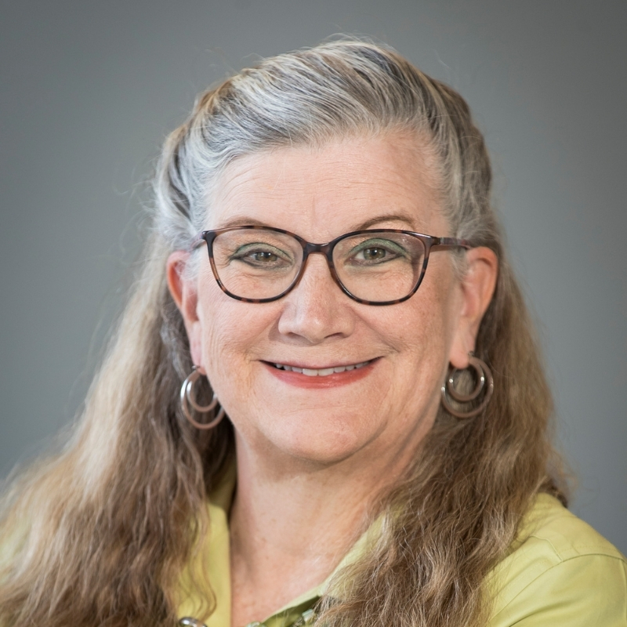
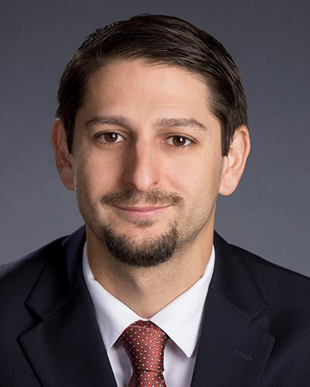
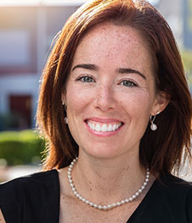
Workgroup 1 Leadership
Dr. Amie Cieminski
Associate Professor, Leadership, Policy, and Development: Educational Leadership, University of Northern Colorado
Dr. David DeMatthews
Professor, Department of Education Leadership and Policy,
The University of Texas at Austin
Dr. Emily Mulvihill
Assistant Professor, K-12 Educational Leadership Program, Student Advisor, Ed.D. Program, Colorado State University: Pueblo
Notes:
Speaker: Abby
3:02-3:10

Slide 5
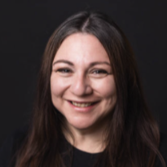
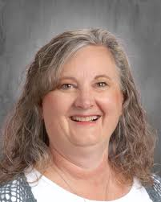
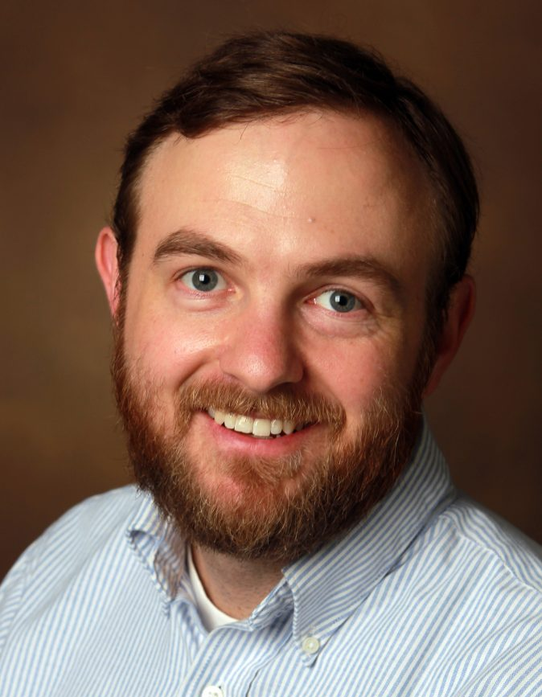
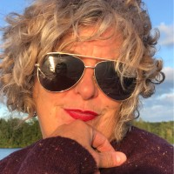
Workgroup 2 Leadership
Christina Guevara
Paraprofessional Behavior Training Specialist, Utah State Board of Education
Lorell Loosle
Director of Specialized Instruction, St. George Academy Charter School, Utah
Dr. Chris Redding
Associate Professor, Department of Educational Leadership and Policy, University of Florida
Heather Barker
Student Services Director, New Hampshire School Administrators Association
Notes:
Speaker: Abby
3:02-3:10

Slide 6





Our Partners
Notes:
Speaker: Abby
A warm thank you to our partners. Our partners are our liaisons and will share resources and can provide additional perspectives.
3:02-10

Slide 7
TAG Workgroup Goal
The Challenge:
Preparing future education leaders to cultivate inclusive schools for students with disabilities is a complex and demanding responsibility for leadership preparation programs.
Our Approach:
We leverage our TAG framework to design robust, practical learning activities that integrate seamlessly into our Course Enhancement Modules, giving you ready-to-use resources for your classes.
Notes:
Speaker: Abby
3:02-10

Slide 8
What we will not focus on:
A focus on any activity that does not prepare a principal to take action to support students with disabilities in their daily practice is not within the scope of our work.
  Broad lesson planning
  Deep dives into special education law
  Curating readings that don’t translate into practical tools
Notes:
Speaker: Abby
3:02-10

Slide 9
Leadership TAG Topics for Discussion
Date | Topic
October 9th, 3-4 EST | Professional Community for Teachers and Staff Meaningful Engagement of Families and Community
November 13th, 3-4 EST | Operations and Management School Improvement
December 11th, 3-4 EST | TAG Workgroups Session 0
January 8th, 3-4 EST | TAG Workgroups Session 1
February 12th, 3-4 EST | No meeting due to CEEDAR Convening
March 12th 3-4 EST | TAG Workgroups Session 2
April 9th, 3-4 EST | TAG Workgroups Session 3
May 14th, 3-4 EST | TAG Workgroups Session 4
June 11th, 3-4 EST | TAG Workgroups Session 5
Notes:
speaker: Abby
3:02-10

Slide 10
Today’s Agenda
Welcome and Introductions
Workgroup Goal & Approach
Project Timeline
  Session 3: Review Resources and Plan Product
Final Thoughts and Action Items
Workgroup Meeting Time
Notes:
Speaker: Abby
3:02-10

Slide 11
Project Timeline
Month | Objective | Milestone/Deliverable
January 8th | Defining Topic and Overview | Identify 2–3 key challenges school leaders face in the selected topic area. Collect examples of assignments, practice/learning opportunities, or resources you currently use that relate to the topic.
February | Asynchronous work and Office Hours | Meet asynchronously during February to complete the work outline. Facilitate email check-ins to confirm progress and deadlines. Attend optional office hours (date TBD) for TAG participants or CEEDAR staff to share updates. Outline and collect examples of assignments, practice/learning opportunities, or resources, as well as key challenges and upload into shared Google Drive.
March 12th | Review Resources | Examine resources gathered by team members from January–March. Determine gaps in the collected assignments, practice/learning opportunities, and resources
April 9th | Plan | Review resources collected January–March Identify gaps in assignments and learning opportunities Align on priorities based on March learnings Decide what to create/revise and assign owners with timelines
May 14th | Draft | Review progress of creation of resources Prepare to create an outlined draft packet that includes resources for each essential component.
June 11th | Feedback | Share drafts with full TAG group for feedback during May meeting Discuss revision based on “Keep/Change/Questions” feedback
Notes:
Speaker: Chris
3:10-15

Slide 12
Plan: April 9th
Objective: Review existing resources, identify gaps, and set direction for revising and creating new practical assignments.
In Meeting Tasks:
  Review resources collected January–March
  Identify gaps in assignments and learning opportunities
  Align on priorities based on March learnings
  Decide what to create/revise and assign owners with timelines
Outputs and Deadline: By May 14, the workgroup should have clear plans detailing who is responsible for each task and when it will be completed, along with intentional resource updates ready to share. These updates should reflect progress and any refinements made since the March meeting.
Notes:
Speaker: Chris
3:10-15

Slide 13
Invitations and Next Steps
Next IC training: May 21st, 12-1:30 pm ET, sign up here
Our next TAG Session is Thursday, May 14th, 3-4 EST This meeting will serve as Session 4 for the workgroup model. This session workgroups will:
Review progress of creation of resources
Prepare to create an outlined draft packet that includes resources for each essential component.
Notes:
Speaker: Abby
3:15-16
IC Training Sign-Up

Slide 14
Leadership TAG Evaluation
Before today’s TAG session (2:45 PM ET), you should have received an email with a link to an evaluation form for the Topical Action Group.​
Please take a few minutes before we go to breakout groups to complete the evaluation form.​
Your feedback is important to us and helps us improve the quality and relevance of our services!​
Check your email for a
link to the CEEDAR Leadership TAG
evaluation form!​
​
If you do not see it,
please check your
junk/bulk/spam folder.​
Notes:
Speaker: Abby
3:16-22

Slide 15
Workgroup Roster
Please open the Workgroup Roster and search for your name to remind you what workgroup you’re in.
Workgroup 1: Curriculum, Instruction, and Assessment (PSEL 4)
Workgroup 2: Operations and Management (PSEL 9)
Notes:
Speaker: Abby
3:22-23
CEEDAR TAG Workgroup Roster

Slide 16
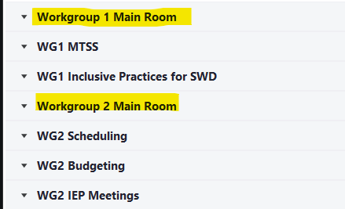
Workgroup Time!
In a moment, please select your workgroup breakout room. You will see multiple breakout rooms, but the ones I have highlighted below is where you should start today’s workgroup time.
Notes:
Speaker: Abby
3:23-4:00

