Slide 1
Thursday, March 12th, 2026
3:00-4:00 Eastern Time
Welcome to
CEEDAR’s Leadership
Topical Action Group (TAG)
Welcome to our TAG!
Participants: please change your Zoom name to
your state and name
Ex: Florida, Agatha Trunchbull
CEEDAR staff: please change your Zoom name to
CEEDAR, Your name
Notes:
Abby: Make everyone co-hosts
Speaker: Abby
3:00-01

Slide 2
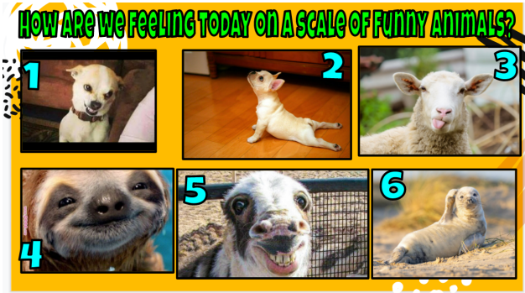
Check In
Notes:
Speaker: Abby
3:00-02

Slide 3
Virtual Meeting Recording Notice
This meeting is scheduled to be recorded by CEEDAR. Your consent to the recording is requested. Participation in the meeting without expressing an objection to recording will be treated as consent. Any participant who prefers to participate via audio only should disable their video camera so only their audio will be captured. External AI bots are prohibited unless specifically authorized.
Notes:
Speaker: Abby
3:02-3:10

Slide 4
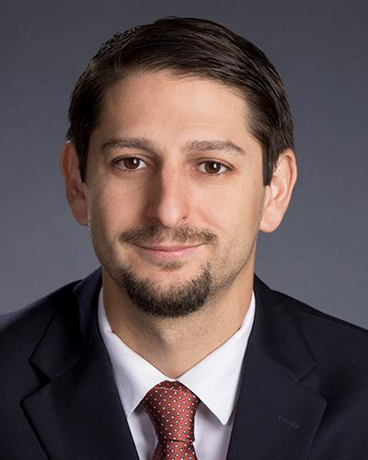
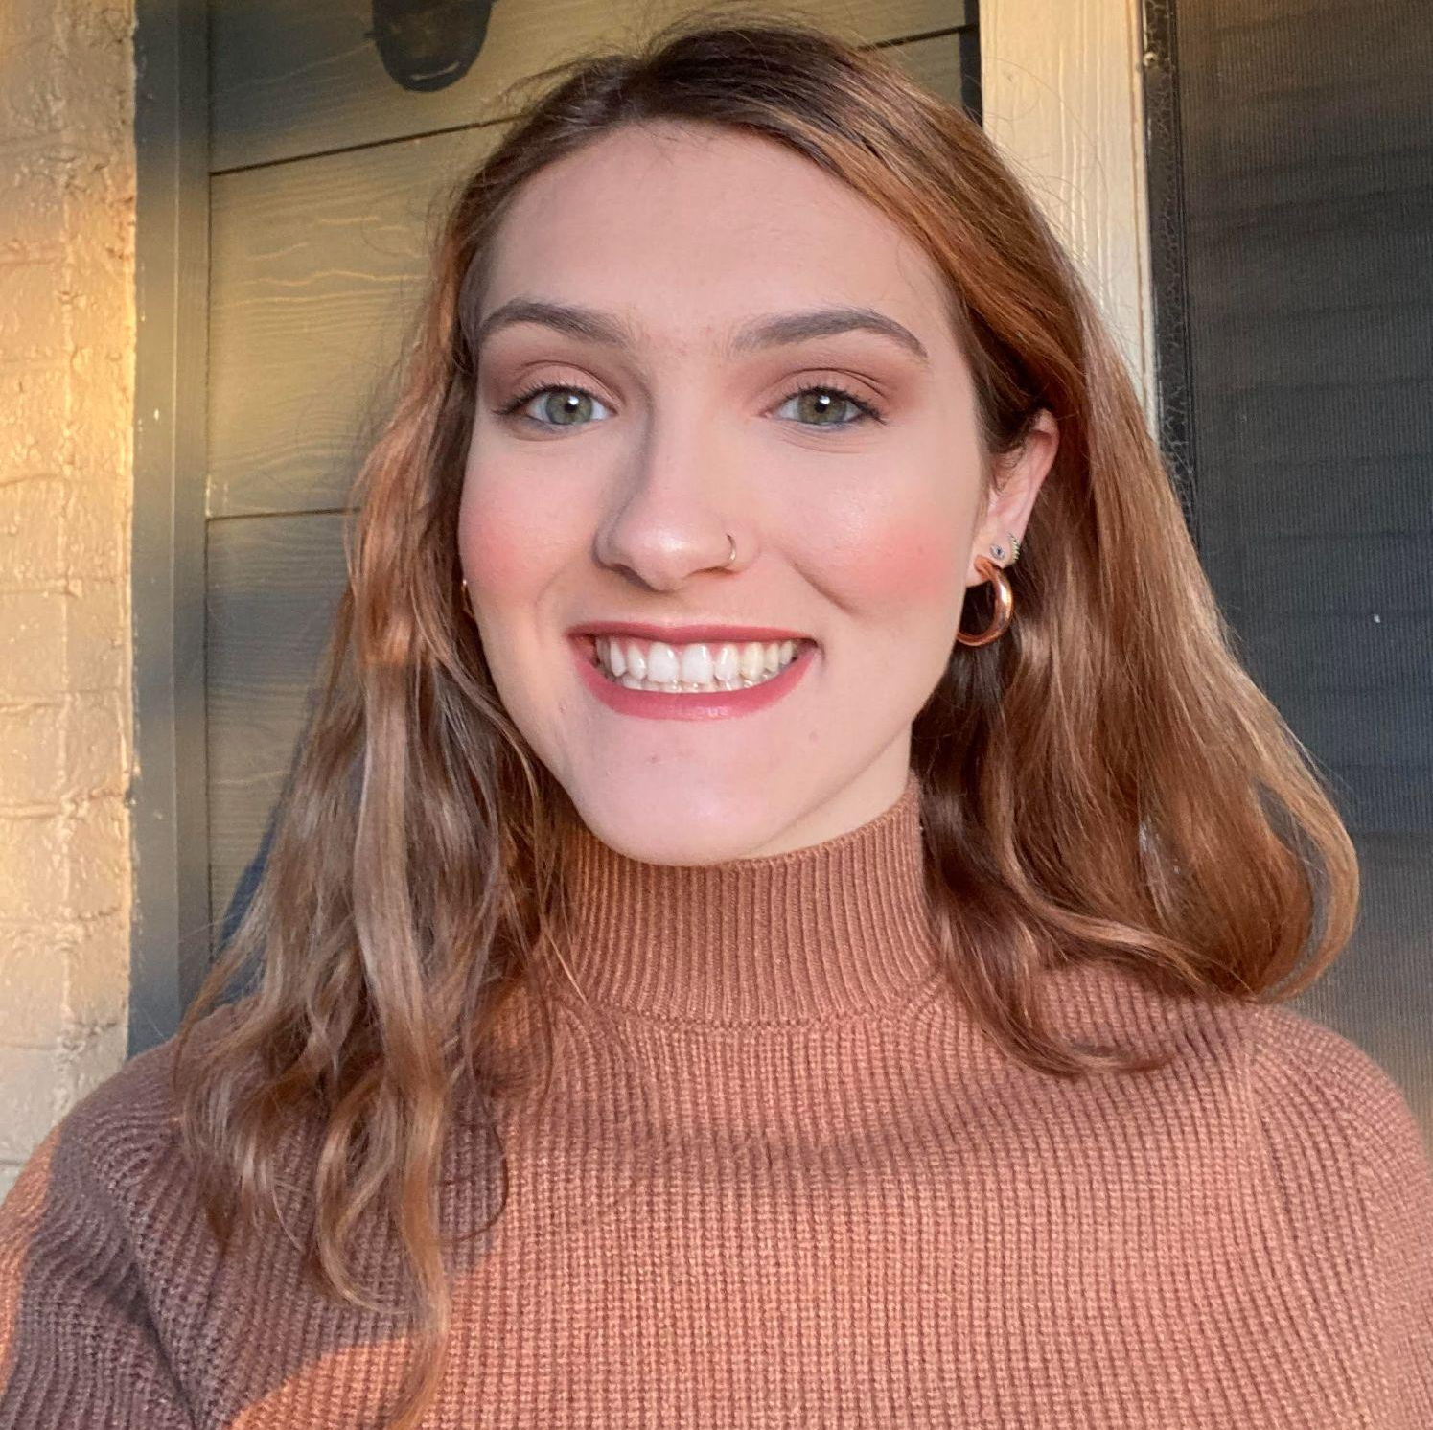
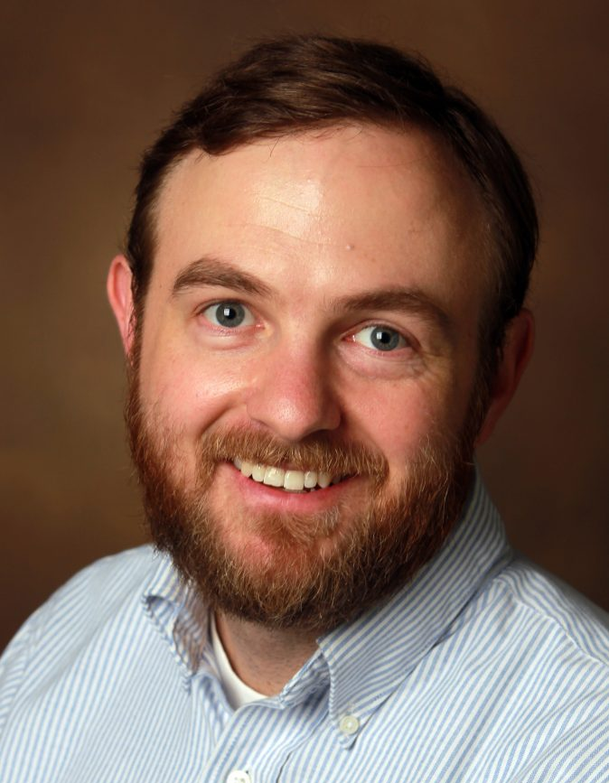
Welcome & Introductions
Dr. David DeMatthews
Professor, Department of Education Leadership and Policy,
The University of Texas at Austin
Abby Berner
Engagement Specialist, CEEDAR, Research Assistant, American Institute for Research (AIR)
Dr. Chris Redding
Associate Professor, Department of Educational Leadership and Policy, University of Florida
Notes:
Speaker: Abby
3:02-3:10

Slide 5





Our Partners
Notes:
Speaker: Abby
A warm thank you to our partners. Our partners are our liaisons and will share resources and can provide additional perspectives.
3:02-10

Slide 6
TAG Workgroup Goal
The Challenge:
Preparing future education leaders to cultivate inclusive schools for students with disabilities is a complex and demanding responsibility for leadership preparation programs.
Our Approach:
We leverage our TAG framework to design robust, practical learning activities that integrate seamlessly into our Course Enhancement Modules, giving you ready-to-use resources for your classes.
Notes:
Speaker: Abby
3:02-10

Slide 7
What we will not focus on:
A focus on any activity that does not prepare a principal to take action to support students with disabilities in their daily practice is not within the scope of our work.
  Broad lesson planning
  Deep dives into special education law
  Curating readings that don’t translate into practical tools
Notes:
Speaker: Abby
3:02-10

Slide 8
Leadership TAG Topics for Discussion
Date | Topic
October 9th, 3-4 EST | Professional Community for Teachers and Staff Meaningful Engagement of Families and Community
November 13th, 3-4 EST | Operations and Management School Improvement
December 11th, 3-4 EST | TAG Workgroups Session 0
January 8th, 3-4 EST | TAG Workgroups Session 1
February 12th, 3-4 EST | No meeting due to CEEDAR Convening
March 12th 3-4 EST | TAG Workgroups Session 2
April 9th, 3-4 EST | TAG Workgroups Session 3
May 14th, 3-4 EST | TAG Workgroups Session 4
June 11th, 3-4 EST | TAG Workgroups Session 5
Notes:
speaker: Abby
3:02-10

Slide 9
Today’s Agenda
Welcome and Introductions
Workgroup Goal & Approach
Project Timeline
  Session 2: Review Resources
Final Thoughts and Action Items
Workgroup Meeting Time
Notes:
Speaker: Abby
3:02-10

Slide 10
Project Timeline
Month | Objective | Milestone/Deliverable
January 8th | Defining Topic and Overview | Identify 2–3 key challenges school leaders face in the selected topic area. Collect examples of assignments, practice/learning opportunities, or resources you currently use that relate to the topic.
February | Asynchronous work and Office Hours | Meet asynchronously during February to complete the work outline. Facilitate email check-ins to confirm progress and deadlines. Attend optional office hours (date TBD) for TAG participants or CEEDAR staff to share updates. Outline and collect examples of assignments, practice/learning opportunities, or resources, as well as key challenges and upload into shared Google Drive.
March 12th | Review Resources | Examine resources gathered by team members from January–March. Determine gaps in the collected assignments, practice/learning opportunities, and resources
April 9th | Plan | Decide which resources to create and assign roles with timelines.
May 14th | Draft | Review progress of creation of resources Prepare to create an outlined draft packet that includes resources for each essential component.
June 11th | Feedback | Share drafts with full TAG group for feedback during May meeting Discuss revision based on “Keep/Change/Questions” feedback
Notes:
Speaker: Chris
3:10-15

Slide 11
Review Resources: March 12th
Objective: Identify gaps in resources, create plan for revision of current resources and creation of new resources, assign people.
In Meeting Tasks:
  Review resources that currently exist collected from January-March by team members
  Determine gaps in the collected assignments, practice/learning opportunities, and resources
Outputs and Deadline: Workgroup participants will review and reflect on the materials shared during the March 12 meeting. By the April 9 meeting, the workgroup will be prepared to collectively decide on the direction of practical assignments, informed by their learnings, discussions, and key findings from the March session.
Notes:
Speaker: Chris
3:10-15

Slide 12
Invitations and Next Steps
Next IC training: March 19th, 11-12:30 pm ET, sign up here
Our next TAG Session is Thursday,April 9th, 3-4 EST This meeting will serve as Session 3 for the workgroup model. This session workgroups will:
Decide which resources to create and assign roles with timelines.
Outline plans detailing who is responsible for each task and when it will be completed
Prepare for intentional updates ready to share at May meeting
Notes:
Speaker: Abby
3:15-17
IC Training Sign-Up

Slide 13
Workgroup Roster
Please open the Workgroup Roster and search for your name to remind you what workgroup you’re in.
Workgroup 1: Curriculum, Instruction, and Assessment (PSEL 4)
Workgroup 2: Operations and Management (PSEL 9)
Notes:
Speaker: Abby
3:17-19
CEEDAR TAG Workgroup Roster

Slide 14
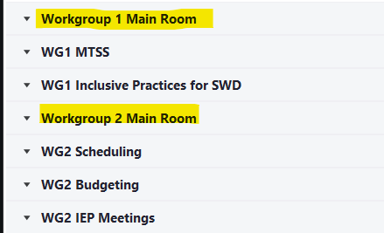
Workgroup Time!
In a moment, please select your workgroup breakout room. You will see multiple breakout rooms, but the ones I have highlighted below is where you should start today’s workgroup time.
Notes:
Speaker: Abby
3:19-4:00

