Slide 1
Session 6: Registered Principal Apprenticeship Programs Preparing Effective Leaders
Featuring the Rhode Island Registered Apprenticeship Principal Pathway (RIRAPP)
April 21, 2026
Notes:
Speaker: Abby
3:00 – 3:03

Slide 2
Housekeeping
Please add your organization to your Zoom name:
In the Participants list, click the “More“ button by your name
Select “Rename” from the drop-down menu
Add a short version of your organization name after your name, then click “OK”
Today’s session is being recorded.
Please remain on mute when not speaking to minimize noise.
We encourage you to turn your video camera on.
Share questions and comments in the chat box.
If you have any technical issues, please contact Abby Berner at aberner@air.org.
Notes:
Speaker: Abby
3:00 – 3:03

Slide 3
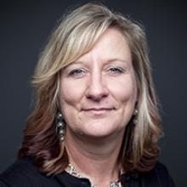
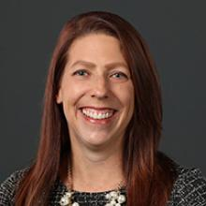

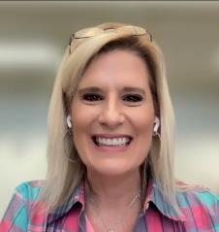
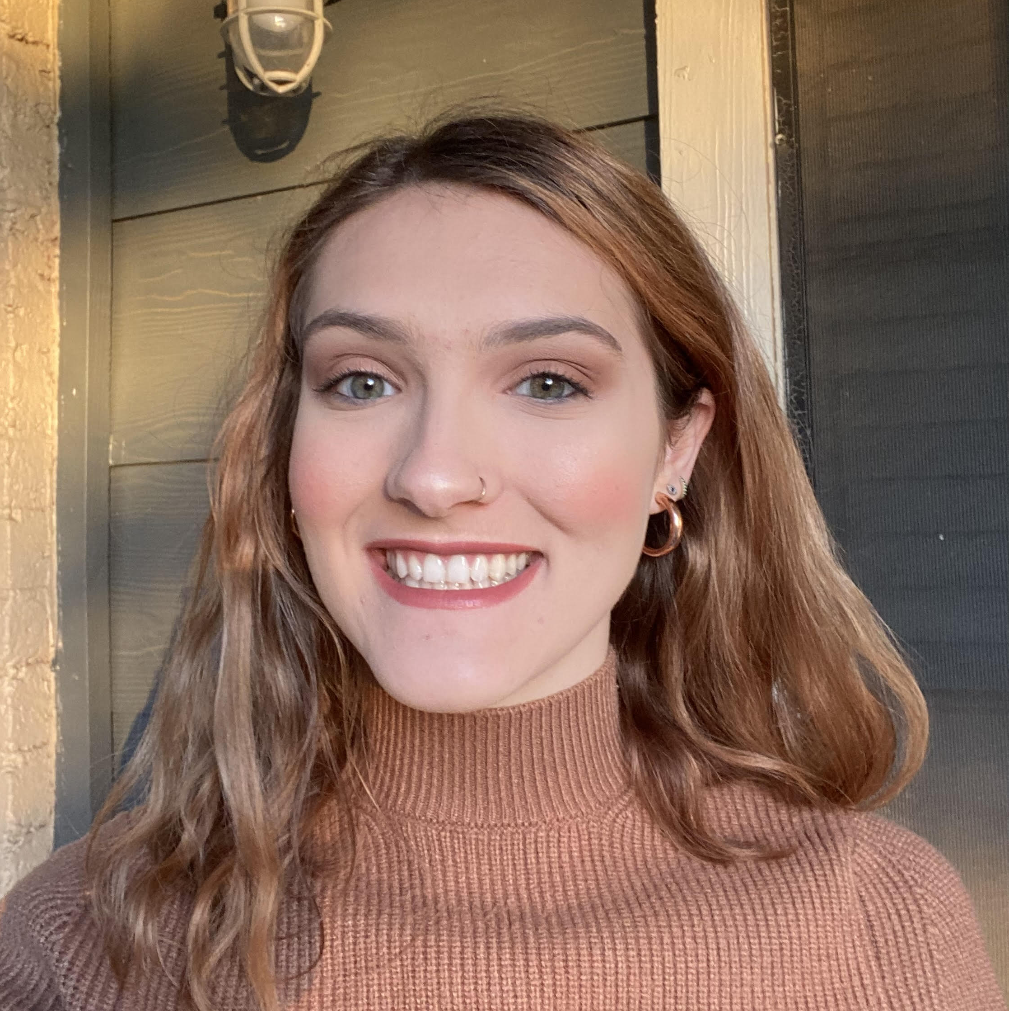
Welcome and Introductions
Lynn Holdheide
Content Expert,
CEEDAR
Managing TA Consultant, American Institutes for
Research (AIR)
Cheryl Krohn
Content Expert, CEEDAR
Senior TA Consultant, American Institutes for Research (AIR)
Meghan Wills
Content Expert, CEEDAR
Senior TA Consultant, American Institutes for Research (AIR)
Lisa White
Facilitator and
RTAP Coordinator, CEEDAR
Abby Berner
Engagement Specialist, CEEDAR
Research Assistant, American Institutes for Research (AIR)
Notes:
Speaker: Abby
3:00 – 3:03

Slide 4

Agenda
Resource Spotlight
Educational Leadership Apprenticeship Panel
Apprenticeship Program Spotlight: Rhode Island Registered Apprenticeship Principal Pathway (RIRAPP)
Q & A
Notes:
Speaker: Abby
3:00 – 3:03

Slide 5

CEEDAR RTAP Affinity Group Purpose
Promote the RTAP pathway as a recruitment and retention strategy for special education teachers to address teacher shortages.
Foster a sense of community, create a shared learning space, and promote mutual support for partners interested in learning more about RTAPs to prepare special education teachers.
Notes:
Speaker: Abby
3:00 – 3:03

Slide 6
Registered Principal Apprenticeship Landscape
In July 2023, the U.S. Department of Labor approved the K-12 principal occupation as eligible for Registered Apprenticeship and authorized the nation’s first registered principal apprenticeship.
Current states with registered principal apprenticeship programs include, but are not limited to:
  North Dakota
  Virginia
  Tennessee (Austin Peay State University)
  Rhode Island
  Alaska
Notes:
3:03 – 3:13
Only share these links if requested
https://www.nasbe.org/states-start-up-registered-principal-apprenticeships/; https://www.nasbe.org/states-launch-and-lead-principal-registered-apprenticeship-programs/
https://www.gmu.edu/news/2025-11/principal-registered-apprenticeship-program-hopes-grow-future-school-leaders
https://www.clee.org/news/program-highlights/prn-ceedar-2026/
https://ride.ri.gov/press-releases/ride-among-first-nation-launch-registered-apprenticeship-program-aspiring-school-principals
https://www.apsu.edu/news/austin-peay-launches-tennessee-first-principal-apprenticeship-program.php#:~:text=%E2%80%94%20Austin%20Peay%20State%20University's%20Eriksson,earn%20while%20you%20learn%E2%80%9D%20model.
https://www.youtube.com/watch?v=ZX3m7jzGEsc

Slide 7
National Guideline Standards
What are National Guideline Standards (NGS)?
  They define nationally recognized benchmarks for training, supervision, and competency development in a specific occupation.
Two sets of National Guideline Standards for Principal Apprenticeships including:
  Approved by US DOL: North Dakota Department of Public Instruction, National Center for Grow Your Own, Council for Chief State School Officers (with letters of support from NAESP, NASSP, ND Council for Educational Leadership, North Dakota United)
  Pending approval by US DOL: Pathways Alliance (consortium of organizations)
Notes:
3:03 – 3:13
National Guideline Standards (NGS) are model apprenticeship frameworks developed by national organizations—such as industry associations, labor unions, or large employers—to help create consistent, high‑quality Registered Apprenticeship Programs (RAPs) across the country.
They are not apprenticeship programs themselves. Instead, they serve as a blueprint that local employers or training providers can adopt and register with the U.S. Department of Labor or a State Apprenticeship Agency.
States and districts can use the NGS to accelerate approval of their own principal apprenticeship programs. National Guidelines for Apprenticeship Standards provide a template that companies, educational institutions, associations, and labor unions can use to create high-quality apprenticeship programs that comply with federal regulations.
ND
Pathways: https://www.thepathwaysalliance.org/principal-apprenticeship-ngs#:~:text=2025%20National%20Guideline%20Standards,that%20meet%20nationally%20recognized%20benchmarks.

Slide 8
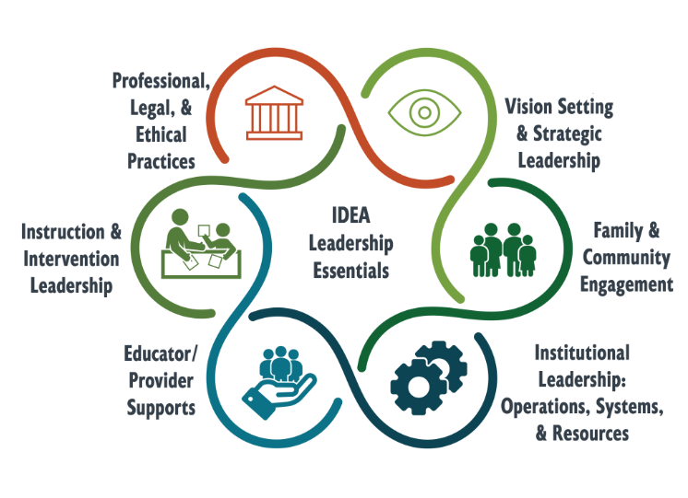

The IDEA Leadership Essentials
Each “essential” includes:
Action-oriented statement
Core mindset
Indicators of success
https://bit.ly/LeadEss
Notes:
3:03 – 3:13
https://bit.ly/LeadEss
3–5 min
Over the past year, our knowledge development team has analyzed existing leadership frameworks, standards, and guidance spanning the birth–grade 12 continuum, as well as recent literature identifying the most impactful leadership behaviors that positively influence children’s outcomes. After crosswalking key domains from these frameworks and the literature, we identified a set of evidence-based leadership knowledge and skills. We have organized this set of evidence-based leadership knowledge and skills into 6 leadership essentials, as shown here.
The IDEA Leadership Essentials describe the knowledge, skills, and mindsets PreK–12 leaders need to effectively implement the Individuals with Disabilities Education Act (IDEA) in programs and schools. Grounded in data and evidence, the Essentials specify the leaders’ role in promoting an ecosystem that leads to progress for all children, including those with disabilities. Each of the Essentials is organized to include an action-oriented statement, a core mindset, and indicators of successful demonstration of the administrator’s IDEA responsibilities.
Underscore that these are not new but, rather, a synthesis.
Diagnostic tool grounded in these Essentials that will also be revisited intentionally throughout our time today.

Slide 9
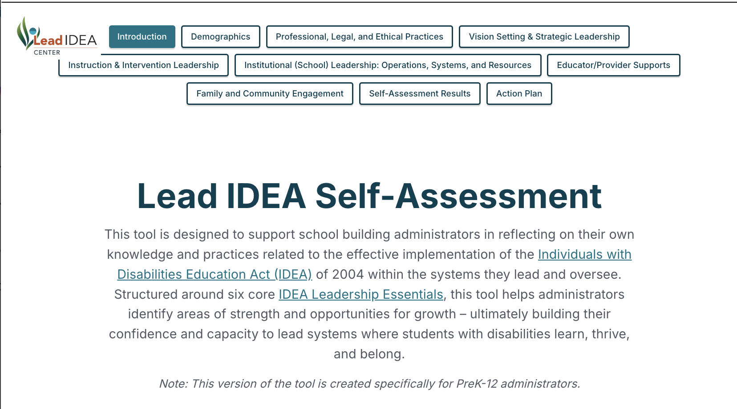

Let’s Explore the Lead IDEA Self-Assessment
Visit lead-idea.org/idea-essential or scan the QR code to get started!
Notes:
3:03 – 3:13
Demo tool live – Lynn will share her screen
Lead IDEA Self-Assessment | Zite

Slide 10

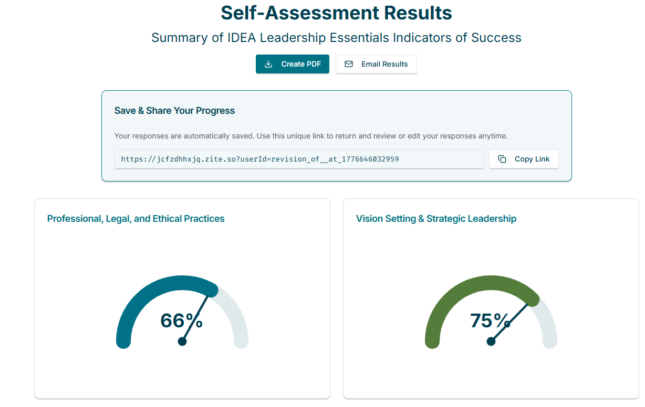
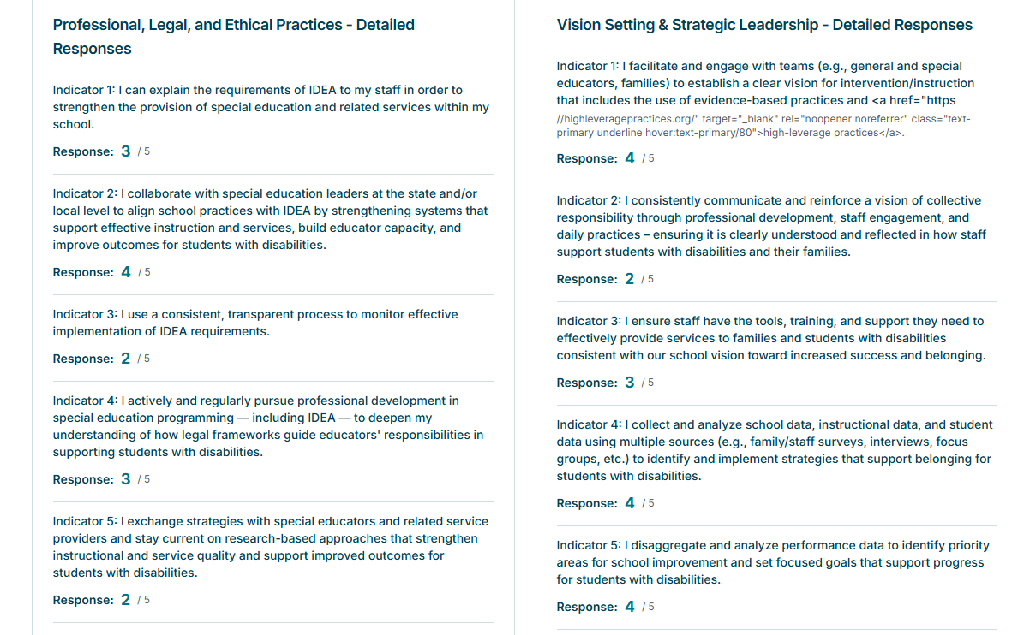
Lead IDEA Self Assessment
Notes:
3:03 – 3:13

Slide 11

Resources
LEAD IDEA and other partner centers have several resources that can support your registered principal apprenticeship efforts!
Notes:
Abby will send handout
3:03 – 3:13
Created image from copilot

Slide 12
Educational Leadership Apprenticeship Program Spotlight:
Rhode Island Registered Apprenticeship Principal Pathway (RIRAPP)
Notes:
Speaker: Lisa
3:13 – 3:30

Slide 13
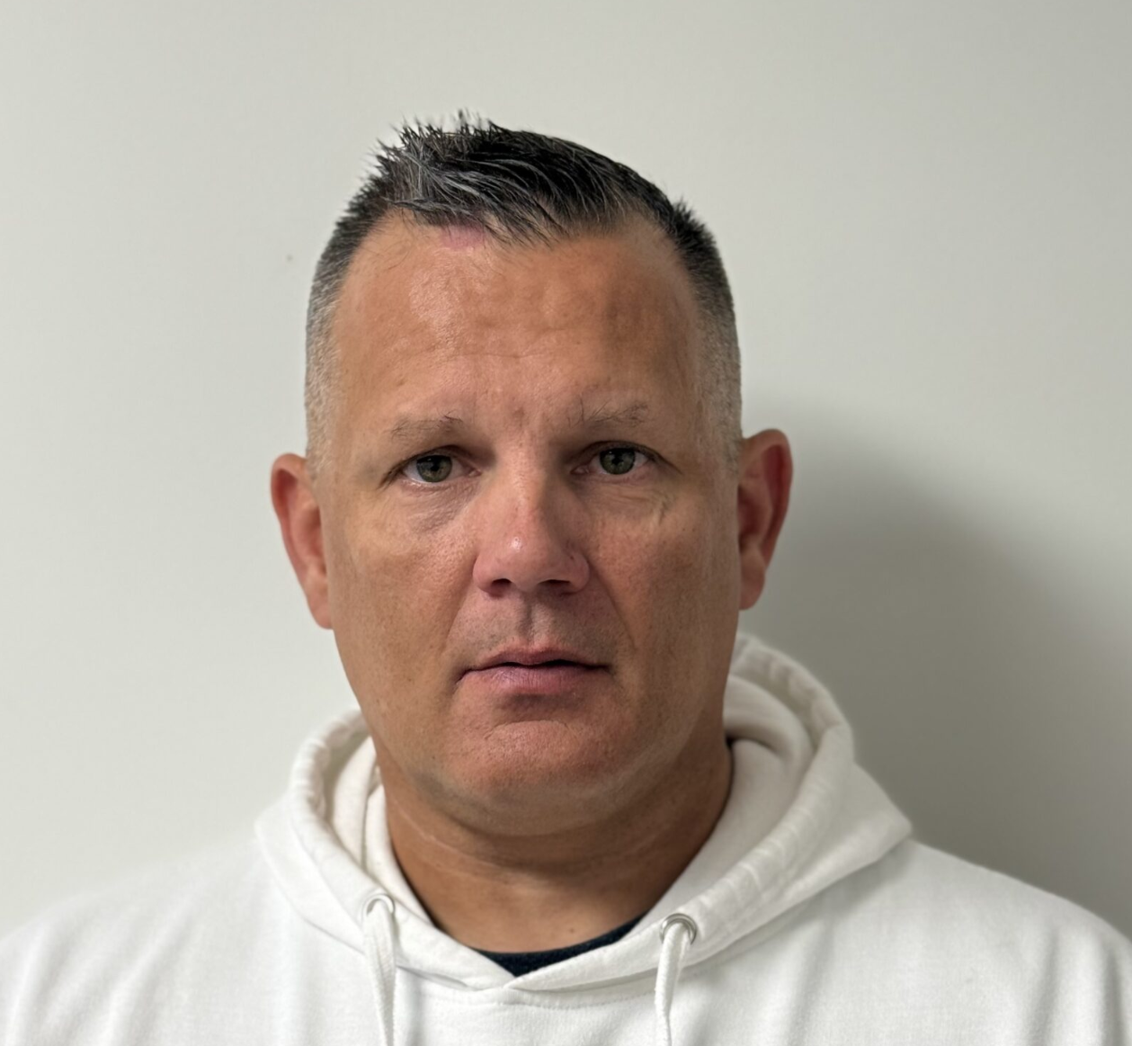

Meet the Panelists
John Fretts
Juanita Sanchez Educational Complex
Providence Public School District
johnfretts@clee.org
Peter Siner
Nathanael Greene Middle School
Providence Public School District
petersiner@clee.org
Notes:
Speaker: Lisa
3:13 – 3:30

Slide 14

Meet the Presenter
Joe Pirraglia
Director of Principal Preparation Programs
CLEE
josephpirraglia@clee.org
Notes:
Speaker: Lisa introducing Joe
3:30 – 3:50

Slide 15
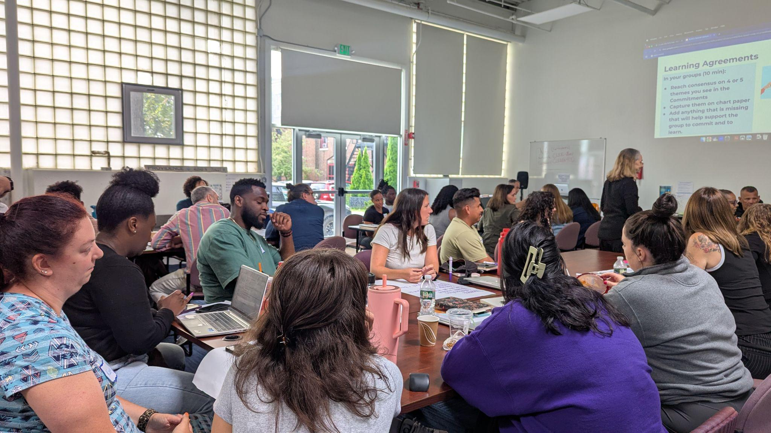
Rhode Island Registered Apprenticeship Principal Program (RIRAPP)
Joe Pirraglia | Director of Principal Preparation Programs | CLEE
Notes:
3:30 – 3:50

Slide 16

RIRAPP Launch and Funding
Origin: 2024 RFP from RI Dept of Ed (RIDE)
Purpose: Create sustainability in the leadership pipeline
Sponsor: RIDE officially sponsors and funds the program through a US Dept of Labor initiative
Candidate Support: Covers tuition, books, and licensure assessment
Strategic Support: Alignment to Registered Apprenticeship requirements provided by Building Futures RI (RI Dept of Labor)
Notes:
3:30 – 3:50

Slide 17
Launching RIRAPP 2025/2026
The Cohort: Launched with 5 apprentices from 4 districts
Apprentice Role: Assistant Principals or Deans
The Commitment: Participants commit to serving 3 years in a RI Building Administrator certified position post-completion
Certification: RIDE created a specific "Registered Apprenticeship Preliminary Certificate"
Notes:
3:30 – 3:50

Slide 18
Integrated Instructional Program
Duration: A fully integrated, 12-month program
The Core: Connects learning directly to daily leadership practice
Delivery Methods:
  Peer and network learning sessions
  Individualized learning through personal Learning Plans
  Formative and summative residency assignments
  Session prepwork including reading and reflection
Notes:
3:30 – 3:50

Slide 19
Principal Residency Network Ecosystem
A Unified Network: RIRAPP is a one-year pathway within the Principal Residency Network (PRN)
PRN Pathway Options: PRN includes Classic (1-year), Extended Time (2-year), and Leader of Record (2-year) pathways
Collaborative Learning: Apprentices join a larger cohort of PRN participants (5 of 35 in ‘25/’26)
Notes:
3:30 – 3:50

Slide 20
Grounded in Research and Standards
Framework: Grounded in Core Leadership Practices and RI Standards for Educational Leaders (RISEL)
Milestones / Wage Progressions:
  Summer: Completion of all summer requirements
  Midyear: Demonstrate proficiency in 50% of Competencies
  End of Year: Demonstrate proficiency in 100% of Competencies
Rating Method: Mentors rate apprentices based on observations, learning plan experiences, and portfolio evidence
Notes:
3:30 – 3:50

Slide 21
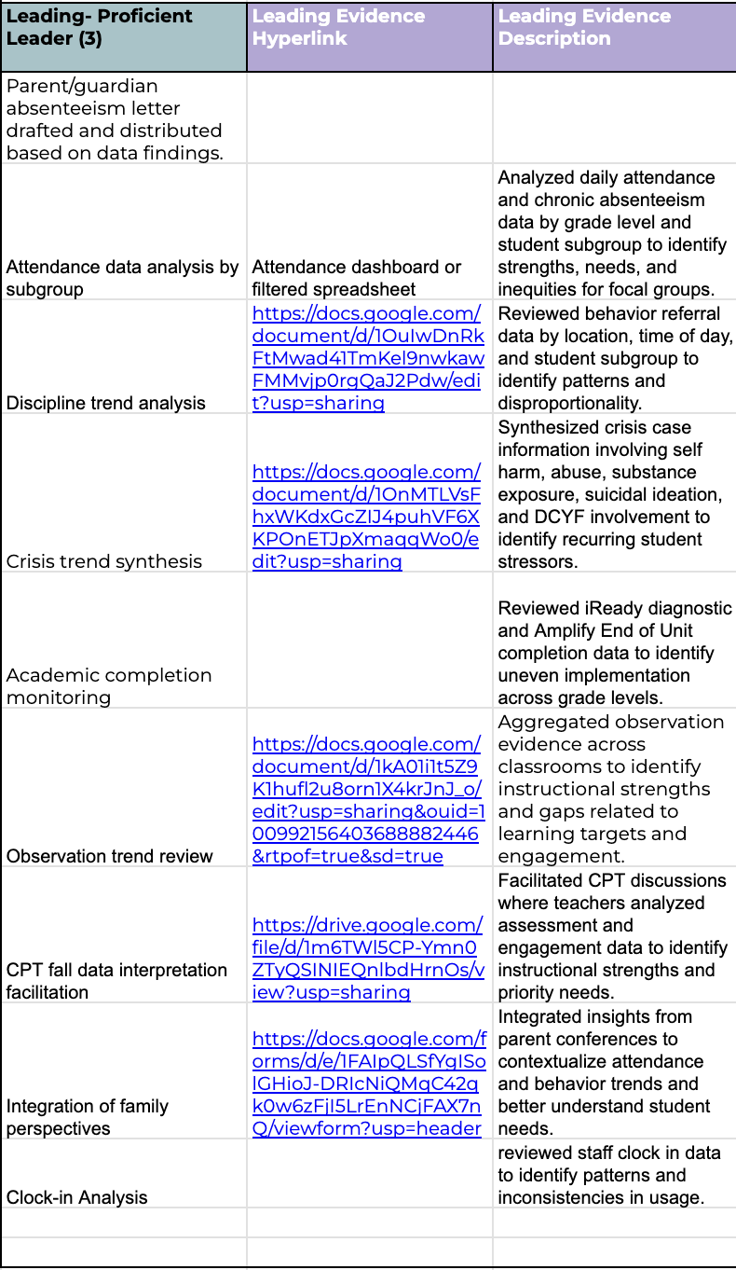
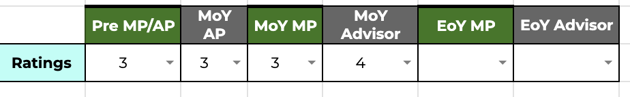
Example Learning Plan
gaps for focal groups
Notes:
3:30 – 3:50

Slide 22
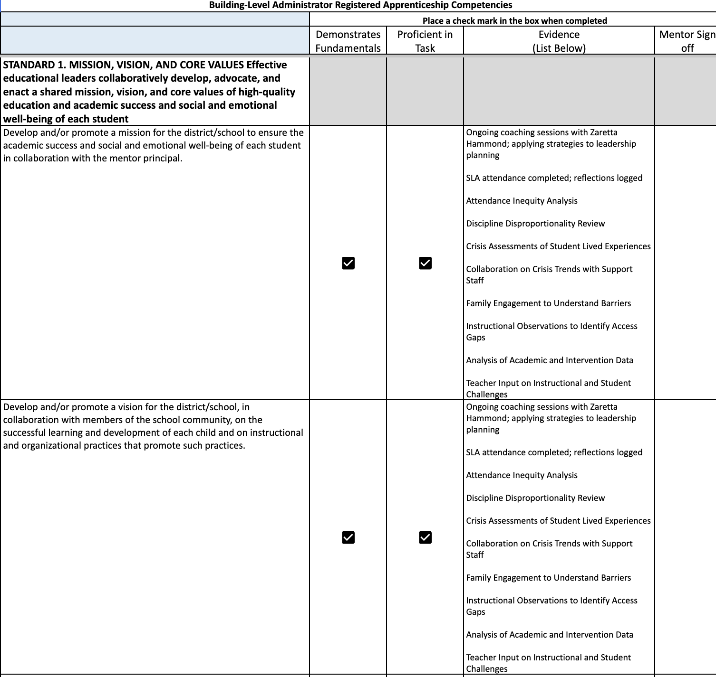
Apprenticeship Competencies Assessment
Attendance Difference Analysis
Attendance Difference Analysis
Notes:
3:30 – 3:50

Slide 23
Continuous Improvement Plan (CIP)
Analyze: Identify a focal group using disaggregated data
Investigate: Conduct root cause analysis with a team
Implement: Lead three cycles of "change ideas" aligned to high-leverage practices
Evaluate: Assess impact on focal and peer groups to address achievement gaps
Notes:
3:30 – 3:50

Slide 24
Focal Group Identification
Target Area: Grades 2–3 ELA achievement
The Concern: Only 5% of Students with Disabilities (SWD) met ELA proficiency in 2024–25, compared to 29% of peers
The Gap: A 24-point disparity highlighting a lack of access to effective literacy instruction
Group Sizes: Focal Group: 19 | Peer Group: 130
Notes:
3:30 – 3:50

Slide 25
Root Cause Analysis
Category | Identified Barriers
Pedagogy | Inconsistent structured literacy routines (phonics/decoding)
Access | Frequent pull-out services reduce exposure to grade-level standards
Teacher Capacity | Variability in expertise; high proportion of inexperienced staff
Systems | Scheduling challenges limit co-planning between Gen Ed and SPED
Notes:
3:30 – 3:50

Slide 26
Cycle 1 | Structured Literacy
Change Idea: Daily systematic, multisensory phonics and fluency routines with intentional scaffolds and biweekly DIBELS checks
High-Leverage Practices: HLP 16 (Explicit Instruction) and HLP 6 (Data-Driven Adjustments)
Initial Results: Increased accuracy in phonics/dictation; DIBELS growth in NWF and ORF
Notes:
3:30 – 3:50

Slide 27
Cycle 2 | Building Consistency
Change Idea: Marked lesson plans with timestamps and daily leader presence during foundational reading blocks
High-Leverage Practices: HLP 12 (Design Instruction) and HLP 1 (Collaboration)
Initial Results: Growth was incremental rather than accelerated; most students remain below benchmark
Notes:
3:30 – 3:50

Slide 28
Next Steps for CIP
Cycle 3: Implement and assess final change ideas
Summative Paper: Complete the Cycles of Improvement Paper
Final Data Analysis: Analyze BOY vs. EOY data to measure overall impact
Notes:
3:30 – 3:50

Slide 29
Lessons Learned from Implementation
Role Challenges: Assistant Principals / Deans often struggle to gain "Principal-level" experiences
Workload: Balancing first-time as an administrator with PRN is a "heavy load"
Systemic Barriers:
  HR departments need support regarding wage progressions and apprenticeship certifications
  Recruitment timelines for AP positions do not currently align with PRN admission deadlines
Notes:
3:30 – 3:50

Slide 30
Next Steps
Mentor Support: Develop a dedicated Mentor Orientation to provide the additional guidance mentors need to support gradual release
Right Sizing Assessments: Reviewing formative/summative work to create non-narrative ways for apprentices to demonstrate mastery
District Partnerships: Collaborating with RIDE and Building Futures RI to support districts with recruitment, HR, and certification
Notes:
3:30 – 3:50

Slide 31

Questions and Discussion
Notes:
Speaker: Lisa
3:50 – 3:59

Slide 32
Disclaimer
This content was produced under U.S. Department of Education, Office of Special Education Programs, Award No. H325A220002. David Guardino serves as the project officer. The views expressed herein do not necessarily represent the positions or policies of the U.S. Department of Education. No official endorsement by the U.S. Department of Education of any product, commodity, service, or enterprise mentioned in this website is intended or should be inferred.

