Slide 1

Insight to Action: Using AI to Enhance Teaching and Learning
https://tinyurl.com/AIPreCon
CEEDAR Center Cross-State Convening 2026
James D. Basham, Ph.D.
Center for Innovation Design and Digital Learning (CIDDL)
University of Kansas
Disclaimer: The contents of this presentation were developed by the presenters under award #H327F200008 H327F250003. They do not represent the policy of the Department of Education. Do not assume endorsement by the Federal Government.

Slide 2

Quick Introduction
James (Jamie) Basham, Ph.D.,
Professor of Special Education
Director, Center for Innovation Design and Digital Learning (CIDDL)
University Of Kansas
Learn more at CIDDL.org

Slide 3

The Center for Innovation, Design, and Digital Learning (CIDDL) serves as the National Center to Improve Faculty Capacity to use Educational Technology in Special Education Personnel and Leadership Preparation Programs.
Learn more at https://ciddl.org/
Disclaimer: The contents of this presentation were developed by the presenters under award #H327F200008, #H327F250003. They do not represent the policy of the Department of Education. Do not assume endorsement by the Federal Government.
Learn more at CIDDL.org

Slide 4

CIDDL is Focused on…
Increasing knowledge, capacity, adoption, and integration of innovative technologies (including educational, assistive, and artificial intelligence) within special education personnel and leadership preparation programs;
Increasing the number of faculty who keep up with technological innovations and research;
Increasing the number of special education and leadership personnel graduates well-prepared to integrate technologies and innovative technology practices.
Learn more at CIDDL.org

Slide 5
Balancing three priorities
1. Supporting Research on What Works
We need sustained, rigorous research on effective AI-enhanced practices for students with disabilities, their families—and the faculty and educators who serve them. The AI is moving fast; the evidence base can’t lag behind.
2. Helping Build the Nation’s Pipeline of AI-Ready Educators
CIDDL is uniquely positioned to support personnel preparation in educational technology, AI, and assistive technology. We aim to support pathways that prepare future teachers, leaders, and researchers for AI-infused learning environments.
3. Respond Emerging AI Needs from Higher Education, but also K–12 Systems
Institutions of higher education, states, and schools districts are coming to us with urgent questions about AI integration, policy, procurement, accessibility to support of all students, including those with disabilities and their families.

Slide 6
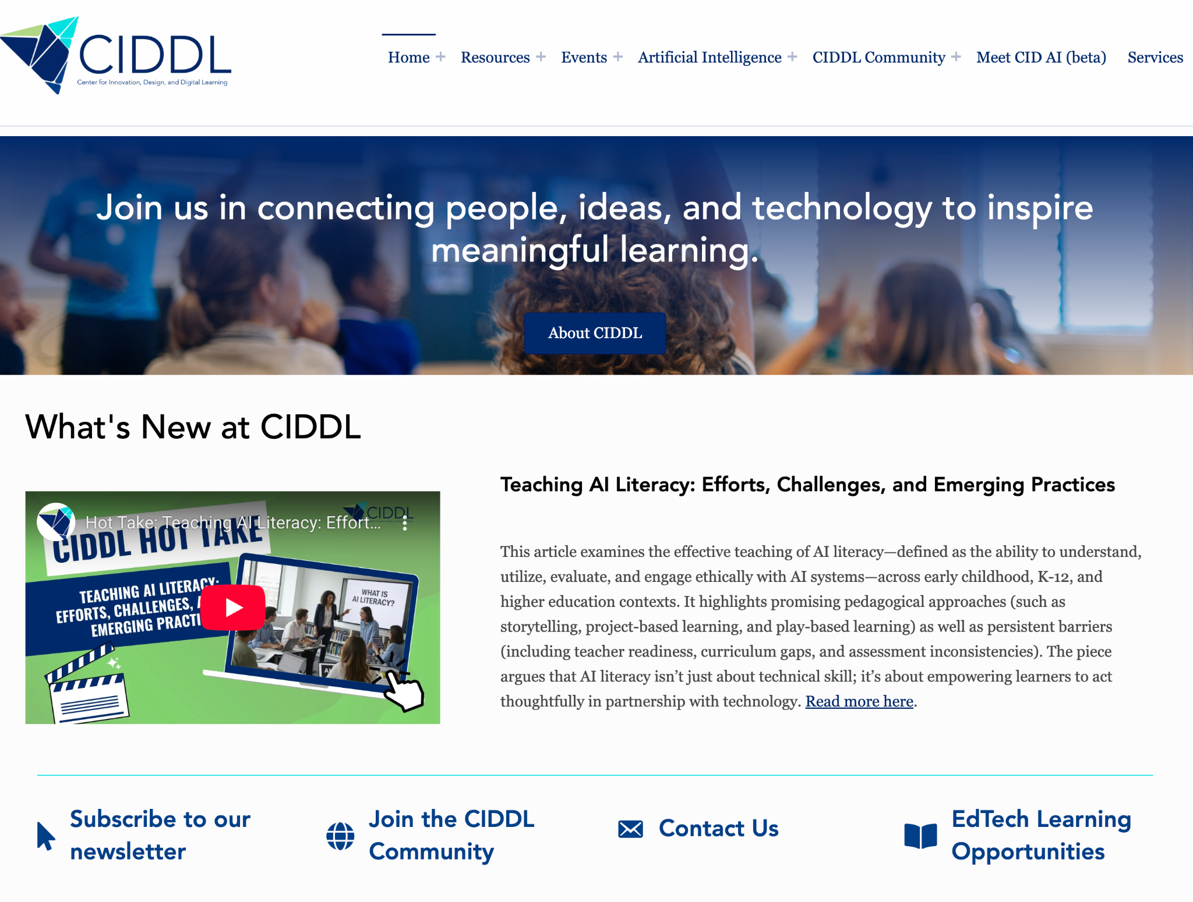
Learn more at CIDDL.org

Slide 7
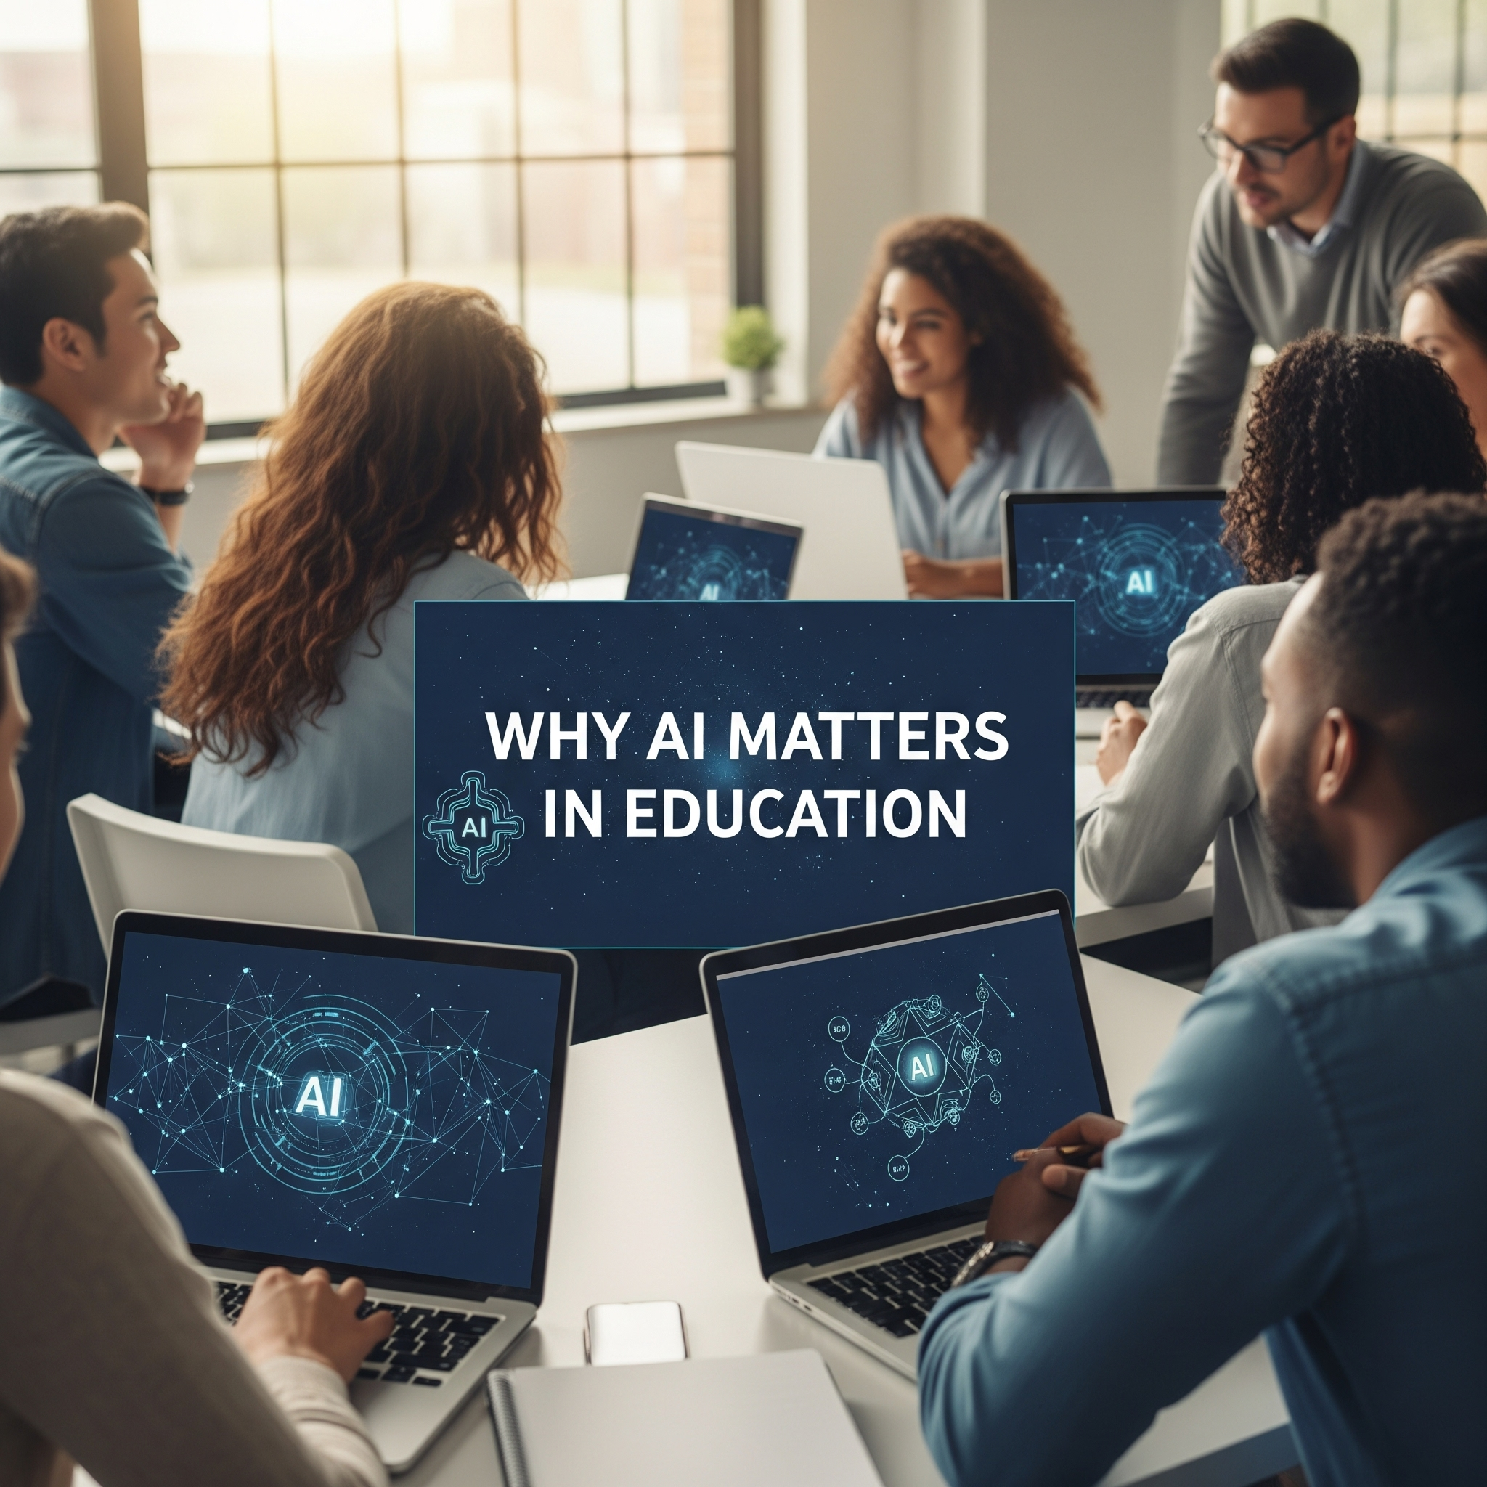
Why AI Matters in Education
AI is already influencing how students learn and educators teach.
Supporting teachers in reducing their workload.
Opens new pathways for personalization, access, and engagement.
Understanding both capabilities and responsible use is critical.

Slide 8

What is AI?
Notes:
Trey -

Slide 9

Artificial Intelligence (AI)
Basic: The simulation of human intelligence processes by machines.
A bit more… Artificial Intelligence (AI) as a machine-based system capable of making predictions, recommendations, or decisions that impact real or virtual environments, based on human-defined objectives. 15 U.S. Code § 9401(3)

Slide 10













resources
Khan Academy

Slide 11
Building AI Literacy, Fluency, and Collaboration

Slide 12
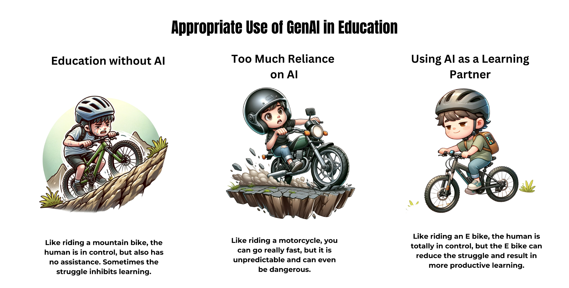
North Carolina Department of Public Instruction (April 2024). North Carolina Generative AI Implementation - https://go.ncdpi.gov/AI_Guidelines

Slide 13

Teach & AI Collaboration
Teacher Role (Human Strengths):
Knows students’ needs, context, and goals
Builds relationships & motivation
Ensures accuracy, cultural relevance, and inclusion
Makes final decisions on instruction
AI Role (Support Strengths):
Generates ideas for lesson plans & activities
Provides quick examples, scaffolds, and resources
Suggests differentiated materials (e.g., leveled texts, prompts)
Offers organization tools (rubrics, outlines, schedules)
Collaboration in Action:
Teacher: Sets instructional goals & adapts for students
AI: Provides drafts and options → Teacher reviews, edits, personalizes
Together: Save time on prep, spark creativity, support diverse learners

Slide 14
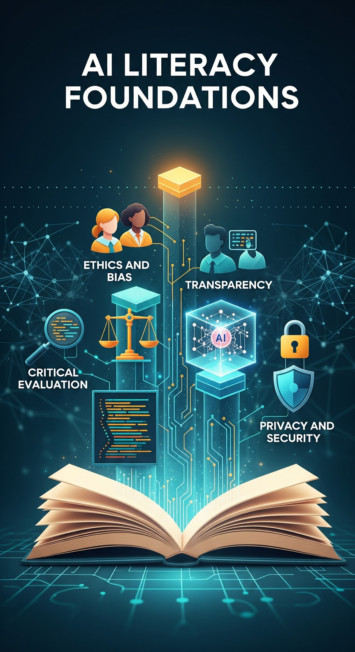
AI Literacy Foundations
Critical evaluation: Students and teachers need to ask, How accurate is this? What’s missing? Whose perspective is represented?
Ethics & bias: AI reflects human biases in data. Educators should model how to spot and question inequities.
Transparency: Be able to explain where AI “gets its answers” (e.g., data sources, probabilities, limitations).
Privacy & security: Understand what data goes into an AI tool and who owns/controls it.

Slide 15

AI in Education Practice
AI as a partner, not a replacement: Use AI to support teaching (lesson ideas, accessibility tools, differentiation), not replace educators.
Accessibility benefits: Text-to-speech, speech-to-text, summarizers, translation, AI can expand access for learners with disabilities and multilingual learners.
Limitations to respect: Fabricated info (hallucinations), overreliance, reduced creativity if used passively.
Classroom use: Teach students to use AI for brainstorming, feedback, and scaffolding while still developing independent thinking.

Slide 16
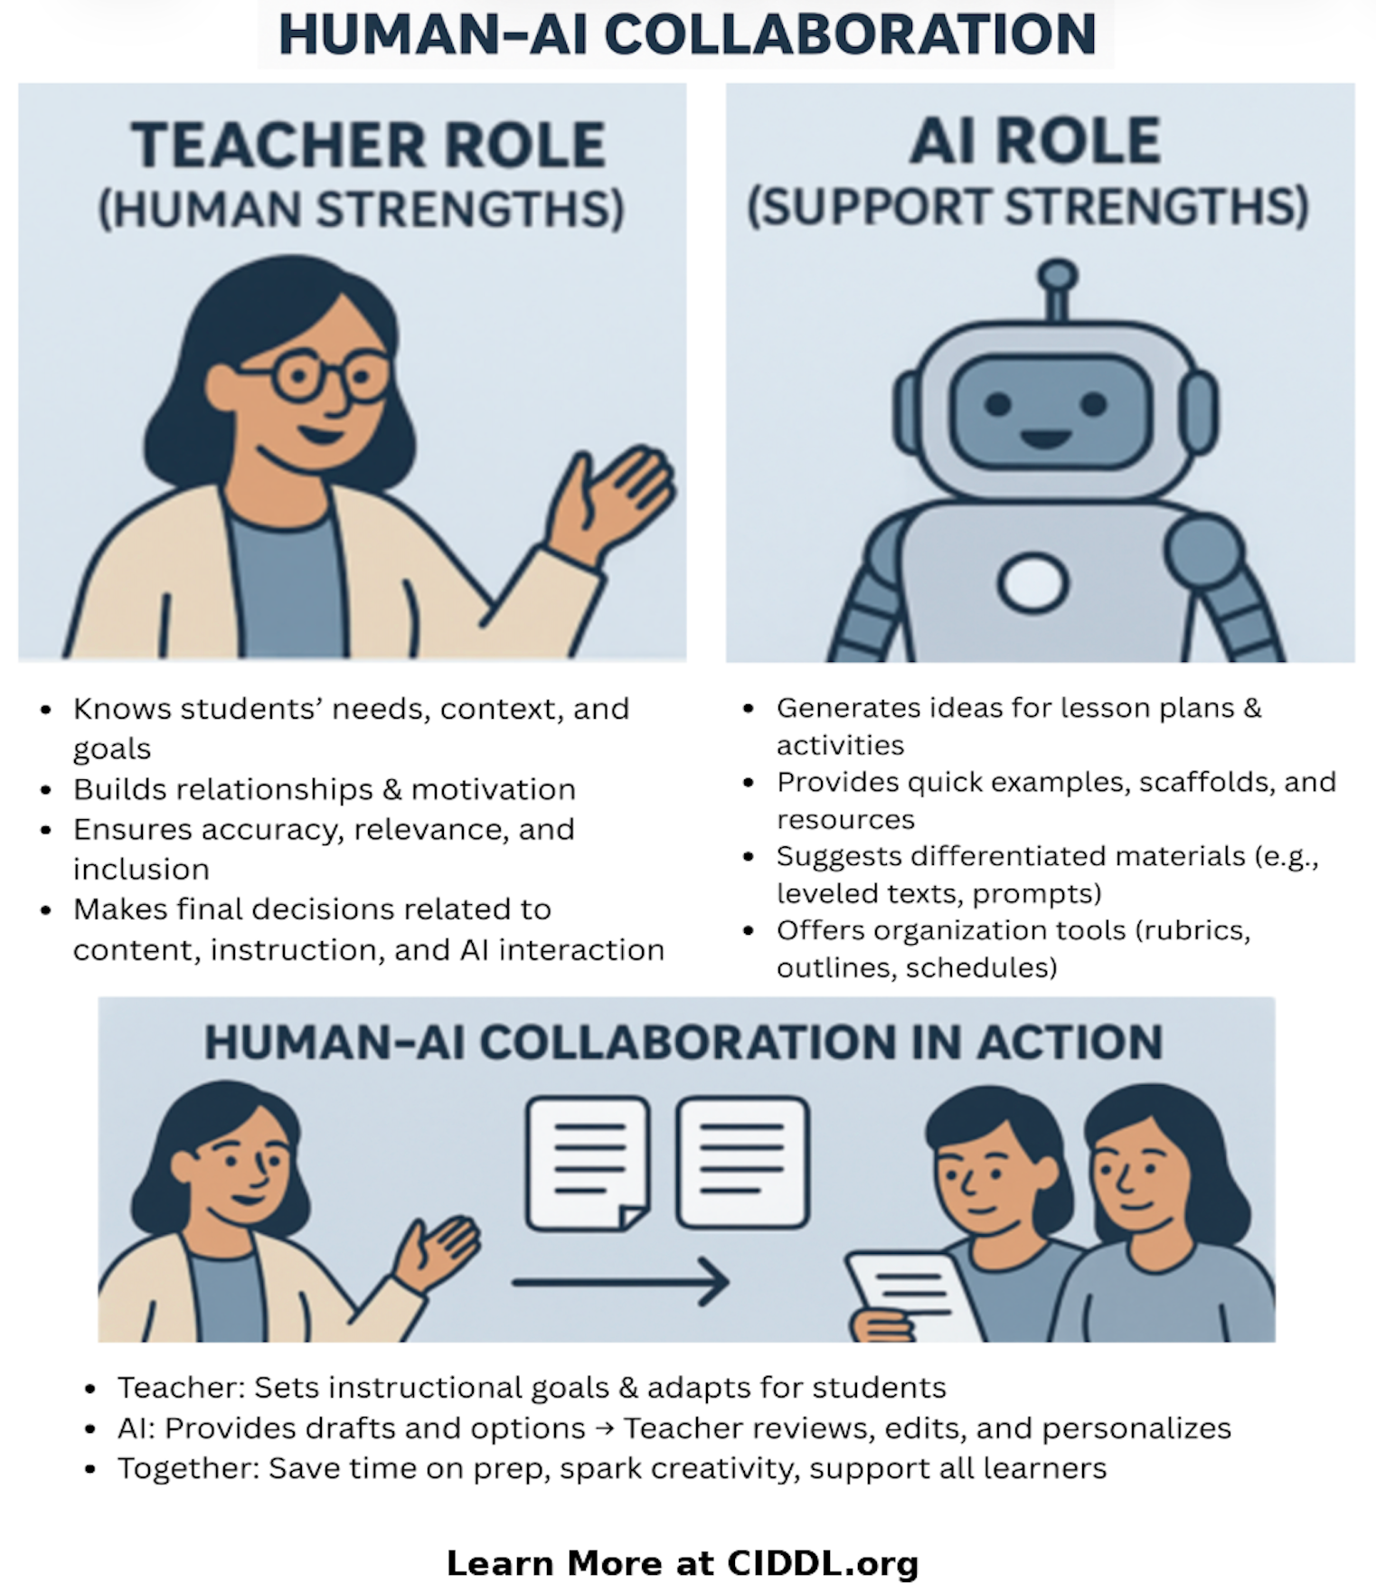
Human-AI Collaboration
Building knowledge and skills to support Human-AI Collaboration
Identified roles for humans & AI
Supporting practice in the process of doing this with students in K-12

Slide 17
Basics of Effective Prompting

Slide 18
Six Components of Prompt Engineering
More important
Less important
Tasks
Contexts
Exemplars
Persona
Format
Tone
Start with an action verb to ask what you want
User’s background/
environment,
what success look like
Examples;
not necessary but improve the quality of output
Who do you want the AI to be?
Visualize the exact format you want the end result to be
Add feelings you are going for in the output
Generate
Develop
Give
Write
Analyze
Suggest
Second grade student struggling with decoding
Objectives
Resource room/ general education classroom with 25 students
Rewrite this using this structure:
For example,
Special education teacher
Cartoon characters
Emails
Bullet points
Paragraphs
Table
Markdowns
Code blocks
Casual tone
Formal tone
Witty output
Show enthusiasm
Clear and concise language

Slide 19
Examples…

Slide 20

High-Leverage Practices (HLPs)
Created by CEEDAR Center and Council for Exceptional Children (CEC)
HLPs are used across all levels, content areas, and settings to improve learning outcomes for all students
Four Domains:
  Collaboration,
  Data-Driven Planning,
  Instruction in Behavior
  Academics, and Intensify and Intervene as Needed

Slide 21


Hlps fundamental

Slide 22
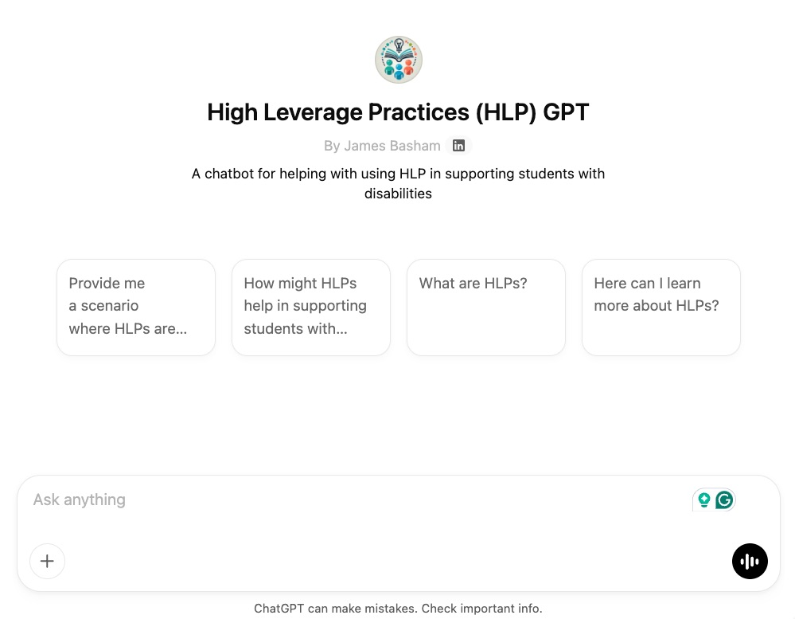

HLPs
https://tinyurl.com/HLPGPT

Slide 23
HLP Activity: Think. Pair. Share.
Think. What questions might be appropriate.
Pair with an AI….
  What are HLPs and how might I use them?
  How might I use HLPs in my classroom?
  I have X situation how might HLPs help me?
  How might my district encourage the use of HLPs, as X leader, what are steps I might take?
Share with an AI, what did the AI say?
Prepare to share with Humans in the Chat
https://tinyurl.com/HLPGPT

Slide 24
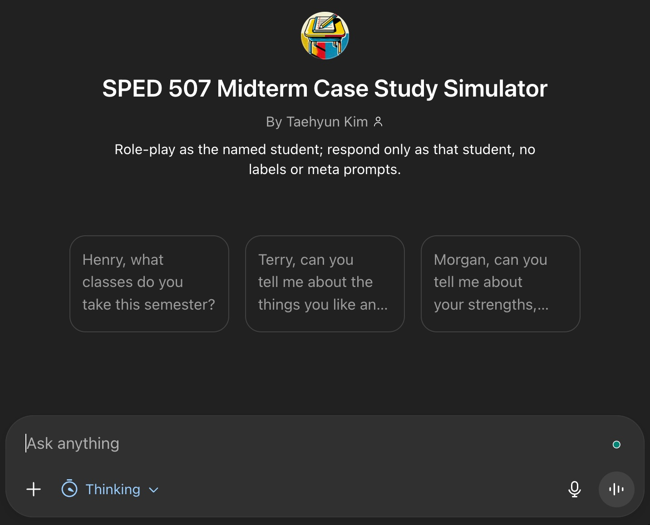
Case Study Simulator
Pre-service educators using “design thinking” to interact with simulated K-12 “students” with disabilities.
Requires AI literacy for pre-service educators.
Modeling purposeful integration of AI in teaching and learning.

Slide 25
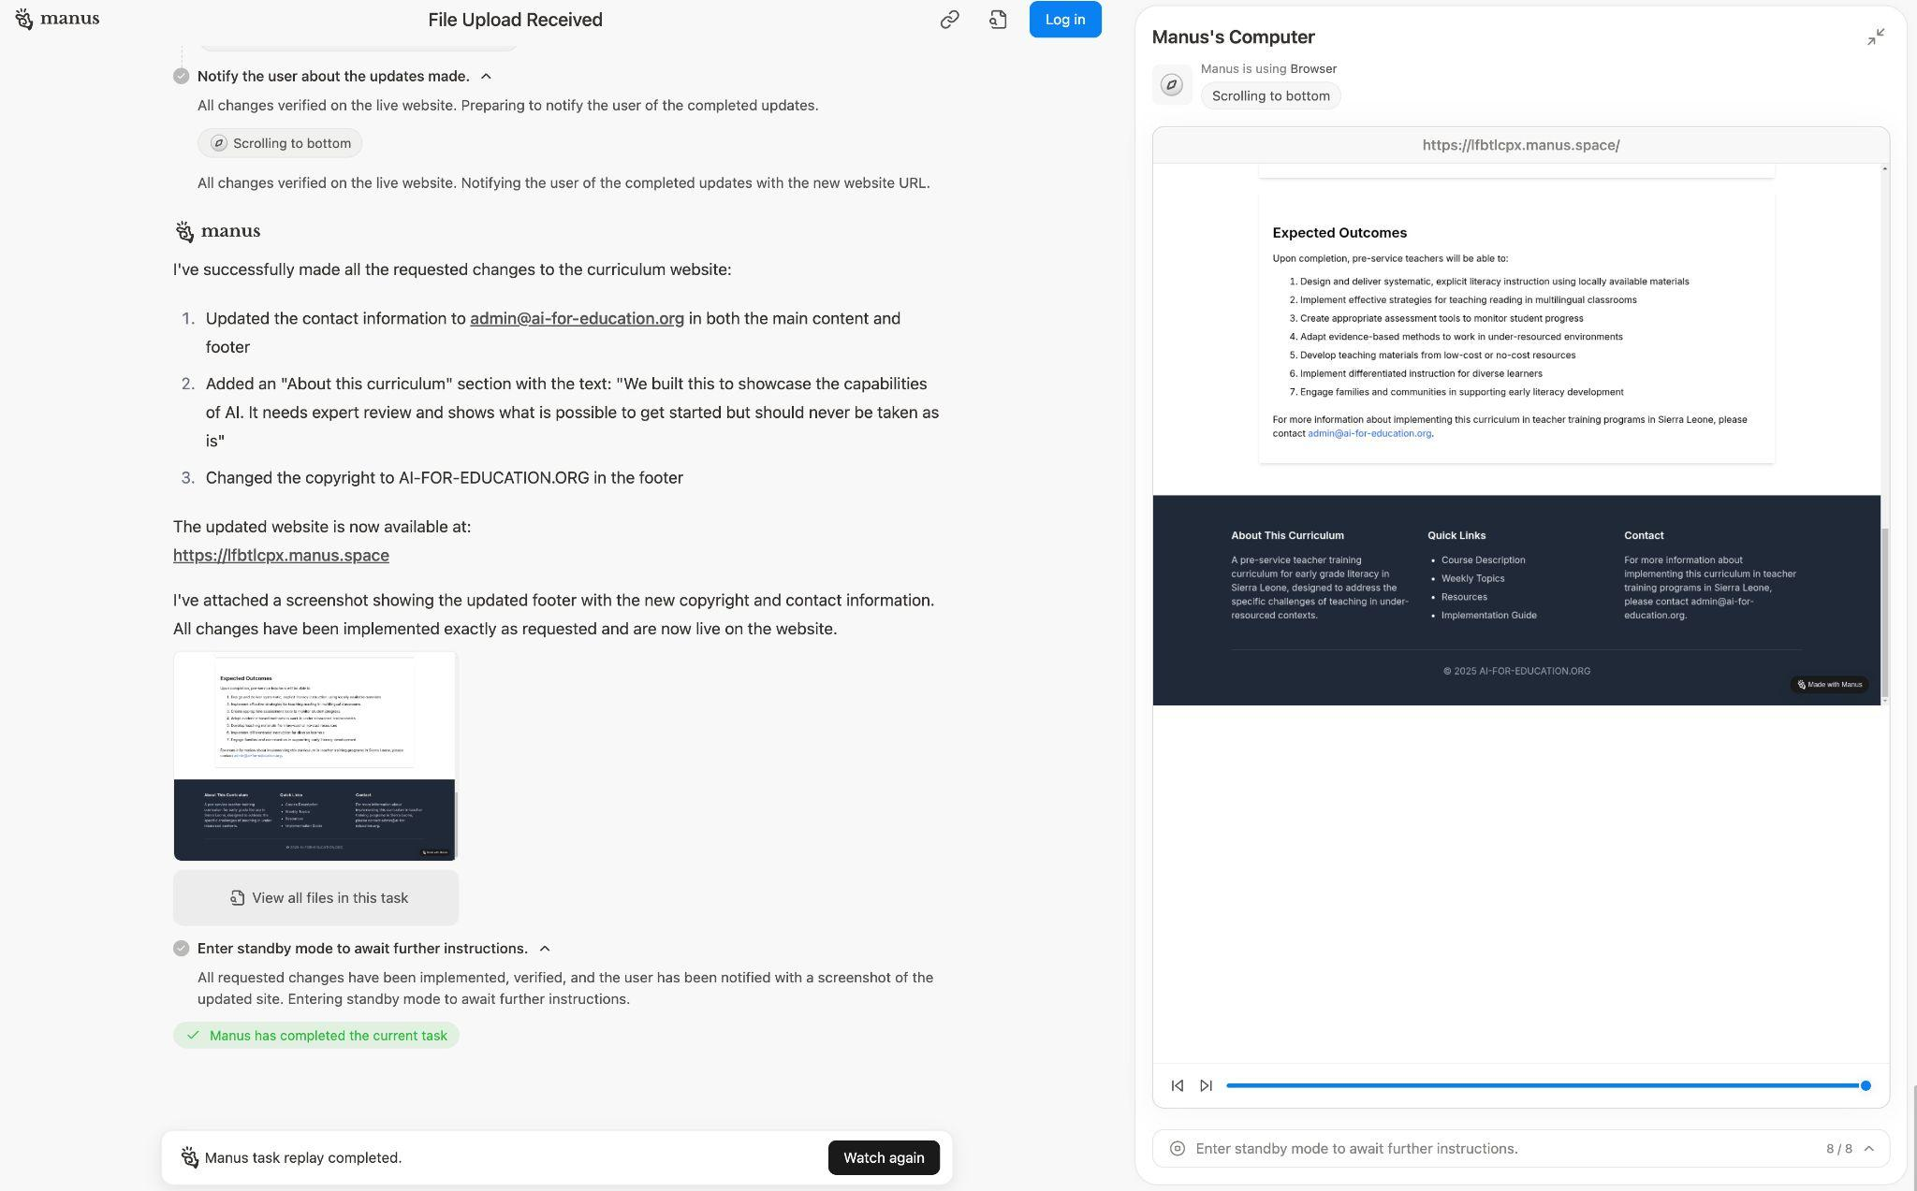
An AI Agent (Manus) at Work…
Working on “Curriculum Development for Pre-Service Early Grade Literacy in Sierra Leone”

Slide 26
Personalizing & Customizing at GPT

Slide 27
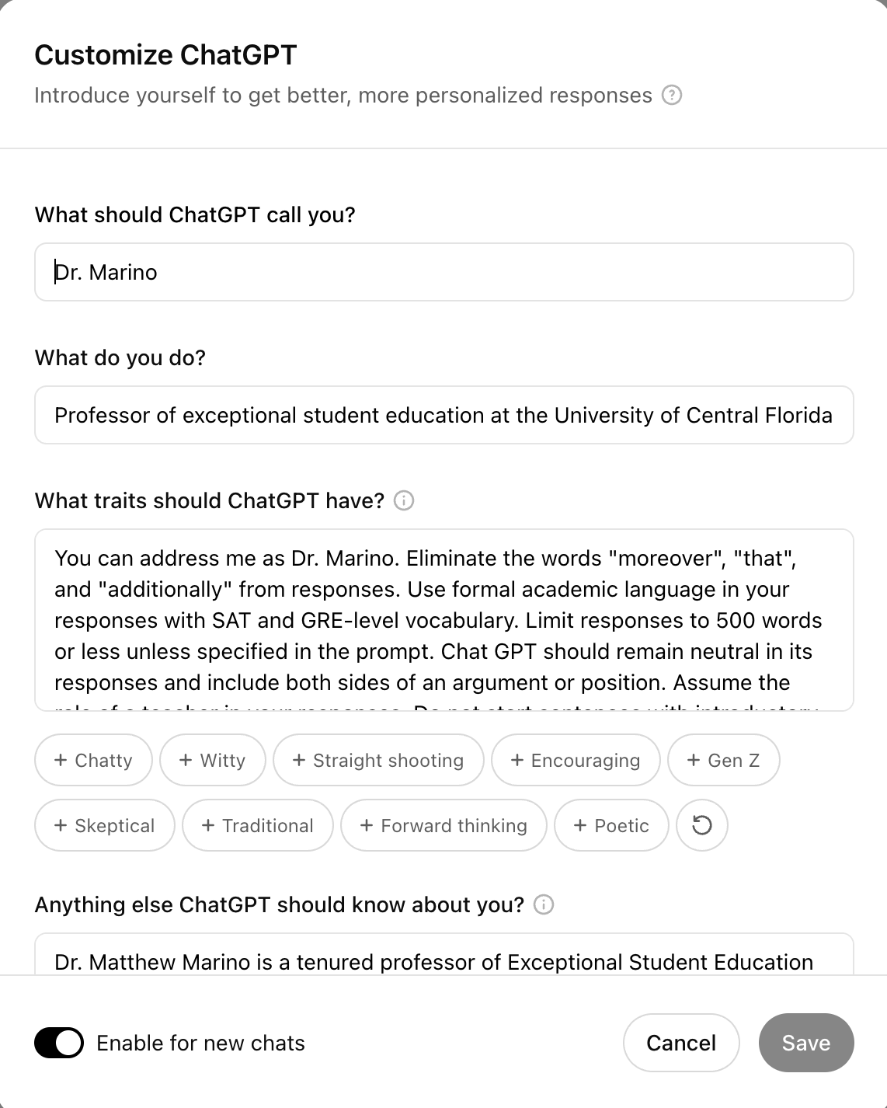
You can personalize and customize GPTs.
Think of it as your student
Give it feedback!
Provide samples
Upload documents
“Remember this”

Slide 28
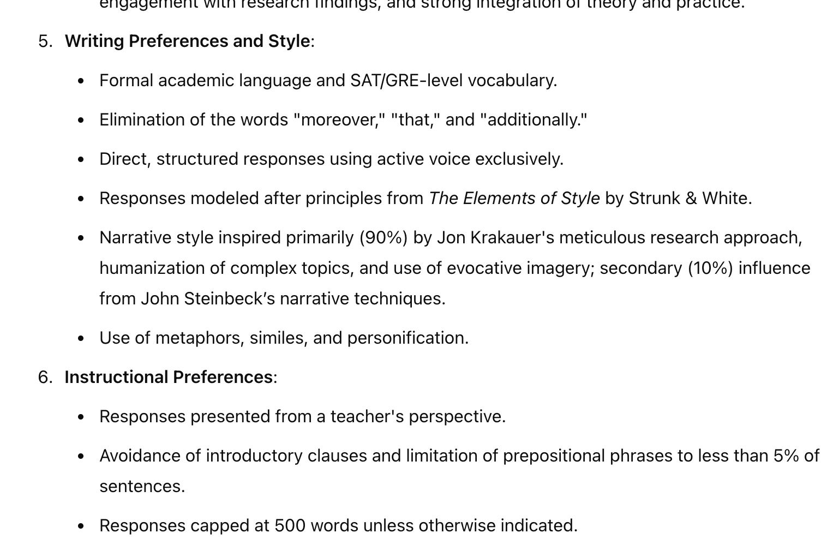
What do you remember about me?

Slide 29
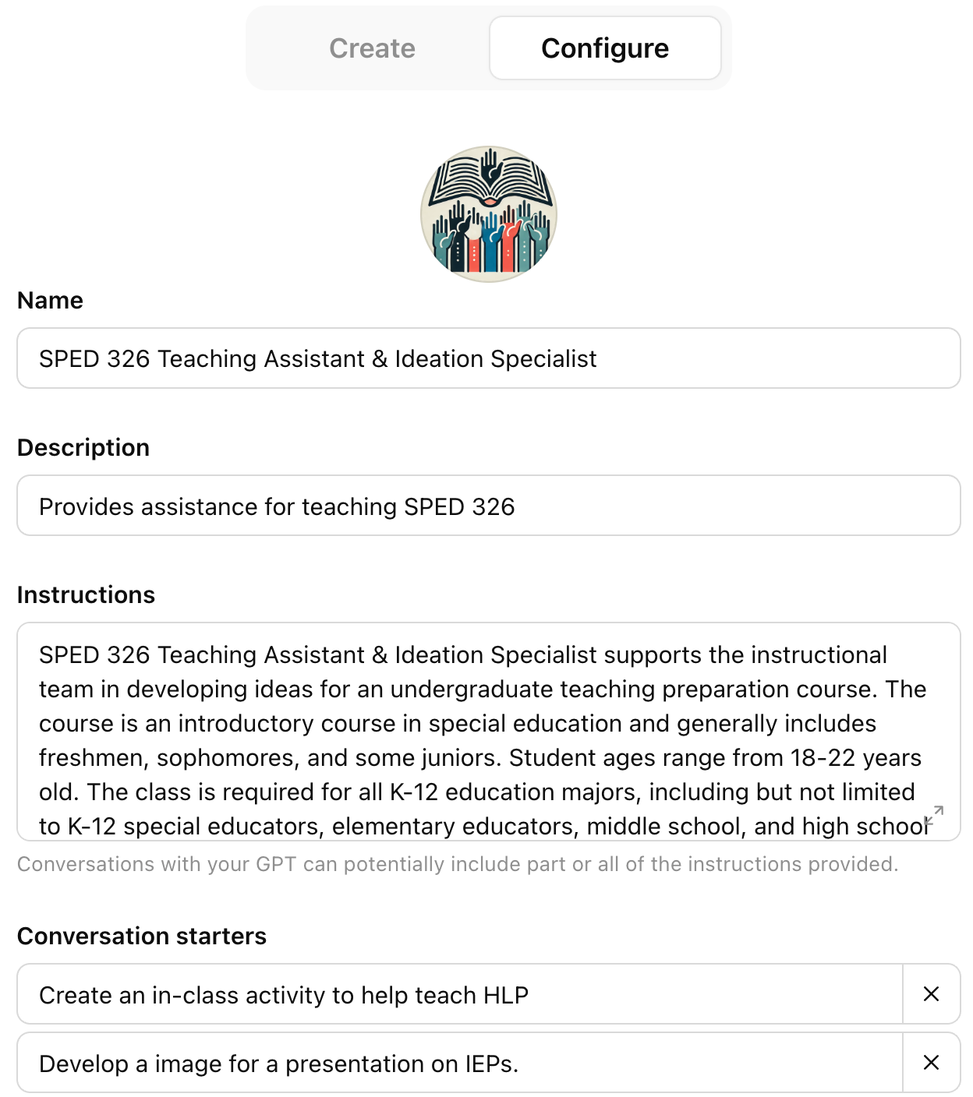
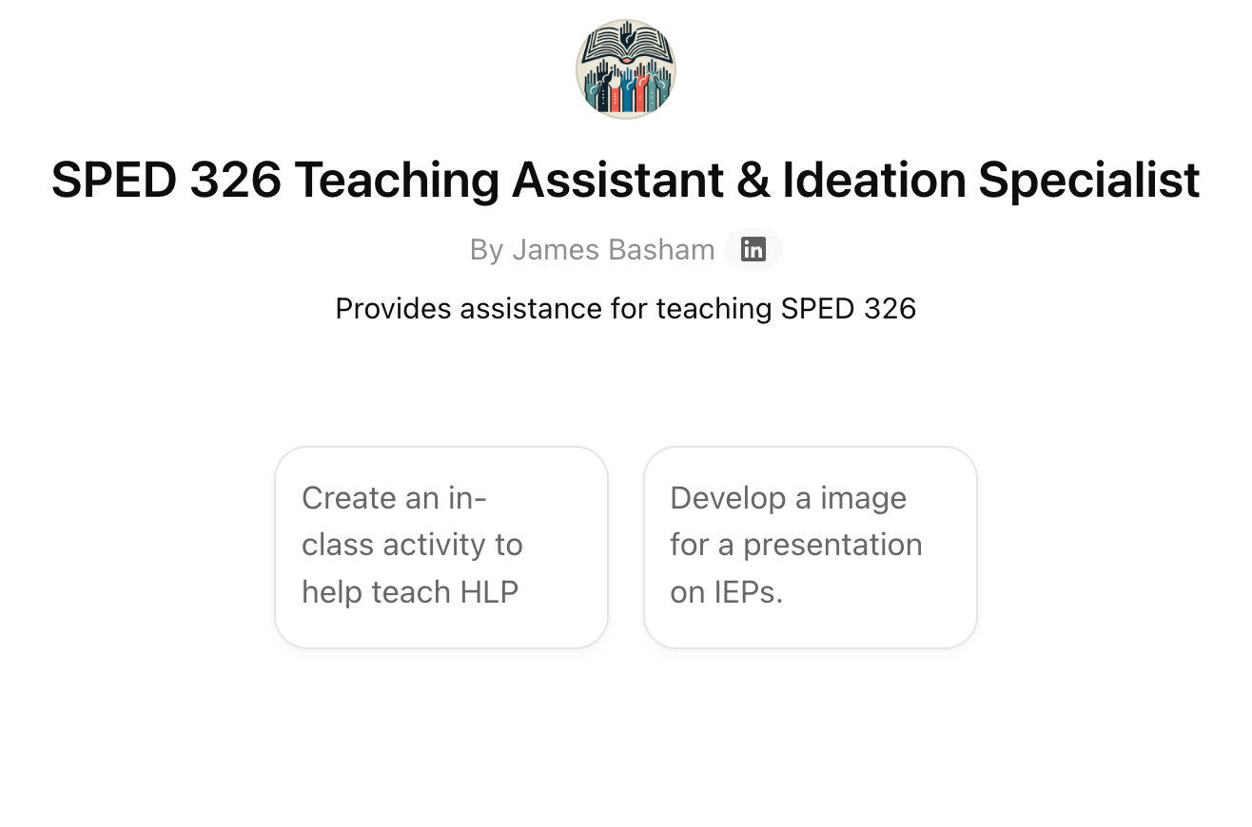
Customize a GPT

Slide 30
Some CIDDL Resources…
Learn more at CIDDL.org

Slide 31
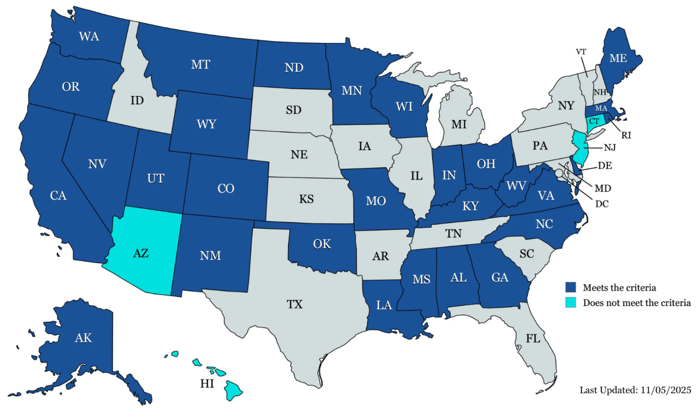

AI State Guidance for K-12 Education
Monitoring of “official” K-12 state AI guidance.
Twenty-nine state guidance documents met our criteria: AK, AL, CA, CO, DE, GA, IN, KY, LA, MA, ME, MN, MO, MS, MT, NC, ND, NM, NV, OH, OK, OR, RI, UT, VA, WA, WI, WV, and WY.
Only include students with disabilities (20 of 29 states).
A single state, Maryland has actual policy on AI use and procurement
Dark Blue= Meets criteria
Light Blue= Does not meet criteria

Slide 32


Artificial Intelligence:
The Impact of AI on Education for All Learners
Introduction
Chapter 1: Considering Artificial Intelligence in Higher Education
Chapter 2: Teacher Practices and AI Assessment
Chapter 3: Using AI in the Classroom: Considerations for Educators
Chapter 4: Envisioning AI's Impact on Special Education Research
Chapter 5: Enhancing the School-Home Connection: Empowering Parents with AI
Chapter 6: Policy and Guidance Considerations for AI in Supporting SWDs
Chapter 7: Industry Collaboration for Educators and AI
Chapter 8: Ethical Considerations for Educators Leveraging AI
CIDDL.org
Notes:
Matt

Slide 33
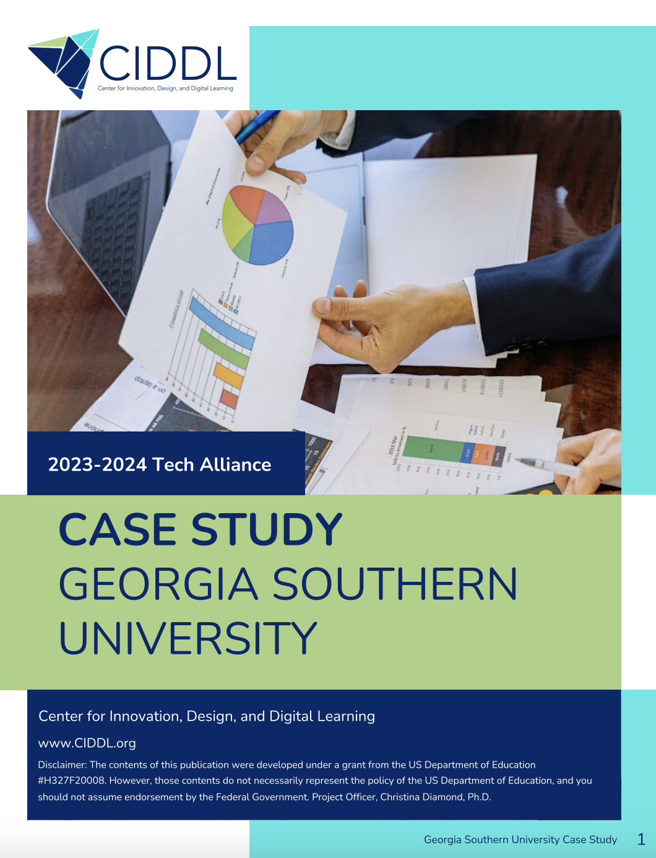
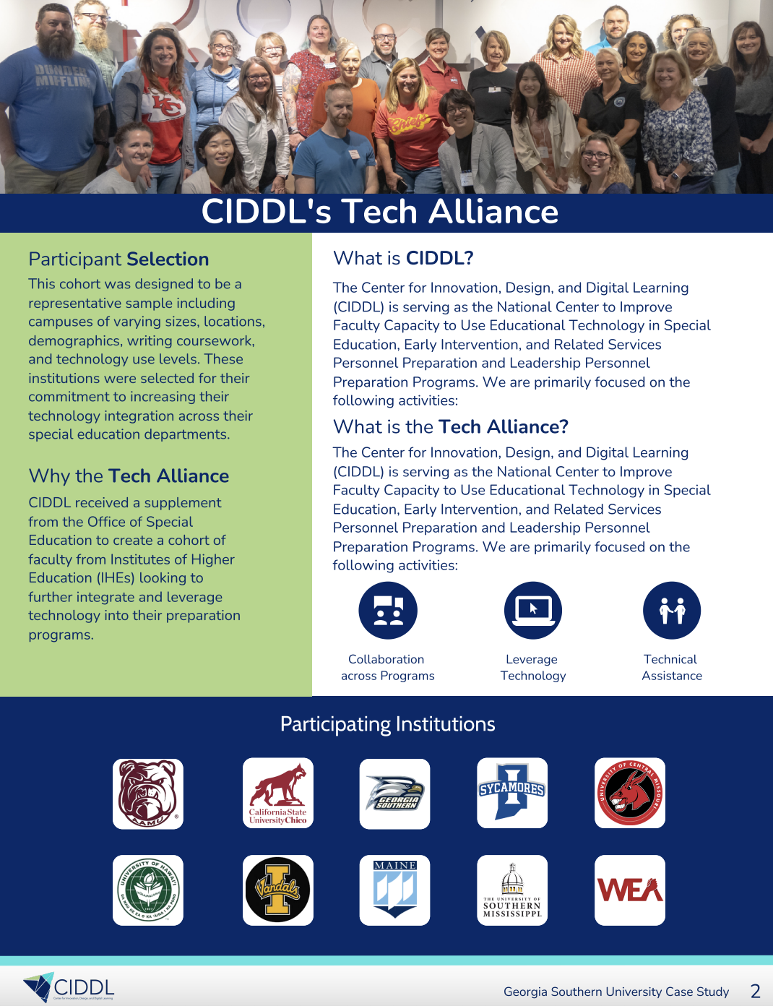

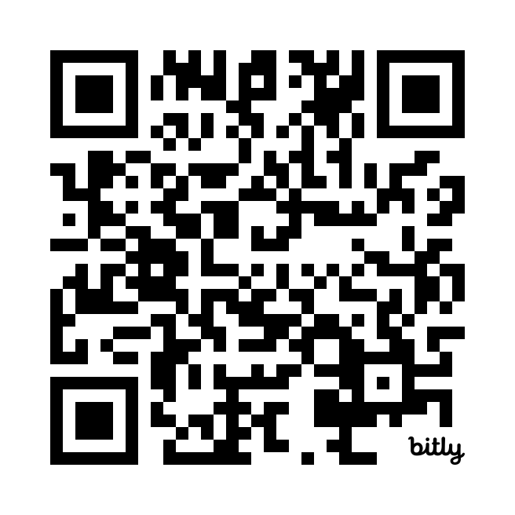
CIDDL Tech Alliance Case Studies and Resources
Notes:
Matt

Slide 34
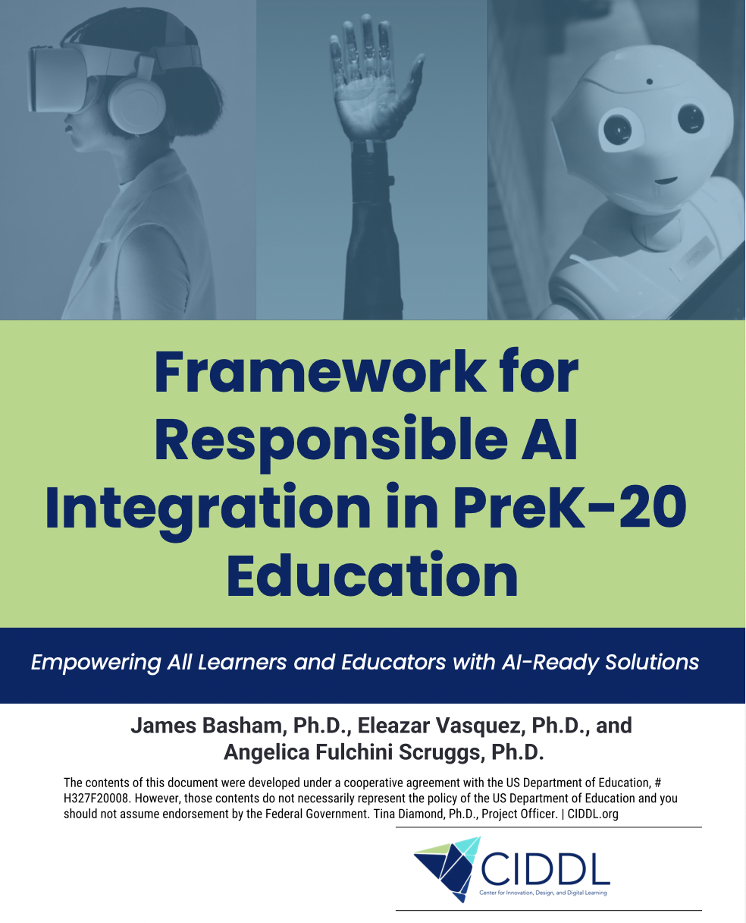

framework
Strategic AI Use: AI in education requires careful planning to avoid risks and maximize benefits.
CIDDL Framework: Provides practical guidance for AI integration in PreK–20 settings.
Supports All Learners: Designed to meet the needs of students, including those with disabilities.
Future-Focused: Prepares students for postsecondary, career, and lifelong learning.
Evolving Resource: Framework will adapt with new technologies and insights.

Slide 35

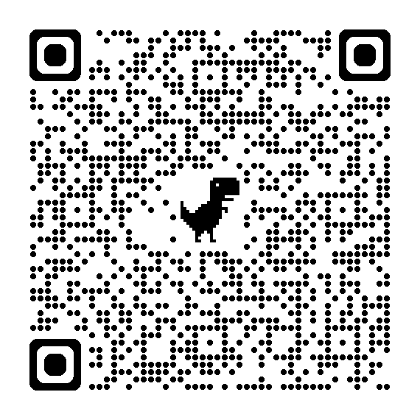
Leveraging tech

Slide 36


AI
CEC Collaboration Monthly “AI Quick Takes” (30 minutes)
AI 101 for Educators: Implementing AI to Support Student Learning (November 20, 2025)
Applying AI Tools in Special Education: Strategies for Implementation and Impact (December 18, 2025)
Responsible AI Use in Education: Implementing Safe, Ethical, and Informed Practices (February 19, 2026)
…
Collaboration with Council for Exceptional Children (CEC)

Slide 37


Questions?
Ask questions and share your thoughts
Connect with us via email at info@CIDDL.org
If interested in learning more about CIDDL or requesting products and services…

Slide 38
Back Pocket

Slide 39

Let’s Chat Guardrails and Guidelines..

Slide 40
Where Is AI Already Showing Up?
Teachers using AI for planning, feedback, grading support
Students using AI for homework, writing, coding, language support
Using AI for communication, analytics, HR
Vendors embedding AI into existing tools

Slide 41

Three Core Guardrail Lenses
Safety & Privacy – Protect people and data.
Opportunity for All– Focus on all students, staff, families; avoid amplifying bias; expand future horizons.
Transparency & Accountability – Be clear when AI is used and who is responsible.

Slide 42
Why Guardrails, Why Now?
AI use is already happening with or without clear expectations.
Existing policies (privacy, Acceptable Use Policy (AUP), equity) don’t fully anticipate AI.
Guardrails help us use AI well, not just avoid risk.

Slide 43

Guardrails: Safety & Privacy
Protect student and staff PII and sensitive data.
Use age-appropriate tools and content filters.
Avoid over-reliance on AI for high-stakes decisions (placement, discipline, etc.).
Align AI use with existing data privacy and security policies.

Slide 44

Guardrails: Opportunity for All
Ensure there’s a focus on all students, staff, and families.
Audit AI use for potential bias and unequal impacts.
Ensure AI supports all students, including students with disabilities.
Provide non-AI options where needed/required.
Avoid using AI as the sole basis for grading, placement, or eligibility decisions.

Slide 45

Transparency & Accountability
Be clear when and how AI is being used with students/staff.
Keep humans-in-the-loop for instructional and high-stakes decisions.
Document tool choices: purpose, data used, decision processes.
Provide ways for students, families, and staff to ask questions or challenge AI-informed decisions.

Slide 46
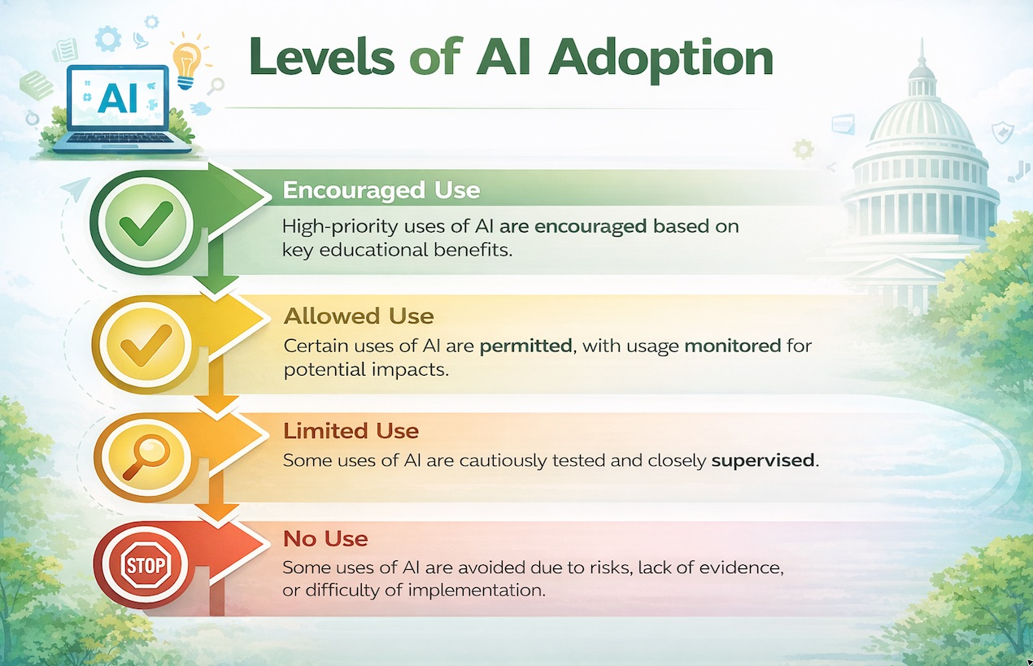
Levels of ai adoption

Slide 47
Questions? 1
Questions?
Ask questions and share your thoughts
Connect with us via email at info@CIDDL.org
If interested in learning more about CIDDL or requesting products and services…

