Slide 1
Welcome to
CEEDAR’s Leadership
Topical Action Group (TAG)
Thursday, October 9th 2025
3:00-4:00 Eastern Time
Welcome to our TAG!
Participants: please change your Zoom name to
your state and name
Ex: Florida, Agatha Trunchbull
CEEDAR staff: please change your Zoom name to
CEEDAR, Your name
Notes:
Abby: Make everyone co-hosts
Speaker: Abby
3:00-3:01

Slide 2

Check in:
Welcome back! What’s your go-to song or quote when you need a boost?
Notes:
Speaker: Abby Please change your name to Your state abbreviation and your first and last name
12:00-12:02

Slide 3
Virtual Meeting Recording Notice
This meeting is scheduled to be recorded by CEEDAR. Your consent to the recording is requested. Participation in the meeting without expressing an objection to recording will be treated as consent. Any participant who prefers to participate via audio only should disable their video camera so only their audio will be captured. External AI bots are prohibited unless specifically authorized.
Notes:
Speaker: Bobbi
12:02-12:03

Slide 4
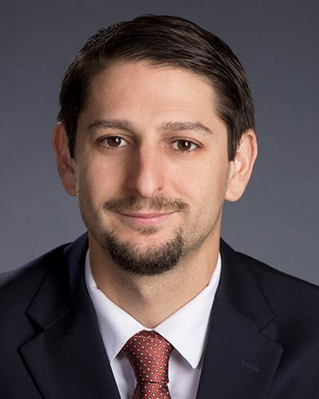
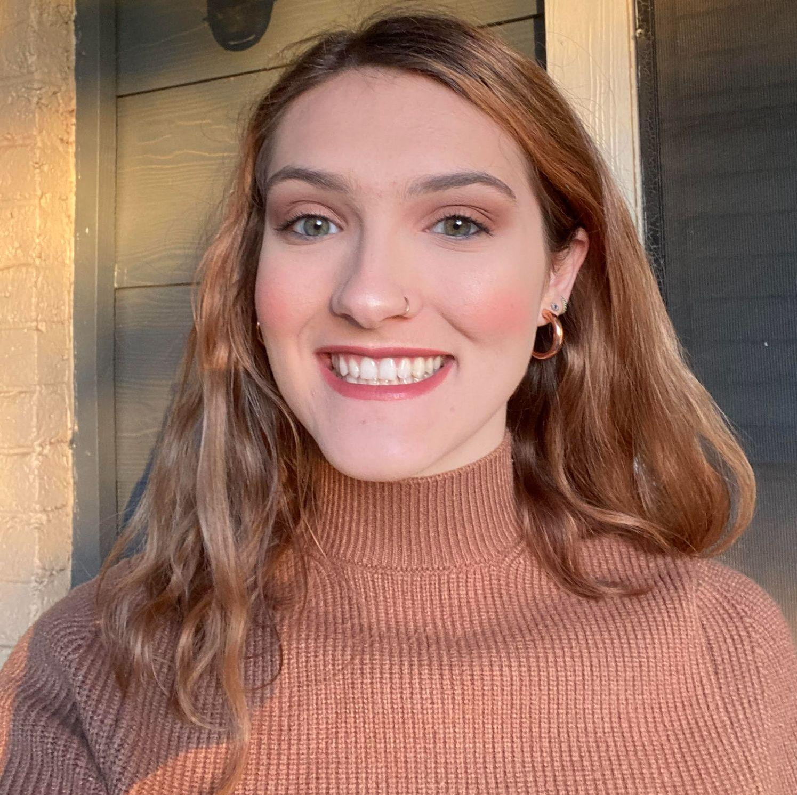
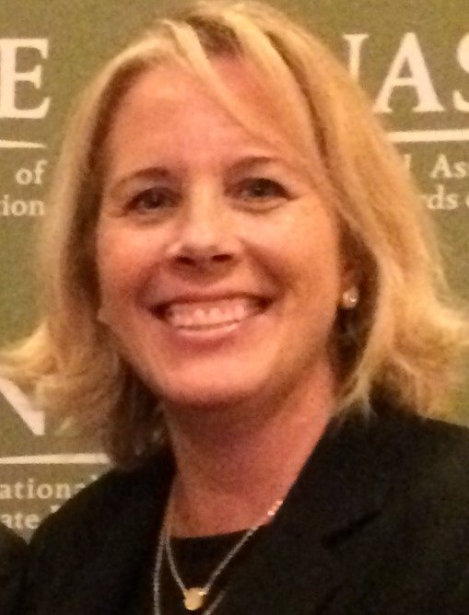
Welcome & Introductions
Dr. David DeMatthews
Professor, Department of Education Leadership and Policy,
The University of Texas at Austin
Abby Berner
Engagement Specialist, CEEDAR, Research Assistant, American Institute for Research (AIR)
Dr. Bobbi Newman
State Lead for CEEDAR Center, Principal Researcher, American Institute for Research (AIR)
Notes:
Speaker: Bobbi
12:02-12:03

Slide 5





Our Partners
Notes:
Speaker: Shelby
A warm thank you to our partners
Our partners are Lead IDEA, NASSP, and CCSSO- they are our liaisons and will share resources, they can provide additional perspectives. If you are here from one of these partner organizations, please share who you are in the chat and feel free to share your expertise!
12:03-06

Slide 6
Lead IDEA Technical Assistance Center Sessions at UCEA: Resource Sharing!
Leadership for All: Enhancing Preparation Programs to Develop School Leaders who Serve Students with Disabilities/Friday 2:40-3:50 in San Juan 8
  This is a hands-on workshop where preparation program faculty will have an opportunity to review several tools that have been developed by the Lead IDEA Technical Assistance Center that can be used within principal preparation to strengthen preparation for effective leadership.
  Strengthening the Work of Principals for IDEA Implementation within their Schools: Examining and Assessing Resources for Use by Principals and Preparation Programs/Saturday at 1:20 to 2:30 (another session immediately after in Miramar 3)
    This is a hands-on session that will allow you to provide feedback on several resources that have been created by the Lead IDEA Technical Assistance Center for use by principal preparation programs and to share your insights about the kinds of resources that would vital to your program as your program works to strengthen preparation for IDEA Implementation.
This material was produced under the U.S. Department of Education, Office of Special Education Programs, Award No. H325Z230007. Anna Macedonia serves as the project officer. The views expressed herein do not necessarily represent the positions or policies of the U.S. Department of Education. No official endorsement by the U.S. Department of Education of any product, commodity, service, or enterprise mentioned on this website is intended or should be inferred.
Notes:
Speaker: Shelby
12:03-06
https://lead-idea.org/

Slide 7
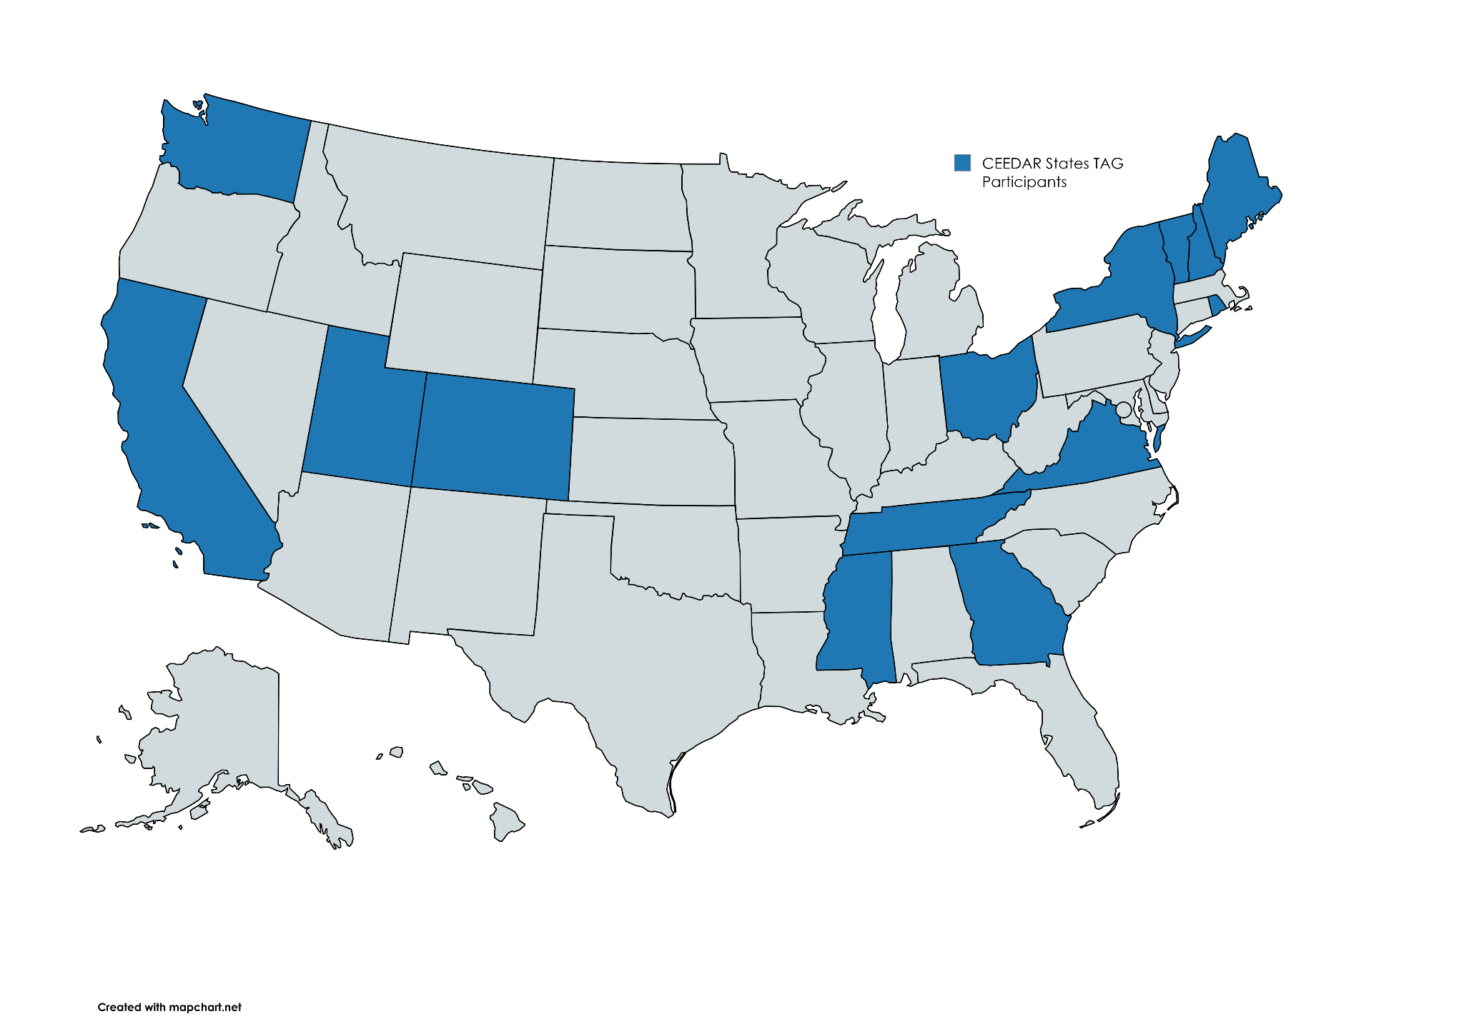
States Participating in the TAG
Notes:
Speaker: Bobbi
12:06-10

Slide 8
The purpose of the TAG is to…
elevate the importance of effective leadership in our work,
focus on effective practices in our programs, coursework, clinical experiences, and policies,
engage in authentic conversations on their effective leadership efforts,
and share expertise, successes and challenges, and discuss how to use resources to support scaling and sustainability.
Notes:
Speaker: Bobbi
Recognize that we have different roles as members of our TAG (SEA, IHE, associations, local) we want to be mindful of these roles as we talk in cross state and state team time
12:06-10

Slide 9
Leadership TAG Topics for Discussion
Date | Topic
October 9th, 3-4 EST | Professional Community for Teachers and Staff Meaningful Engagement of Families and Community
November 13th, 3-4 EST | Operations and Management School Improvement
December 11th, 3-4 EST | TAG Workgroups Kick-Off
January 8th, 3-4 EST | TAG Workgroups Session 1
February 12th, 3-4 EST | TAG Workgroups Session 2
March 12th 3-4 EST | TAG Workgroups Session 3
April 9th, 3-4 EST | TAG Workgroups Session 4
May 14th, 3-4 EST | TAG Workgroups Product Presentation
June 11th, 3-4 EST | TAG Workgroups Product Presentation
Notes:
speaker: Bobbi
12:06-10

Slide 10
Today’s Agenda
Welcome and Introductions
TAG 24-25 Recap and 25-26 Vision
Cross State Breakout Groups
Final Thoughts and Action Items
Notes:
Speaker: Bobbi
Abby put meeting norms in chat
Meeting norms:
Be present and prepared
Respect in the shared space and keep what is shared in confidence. We are creating a community.
We will record guest speakers and resources sharing, but nothing else. What happens in the TAG, stays in the TAG!
Breakout rooms could be mixed cross state or state specific depending on the work.
Group members should “believe the best” and lead with positive intentionality.
12:06-10

Slide 11
2024-25 Recap
Review PSEL standards 1-7 in relation to meeting the needs of students with disabilities.
Learned from exemplary programs and practitioners.
Discussed among state teams how to infuse learning into state plans and actions.
Connected across states to share ideas, resources, and information to strengthen preparation and in-service professional development.
Notes:
Speaker: Dave
12:10-20

Slide 12
2025-26 Vision
Our TAG envisions a shift in leadership preparation that moves beyond foundational understanding of the Professional Standards for Educational Leaders (PSEL) to the active development and implementation of tools that prepare leaders to better serve students with disabilities.
Through monthly collaboration across CEEDAR states, our TAG will co-create, test, and refine innovative resources, activities, and experiential learning opportunities that strengthen leadership programs and practices.
These efforts will be shared across the CEEDAR network to build collective capacity, foster sustainable change, and ensure that future school leaders are equipped to advocate for and support students with disabilities in effective ways.
Notes:
Speaker: Dave
12:10-20

Slide 13
October and November 2025
Review final PSEL Standards (7-10)
Discuss survey results
Learn more about formatting of work groups
Notes:
Speaker: Dave
12:10-20

Slide 14
December 2025 to June 2026
Monthly Virtual Convenings
Whole-group meetings to identify key focus areas aligned with PSEL and leadership preparation needs
Collaborative discussion to surface challenges, opportunities, and priorities across states
Small Team Breakouts
Engage in targeted learning facilitated by a designated lead.
Focus on developing, testing, and refining resources, activities, and tools.
Iterative Development Cycle
Multiple rounds of design, testing, and revision
Finalized tools presented and shared across CEEDAR states
Notes:
Speaker: Dave
12:10-20

Slide 15
Cross State Breakout Room Guiding Questions
Based on the presentation from David, consider these questions:
How can we help school leaders better support students with disabilities?
What tools or activities would make leadership prep more effective for everyone?
What aspect of principal leadership in your program or organization are you most excited about?
CEEDAR staff, please help participants engage with the discussion questions as well as facilitate introductions. With many new faces today, we’re eager to begin building cross-state connections and collaboration.
We will stay in these breakout rooms until 3:33 ET.
Notes:
Speaker: Bobbi
groups till 3:33 ET
Mix of state and CEEDAR facilitators
Abby will put in chat: slide screenshot
12:20-21

Slide 16
Takeaways from Cross State Discussion
Welcome back! Feel free to share 1-2 sentences in the chat that summarize your group’s discussion.
Notes:
Speaker: David
intro RBE folks
12:33-34

Slide 17
Invitations and Next Steps
Please complete this survey if you have not done so already. We want to learn more about your areas of interest to structure our workgroups in an intentional and meaningful way.
Next IC training: October 23rd 12:00-1:30pm ET, sign up here
Our next TAG Session is Thursday, November 13th, 3-4 EST.
  We will be covering PSEL Standards: Operations and Management and School Improvement.
  We need a guest presenter for November that would align with the standards outlined above. If you have a recommendation, please reach out to Abby at aberner@air.org to explore the opportunity.
Notes:
speaker: Bobbi
thank the presenters from RBE and share out final thoughts
12:57-1:00
TAG BOY Participant Survey
IC Training Sign-Up

