Slide 1
Preparing Special Education Teachers Through Registered Teacher Apprenticeships
An Affinity Group hosted by the CEEDAR Center
Notes:
Speaker: Abby
3:00 – 3:05

Slide 2
Session 5: Supporting Growth on the Job: Mentoring in Teacher Apprenticeships
Featuring Programs from Missouri State University and EDHUBNY
March 17, 2026
Notes:
Speaker: Abby
3:00 – 3:05

Slide 3
Housekeeping
Please add your organization to your Zoom name:
In the Participants list, click the “More“ button by your name
Select “Rename” from the drop-down menu
Add a short version of your organization name after your name, then click “OK”
Today’s session is being recorded.
Please remain on mute when not speaking to minimize noise.
We encourage you to turn your video camera on.
Share questions and comments in the chat box.
If you have any technical issues, please contact Abby Berner at aberner@air.org.
Notes:
Speaker: Abby
3:00 – 3:05

Slide 4
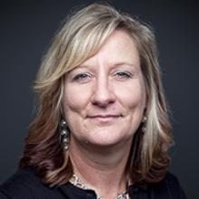
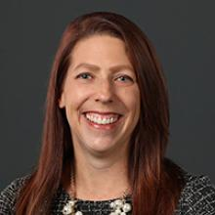
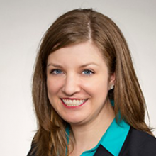
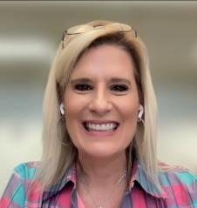
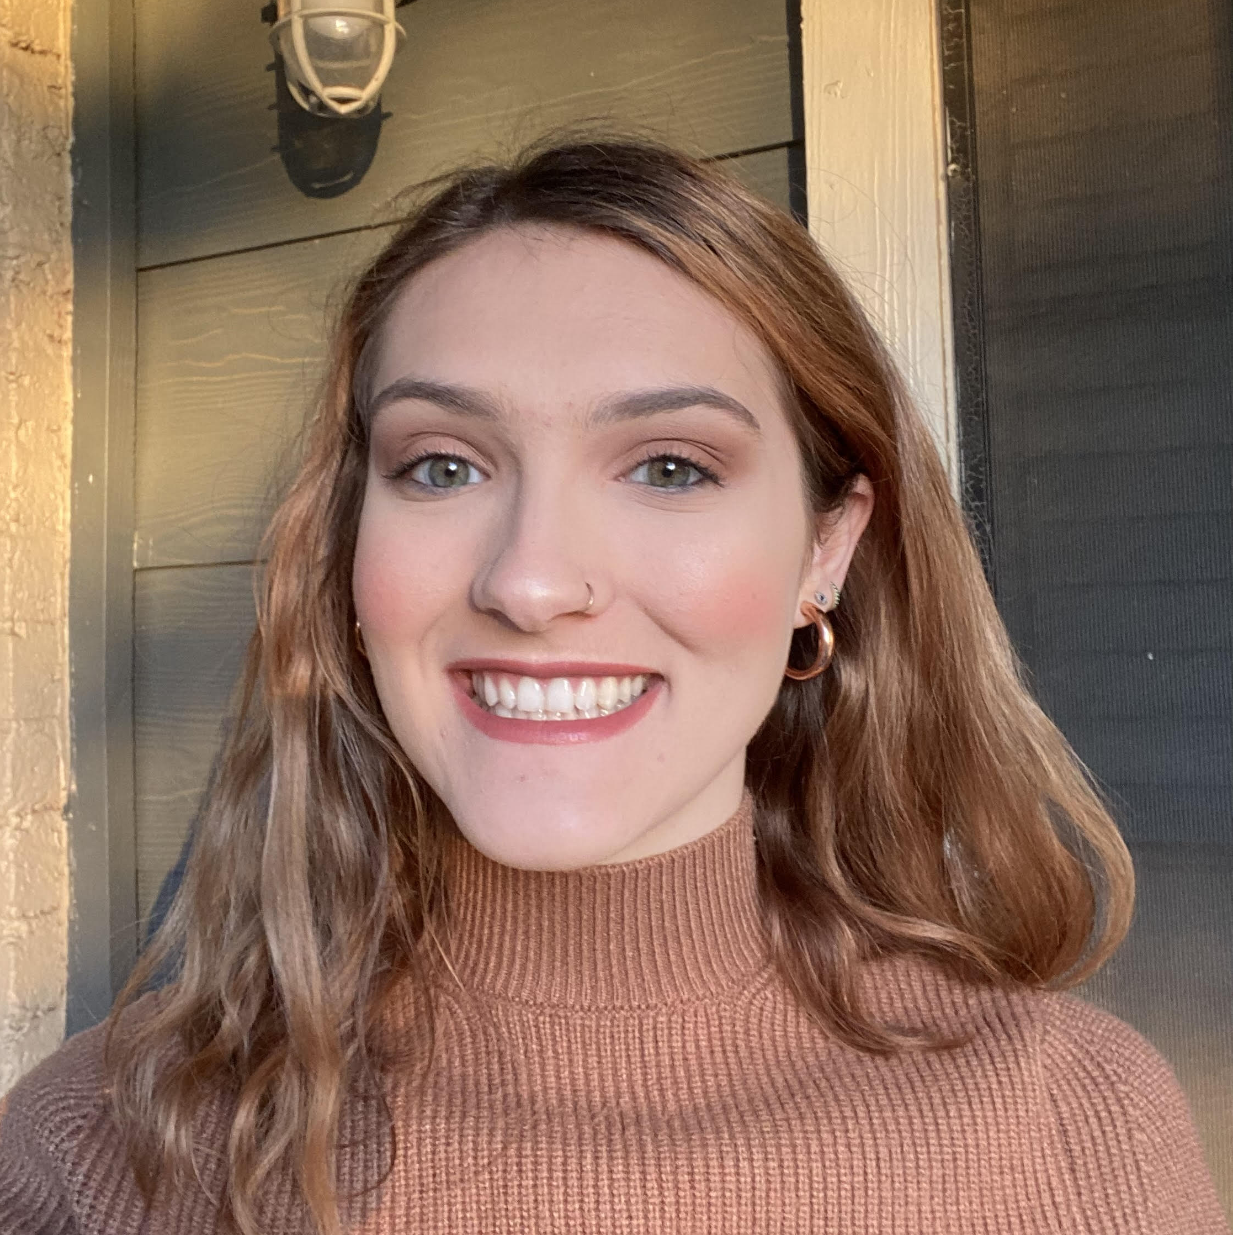
Welcome and Introductions
Lynn Holdheide
Content Expert,
CEEDAR
Managing TA Consultant, American Institutes for
Research (AIR)
Cheryl Krohn
Content Expert, CEEDAR
Senior TA Consultant, American Institutes for Research (AIR)
Meghan Wills
Content Expert, CEEDAR
Senior TA Consultant, American Institutes for Research (AIR)
Lisa White
Facilitator and
RTAP Coordinator, CEEDAR
Abby Berner
Engagement Specialist, CEEDAR
Research Assistant, American Institutes for Research (AIR)
Notes:
Speaker: Abby
3:00 – 3:05

Slide 5

Agenda
CEEDAR Center Affinity Group Overview
Apprenticeship Program Spotlights:
Missouri State University and EDHUBNY
Mentoring in Apprenticeship Programs Panel
Notes:
Speaker: Abby
3:00 – 3:05

Slide 6

CEEDAR RTAP Affinity Group Purpose
Promote the RTAP pathway as a recruitment and retention strategy for special education teachers to address teacher shortages.
Foster a sense of community, create a shared learning space, and promote mutual support for partners interested in learning more about RTAPs to prepare special education teachers.
Notes:
Speaker: Abby
3:00 – 3:05

Slide 7
Teacher Apprenticeship Program Spotlights:
EDHUBNY
&
Missouri State University
Notes:
Speaker: Lisa
3:05 – 3:20 PM

Slide 8
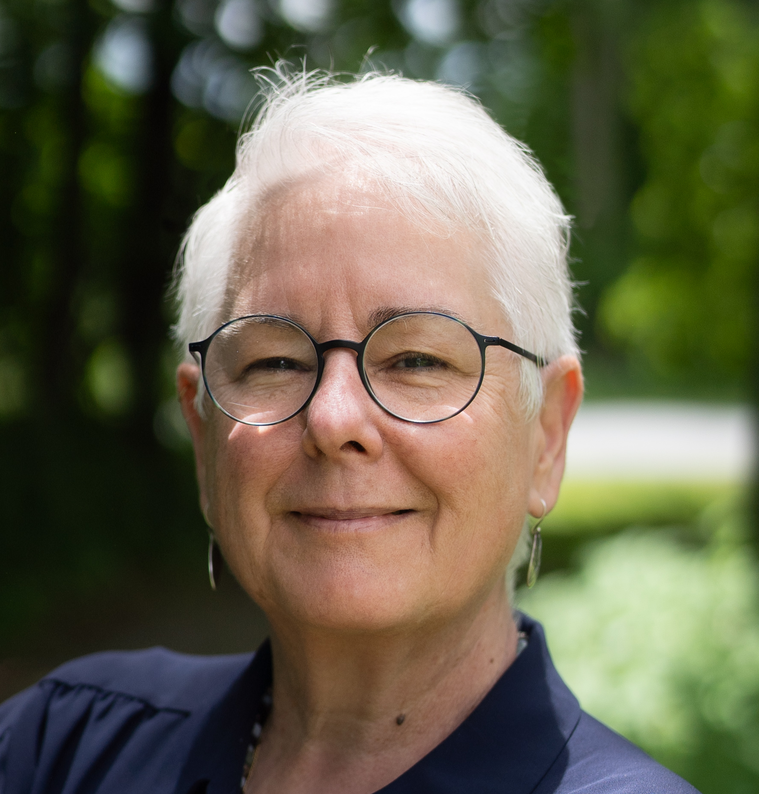
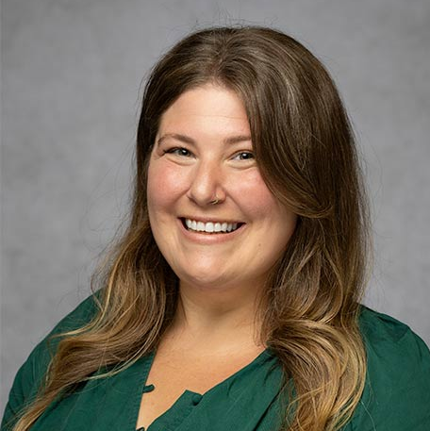
Meet the Panelists
Colleen McDonald
NYS Educator Workforce Development HUB
EDHUBNY
colleen@edhubny.org
Kaleigh Pickett
Teacher Apprenticeship Coordinator
Missouri State University
KaleighPickett@MissouriState.edu
Notes:
Speaker: Lisa
3:05 – 3:20 PM

Slide 9

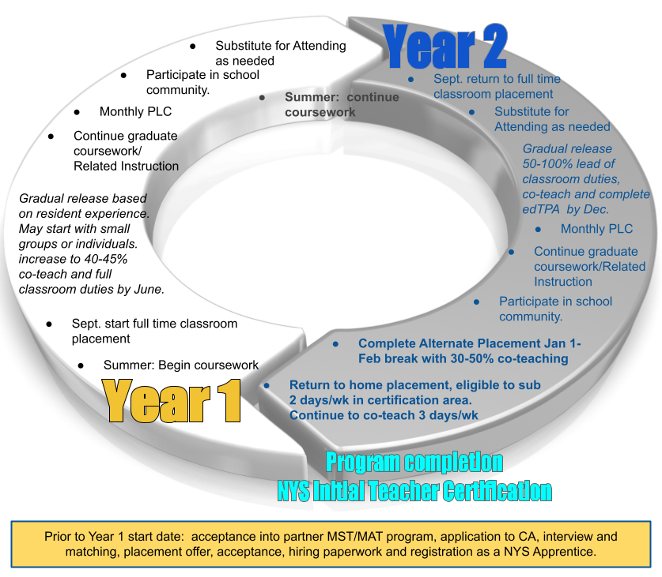
Background
2017- Launched a 2-year graduate residency program
Residents are hired and paid $22,000/year.
  Embedded in a classroom with an attending teacher full time.
Attending teachers earn a $4,500/year stipend.
Districts pay total program costs (approx. $33,000/resident) and receive state aid on those costs the following year, establishing a revenue stream which is reinvested in CA.
2021 - Became a Registered Apprenticeship
Provided additional financial support
NYS Registered Apprenticeship
Notes:
2016 planning grant, brought together a team of stakeholders to identify and solve the problem. District leadership, at that time, did not feel that first year teachers were coming in well enough prepared to meet student needs. So pay, embedding coursework, longer experience, mentoring to navigate all of the aspects-including the adult relationships- of the school community
Speaker: Lisa
3:05 – 3:20 PM

Slide 10

Matching Process
Apprentice
Interest
Complete Questionnaire
Matching
Conversation
Classroom Visit
Placement Offer
Teacher Nomination
Complete Questionnaire
Notes:
Speaker: Lisa
3:05 – 3:20 PM

Slide 11

Roles and Responsibilities
NYS Registered Apprenticeship
Apprentice
Register for and complete all required IHE coursework, maintaining a “B” average
Attend and engage in the classroom daily becoming a full partner as described in the Gradual Release document
Collaborate, co-plan and co-teach with my Attending Teacher
Report absences through the system and to the Attending Teacher
Participate in the school community, events, and PLC
Agree to substitute for my Attending anytime after 11/1 and for up to 2 days per week in my certification area the second semester of the 2nd year.
Attending Teacher
Engage, inspire, assist, encourage, and advance the professional learning of the Apprentice by providing information, mentoring, coaching, modeling, meta-cognition around professional decision making and problem solving around group and individual classroom needs,
Model professional conduct
Collaborate with partners
Participate in matching process, professional development, and PLC
Notes:
2016 planning grant, brought together a team of stakeholders to identify and solve the problem. District leadership, at that time, did not feel that first year teachers were coming in well enough prepared to meet student needs. So pay, embedding coursework, longer experience, mentoring to navigate all of the aspects-including the adult relationships- of the school community
Speaker: Lisa
3:05 – 3:20 PM

Slide 12
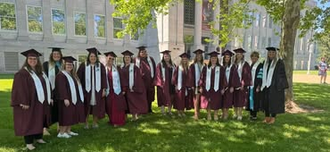
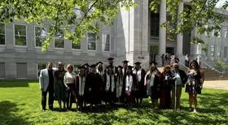
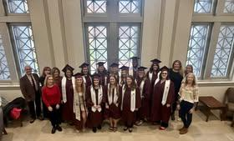
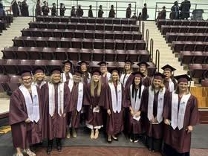
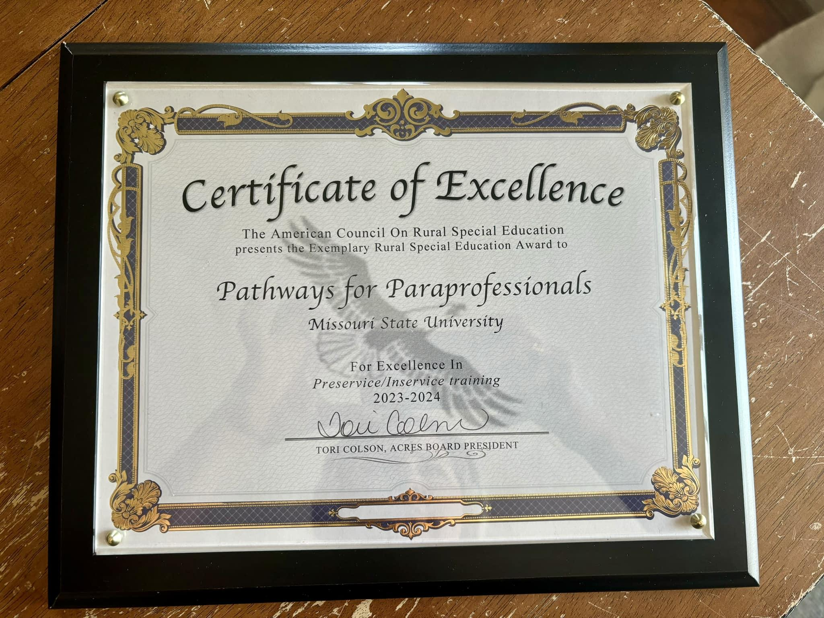

Pathways for Paras: A Grassroots RTAP Model
Began with a simple question:
“How can we help districts grow special education teachers?”
Started with small university start-up funds
Direct outreach to districts across Missouri
Built through district partnerships and shared design
Now supports around 200 active teacher apprentices
Notes:
Before I talk about mentorship specifically, I want to provide a little context about our program.
Pathways for Paras started in 2021 when faculty at Missouri State sat down with Missouri superintendents and asked a simple question: “How can we help?”
Districts consistently told us they already had talented paraprofessionals working in their schools who wanted to become teachers — they just needed a pathway that worked with their jobs and their lives.
So we designed Pathways for Paras, a registered teacher apprenticeship program that allows paraprofessionals to earn their teaching certification while remaining employed in their school districts.
What makes our program somewhat unique is that it did not start with a large grant. We began with a small amount of start-up funding and literally mailed postcards to paraeducators across the state and visited districts to talk about the idea.
The response was overwhelming. In fall 2022 we launched with around 350 apprentices, and we now sustain around 200 active apprentices at any given time.
CEEDAR RTAP AG_ Mentorship, MSU
The program continues to grow through strong partnerships with districts, and that collaborative design really shapes everything we do — including our mentorship model.
Speaker: Lisa
3:05 – 3:20 PM

Slide 13
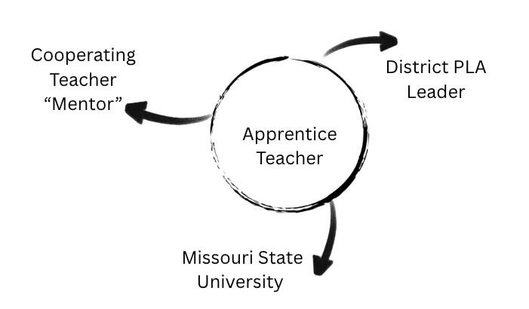
Pathways Mentorship Ecosystem
Teacher apprentices are supported by three partners:
Missouri State University
Coursework, coaching, evaluation
District PLA Leader
Placement, program coordination, assessment support, mentor/mentee on-site support
Cooperating Teacher (Mentor)
Daily coaching and instructional modeling,
Supports instructional skill development
Includes apprentices in professional learning
Models collaboration with families and colleagues
Helps evaluate program competencies
Apprentice = Paraeducator learning while working
Notes:
Because our apprentices are already working in schools as paraeducators, their preparation happens in two places at once.
They are learning through university coursework while also working directly with students every day.
That means mentorship becomes absolutely critical. It is what helps apprentices connect what they are learning in their courses with what they are doing in real classrooms.
Our model relies on three key partners working together.
Each district designates a PLA leader, who helps coordinate the apprenticeship locally.
Each apprentice is also paired with a cooperating teacher, who serves as their day-to-day mentor.
And then our university faculty and program team support the coursework, evaluation, and overall program coordination.
This shared structure allows the apprentice to receive consistent guidance from both the district and the university.
Speaker: Lisa
3:05 – 3:20 PM

Slide 14

Moving Forward
Current reality:
Mentors provide significant support
Training often informal
Mentorship varies across districts
Cohorts created organically
Next steps:
Structured mentor training in Year 1
Mentor/mentee onboarding resources
Intentional cross-district collaboration
Continuous program improvement
Notes:
The cooperating teacher is really the heart of the mentorship model.
This person acts as an on-site coach and guide, helping the apprentice apply new instructional strategies with students and develop the habits of effective teaching.
Mentors often bring apprentices into professional learning opportunities, department meetings, and parent meetings so they can see how teachers collaborate and make decisions.
They also help assess the apprentice’s development at key checkpoints in the program, often working with district leaders and university faculty to evaluate competencies aligned with state teaching standards.
CEEDAR RTAP AG_ Mentorship, MSU
Ultimately, mentors help apprentices navigate the transition from supporting instruction as a paraeducator to leading instruction as a teacher.
Speaker: Lisa
3:05 – 3:20 PM

Slide 15
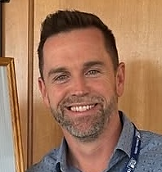

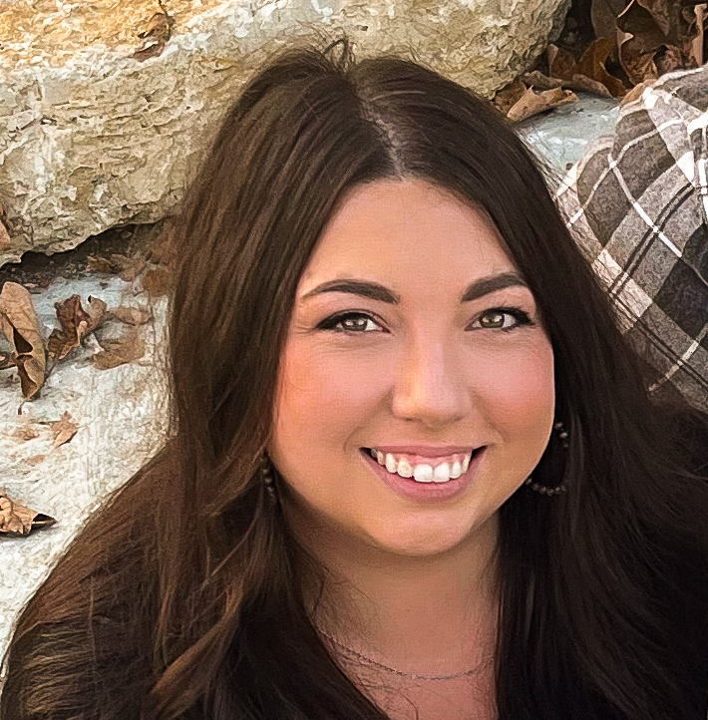
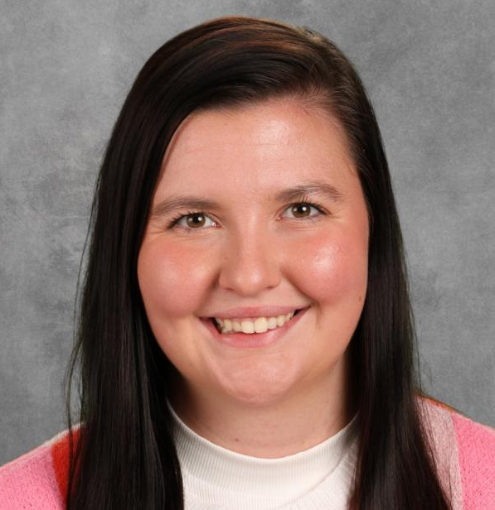
Meet the Panelists
Jason Sutliff
7-12 English Teacher
Lead Teacher Apprenticeship Program
Cambridge Central School District (NY)
jason.sutliff@cambridgecsd.org
Olivia Stanzl
2nd Year Apprentice
Cambridge Central School District (NY)
olivia.stanzl@cambridgecsd.org
Abigail Wray
Special Education Teacher/Mentor Teacher
Hollister High School (MO)
abigail.wray@hollisterschools.com
McKenzie Hamilton
Special Education Teacher Apprentice
Hollister High School (MO)
mrh2836s@MissouriState.edu
Notes:
Speaker: Lisa
3:20-49 PM

Slide 16

Questions and Discussion
Notes:
Speaker: Lisa
3:49-54

Slide 17

Final Affinity Group Session
Tuesday, April 21, 2026
3:00 – 4:00 p.m. ET
Topic: Registered Principal Apprenticeship Programs Preparing Effective Leaders
Featured Program: Rhode Island Registered Apprenticeship Principal Pathway (RIRAPP)
Notes:
Speaker: Meghan
3:54-55

Slide 18
RTAP Affinity Group Evaluation
During today’s Affinity Group session, you should have received an email with a link to an evaluation form for the Affinity Group.
Please take a few minutes before signing out of today’s affinity group session to complete the evaluation form.
Your feedback is important to us and helps us improve the quality and relevance of our services!
Check your email for a link to the CEEDAR RTAP Affinity Group evaluation form!
If you do not see it, please check your junk/bulk/spam folder.
Notes:
Speaker: Meghan
3:55-4:00

Slide 19
Disclaimer
This content was produced under U.S. Department of Education, Office of Special Education Programs, Award No. H325A220002. David Guardino serves as the project officer. The views expressed herein do not necessarily represent the positions or policies of the U.S. Department of Education. No official endorsement by the U.S. Department of Education of any product, commodity, service, or enterprise mentioned in this website is intended or should be inferred.

