Slide 1
Preparing Special Education Teachers Through Registered Teacher Apprenticeships
An Affinity Group hosted by the CEEDAR Center
Notes:
Speaker: Abby
3:00 – 3:07

Slide 2
Session 4: Building the
Paraeducator Pipeline Using
Registered Apprenticeships
Featuring Gorham School District's Paraeducator Apprenticeship Program
February 17, 2026
Notes:
Speaker: Abby
3:00 – 3:07

Slide 3
Housekeeping
Please add your organization to your Zoom name:
In the Participants list, click the “More“ button by your name
Select “Rename” from the drop-down menu
Add a short version of your organization name after your name, then click “OK”
Today’s session is being recorded.
Please remain on mute when not speaking to minimize noise.
We encourage you to turn your video camera on.
Share questions and comments in the chat box.
If you have any technical issues, please contact Abby Berner at aberner@air.org.
Notes:
Speaker: Abby
3:00 – 3:07

Slide 4
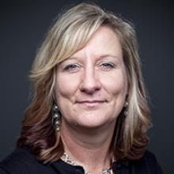
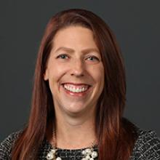
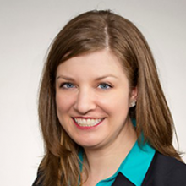
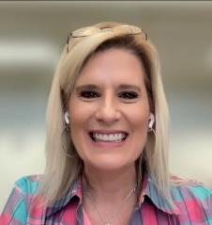
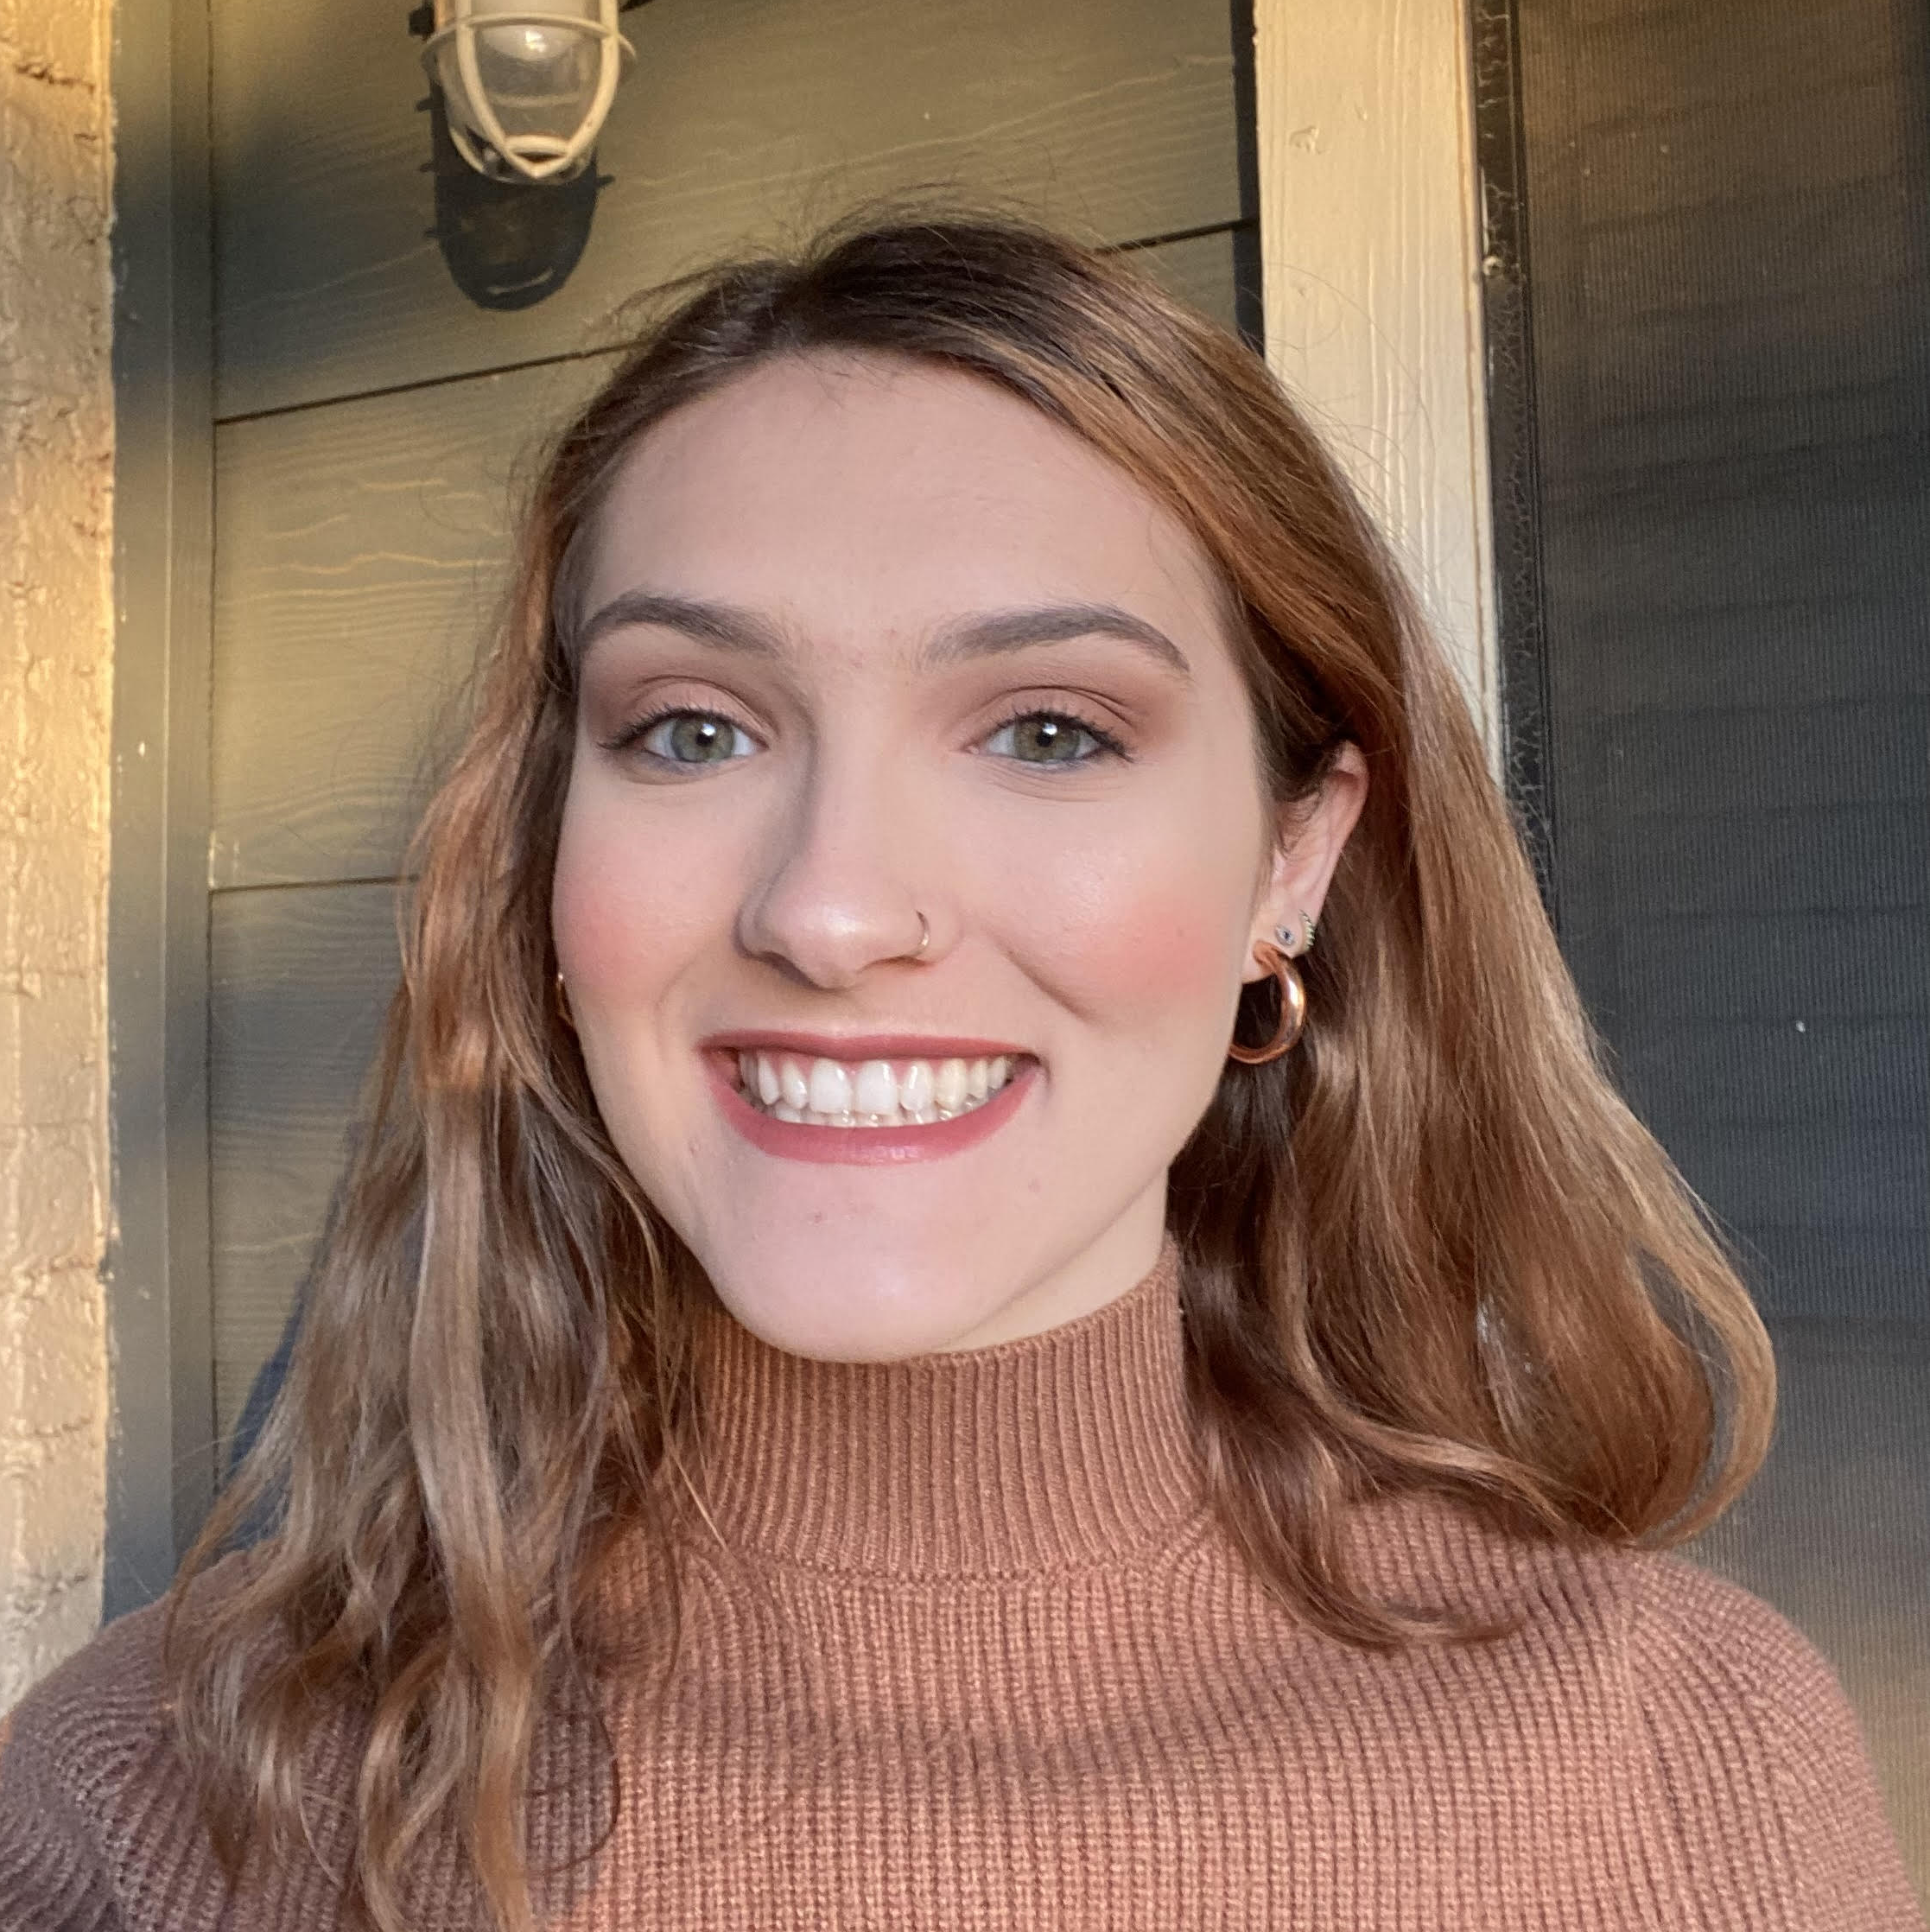
Welcome and Introductions
Lynn Holdheide
Content Expert,
CEEDAR
Managing TA Consultant, American Institutes for
Research (AIR)
Cheryl Krohn
Content Expert, CEEDAR
Senior TA Consultant, American Institutes for Research (AIR)
Meghan Wills
Content Expert, CEEDAR
Senior TA Consultant, American Institutes for Research (AIR)
Lisa White
Facilitator and
RTAP Coordinator, CEEDAR
Abby Berner
Engagement Specialist, CEEDAR
Research Assistant, American Institutes for Research (AIR)
Notes:
Speaker: Abby
3:00 – 3:07

Slide 5

Agenda
CEEDAR Center Overview
Today's Objectives
Affinity Group Overview
Resources from Council for Exceptional Children on Training and Supporting Paraeducators
Apprenticeship Program Spotlight: Gorham School District's Paraeducator Apprenticeship
Breakout Groups
Notes:
Speaker: Abby
3:00 – 3:07

Slide 6


CEEDAR Center Overview
Collaboration for Effective Educator Development, Accountability, and Reform (CEEDAR) Center at the University of Florida, with American Institutes for Research (AIR) as a partner.
National Technical Assistance Center, currently partnering with 21 states.
Provides assistance to collaborating teams of state departments of education, institutes of higher education, and local education agencies to ensure effective teachers and leaders for each student.
Resources available at CEEDAR.org
Notes:
Speaker: Abby
3:00 – 3:07

Slide 7

CEEDAR’s Mission
To support students with disabilities (SWDs) in achieving college- and career-ready standards by building the capacity of state personnel preparation systems to prepare teachers and leaders to implement evidence-based practices (EBPs) within multi-tiered systems of support (MTSS).
“Every student with a disability
has an opportunity to achieve.”
Notes:
Speaker: Abby
3:00 – 3:07

Slide 8
CEEDAR States
Direct TA States
Universal TA States
© FreePowerPointMaps.com
Notes:
Speaker: Abby
3:00 – 3:07

Slide 9
Today’s Objectives
Share the Council for Exceptional Children's resources related to training and supporting paraeducators
Spotlight an innovative Registered Apprenticeship Program (RAP) preparing paraeducators in Maine.
Discuss considerations for designing a RAP for paraeducators.
Notes:
Speaker: Abby
3:00 – 3:07

Slide 10

CEEDAR RTAP Affinity Group Purpose
Promote the RTAP pathway as a recruitment and retention strategy for special education teachers to address teacher shortages.
Foster a sense of community, create a shared learning space, and promote mutual support for partners interested in learning more about RTAPs to prepare special education teachers.
Notes:
Speaker: Abby
3:00 – 3:07

Slide 11

RTAP Affinity Group Overview
Collaborative discussions on RTAPs for special education teachers
Cross-state learning to amplify promising practices and address common barriers
Resource sharing to promote existing resources
Six (6) sessions, October 2025 – April 2026; each session covers a different topic
Join any/all sessions that are of interest to you!
Notes:
Speaker: Abby
3:00 – 3:07

Slide 12
RTAP Affinity Group Session Topics
Session | Date* | Topic
1 | October 28, 2025 | Building Apprentice Capacity Using the High-Leverage Practices (HLPs) for Students with Disabilities
2 | November 18, 2025 | Dual Certification in RTAPs
3 | January 13, 2026 | Preparing Specialized Special Education Teachers Through RTAPs
4 | February 17, 2026 | Building the Paraeducator Pipeline Using Registered Apprenticeships
5 | March 17, 2026 | The Importance of Mentor Teachers/Journey Workers in RTAPs
6 | April 21, 2026 | Topic TBD
*All sessions will take place from 3:00-4:00 p.m. ET.
Notes:
Speaker: Abby
3:00 – 3:07

Slide 13
Resources
Notes:
Speaker:

Slide 14
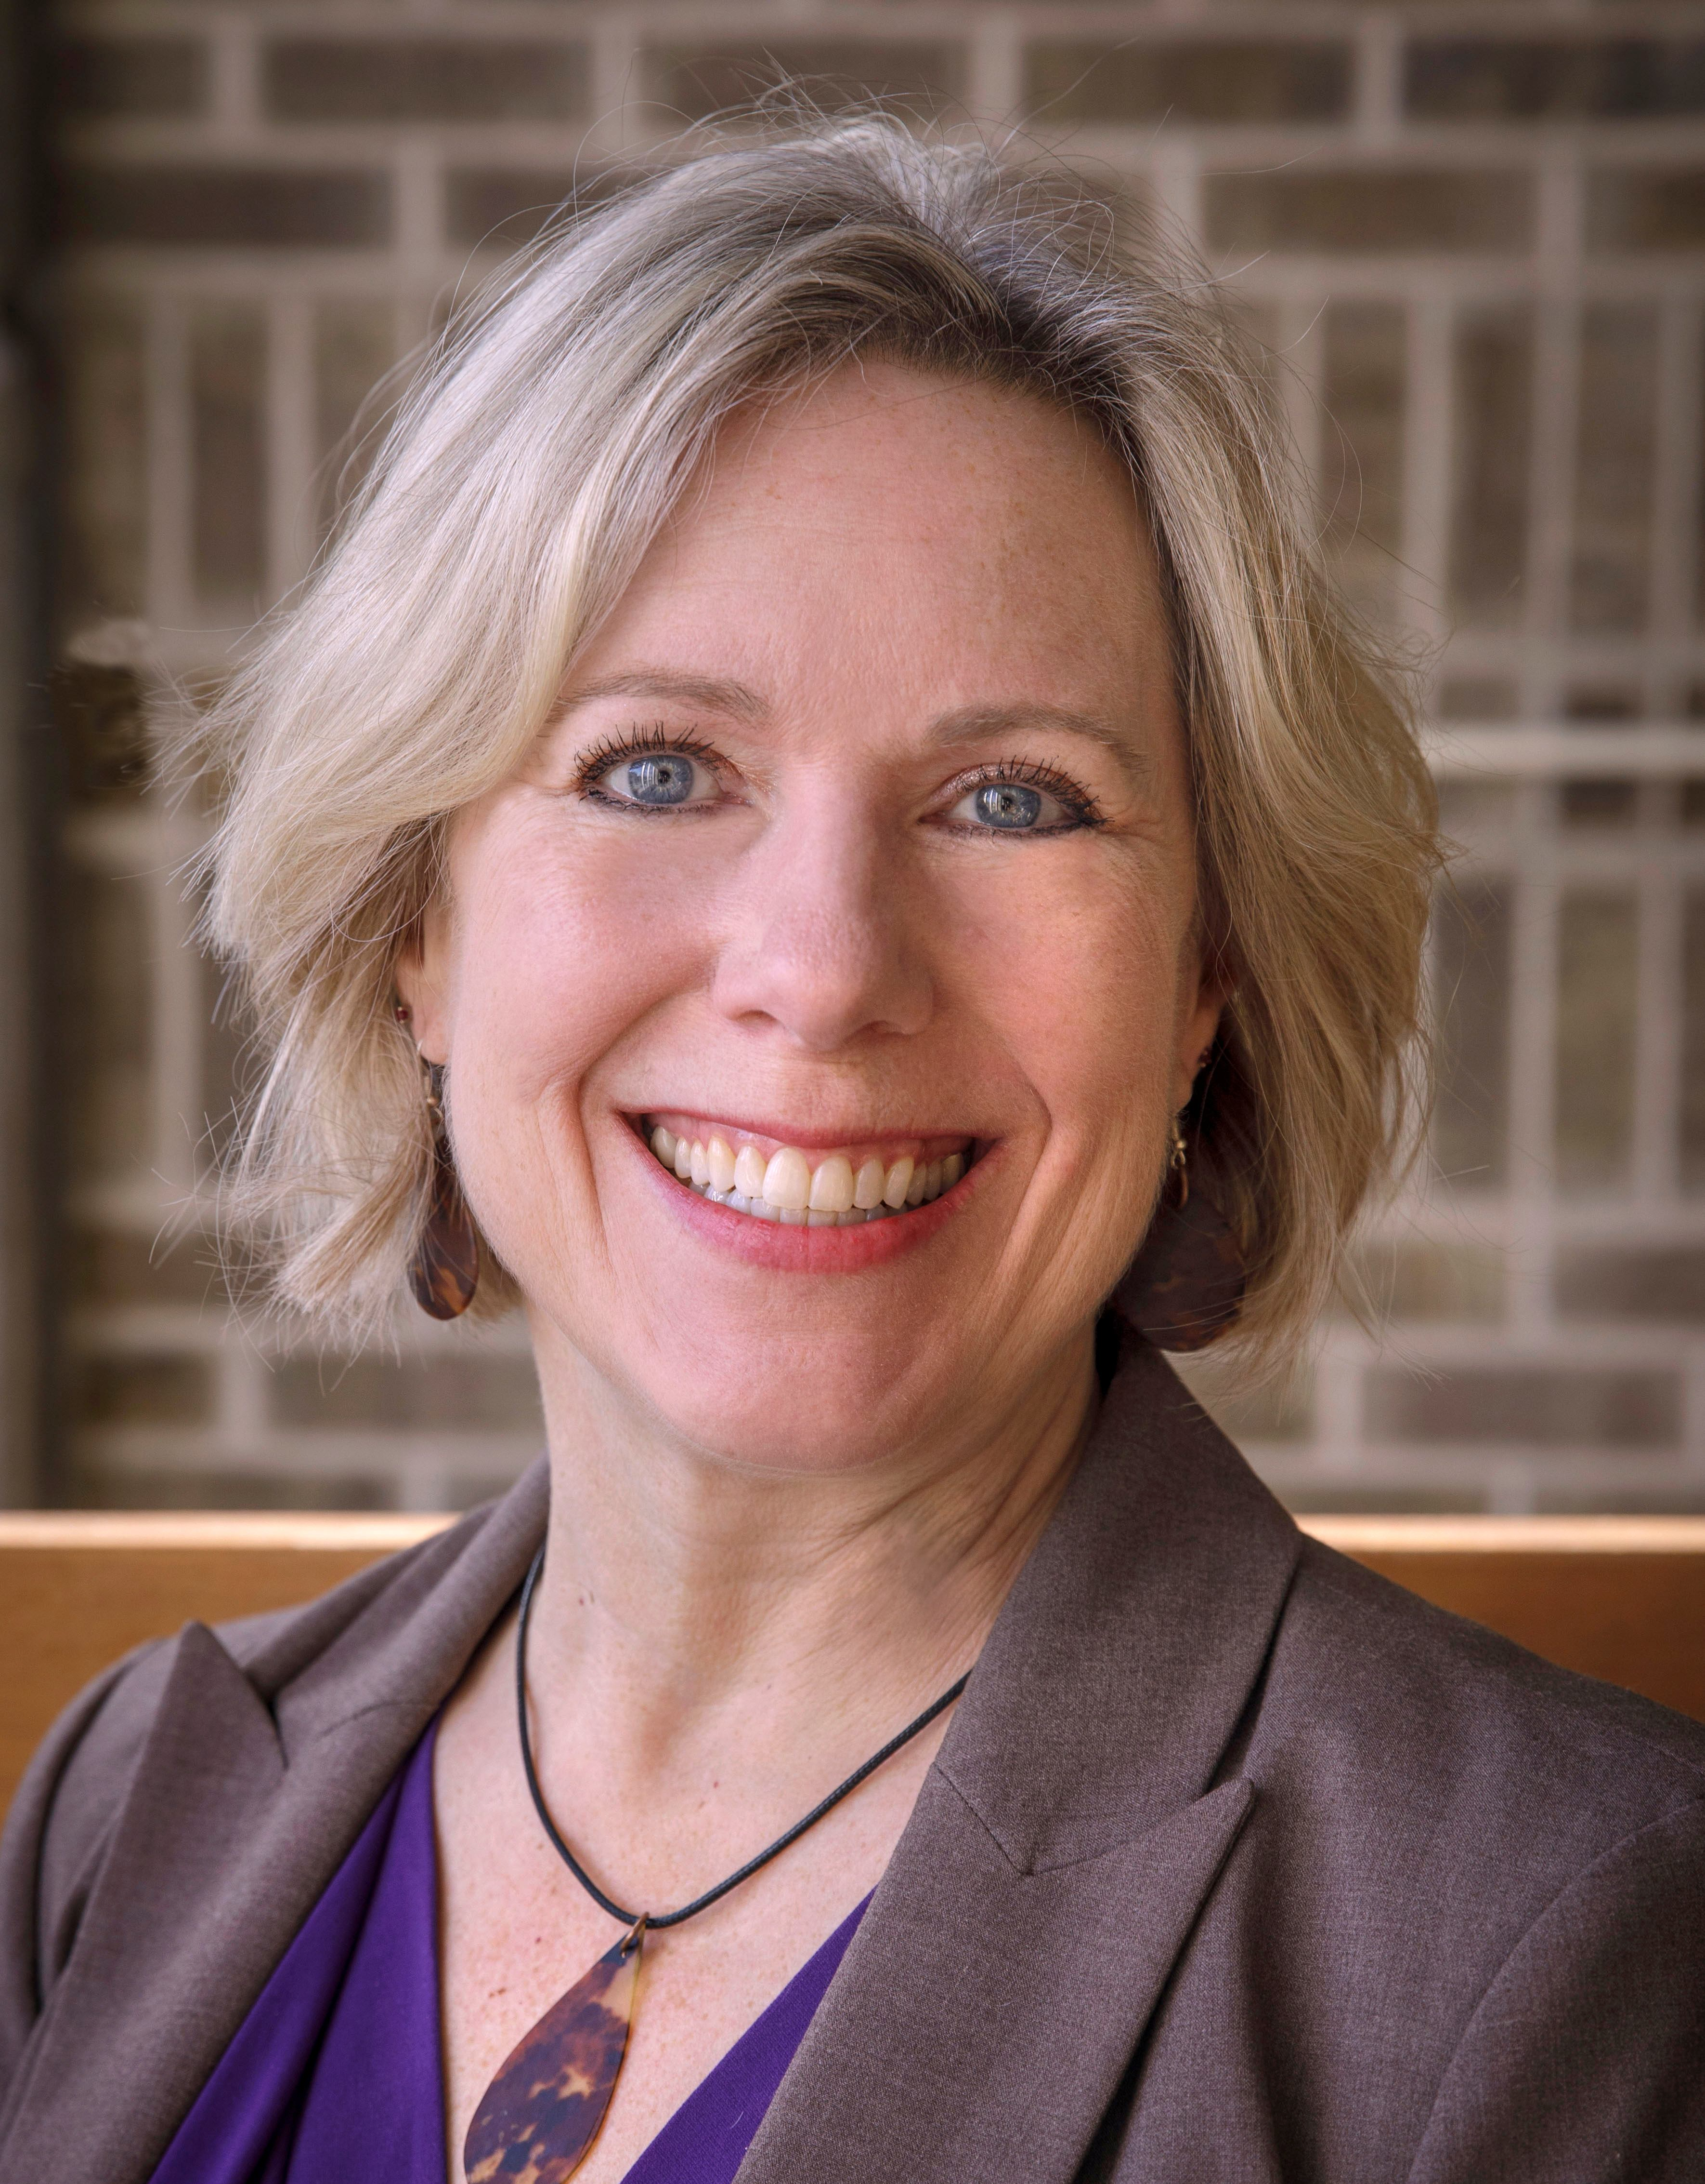
Meet the Presenter
Dr. Amy C. Stevens
Senior Director, Professional Development and Standards
Council for Exceptional Children
astevens@exceptionalchildren.org
Notes:
Speaker: Lisa introducing Amy
3:07-3:17

Slide 15
Paraeducator Support
Amy C. Stevens, PhD
Senior Director, Professional Development & Standards
Professor Emerita, UWW

Slide 16
Overview
16
Membership
Convention
CECommunity
Paraeducator Resource Page
Notes:
Why its important for our standards to have impact in the field
How we’re using the standards now for program review and what program review is
How it fits into accreditation with CAEP highlighting diminishing scope

Slide 17

Paraeducator Benefits
Membership
Annual Convention
Special Discounted Membership
  Basic $85 reduced to $45
Membership Chart
Free Registration
Convention Registration
Workshop: From Support to Success (Admin & Teachers)
Notes:
Workshop From Support to Success: Tools for Teachers and Administrators to Build Paraeducator Capacity
Ritu Chopra, Executive Director of PARA Center U of Colorado Denver &
Peggy Yates, Assoc Prof Alma College

Slide 18
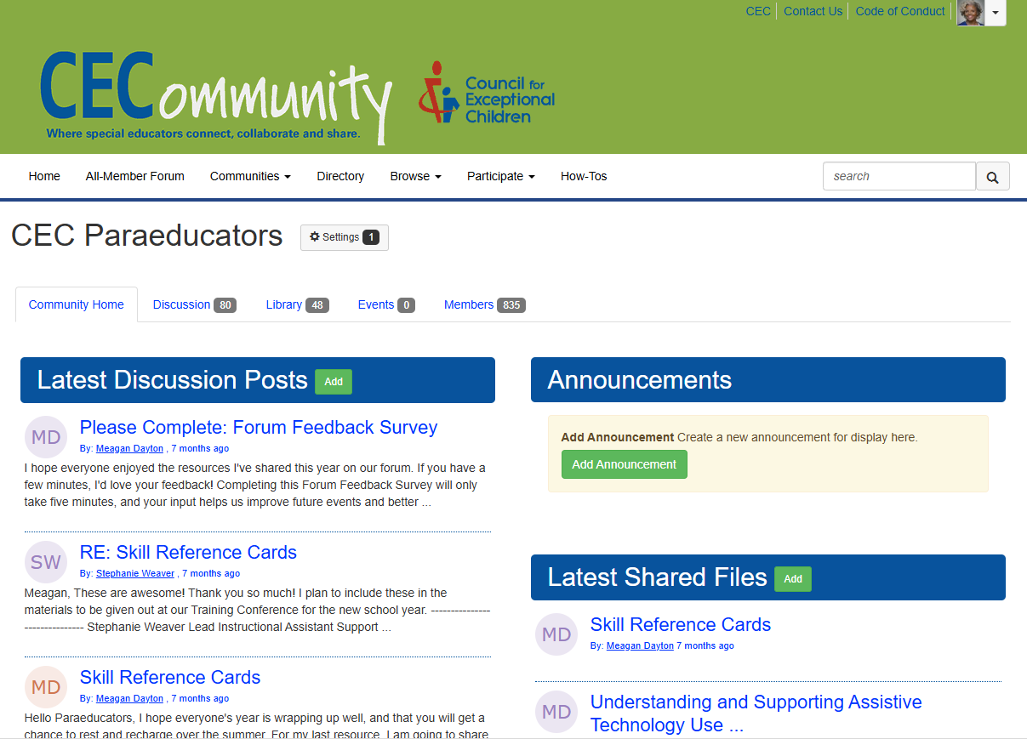
CECommunity: CEC Paraeducators
Discussion Posts & Announcements
Topic Folders with Useful Documents
  Behavior Management
  Instructional Strategies
  Accommodations
  IEPs & Special Educ Law
  Technology
  Collaboration
CECommunity Paraeducators

Slide 19
Paraeducator Resource Page: Free to All!
https://exceptionalchildren.org/paraeducators
Competencies for Paraeducators
PD Programs based on the first iteration of HLPs
Effective & High Leverage Practices for Paraeducators
  Collaboration
  Assessment
  Instruction
  Social/Emotional/Behavioral
  Effective & HLP
Supporting Paraeducators: Admins & Teachers
Paraeducator Assessment & Evaluation Toolkit
Notes:
Collection | Supporting Paraeducators: Successful Systems & Strategies for Admins and Teachers
September 6, 2021 - December 31, 2025
Who is this collection for?
Special education teachers
Special education administrators
Building/district administrators
Even general education teachers will benefit from this collection
*This collection is intended for anyone working directly with paraeducators -- not for paraeducators directly.
What do I get?
8 curated, on-demand workshops (which means 9 continuing education units (CEUs) too!)
One year access from registration date to watch and re-watch any or all the workshops at your own pace and convenience.
Receive CEH certificates for the workshops you complete or for completing the whole collection (9 CEHs).
A selection of multiple extremely helpful resources and journal articles chosen by the presenters to enhance and support your supporting paraeducators learning journey.

Slide 20
Apprenticeship Spotlight:
Gorham School District's Apprenticeship Preparing Paraeducators
Notes:
Speaker: Lisa introducing Heather
3:17-3:27

Slide 21
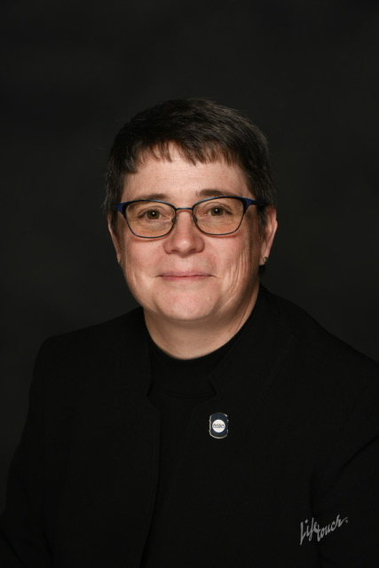
Meet the Presenter
Dr. Heather Perry
Superintendent
Gorham School District
heather.perry@gorhamschools.org
Notes:
Speaker: Lisa introducing ADE
3:07-20

Slide 22
Apprenticeships
Educator
Creating Pathways to Address Educator Pipeline Needs in Maine

Slide 23
Our Why?
Educator Apprenticeship programs matter because they build strong, representative teacher pipelines, and provide paid, hands-on pathways into the profession that allow us to grow and retain educators who know our schools, our students, and our communities.
  Clear Pathways
  Theory Into Practice
  Remove Barriers (Time and $)
  Access immediate benefits (employer & employee)
  Strong mentors
  Recruit & Retain

Slide 24
Glossary of Terms
  Ed. Tech. I - In Maine is a paraprofessional with less than 60 college credits
  Ed. Tech. II - In Maine is a paraprofessional with between 60-90 college credits
  Ed. Tech. III - In Maine is a paraprofessional with 90+ college credits
  SAU - In Maine, it is a School Administrative Unit, similar to LEA.
  Capstone - Required presentation & reflection of learning at conclusion of Pre Apprentice and Phase I apprentice programs. For Phase I, worth 9 credits.

Slide 25
Program Overview
Pre-Apprentice Program
Educator Apprentice Phase I
Educator Apprentice Phase II
  High School Juniors & Seniors
  Paid School-Based Mentors
  Year-Long Apprenticeship
  Dual Enrollment with USM
  Capstone project
  No Cost to participants
Upon completion & graduation may enter Educator Apprentice Phase I
  Min. HS Diploma
  Max Ed. Tech. II status
  No Cost to Participants
  18-month program
  61 College credits (31 are “traditional” and 30 are Work-based.
  Employed full-time w/benefits
  Assigned mentor
  Capstone Project
Upon completion, students eligible for Ed. Tech. II status & may continue into Phase II
  Min. Ed. Tech. II Status
  2-3 Year Program
  Employed full-time with benefits as Ed. Tech.
  Special Education Teacher Prep only right now
  Complete full credit requirements; each class has work-based requirements.
  Assigned Mentor
  Cost = braided structure (3-4 classes)
  Final semester = sabbatical concept
Upon completion, students earn B.S. and are certified to teach Special Ed. (282)

Slide 26
Key Challenges
Target Recruits
On Ramps and Off Ramps Are The Key!
Existing Ed. Techs
“Traditional”
Career Changers
Representative Populations
Lessons Learned
  Communication is key, especially w/partners
  Timelines are important, when to recruit
  Plan ahead; set aside slots in advance
  Understand the “behind the scenes” work - DOL
  Train mentors
  Have great partners!
  Certificate Programs, Associate's Degrees, Core Requirements, & navigation
  Tuition support for Phase II
  Continued support for “back end” work required
  Too many “cooks” in the “kitchen”
  Time for Ed. Tech. to teach

Slide 27

Questions and Discussion
Notes:
Speaker: Lisa
3:27-3:37

Slide 28
Breakout Groups
Notes:
Speaker: Meghan
3:37-3:55

Slide 29
Breakout Groups:
Join one of two breakout rooms:
CEC Resources for Paraeducators: Learn more about CEC's resources and supports for paraeducators and get answers to your questions.
District and School Considerations for Paraeducator Apprenticeships: Take a deeper dive into district and school considerations for paraeducator apprenticeships and engage in discussion with your peers and today’s speaker.
Select the breakout room that best meets your needs today!
CEEDAR staff members will be in each breakout room to guide the conversation.
Notes:
3:37 – 3:55

Slide 30
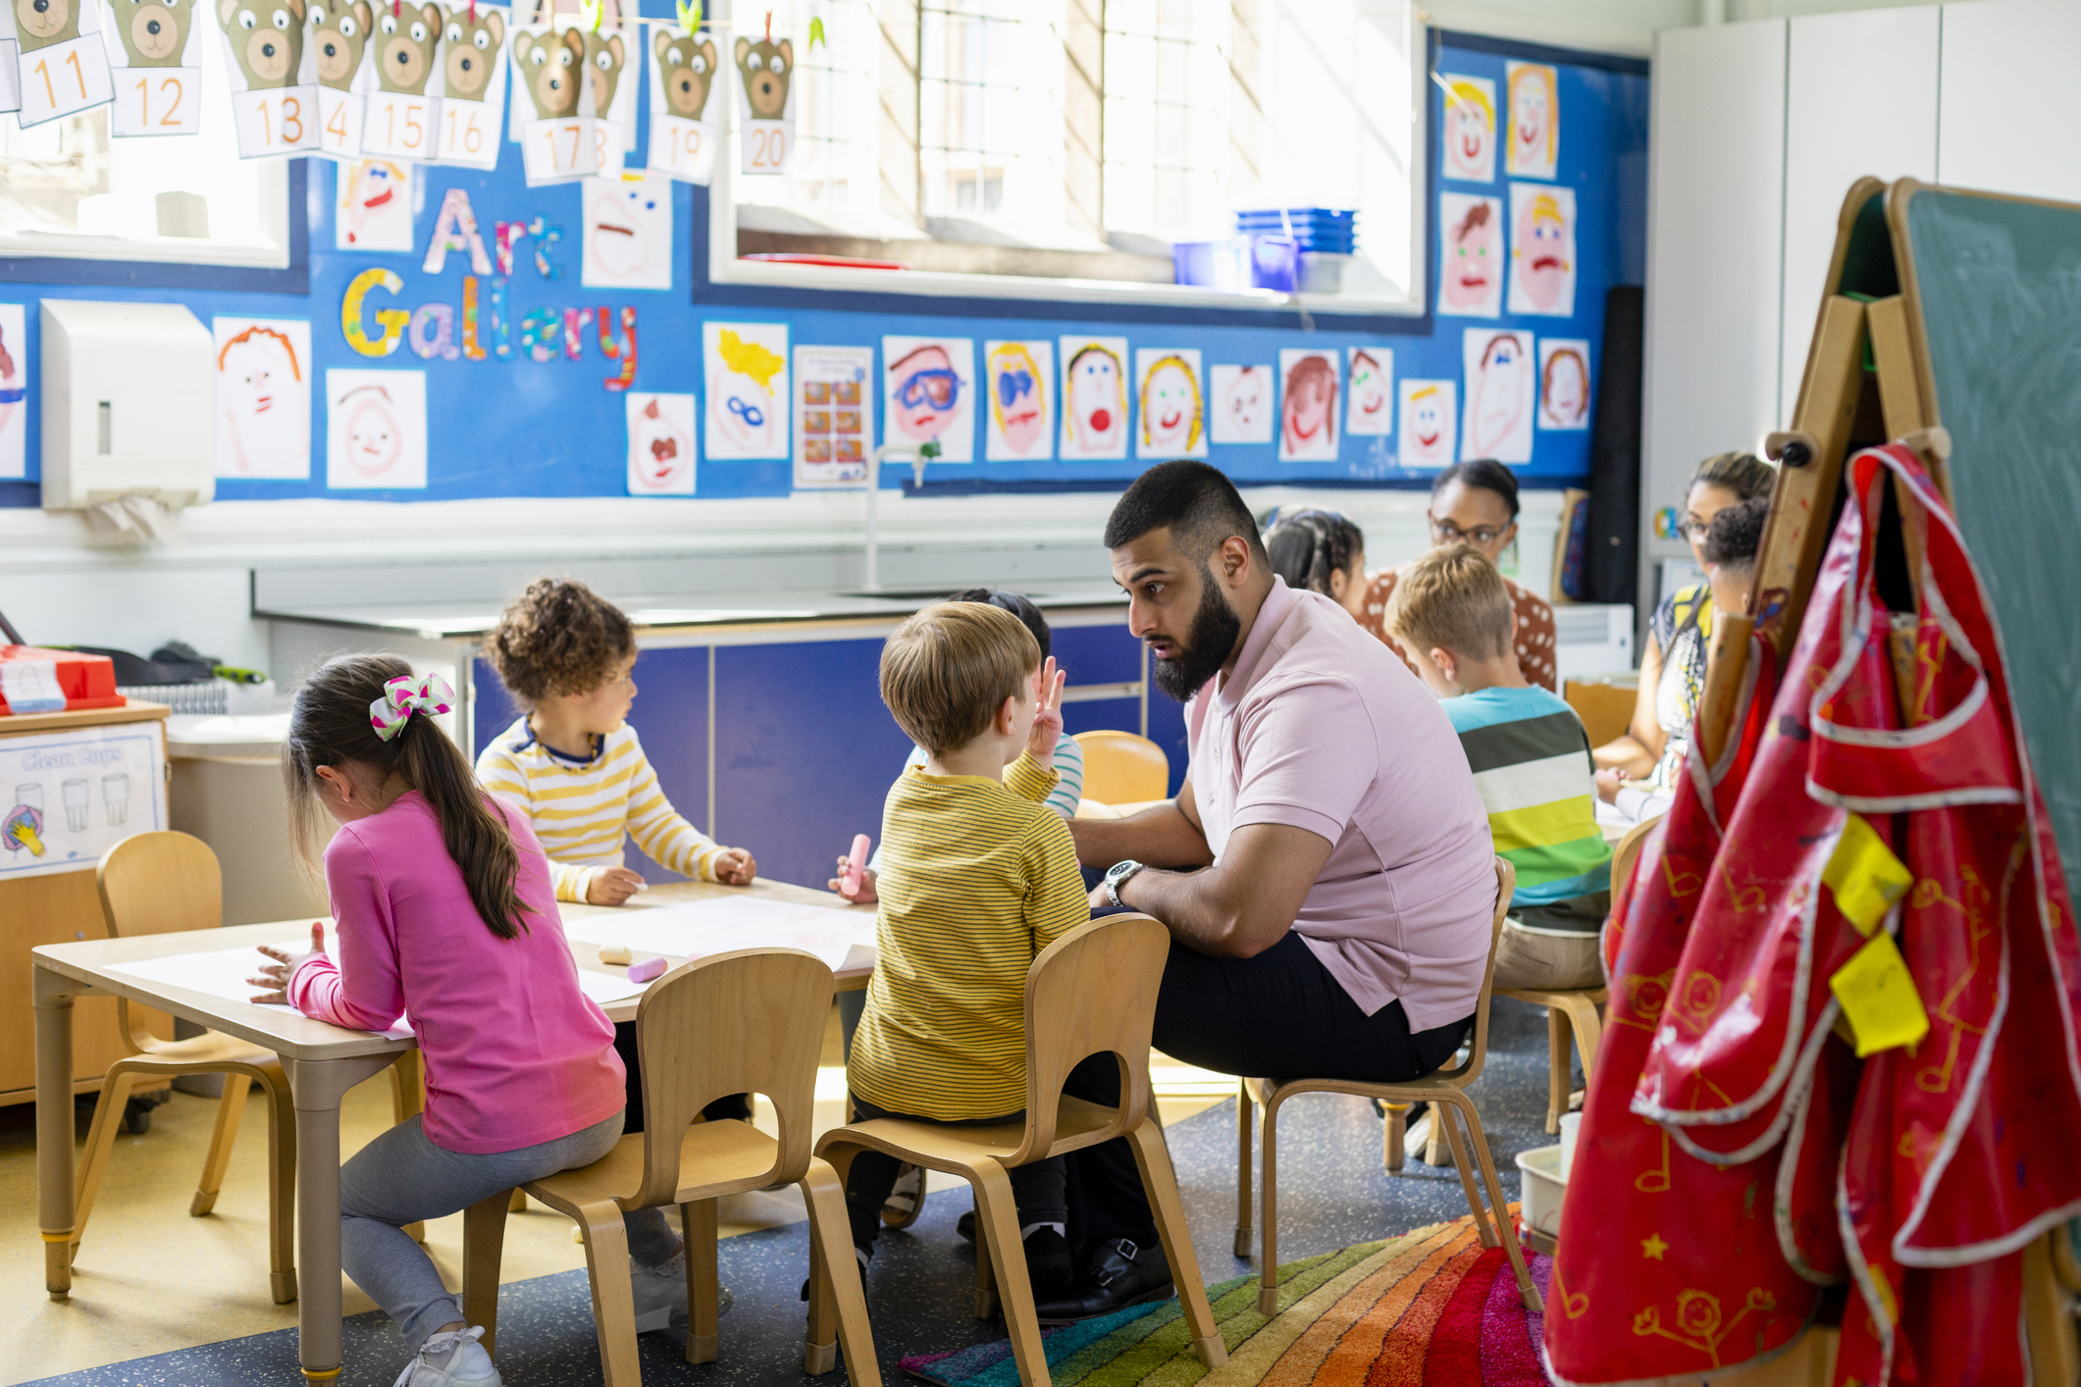
Breakout Group Debrief
CEEDAR staff, use the chat box to share one key takeaway from your breakout group.
Notes:
Speaker: Meghan
3:55-3:57
Start recording again

Slide 31
Next Affinity Group Session
Tuesday, March 17, 2026
3:00 – 4:00 p.m. ET
Topic: The Importance of Mentor Teachers/Journey Workers in RTAPs
Featured Programs: Missouri State University and EDHUBNY
Notes:
Speaker: Meghan
3:57-58

Slide 32
Disclaimer
This content was produced under U.S. Department of Education, Office of Special Education Programs, Award No. H325A220002. David Guardino serves as the project officer. The views expressed herein do not necessarily represent the positions or policies of the U.S. Department of Education. No official endorsement by the U.S. Department of Education of any product, commodity, service, or enterprise mentioned in this website is intended or should be inferred.

