Slide 1
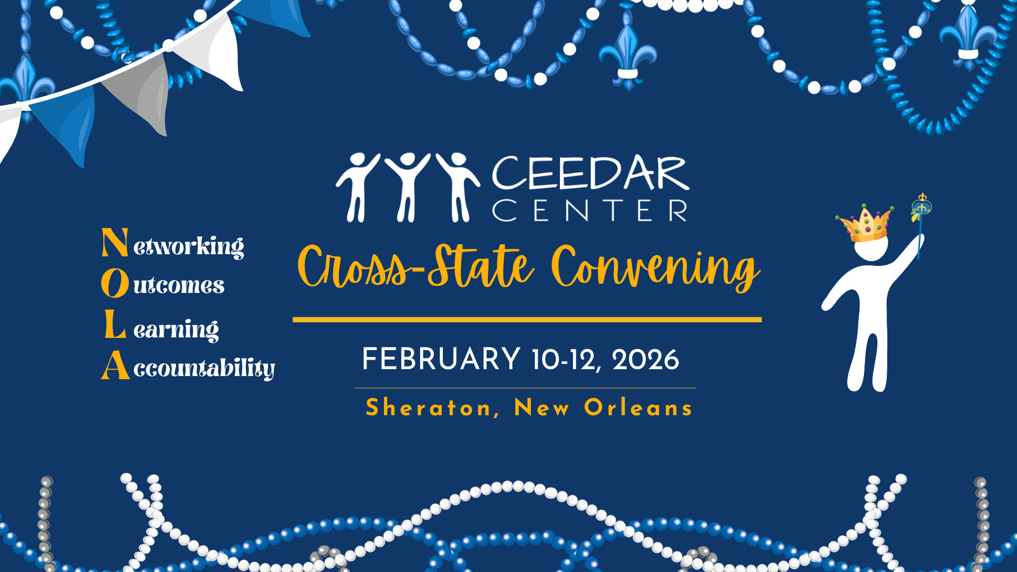
CCSC intro

Slide 2


Accountability in action
Using Innovation Configurations to Strengthen Teacher and Leader Preparation
Presented by:
Lori Farley, Tennessee Department of Education
Farnoosh Shahrokhi, George Mason University
Pari Paluszak, Mary Baldwin University
Katrina Maynard, James Madison University
Cross-State Convening

Slide 3




Outcomes
Cross-State Convening
What we'll cover in this session:
  Understanding how the innovation configurations strengthen accountability and support continuous improvement
  Identifying strategies for building effective teams within universities and across partners including SEAs, LEAs, and other collaborating organizations

Slide 4


Engagement
When you think of program improvement, what is one thing that comes to mind?
Write your response on a post-it note
Cross-State Convening

Slide 5


Essential Question VA
Cross-State Convening
Essential Question VA:
How can university units collaborate intentionally to leverage CEEDAR resources to strengthen educator preparation programs and improve candidate outcomes?

Slide 6



VIRGINIA
Katrina Maynard
Cross-State Convening

Slide 7

What We Know About Innovation Configuration (IC)
Has a variety of purposes.
Can be tailored to program’s personal needs.
Aligns with a variety of standards.
Provides a crosswalk between standards.
Provides a holistic view of your program once information has been entered into IC.
Helps programs identify areas of need or needs for program adjustments/improvement (i.e., missing HLPs or VDOE Competencies).
Cross-State Convening

Slide 8
1-3
Cross-State Convening
1.JMU’s CEEDAR relationship began in 2022.
2.Provided PD on HLPs for all Faculty (Fall 2022).
3.SPED and IECE Program completed Innovation Configuration (IC) on HLPs and VDOE Competencies (Fall 2023-present).
What HLPs are covered in which specific courses?
Determined whether specific skill and/or HLPs are at the introductory, developing, and applied level for each course.
What are our program holes?
How do we ensure all identified HLPs are being adequately covered across the program?

Slide 9
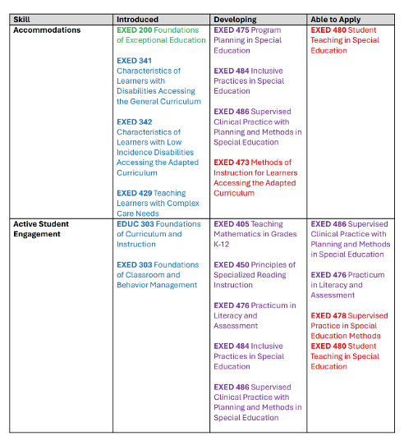
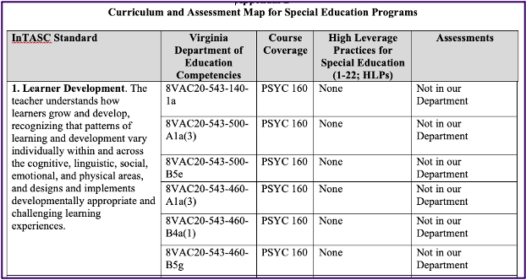
Tables
Cross-State Convening

Slide 10
4-7
Cross-State Convening
4. Training and Technical Assistance Center (TTAC) provided multiple trainings with paraprofessionals on HLPs in Region 5 within the local school divisions.
5. Programs discussed and decided on their top 5-7 HLPs to highlight (Summer 2023).
6. Added HLPs to all program courses and syllabi (Fall 2024).
7. Aligned all HLPs, VDOE competencies and course key assessments/assignments (Fall 2024).

Slide 11
8-9
Cross-State Convening
8. Developed and implemented a two-year study to support ST, US and CT (Fall 2024) in the areas of:
Effective implementation of Systematic Designed Instruction (SDI), Universal Design for Learning (UDL) and High Leverage Practices (HLPs).
Use and importance of effective feedback and providing quality feedback in a coaching setting (specific, statement focused and connection making with real examples).
Use of Opportunities to Respond (OTRs) to enhance engagement.
9. Attempting to close the Research to Practice Gap by presenting research to constituents in the field.

Slide 12
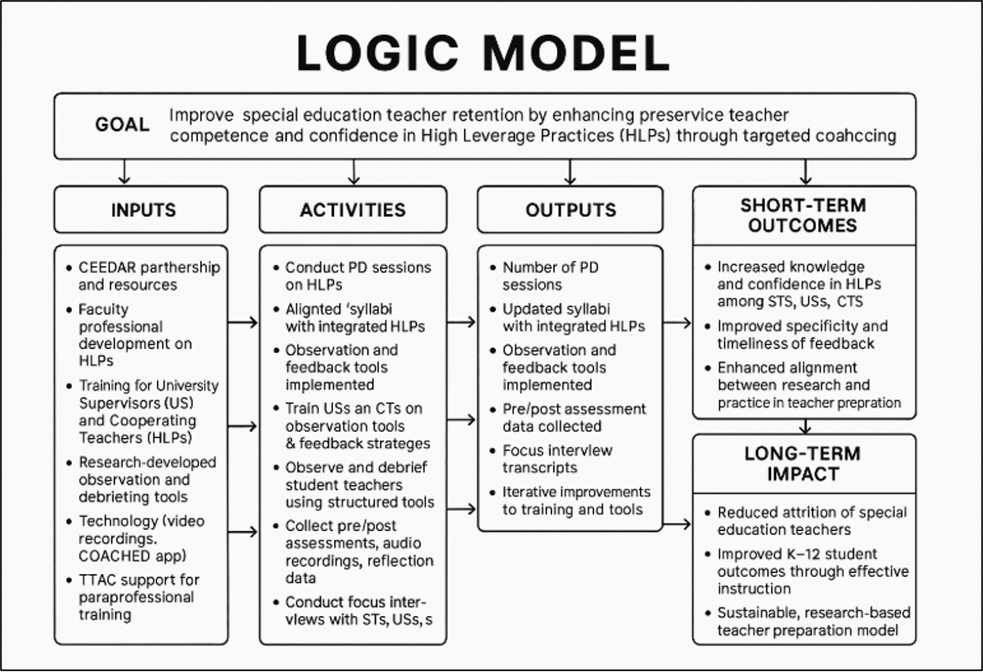

Logic Model
Cross-State Convening

Slide 13

Virginia 2
VIRGINIA
FARNOOSH SHAHROKHI
Cross-State Convening

Slide 14
George Mason University Example:
Special Education
●Undergraduate program developed in short period of time
●In collaboration with ELED, Leadership, and our Training and Technical Assistance Center faculty, used Q Sort and IC+ Tool to prioritize HLPs and evaluate their place in our program
●Will use this data to further revise and update the program
●We learned it is not an easy process but definitely worthwhile, especially when collaborating
Video
Passcode: 4.8d.U.Q
.
Cross-State Convening

Slide 15
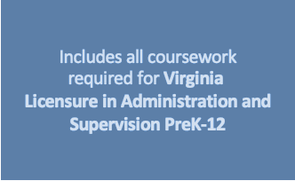
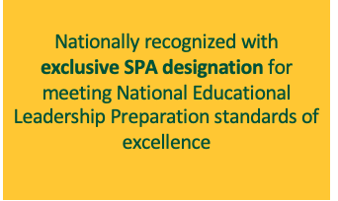
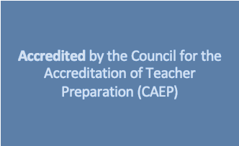

Educational Leadership Program
Cross-State Convening

Slide 16
George Mason University Example:
Leadership
Goal:
Through partnership with CEEDAR and collaboration with GMU special education colleagues, we focused on leader candidates in developing the skills needed for inclusive leadership
·Identify strengths and gaps in our current program to build capacity for high‑quality preparation
·Align coursework and refine internship experiences to integrate prioritized High-Leverage Practices (HLPs)
Next Step:
Use the IC tools for continuous program improvement
.
Cross-State Convening

Slide 17

Virginia 3
VIRGINIA
PARI PALUSZAK
Leveraging the IC Tool for
Visual Mapping and Strategic Growth
Cross-State Convening

Slide 18

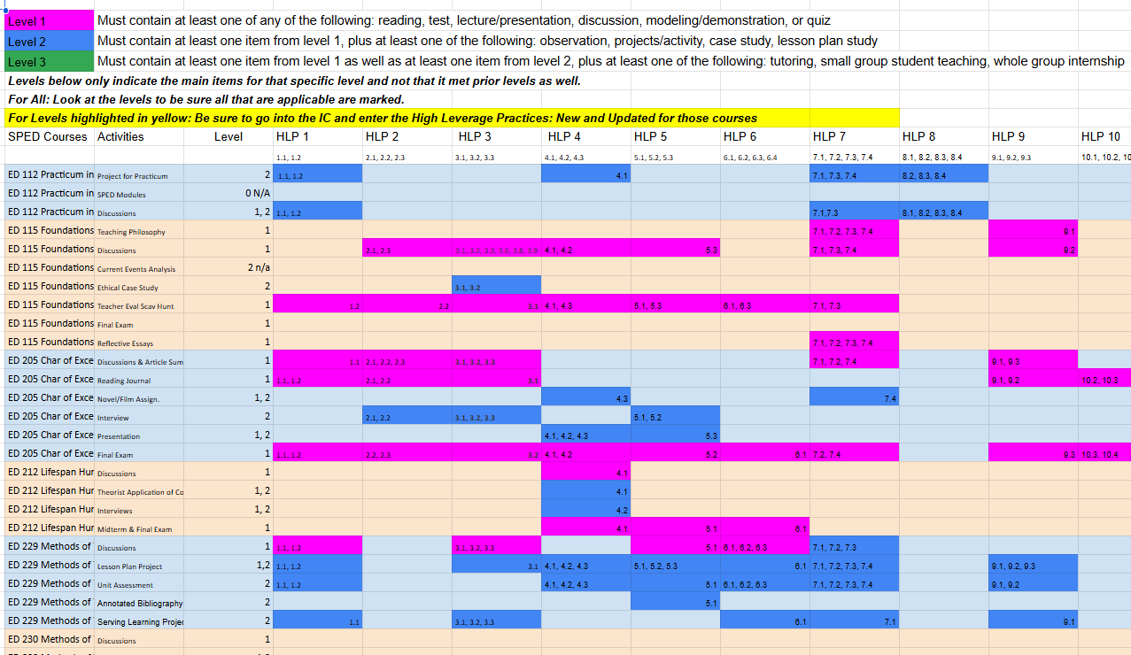
Our process
Our Process
Reviewed each syllabus and recorded course activities and their connections to High-Leverage Practices (HLPs).
  Began with the BA in Special Education program.
  Continued with Elementary and MS/Secondary Content Area courses.
Pulled data from the IC report into a spreadsheet for organization and analysis.
  Shared the compiled spreadsheet with faculty and staff.
Used the spreadsheet data to create visual mappings (shown on the next slide).
Conducted an AI-assisted analysis to identify strengths and gaps.
Reviewed findings for accuracy and discussed results during data meetings.
Cross-State Convening

Slide 19
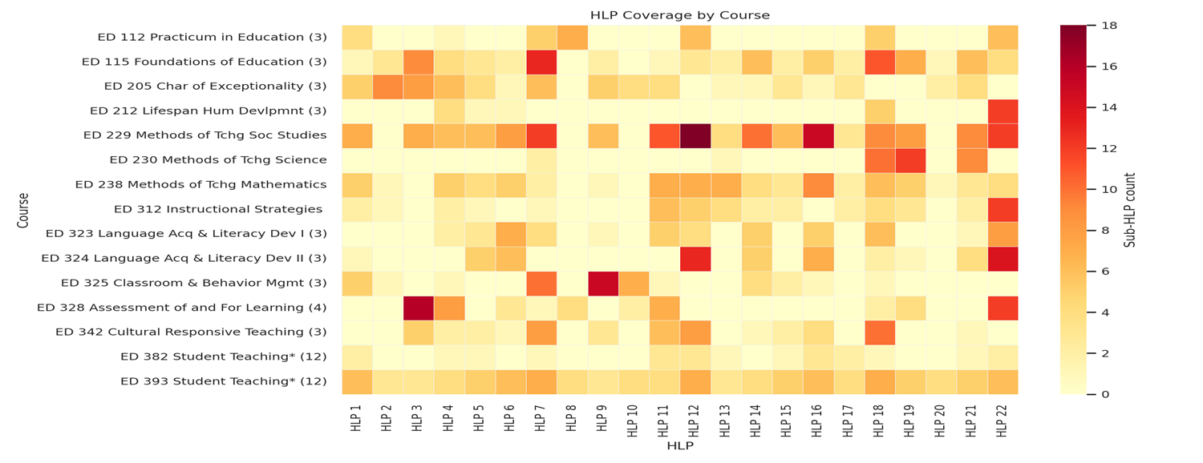
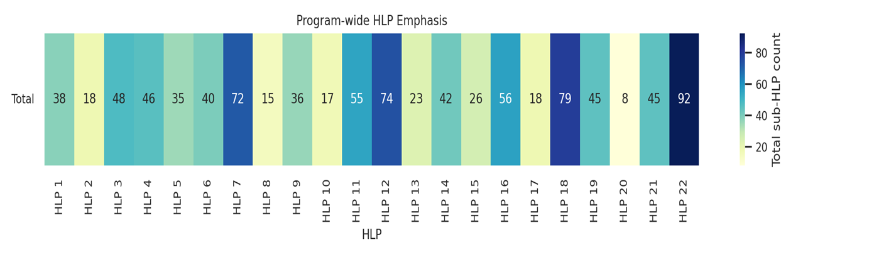
HLP Coverage by
Course
Cross-State Convening
Program Wide HLP Emphasis

Slide 20
What the IC Tells Us
We can see where instruction is densely and consistently present.
Visualizing Data: Through color coded excel or heatmap analysis of our IC/HLP, we can see that there is:
Heavy coverage of HLP 22 (Family Communication), HLP 18 (Engagement), HLP 12 (Systematic Instruction), HLP 7 (Learning Environment), and HLP 16 (Explicit Instruction).
We can demonstrate:
–Alignment with state and accreditation priorities
–Coherence across courses
–Evidence-based practices embedded consistently
We can see where practices are underrepresented, missing, or isolated.
Visualizing Data: Through color coded excel or heatmap analysis of our IC/HLP, we can see that there is:
Underrepresentation of HLP 20 (Feedback), HLP 8 (SEL/behavioral practices), HLP 10 (FBA), HLP 2 (Learning goals), and HLP 17 (Collaborative structures).
Identifies clear strengths across the curriculum
Reveals gaps or uneven distribution of essential practices
We can:
–Revisit syllabi
–Add targeted learning experiences
–Strengthen vertical alignment/ scaffolding of instruction
–Ensure candidates see each HLP more than once and earlier in the sequence
Cross-State Convening

Slide 21





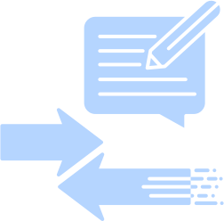

What Structures and Supports Make This Work Effective and Sustainable?
Faculty Facing Tools
Shared Visualizations
Using Tools (Excel, Visuals, AI) that helps to:
Simplify tagging and representation
Ensures consistency in language.
The visuals (heatmaps) generated provide instant, intuitive understanding of your data.
Advantages
More Accessible Data
Produces actionable datasets
Reduces faculty burden
Participation stays high and accurate.
Faculty | Program coordinators
Department chairs | CEEDAR teams
Accreditation reviewers
Cross-State Convening

Slide 22

Tennessee
Lori Farley
Cross-State Convening

Slide 23
Questions to consider
Cross-State Convening
Questions to Consider :
Policy
What is one area of literacy policy implementation within your state that could be strengthened with an IC?
Standards
How can ICs strengthen alignment and implementation of EPP literacy standards?

Slide 24
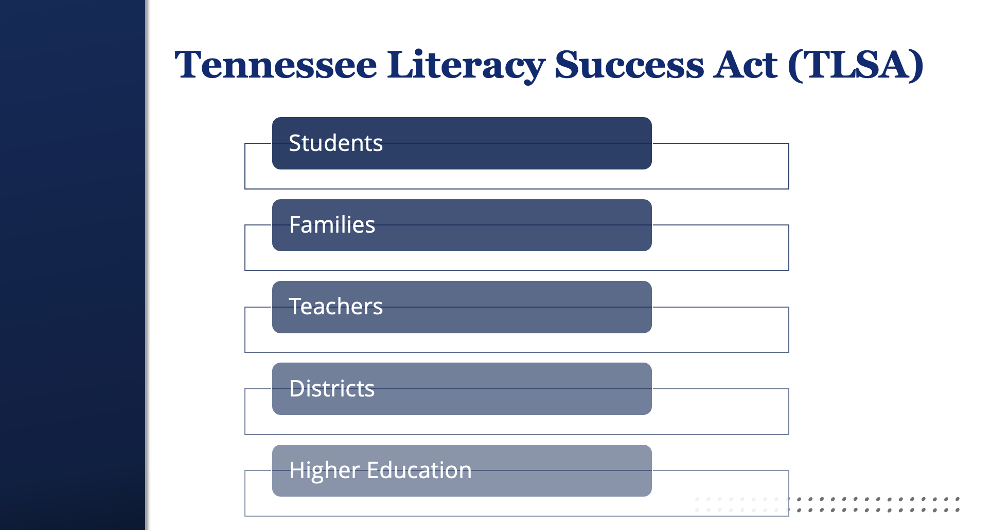
TLSA

Slide 25
Tennessee Literacy Success Act (TLSA)
Cross-State Convening
As of August 1, 2022, EPPs must provide training on reading instruction focused on foundational literacy standards for K-3, general and special education, and instructional leader candidates that include:
foundational literacy skills;
supporting students with advanced reading skills and students with significant reading deficiencies;
identifying characteristics of dyslexia and providing effective instruction;
implementation of high-quality instructional materials;
behavior management through trauma-informed principles; and
administration of a universal reading screener and use of resulting data for improving reading instruction.

Slide 26
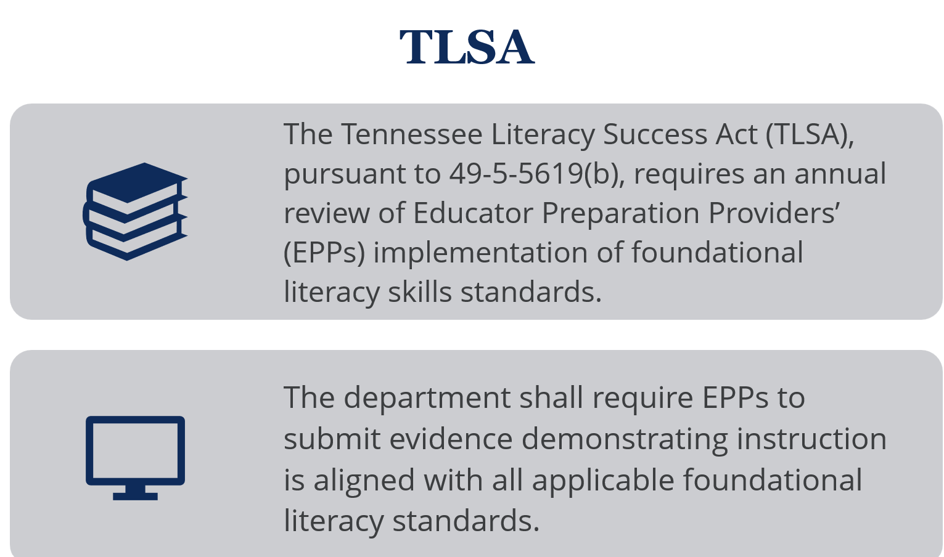
TLSA 2
Cross-State Convening

Slide 27
TN-CEEDAR
Literacy Innovation Configuration
Cross-State Convening
Cross-State Convening

Slide 28

TN-Specific Innovation
Configuration Project
Cross-State Convening
The Tennessee Collaboration for Effective Educator Development, Accountability, and Reform (TN-CEEDAR) State Leadership team, in collaboration with the department, developed a Tennessee (TN) specific Innovation Configuration (IC).

Slide 29

TN- Specific Innovation Configuration (IC)
Centers on Tennessee Foundational Literacy Skills (FLS) standards and high-leverage practices (HLPs)
Supports EPPs in identifying strengths and areas for growth in implementing FLS standards
Promotes reflection on how standards are integrated throughout coursework and programs
.
Cross-State Convening

Slide 30
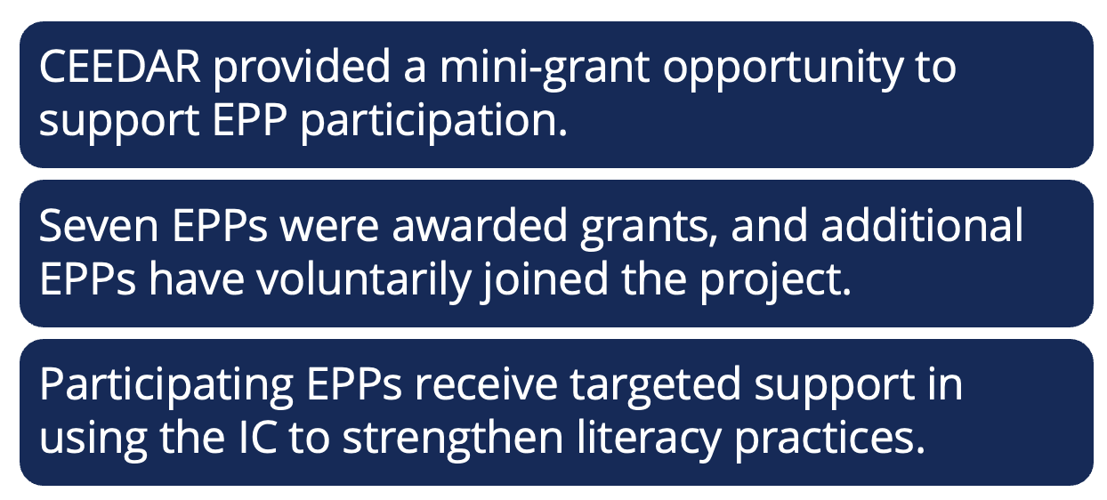
tn specific ic project
TN-Specific Innovation Configuration Project
Cross-State Convening

Slide 31

Work in Progress
Learning from participating EPP reports and reflections on the TN-specific IC
Collaborating on approaches to scale and sustain use of the IC
Considering how the IC can enhance and support the literacy review process
.
Cross-State Convening

Slide 32

Small Group Breakouts
Cross-State Convening
Cross-State Convening
  What stood out to you most from the presentations?
  What approaches or methods did they use that felt particularly effective or adaptable?
  What capacity do we currently have to engage in this work?
  What do we need to move this work forward?

Slide 33



Every student deserves an opportunity to achieve
Cross-State Convening
Every student deserves an opportunity to achieve.

Slide 34
Wrap Up
Cross-State Convening
  In Virginia’s work, how have educator preparation programs used ICs to surface strengths and growth areas? What structures or supports make this type of self‑study effective and sustainable?
  How did Tennessee’s pilot use of Innovation Configurations help clarify alignment—or misalignment—with statewide literacy legislation, and what insights might other states or programs draw from this approach?

Slide 35
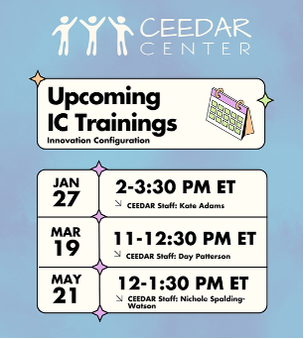
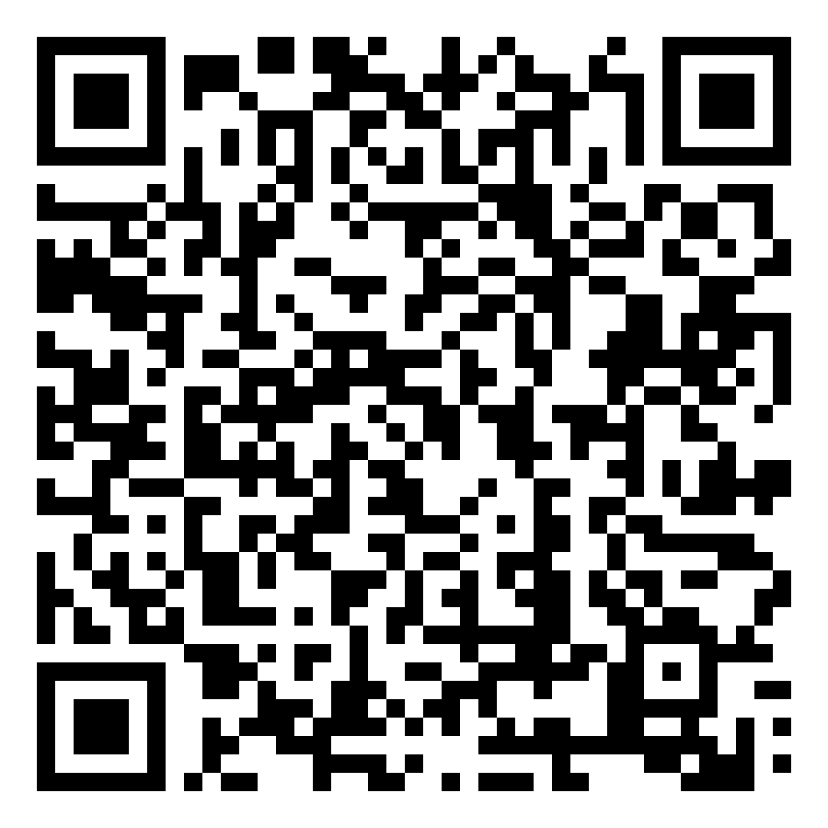
Innovation Configuration Trainings
Cross-State Convening
Cross-State Convening

Slide 36
State Team Padlet
Session Title: Accountability in Action: Using Innovation Configurations to Strengthen Teacher and Leader Preparation (with VA & TN)
Notes: Brief summary of the session, lessons learned, ideas that could support your context, potential pitfalls to avoid, etc.
Connections: How does this connect to your state’s current work? How could this connect to future work (use the future work column)? Are there follow-ups/additional networking needed with CEEDAR states or staff?
Cross-State Convening

Slide 37


thanks
Cross-State Convening
THANK YOU!

Slide 38

Disclaimer
This content was produced under U.S. Department of Education, Office of Special Education Programs, Award No. H325A220002. David Guardino serves as the project officer. The views expressed herein do not necessarily represent the positions or policies of the U.S. Department of Education. No official endorsement by the U.S. Department of Education of any product, commodity, service, or enterprise mentioned in this website is intended or should be inferred.
Cross-State Convening

