Slide 1

Ccsc title

Slide 2



Build, Test, Rethink
Cross-State Convening
A Data Think Tank with Utah and Minnesota
Wednesday, February 11th 10:15-11:30 AM
Notes:
Abby

Slide 3

Evaluating and Improving Mentor Teacher
Training Modules
Cross-State Convening
Presented by: Kristen R. Rolf, Ph. D. & Mallory Poole, Ph. D.

Slide 4



Overview
Cross-State Convening
What we'll cover in this session:
  Description of Utah mentor teacher training modules
  Plan, Do, Study, Act Improvement Cycles
  Feedback on next steps

Slide 5


“Treasure Hunt”
Find 3 types of data that would allow a state to judge whether a mentor/induction program is worth continuing or scaling
What is the type of data?
Who controls it? (e.g., SEA, LEA, IHE)
What decision could that data actually inform?
Cross-State Convening

Slide 6
The Role of Mentor Teachers
  1
  2
  3
Many teachers supervise pre-service teachers during field experiences
Mentor teachers may play a critical role in preparing effective teachers (Goldhaber et al., 2019; Ronfeldt et al., 2020; Ronfeldt et al., 2023)
The National Council on Teacher Quality (2020) recommends LEAs recruit their strongest teachers as mentors
The Association of Teacher Educators (2023) calls for mentor teachers to be trained and receive ongoing professional development
Cross-State Convening

Slide 7
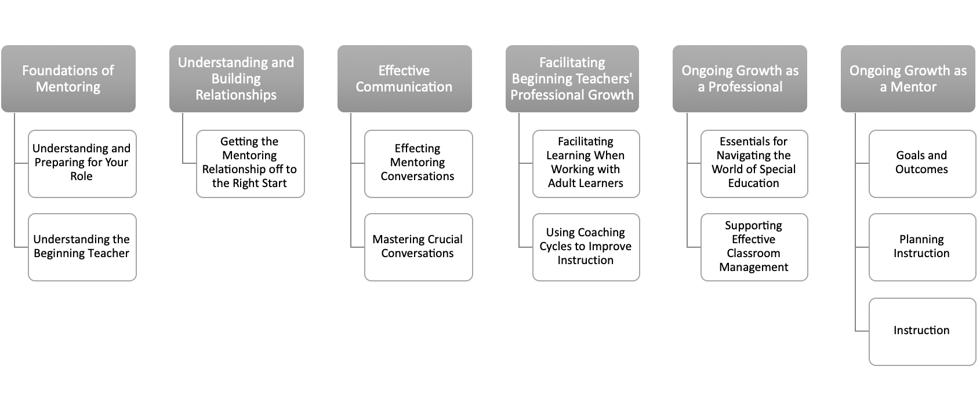

Utah’s Mentor Teacher Training Modules
6 topics
12 modules
Designed by Utah State Board of Education (USBE) for teachers across all licensing areas
Cross-State Convening

Slide 8
Module Engagement Strategies
Self-paced
1
2
Text, video, and audio recordings
3
Online discussions, creating graphics, completing graphic organizers
4
Create and provide implementation schedules
5
Reflective journal entries, write letter to future mentee
6
Write mentoring vision statement
Cross-State Convening

Slide 9
Module Dissemination and Use
Modules released spring 2022
LEAs sign export agreement with USBE and host via their learning management system (e.g., Canvas)
17 LEAs and 1 RESA (4 school districts) implementing
243 mentor teacher endorsements awarded since spring 2022 across 3 pathways
  Mentor teacher modules are 1 pathway
Completers receive a Utah Teacher Mentor Endorsement
Pathway to earn master’s credits at Southern Utah University
Cross-State Convening

Slide 10
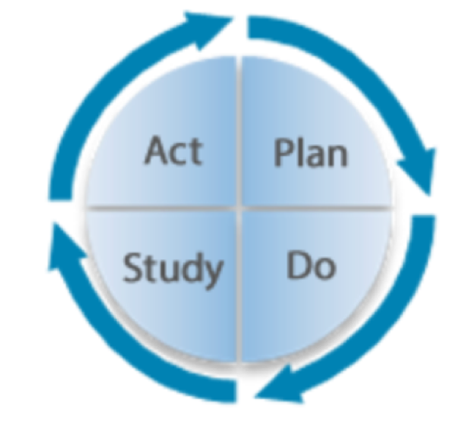
Plan, Do, Study, Act (PDSA) Cycles
Iterative
Continuous Improvement
Data-informed changes to improve outcome(s)
Plan an intervention and its implementation
Do the activities in the proposed plan
  Collect data on its effectiveness and implementation
Study the data collected
  Revise the initial plan as indicated by the data
Act on the new plan
Continue implementing, collecting data, and adjusting the plan
Cross-State Convening

Slide 11



PDSA Cycles and Mentor Teacher Modules
Cross-State Convening
Plan - Mentor modules conceived and created
Do - Mentor modules rolled out to LEAs
Study - How do we evaluate the effectiveness and implementation of the modules?
Act

Slide 12


We want to hear from you!
Cross-State Convening
Cross-State Convening
•What questions do we need to ask to evaluate the effectiveness of the mentor teacher modules?
•What questions do we need to ask to evaluate implementation of the mentor teacher modules?
•What data do we need to evaluate effectiveness and/or implementation of the mentor teacher modules?
•What experiences/recommendations do you have for evaluating the effectiveness and/or implementation of the mentor teacher modules?
•On whom should we focus the evaluation – the mentor? The mentee? The administrator?
•How do your states share resources to facilitate projects?

Slide 13
References
Cross-State Convening
•Association of Teacher Educators. (2023). Clinical Experience Standards (3rd Ed.).
•Deming, W. E. (1986). Out of the crisis. MIT Press.
•Goldhaber, D., Krieg, J., Naito, N., & Theobald, R. (2019). Making the most of student teaching: The importance of mentors and scope for change. Education Finance and Policy, 1-11.
•Kennedy, S. & Ryan Jackson, K. (n.d.). PDSA Cycles: Improvement and Implementation. National Implementation Research Network. https://nirn.fpg.unc.edu/blog/pdsa-cycles-improvement-and-implementation/
•Pomerance, L. (2020). Student teaching: The pipeline to great new teachers. National Council on Teacher Quality. https://www.nctq.org/research-insights/student-teaching-the-pipeline-to-great-new-teachers/
•Ronfeldt, M., Bardelli, E., Truwit, M., Mullman, H., Schaaf, K., & Baker, J. C. (2020). Improving Preservice Teachers’ Feelings of Preparedness to Teach Through Recruitment of Instructionally Effective and Experienced Cooperating Teachers: A Randomized Experiment. Educational Evaluation and Policy Analysis, 42(4), 551-575. https://doi.org/10.3102/0162373720954183
•Ronfeldt, M., Truwit, M., Bardelli, E., Schaaf, K., & Smith, B. (2023). Cultivating Stronger Coaching in Clinical Mentors: An Experimental Evaluation of the Mentors Matter Professional Development Initiative. Educational Evaluation and Policy Analysis, 46(4), 646-672. https://doi.org/10.3102/01623737231183414 (Original work published 2024)

Slide 14


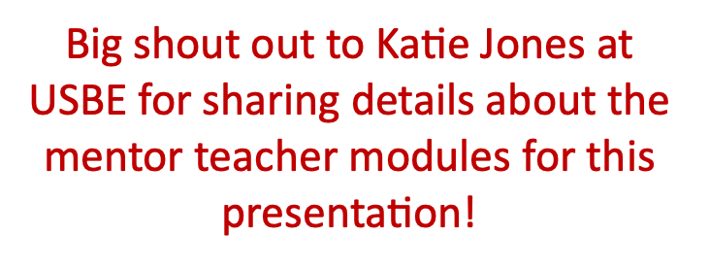


THANK YOU!
Cross-State Convening
For questions, email us at
kristen.rolf@usu.edu or mallorypoole@suu.edu

Slide 15
Minnesota
Teacher & Leader Preparation License Policies
Cross-State Convening
Keri DeSutter, PhD, Minnesota State University, Moorhead
Jennifer Christensen, PhD, LDA Minnesota

Slide 16
Goal for our session:
Cross-State Convening
  After engaging in discussions of policy related to teacher and leader preparation and licensing, participants will walk away with a process to survey policies to consider in their contexts.

Slide 17
Identify two (2) policies that most directly influence teacher and leader preparation and licensing in your state.
Cross-State Convening
Where do they live?
What behavior do they incentivize or constrain?
What data would be required for this policy to work?

Slide 18



Minnesota Policy Survey
Policy Discussion
Clarity
Survey Creation
Listed Minnesota Policies that have potential to impact students with disabilities in schools.
Through discussion, differing levels of understanding and knowledge of these policies led to further wonderings.
Thought through ways to ascertain levels of knowledge and understanding of our Leadership Team membership.
Cross-State Convening
Notes:
Describe the process we used, from developing the survey through CEEDAR disbursing to the leadership team.

Slide 19
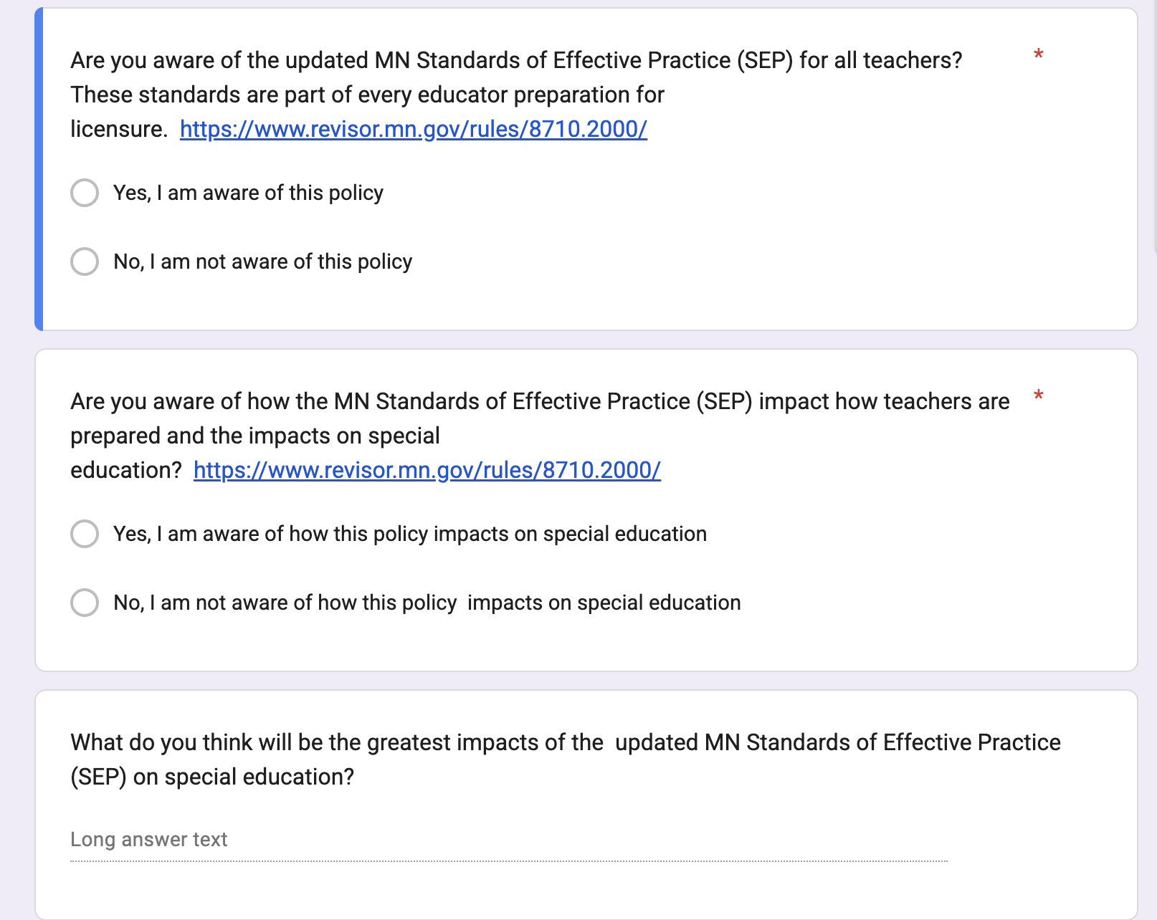
Survey
Cross-State Convening
Cross-State Convening
Notes:
Total of 8 policies surveyed. All had the same format with a link to the policy if applicable.

Slide 20
Minnesota Policies
Teacher Licensure Preparation
  Standards of Effective Practice
  Special Education licensure specific standards
Administrator Preparation Rules
Literacy
  Read Act relates to both preservice and inservice preparation
School/Systems Related Policies
  MTSS
  Caseload limits
  Changes to SLD criteria
  Restrictive Procedures
Cross-State Convening

Slide 21
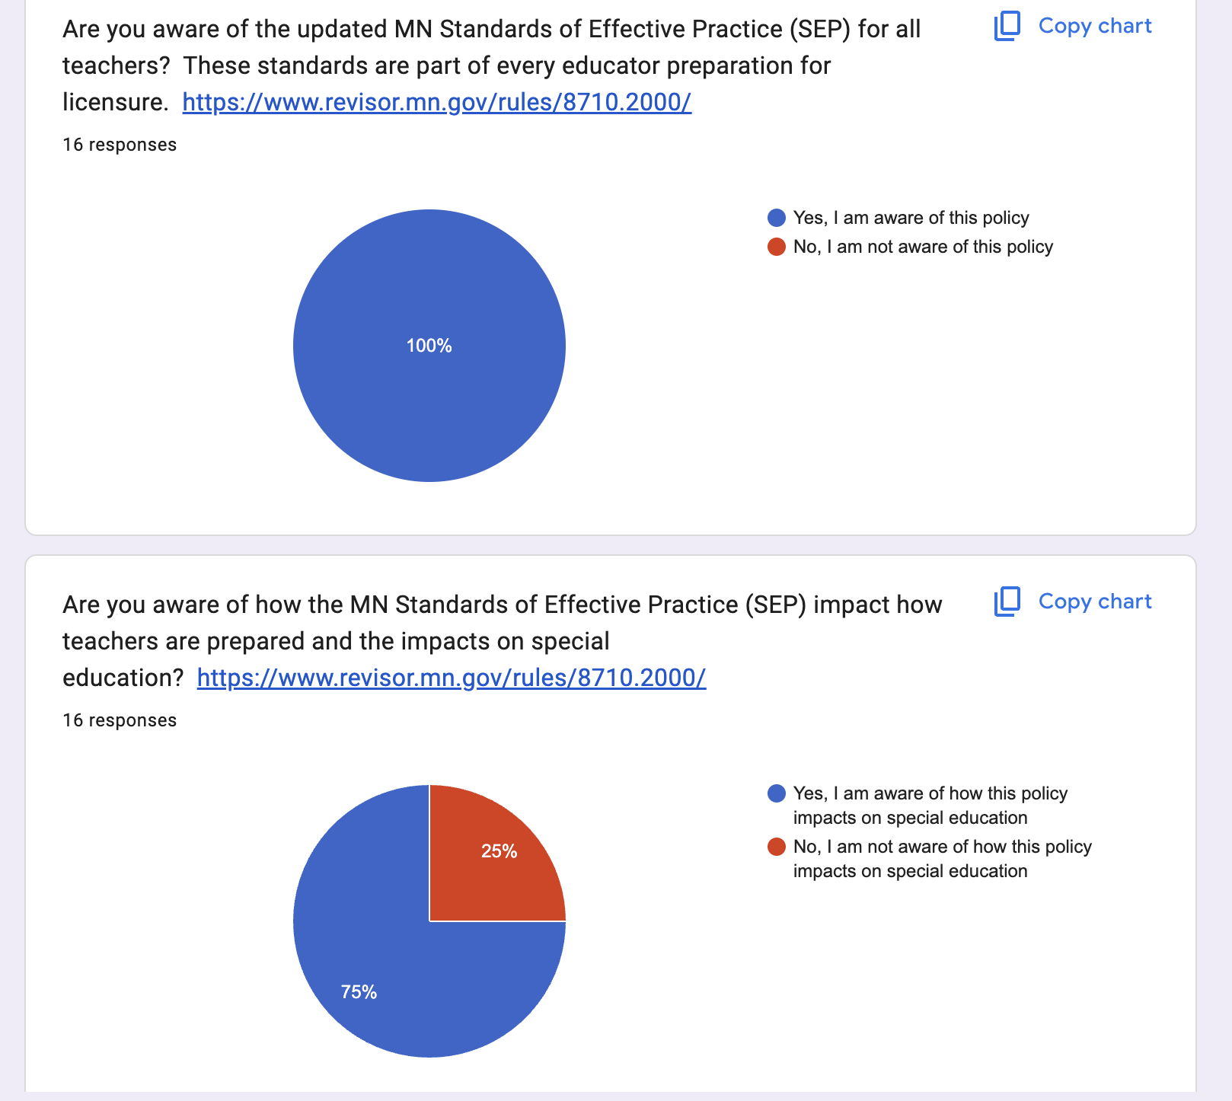
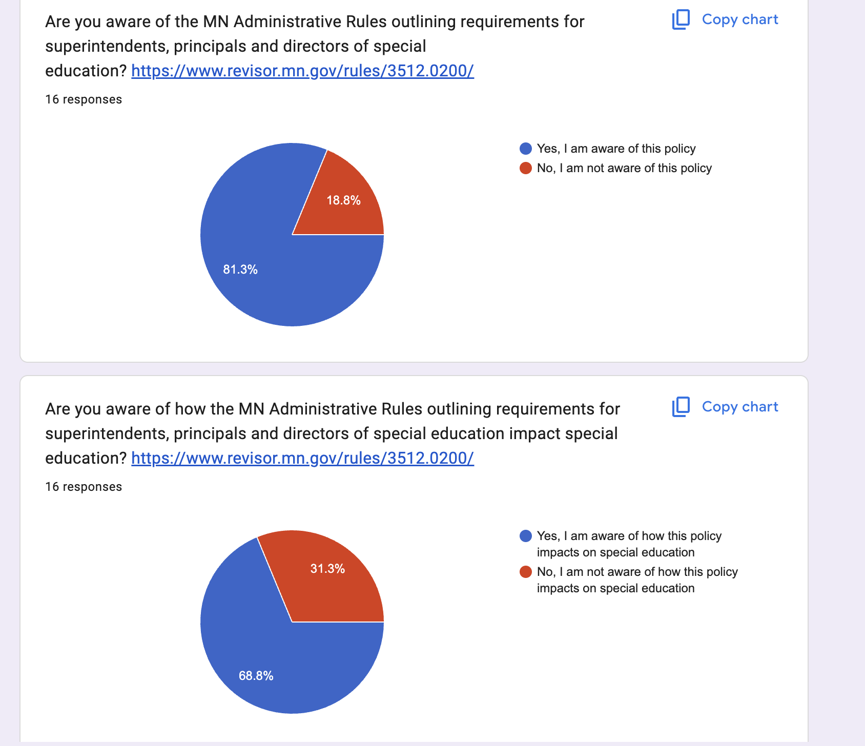
Survey Results
Cross-State Convening
COMMENTS: The policy question regarding the standards of effective practice received the most written comments.
Respondents made comments regarding how they were going to get up to speed on policies they were unaware of or unaware of the impact on special education.
Notes:
16 total respondents. Some of the data surprised us. Lead us to wonder about expanding our reach and including other populations in our data gathering.

Slide 22
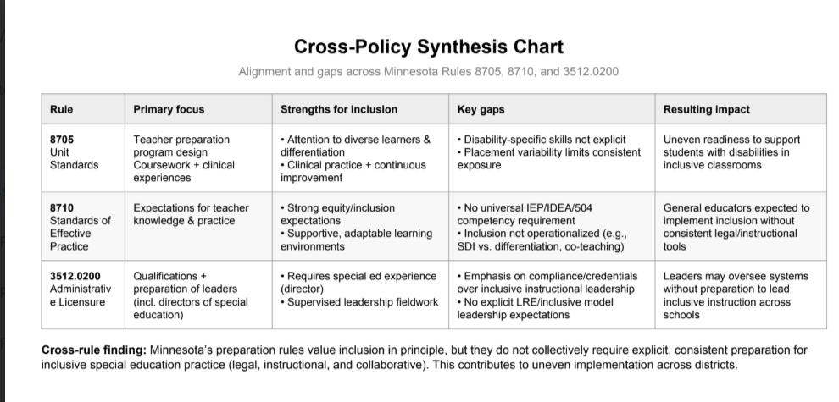

Policy strength/gap analysis
Cross-State Convening
Notes:
It’s difficult to have an impact on policy when leadership is not informed or aware of what is happening.

Slide 23
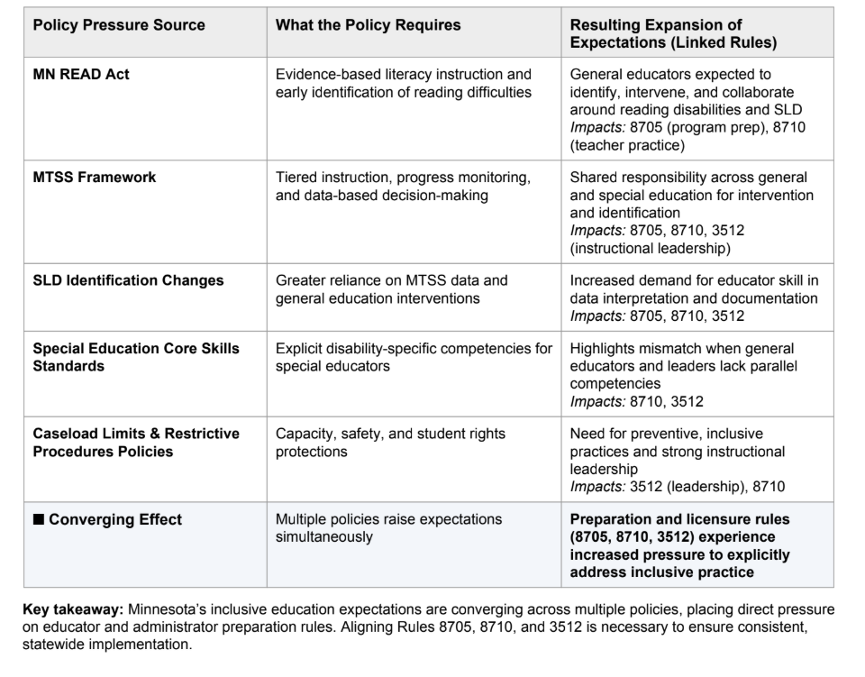
Policy pressure
Cross-State Convening
Notes:
It’s difficult to have an impact on policy when leadership is not informed or aware of what is happening.

Slide 24
SURVEY RESULTS.
Cross-State Convening
  Survey results showed disparate understandings of policy and impact among our leadership team.
  Strength/gap analysis shows inconsistency in policy expectations and policy pressure map indicates need for alignment within preparation rules.
  Where do we go from here?
  How do we use this data to inform our next steps?
  What should the goal be now?
Notes:
It’s difficult to have an impact on policy when leadership is not informed or aware of what is happening.

Slide 25
thanks
Cross-State Convening
THANK YOU!
For questions, email us at desutter@mnstate.edu
jec@ldaminnesota.org

Slide 26

Disclaimer
This content was produced under U.S. Department of Education, Office of Special Education Programs, Award No. H325A220002. David Guardino serves as the project officer. The views expressed herein do not necessarily represent the positions or policies of the U.S. Department of Education. No official endorsement by the U.S. Department of Education of any product, commodity, service, or enterprise mentioned in this website is intended or should be inferred.
Cross-State Convening

