Slide 1
Stop Guessing, Start Planning
CEEDAR Cross State Convening
Rebekah Hornak & Kris Earl
February 11, 2026

Slide 2


Welcome & Introductions
Kris Earl Ed.D.
Implementation Specialist
Rebekah Hornak
Implementation Specialist & SISEP Director
Notes:
Replace pictures -

Slide 3

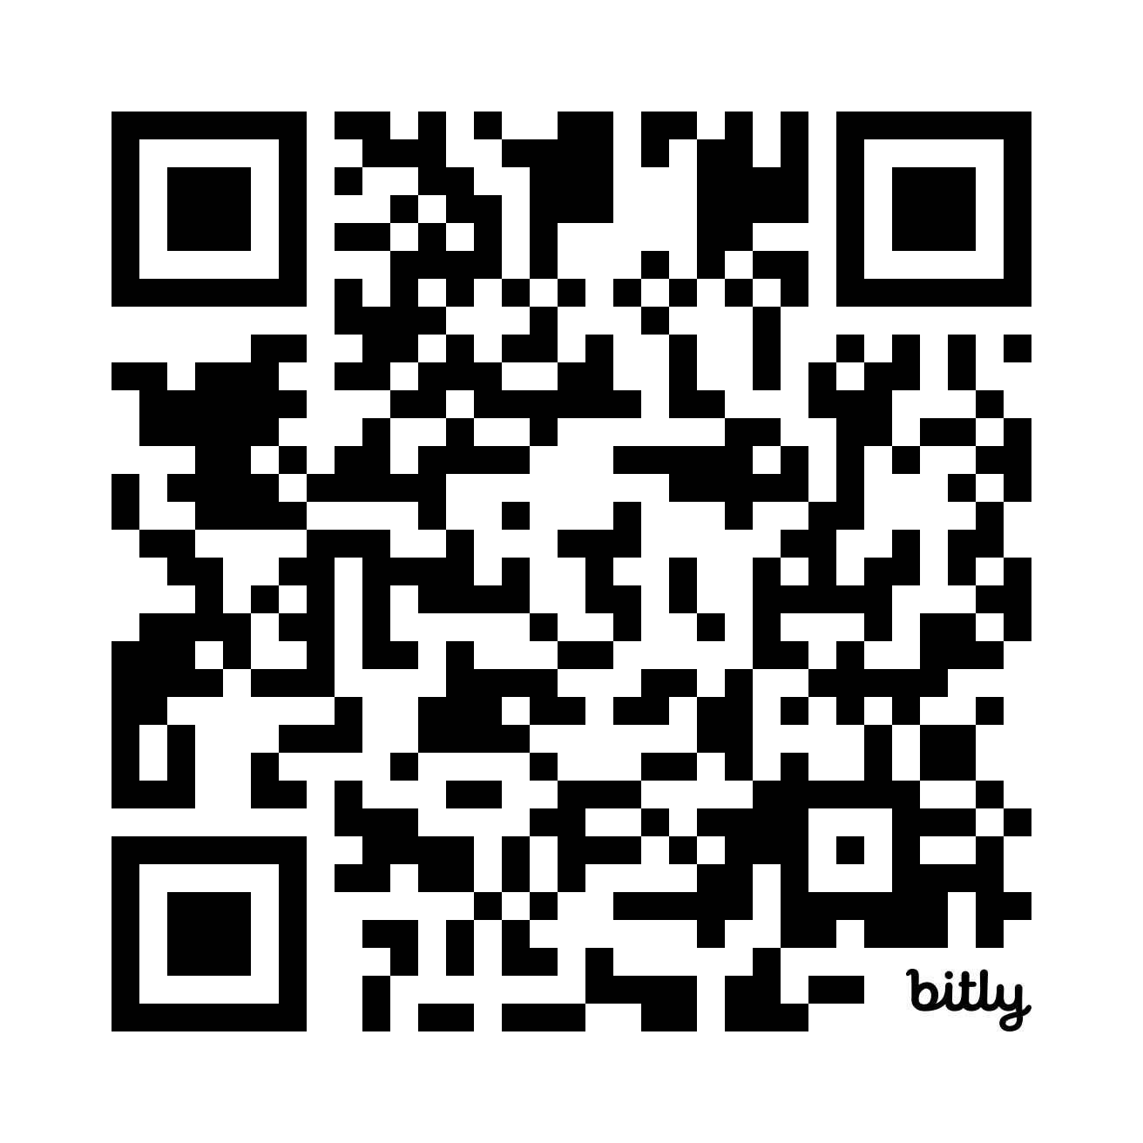

NIRN - Who We Are
As a leader in implementation science, we strive to blend practice and research to improve outcomes across the spectrum of health and human services.
We lead the advancement of implementation science through practice-based research and a focus on practical implementation to solve real-world problems and improve outcomes for children and families.

Slide 4
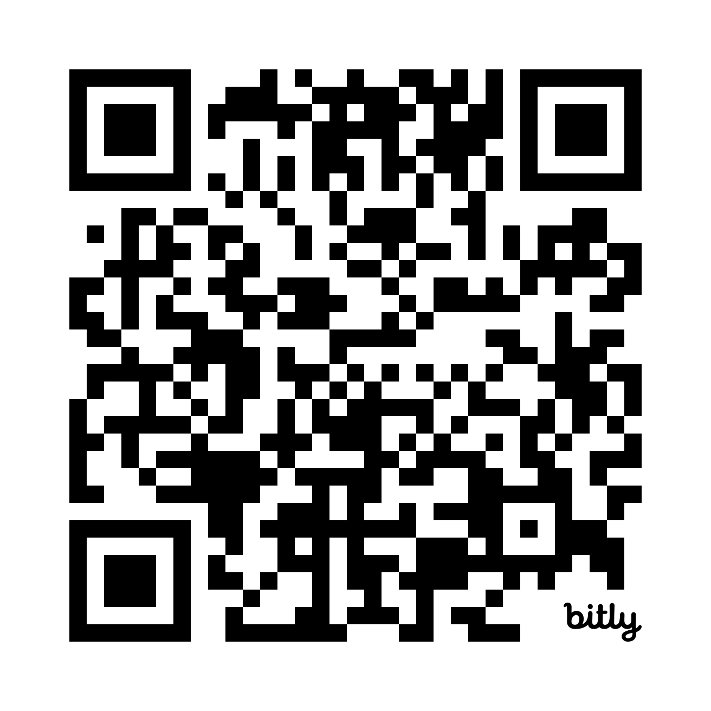

SISEP Center
The State Implementation and Scaling-up of Evidence-based Practices (SISEP) Center is a national technical assistance center funded by the U.S. Department of Education’s Office of Special Education Programs.
The SISEP Center, a project within the National Implementation Research Network (NIRN), is housed within the FPG Child Development Institute at the University of North Carolina at Chapel Hill.

Slide 5
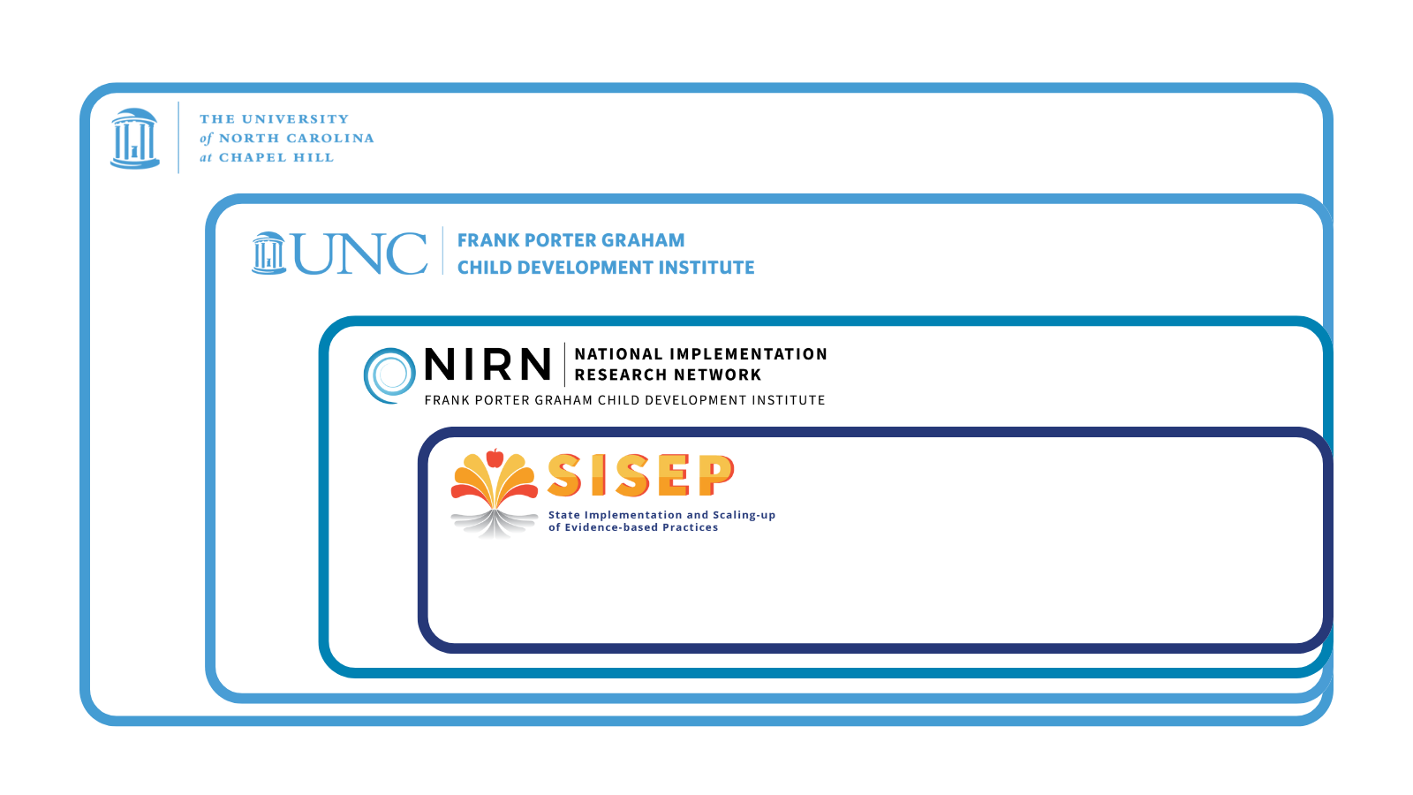
Logos

Slide 6

Implementation Science
1
Let’s explore What and Why

Slide 7


Think, then Neighbor Share
Reflect on current or past work related to improving outcomes for students and families
What worked?
What didn’t go so well?
Think
Neighbor Share
Notes:
Replace pictures -

Slide 8
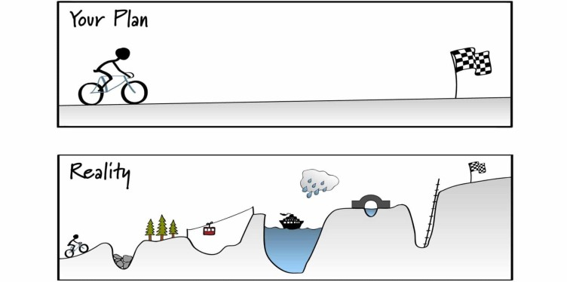
Implementation
Implementation science refers to the “methods or techniques used to enhance the adoption, implementation, and sustainability” of an intervention.
(Powell et al., 2015)
Implement = Use

Slide 9
Implementation Science 1
Implementation Science
Implementation Research:
Seeks to understand the approaches that work best to translate research to the real work
Implementation Practice:
Seeks to apply and adapt these approaches in different context settings to achieve outcomes
(Ramaswamy, et al., 2019)

Slide 10
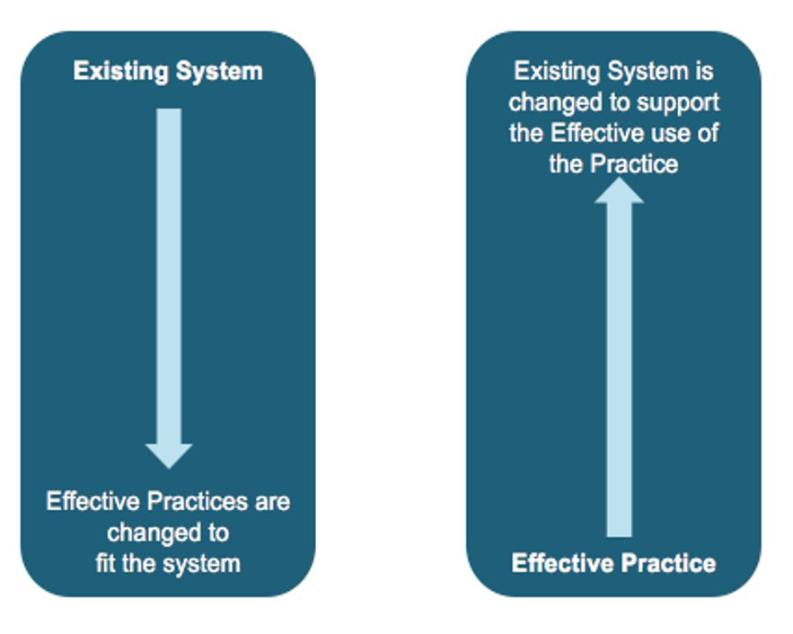
Systemic Change
Notes:
Recall foundations of equity in active implementation and alignment with improvement science

Slide 11
Active Implementation
2
Let’s explore How

Slide 12
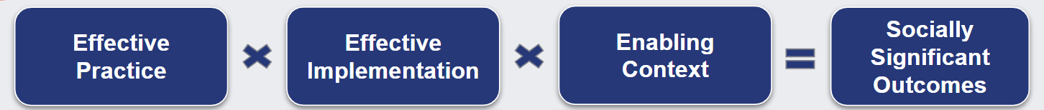
Our Active Implementation Approach

Slide 13


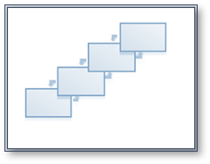
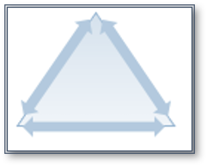
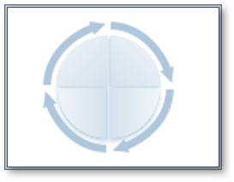
Active Implementation Frameworks
Effective Practice
Effective Implementation
Enabling Context
Socially Significant Outcomes
Usable Innovations
Stages
Teams
Drivers
Improvement Cycles

Slide 14

Implementation Stages
Initial Implementation
Full
Implementation
Exploration
Installation
Identify
Plan
Get Started
Get Better
Assess need;
Examine fit and feasibility
Assure resources;
Develop supports
Initiate practice; use data to improve supports
Practice is consistent; positive outcomes
Time 3-5 Years = Social Significant Outcomes

Slide 15
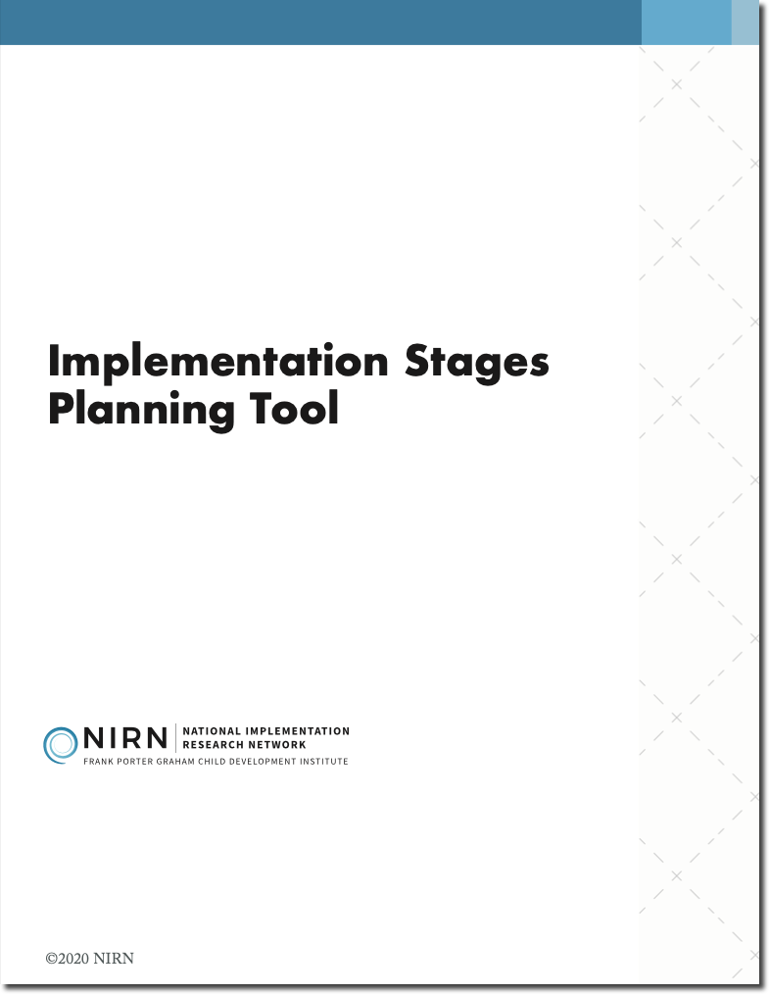
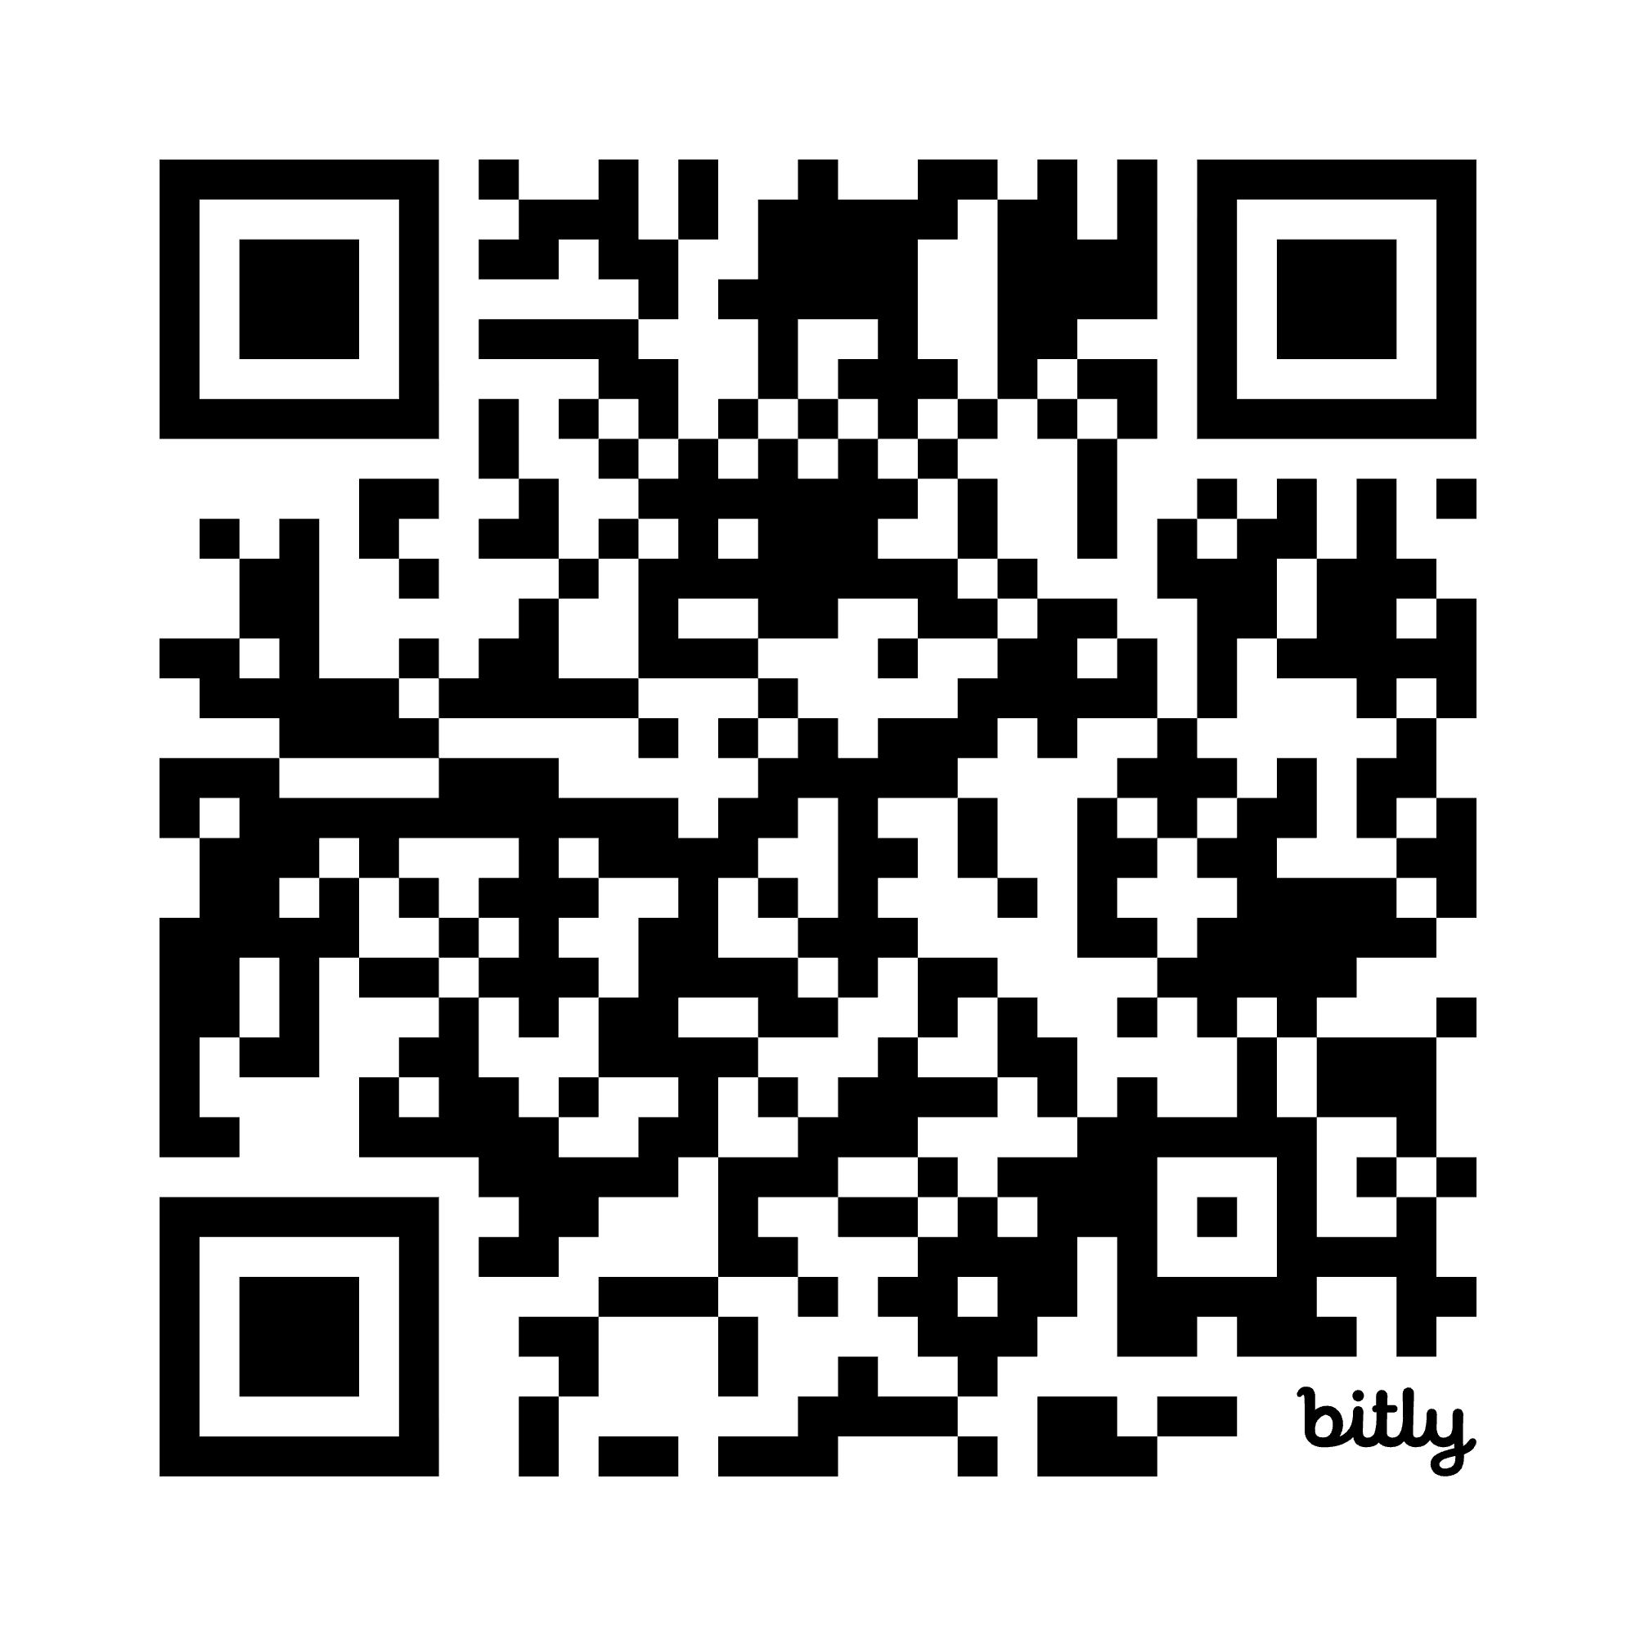
Implementation Stages Planning Tool
Tool for Purposeful Planning

Slide 16
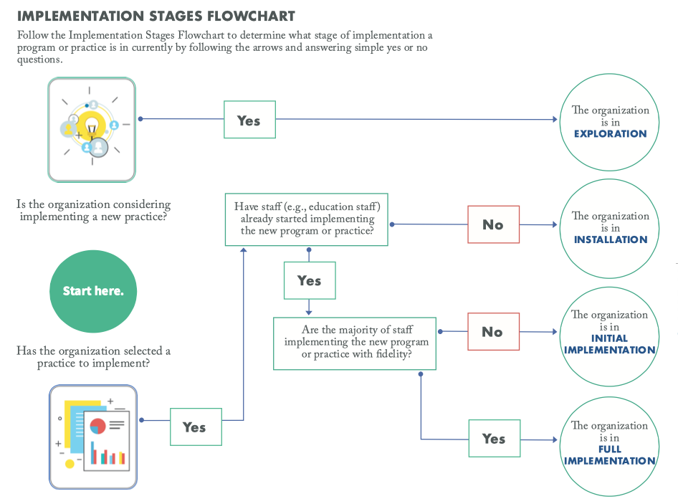
Implementation stages flowchart
Notes:
The implementation stages address how implementation progresses over time. Each stage consists of specific activities to ensure practices are intentionally selected and used as intended.
Prior to selecting something new, districts need to engage in exploration. In this stage, districts assess the need, fit, and feasibility for the innovation. Staff are asking “Should we do it?” Staff will engage in readiness activities and a comprehensive selection process will examine the critical features of the innovation to determine if it should be selected. If the innovation is selected, districts move into the installation stage. It is in installation where resources are allocated, supports are developed, and systems are set up. Once the initial components are installed, districts transition into initial implementation and begin to use the practice. Data is collected to improve supports and staff are working to do it right! Full implementation is when the practice is consistently used as intended (at least 50% of practitioners) and it is having a positive impact on outcomes. During this stage, data is being used to continuously improve the use of the innovation.
To effectively implement an initiative or innovation, districts need to consider all four stages. The infinity symbol speaks to the iterative nature of implementation and that stages repeat at every level of the system. Due to turnover or changes in district staff, a district that was in initial implementation may need to go back to exploration to ensure buy-in from new staff before being able to move forward. Any time consideration is given to selecting a new practice, each stage of implementation should be carefully considered and planned for.

Slide 17
Implementation Stages 1
Implementation Stages
Initial Implementation
Full
Implementation
Exploration
Installation
Identify
Plan
Get Started
Get Better
Assess need;
Examine fit and feasibility
Assure resources;
Develop supports
Initiate practice; use data to improve supports
Practice is consistent; positive outcomes
Time 3-5 Years = Social Significant Outcomes

Slide 18

Exploration Stage
Outcomes
A representative implementation team is formed
Need for program/practice is demonstrated
Program/practice is assessed for fit and feasibility
A program/practice is selected
Acceptability and buy-in gained from leaders, staff, and community partners
Notes:
Emphasize Teams and Usable Innovation

Slide 19
Implementation Stages 2
Implementation Stages
Initial Implementation
Full
Implementation
Exploration
Installation
Identify
Plan
Get Started
Get Better
Assess need;
Examine fit and feasibility
Assure resources;
Develop supports
Initiate practice; use data to improve supports
Practice is consistent; positive outcomes
Time 3-5 Years = Social Significant Outcomes

Slide 20
Installation Stage
Outcomes
Implementation team is functioning well
Majority of practitioners are trained in the program/practice
Infrastructure is in place to support coaching to effectively develop competencies required to use the program/practice
Fidelity measure and criteria are established for the program/practice
Infrastructure is in place to collect, analyze, and use data (i.e., fidelity, program/process, outcome) to continuously improve use of program or practice
Staff have access to data infrastructure and are equipped to use it
Policies and procedures to support use of the program/practice are in place and understood by practitioners, leaders, community partners, and stakeholders
Bi-directional communication is taking place among stakeholders including community partners, individuals and families, practitioners, supervisors and leaders
Notes:
Emphasize continued development of Teams, Usable Innovation, and building of Drivers

Slide 21
Implementation Stages 3
Implementation Stages
Initial Implementation
Full
Implementation
Exploration
Installation
Identify
Plan
Get Started
Get Better
Assess need;
Examine fit and feasibility
Assure resources;
Develop supports
Initiate practice; use data to improve supports
Practice is consistent; positive outcomes
Time 3-5 Years = Social Significant Outcomes

Slide 22
Initial Implementation Stage
Outcomes
Majority of practitioners are using the program/practice
Data are used regularly to inform decision-making and improve implementation of the program/practice
Practitioners are beginning to achieve fidelity in their use of the program/practice
Quality of implementation is improving across practitioners, however, variability in quality exits
Evidence for feasibility of implementation such as
  Increase in use of the program/practice with fidelity
  Increase in staff confidence and skill in using the program/practice
  Increase in coaches’/supervisors’ confidence in supporting staff; and
  Meaningful engagement of recipients and families in the program/practice

Slide 23
Implementation Stages 4
Implementation Stages
Initial Implementation
Full
Implementation
Exploration
Installation
Identify
Plan
Get Started
Get Better
Assess need;
Examine fit and feasibility
Assure resources;
Develop supports
Initiate practice; use data to improve supports
Practice is consistent; positive outcomes
Time 3-5 Years = Social Significant Outcomes

Slide 24
Full Implementation Stage
Data are used regularly to inform decision-making and improve implementation of the program/practice
Sustained use of the program/practice with all practitioners delivering with fidelity and ease
Evidence that identified outcomes are improving through use of the program/practice
Outcomes

Slide 25
Let’s Explore
Access the Implementation Stages Planning Tool

Slide 26
SISEP Resources
3
Let’s continue to explore

Slide 27

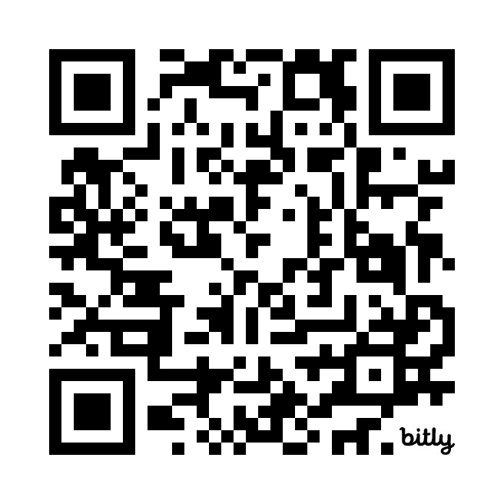
SISEP Website

Slide 28
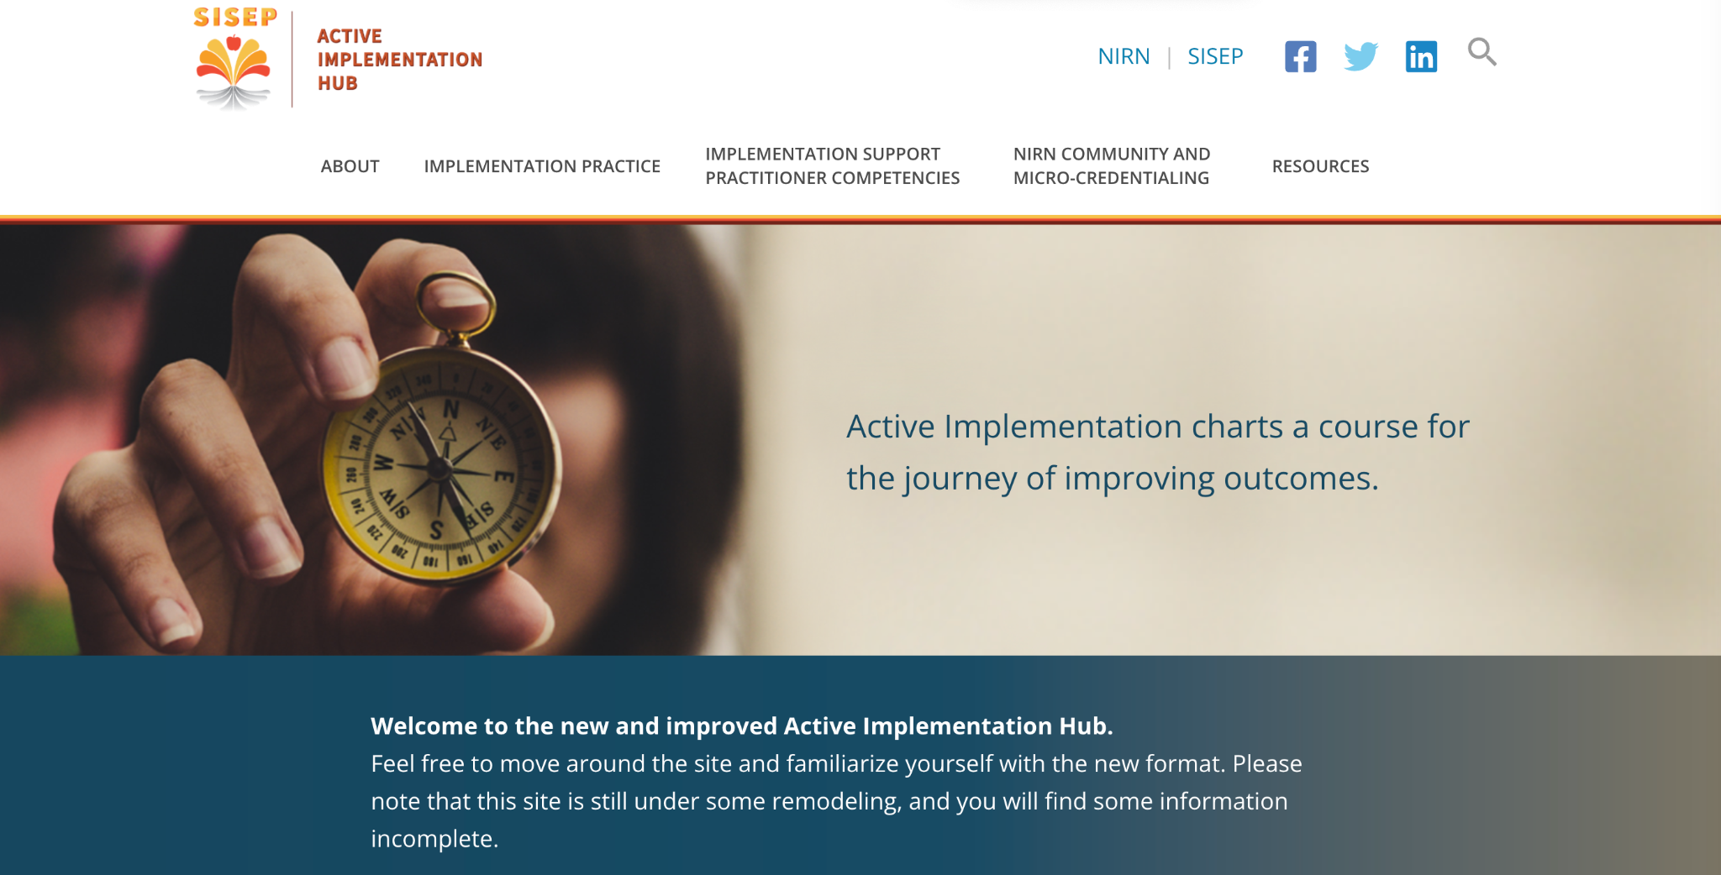
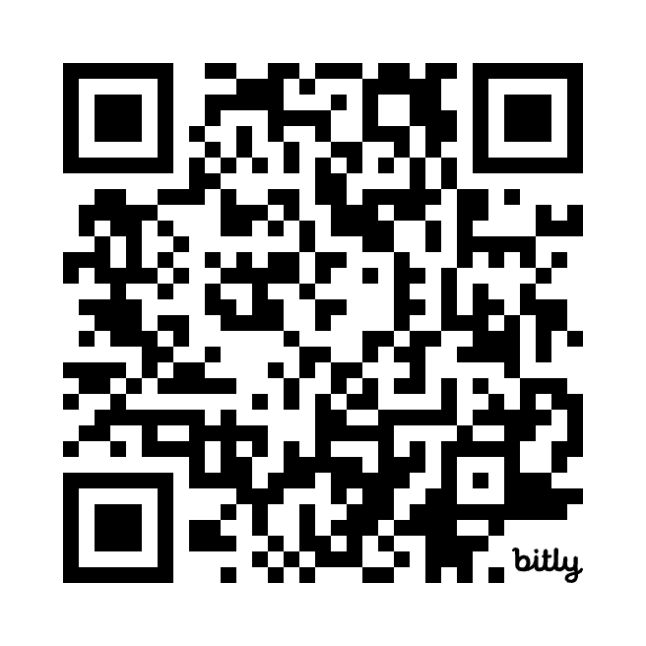
Active Implementation Hub

Slide 29
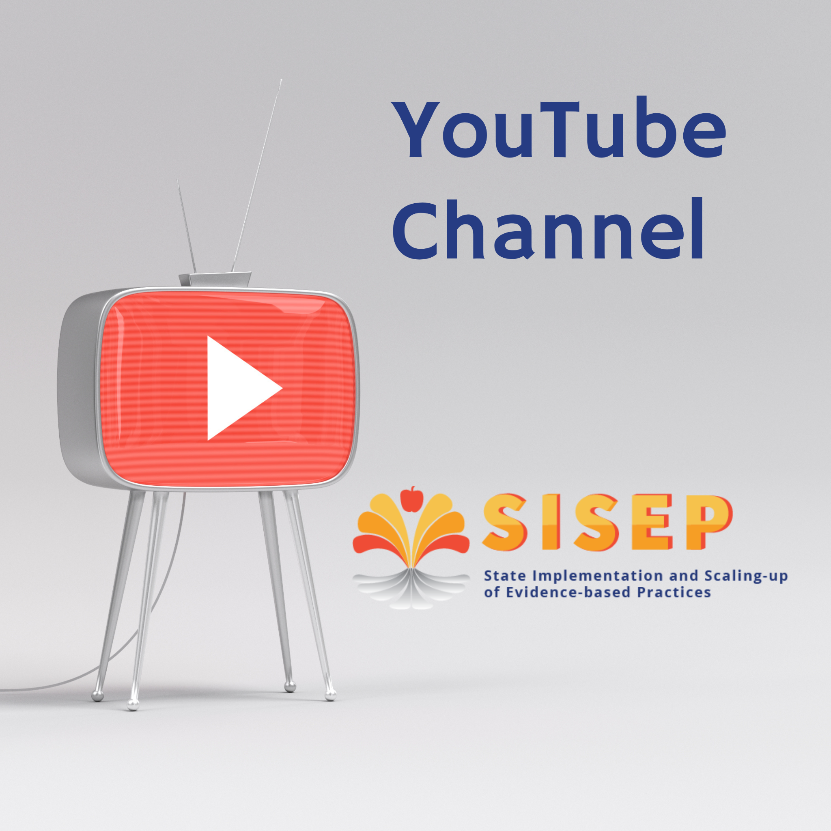
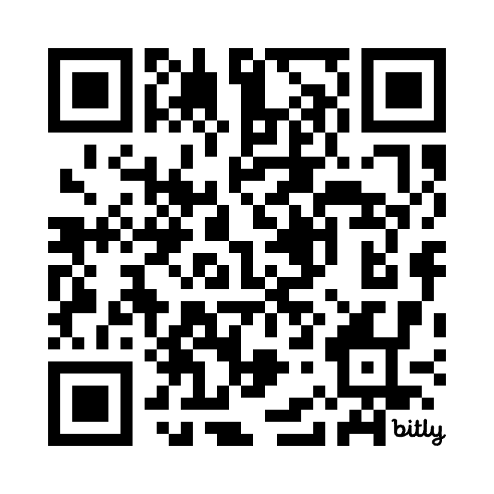
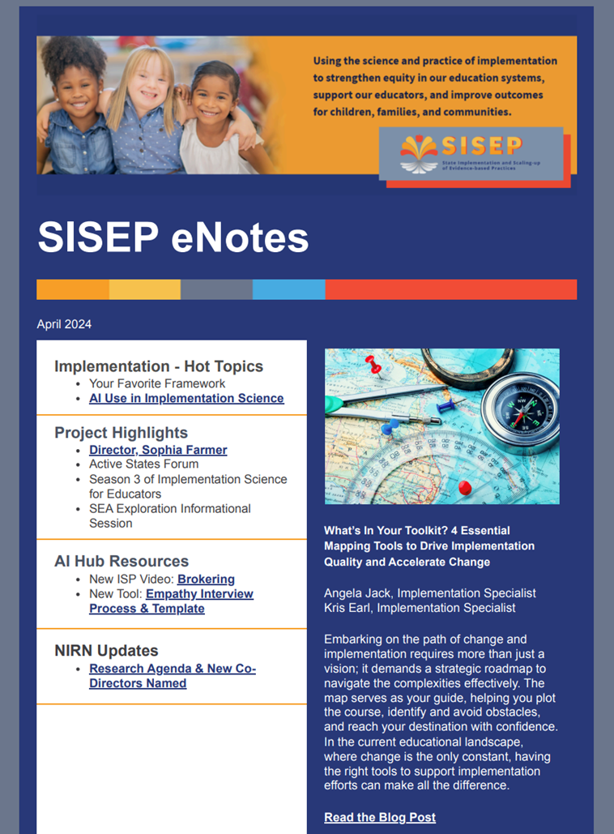
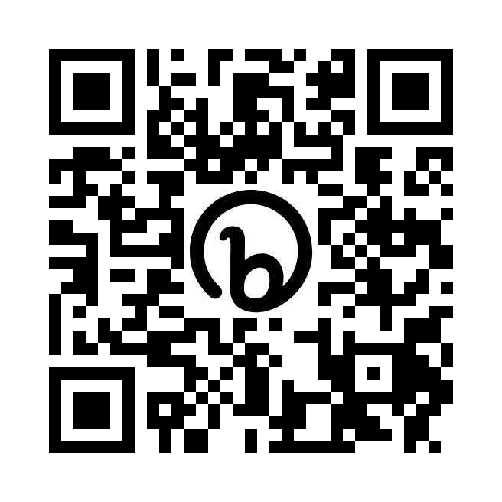
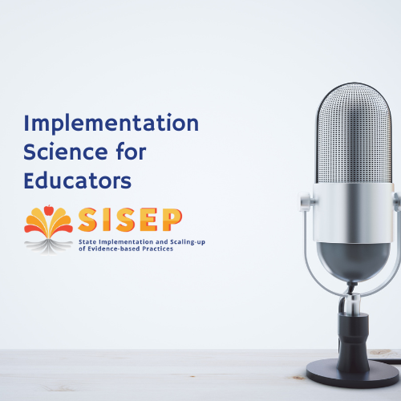
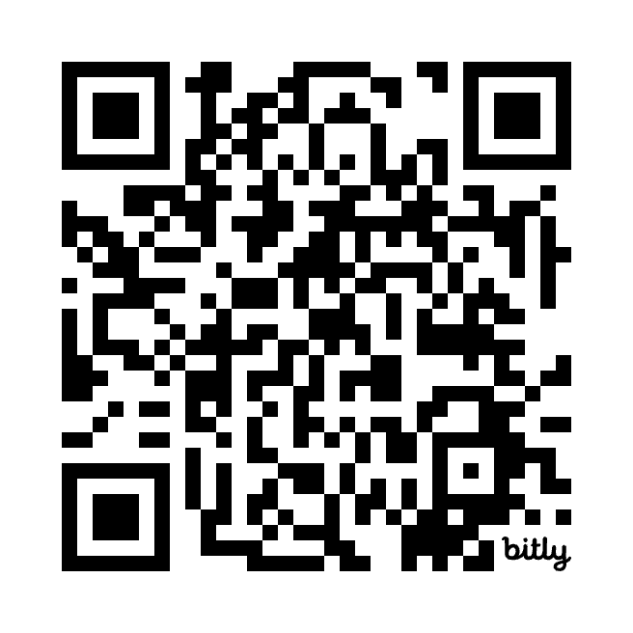
Additional Resources
Subscribe Today

Slide 30

SISEP
More information, contact:
Rebekah Hornak
rhornak@unc.edu

