Slide 1

CCSC Slide

Slide 2



Krewe collaboration
Cross-State Convening
Krewe Collaboration
Focused Goals and Shared Responsibility with Statewide Mentoring and P-20 Literacy (Rhode Island and Ohio)
Wednesday, February 11th 10:15-11:30 AM
Notes:
Abby

Slide 3
P-20 Literacy Collaborative &
Effective State Collaboration
Cross-State Convening
David Brobeck
University of Cincinnati, Systems Development & Improvement Center
Lindsey Roush
University of Cincinnati, Systems Development & Improvement Center
L.M. Clinton
Ohio Department of Education and Workforce
Notes:
Abby

Slide 4




How does Ohio’s P-20 vision, DEW’s MTSS framework, and ALL Ohio resources work together to strengthen educator preparation and support seamless alignment across literacy initiatives?
Cross-State Convening
Notes:
Abby

Slide 5



Overview 1
Cross-State Convening
What we hope to accomplish in this session:
Highlight key components of the P-20 Literacy Collaborative, Ohio’s MTSS framework created by Ohio DEW and the ALL Ohio Resources from University of Cincinnati’s Systems Development and Improvement Center
Identify connections among Ohio’s current initiatives and ways they work together to support effective systems of practice.
Engage with peers through a World Café structure to explore presentation topics and share insights.
Consider implications for educator preparation, including how to bring statewide initiatives into pre‑service teacher training and field experiences.
Notes:
Abby

Slide 6

Whole Brain Teaching (WBT) Techniques
Class yes
  Attention getter
Ah switch!
  Neurotransmitter breaker
High Five switch
Notes:
David and Lindsey

Slide 7
WBT – Maximizing Time!
Taking Care of the Learner
Q R S T
Question: ask clearly
Reflect: timed (10-20 seconds)
Share: (with partner)
  Ah switch! (seeking equitable time)
Total Room: (formatively assess)
Notes:
David and Lindsey

Slide 8

P20 Literacy Collaborative
Cross-State Convening
Notes:
David

Slide 9

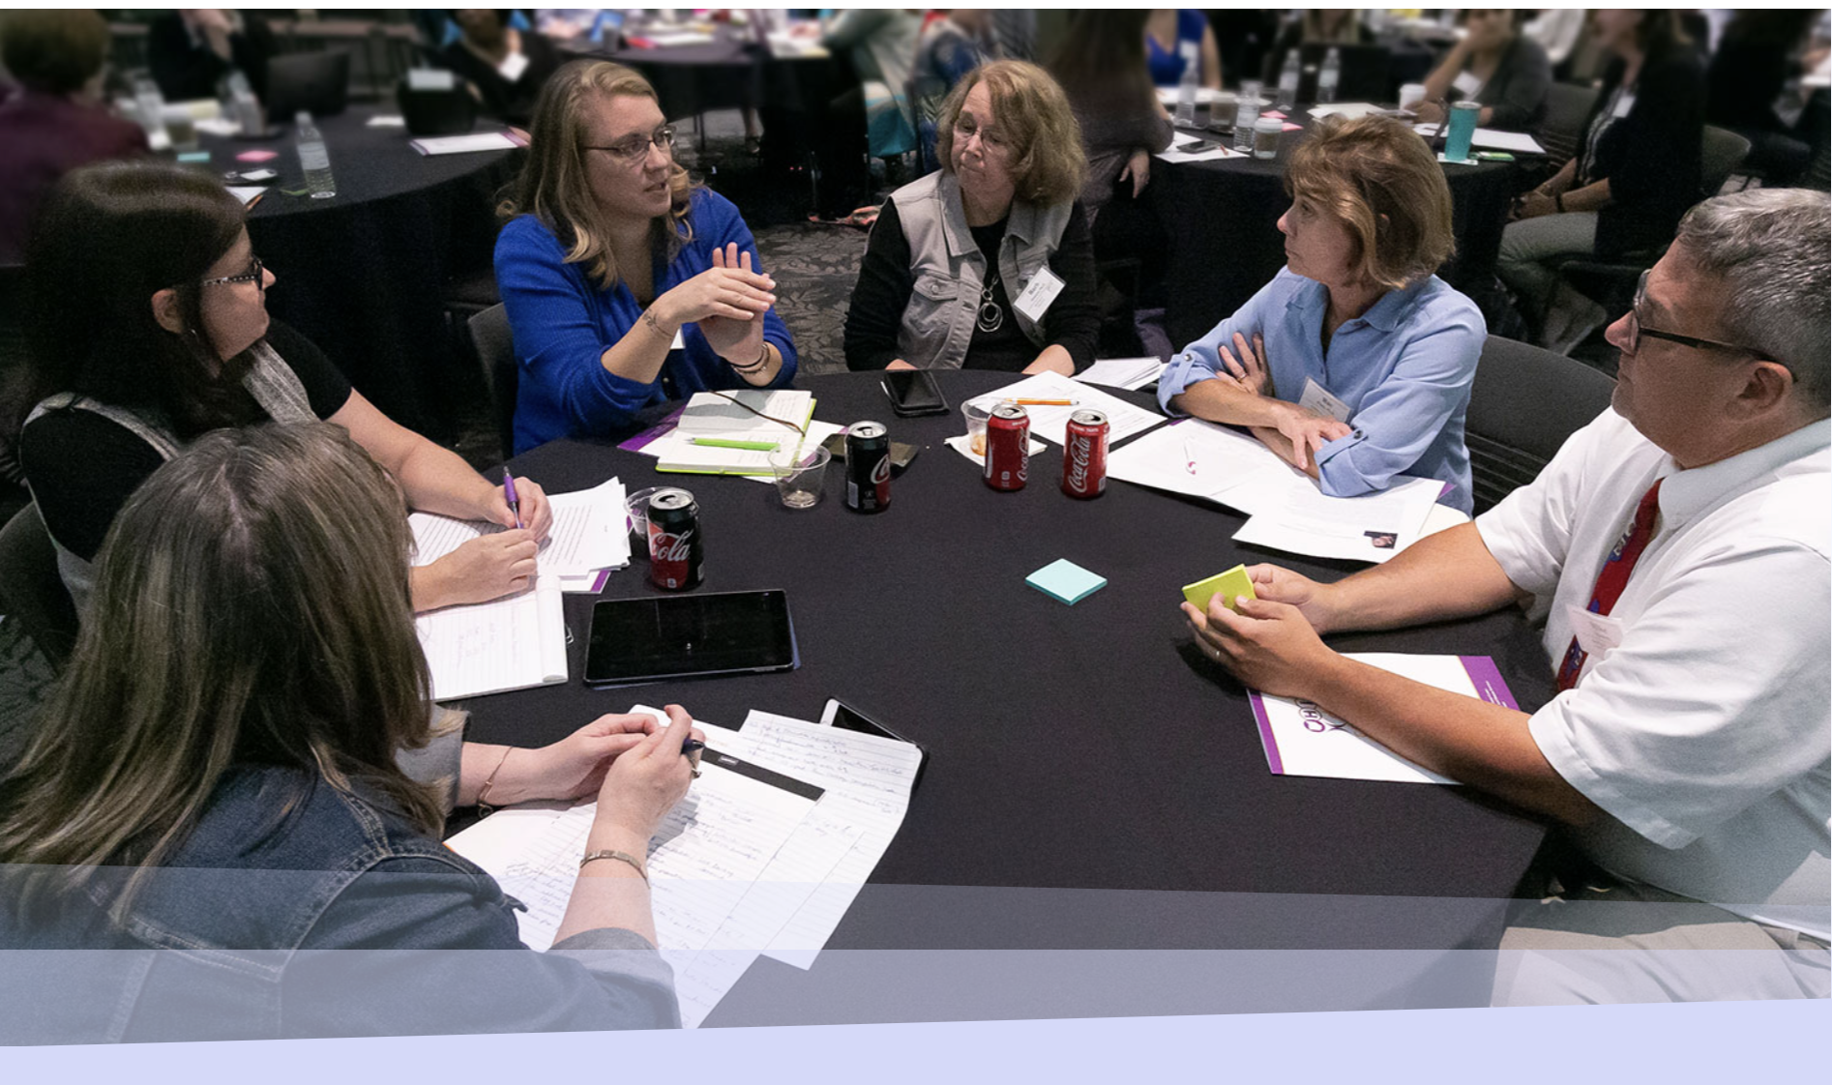
P20 Literacy Collaborative History
Cross-State Convening
2018: Higher Ed Literacy planning
2019: University-District team evolve
2020: P20 LC foundation established
Community of Practice
Focus on sustainable partnerships
Access to HQ literacy instruction
Support for struggling readers
Fostering collective inquiry
Notes:
David

Slide 10
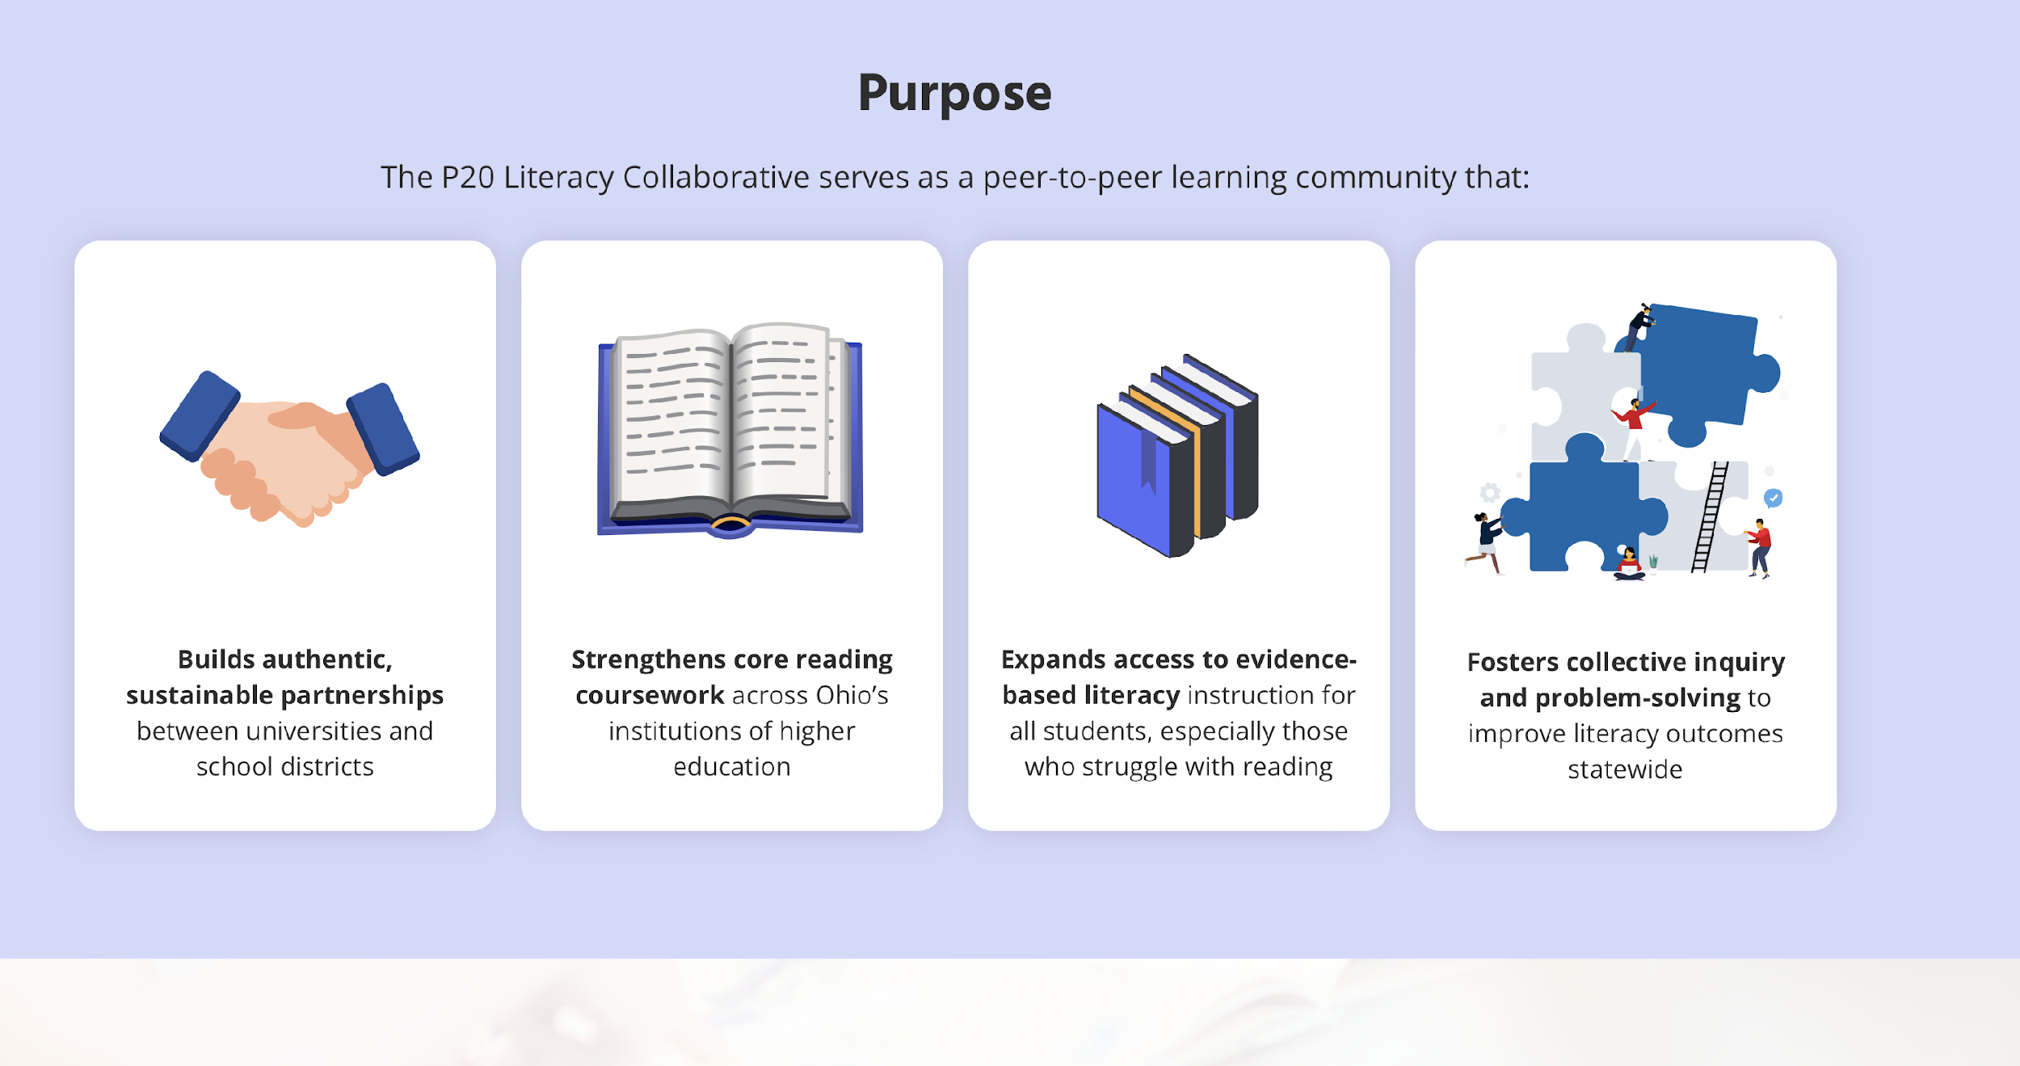
P20 Literacy Collaborative: Our Purpose
Cross-State Convening
Notes:
David

Slide 11
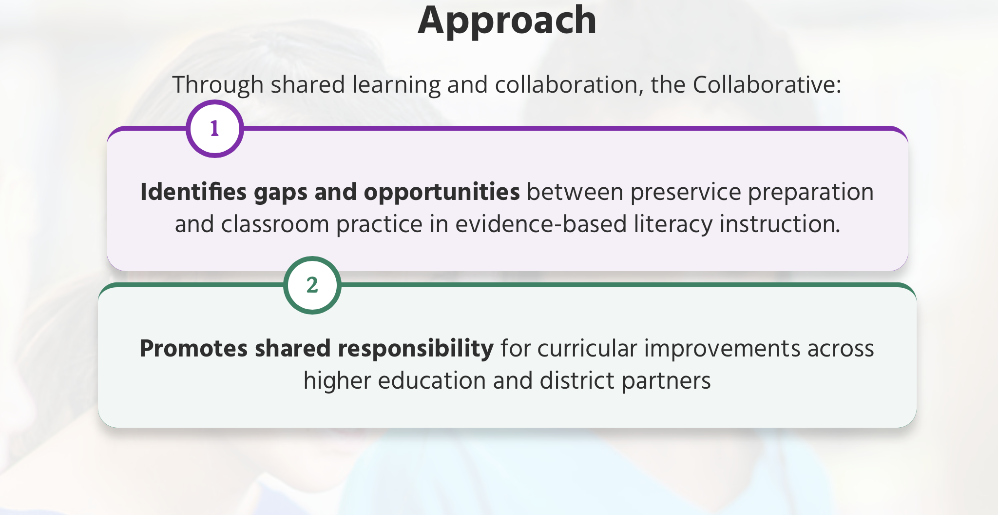
P20 Literacy Collaborative: Our Approach 1
Cross-State Convening
Notes:
David

Slide 12
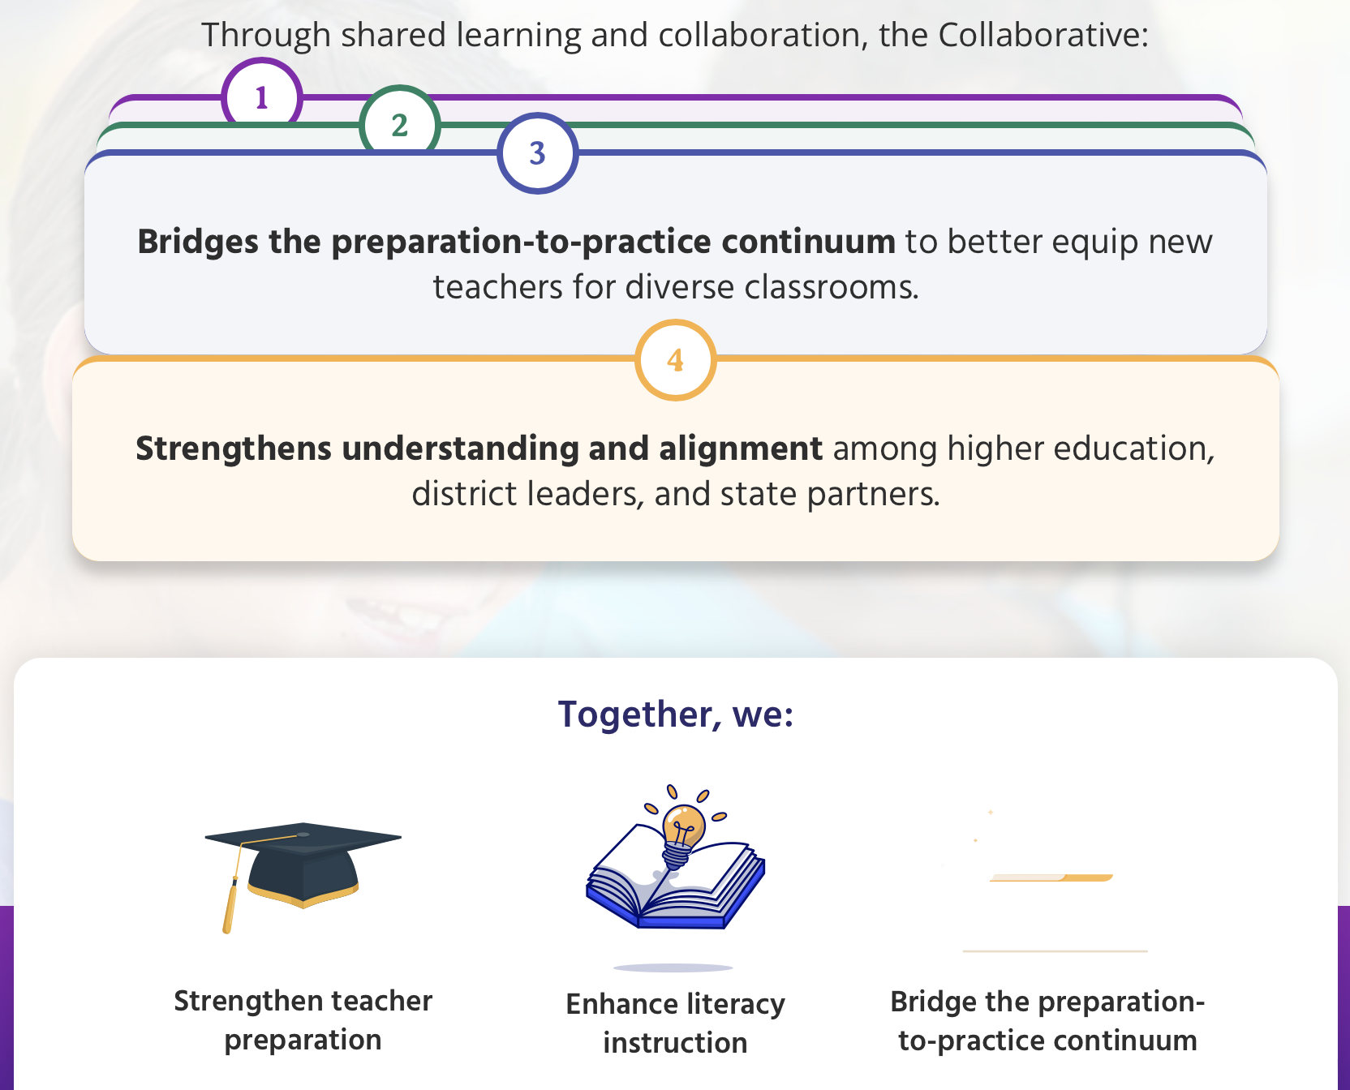
P20 Literacy Collaborative: Our Approach 2
Cross-State Convening
Notes:
David

Slide 13

P20 Literacy Collaborative: Our Resources 1
Cross-State Convening
Notes:
David

Slide 14

P20 Literacy Collaborative: Our Resources 2
Cross-State Convening
Notes:
David

Slide 15



P20 Literacy Collaborative: Our Resources 3
Cross-State Convening
Notes:
David

Slide 16

P20 Literacy Collaborative: Our OnDemand Tools
Cross-State Convening
Notes:
David

Slide 17

P20: ALL Ohio Literacy & Learning Science 1
Cross-State Convening
Notes:
Lindsey

Slide 18


P20: ALL Ohio Literacy & Learning Science 2
Cross-State Convening
Notes:
Lindsey

Slide 19
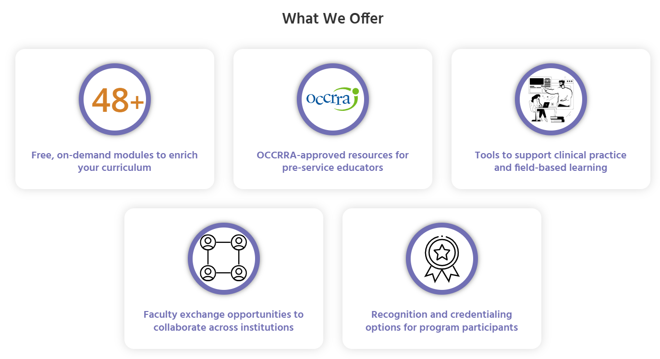


What we Offer
Cross-State Convening
Notes:
Lindsey

Slide 20
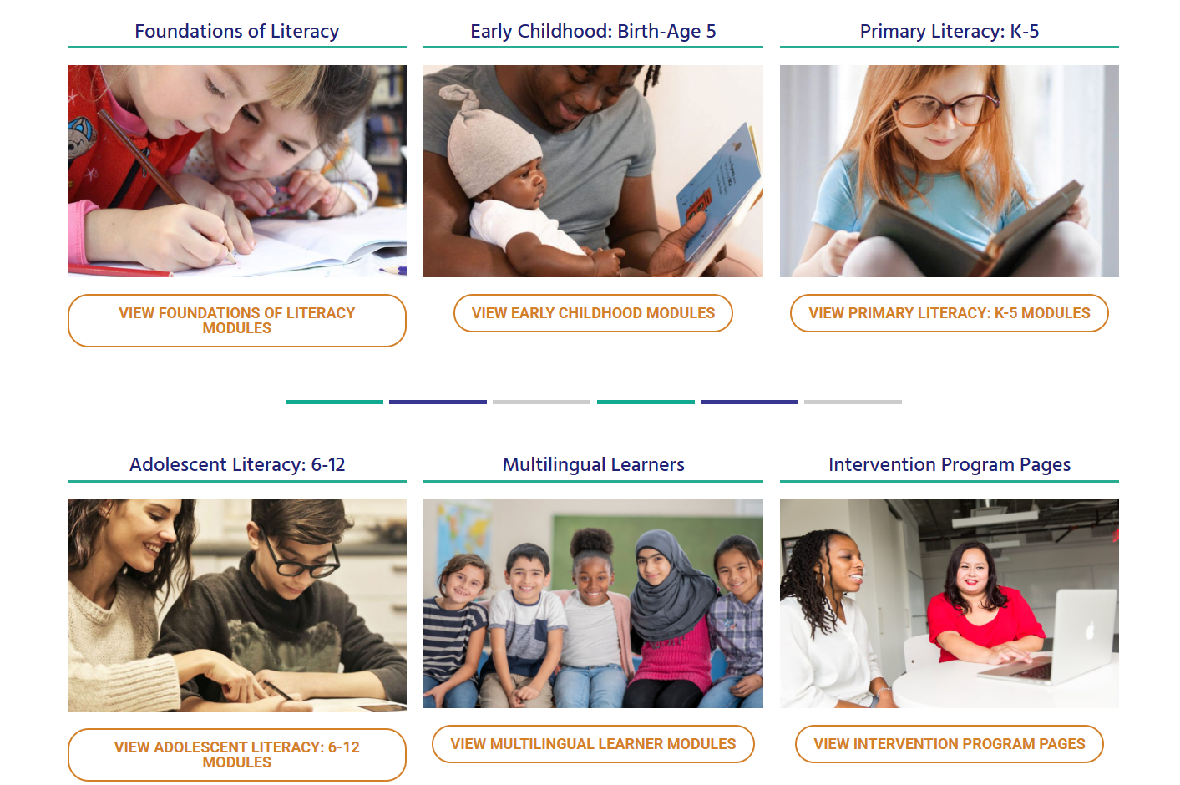
P20: ALL Ohio Literacy & Learning Science
Cross-State Convening
Notes:
Lindsey

Slide 21
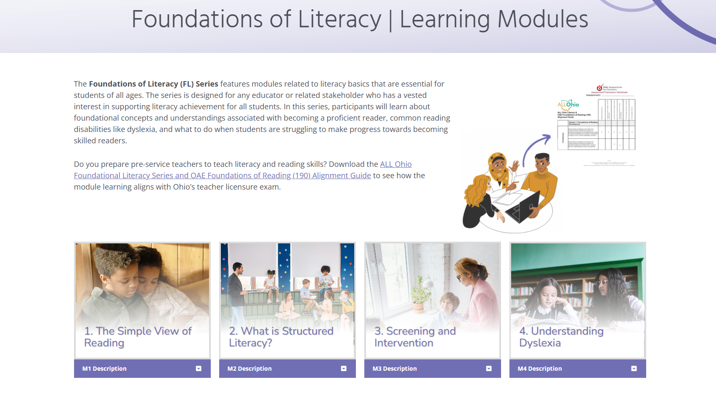
Foundations of Literacy
Cross-State Convening
OAE Alignment Guide
Notes:
Lindsey

Slide 22
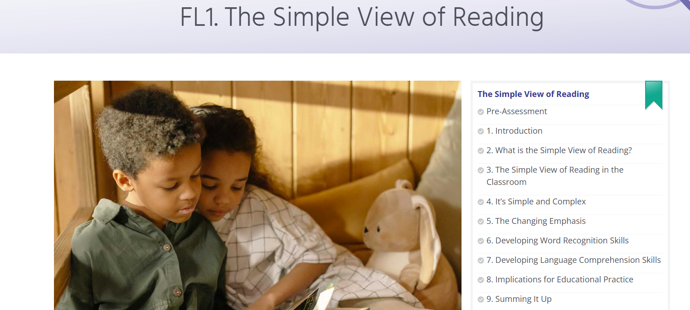
FL1. The simple view of reading
Cross-State Convening
Notes:
Lindsey

Slide 23
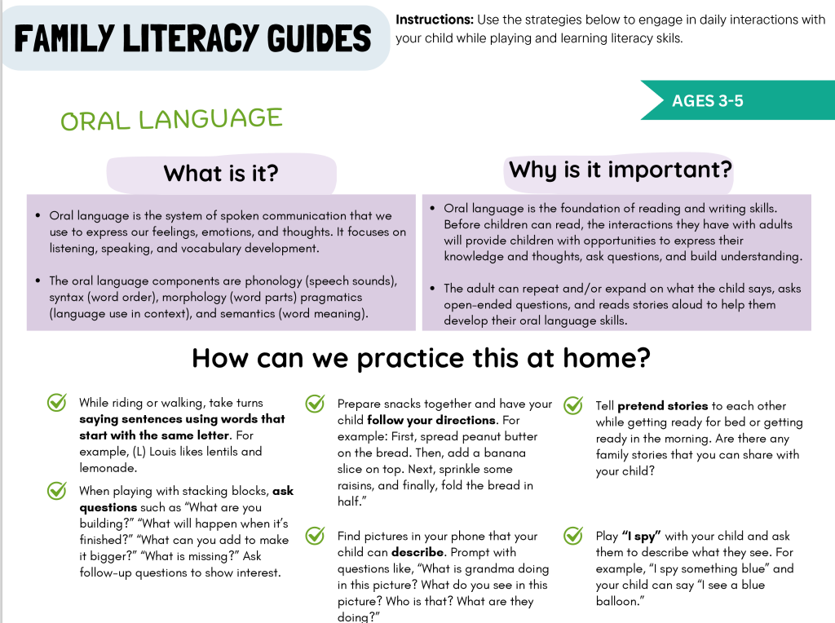
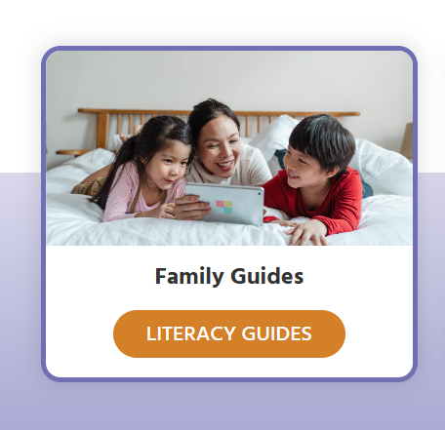
Family Literacy Guides
Cross-State Convening
Families
First Steps in Literacy
Oral Language
Vocabulary
Sounds & Letters
Print Awareness Parts 1 & 2
Notes:
Lindsey

Slide 24
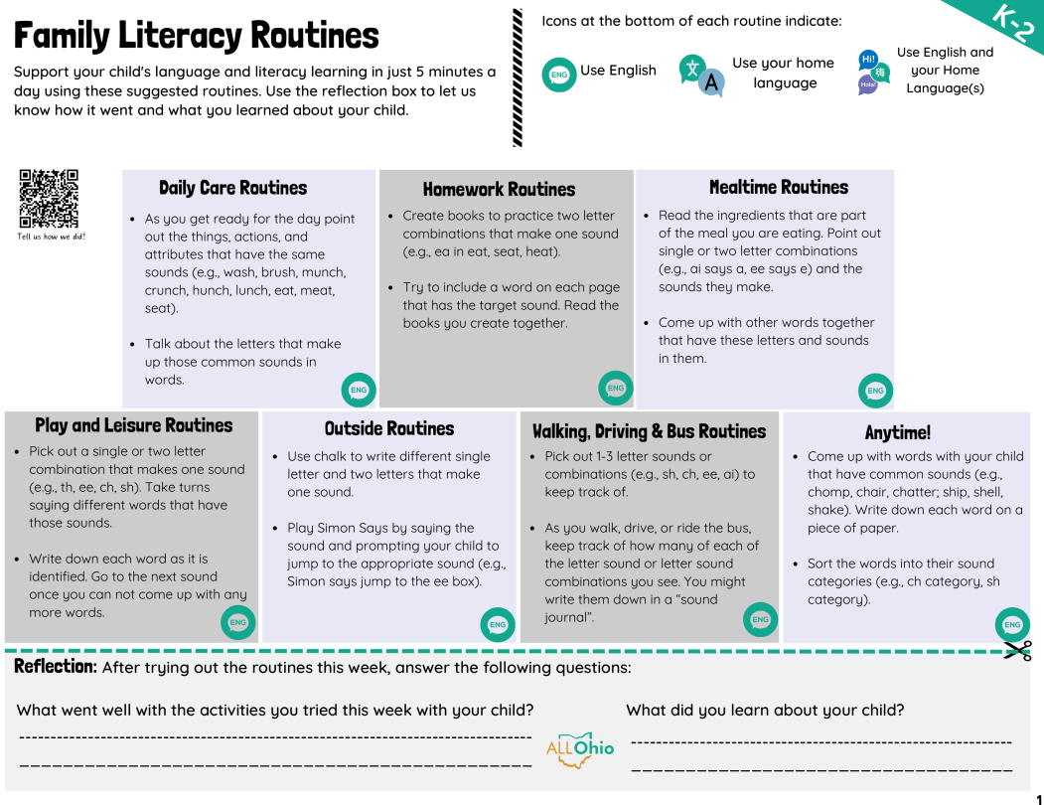

Families
Cross-State Convening
10 Categories
6 Languages
Broken into age groups of PK-K, K-2, & 3-5
Notes:
Lindsey

Slide 25
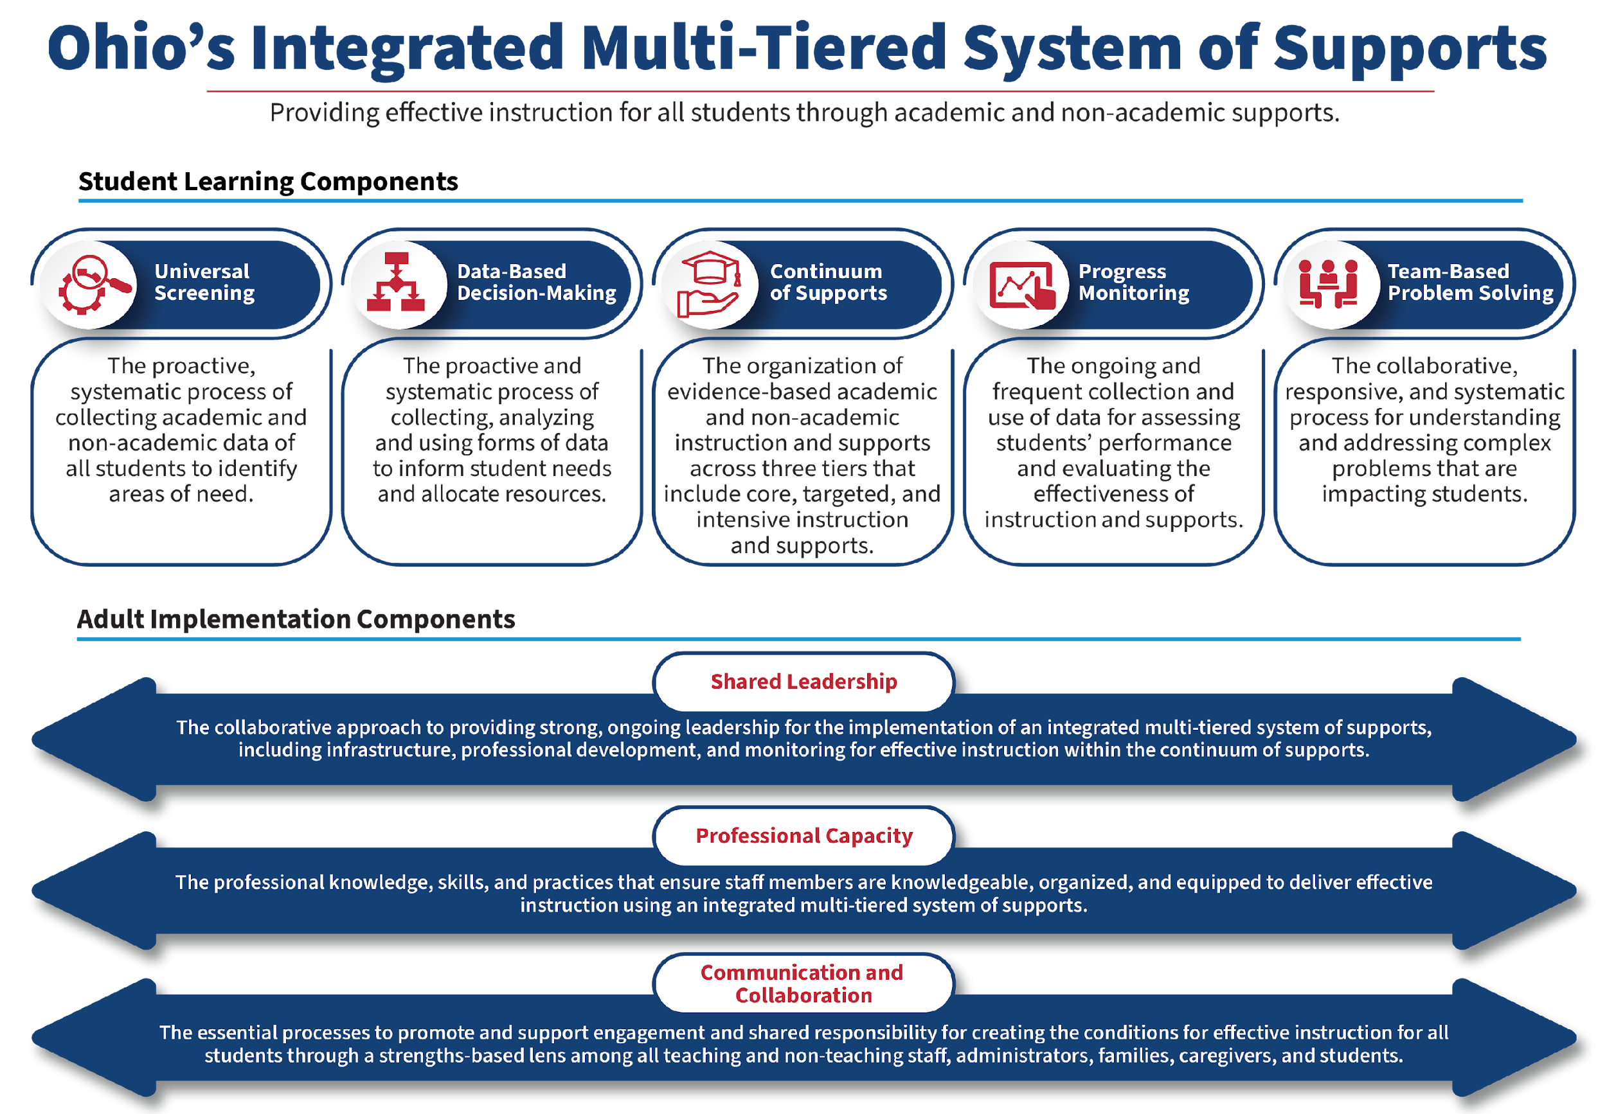
Ohio’s Integrated Multi-Tiered System of Supports
Notes:
LM
Ohio’s Integrated Multi-Tiered System of Supports (Ohio’s Integrated MTSS) is a framework designed to assist districts and schools in developing a local multi-tiered system of supports for providing effective instruction that meets the academic and non-academic needs of all students. Ohio’s Integrated MTSS framework includes key student learning and adult implementation components shown to improve student outcomes.

Slide 26



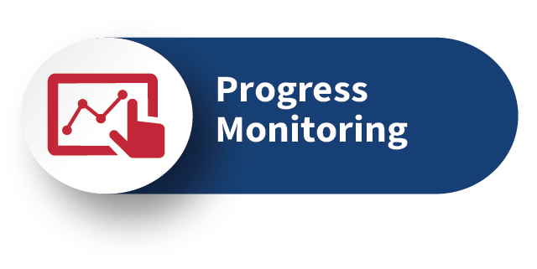
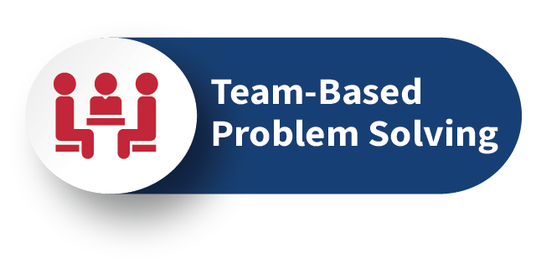

Student Learning Components
Ohio’s Integrated-MTSS Framework
Cross-State Convening
Notes:
LM

Slide 27
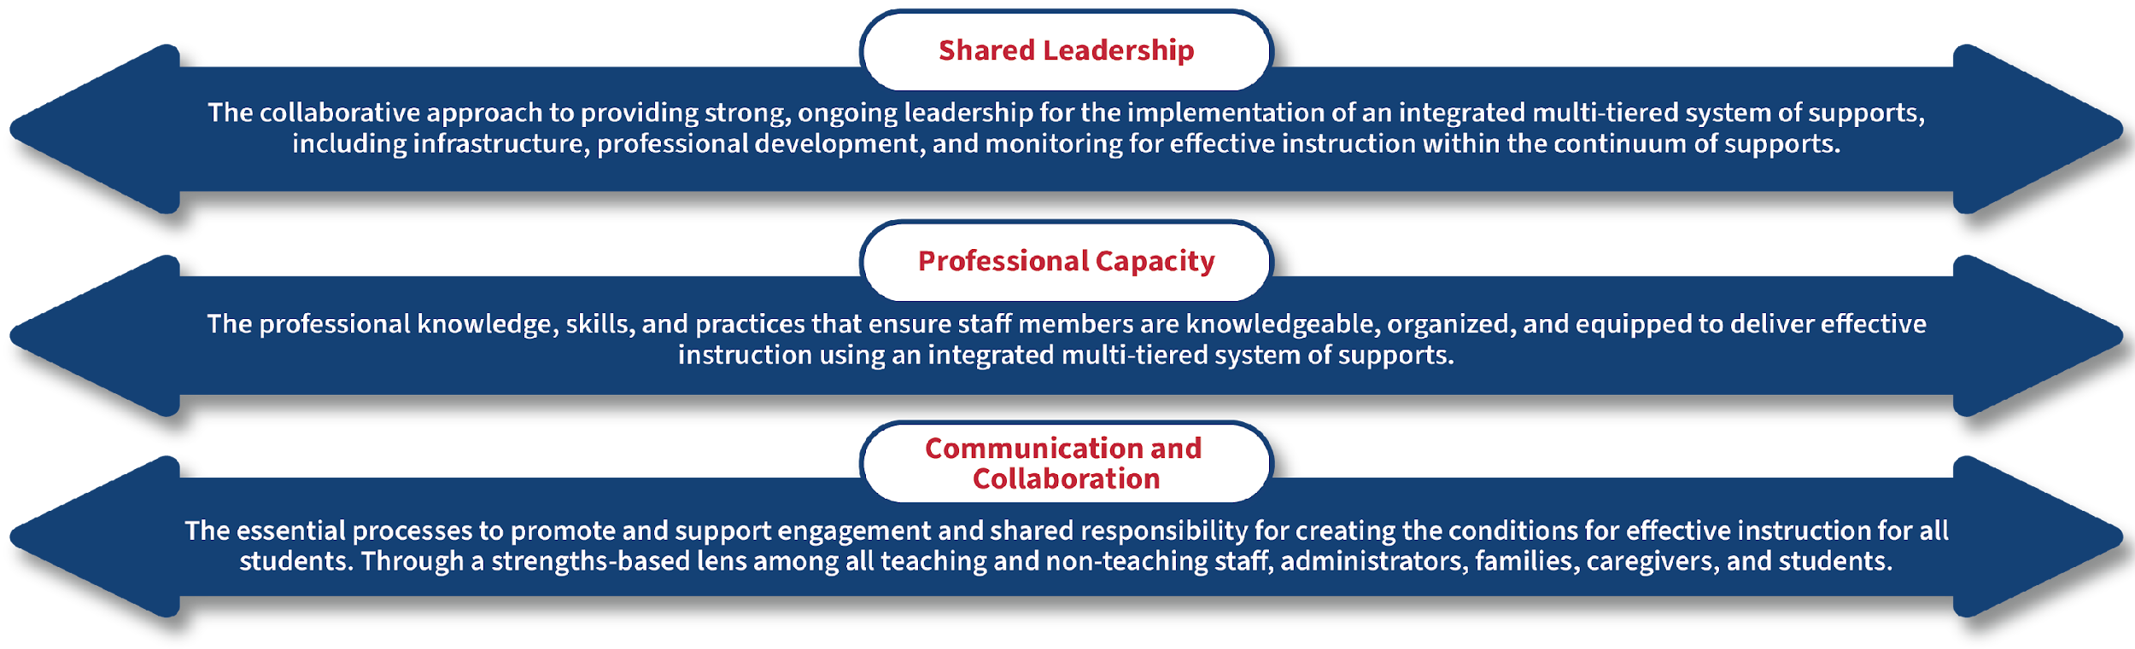
Adult Implementation Components
Ohio’s Integrated-MTSS Framework
Cross-State Convening
Notes:
LM
Ohio’s integrated MTSS framework recognizes that all the activities and policies we just discussed will only be effective if the adults responsible for those activities are also supported. In recent years, legislation has placed a renewed focus on adult implementation.

Slide 28
World Café
Cross-State Convening
The room will be set up in five groups.
  your group is the number you were given when you entered this presentation
We will have discussion time for the three topics from our presentation:
  P20 Collaborative
  ALL Ohio Literacy and Learning Science
  DEW's MTSS Framework.
Notes:
Abby: We are ready to begin the World Café. We have planned this to be an engaging and fun activity. You have been divided into XXXX groups, each group will move to an area of the room for the discussion time. We will spend 4 minutes on each discussion topic.You will get to engage with each of the ideas shared with you today
With a goal for everyone to benefit from the discussions, each table will have a host and recorder to capture highlights from each prompt. At the conclusion of the third round, we will take the final minutes to share highlights from each section as well as opportunity for any participant to share with the entire group. We may ask you to prioritized which topic to begin the share out.

Slide 29
World Café 1
Cross-State Convening
Your group host will facilitate the group process
You will have 4 minutes for each topic.
Consider your role, organization, and or state
  Open sharing of ideas
  Strengths? Opportunities?
Comment "highlights" will be recorded on the anchor document by the recorder.
Notes:
Abby

Slide 30
World Café 2
Cross-State Convening
Listen for the CLASS-YES to "Ah, switch."
On the “Ah, switch,” your group will move to the next topic/question.
At the end of round three, the “room” will reconfigure for quick share out.
Notes:
Abby

Slide 31

Timer

Slide 32
World Café 3
Cross-State Convening
Share out
Share something you heard that you believe is
A STRENGTH or
An OPPORTUNITY
(Please identify which of the three topics your are referencing)
Notes:
OH Team and CEEDAR Staff:

Slide 33
Ah, Switch!
Hello Rhode Island!
Cross-State Convening
Notes:
OH Team

Slide 34
Finding the Rhythm: Mentoring and Collaborating to Prepare Pre-Service Teachers
Cross-State Convening
Presented by:
Amy Broemmel, PhD
University of RI
Kimberlee Johnsen-Smith, Ed.D.
Roger Williams University
Diana Marshall, PhD
University of RI

Slide 35
Overview
Cross-State Convening
We hope participants will walk away from this session with ideas for:
  Networking within and across states
  Valuing teacher expertise
  Broadening understanding of what it means to mentor adults

Slide 36


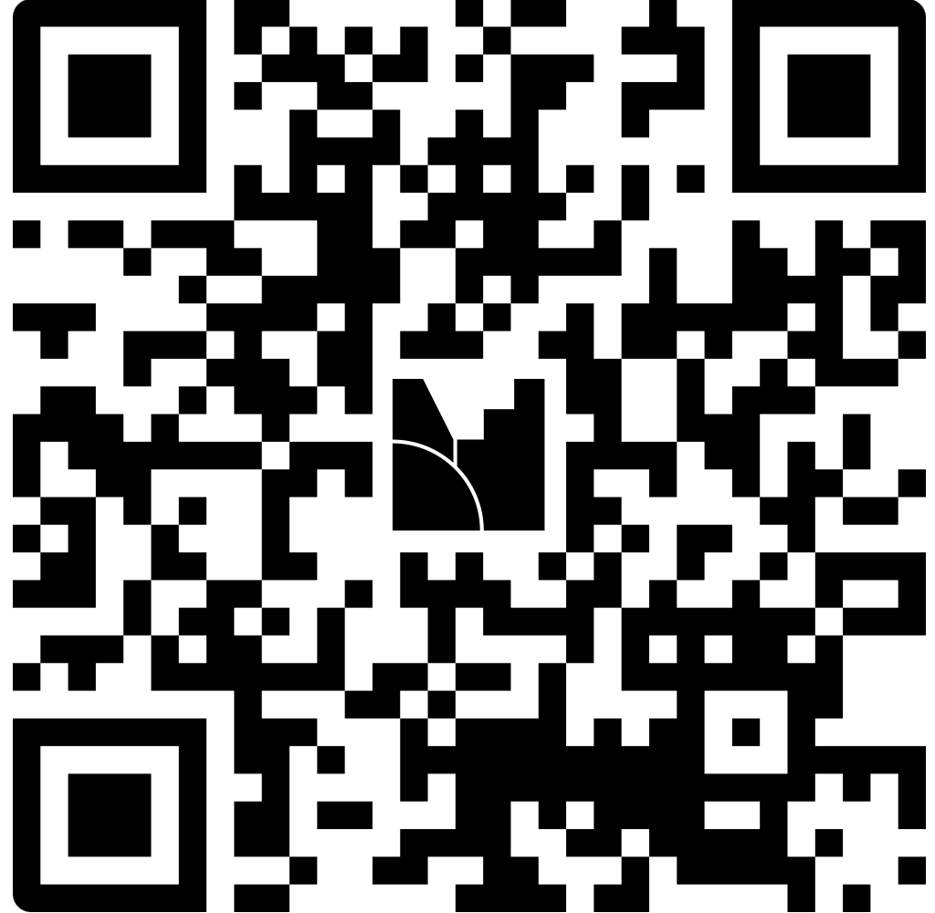

What knowledge, skills, and qualities do mentor teachers need to effectively support pre-service teachers?
https://www.menti.com/alod4gxicjxh
https://www.menti.com/alod4gxicjxh
Cross-State Convening

Slide 37
Collaboration: Across and Within the State
‘Small State, Big Leverage’: CEEDAR State Leadership Team Workgroup
    Representatives from RI EPPs and Rhode Island Department of Education
    Ongoing Subcommittee Meetings - Laid Foundation/Charge for Work at SLT
      Modules Inspired Continuous Improvement - CEEDAR workgroup - URI/JWU/PC
    Strategic Guidance Provided By: Dr. Kelly Acosta, Ashton Johnson, and Jen Greer
Lean Into Cross-State Models - Research Best Practices Nationwide
    George Mason University Faculty and Director Outreach - Met our SLT to Discuss
    Our team was granted permission to use Virginia Mentoring website resources
      SLT found modules helpful to determine general guide that we wished to build for EPPs and CEs in RI. SLT specifically focus on reviewing/reporting on RI application.
Purpose: To design and promote modules that could be utilized across the state. Further, we wanted to engage CEs in professional learning about working with teacher candidates and to provide them with a voice in the development process.
Cross-State Convening
Notes:
Potential ideas to talk about are how we worked within and across state networks to develop these modules; include information here from Mentoring VA (https://www.mentoringvirginia.com/) as well as our RI CEEDAR webpage: https://web.uri.edu/ri-ceedar/

Slide 38
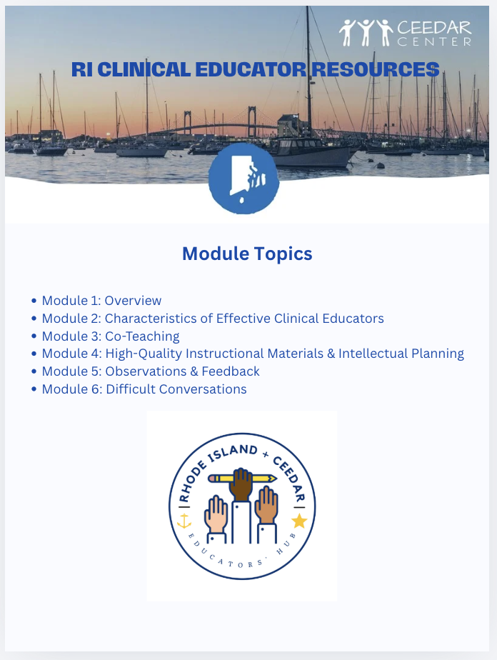

Module Design Timeline
Cross-State Convening

Slide 39
Collaboration:
Broadening Understanding of Adult Mentoring
Cross-State Convening
RIDE & RI EPPs
  RI Dept of Education (RIDE) expectations for EPPs include that, “All clinical educators are prepared to mentor and coach adult learners.”
  EPPs worked in collaboration with RIDE through CEEDAR to establish a common tool for conveying this knowledge
  RIDE is in the process of approving the completion of the modules as one option for extending the time period for renewal of professional licensure

Slide 40


Collaboration:
Valuing Teacher Expertise
Cross-State Convening
EPPs & Clinical Educators
  Educators will come to these modules with many experiences as clinical educators
  Educator directives often undervalue the knowledge and experience teachers bring to professional learning
  Educators who feel “othered” or talked down to are unlikely to engage with the modules in meaningful and lasting ways
  Intentional use phrases like, “As you know…” or “Consider…” frame educators as active participants and decision makers in their own learning

Slide 41






Collaboration: Lessons Learned
Be inclusive!
Network!
Consider including partners from diverse perspectives, including EPPs, SEAs, and/or LEAs.
Reach across states, find what already exists related to your goals, use your network to be efficient!
Set the stage!
Begin and begin again!
Take time early on to establish common language and goals. Come with your own priorities (keep at a minimum).
Be prepared! As you work through collaboration, you are likely to go through various iterations of your project.
Cross-State Convening
Notes:
Diana

Slide 42

Breakout Discussion
Cross-State Convening
Cross-State Convening
Group 1
  What kind of challenges have you faced in collaborating within and across states to enact potential changes? How have you navigated these challenges?
Group 2
  How have you tried to develop support for clinical educators/mentors to better support their residents?
Notes:
Diana

Slide 43
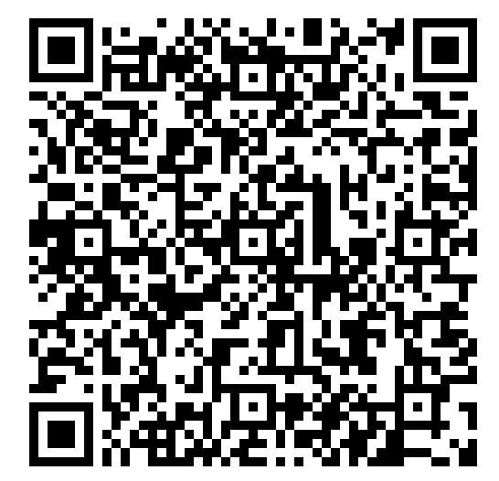
resources
Resources
Mentoring Virginia: https://www.mentoringvirginia.com/
1
2
Rhode Island CEEDAR Site: Clinical Educator Introductory Modules https://web.uri.edu/ri-ceedar/partnerships/
Contact Information
Amy Broemmel: amy.broemmel@uri.edu
Kimberlee Johnsen-Smith: kjohnsen-smith@rwu.edu
Diana Marshall: dmarshall@uri.edu
3
Module 1 Checklist for Educators
4
Module 1 Clinical Educator Criteria
QR Code to Resources
Cross-State Convening

Slide 44
State Padlet Debrief
Cross-State Convening
What should you include in your notes?
Our Session Name: Krewe Collaboration: Focused Goals and Shared Responsibility with Statewide Mentoring and P-20 Literacy
Notes: Brief summary of the session, lessons learned, ideas that could support your context, potential pitfalls to avoid, etc.
Connections: How does this connect to your state’s current work? How could this connect to future work (use the future work column)? Are there follow-ups/additional networking needed with CEEDAR states or staff?

Slide 45


THANK YOU!
Cross-State Convening

Slide 46

Disclaimer
This content was produced under U.S. Department of Education, Office of Special Education Programs, Award No. H325A220002. David Guardino serves as the project officer. The views expressed herein do not necessarily represent the positions or policies of the U.S. Department of Education. No official endorsement by the U.S. Department of Education of any product, commodity, service, or enterprise mentioned in this website is intended or should be inferred.
Cross-State Convening

