Slide 1

An Observation & Evidence Collection Guidance Tool: Making High-Leverage Practices Tangible
Dr. Daphne D. Smith
Asst. Professor of Educational Leadership
Delta State University, Mississippi

Slide 2

The Leadership Dilemma
Leaders come from diverse content and grade levels
Must recognize high-quality instruction across contexts
Essential Question: Can leaders recognize high-quality instruction anywhere?

Slide 3
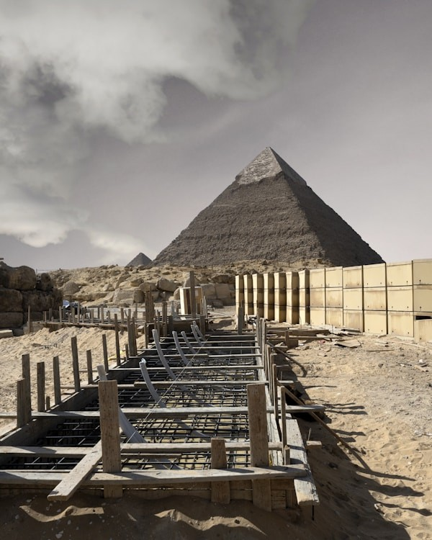
Research Foundation
High-Leverage Practices (HLPs)
Effective across grade levels and content areas
Aligned with high-impact instructional strategies

Slide 4

John Hattie & Effect Size
Synthesized 800+ meta-analyses
Identified practices with high effect sizes
Hinge point: 0.40

Slide 5
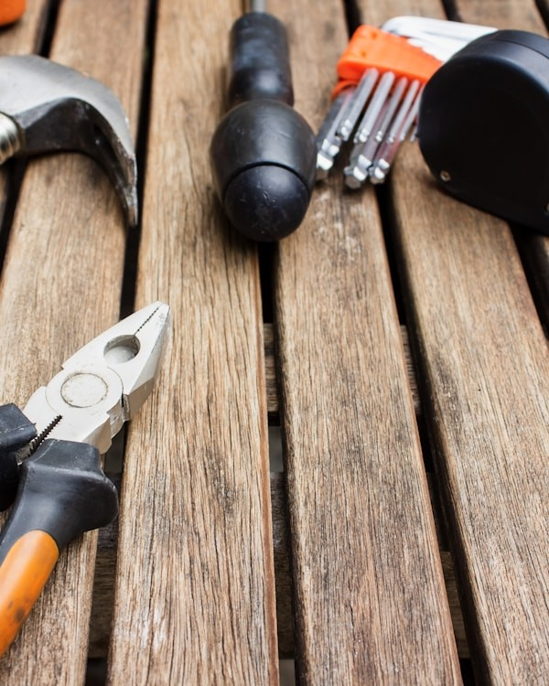
Purpose of the Tool
Align HLPs with Teacher Growth Rubric (TGR)
Provide concrete "Look Fors"
Support feedback conversation
Promote shared instructional language

Slide 6

How the Tool Works
Shows TGR domains and standards and their aligned HLPs
Provides HLP definitions + observable indicators ("look fors")
Used for observation, evidence collection, & coaching, not evaluation

Slide 7
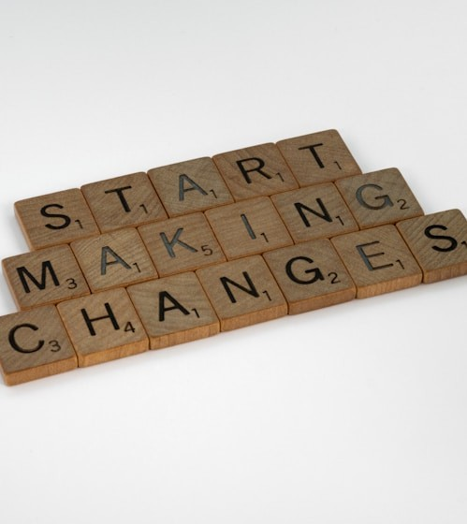
Implementation Uses
Leadership preparation programs
Administrator observations
Mentoring and coaching
Professional development planning

Slide 8
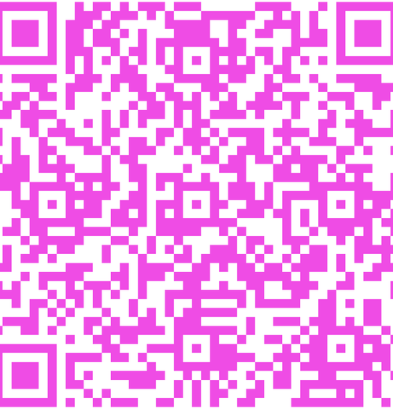
Examination of the Tool

Slide 9

Reflection & Feedback Questions
How do you see yourself using this tool?
What challenges do you anticipate?
What revisions would make it more usable?
What should be next for this tool?

Slide 10
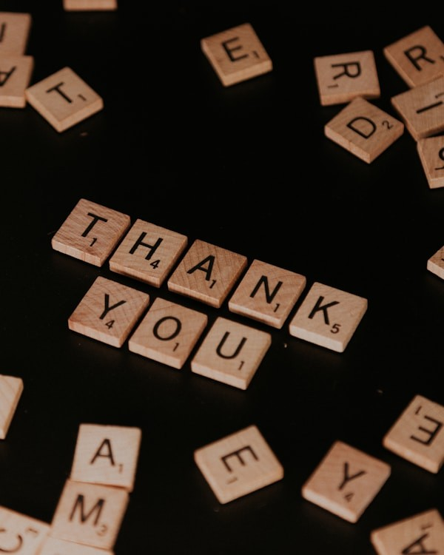
Thank you!
ddsmith@deltastate.edu

