Slide 1
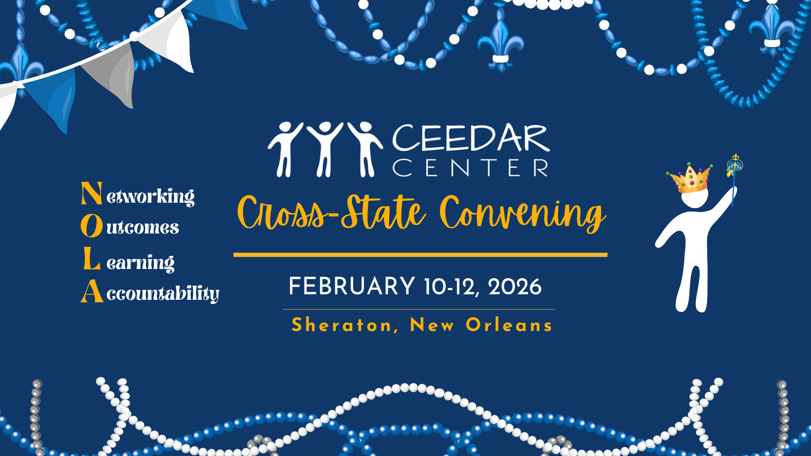
CCSC Title

Slide 2


Leveraging Networks to Integrate Content Across Departments
Cross-State Convening
Presented by: Nakia M. Gray-Nicolas, EdD, Denise Ferrara, MSEd, Jennifer Diliberto, PhD

Slide 3


Agenda
Cross-State Convening
Agenda
Welcome & Engagement Activity
Leveraging Partnerships Across Educational Leadership and Special Education (NY)
Breaking Down Barriers to Support the Inclusion of Students with Disabilities (NC)
Small Group Breakout Discussion
Share Out & Closing

Slide 4



Session Outcomes
Cross-State Convening
Participants will learn:
  Strategies for breaking down barriers to support the inclusion of students with disabilities.
  Knowledge of how to leverage education preparation programs to collaboratively prepare for challenges that candidates may encounter during in-service practice.
  Considerations for integrating High-Leverage Practices (HLPs), Multi-Tiered System of Supports (MTSS), and Universal Design for Learning (UDL) across disciplines and programs to enhance teaching and leadership practices for all learners.

Slide 5


Engagement Activity:
“Frame” what it means for you to have effective partnerships (e.g., terms, skills, traits, dispositions).
Cross-State Convening

Slide 6


New York
Cross-State Convening
New York
Leveraging cross-disciplinary partnerships across educational leadership and special education (and other EPPs)

Slide 7
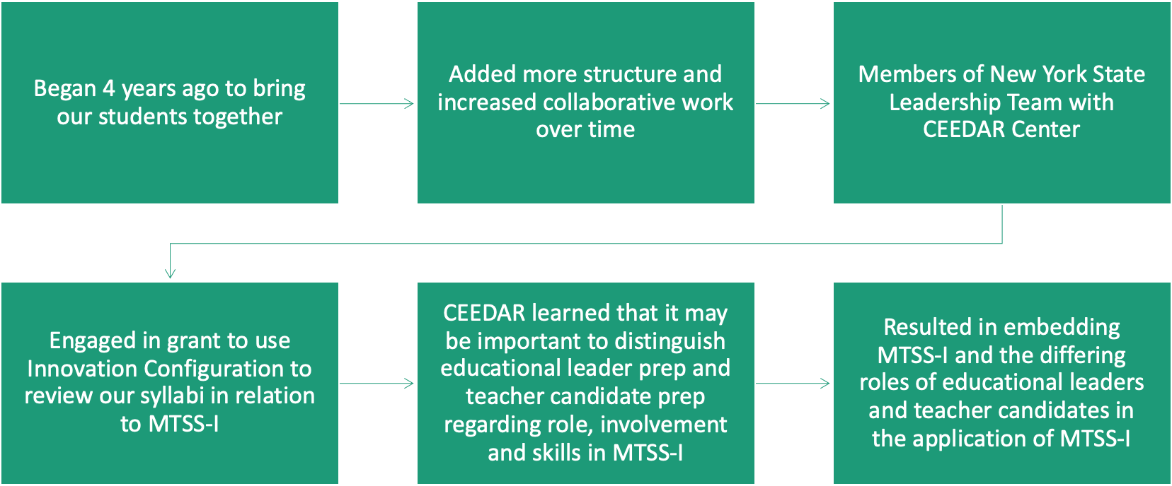
How it Started…
Cross-State Convening

Slide 8
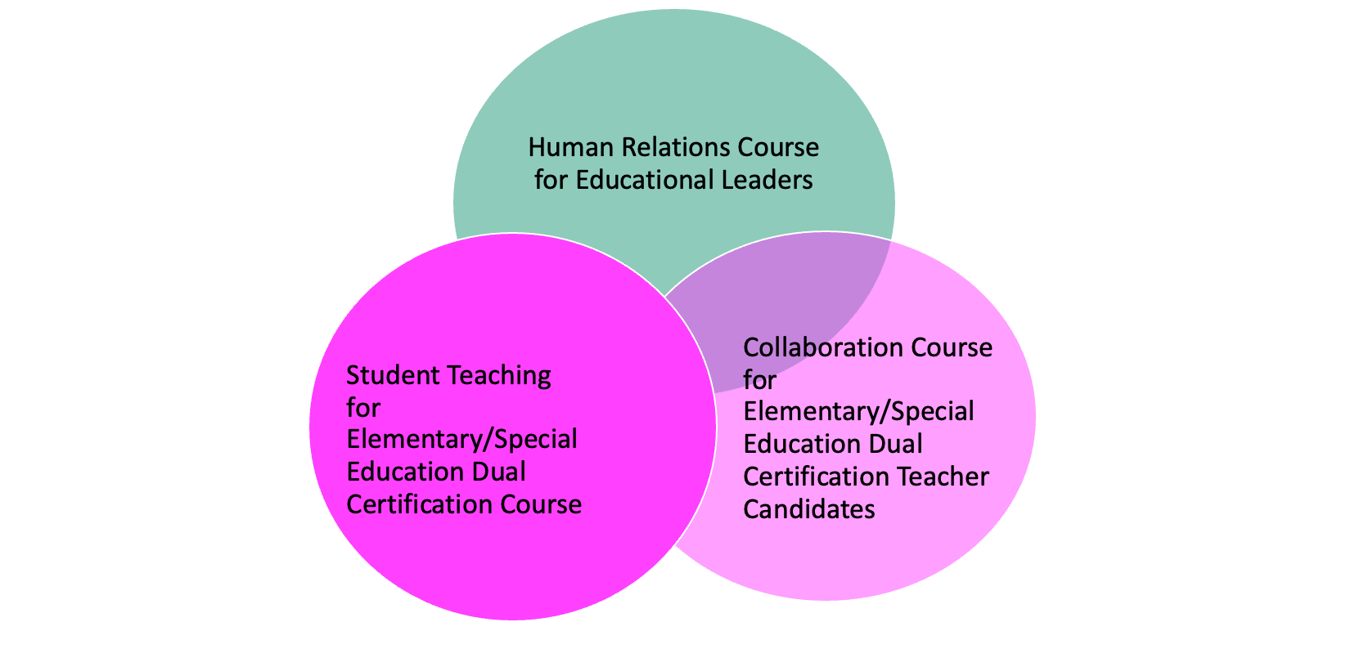







Project Goals
Childhood/special education candidates have authentic opportunities to learn and apply collaboration skills.
Educational leadership
candidates strengthen their human relation skills, conflict management, and communication skills.
Childhood/special education candidates have authentic and extended opportunities to identify and address a self-defined problem of practice encountered in their student teaching.
Educational leadership candidates have authentic and extended opportunities to provide guidance, support, feedback, and supervision to teacher candidates during their student teaching experiences.
Cross-State Convening

Slide 9
Project Structure
Designed with a Gradual Release of Responsibility model
Established communities of practice consisting of educational leaders and teacher candidates
Formal work structure established by faculty
Informal work structure established by individual communitiese of practice
Cross-State Convening

Slide 10

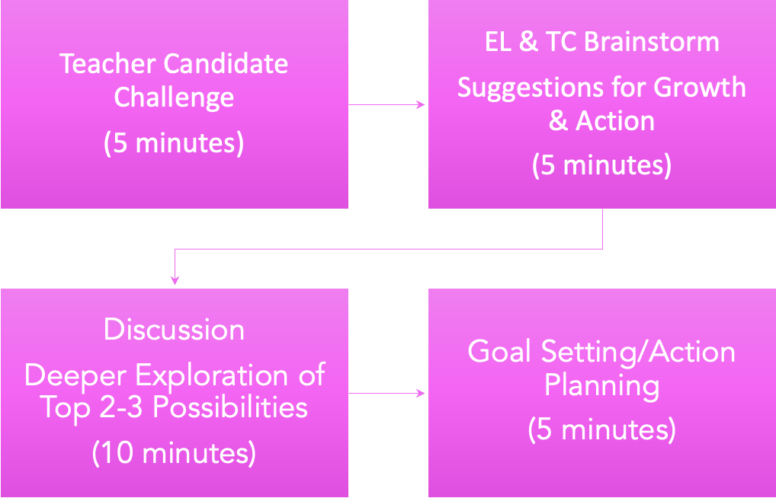

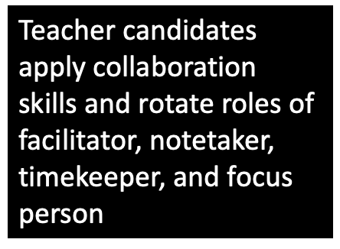
Solution Circle Structure: Supporting Teacher Reflective Practice
Solution Circle Structure:
Supporting Teacher Reflective Practice
Cross-State Convening

Slide 11
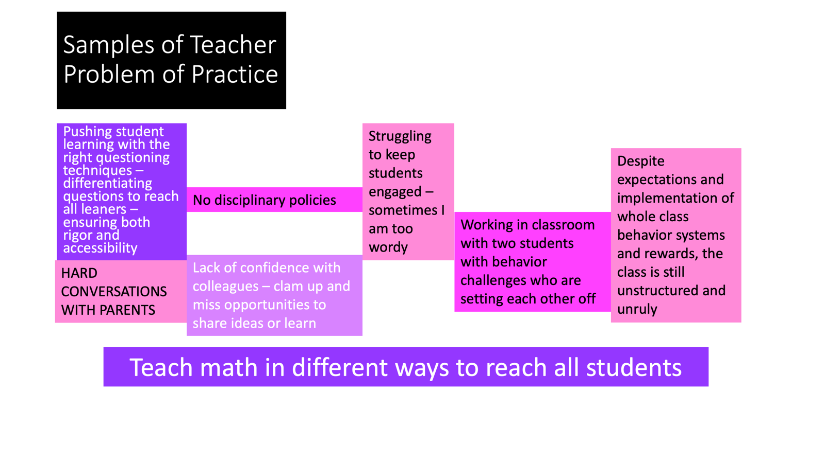
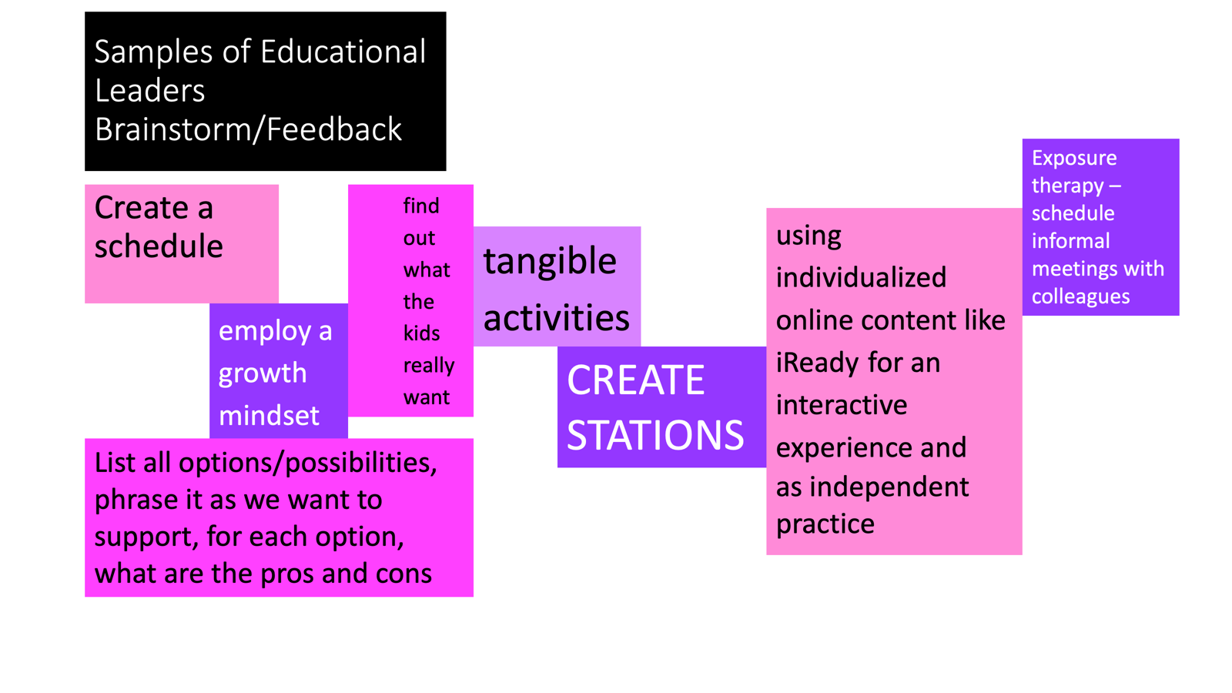
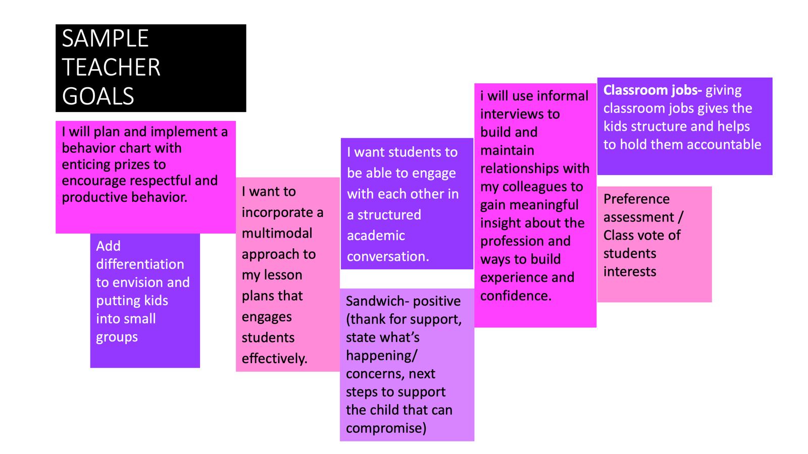
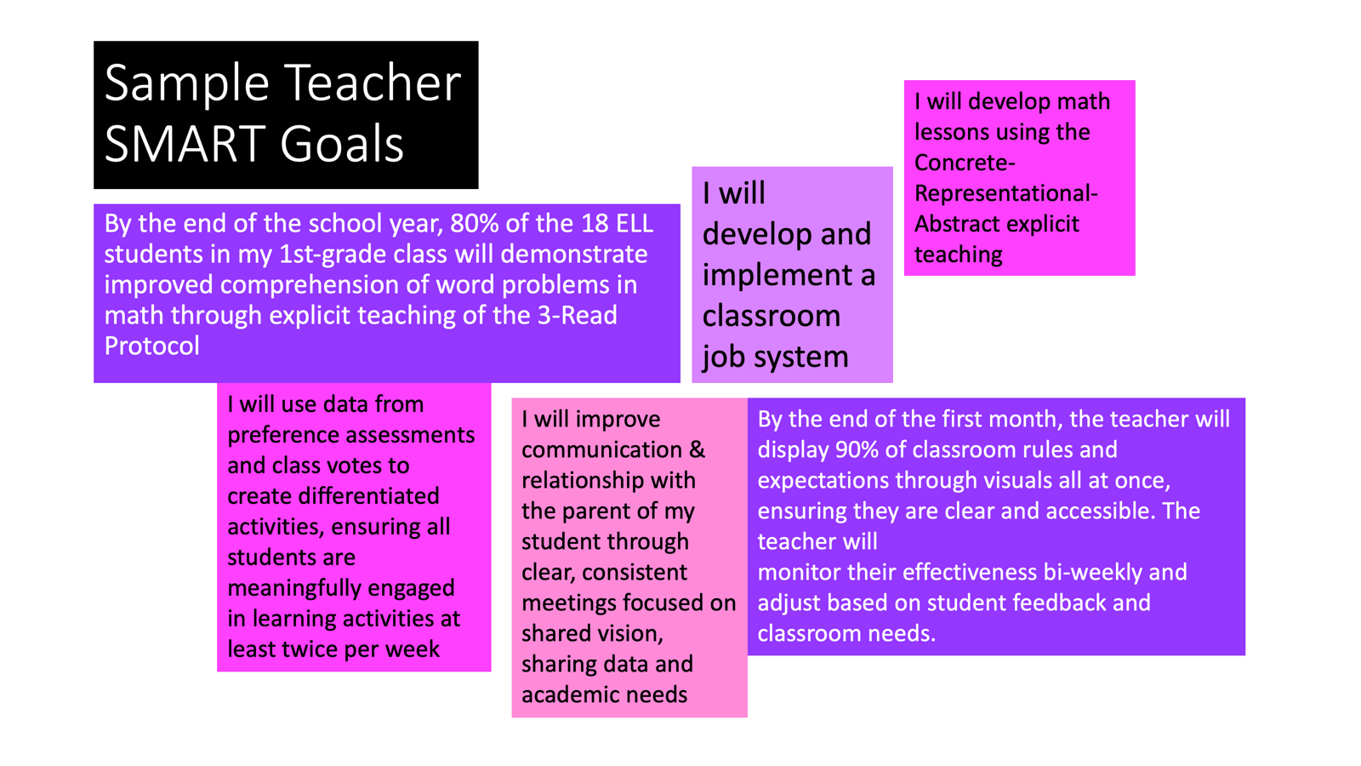
Solution Circle Sample Outcomes
Cross-State Convening

Slide 12
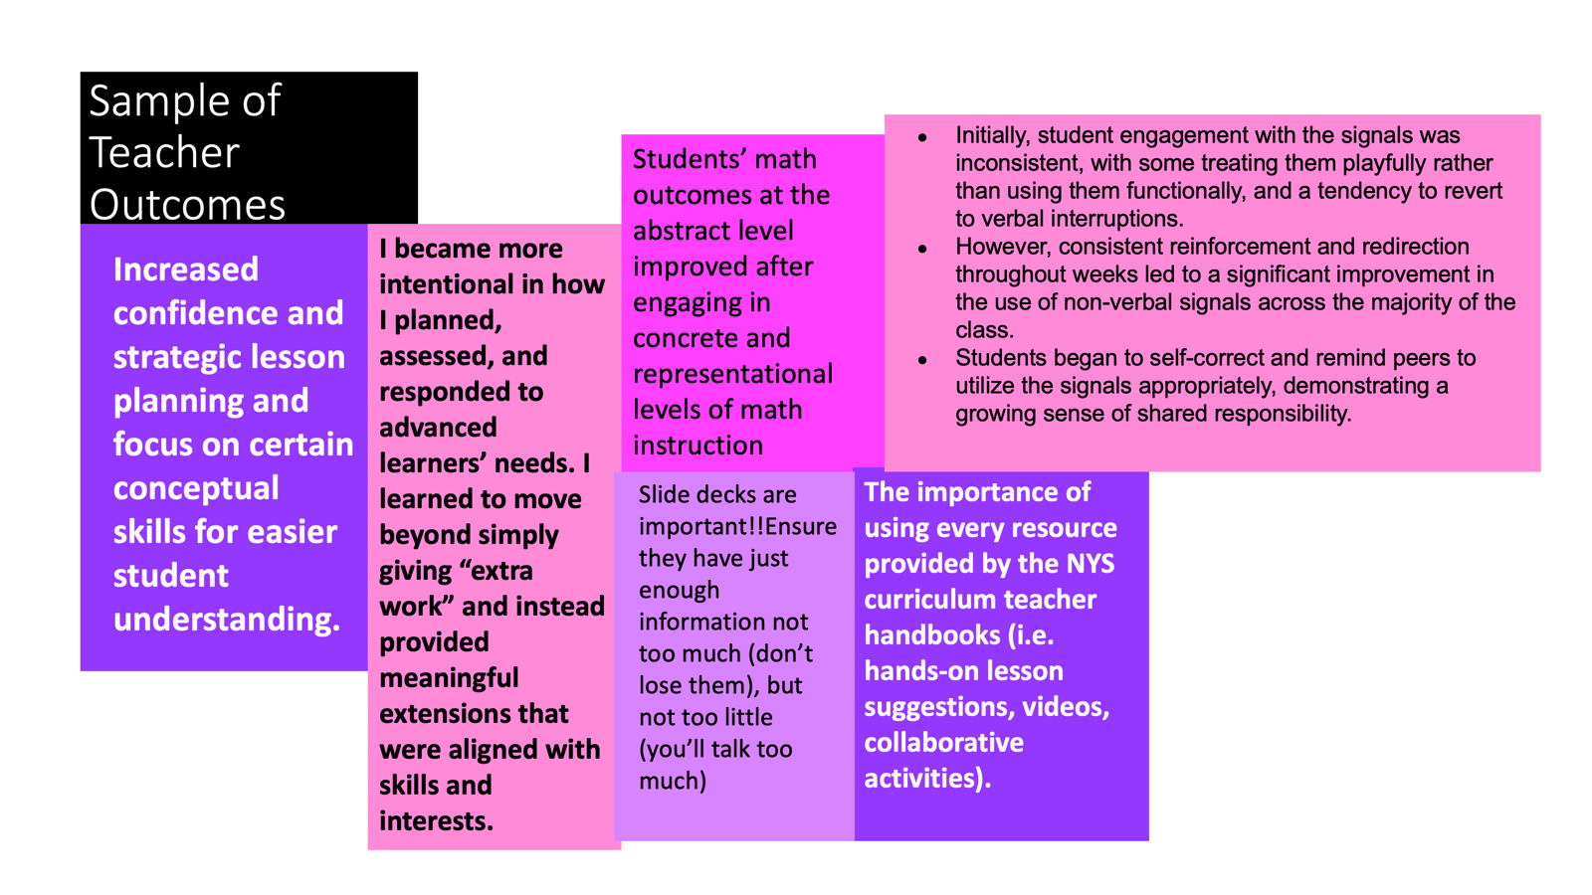
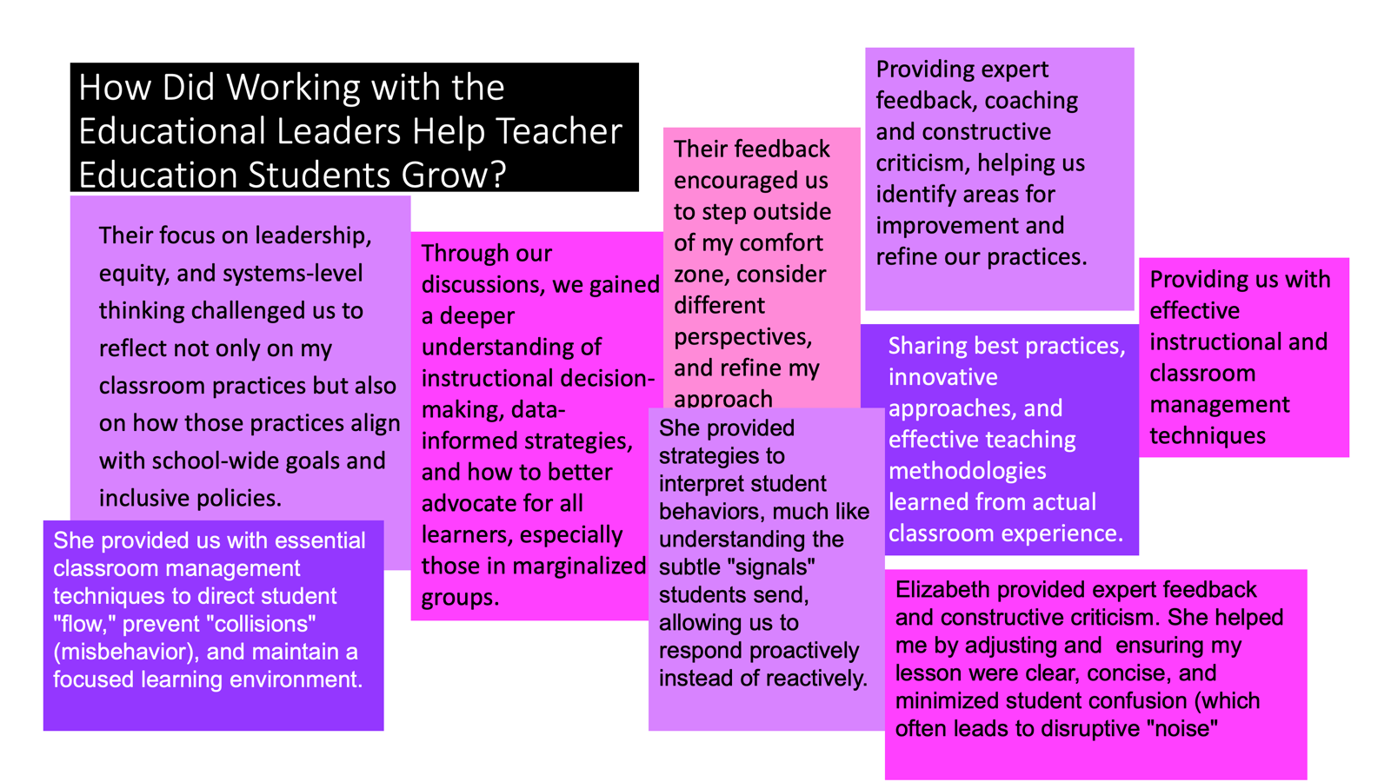
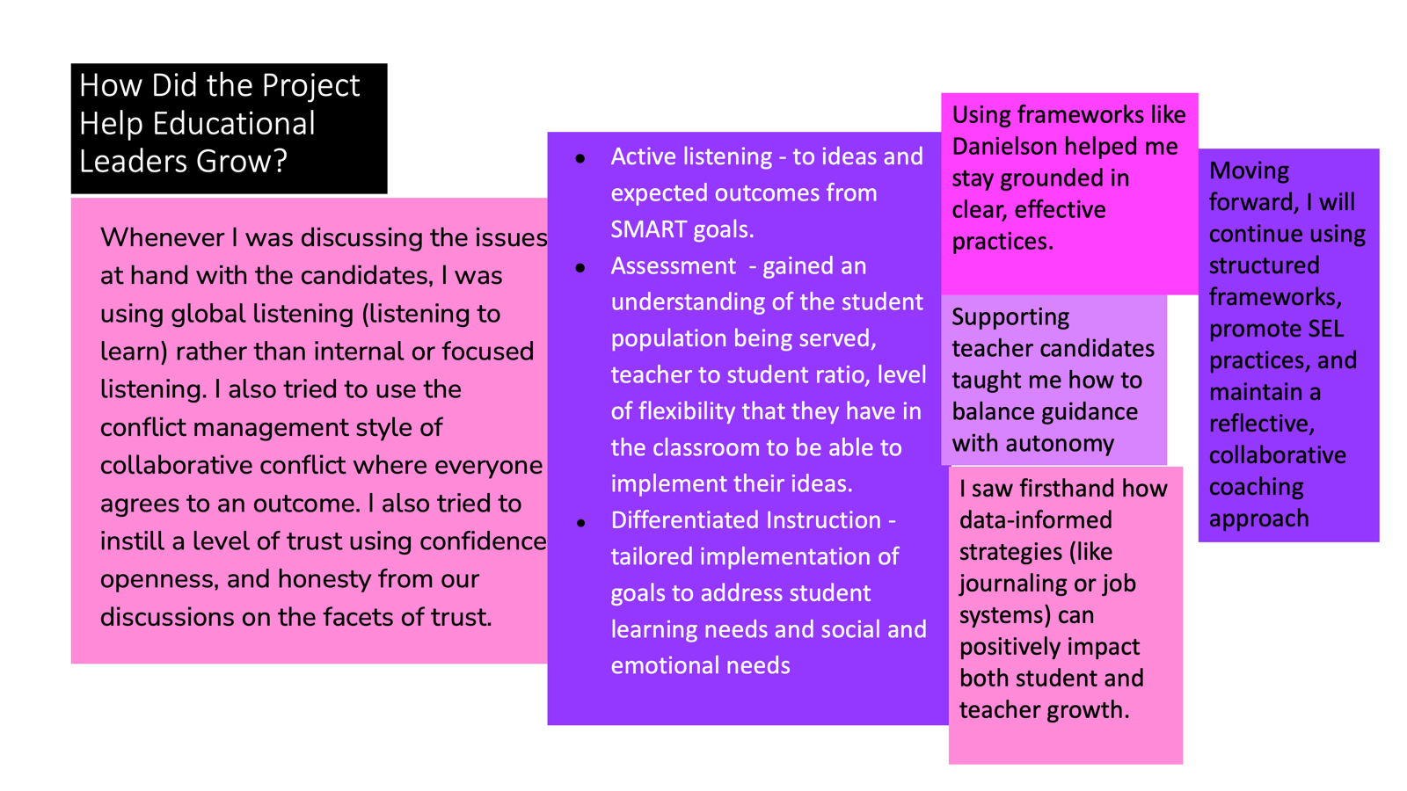
Student Reflections
Cross-State Convening

Slide 13
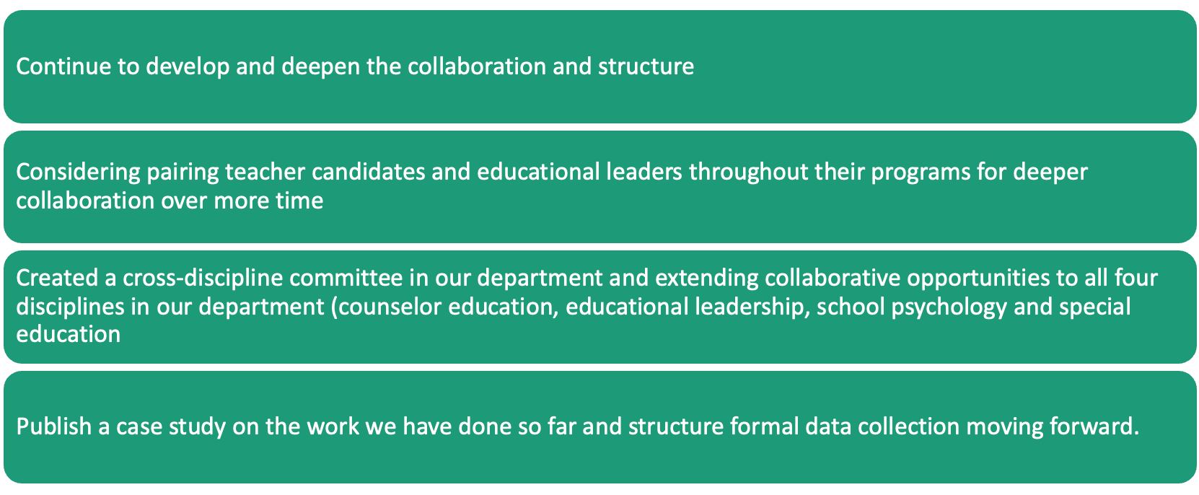
Next Steps
Cross-State Convening

Slide 14
Cross-State Convening
North Carolina
Breaking down barriers to support the inclusion of students with disabilities

Slide 15

UNC-CH EPP Offering
UNC-CH EPP Offering
Cross-State Convening
  Master’s in the Arts of Teaching (MAT)
    Licensure Areas: Elementary Education w/ or w/o SPED add-on; Secondary (both middle and high school) Science, Social Studies, Mathematics, English; K-12 General Curriculum-Special Education
  BEST Minor
    Undergraduates pursuing a bachelor’s degree in science or math can add licensure as a minor
  Elementary Education Dual Licensure (starting 2026-2027)
    Special Education Track
    Multilingual Learners Track

Slide 16
Steps for breaking down barriers
Steps for Breaking Down Barriers
Steps with tools for breaking down barriers to prepare all educators to reach and teach all students.
  1
  2
  3
Step 1: Discuss the current roles of educators in K-12 schools coupled with our role in preparing educators for FAPE in the LRE.
Tool: Local Data Platforms
Step 2: Build Common Language through the HLPs.
Tool: HLP Pillar to highlight structure & practices for implementation of MTSS & SDI.
Step 3: Determine ways to embed HLPs within current & future program of studies.
Tool: Course syllabi,, Standards Matrix with HLPs as the anchor, CEEDAR IC, NC HLP Continuums,
Cross-State Convening

Slide 17

Examples 1 and 2
Example 1
Example 2
EDUC 689:
Foundations of Special Education
Core & Prerequisite Course
Classic introduction to special education course taught asynchronously online from a interdisciplinary perspective arounding five big ideas.
Community
History & Legislation
High-Leverage Practices
Differentiation
Individualization
Major assignment, Classroom Plan, must include HLPs
EDUC 628:
Teaching English Language Learners
Core & Prerequisite Course
Introduction to multilingual learners course. Introduces students to the components of the SIOP Model (Sheltered Instruction Observation Protocol). Students analyze how the SIOP Model connects to the HLPs to further support student learning.
:
Cross-State Convening

Slide 18
Examples 3 and 4
Example 3
Example 4
EDUC 699:
Science of Literacy
Literacy Method 1 for Elementary and Special Education
Aligns HLPs to literacy methods with a focus on oral language and early literacy for reading and writing.
Focus with HLPs on the instructional HLPs.
EDUC 746:
Student Teaching Internship
Student Teaching Observation Tool, connected ‘look for’ within the domains and indicators to the HLPs.
Currently Use:
© 2011, CU Boulder & CU Denver (Whitcomb & Gutierrez). This version of the QRC builds upon the 2009 Quality Urban Classroom (QUC) observation tool developed by the Denver Public Schools Preparation Partnership Team Consortium (Seidel, Whitcomb, Pidick, et al.)
:
Cross-State Convening

Slide 19
Resources
1
CEEDAR High-Leverage Practices Crosswalk
UNC-CH Crosswalk: Alignment of the CEEDAR HLPs with CEC Initial standards, NCPTS, & NCSPED GC & AC Standards
2
The High-Leverage Practices Continuum for North Carolina
3
Cross-State Convening

Slide 20

Breakouts
Cross-State Convening
Cross-State Convening
Questions to consider
  How did you and your partners start your initiative? If you haven’t started, what barriers are you facing?
  What did you accomplish with your initiative (big and small wins)?
  Where do you envision this initiative going? How are you thinking about scaling up or sustainability?
  What are your tips/takeaways for others who might be interested in similar collaborative work?

Slide 21


Reminder of our session outcomes:
Cross-State Convening
Participants will learn:
1
Strategies for breaking down barriers to support the inclusion of students with disabilities.
2
Knowledge of how to leverage education preparation programs to collaboratively prepare for challenges that candidates may encounter during in-service practice.
Considerations for integrating High-Leverage Practices (HLPs), Multi-Tiered System of Supports (MTSS), and Universal Design for Learning (UDL) across disciplines and programs to enhance teaching and leadership practices for all learners.
3
4
Other takeaways?

Slide 22
Reflect in Padlet
Cross-State Convening
Pull up your state team Padlet and add some reflective notes:
  Session: “Leveraging Networks to Integrate Content Across Departments”
  Notes: Brief summary of the session, lessons learned, ideas
that could support your context, potential pitfalls to avoid, etc.
  Connections: How does this connect to your state’s
current work? How could this connect to future work
(use the future work column)? Are there follow-ups/
additional networking needed with CEEDAR states or
staff?

Slide 23


Thanks
Cross-State Convening
THANK YOU!

Slide 24

Disclaimer
This content was produced under U.S. Department of Education, Office of Special Education Programs, Award No. H325A220002. David Guardino serves as the project officer. The views expressed herein do not necessarily represent the positions or policies of the U.S. Department of Education. No official endorsement by the U.S. Department of Education of any product, commodity, service, or enterprise mentioned in this website is intended or should be inferred.
Cross-State Convening

Slide 25



Every student
Cross-State Convening
Every student deserves an opportunity to achieve

