Slide 1

CCSC Title

Slide 2


Setting the rhythm for retention: utilizing data to design induction for New teachers
Setting the Rhythm for Retention: Utilizing Data to Design Induction for New Teachers
Setting the Rhythm for Retention: Utilizing Data to Design Induction for New Teachers
Setting the Rhythm for Retention: Utilizing Data to Design Induction for New Teachers
Presented by: Stacey Todd
Cross-State Convening

Slide 3




Overview
Cross-State Convening
What we'll cover in this session:
  How Mississippi uses multiple data sources to inform the design and continuous improvement of a statewide mentoring and induction program for new special education teachers
  Key findings from program data and how those findings directly informed changes to program structure, content, and supports across cohorts
  Strategies used to strengthen mentor capacity, administrator engagement, and instructional support for new special education teachers
Notes:
“We learned quickly that participation numbers don’t tell the full retention story—our data forced us to rethink how we design induction.”

Slide 4
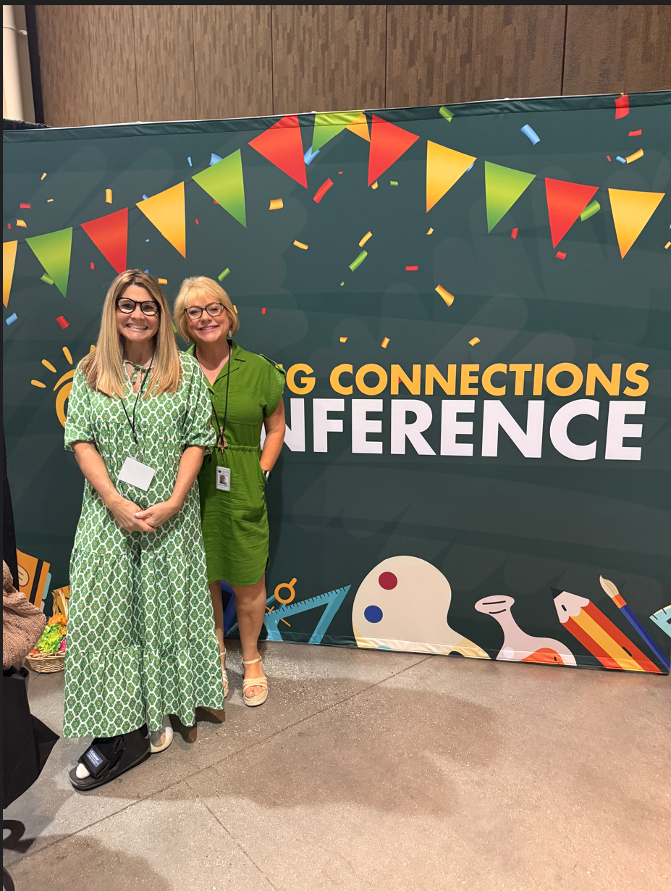

Goals of the MS Mentoring and Induction Program
Improve instructional effectiveness.
Foster collaboration.
Improve data management.
Cultivate teacher commitment and support.
Increase teacher satisfaction and retention.
Cross-State Convening

Slide 5

MS New Special Education Teacher Mentoring and Induction Program
Cross-State Convening
MDE has partnered with CEEDAR and MSU’s Research and Curriculum Unit (RCU) to target teacher and leader effectiveness and retention through The New Special Education Teacher Mentoring and Induction Program.
Two-year program focused on:
Building effective coaches through ongoing virtual and in-person professional learning and one-on-one coaching support.
Increasing instructional effectiveness of new special education teachers through ongoing virtual and in-person professional learning and the support of a trained, veteran special educator
Increasing administrator understanding of how to support special educators, new teachers, and mentors through ongoing virtual and in-person professional learning.
Building school and district capacity to develop and implement their own sustainable mentoring and induction programs.

Slide 6
MS New Special Ed Part 2
MS New Special Education Teacher Mentoring and Induction Program
Cross-State Convening
MDE and RCU will provide the following:
A two-day bootcamp for mentors.
A virtual kick-off meeting for administrators, mentors, and mentees.
Monthly virtual professional learning on High Leverage Practices for Special Education and special education roles and responsibilities such as IEPs, transition planning, and behavior management for mentees.
Monthly virtual professional learning on High Leverage Practices for Special Education, mentoring and coaching, and special education roles and responsibilities for administrators and mentors.
Twice a year in-person professional learning.
On-site and virtual coaching support for mentors.
Annual stipend for mentors.
CEU, SEMI, and OSL opportunities will be discussed with administrators, mentors and mentees.

Slide 7
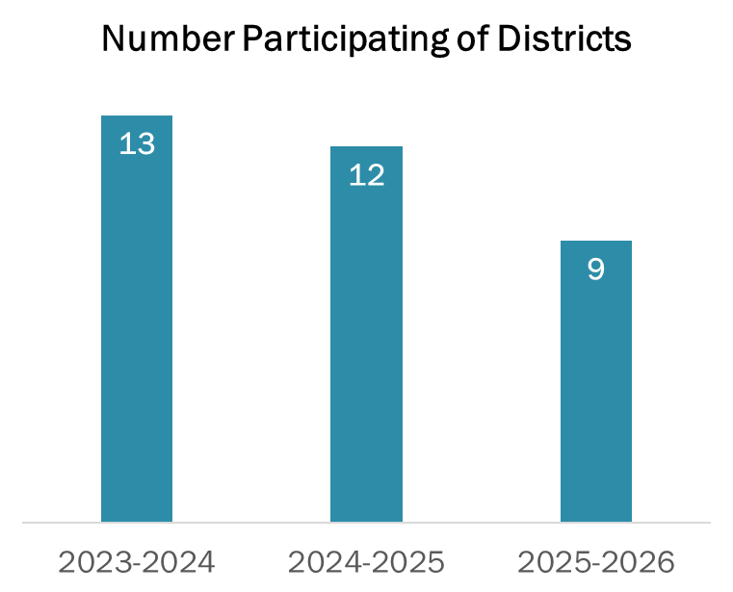
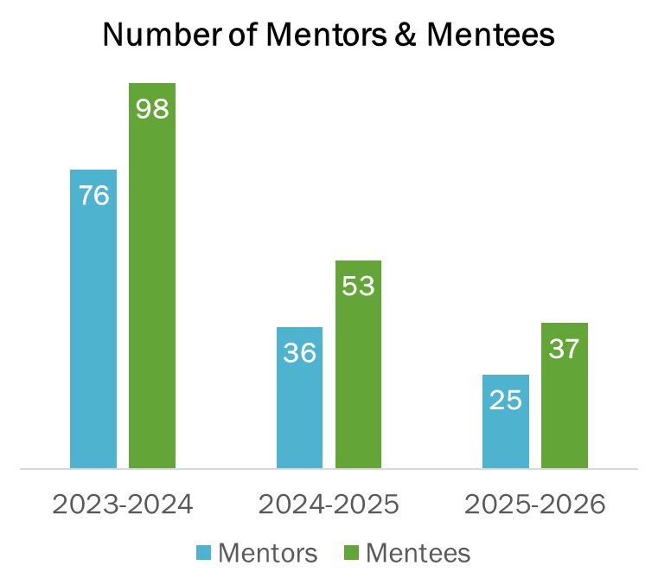
Program Numbers: Decreases in the districts and participants, but not equivalent to teacher retention.
Cross-State Convening

Slide 8
Cohort 1: Year-End Program Ratings: 87% program effectiveness. Good short-term outcome ratings.

Slide 9
Cohort 1: What did they like?
Cross-State Convening
Training content:
  IEPs & HLPs, particularly writing IEPs (n=51)
  Learning how to communicate/ask questions/listen (n=19)
  How to be a mentor teachers & create a program (n=10)
  Writing (n=5)
Other content: progress monitoring, student learning, standards, accommodations
Collaboration, learning from others, and mentor relationship (n=14)
Resources & materials accessible after training (n=9)
Format of the professional learning, including in-person and virtual sessions

Slide 10
Cohort 1: How could the program improve?
Cross-State Convening
No recommendations or accolades (n=27)
Timing and order of the program, particularly more flexibility, IEP content sooner (n=20)
Paperwork and forms were cumbersome, and streamlining would save time (n=19)
Training content, including more practical IEP training, examples, self-contained classrooms, co-teaching (n=18)
Organization and implementation of the program, including expectations for mentors and administrators at the beginning, payment, communication (n=12)
In-person training (n=11)
Created IEP recordings as an on-demand resource
Moved all program components, forms, and resources to Canvas
Changed to 2 year in part to provide additional training. Change some aspects of training.
Provided clear expectations and information at beginning of program via Mentor Bootcamp and Kick-Off meeting.
Added in-person and virtual coaching for mentors (fall and spring)
Notes:
Every change you’re seeing was directly tied to a data point—not a guess.

Slide 11
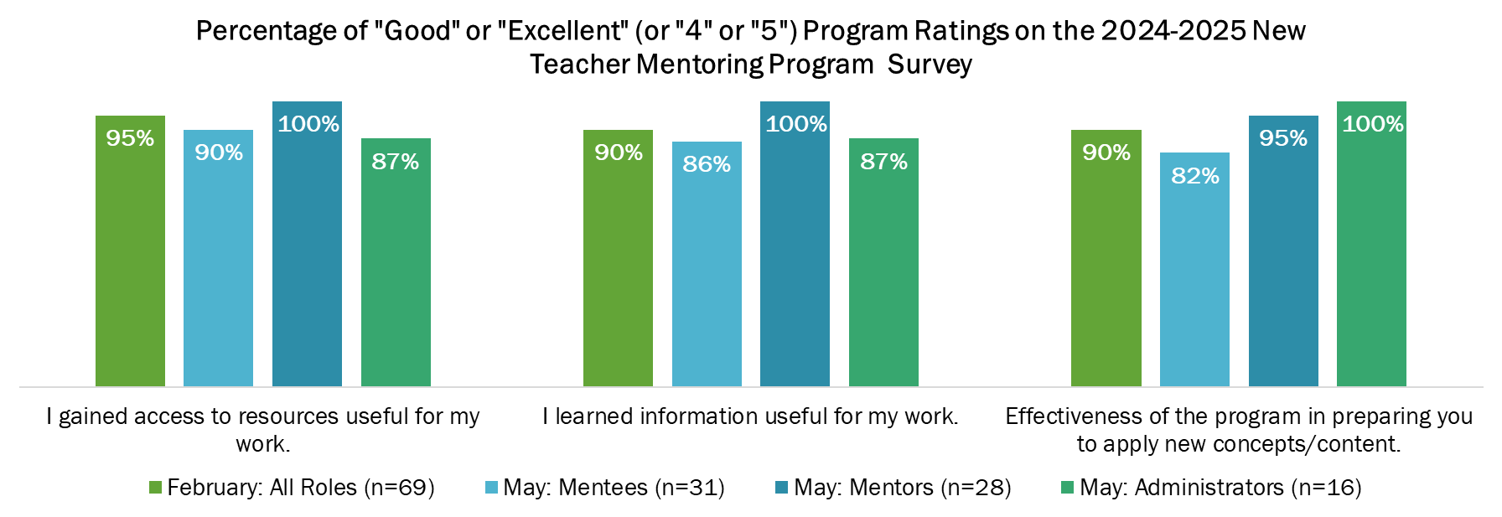
Cohort 2 Program Ratings: Higher ratings than Cohort 1. Mentors had highest ratings and mentees had lowest ratings.
Cross-State Convening

Slide 12
Cohort 2: How could the program improve?
Cross-State Convening
Administrator involvement/communication with administrator
Timing
Training (earlier/later in day, more options)
Content (IEPs earlier)
In-person meetings generally preferred
Changes in content: behavior, IEPs, how to mentor
Changes in format: guest speakers, more collaboration, general education teacher participation
Less burden to complete training and assignments
Superintendent approval required for acceptance into mentoring program, not just special education director. Agreement to expectations via signatures from superintendent, administrators, and special education director
Procure guest speakers for virtual trainings
Plan additional collaborative sessions between mentors, admins, and mentees

Slide 13
Looking Forward to Cohort 3
Cross-State Convening
Prioritize districts identified for school improvement related to outcomes for students with disabilities.
Provide trained mentors virtually to districts without access to qualified on-site mentors.
Secure formal commitment to program expectations from district and school leaders prior to participation.
Revisit and refine the scope and sequence of professional learning.
.

Slide 14
Survey Feedback from Cohort 2
Cross-State Convening
Administrators:
“My first-year teachers are more knowledgeable of policies, practices, and pedagogy than some of my experienced veteran teachers. I can thank this program for that.”
“The most helpful aspects of the mentoring program have been the one-on-one support, access to experienced mentors, and the practical resources shared.”
Mentors:
“Both of my mentees have shown tremendous progress this year. I am thankful for the relationship that I have built with both. I am looking forward to next year as they continue to be more independent and confident in their roles as Special Educators.”
“Being a part of a cohort of teachers who are committed to increasing the knowledge and morale of new teachers has been a rewarding experience. This has been a win-win for everyone involved!”

Slide 15
Survey feedback part 2
Cross-State Convening
Survey Feedback from Cohort 2
Mentees:
“This year would not have been possible without my mentor. She has guided, supported, and encouraged me all year.”
“My mentor was invaluable and encouraging throughout my first year in special education. She showed me the best practices and shared ideas, tools, and experiences that have made me a better teacher and coworker.”
“It was great having a community of educators to lean on during this challenging transition from general education to special education. Learning more in-depth about the HLPs was beneficial.”
“Real-world examples during virtual training were helpful to make those connections of when and how to use different strategies appropriately.”

Slide 16
Breakout Sessions
Cross-State Convening
How can we foster collaboration, commitment and support among mentors, mentees and principals (or whichever admin leaders peeps are using)?
What are some ways to improve data management?

Slide 17




When we mentor a new special education teacher, we don’t just support a colleague—we strengthen outcomes for every student they will ever serve.
Cross-State Convening

Slide 18


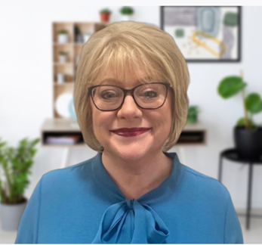
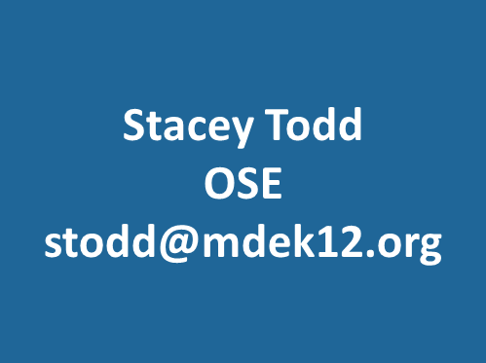
Contact Information
Cross-State Convening

Slide 19

Disclaimer
This content was produced under U.S. Department of Education, Office of Special Education Programs, Award No. H325A220002. David Guardino serves as the project officer. The views expressed herein do not necessarily represent the positions or policies of the U.S. Department of Education. No official endorsement by the U.S. Department of Education of any product, commodity, service, or enterprise mentioned in this website is intended or should be inferred.
Cross-State Convening

