Slide 1


The
Slides
Planning and Implementing Across the HLPs:
Strategic Considerations for Maximum Effectiveness
Notes:
A challenge that impacts faculty, state level personnel, and practitioners of all experience levels is the limited time we have in preparation programs and professional developments to learn and master all that is needed to be successful in the classroom and beyond. Difficult choices must therefore be made to select key, or pillar practices to prioritize. However, a one size fits most approach has rarely proven effective in our complex work in schools serving students with disabilities given many teaching rosters are largely filled out with inexperienced educators. In this early bird session, Dr. Michael Kennedy from the University of Virginia lays out a strategic plan for helping faculty and practitioners consider the High-Leverage Practices (HLPs) in powerful combinations instead of one-by-one to help address student learning needs and educator overload. Resources including the HLP video series, leadership guides, and other CEEDAR resources will be highlighted to help your team put together a creative and unique plan for quality and improvement.

Slide 2
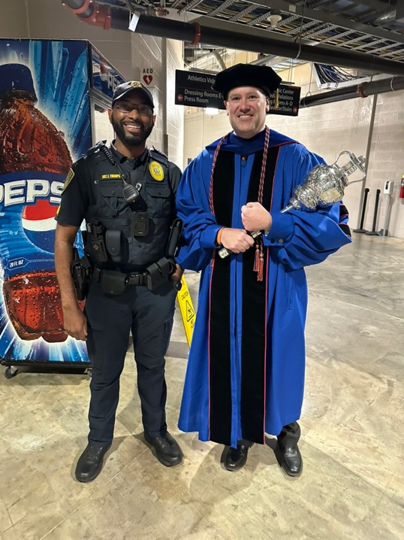
Michael J. Kennedy, Ph.D.
MKennedy@Virginia.edu
15th Year as Professor at U.Va
Public school special education teacher for 9 years
President-Elect of the Higher Education Consortium for Special Education (HECSE)
Co-Editor, Journal of Special Education Technology
Contributing author of original HLP book from CEC and CEEDAR and Co-Team Lead of Revised and Updated Text
Producer & Director of HLP Video Series
Father of three kids, including one with IEP

Slide 3

Thank you

Slide 4
CEEDAR and OSEP are not responsible for ANYTHING I say
(But thanks for inviting me!!!)

Slide 5
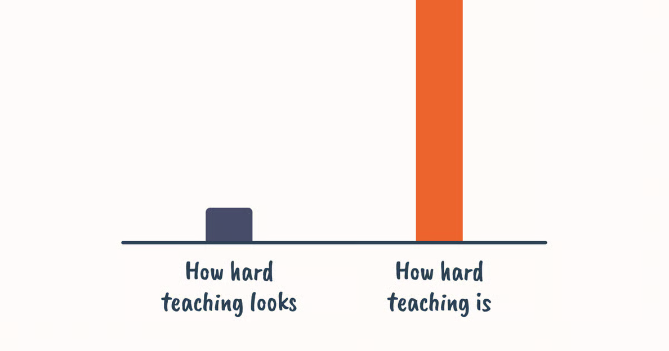
Teaching

Slide 6
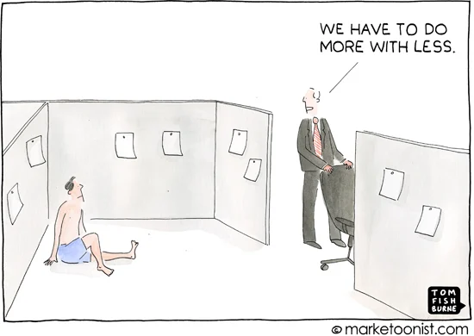
cartoon

Slide 7

Educators stand in the gap

Slide 8
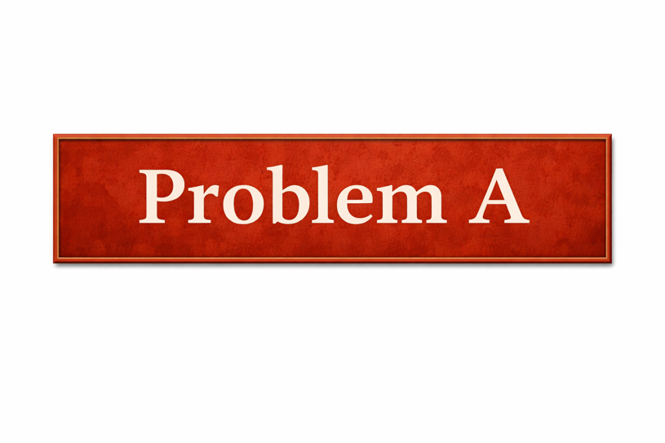
Problem A

Slide 9

Principal

Slide 10
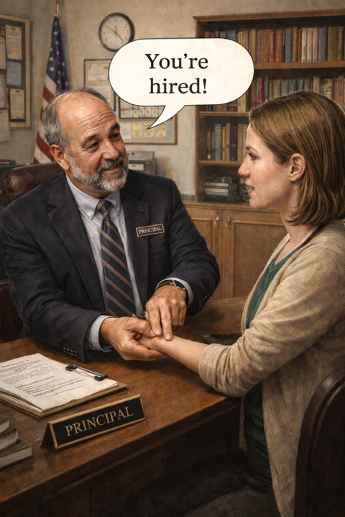
You’re hired

Slide 11
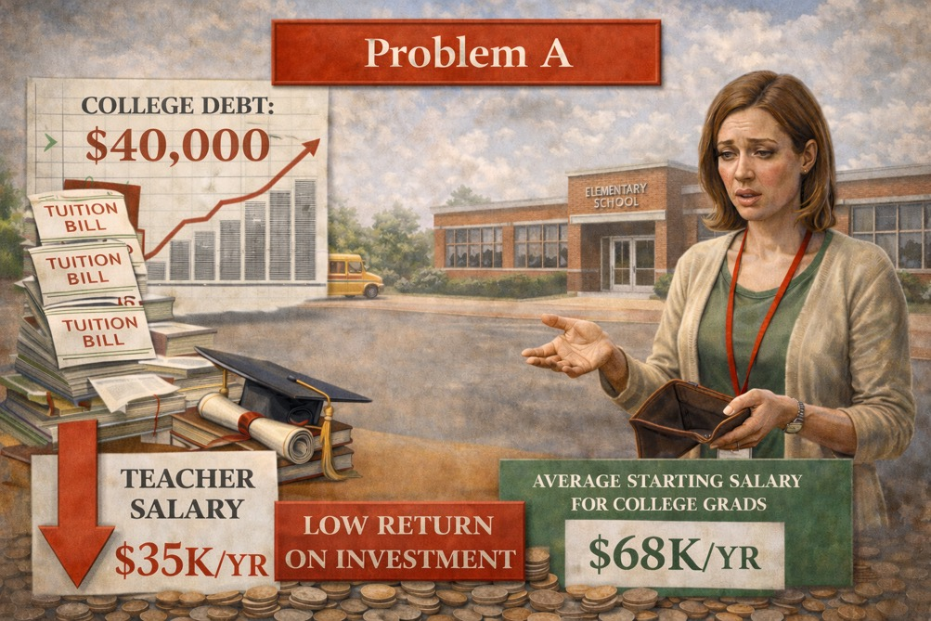
Problem A-

Slide 12

Nationwide Crisis

Slide 13

https://aacte.org/wp-content/uploads/2026/02/Student-Loan-Explainer.pdf

Slide 14
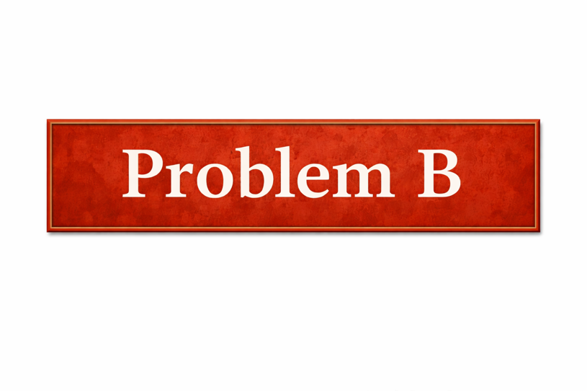
Problem B

Slide 15

Even when and if…

Slide 16
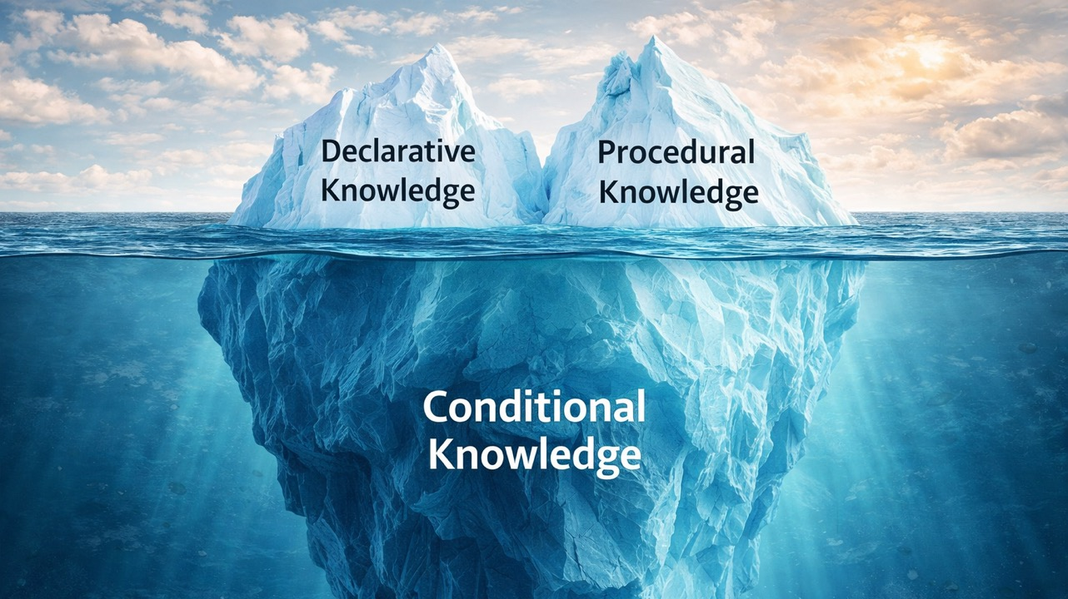
To be a successful teacher…

Slide 17
Conditional Knowledge

Slide 18
Procedural

Slide 19
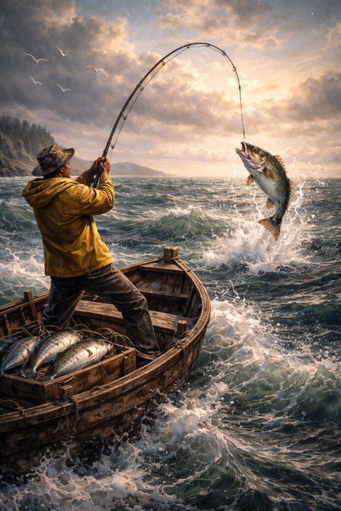
We know how and have the tools to land that fish
Videos, Podcasts, & Webinars
This conference and ones like it
ICs and other CEEDAR content
IRIS Modules
CEC content & offerings
IES Practice Guides
Teacher Ed Coursework & Field
Journal articles & book chapters
Coaching & more

Slide 20

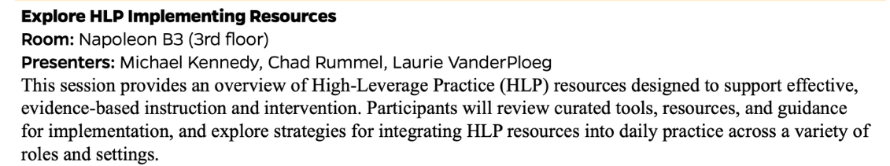
Day 2

Slide 21

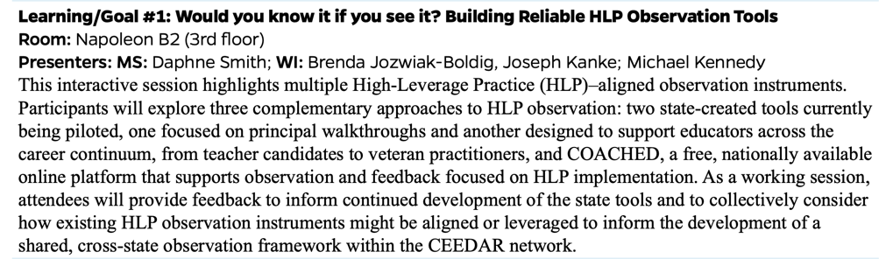
Day 3

Slide 22
Conditional

Slide 23
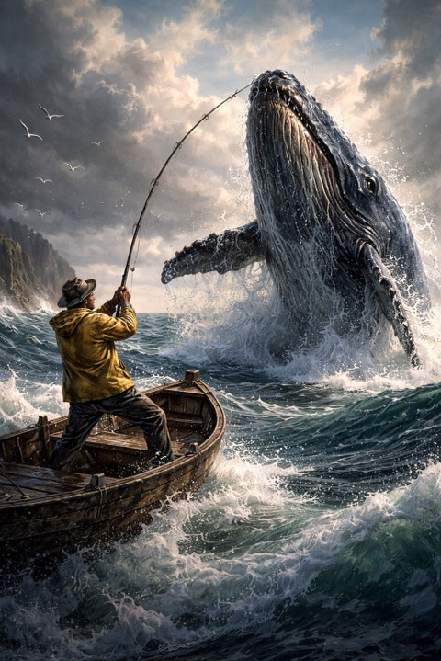
Nowhere near as easy/routine
Requires declarative and procedural knowledge PLUS:
Repeated authentic practice across time with high quality feedback
Right “equipment”
No shortcuts

Slide 24
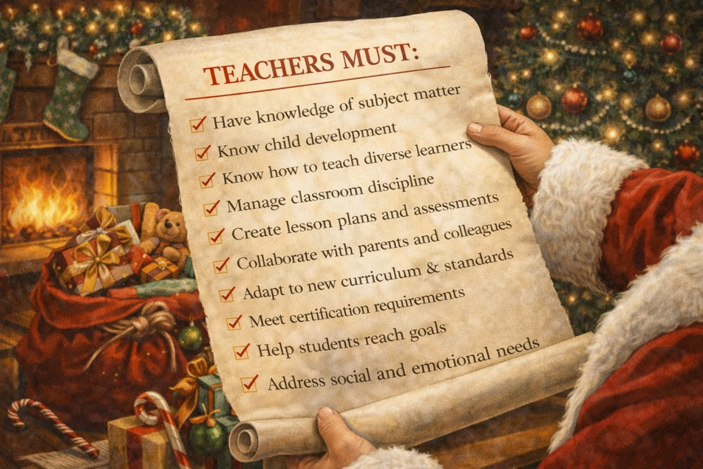
Teachers Must

Slide 25


One big reason why the HLPs were developed
in the first place

Slide 26

Collaboration
Collaborate with colleagues
Run effective meetings
Collaborate with families

Slide 27
Data-Driven Planning
Use a range of data sources
Interpret data to be easily understood
Make data-driven decisions
Create long- and short-term learning goals
Systematically design instruction

Slide 28
Instruction for All
Make adaptations when needed
Use scaffolded supports
Teach and use strategies
Use explicit instruction
Create an organized, responsive learning environment
Use flexible groupings
Engage students
Use assistive and instructional tech
Teach to generalization
Provide high-quality feedback

Slide 29
Intensify Academic and Behavioral Supports when Needed
Provide intensive instruction for academics and behavior
Use functional behavioral assessments and behavior improvement plans

Slide 30
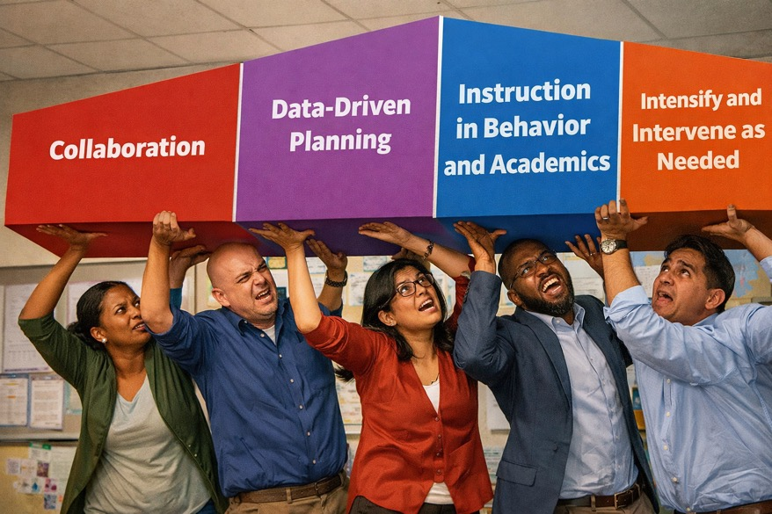
A Heavy Lift – In the old format or the new

Slide 31
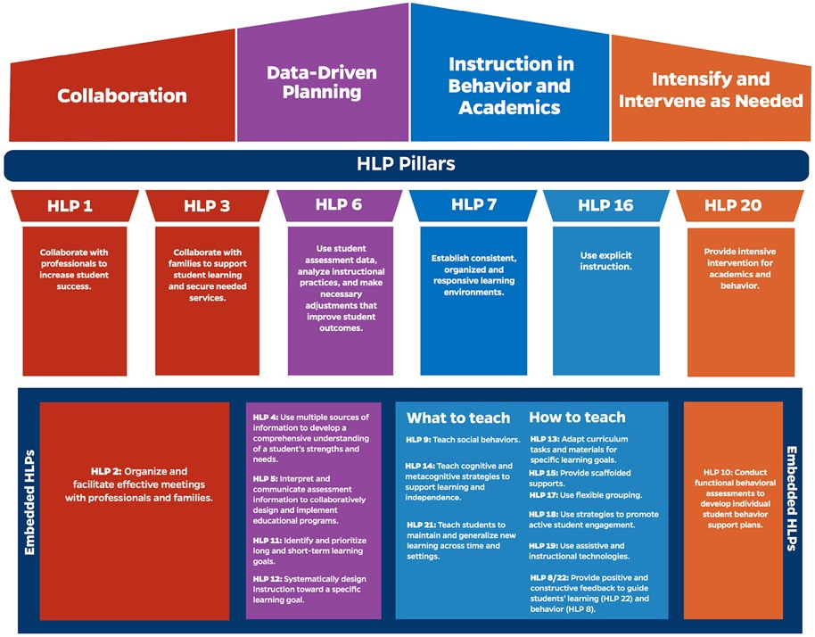
HLP pillars

Slide 32

Pillar HLPs – An attempt to make the load not quite so heavy…
Collaborate with colleagues
Collaborate with families
Make data driven decisions
Use explicit instruction
Create a responsive and organized learning environment
Provide intensive instruction for academics and behavior

Slide 33
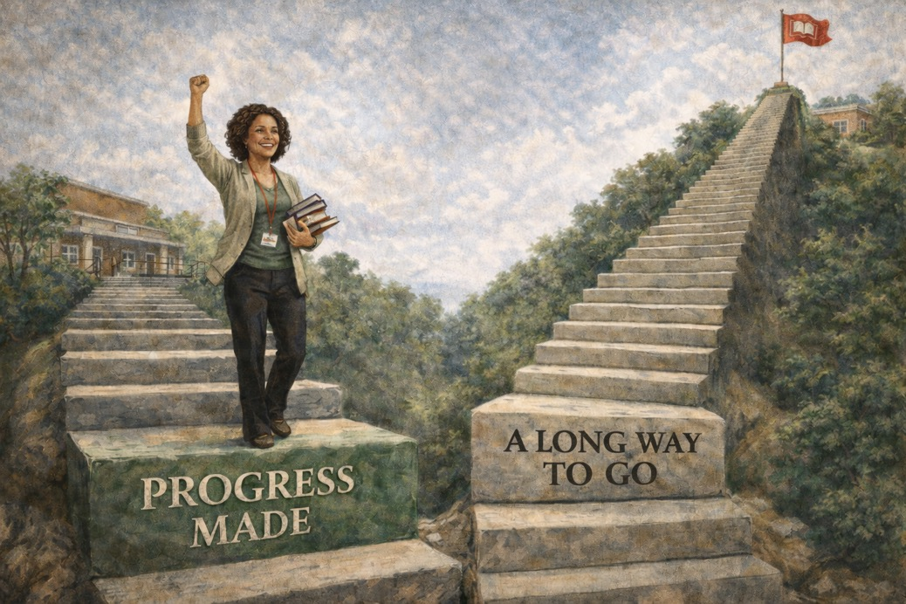
Progress made

Slide 34
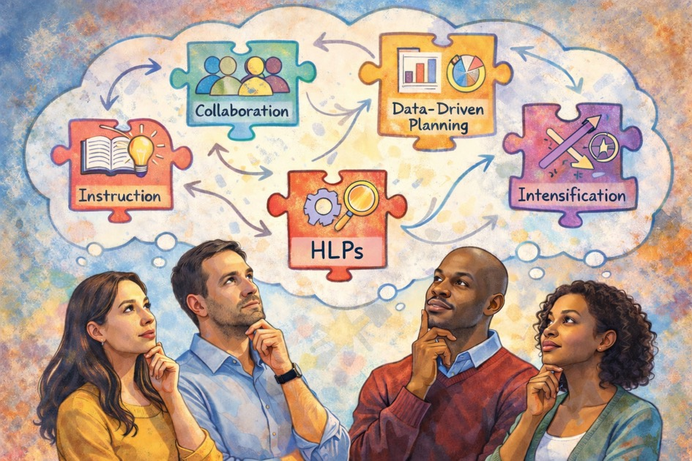
HLPs

Slide 35

The HLPs do not exist in isolation. There is (and should be) substantial overlap in how the practices are implement and support one another. HLPs also occur as key components of many EBPs. Making investments in your practice by learning about HLPs and implementation is a terrific way to support outcomes for all students.

Slide 36

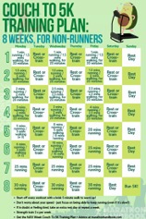

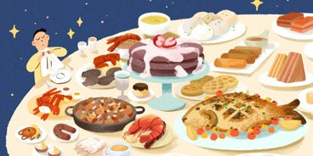

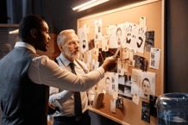
Notes on Advanced Implementation of Pillar and Embedded
HLPs for Students with Disabilities

Slide 37
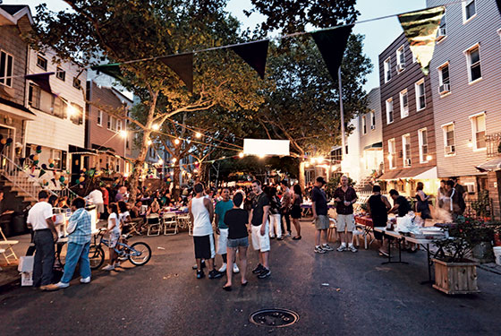

Domain 1: Collaboration (HLPs 1-3)

Slide 38
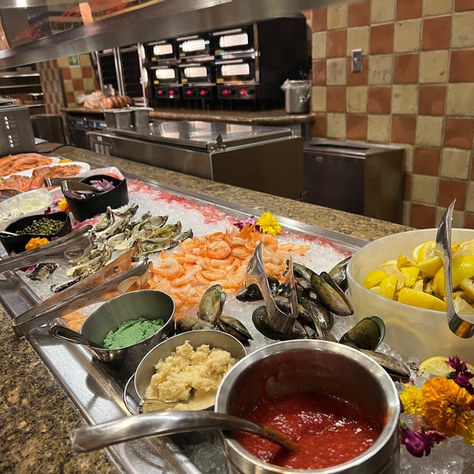

Domain 2: Data-Driven Planning (HLPs 4-6 and 11-12)

Slide 39
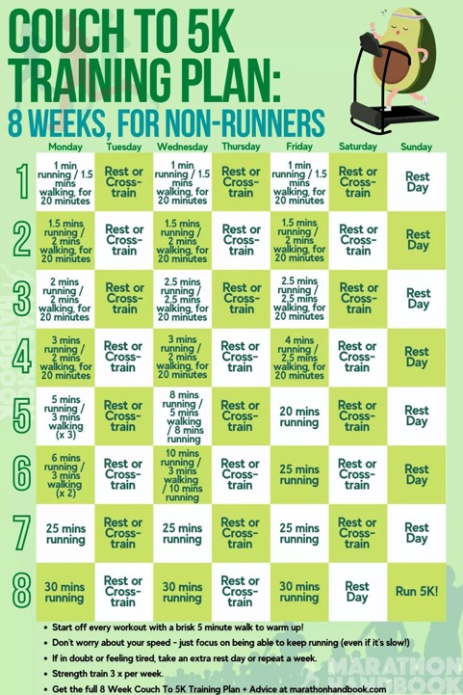
Still Domain 2:
HLPs 11 and 12

Slide 40
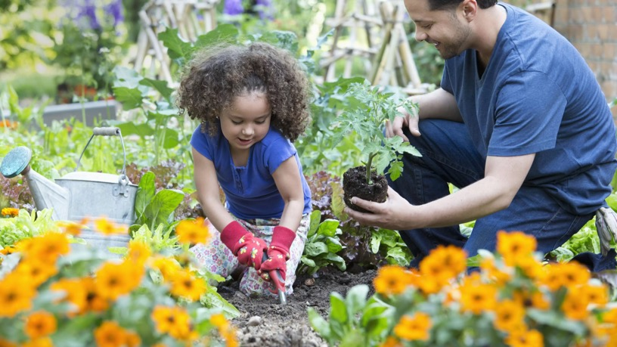
Domain 3: Instruction for Academics & Behavior

Slide 41

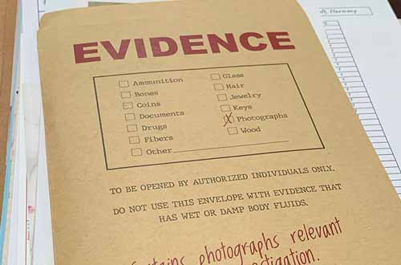
Domain 4: Intensify Supports When Needed

Slide 42

Block party

Slide 43

food

Slide 44

5k

Slide 45

planting

Slide 46

research

Slide 47
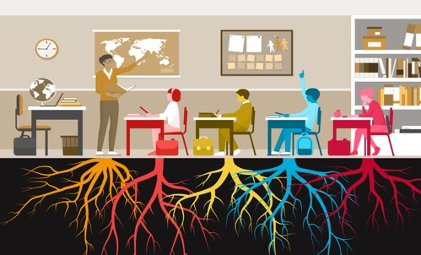
roots

Slide 48
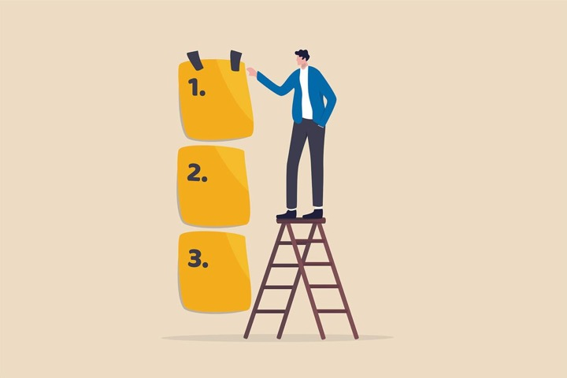
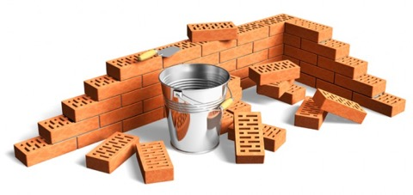
Prioritize which practices and competencies are most critical for success and invest heavily in those to help achieve as much automaticity as possible. Then you have a strong foundation to build upon.

Slide 49
knowledge

Slide 50
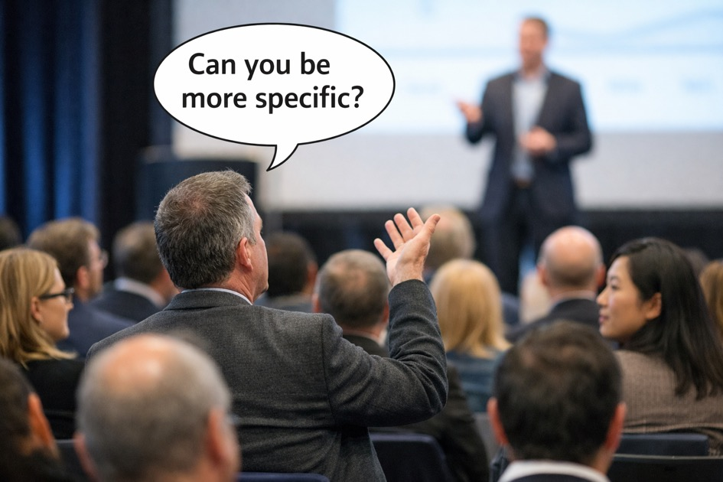
presenting

Slide 51
Ten (10) practices just in this domain
Make adaptations when needed
Use scaffolded supports
Teach and use strategies
Use explicit instruction
Create an organized, responsive learning environment
Use flexible groupings
Engage students
Use assistive and instructional tech
Teach to generalization
Provide high-quality feedback for academics and behavior

Slide 52
Two Pillar Practices
Use explicit instruction
Create an organized, responsive learning environment
Make adaptations when needed
Use scaffolded supports
Teach and use strategies
Use flexible groupings
Use assistive and instructional tech
Teach to generalization
Provide high-quality feedback for academics and behavior

Slide 53
They all relate to Use Explicit Instruction in some way
Use explicit instruction
Create an organized, responsive learning environment
Make adaptations when needed
Use scaffolded supports
Teach and use strategies
Use flexible groupings
Use assistive and instructional tech
Teach to generalization
Provide high-quality feedback for academics and behavior

Slide 54
EI and Feedback are not separable
Use explicit instruction & provide high-quality feedback for academics and behavior
Create an organized, responsive learning environment
Make adaptations when needed
Use scaffolded supports
Teach and use strategies
Use flexible groupings
Use assistive and instructional tech
Teach to generalization

Slide 55
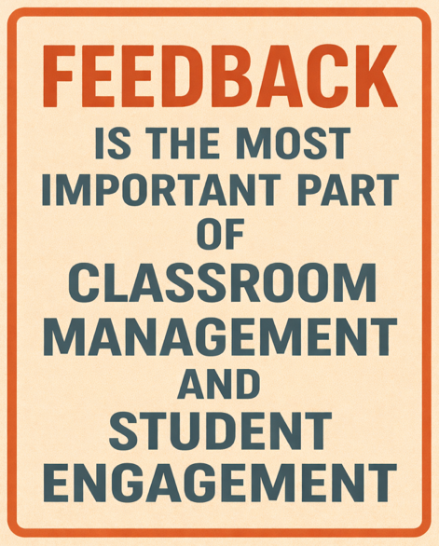
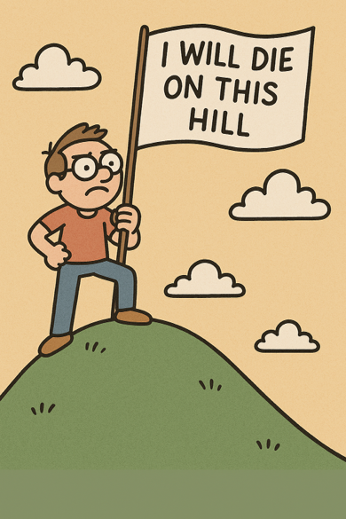
feedback

Slide 56

Because you can’t provide explicit instruction without it…

Slide 57
knowledge2

Slide 58

HLP 16: Key Elements of Explicit Instruction
Use clear language and anchor images
Use cues
Break complicated content into chunks
Make connections to prior learning
Highlight relevant and varied examples (and non-examples)
Use an engaging, deliberate, and predictable pace
Provide lots of (varied) opportunities to respond (OTRs)
Deliver high-quality feedback
Model (I do) regularly
Provide guided practice (we do) regularly
Utilize independent practice (you do) when students are ready
Notes:
The best explicit instruction will still result in some students not making progress and needing clarification or other supports to succeed. That is what HLPs 13 and 15 are really all about.

Slide 59
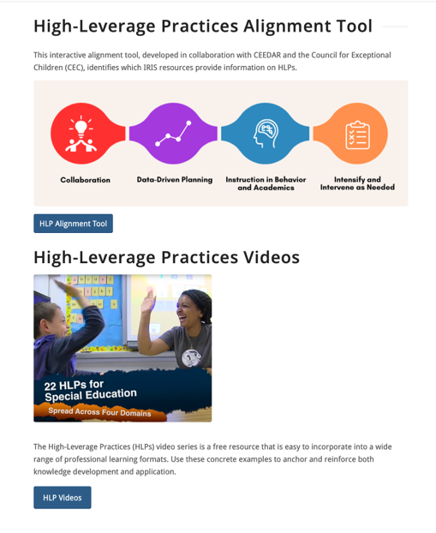

https://ceedar.education.ufl.edu/high-leverage-practices/

Slide 60
Three Very Similar Practices
Use explicit instruction & provide high-quality feedback for academics and behavior
Create an organized, responsive learning environment
Make adaptations when needed
Use scaffolded supports
Teach and use strategies
Use flexible groupings
Use assistive and instructional tech
Teach to generalization

Slide 61
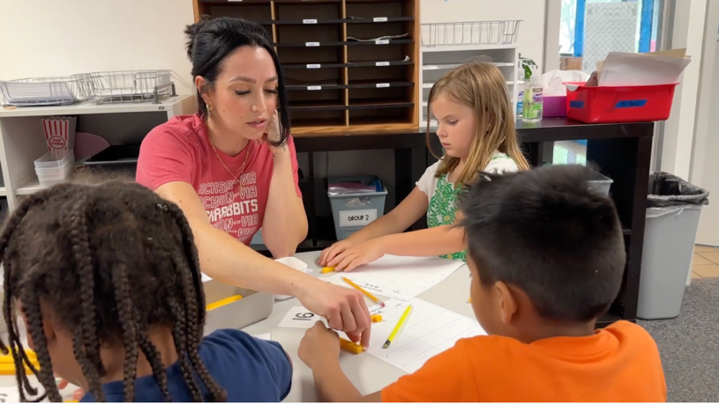
https://vimeo.com/935980376

Slide 62
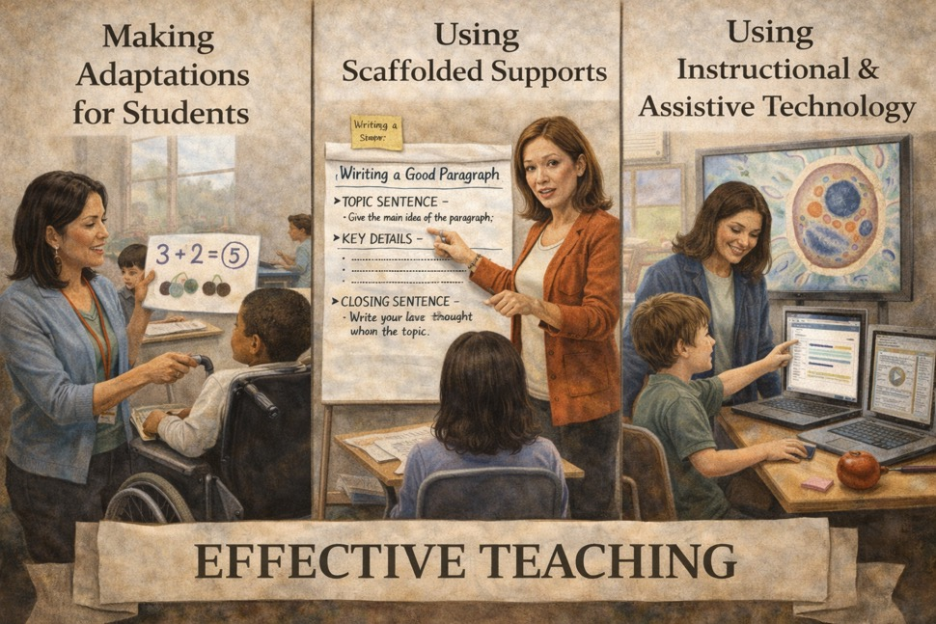
Effective teaching

Slide 63
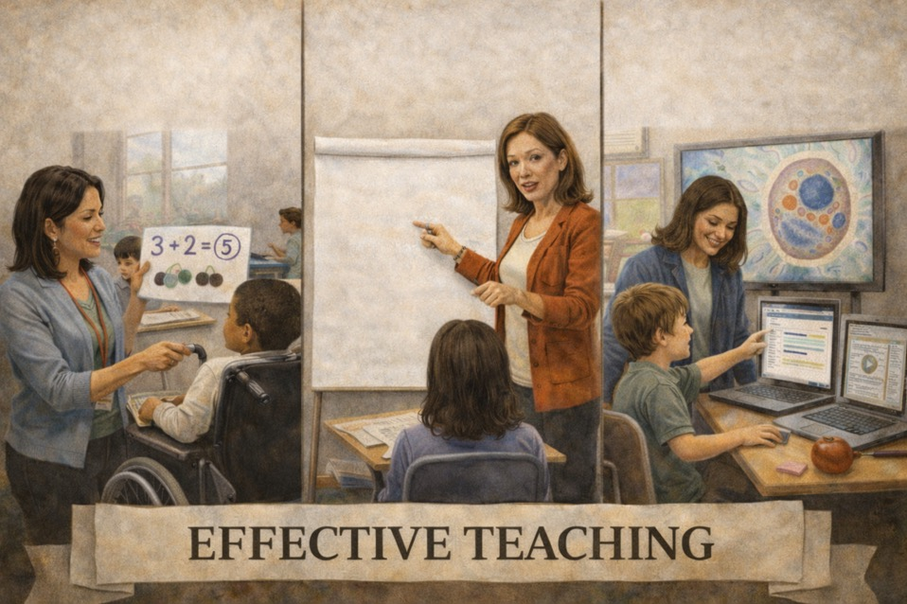
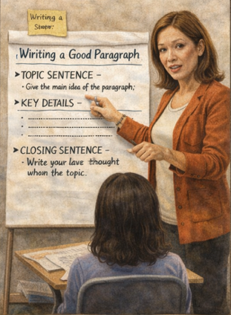
Making
Adaptations
Using Assistive &
Instructional Tech
Using Scaffolded
Supports

Slide 64
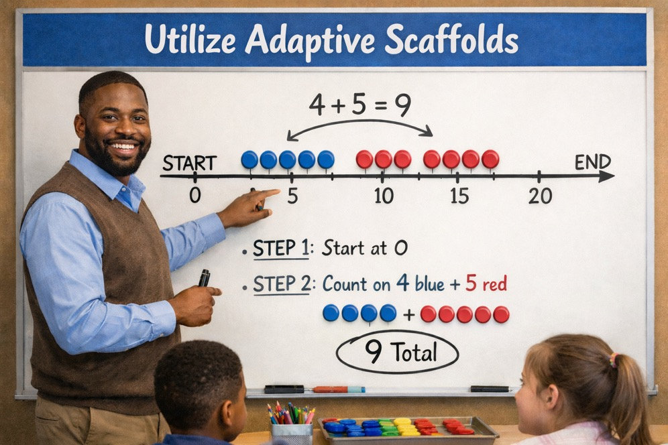
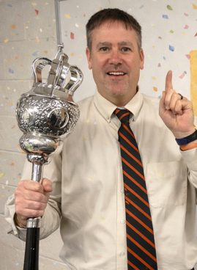
Utilize adaptive scaffolds

Slide 65
Knowledge 3

Slide 66
Pollination
Definition
Picture
Example
How does pollination impact my life?
Notes:
To complete the Frayer model, we will choose from four choices the correct picture, definition, example, and response to the question, “How does pollination impact my life?” Select the best response for each question using the information you just learned. As we select responses, we will see how this model looks filled in for the term pollination.

Slide 67
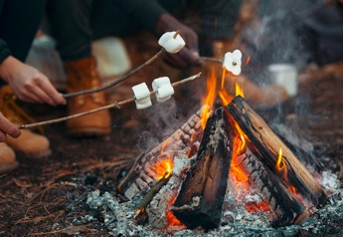
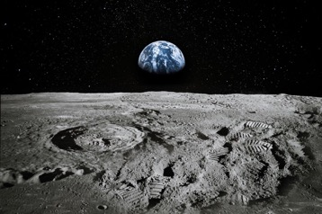

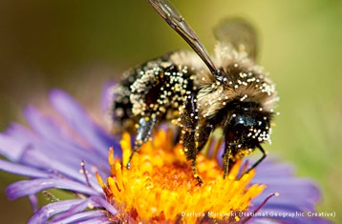
A
Directions: Choose the correct picture of pollination from the choices below.
B
C
D
Notes:
Choose the one correct picture of pollination from these four choices.

Slide 68
A.
Directions: Choose the correct picture of pollination from the choices below.
B
C
D
Notes:
This is the picture that shows pollination.

Slide 69
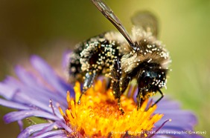
Pollination.
Definition
Picture
Example
How does pollination impact my life?
Notes:
Here is the Frayer model filled in with a picture of pollination.

Slide 70
Directions: Choose the correct definition of pollination from the choices below.
A
The transfer of pollution
B
The transfer of pollen
C
The transfer of paint
D
The transfer of energy
Notes:
Choose the one correct definition of pollination from these four choices.

Slide 71
Directions: Choose the correct definition of pollination from the choices below.
A
The transfer of pollution
B
The transfer of pollen
C
The transfer of paint
D
The transfer of energy
Notes:
“The transfer of pollen” is correct! This is the definition of pollination.

Slide 72
definition
Definition
Picture
The transfer of pollen
Pollination
Example
How does pollination impact my life?
Notes:
Here is the Frayer Model with a picture and the definition filled in for pollination: The transfer of pollen.

Slide 73
Directions
Directions: Choose the correct example of pollination from the choices below.
A
A pile of sand that is blown by the wind
B
A fire that produces smoke
C
A butterfly taking pollen from one flower to another flower
D
A leaf falling off of a tree
Notes:
Choose the one correct example of pollination from these four choices.

Slide 74
Option C
Directions: Choose the correct example of pollination from the choices below.
A
A pile of sand that is blown by the wind
B
A fire that produces smoke
C
A butterfly taking pollen from one flower to another flower
D
A leaf falling off of a tree
Notes:
“A butterfly taking pollen from one flower to another flower” is correct! This is an example of pollination.

Slide 75
Pollination2
Definition
Picture
The transfer of pollen
Pollination
A butterfly taking pollen from one flower to another flower
Example
How does pollination impact my life?
Notes:
Here is the Frayer Model with a picture, definition, and an example of pollination: A butterfly taking pollen from one flower to another flower

Slide 76
Answers 2
Directions: Choose the correct response for “how does pollination impact my life?” from the choices below.
A
Pollination helps the plants I see everyday to reproduce
B
Pollination helps the trees I see everyday to stay in the ground.
C
Pollination helps the animals I see everyday to eat.
D
Pollination helps the animals I see everyday to reproduce.
Notes:
Choose the one correct response for “how does pollination impact my life?” from these four choices.

Slide 77
Directions: Choose the correct response for “how does pollination impact my life?” from the choices below.
A
Pollination helps the plants I see everyday to reproduce
B
Pollination helps the trees I see everyday to stay in the ground.
C
Pollination helps the animals I see everyday to eat.
D
Pollination helps the animals I see everyday to reproduce.
Notes:
“Pollination helps the plants I see everyday to reproduce.” That is correct! This is an example of how pollination impacts your life.

Slide 78
www.vocabsupport.com
Definition
Picture
The transfer of pollen
Pollination
A butterfly taking pollen from one flower to another flower
Pollination helps the plants I see everyday to reproduce.
Example
How does pollination impact my life?
Notes:
Here is the Frayer Model with a picture, definition, example, and a correct response to “how does pollination impact my life?”: Pollination helps the plants I see everyday to reproduce.

Slide 79
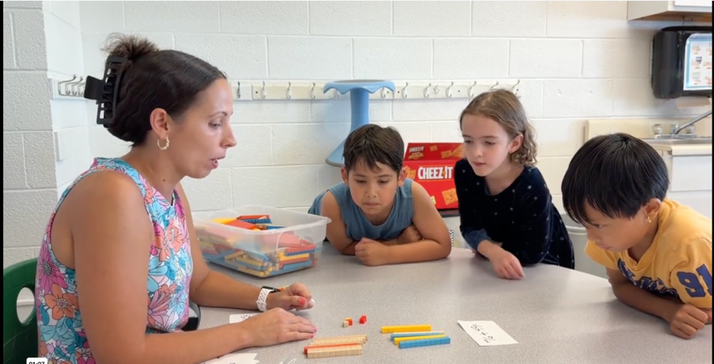
https://vimeo.com/1125861585

Slide 80
Interdependent Practices
Use explicit instruction & provide high-quality feedback for academics and behavior
Create an organized, responsive learning environment
Make adaptations when needed
Use scaffolded supports
Teach and use strategies
Use flexible groupings
Use assistive and instructional tech
Teach to generalization

Slide 81
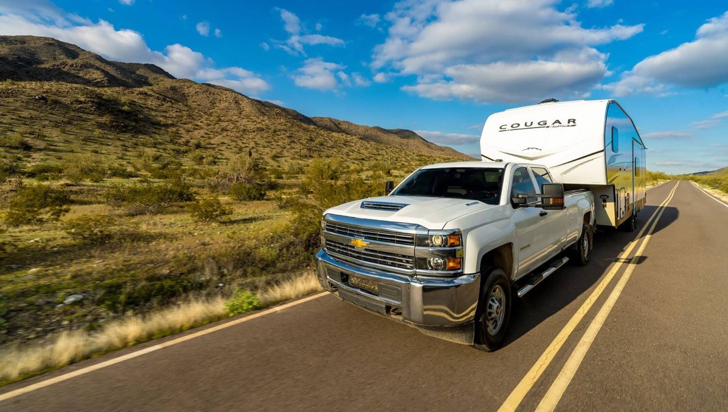
HLP 14 is a vehicle for HLP 21
Generalize
Learning
Use Strategies

Slide 82

Use Strategies
Teach to Generalization Through Strategies
(& Other Explicit Moves)
Generalize
Learning

Slide 83
Knowledge 4

Slide 84

We want students who learn a skill or strategy in setting A

Slide 85

To successfully apply that skill/strategy in setting B
(as independently as they can)

Slide 86
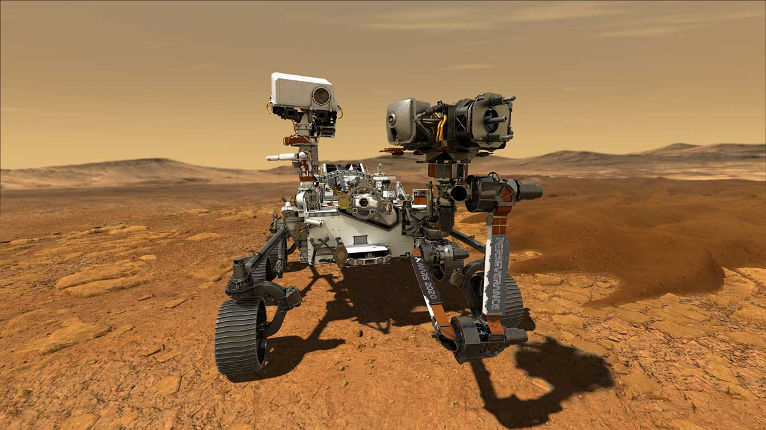
To do this: Need Perseverance

Slide 87
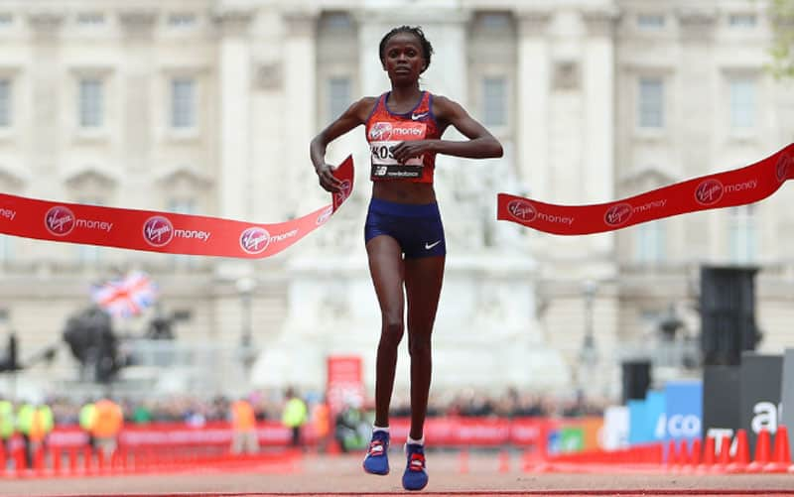
And a ton of training

Slide 88
Pillars

Slide 89

HLP 1

Slide 90

HLP 3

Slide 91

HLP 6

Slide 92

HLP 11

Slide 93

HLP 12
Notes:
Many teachers provide instruction using evidence-based practices during the acquisition phase of learning, but unless generalization and maintenance are also considered, students may not be able to access their new behavior in applied settings, such as at home or the playground. It is our contention that both generalization and maintenance should be programmed systematically.

Slide 94

Crawl walk run fly
Notes:
Why include maintenance of behavior when we talk about generalizing newly acquired skills to new settings, people, and/or other behaviors? The learner cannot generalize a behavior if she cannot maintain the behavior in the first place, so maintenance is integral to the learning process.

Slide 95

We ultimately want students to perform the skill/strategy on their own in a new environment, but it won’t happen by magic
(or one lesson delivered one time)
Notes:
Expecting learners to automatically transfer newly learned skills when supports have been withdrawn is asking a lot of students and, in fact, may be setting them up for failure. It is meaningless to change any learner’s behavior unless the change is made to last (maintenance) and the new behavior occurs in settings other than the original training site and in the absence of the original trainer (generalization).

Slide 96
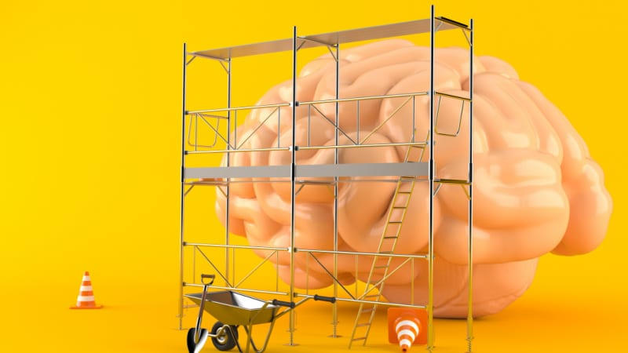
HLP 13, 15, 19:
Make Adaptations,
Use Scaffolds,
Use Tech

Slide 97

HLP 17: Use flexible groupings

Slide 98
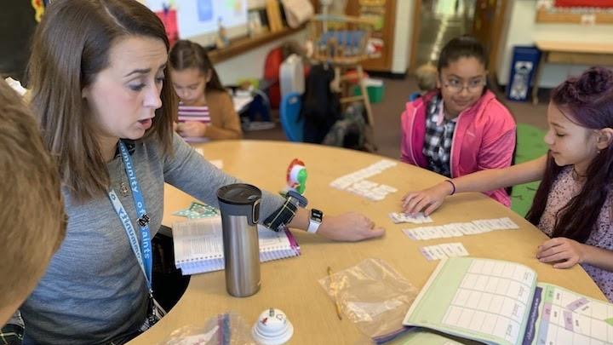
HLP 18: Engage students

Slide 99

HLP #22
Provide high-quality academic feedback
Notes:
This first video in our series focuses on providing Academic-Specific Feedback

Slide 100
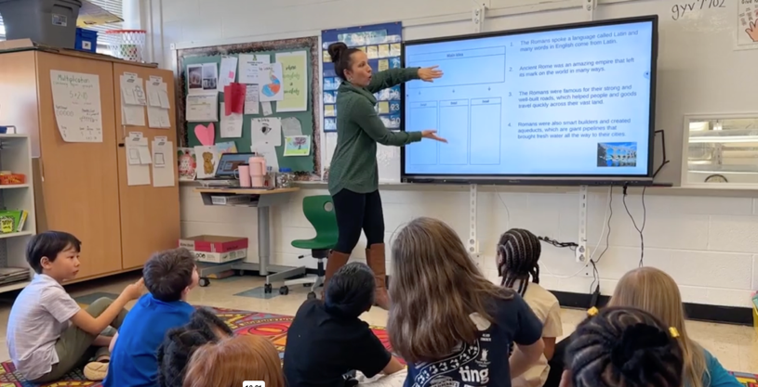
https://vimeo.com/922511270

Slide 101
Interdependent Practices.
Use explicit instruction & provide high-quality feedback for academics and behavior
Create an organized, responsive learning environment
Make adaptations when needed
Use scaffolded supports
Teach and use strategies
Use flexible groupings
Engage students
Use assistive and instructional tech
Teach to generalization

Slide 102

Create an Organized, Responsive Classroom Environment
Through Engaging Instruction

Slide 103
Knowledge 5

Slide 104
HLP 16: Key Elements of Explicit Instruction.
Use clear language and anchor images
Use cues
Break complicated content into chunks
Make connections to prior learning
Highlight relevant and varied examples (and non-examples)
Use an engaging, deliberate, and predictable pace
Provide lots of (varied) opportunities to respond (OTRs)
Deliver high-quality feedback
Model (I do) regularly
Provide guided practice (we do) regularly
Utilize independent practice (you do) when students are ready
Notes:
The best explicit instruction will still result in some students not making progress and needing clarification or other supports to succeed. That is what HLPs 13 and 15 are really all about.

Slide 105
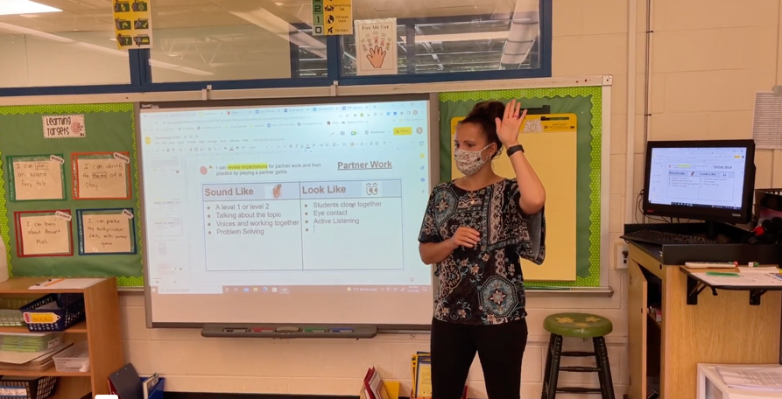
https://vimeo.com/713729052?share=copy

Slide 106
Collaboration.
Collaborate with colleagues
Run effective meetings
Collaborate with families

Slide 107
Data-Driven Planning.
Use a range of data sources
Interpret data to be easily understood
Make data-driven decisions
Create long- and short-term learning goals
Systematically design instruction

Slide 108

Use Responsive and Deliberate Language with Colleagues and Families

Slide 109
Knowledge 6

Slide 110

Summary

Slide 111

Meme

Slide 112



MKennedy@virginia.edu
The
Slides

