Slide 1
Educator Preparation Aligned With the Science of Learning and Development (SoLD)
Ceedar convening 2026
Dr. Cathy Yun
February 11, 2026

Slide 2
LPI Resources Overview
SoLD Design Principles for Schools
Teacher Preparation Design Principles aligned with SoLD
SoLD Video Library
EdPrepLab Resource Library
Teacher Residencies and Strategic Staffing Models

Slide 3
Design Principles for Schools

Slide 4

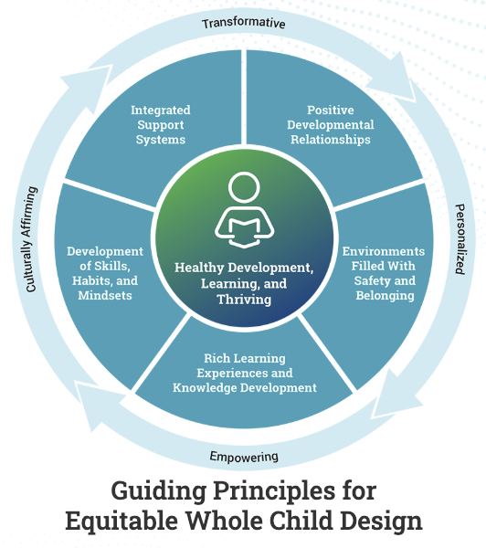
SoLD-Aligned Design Principles for Schools
Notes:
So based on what we know about the science of learning and development, the Learning Policy Institute and Turnaround for Children partnered with other orgs to create a framework for equitable whole child CLASSROOMS and SCHOOLS.
These principles include…

Slide 5
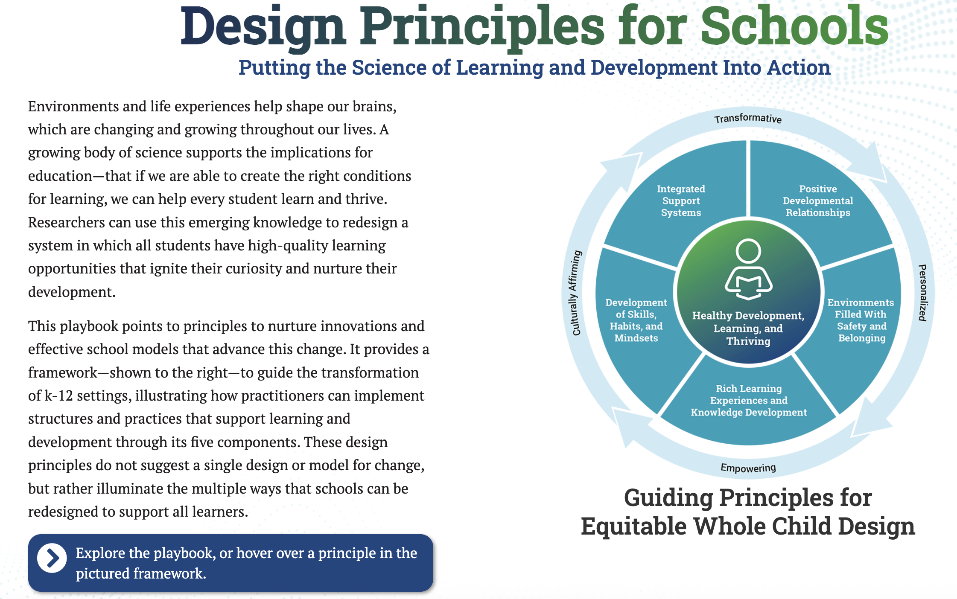

Design principles for schools 1

Slide 6
Teacher Preparation Design Principles

Slide 7
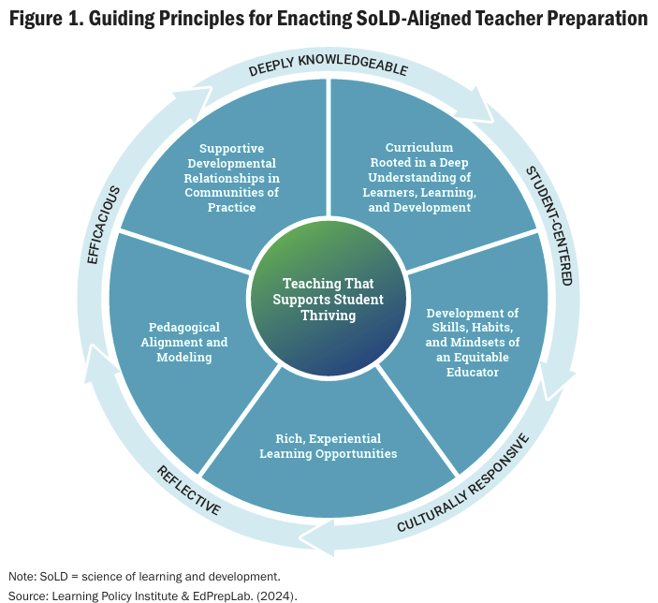
Principles for Teacher Preparation
1
The HOW of
Teacher Education
5
2
The WHAT of Teacher Education
4
3
Notes:
So these FIVE overarching principles are components of a teacher education framework that is aligned to the science of learning and development
It’s a little confusing because the colors are the same as the K-12 schools and classrooms version but these are the 5 principles for teacher prep based on SoLD.
Read the principles

Slide 8
Design Principles Advisory Committee
Travis Bristol, Associate Professor of Teacher Education and Education Policy, UC Berkeley
Megan Franke, Professor, UCLA
Kay Fujiyoshi, Foundations Year Instructor and Advisor, UTEP
Cindy Gutierrez, Director of Partnerships, Urban Community Teacher Education, CU Denver
Jenny Langer-Osuna, Professor, Stanford
Violet Jiminez Sims, former Associate Director, Teacher Education, UConn
Susan Keesey, Interim Director, Associate Professor in Special Education, Western Kentucky University
Gloria Ladson-Billings, Kellner Family Chair in Urban Education, UW Madison
Jeannie Oakes, Senior Fellow in Residence, LPI
Jabari Mahiri, Professor and William and Mary Jane Brinton Family Chair in Urban Teaching, UC Berkeley
Gilda Martinez-Alba, Assistant Dean and Professor, Towson University
Rich Milner, Chair, Teaching and Learning; Professor, Leadership, Sociology, Vanderbilt
Na’ilah Nasir, President, Spencer Foundation
Desiree Pointer-Mace, Director of Graduate Programs, Alverno College
Shael Polakow-Suransky, President, Bank Street College
Jennifer Robinson, Executive Director, Center for Pedagogy, Montclair State University
Misty Sato, Associate Professor, University of Canterbury
Kathy Schultz, Dean, CU Boulder
Ken Zeichner, Professor Emeritus, University of Washington
Kimberly Schonert-Reichl, Professor, University of Illinois Chicago
Lee Schulman, Professor Emeritus, Stanford University
Carol Lee, Senior Research Fellow, LPI
Jacqueline Rodriguez, Vice President, Research, Policy, and Advocacy, AACTE
Dyan Smiley, Associate Director, Educational Issues, AFT
Blake West, Senior Policy Analyst, Center for Great Public Schools, NEA
Rebecca Cheung, Assistant Dean, Leadership Programs, UC Berkeley (leadership preparation liaison)
Steve Tozer, Senior Research Fellow, LPI (leadership preparation liaison)
Notes:
And I just want to mention very quickly that this framework and these principles were developed based on research and evidence in partnership with an advisory committee made up of teacher educators across a diverse range of institutions.

Slide 9




Teacher Preparation Design Principles 1
Teacher Preparation Design Principles

Slide 10
SoLD Video Library

Slide 11



SoLD Video Library

Slide 12
EdPrepLab Resource Library

Slide 13




























EdPrep Lab

Slide 14

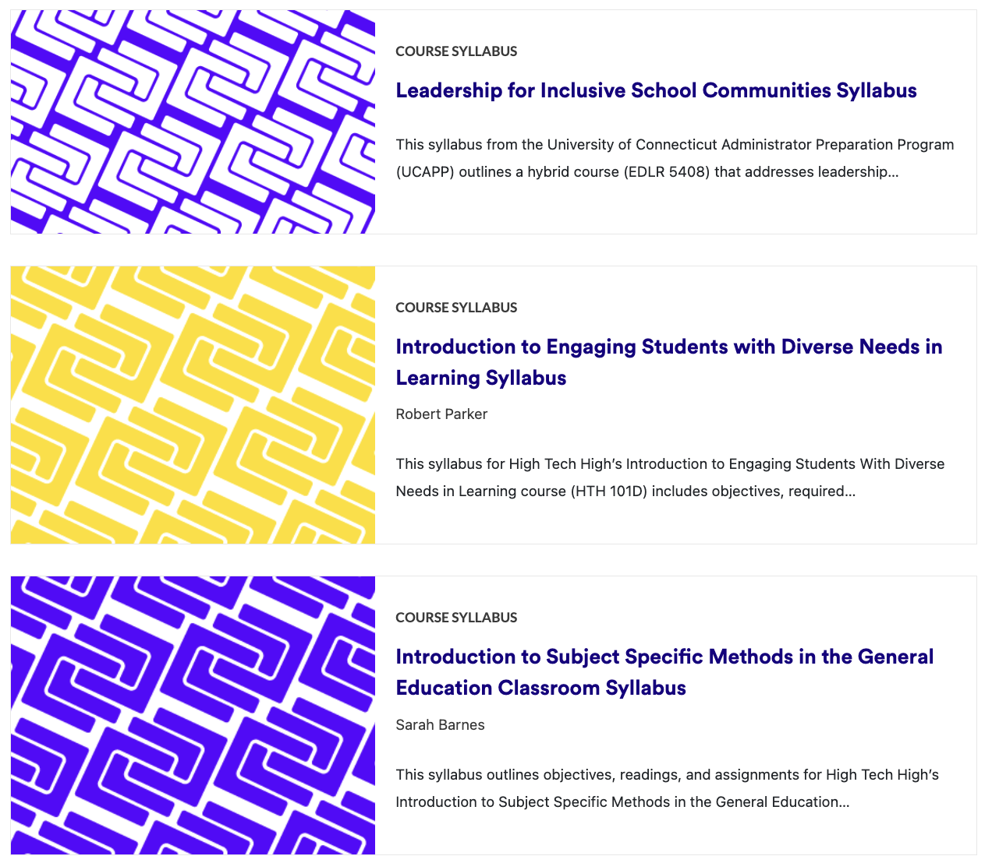

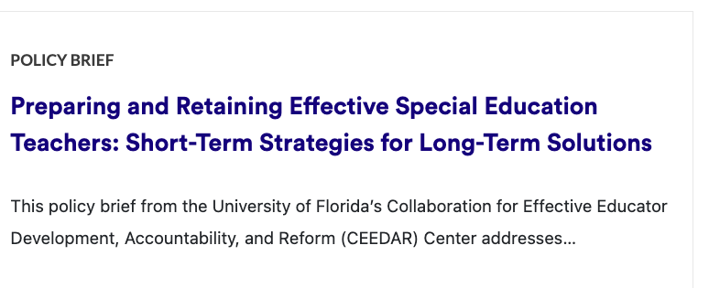





Resource library
Notes:
https://edpreplab.org/resource-library

Slide 15


Submit a Resource

Slide 16
Teacher Residencies & Strategic Staffing Models

Slide 17



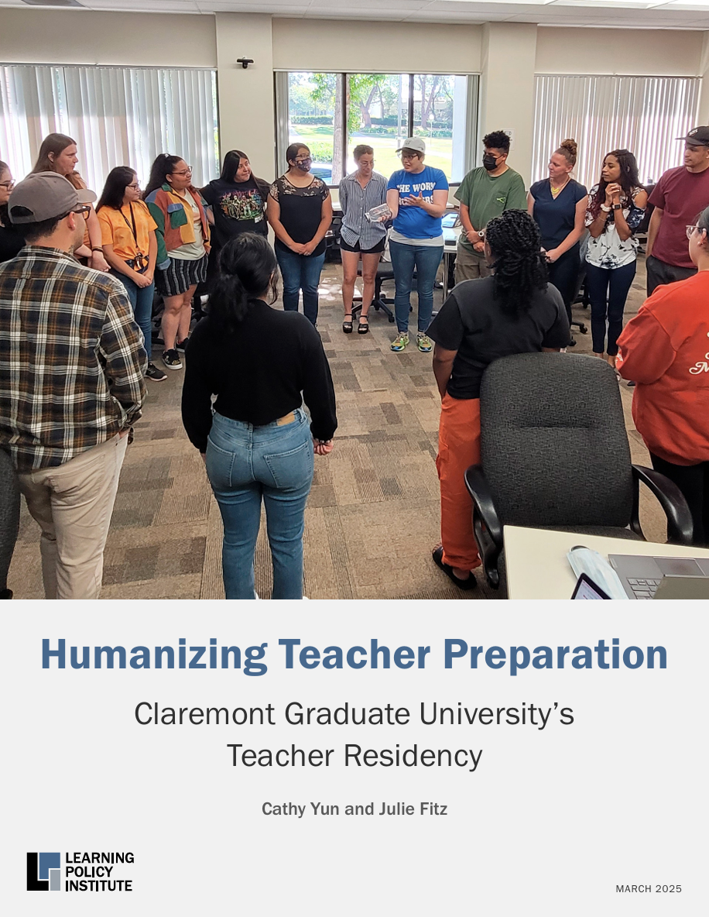

Teacher Residencies in California

Slide 18



Teacher Residencies in Texas

Slide 19
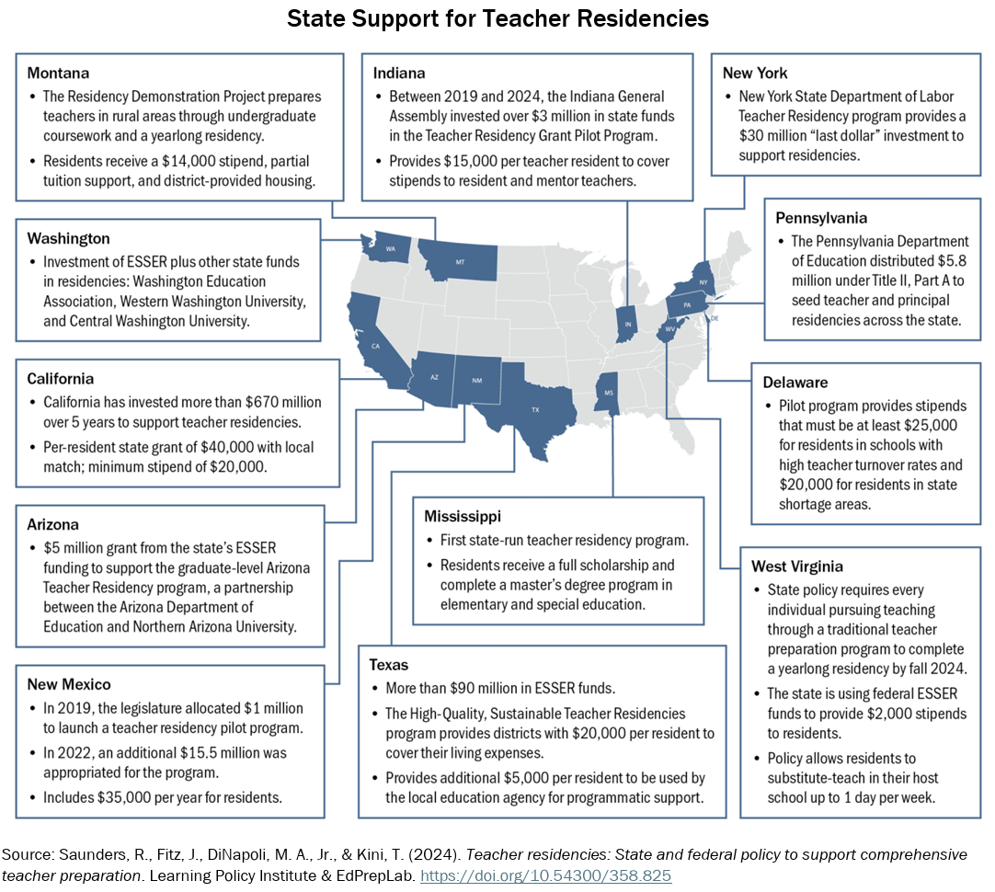


Teacher Residencies in 12 States

Slide 20
Thank you!
cyun@learningpolicyinstitute.org

Slide 21
Teacher Turnover Calculator

Slide 22

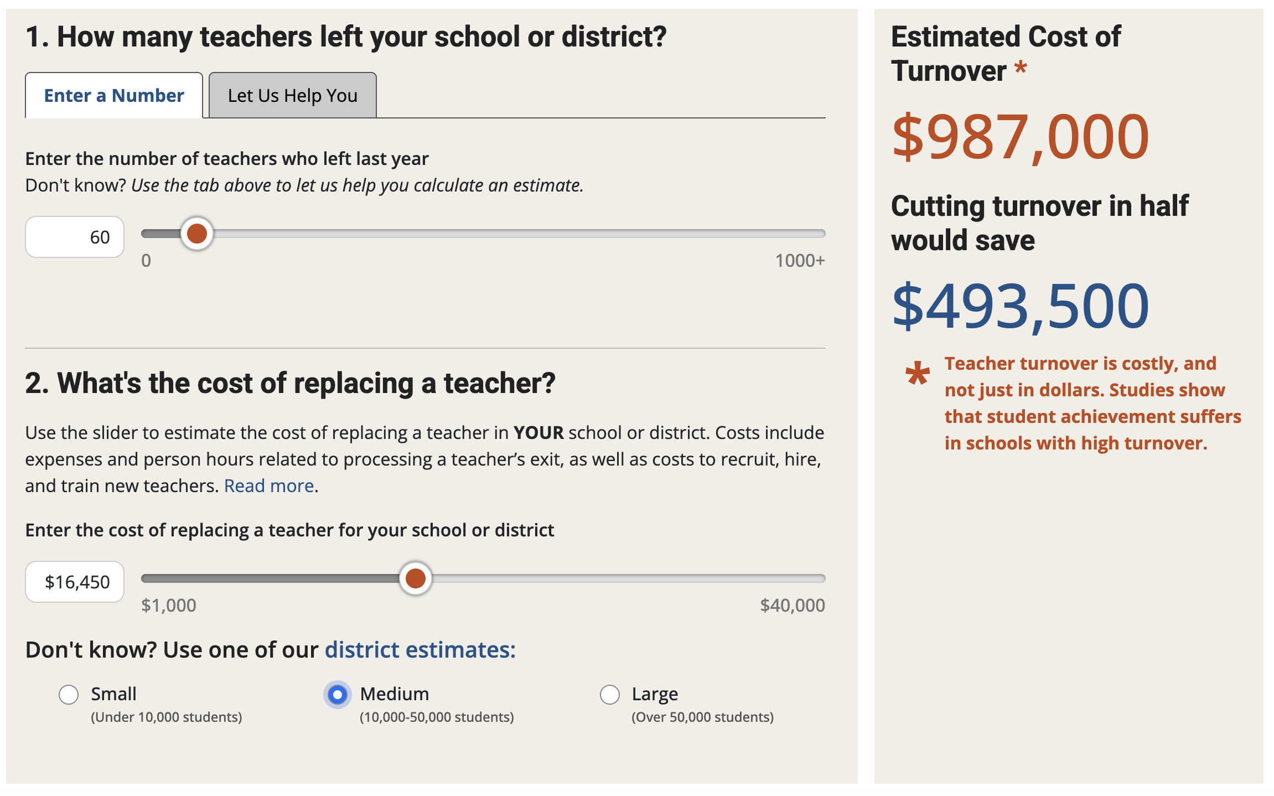

What’s the cost of teacher turnover?

