Slide 1
High Leverage Practice (HLP) Resources
Laurie VanderPloeg , CEC
Michael Kennedy, University of Virginia

Slide 2

HLP
Discover how the HLP domains can enhance student engagement, academic and behavioral outcomes and well-being
Consider practical strategies for using HLPs

Slide 3
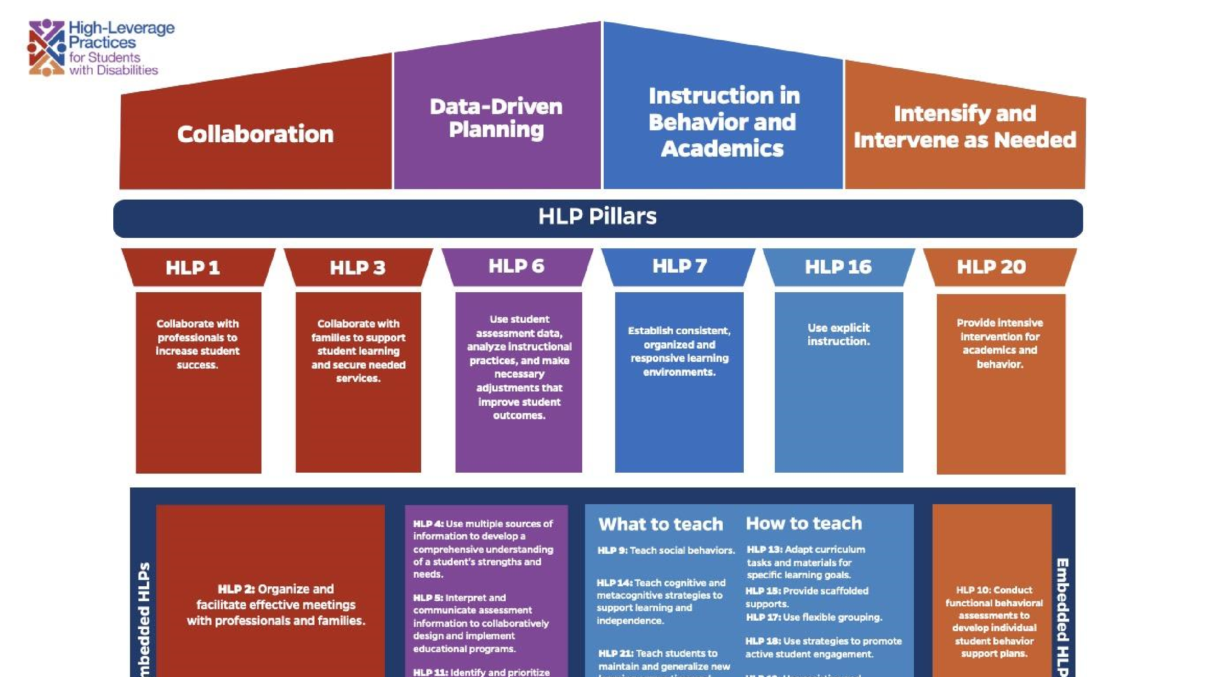
HLP pillars

Slide 4
HLP Leadership and Faculty Guides
Leadership
Faculty
These guides are intended for school leaders (Administrators, Teacher Coaches, Mentors, etc.) to support their teams in effectively implementing the High Leverage Practices in the classroom.
https://ceedar.education.ufl.edu/hlp-leadership-guides/
These guides are intended to support educator preparation faculty in effectively training teacher candidates on implementing the High Leverage Practices in classroom settings.
https://highleveragepractices.org/hlp-faculty-guides

Slide 5
Paraeducator Webinar Series (FREE)
https://learn.exceptionalchildren.org/products/effective-high-leverage-practices-for-paraeducators
The Core Competencies for Special Education Paraeducators represent the required knowledge and skills all paraeducators need to safely and effectively support students with disabilities in K-12 settings.
https://exceptionalchildren.org/standards/competencies/core-competencies-special-education-paraeducators
The toolkit is designed to improve the assessment and evaluation of paraeducators who work with students with disabilities. The goal is to ensure the effective utilization of paraeducators and provide them with ongoing mentoring and professional development.
https://exceptionalchildren.org/webinar/special-education-paraeducator-assessment-and-evaluation-toolkit

Slide 6
Early Childhood HLP Series
Ideal for higher education faculty, teachers, administrators, and support personnel who work with students in kindergarten through 3rd grade.
Benefits of Participating
  Gain a deeper understanding of HLPs, RPs, and DAPs and their importance for early childhood learners
  Learn how to implement HLPs and RPs effectively in their classrooms
  This program will explore specific HLPs and their alignment with DEC Recommended Practices
https://learn.exceptionalchildren.org/products/early-childhood-recommended-practices-informing-the-high-leverage-practices-for-k-3

Slide 7

HLP Videos
https://highleveragepractices.org/implementation-resources/videos

Slide 8

Make Your
Own

Slide 9
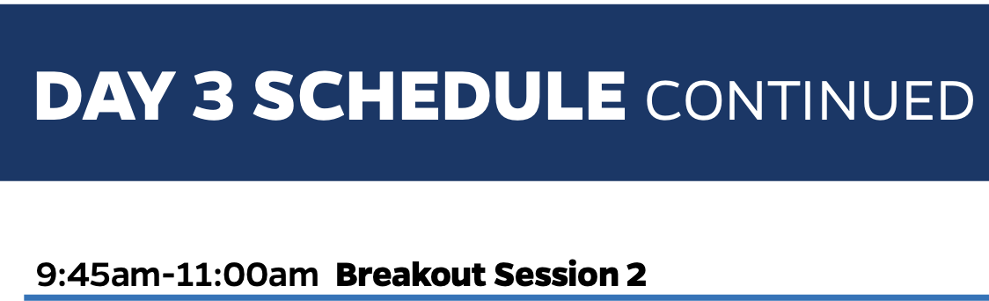
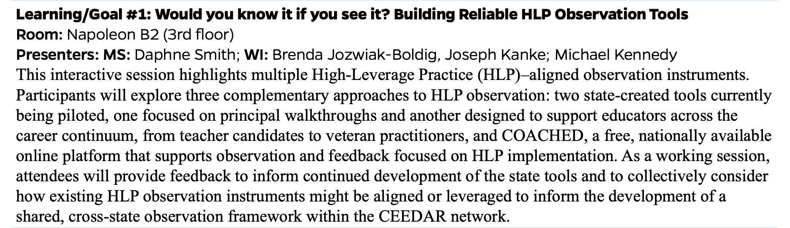
COACHED
www.coached.education.virginia.edu
Free and customizable tool for observing instruction and generating editable automatic feedback.

Slide 10
HLP Assessment Toolkit
These High-Leverage Practices for Students with Disabilities Self-Assessment Tools are designed to help preservice and in-service teachers reflect on and assess how well they are implementing high-leverage practices (HLPs) for students with disabilities. Teachers and teacher candidates can self-assess on all 22 HLPs or target only specific HLPs.
https://ceedar.education.ufl.edu/wp-content/uploads/2021/07/HLP-Self-Assessment-Tools-Cover-Page-combined.pdf
https://ceedar.education.ufl.edu/wp-content/uploads/2021/07/HLP-Self-Assessment-508.pdf

Slide 11
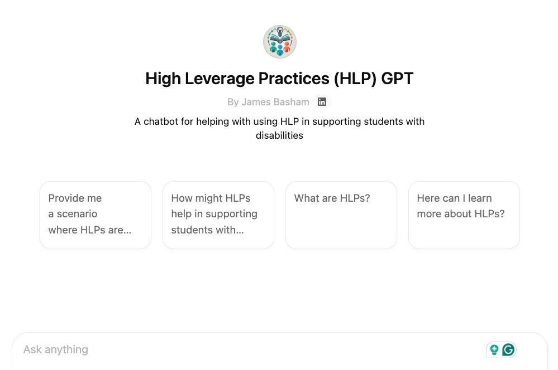
Chat GPT
https://chatgpt.com/g/g-67b53457ec28191b9c82aa7e6bcf1a9-high-leverage-practices-hlp-gpt

Slide 12

CEC Solutions
High Leverage Practice Book Study-
It’s a structured, facilitated learning experience designed to move ideas into practice.
State Department of Education
Local Education Agency
Building Level
For more information contact-
cecsolutions@exceptionalchildren.org

Slide 13

HLP Publications
httphttps://exceptionalchildren.org/stores://exceptionalchildren.org/store

Slide 14
Coming Soon!
Old laminated guides to NEW set of implementation guides provides educators with practical, classroom-ready tools for implementing High-Leverage Practices (HLPs). The guides emphasize how HLPs work together to support positive academic, behavioral, and social outcomes for all students with disabilities.
Expected spring 2025!

Slide 15
Thank You
LVanderPloeg@exceptionalchildren.org
MKennedy@virginia.edu

