Slide 1


Learning That Drives Practice:
High-Leverage Practice Tools for Teacher and Leader Candidates
(Learning; Goal #1)
Minnesota
Dr. Ruby Owiny &
Dr. Dana Wagner,
Minnesota State University, Mankato
Georgia
Dr. Nick Sauers, Georgia State University
Dr. Karen Bryant, University of Georgia
Cross-State Convening

Slide 2

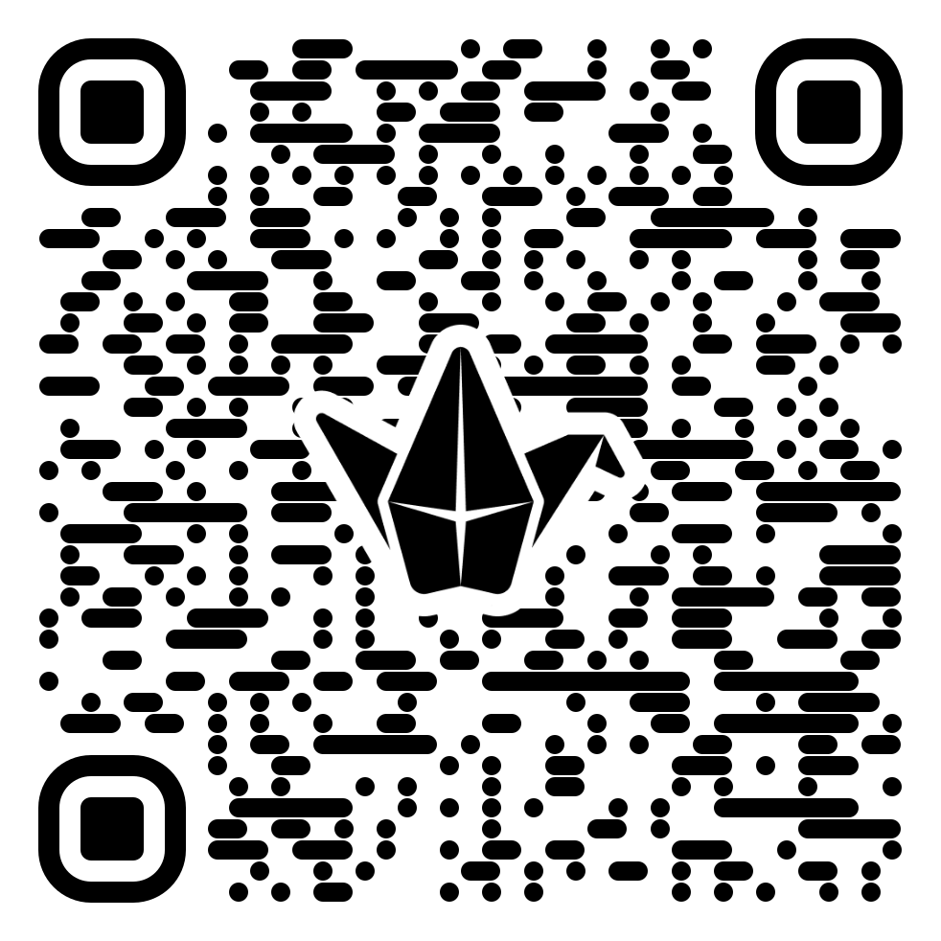



Check-in
Cross-State Convening
How are you incorporating HLPs into coursework?
  Provide examples of assignments, field placements, in-class activities, mentoring and induction, instruction, or other.
  Respond using Padlet: https://padlet.com/amycolpo/how-are-you-incorporating-hlps-into-coursework-vaq2uzkxjzq8ctu8
Notes:
Nick
Respond using Padlet: https://padlet.com/amycolpo/how-are-you-incorporating-hlps-into-coursework-vaq2uzkxjzq8ctu8

Slide 3


TeachTrack Master Your HLPs with ease
Cross-State Convening
Ruby L. Owiny, Ph.D. & Dana Wagner, Ph.D.
Minnesota State University, Mankato
Notes:
Dana

Slide 4

What is TeachTrack?
Cross-State Convening
  Online platform for pre- or in- service teachers using HLPs with streamlined tools for improving HLP understanding and implementation
Notes:
Dana

Slide 5


How might I use TeachTrack
Cross-State Convening
How might I use TeachTrack?
Self-monitoring log
Goal setting and progress monitoring
Supervisor/coach communication and feedback
Professional development
Notes:
Dana - up to 5 min

Slide 6


Demonstrations
Cross-State Convening
Teacher Candidate View
Supervisor/Coach View
Notes:
Ruby - 10 min
ruby.owiny@gmail.com
Edwards2Olila2001!
Teacher Candidate Account
rubyowiny2teach@gmail.com
Edwards2Olila2001!
Supervisor Account

Slide 7



Let’s practice with a partner - one person is a supervisor and the other a teacher candidate.
Write comments/?s on post it notes as you are practicing.
Cross-State Convening
Notes:
Ruby

Slide 8
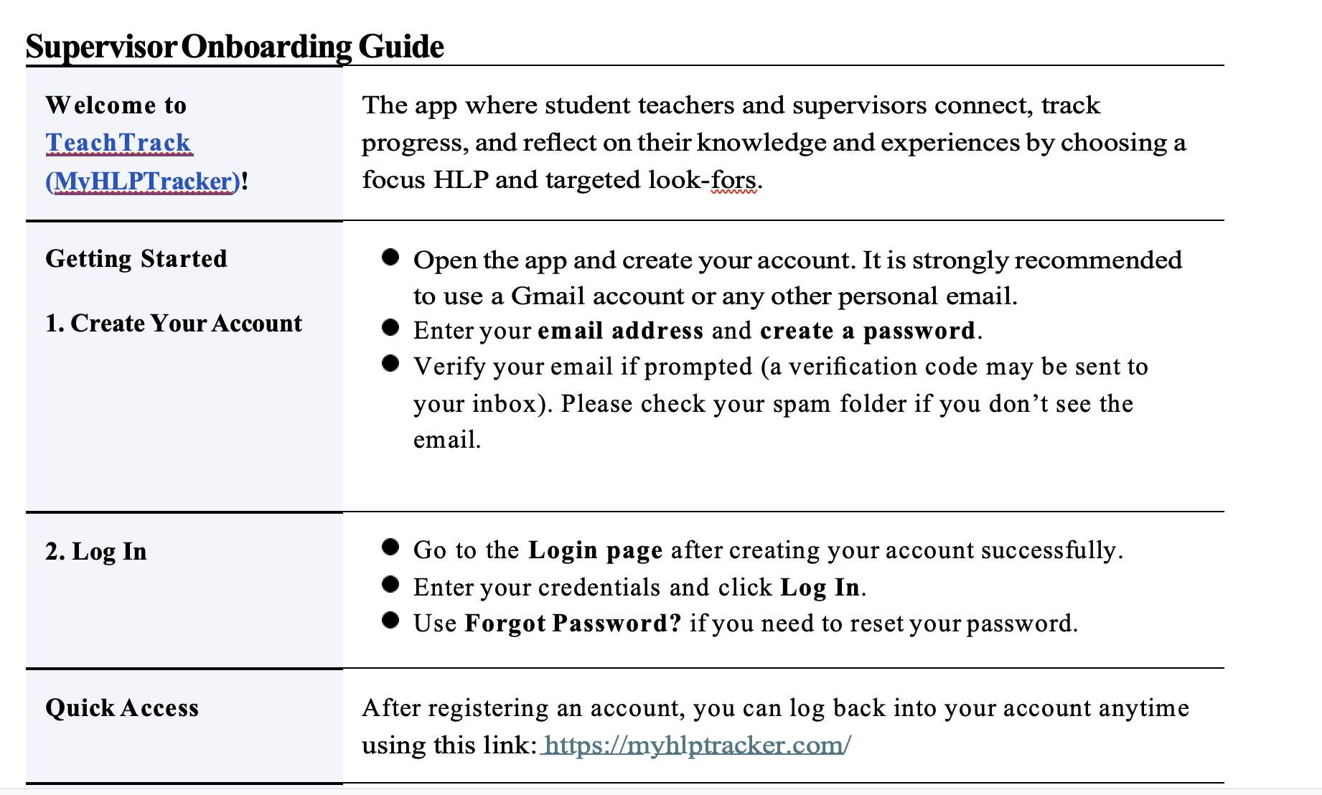
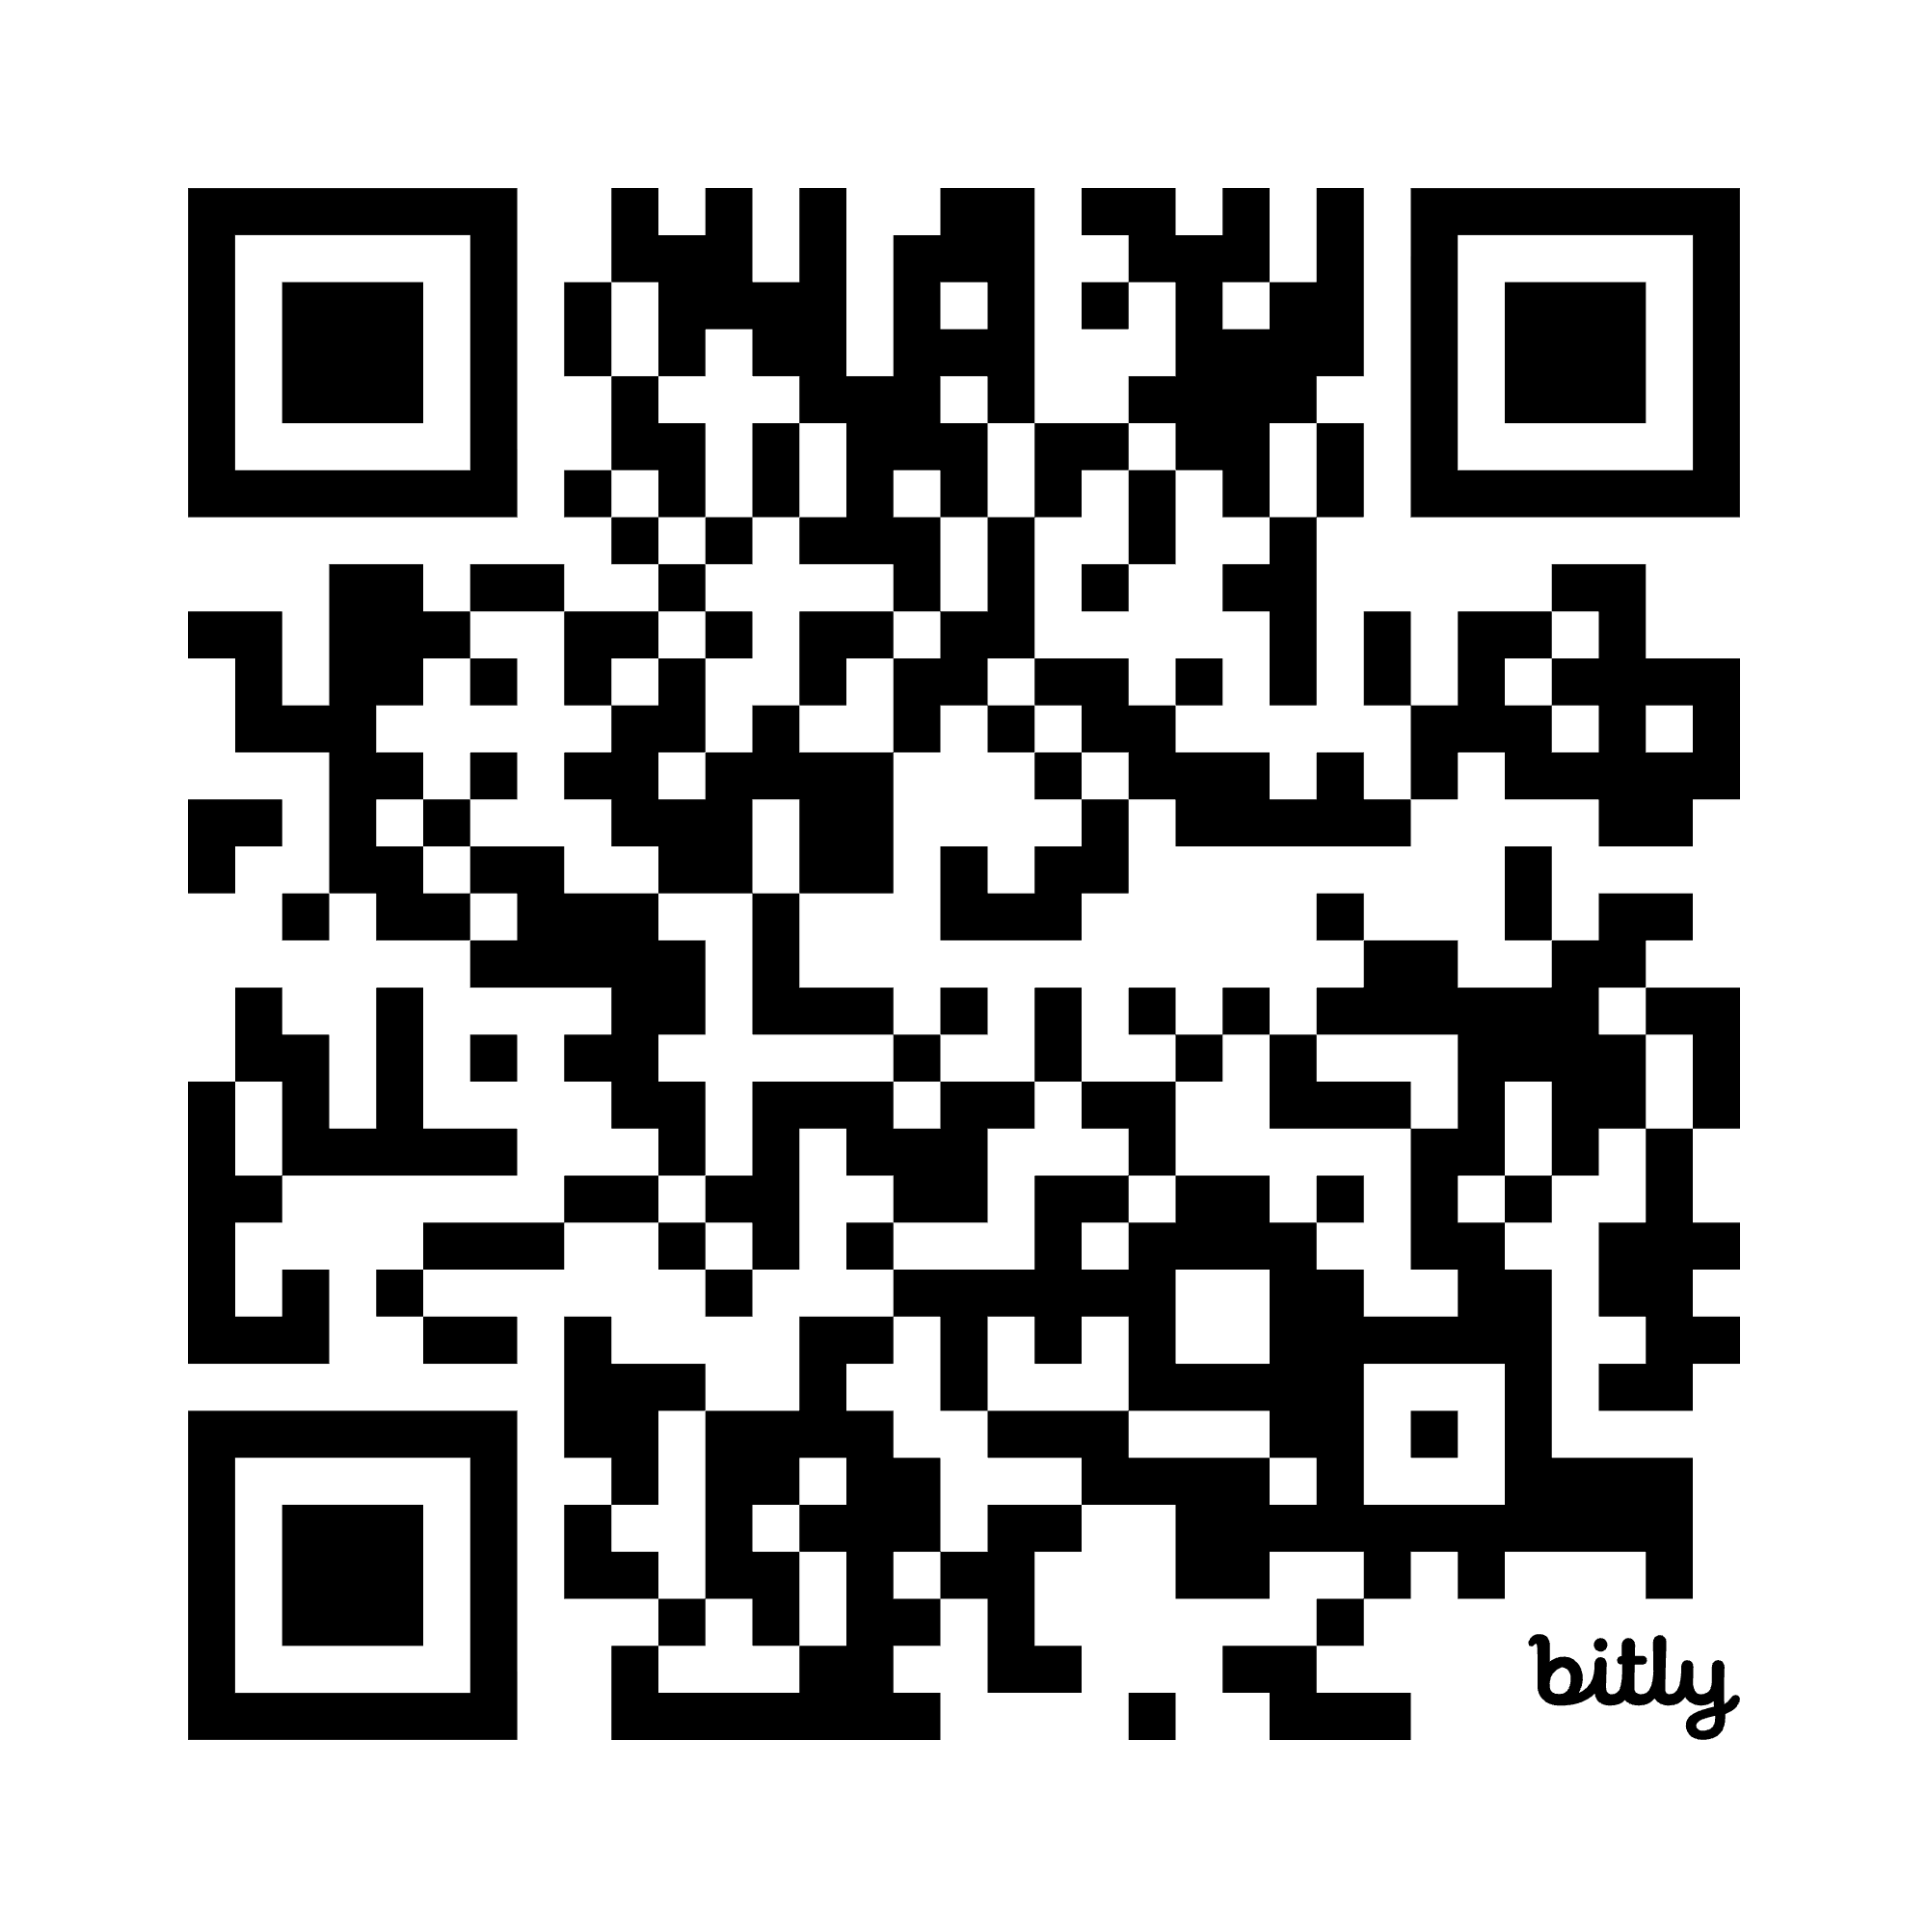
Supervisor creates account first!
Cross-State Convening
Notes:
Ruby -

Slide 9

Supervisor set up continued
Cross-State Convening
Click “Class Admin”
Enter a class name in the text box
Click “Generate Class”
Go back to the home page (back arrow in upper left corner)
Click “Invite to Class”
Select class from the dropdown menu
Click “Generate invite link” and copy link
Share the link with a partner
The partner then follows the teacher candidate guide
Notes:
Ruby

Slide 10
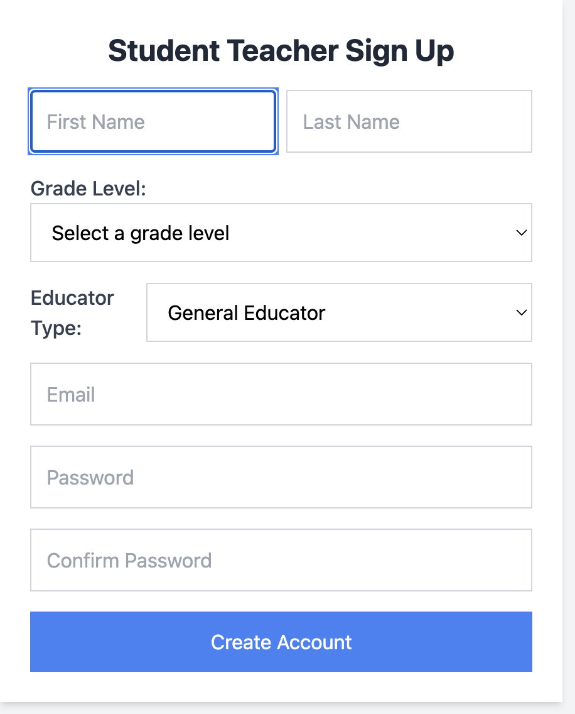
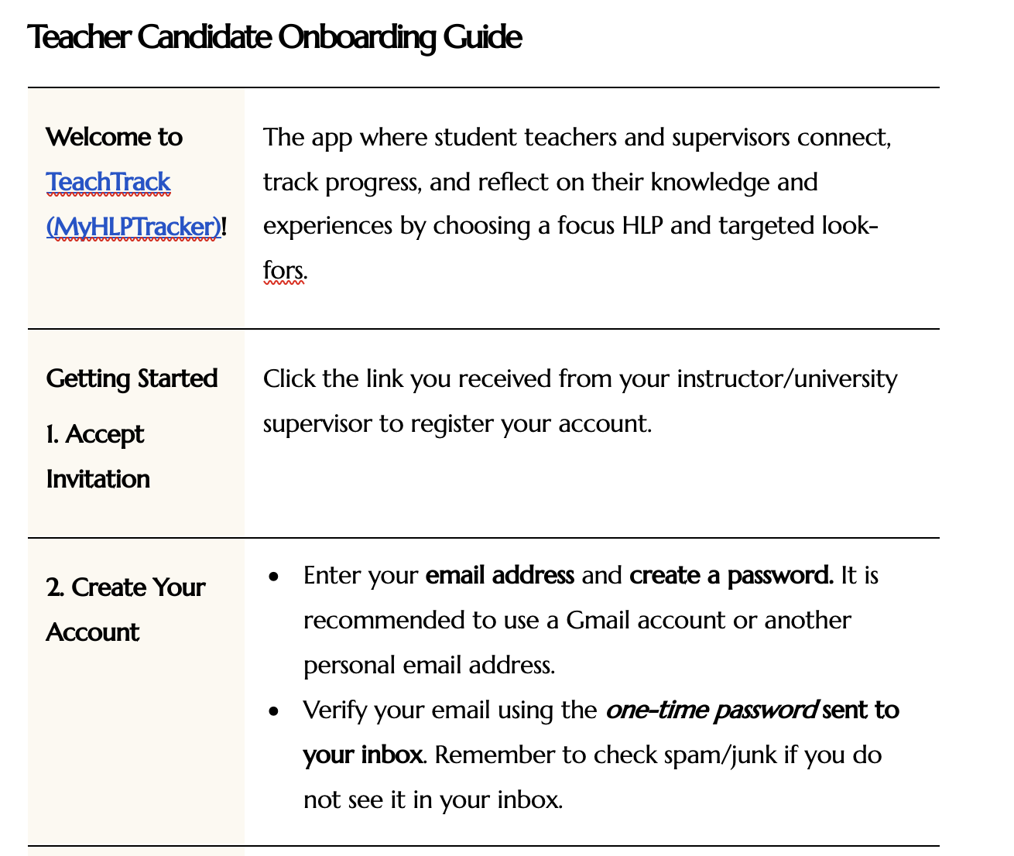
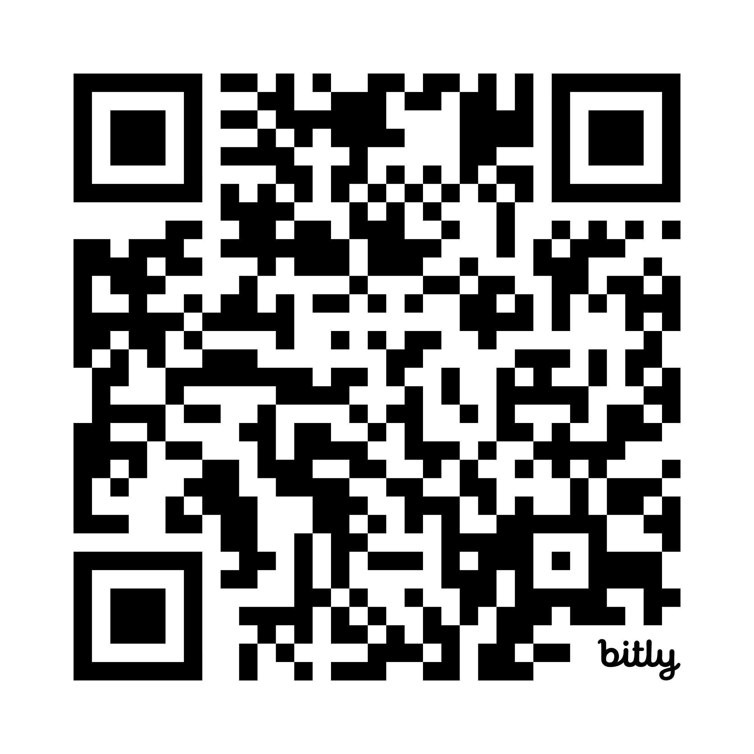
Teacher candidate creates their account
Cross-State Convening
Notes:
Dana - after completing the sign up process, you will receive an email verification code. Verify, then log in again.

Slide 11

Teacher candidate enters a reflection
Cross-State Convening
Click on new HLP reflection
Select the category
Select the HLP
Click on add new reflection
Select a look for
Choose score
Respond to the open ended prompts
Click submit
Notes:
Dana

Slide 12
Supervisor provides feedback
Cross-State Convening
View Reflections
Click on your class
Click view all reflections for this class
Top right dropdown - click all statuses
Click on the first pending entry - review details
Read candidate’s reflection
Provide feedback in comments
Click submit
Notes:
Ruby

Slide 13
Teacher candidate reviews feedback
Cross-State Convening
From homepage, click “My Reflections”
On the next screen, click “Show Entries” on the right side of the screen to view supervisor feedback.
To see the feedback with candidate response, click “View Details.”
Notes:
Ruby

Slide 14
Discussion
Cross-State Convening
What did you jot down on your post-it notes?
What do you see as strengths of TeachTrack?
What are potential benefits of using TeachTrack?
How might you use TeachTrack in your work?
What should we consider for further development of TeachTrack?
Notes:
Dana

Slide 15



Thank you!
Cross-State Convening
For questions, email us.
ruby.owiny@mnsu.edu
dana.wagner@mnsu.edu
Notes:
Dana

Slide 16
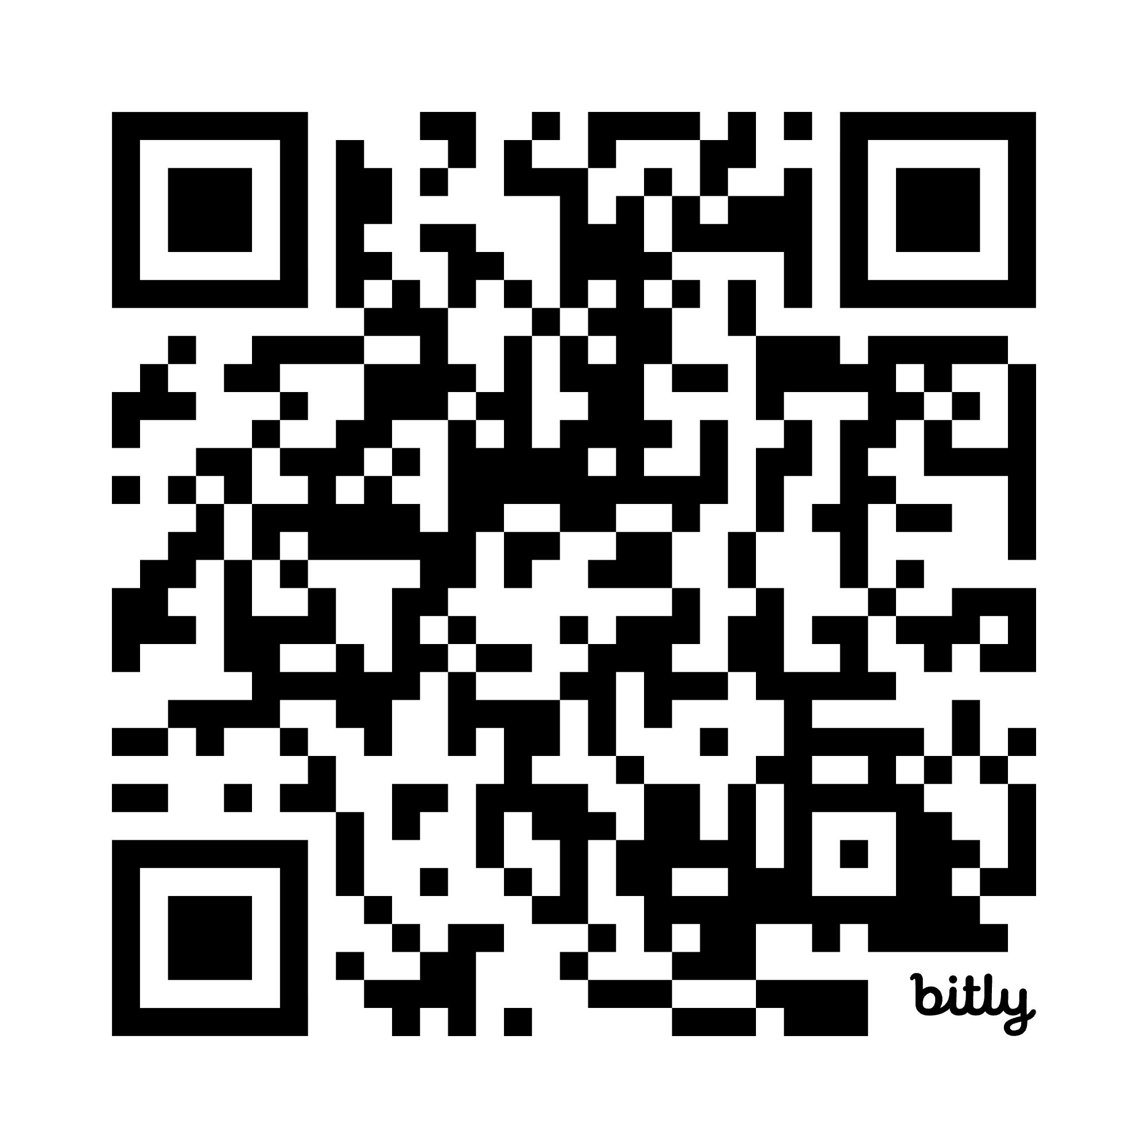
Welcome!
Cross-State Convening
https://bit.ly/CEEDARLead
Nick Sauers, Georgia State University
Karen Bryant, University of Georgia
Notes:
Nick

Slide 17
Agenda
SOR Overview
State Partnerships - GELFA
HLP Examples
HLP Leadership Guide
Challenges/Next Steps
Breakout Session
Cross-State Convening
Notes:
Nick

Slide 18
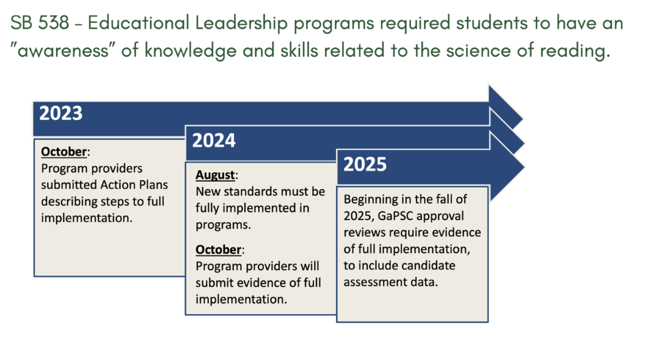
SB 538
Cross-State Convening
Notes:
Karen

Slide 19
Module Content
Cross-State Convening
Cross-State Convening
Module 1:
Introduction to Language and Literacy (~2 hours)
Module 2:
High-Quality Literacy Instruction and Assessment (~2 hours)
Module 3:
Curriculum Evaluation and Professional Development (~1.5 hours)
Notes:
Karen

Slide 20

Georgia Educational Leadership Faculty Association (GELFA)
Cross-State Convening
Our mission is to support personal and
professional growth for improving the teaching and learning of educational leadership in Georgia.
Notes:
Nick

Slide 21
HLP Examples
Cross-State Convening
Created content collaboratively at CEEDAR SLT
  Overview/definition
  Identified/created principal examples
  Identified/created assignment examples
Developed Graphics - Micayla Kinder
Shared with GELFA
Notes:
Karen

Slide 22
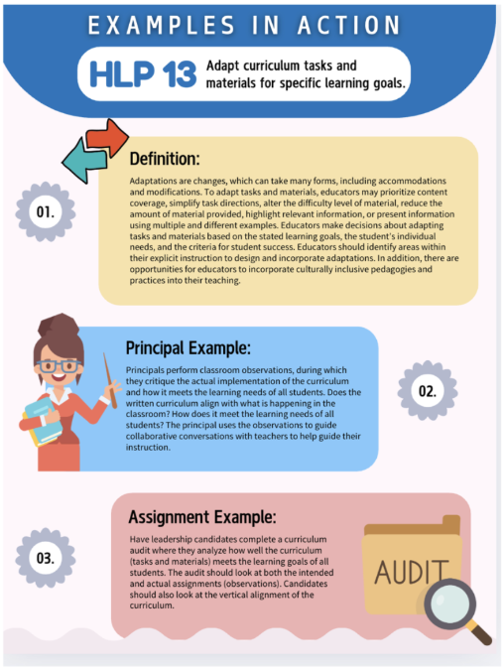



HLP13
Cross-State Convening
Notes:
Nick

Slide 23

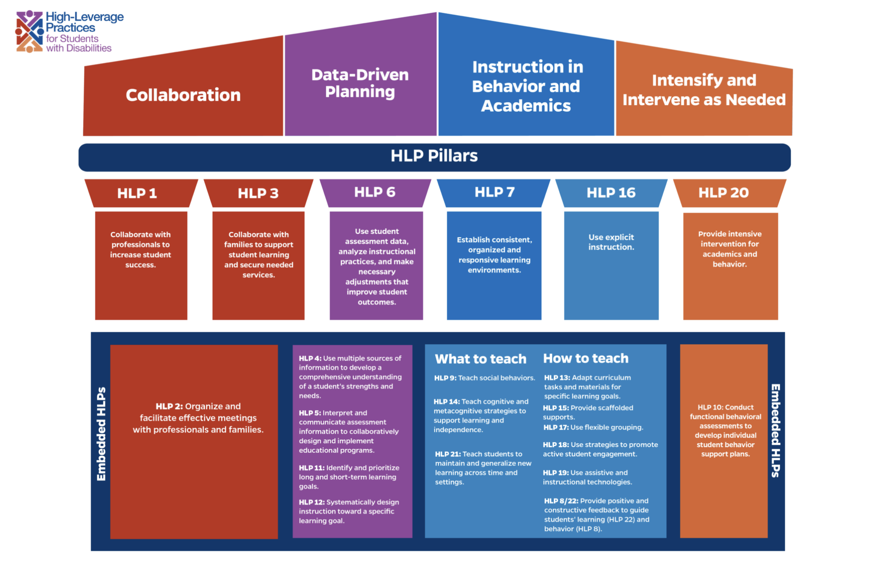
HLP Leadership Guides
“Look fors” Related to Teacher Implementation
Tips for School Leaders to Support Teachers
Questions to Prompt Discussion, Self-Reflection, and Feedback
Cross-State Convening
Notes:
Karen- https://ceedar.education.ufl.edu/hlp-leadership-guides/

Slide 24
Challenges
Cross-State Convening
Buy-in - How do you get all faculty on board?
  Flyers
  Presentation to faculty (Meg Kamman)
  Faculty conversation
Sustainability
  Leadership
  Collaborative University Team meeting time
Notes:
Nick and Karen

Slide 25
Breakout Agenda
Share and Discuss HLP Examples in Action and Leadership Guides
Share Whole Group
Cross-State Convening
Notes:
Nick

Slide 26
HLP Examples in Action and Leadership Guides
Conversation Prompts
What stands out about the examples?
What could be improved?
How could you use these in your courses and preparation programs?
Cross-State Convening
Notes:
Both

Slide 27

thanks
Cross-State Convening
Thank you!
For questions, email us at
nsauers@gsu.edu
bryantkc@uga.edu

Slide 28

Disclaimer
This content was produced under U.S. Department of Education, Office of Special Education Programs, Award No. H325A220002. David Guardino serves as the project officer. The views expressed herein do not necessarily represent the positions or policies of the U.S. Department of Education. No official endorsement by the U.S. Department of Education of any product, commodity, service, or enterprise mentioned in this website is intended or should be inferred.
Cross-State Convening

