Slide 1
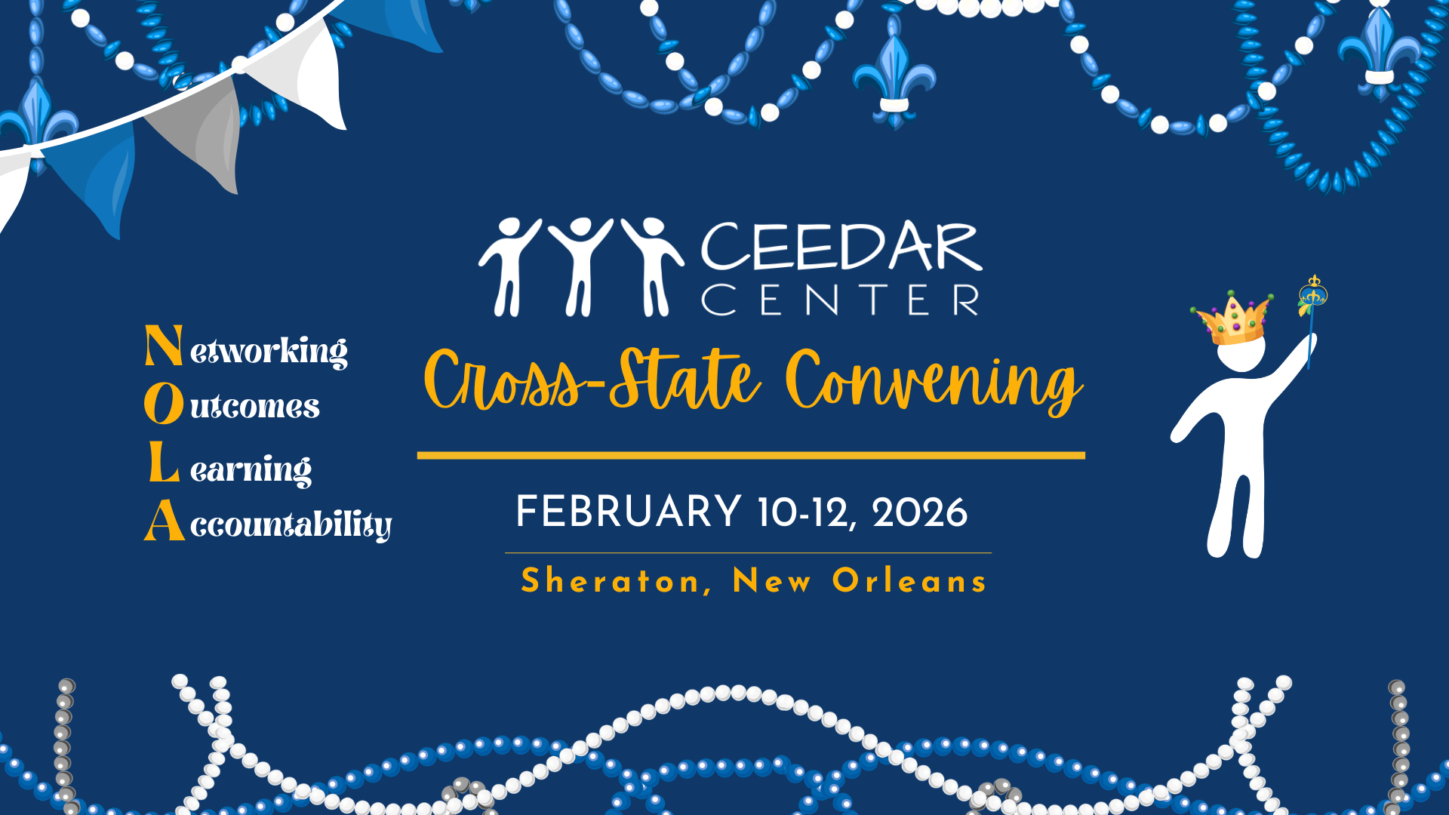
CCSC title

Slide 2


Hot topics in Registered Teacher Apprenticeships: Roundtable Conversations with practitioners
Cross-State Convening
Presented by:
CEEDAR Apprenticeship Team

Slide 3



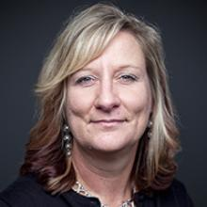
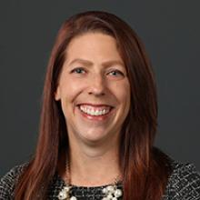
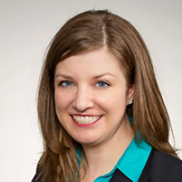
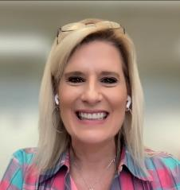
CEEDAR Apprenticeship Team
Cross-State Convening
Lynn Holdheide
Content Expert,
CEEDAR
Managing TA Consultant, American Institutes for
Research (AIR)
Cheryl Krohn
Content Expert, CEEDAR
Senior TA Consultant, American Institutes for Research (AIR)
Meghan Wills
Content Expert, CEEDAR
Senior TA Consultant, American Institutes for Research (AIR)
Lisa White
Facilitator and
RTAP Coordinator, CEEDAR

Slide 4
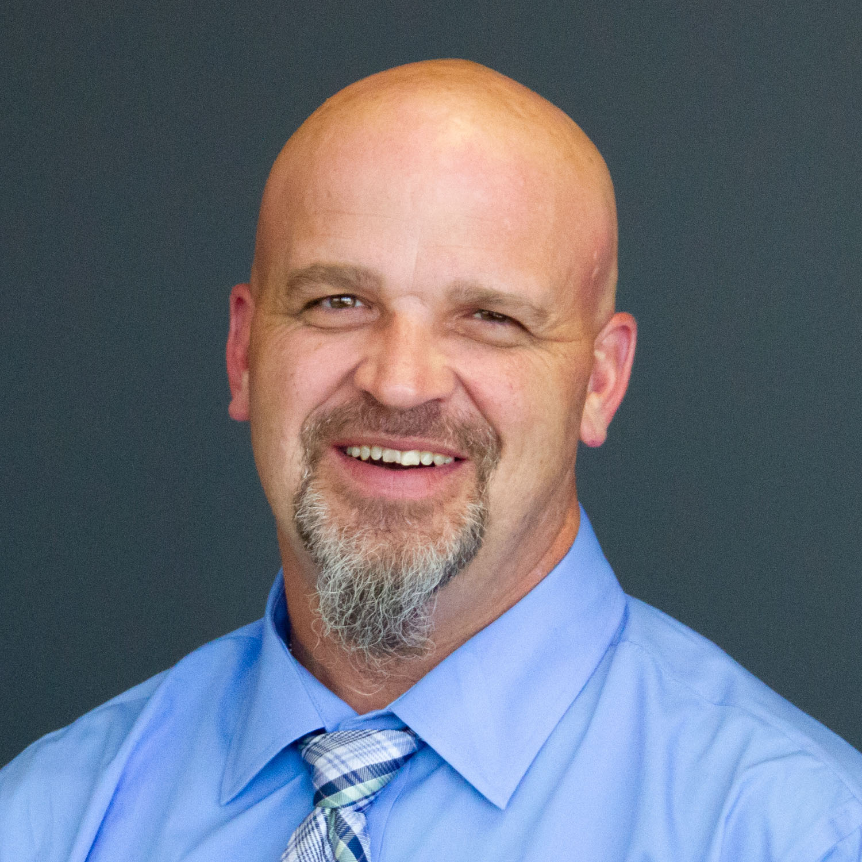
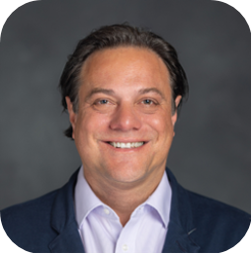
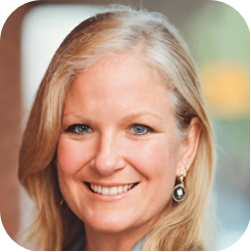
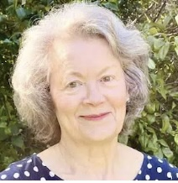



Conversation Leaders
Cross-State Convening
Christopher Leonard
Coordinated Federal Programs Specialist
Office of Federal Programs
Georgia Department of Education
Dr. David Cihak
Associate Dean & Director, Bailey Graduate School of Education
University of Tennessee, Knoxville
Dr. Amelia A. Brown
Director, Office of Professional Licensure
University of Tennessee, Knoxville
Dr. Mary J. Ford
Director, NH Registered Educator Apprenticeship Program
National Collaborative for Digital Equity (NCDE)
Jordan DeHaan-Magalei
Supporting Personnel and Preparation Coordinator
Utah State Board of Education

Slide 5


Hot Topics
Cross-State Convening
Cross-State Convening
Conversation Leader | Topic
Christopher Leonard, GA Department of Education | Funding RTAPs with Title II-A Funding
Dr. Mary J. Ford, National Collaborative for Digital Equity (NH) | Role of an Intermediary in Facilitating RTAPs
Dr. David Cihak and Dr. Amelia A. Brown, University of Tennessee Knoxville | Competency-Based Learning and Credit for Prior Learning
Jordan DeHaan-Magalei, Utah State Board of Education | Mentoring in RTAPs

Slide 6


THANK YOU!
Cross-State Convening
For questions, email us at mwills@air.org

Slide 7

Disclaimer
This content was produced under U.S. Department of Education, Office of Special Education Programs, Award No. H325A220002. David Guardino serves as the project officer. The views expressed herein do not necessarily represent the positions or policies of the U.S. Department of Education. No official endorsement by the U.S. Department of Education of any product, commodity, service, or enterprise mentioned in this website is intended or should be inferred.
Cross-State Convening

