Slide 1


Working Smarter Together
USING DREAM’S UNIVERSAL TA RESOURCES
Making the DREAM a reality!

Slide 2



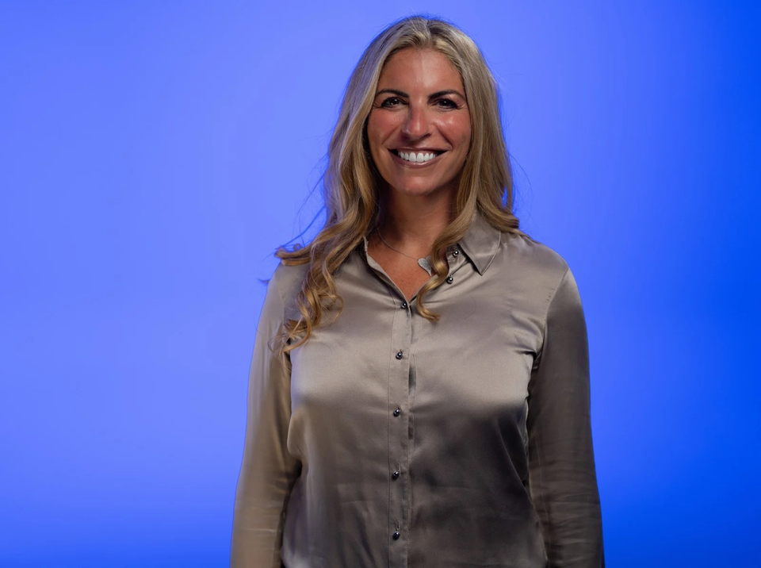
Dr. Liz Cramer
Executive Director & Principal Investigator

Slide 3

Welcome to The DREAM Center!
Delivering Resources, Education,
Access, & Mentorship
  National technical assistance center funded by the Office of Special Education Programs (OSEP) of the U.S. Department of Education.
  Committed to supporting programs that develop and train early intervention, early childhood special education, special education, & related services.
    Enhance program quality
    Expand grant access
    Foster collaboration

Slide 4


SUPPORTING IHEs THROUGH TECHNICAL ASSISTANCE
  Develop and enhance high-quality degree and certification programs in:
    early intervention
    early childhood special education
    special education
    related services
  Secure Federal grants that fuel program development and implementation, paving the way for innovative solutions and stronger preparation of special education personnel.

Slide 5

COLLABORATION BETWEEN DREAM AND CEEDAR
The partnership between the DREAM Center & the CEEDAR Center providers opportunities to:
  Leverage complementary expertise
  Align resources
  Coordinate efforts to better support shared audiences
Together, this collaboration expands our collective reach by:
  Increading impact, efficiency, & sustainability
  Addressing complex, overlapping needs across the field

Slide 6









ADDITIONAL PARTNERSHIPS

Slide 7
ENHANCING PROGRAMS & BUILDING CAPACITY THROUGH DREAM’S TA SUPPORT
  Strengthen grant proposal development through hands-on tools, guidance, and exemplars
  Support program revitalization aligned with evidence-based practices and workforce needs
  Advance effective grant management from start-up through implementation
  Deliver practical support via recorded webinars, checklists, and on-demand resources
  Build sustainable capacity for IHEs preparing the next generation of professionals

Slide 8
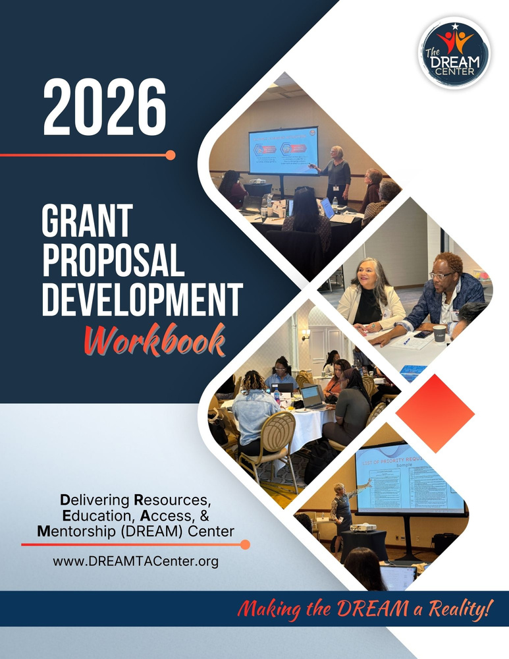
GRANT PROPOSAL DEVELOPMENT WORKSHOPS
During our trainings we:
  Break down the Notice Inviting Applications (NIA) so participants understand priorities, requirements, and scoring criteria
  Guide participants through each major proposal section (Significance, Project Design, Evaluation, Budget, etc.)
  Translate requirements into actionable writing strategies using plain language and real examples
  Provide structured work sessions where participants draft and refine proposal language in real time
  Share tools, templates, and checklists participants can reuse beyond the training

Slide 9

2025 GRANT PROPOSAL DEVELOPMENT WORKSHOPS
Number of
GPD Workshops
Number of
Universities
Total Number
of Participants
4
59
81

Slide 10
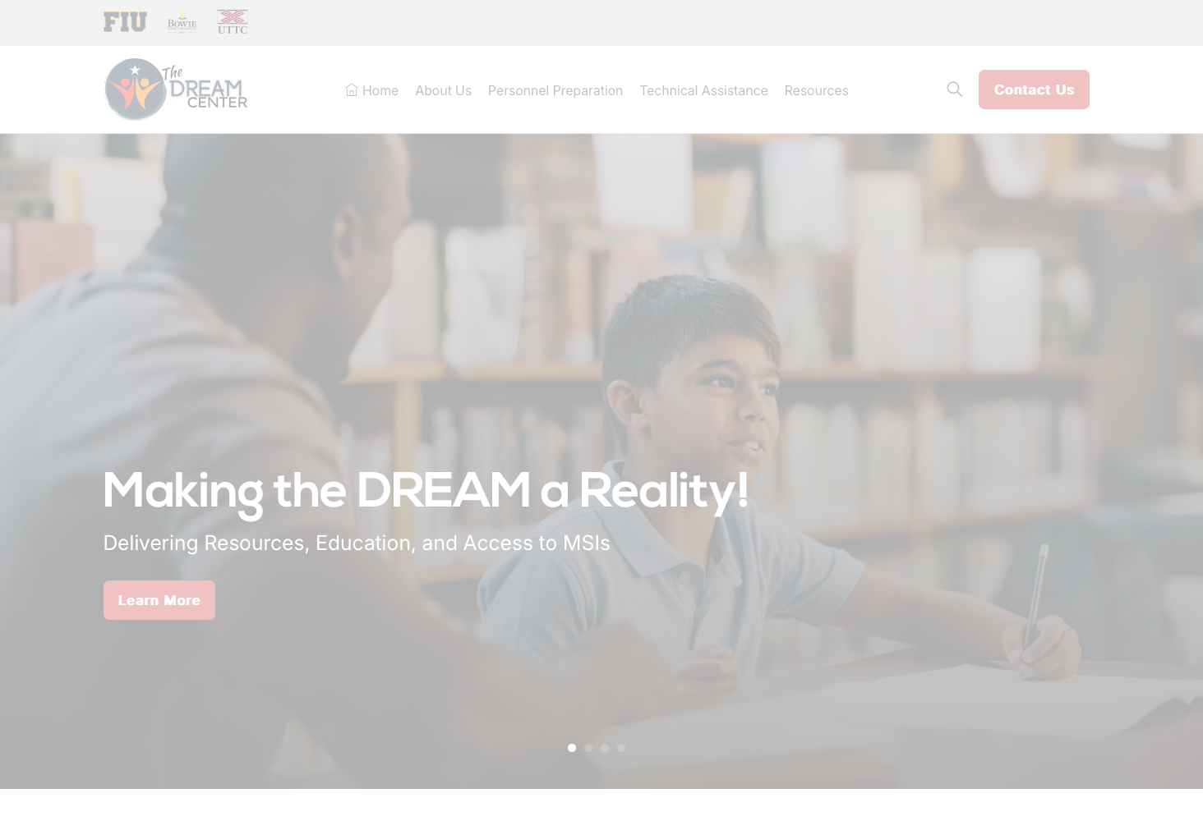





DREAM CENTER
UNIVERSAL RESOURCES
Notes:
“Before we dive into APR specifics, we want to highlight the DREAM Center’s universal resources for grant management. These tools are designed to support grantees across the full lifecycle of their OSEP awards—from planning and implementation to reporting and compliance.”

Slide 11
DREAM CENTER
UNIVERSAL TA
  DREAM Website: www.DREAMTACenter.org
  Website Resource Hub
  DREAM Universal Products
  DREAM YouTube Channel
Notes:
“The DREAM Center provides universal technical assistance that is available to everyone. Through our website, resource hub, universal products, and YouTube channel, we offer on-demand support to help grantees navigate grant management requirements with confidence.”

Slide 12


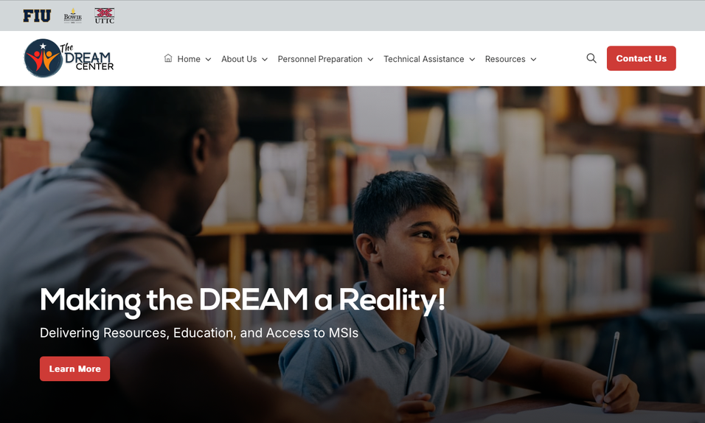

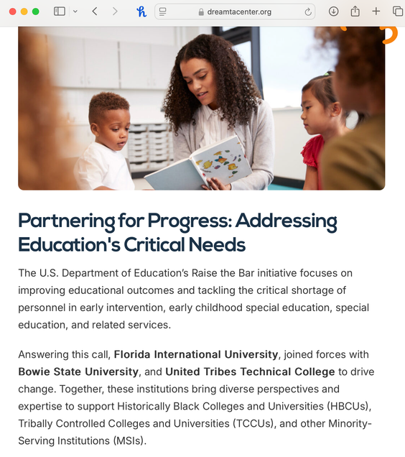

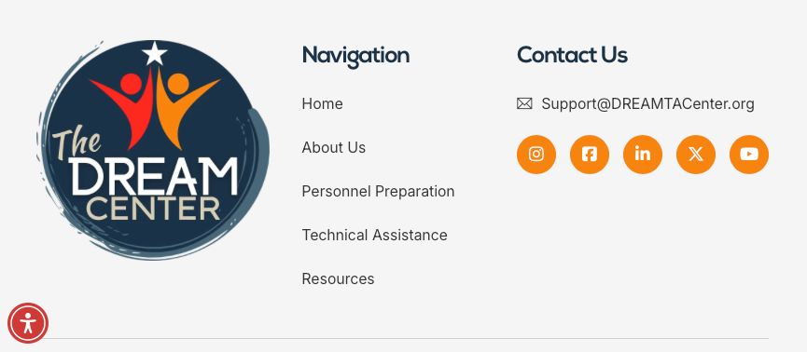
Delivering Resources, Education, Access, & Mentorship
DREAM WEBSITE
www.dreamtacenter.org
Notes:
“Our website serves as the central hub for all DREAM Center resources. It reflects our mission of delivering resources, education, access, and mentorship to IHEs and their partners.”

Slide 13
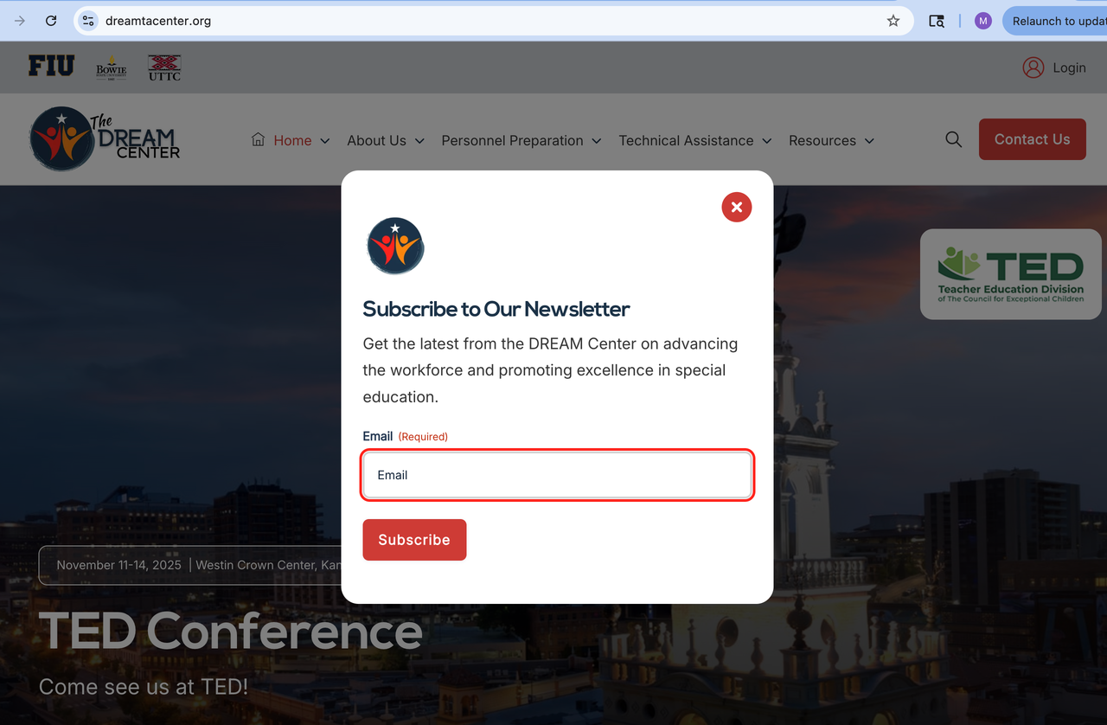
SUBSCRIBE TO NEWSLETTER
DREAM WEBSITE
All visitors to the website are first prompted to subscribe to our newsletter (OPTIONAL).
www.dreamtacenter.org
Notes:
“When you visit the DREAM Center website, you’ll see an optional prompt to subscribe to our newsletter. This is one of the best ways to stay informed about upcoming trainings, new resources, reporting reminders, and important OSEP-related updates.”

Slide 14
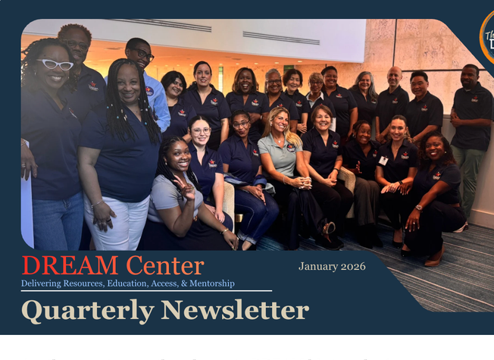
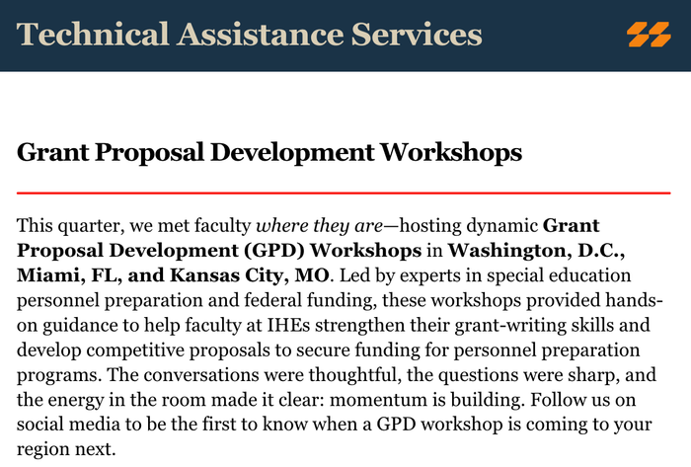
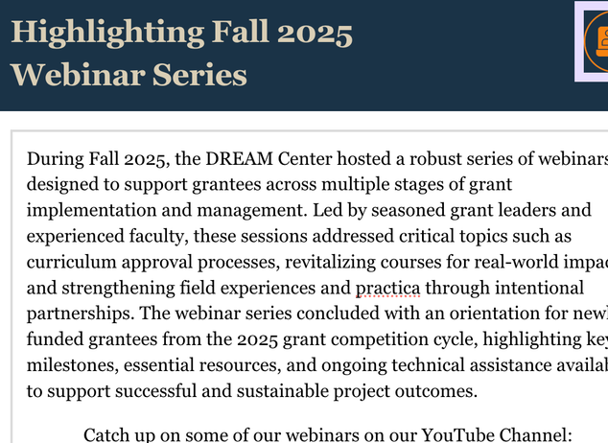
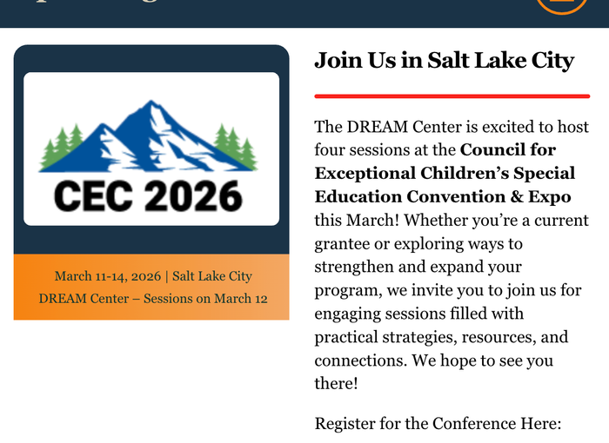
QUARTERLY NEWSLETTER
Stay up-to-date with:
  Upcoming Training events
  New DREAM Resources
  Recently added YouTube Webinars
  And much more!
Notes:
“When you visit the DREAM Center website, you’ll see an optional prompt to subscribe to our newsletter. This is one of the best ways to stay informed about upcoming trainings, new resources, reporting reminders, and important OSEP-related updates.”

Slide 15
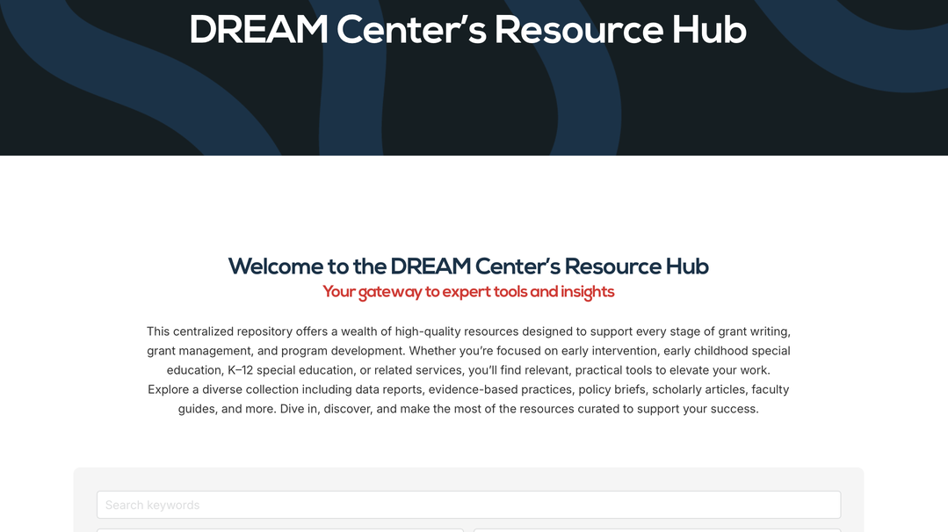
Resource Hub
DREAM WEBSITE
Resource Hub
  160+ resources and growing! Submit your resources to share!
  Resources by Program Focus:
    Early Intervention, Early Childhood Special Education, Special Education, & Related Services
  Resources by Types:
    Data Reports, Publications, Standards, Faculty Guides, Grant Management, Information Briefs, & more
www.dreamtacenter.org
Notes:
“The DREAM Center Resource Hub includes over 160 resources—and it continues to grow. Resources are organized by program focus, such as early intervention, early childhood special education, special education, and related services, as well as by type, including data reports, grant management tools, faculty guides, and information briefs.”

Slide 16

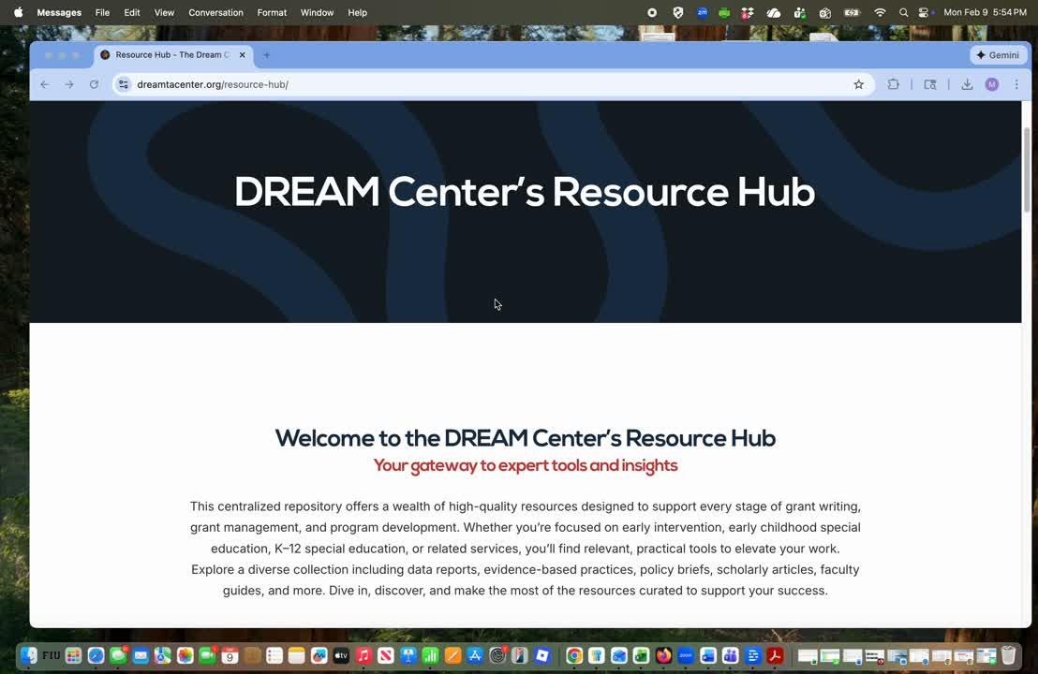
EXPLORE OUR RESOURCE HUB
Notes:
“The DREAM Center Resource Hub includes over 160 resources—and it continues to grow. Resources are organized by program focus, such as early intervention, early childhood special education, special education, and related services, as well as by type, including data reports, grant management tools, faculty guides, and information briefs.”

Slide 17
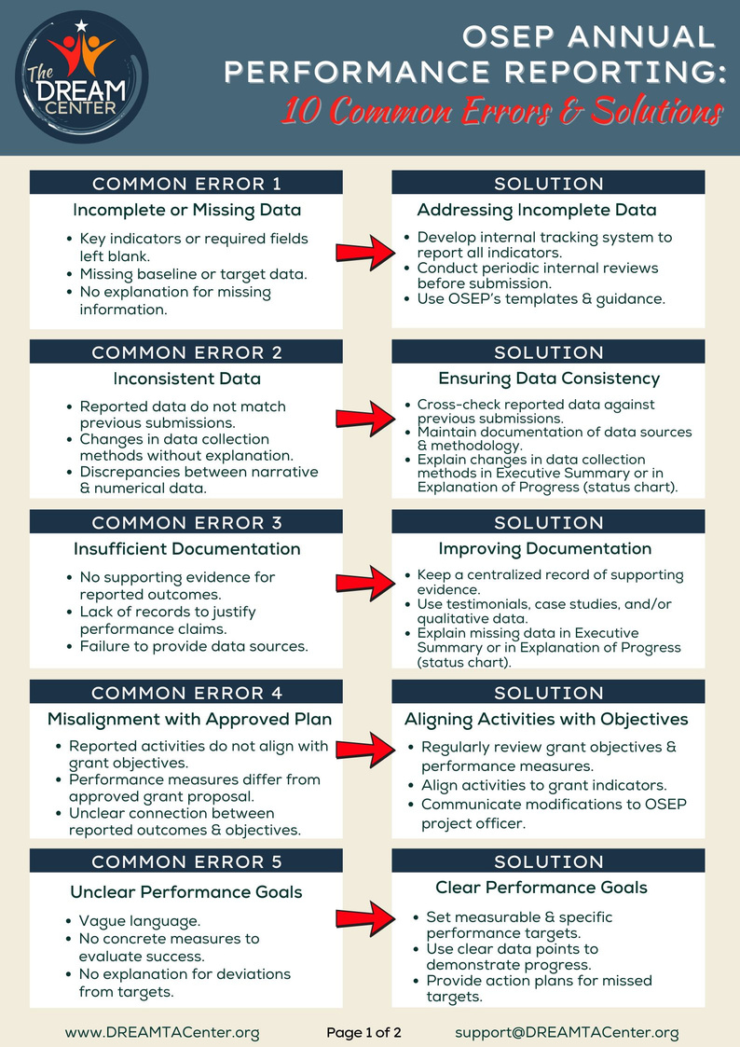
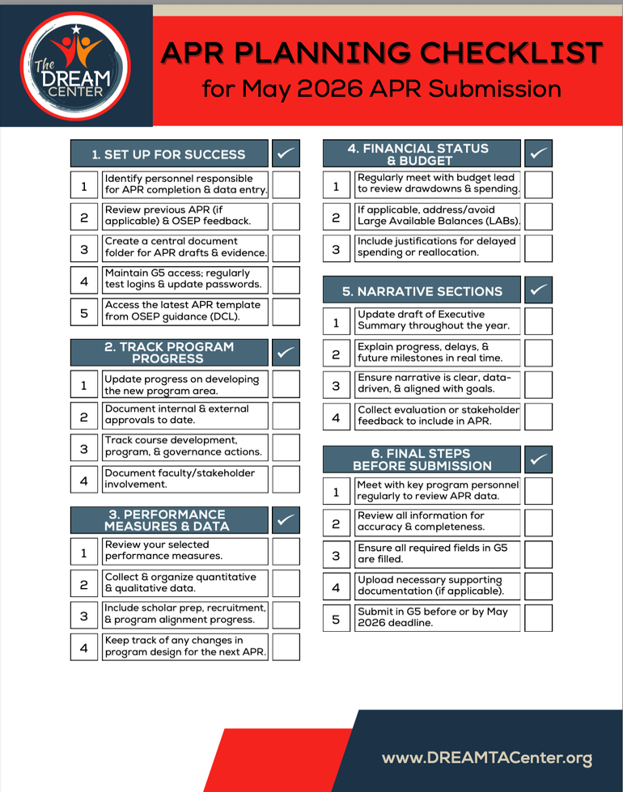
DREAM APR RESOURCES
Notes:
“Here are examples of DREAM Center products designed specifically to support APR planning and reporting. These include our APR Planning Checklist and guidance on common APR errors and solutions, both of which are intended to help grantees submit strong, accurate, and timely reports.”

Slide 18

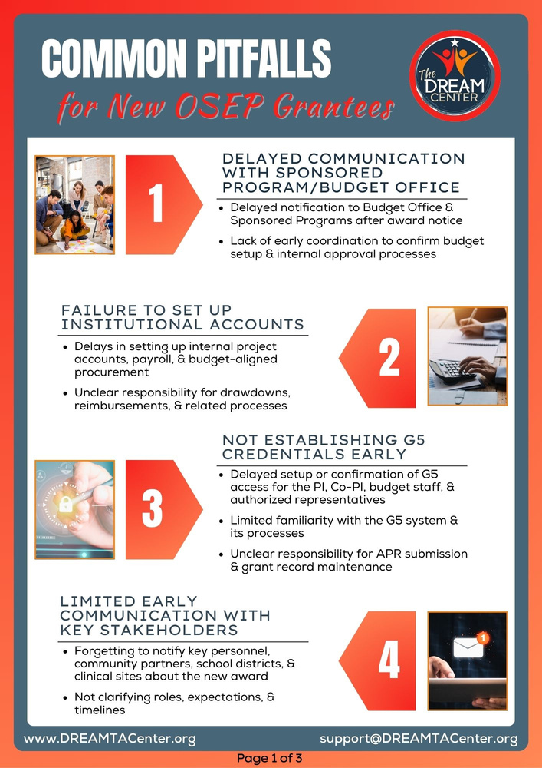
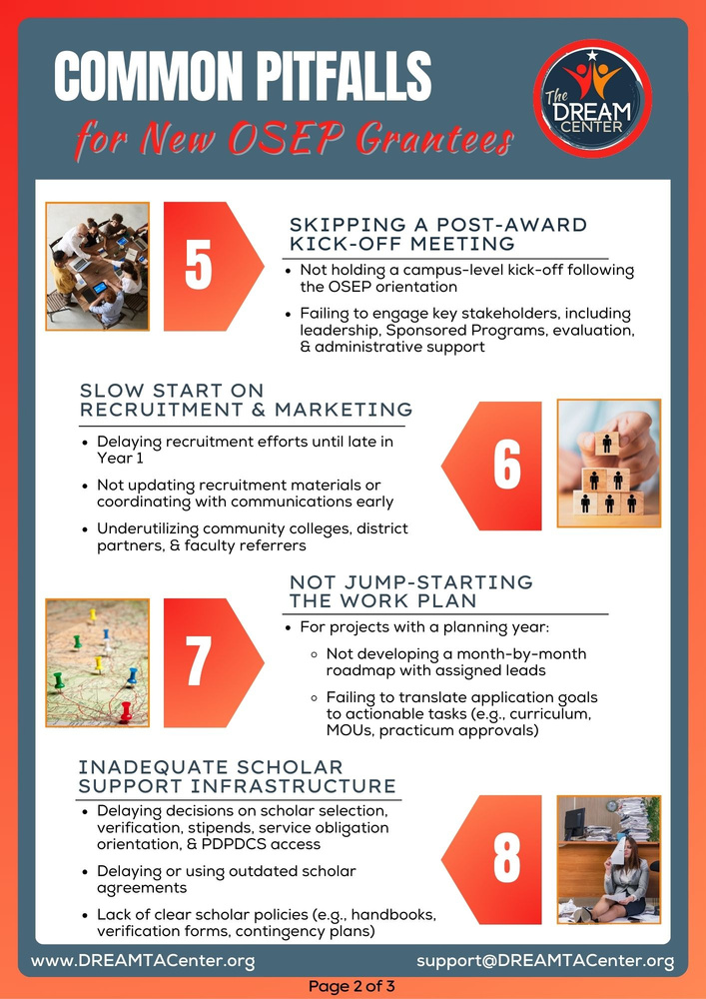
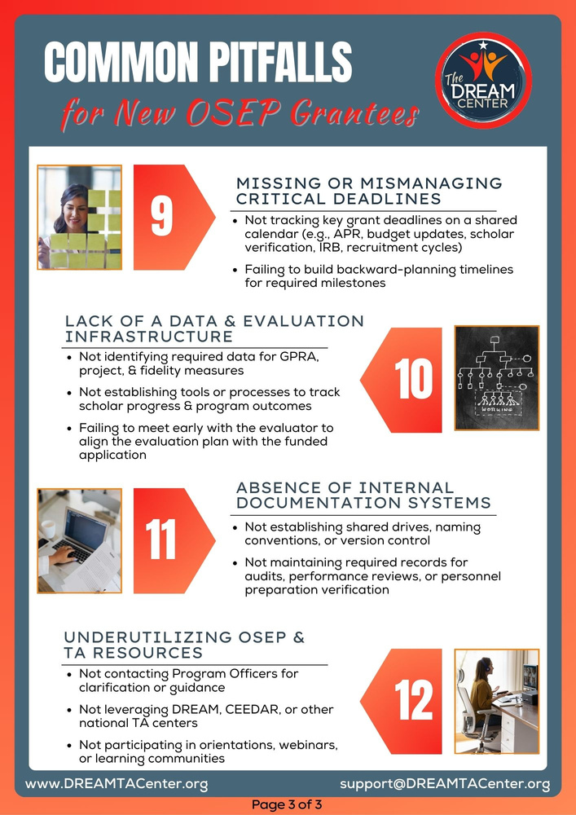
RECENT RELEASE!
Notes:
“Here are examples of DREAM Center products designed specifically to support APR planning and reporting. These include our APR Planning Checklist and guidance on common APR errors and solutions, both of which are intended to help grantees submit strong, accurate, and timely reports.”

Slide 19
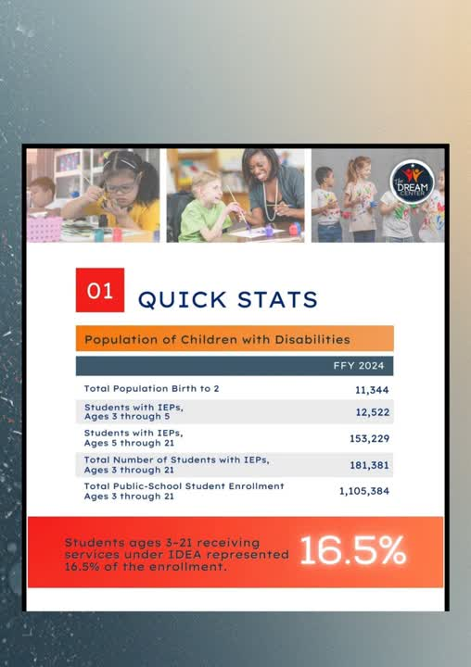
STATE DATA REPORTS
Most Current Part B & Part C Data:
  Enrollment by race/ethnicity, eligibility category, gender, & ELL status
  Discipline Reports
  Preschool Outcomes
  Graduation & Post-School Outcomes
  Early Intervention
  Educational Environments
  Personnel Data
  Qualification Status & Shortages
Notes:
“Here are examples of DREAM Center products designed specifically to support APR planning and reporting. These include our APR Planning Checklist and guidance on common APR errors and solutions, both of which are intended to help grantees submit strong, accurate, and timely reports.”

Slide 20
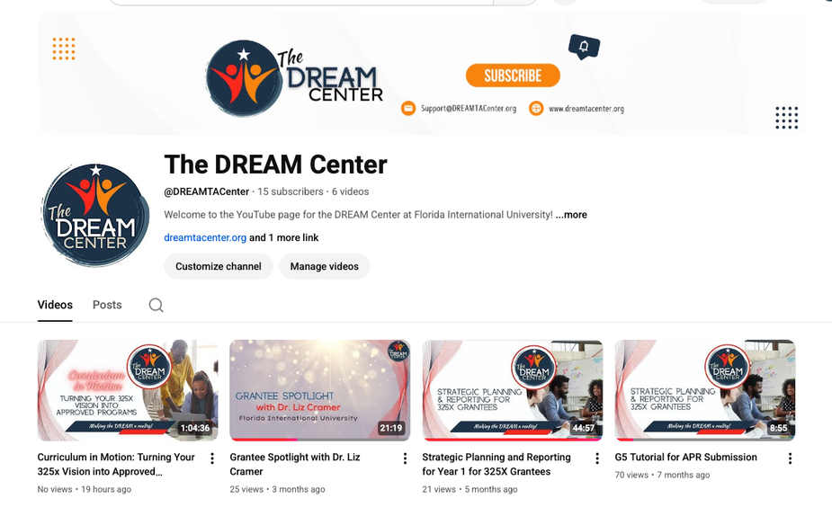


YouTube Channel
DREAM CENTER
YouTube Channel
@DREAMTACenter
Notes:
“Our YouTube channel is another key universal resource. It houses recorded trainings, walkthroughs, and short videos that grantees can access anytime to reinforce learning and support grant management tasks.”

Slide 21



Recorded Webinars
REVITALIZING COURSES FOR REAL-WORLD IMPACT
APR WEBINAR
RECORDED WEBINARS
Key components & requirements are shared to support strong, error-free APR submissions.
Strategies are shared for strengthening course design and increasing real-world relevance.
@DREAMTACenter
Notes:
“These recorded webinars walk viewers step-by-step through submitting the APR in the G5 system and highlight key APR components and requirements. They’re especially helpful if you’re new to reporting or want a refresher before submission.”

Slide 22

DISCUSSION
  What TA resources would be most helpful to IHEs in strengthening their personnel preparation programs?
  Are there additional tools, templates, or guides you would recommend for IHEs to support them in developing, implementing, or managing their programs?
Notes:
“The DREAM Center provides universal technical assistance that is available to everyone. Through our website, resource hub, universal products, and YouTube channel, we offer on-demand support to help grantees navigate grant management requirements with confidence.”

Slide 23









Stay
CONNECTED!
Follow Us @DREAMTACenter
support@dreamtacenter.org
www.DREAMTACenter.org
Notes:
“We encourage you to stay connected with the DREAM Center by following us on social media, subscribing to our YouTube channel, and reaching out with questions. Our goal is to make grant management clearer, more manageable, and more sustainable for your team.”

Slide 24



OUR CONTACT
support@dreamtacenter.org
www.DREAMTACenter.org

