Slide 1
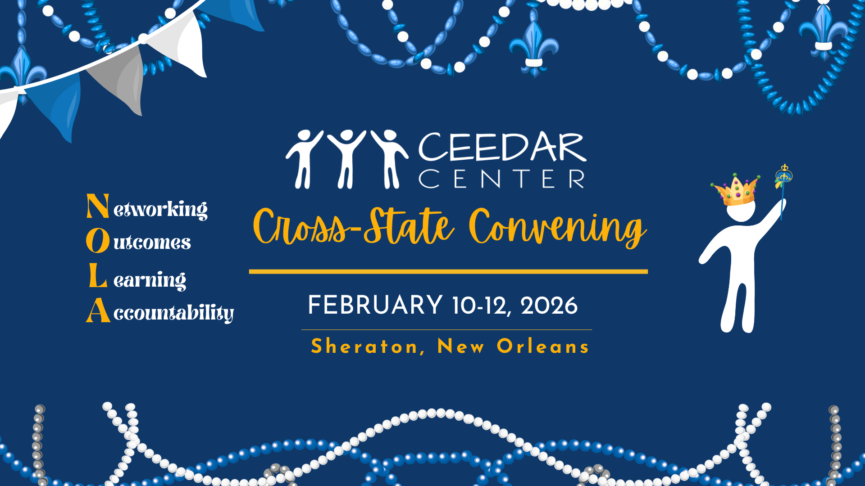
CCSC title

Slide 2


LEt the good outcomes Roll: scaling effective principal Leadership
Wendy Barnes, Colorado State University
Jerry Goings, Regis University
Sarah Griffin, Vermont State University
Erica McLaughlin, Vermont Principals’ Association
Cross-State Convening

Slide 3

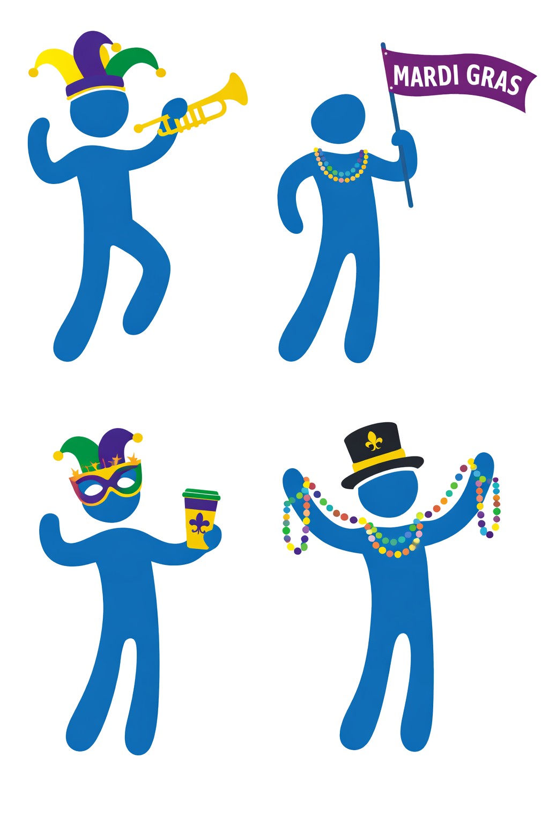
Whole Group Connections
Cross-State Convening
Visual Explore: What image exemplifies what an inclusive learning environment looks like to you?

Slide 4
Session Outcomes
Cross-State Convening
Cross-State Convening
Participants will learn:
Deeper understanding of effective strategies for scaling effective principal leadership preparation, professional learning, and policy efforts.
Ideas for ways to strengthen cross‑agency collaboration, preservice‑to‑inservice partnerships, and system‑level alignment for effective principal leadership in your state.

Slide 5




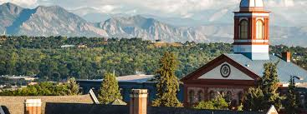

COLORADO’S
Cross-State Convening
STATEWIDE
EFFECTIVE PRINCIPAL LEADERSHIP
LEARNING COMMUNITY

Slide 6
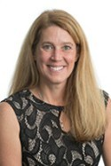
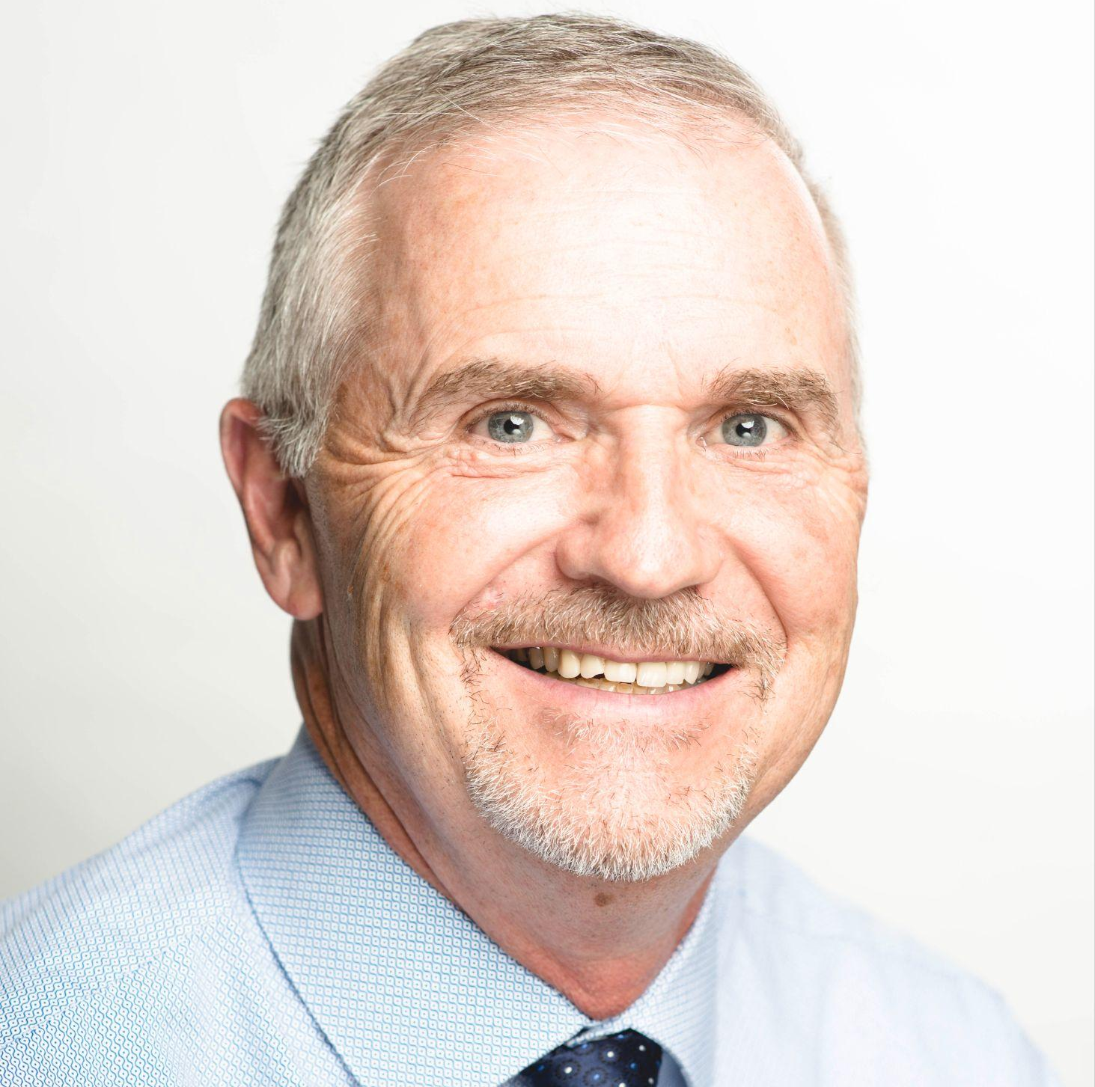
Who We Are
Cross-State Convening
Wendy Barnes
Colorado State University, Associate Professor, School Leadership and Center for Educator Preparation
Jerry Goings
Regis University, Program Director, Educational Leadership

Slide 7
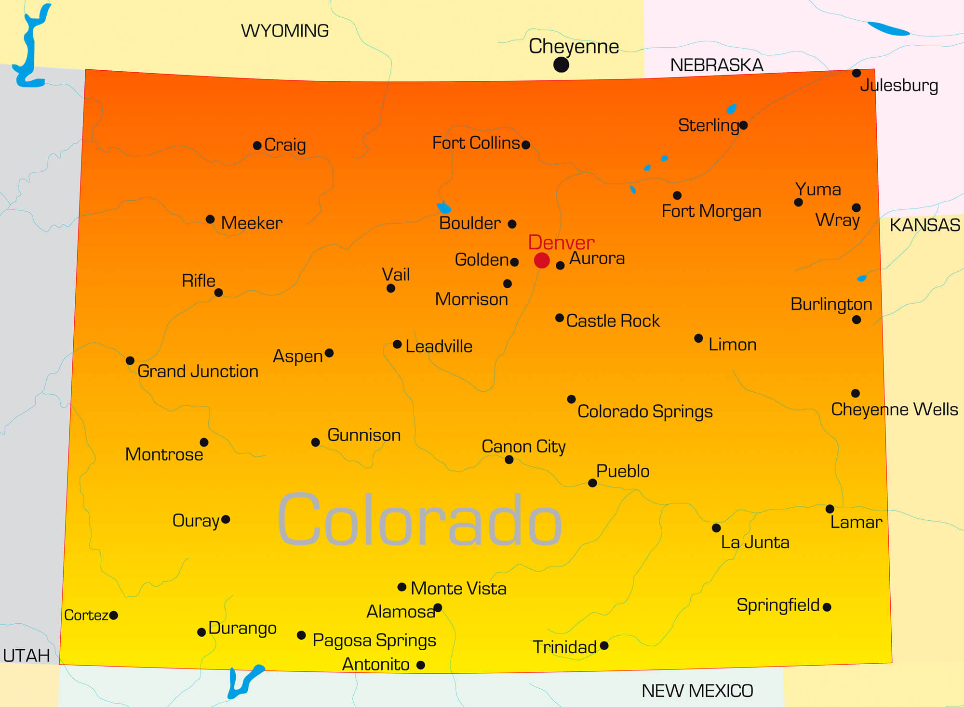
Participants
Cross-State Convening
Colorado State University, Fort Collins/North Central
Fort Lewis College, Online
Regis University, Denver Metro-Online
University of Colorado-Colorado Springs, Southeast, Southwest, & Online
University of Colorado-Denver Metro & Online
University of Northern Colorado, Greeley, Northern Colorado, & Online
University of Denver, Denver Metro & Online
Western Colorado University, Online

Slide 8
Our Community and Journey
Cross-State Convening
What We Are | Professional Learning Community: Exploring Educational Leadership Preparation
Who | Faculty or Administrative Representatives from Most Colorado Principal Preparation Programs
What We Do | Discussions about effective leadership practices Discussions about state-level policy and implications for preparation programs Networking Resource sharing
When | Quarterly via Zoom 2021-22 School Year- Innovation Configuration 2022-23 School Year – innovation Configuration Monthly via Zoom 2023-24 School Year- Finish Innovation Configuration and Read Act/Educator Effectiveness 2024-25 School Year- Read Act/Educator Effectiveness Integration and Transition 2025-26 School Year- Internship and Practices

Slide 9

Innovation Configuration Work
Cross-State Convening
Discovery of…
  Problem based learning scenarios needed diverse components
  Internship needed required targeted activities
Which led to….
  Documentation of the work we are already doing
  Alignment of syllabi
  Stronger presence of effective practices across all courses
  Ongoing discussions with our faculty and our collaborative leadership group about regional needs for building leaders
  More intentional practicum opportunities

Slide 10

Innovation Configuration Work (cont.)
Cross-State Convening
Discovery of…
  Courses are indirectly aligned to effective leadership practices. We have gaps in the assessment and accountability–direct alignment.
  Overall we are aligned to Effective Leadership Practices Standards. There are gaps in the level of implementation: Need more Level 2-Observation, Projects/Activities and Level 3-Internship Requirements.
Which led to….
  Major Course/Syllabi Revisions: To include a focus on leading systems for effectively meeting the need for special populations.
  Revision of internship activities with specific requirements to observe, participate, and reflect in leadership for special populations (e.g. attending IEP, manifestation, or parent meetings; observing co-taught classes; attending Student Support Meetings)

Slide 11
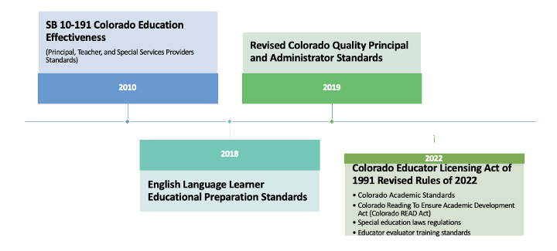
Colorado State Policy Affecting Principal Preparation Programs Alignment Work
Cross-State Convening
2023-Present: Collaboration on implementing new standards for the principal license. We now are focused on how we use our internship to better align to all of the standards.

Slide 12
Vermont
Cross-State Convening

Slide 13
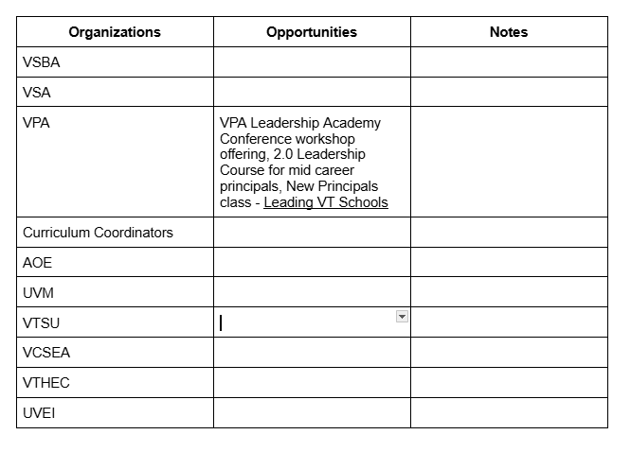
Vermont Story
Cross-State Convening
Goal: Build the capacity of Vermont principal preparation programs and in-service to embed inclusive leadership practices into preparation coursework and field experiences.
→ Strengthen school and district leader’s understanding of high-leverage practices that improve outcomes for students with disabilities, and clarify leadership responsibilities for creating the conditions necessary for implementation
→ Reinforce inclusive education as a shared, whole-system responsibility across general and special education

Slide 14



Breakout Discussion
Cross-State Convening
Give an Idea/Take an Idea
  Round 1: Cross‑Agency Collaboration: What are your successes and challenges? What do you wish was happening?
  Round 2: Preservice‑to‑Inservice Partnerships: What are your successes and challenges? What do you wish was happening?
  Round 3: State-Level Systems and Initiatives Alignment: What are your successes and challenges? What do you wish was happening?

Slide 15
Whole Group Debrief & Closing Connections
Cross-State Convening
Effective principal leadership scales through aligned systems, not isolated programs
Cross-agency collaboration depends on clear roles, shared priorities, and sustained relationships
Alignment between preparation, professional learning, and policy is essential for impact
Complete your State Padlet

Slide 16


THANK YOU!
Cross-State Convening

Slide 17

Disclaimer
This content was produced under U.S. Department of Education, Office of Special Education Programs, Award No. H325A220002. David Guardino serves as the project officer. The views expressed herein do not necessarily represent the positions or policies of the U.S. Department of Education. No official endorsement by the U.S. Department of Education of any product, commodity, service, or enterprise mentioned in this website is intended or should be inferred.
Cross-State Convening

