Slide 1


Let the good times roll
Cross-State Convening
Let the Good Times Roll!
Celebrating Dual Certification
Progress in CA and ME

Slide 2



Overview
Cross-State Convening
What we'll cover in this session:
  ME: Understand what pieces are involved in starting up a new dual certification pathway/program
  CA: Learn about the strengths, challenges, and implications with dual certification pathways

Slide 3
Agree or Disagree?
Faculty are supportive of Dual Certification only pathways.
Take 2 minutes to partner with the people around you and come to consensus. Be prepared to share out!
Cross-State Convening
Notes:
Lead: Dee
Activity description: 1-2 provocative statements that you hope 50/50 agree/disagree
Partner with people around you and come to consensus

Slide 4




Dual certification pilot in Maine
Cross-State Convening
Dual Certification Pilot in Maine
Presenters
Sarah Howorth, Dee Nichols, and Kimm Kenniston

Slide 5
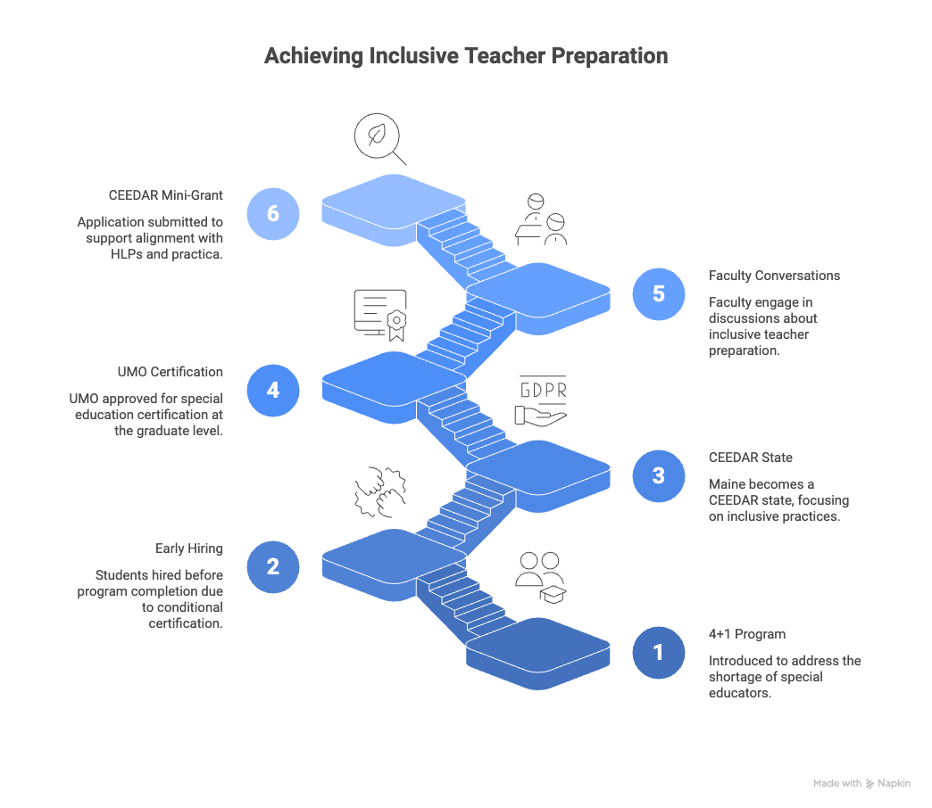

Achieving inclusive teacher preparation
Cross-State Convening
Notes:
Sarah

Slide 6


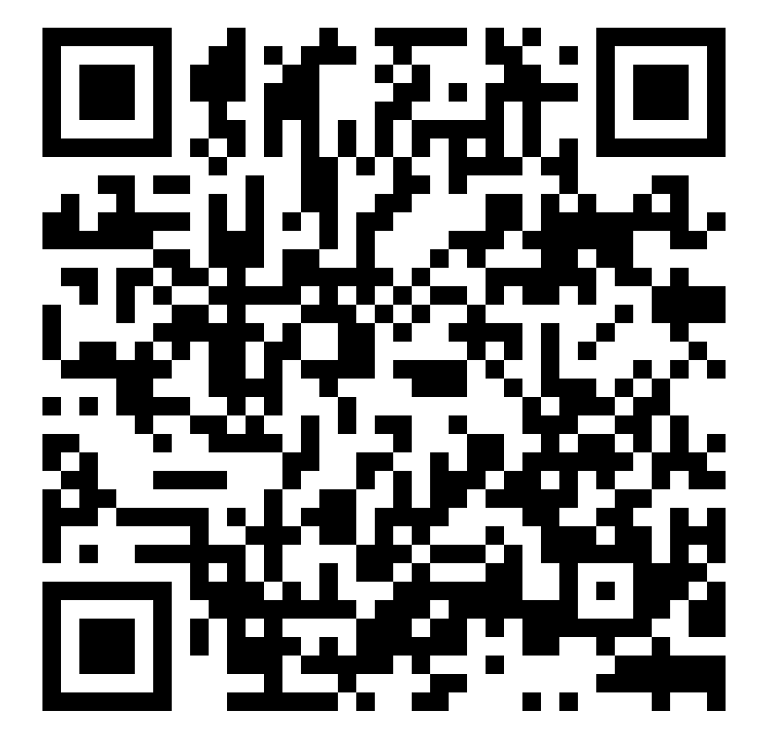
CEEDAR Mini GRANT
HLP/ COEHD Inclusive Teacher Prep Syllabus Crosswalk
Cross-State Convening
Notes:
Sarah

Slide 7
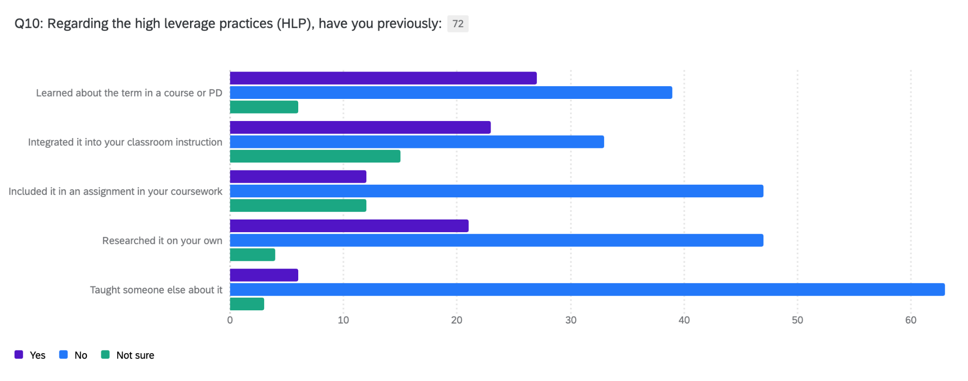
Baseline Survey Data re: High Leverage Practices
Cross-State Convening
Notes:
Sarah

Slide 8

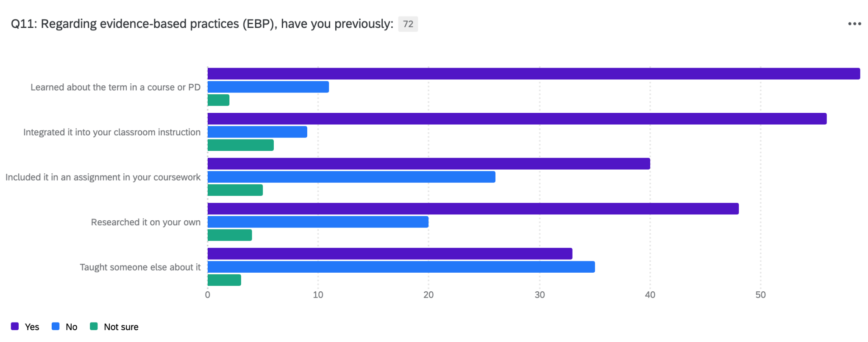
Baseline Survey Data re: Evidence-Based Practices
Notes:
Sarah

Slide 9




Benefits and Challenges
Benefits
Challenges
Increased Teacher Retention
Stronger Inclusive Practices
Workforce Pipeline Expansion
Reduced Segregation of Students with Disabilities
Program Faculty push back
Faculty and Curriculum Integration
Communicating that this is not “just a special ed” thing
Finding high quality inclusive practicum & student teaching placement
Systemic Barriers
Cross-State Convening
Notes:
DEE & KIM

Slide 10
Dual credential pathways in CA
Cross-State Convening
Dual Credential Pathways in California
Presenters
Audri Gomez
William Hatrick

Slide 11
Dual Credential Pathways in California
California lags behind national averages in inclusive placement of students with disabilities (59% vs. 67%).
PK–12 and higher education systems operate in silos; stronger alignment is needed to prepare educators for inclusive schools.
Dual credential programs (general + special education) offer a pathway to build an inclusive teacher workforce, but vary widely in design and quality.
Effective programs require deep collaboration between general and special education faculty, unified coursework, and shared field experiences.
Cross-State Convening

Slide 12

Policy Pathways for a Stronger Teacher Pipeline
Cross-State Convening
Cross-State Convening
Assembly Bill 1110 calls for an analysis of how dual credentialing programs can be strengthened to better support the state’s goal of increasing the inclusion of students with disabilities in general education settings.
Assembly Bill 1119 (Patel), a 2025‑2026 legislative proposal titled “Teacher Credentialing: Dual Credentialing: Workgroup”, aims to increase inclusion by expanding pathways for teachers to become dually credentialed
Common Trunk approach to teacher credentialing. Adopted in 2017 by the California Commission on Teacher Credentialing (CTC), the Common Trunk establishes a unified set of Teaching Performance Expectations (TPEs) that apply across Multiple Subject, Single Subject, and Education Specialist credential pathways.

Slide 13
A Review of California’s Dual Credential Programs
Analysis indicated that 21 of the 80 educator preparation programs reviewed (26%) were identified as dual credential programs.
California State University
Association of Independent California Colleges and Universities
University of California
8 Dual Credential Programs out of 23 Total Educator Preparation Programs Examined
13 Dual Credential Programs out of 48 Total Educator Preparation Programs Examined
0 Dual Credential Programs out of 9 Total Educator Preparation Programs Examined
Cross-State Convening

Slide 14
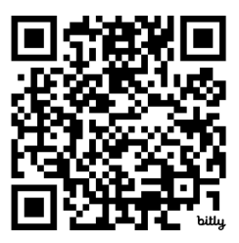
Benefits & Challenges
Benefits
Challenges
Increased Teacher Versatility
Stronger Inclusive Practices
Workforce Pipeline Expansion
Reduced Segregation of Students with Disabilities
Program Intensity and Duration
Faculty and Curriculum Integration
Maintaining Depth and Quality
Systemic Barriers
Cross-State Convening

Slide 15

Institutional Leadership Perspectives on Dual Credentialing
Cross-State Convening
  Dual Credentials as a Strategy for Inclusive Education
  Two Years, Too Much: Time-to-Degree, Cost, and Candidate Burden
  Complex and Challenging Clinical Practice and Placement
  Residency Programs: Opportunity and Complication
  Utilizing Existing Infrastructure Rather Than Building New Programs
  Enrollment Viability and Institutional Context Matter
  Employment Outcomes: Strong Demand, Mixed Implications
  Need for Policy Alignment and Incentives

Slide 16

Breakout discussions
Breakout Discussions
Cross-State Convening
ME Essential Question: What are methods to show gen ed and special ed faculty that they are working for a common goal?
CA Essential Question: What are the conditions needed to sustain high-quality dual credential programs?

Slide 17

Disclaimer
This content was produced under U.S. Department of Education, Office of Special Education Programs, Award No. H325A220002. David Guardino serves as the project officer. The views expressed herein do not necessarily represent the positions or policies of the U.S. Department of Education. No official endorsement by the U.S. Department of Education of any product, commodity, service, or enterprise mentioned in this website is intended or should be inferred.
Cross-State Convening

