Slide 1

Unlocking CASE: Resources to Support You and Your Work
Notes:
CASE exists to ensure that every student has equitable opportunities, and we support the leaders who make that possible.

Slide 2
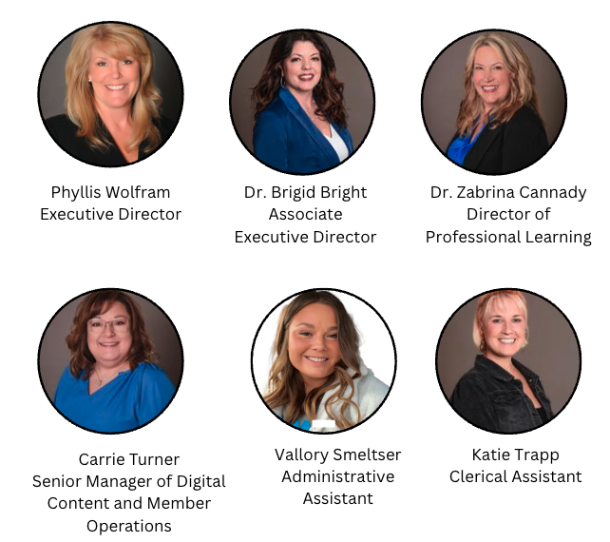
Greetings from the National CASE Office

Slide 3
CASE Mission
MISSION
CASE provides leadership to advance the field of special education through professional learning, policy, and advocacy.
CORE VALUES
Visionary Leadership – Inclusionary Practices – Engagement - Integrity
www.casecec.org
Notes:
CASE exists to ensure that every student has equitable opportunities, and we support the leaders who make that possible.

Slide 4
Membership – Organizational Structure
Council for Exceptional Children (CEC)
Council of Administrators of Special Education (CASE)
A Division of CEC
43 Active State Units and 2 Provinces
A Subdivision of CASE
(state and provincial units)
*6,000 current CASE Members
*13,000+ School Districts

Slide 5
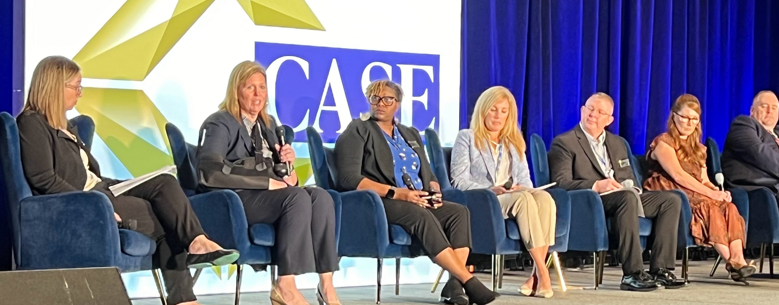
CASE Current Focus…Let’s Take a Look
Leadership Development – Building the capacity of current and future special education leaders through institutes, training, and professional learning.
Policy & Advocacy – Serving as the national voice for special education administrators in Washington, D.C. and at state levels, influencing IDEA, Section 504, funding, and policy.
Member Support & Resources – Providing practical tools, guidance, and real-time updates to help leaders improve systems and outcomes.
Collaboration & Partnerships – Strengthening connections with educators, organizations, and sponsors to expand CASE’s impact.

Slide 6
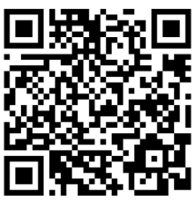
Professional Development Highlights
CASE focuses on offering varied, high-impact professional learning for leaders at all levels.
In-Person Events
2026 CASE Academy of Law and Leadership - Atlanta, GA, April 21-23, 2026
2026 Special Education Legislative Summit (SELS) - July 19-22, 2026
2026 CASE Conference - Providence, RI, November 11-13, 2026
Virtual Events
Legal Suite of Professional Learning
Leadership Suite of Professional Learning
Hybrid Events
CASE Special Education Leadership Institute

Slide 7




FREE Professional Development for Members
Mindful Matters
New Directors’ Network
Book Study: Six Shifts to Improve Special Education
Low Incidence Disabilities Series
60 Minutes with Myrna
Notes:
CASE exists to ensure that every student has equitable opportunities, and we support the leaders who make that possible.

Slide 8
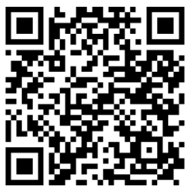
Policy & Advocacy
It’s About A COLLECTIVE VOICE
Advocacy remains a central part of our mission — CASE is the national voice for special education administrators.
Focus: IDEA, Section 504, and policy shifts
“60 Minutes with Myrna” Federal updates from Washington, D.C. (Myrna Mandlawitz)
CASE Collective - FREE Webinar for members
Ongoing collaboration with Congress and federal agencies
Meetings with OSEP and OCR
Committee Work
  Policy Statements: https://www.casecec.org/policy-statements
Coalition - IDEA Implementation Coalition
  21 national organizations have joined us

Slide 9

Case action center
CASE Action Center
Your Voice Matters!
Access to the CASE Action Center puts advocacy at your fingertips!
Notes:
CASE exists to ensure that every student has equitable opportunities, and we support the leaders who make that possible.

Slide 10

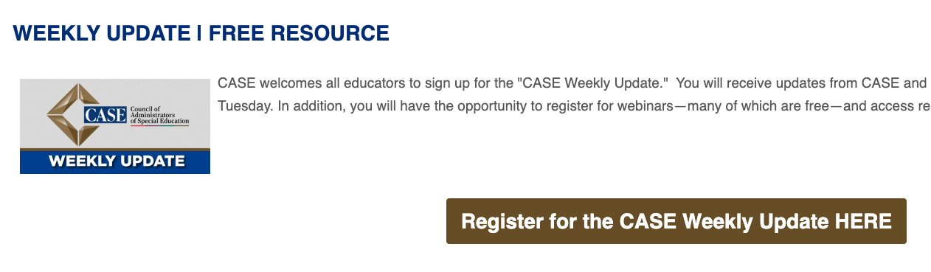
Stay Up to Date with CASE
Member
Update
Notes:
Ask everyone who is a case member to stand up; then ask everyone who is a mo-case member to stand!
CASE members gain both knowledge and a supportive professional network.

Slide 11

Access to the Journal of Special Education Leadership
Notes:
CASE exists to ensure that every student has equitable opportunities, and we support the leaders who make that possible.

Slide 12

Endorsed Products
CASE members have access to the endorsed product list, with discounts to some of the resources available.
Notes:
CASE exists to ensure that every student has equitable opportunities, and we support the leaders who make that possible.

Slide 13

Recruitment Tools
Access to the CASE Career Center, which can be used to post open positions or for those seeking a position.
Notes:
CASE exists to ensure that every student has equitable opportunities, and we support the leaders who make that possible.

Slide 14

2026 Academy of Law and Leadership
The 2026 CASE Academy
Legal Conference with partner presentations from district special education leaders and special education attorneys
Atlanta, GA
April 21-23, 2026
Registration is open!

Slide 15

The 2026 CASE Conference
Conference Strands
Advancing Equity: Practices for All Learners
Conflict Resolution: Resolving Challenges
Educational Leadership: Leading with Purpose
Exploring Hot Topics: Trends and Emerging Issues
Forging Partnerships: Collaborative Leadership
Human Resources: Empowering Teams
innovating for Success: Cutting Edge Practices
Instructional Excellence: Achieving Success
Legal Issues: Navigating Special Education
Putting Research Into Practice: Evidence for Impact
Staff Wellness: Fostering Resilience
Student Wellness: Prioritizing Balance for Success
Transition: Supporting Pathways to Independence
Notes:
CASE exists to ensure that every student has equitable opportunities, and we support the leaders who make that possible.

Slide 16

Special Education Leadership Institute (SELI)
Special Education Leadership Institute
CASE is ”Setting the Standard” and is the Collective Voice of Special Education Leaders.
CASE is committed to leadership development to drive our profession forward.
Curriculum based on the CASE/CEC Special Education Administrator Leadership Standards
Micro-credential for special education leadership
Hybrid model with both in-person and virtual professional learning

Slide 17
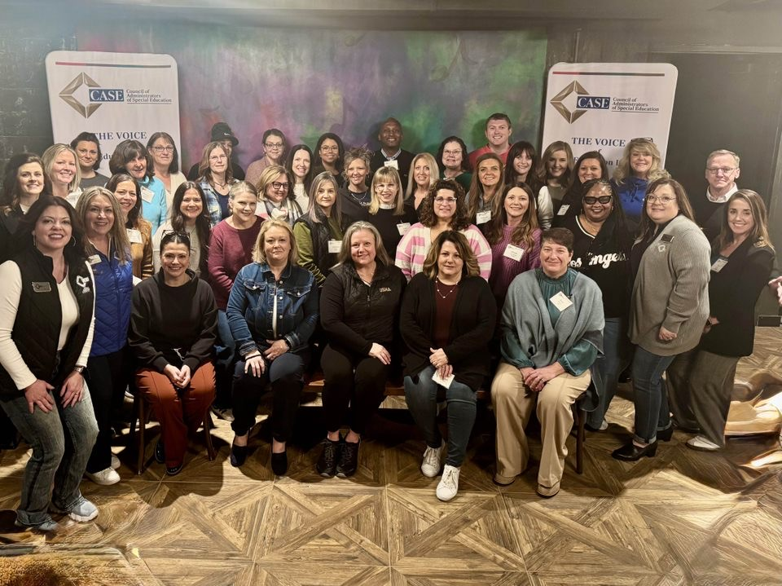
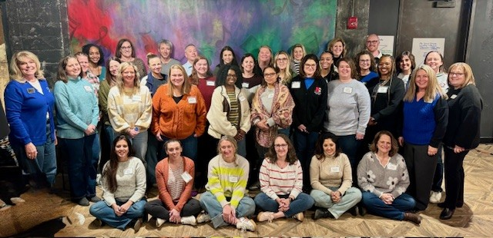
Special Education Leadership Institute (SELI)
CASE recognizes the critical shortage of leaders trained to supervise special education and is committed to developing current and future administrators through the Leadership Institute, strengthening foundations in effective program leadership.
Cohort 1
Cohort 2

Slide 18

Networking and Growing
FREE
Member Benefit

Slide 19

Resources and Swag
Notes:
CASE exists to ensure that every student has equitable opportunities, and we support the leaders who make that possible.

Slide 20

Thank you for all that you do!
Dr. Zabrina Cannady
CASE Director of Professional Learning
zcannady@casecec.org
478.447.4624
STAY AWESOME!

