Slide 1
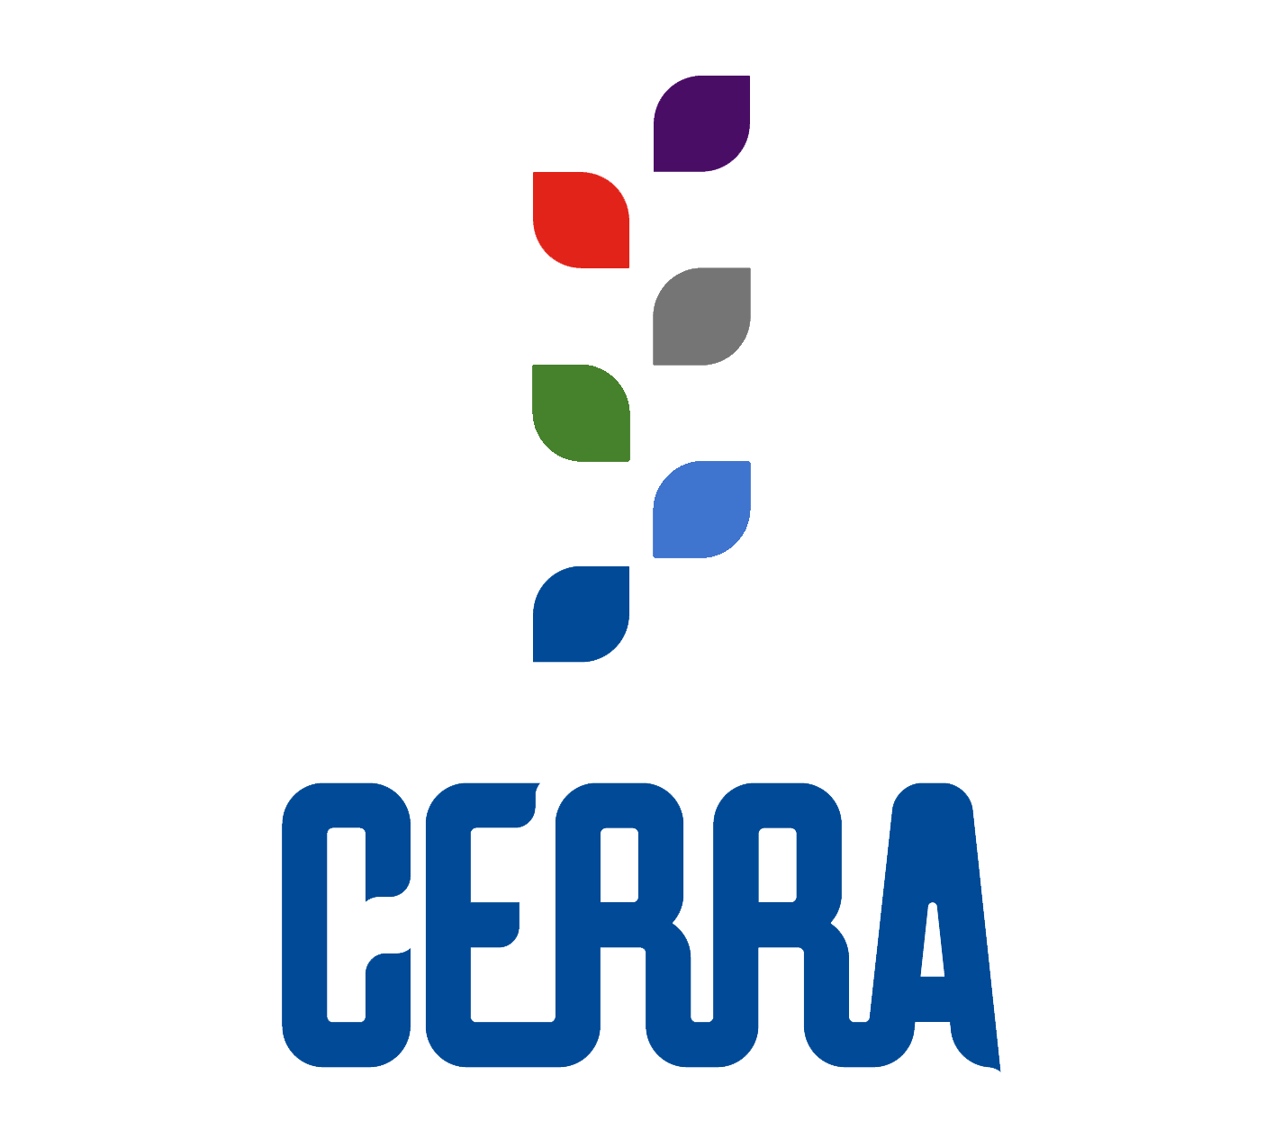
Accountability in Action:
Leveraging Educator Workforce Data to Inform Systemic Change

Slide 2
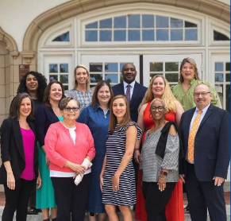


CERRA in South Carolina
Oldest & most established teacher recruitment program in the nation
Funded by the General Assembly
Partners include: the SCDE, K12 school districts, Colleges and Universities in SC.
Three programmatic “arms”
  PreCollegiate
  Collegiate
  Service
Other Services
  NBCT
  Statewide Job Board
  Rural Recruitment Initiative
  Teachers’ Loan Advisory Committee
  Research (Supply & Demand Data)
Notes:
Brief Background on CERRA and how we fit in with the organization of state agencies

Slide 3
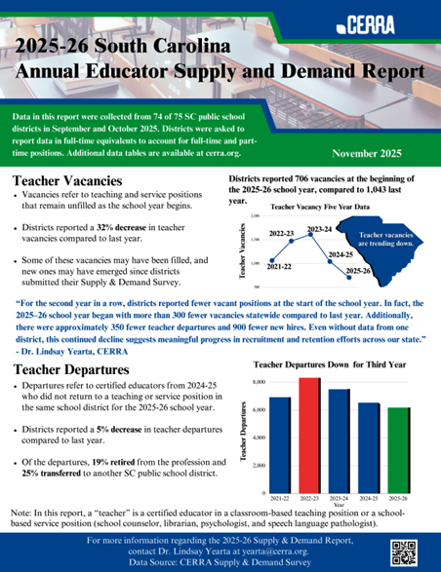
Data Collection: Supply & Demand
Data Collected
Positions
Teaching and service
Departures
By years of experience; retire or transfer to another district
New Hires
Teaching and service; hiring source
Vacancies
Teaching and service
Analyzed
Disseminated
Posted to Website (cerra.org)
Emailed to Stakeholders
Notification via Press Release
Notes:
Data Collection: what is being collected (everything reported in FTEs), how is it being used
Distribute to attendees: S&D Report, Data Tables, Key Data

Slide 4

Data to Make Informed Decisions
Key Data Points
In the 2024-2025 academic year, there were 2,081 teacher candidates who completed a teacher certification program at a South Carolina IHE (27% increase since 2017-2018 year).
This is the second year of declining vacancies.
  2023-2024: 1,612.6
  2024-2025: 1,042.9
  2025-2026: 706.2
Over 25% of this year’s vacancies are in Special Education.
There was a 5% decrease in statewide teacher departures. Of these departures, 19% retired from the profession and 25% transferred to another public school district in South Carolina. Notably, 34% were early career departures with five or fewer years of experience.
Of the 6,462 new hires this year, 1,190 were graduates from South Carolina educator preparation programs, and 711 entered the profession through a South Carolina-approved alternative certification program.
Notes:
If we’re using data as a roadmap for change, what might you notice from these high-level data points? What changes might you make if this were data from your own contexts?

Slide 5

What’s Next?
Possibility for further disaggregation of subject areas
Dashboard for all data statewide (CHE, SCDE,CERRA, EOC)
Deeper dive around context
Streamline data collection process; eliminate the need for self-reported data
Notes:
Thus far we’ve chronicled what’s working well; as you know- there is always room for improvement.

Slide 6
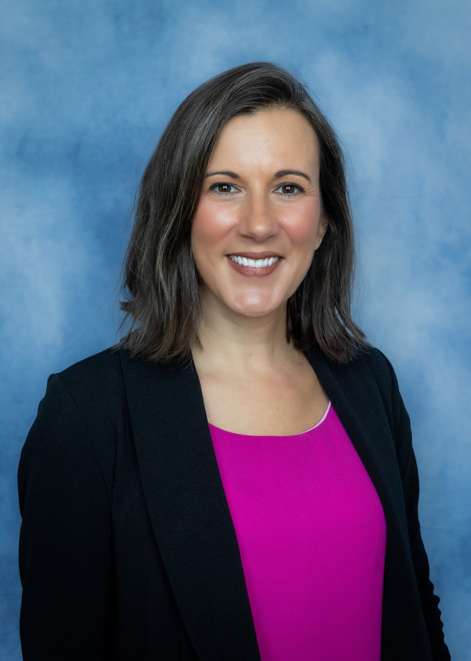


Contact
Dr. Lindsay Yearta
SC-CERRA Executive Director
yearta@cerra.org
803-230-7703

