Slide 1

CCSC title
Notes:
as they come in, have people come to the front and sit at Cross state tables

Slide 2


The Parade of Progress
is paved with good data:
Mapping the Route to Educator Outcomes and Accountability in Special Education
Presented by:
Corey Pierce, Colorado
Tracey Sridharan, Jennifer Gresko & Kim Rice-Gentry, Arizona
Cross-State Convening

Slide 3




Overview
Cross-State Convening
What we'll cover in this session:
This session explores how Colorado and Arizona are using data to improve outcomes for all: teachers, students, and the education community.
In Colorado, the state education agency and EPPs partnered to launch a statewide program completer survey, creating a structured feedback loop to inform policy and practice.
In Arizona, AZed and EPPs are using the AZ data dashboard to create a data summary and examine the impact of multiple pathways to teaching. These efforts highlight how data can drive meaningful efforts in teacher retention.

Slide 4

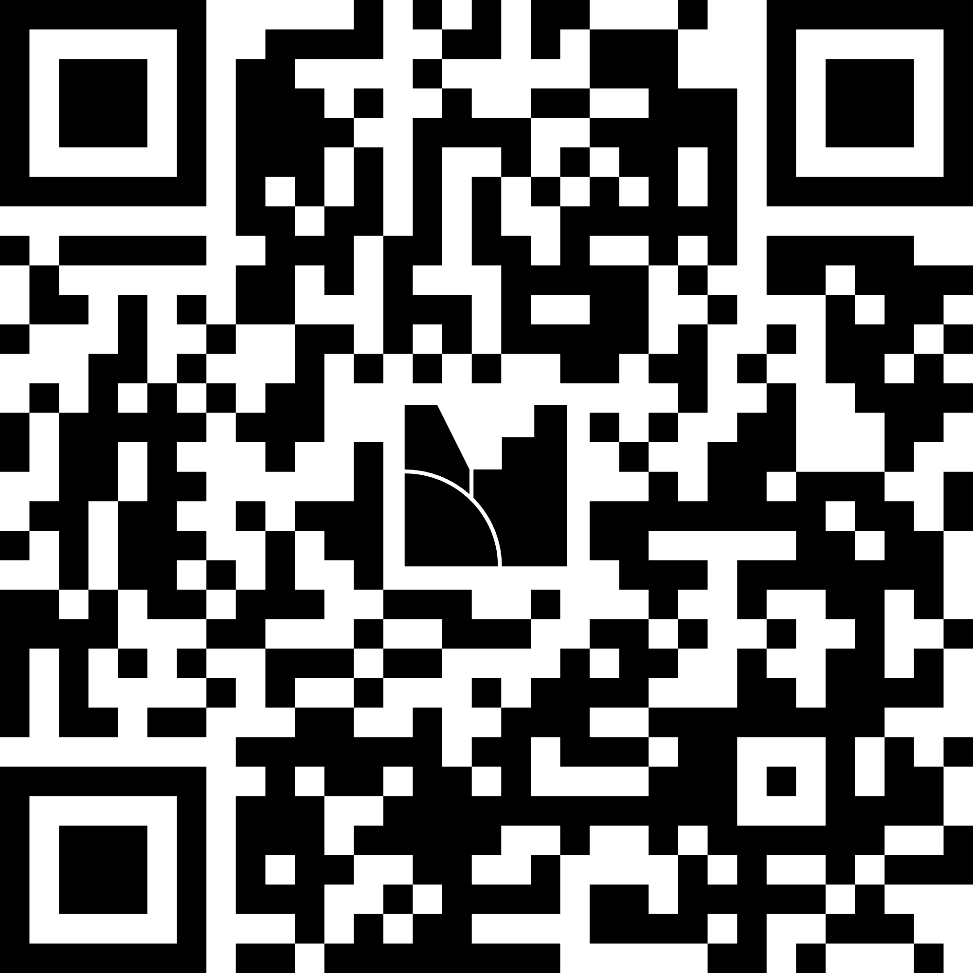

Let’s get some data about
our own accountability and outcomes…
.
Cross-State Convening

Slide 5


Where we’re headed
Where We’re Headed
Cross-State Convening
A model for a feedback loop to impact state reauthorization and program improvement in Colorado.
An awareness of available essential data AZ uses to assist in understanding the shifting local landscape of educator preparation.

Slide 6
Dr. corey pierce university of northern colorado
Cross-State Convening
Dr. Corey Pierce
University of Northern Colorado

Slide 7
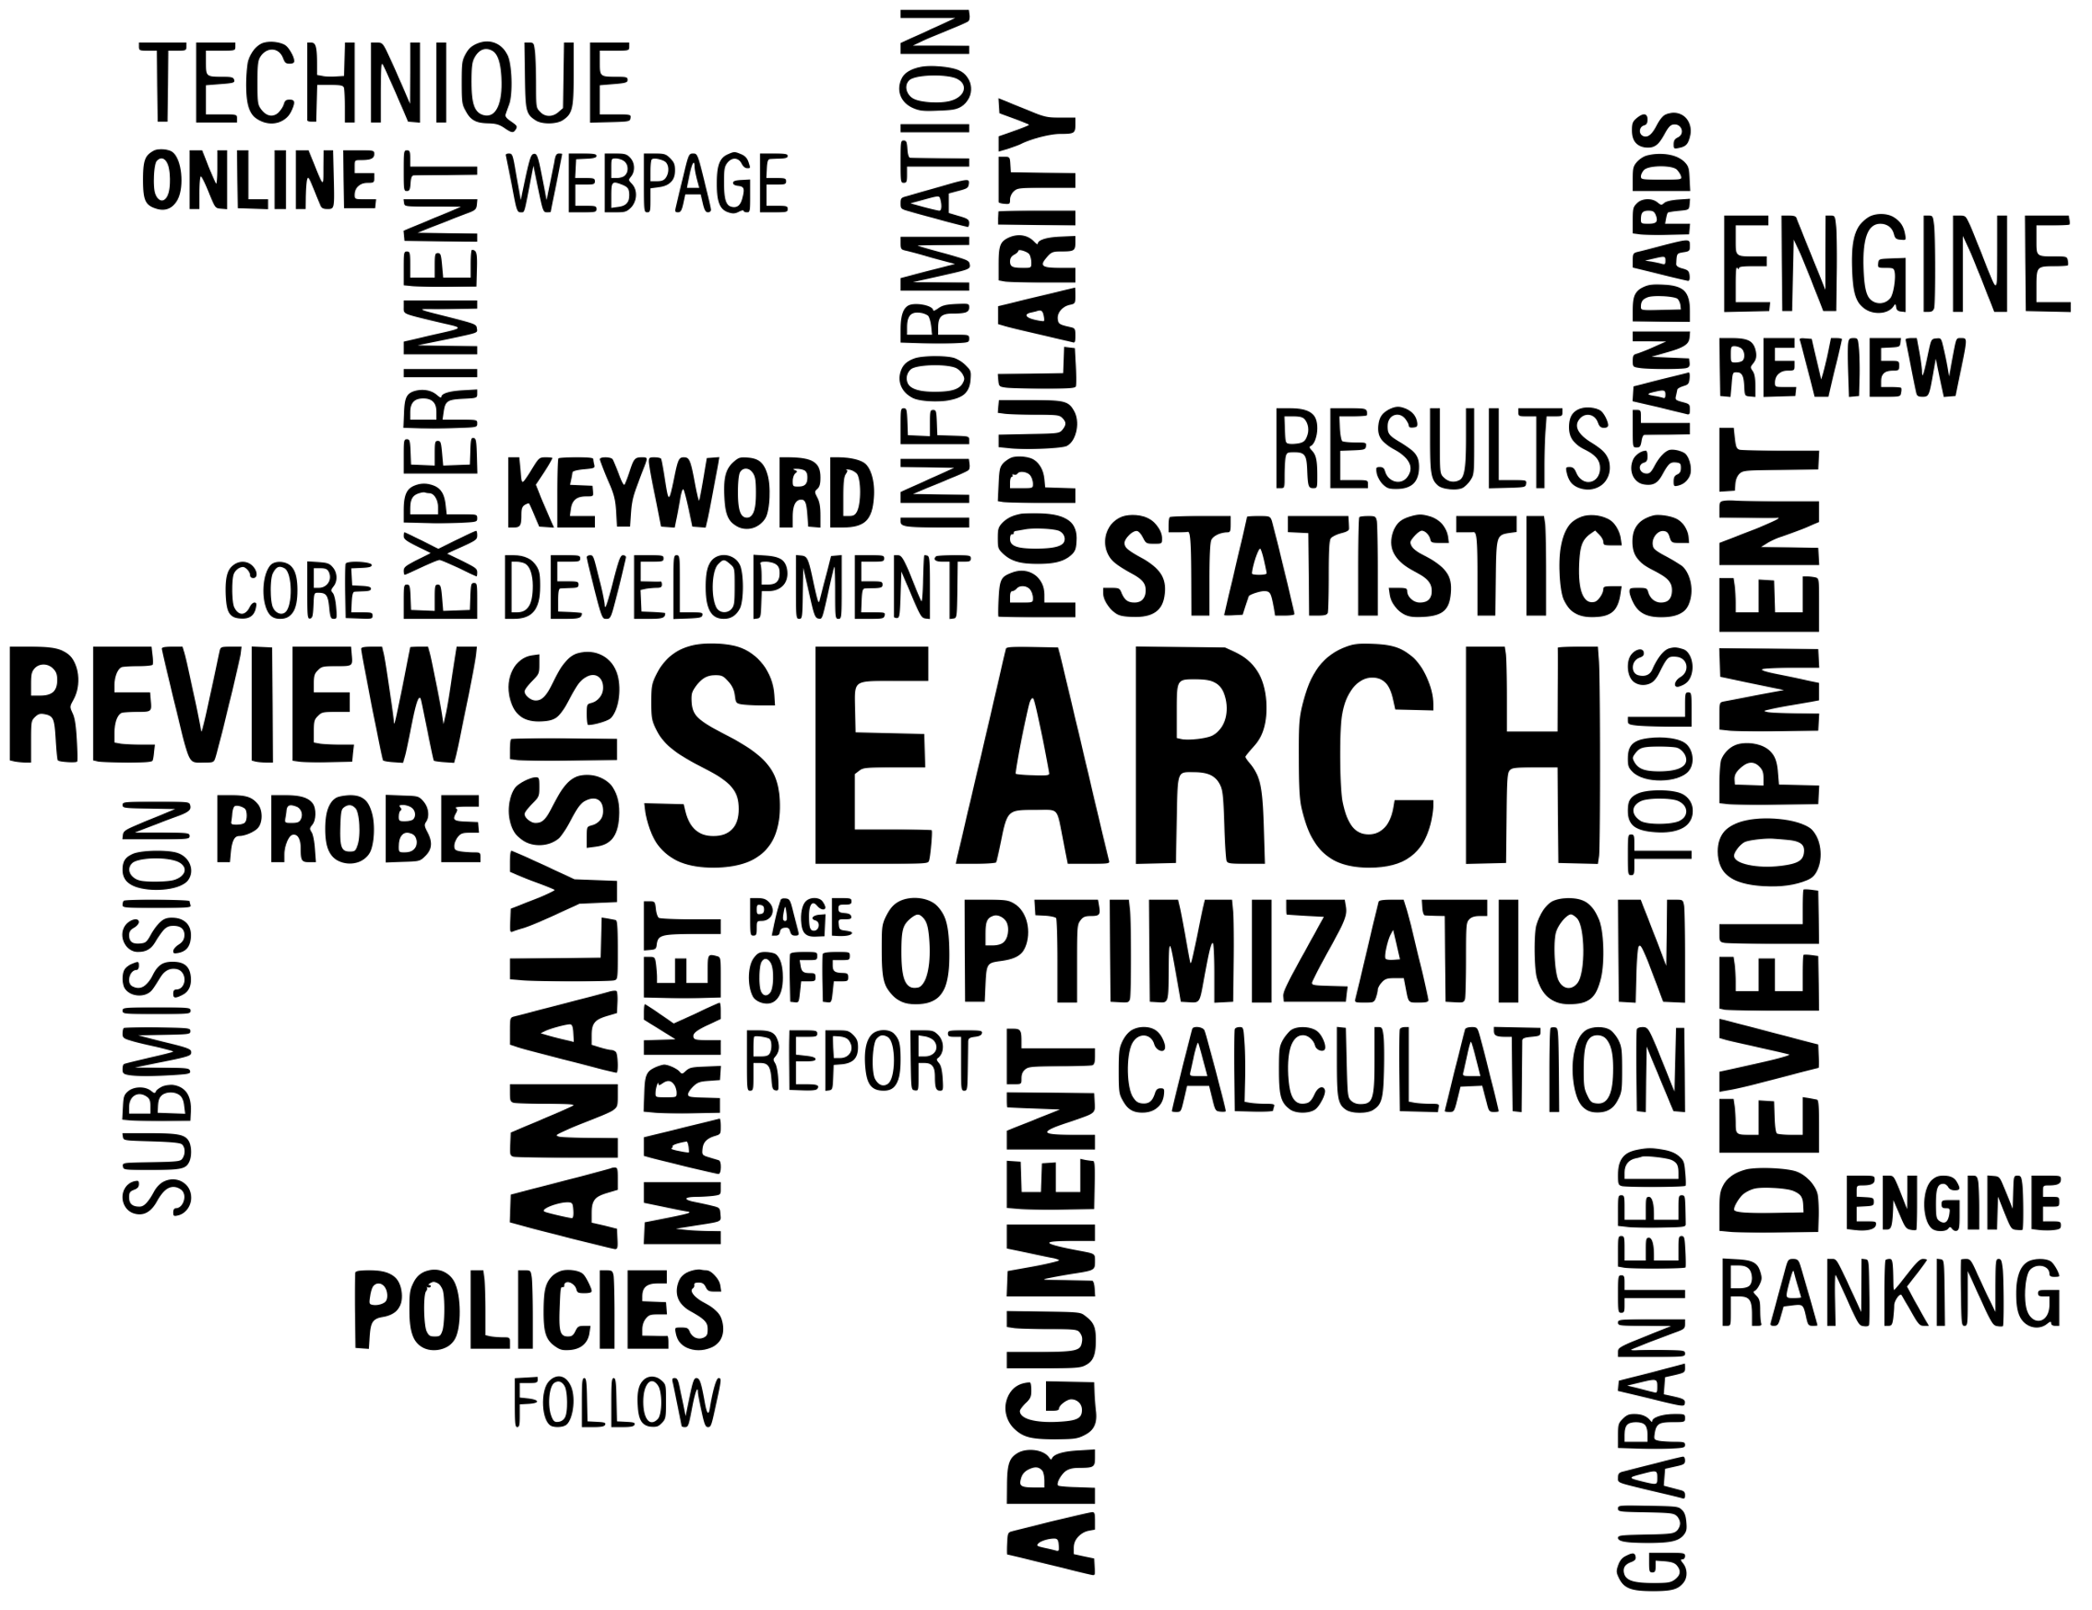
Colorado’s story
Colorado’s Story
In collaboration with the Colorado Preparing Excellent Educators and Leaders (CO-PEEL/CEEDAR) team, the Colorado Department of Education (CDE) developed and administered an Educator Preparation Program Initial Completers survey.
The survey is designed to gather feedback from individuals holding an active initial teacher licensure on the adequacy of their preparation to teach using Colorado’s Teacher Quality Standards.
A Common Measure for EPPs
State Reauthorization
Program Review
Cross-State Convening

Slide 8

How We Worked Together
Cross-State Convening
Cross-State Convening
  The CO-PEEL (CEEDAR) team provided extensive feedback on the survey content and administration procedures.
  CEEDAR supported CDE to develop reporting templates for individual EPPs and to link survey data with existing administrative datasets.
  First administration targeted individuals holding an active initial teacher license between May 1, 2023 and April 30, 2024.

Slide 9
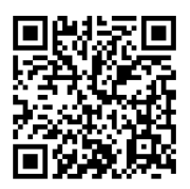
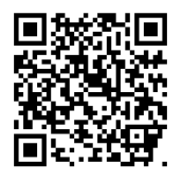
Summary and technical reports
Summary & Technical Reports
Summary of Findings: 2024 Educator Preparation Program Initial Completers Survey
Technical Report: 2024 Educator Preparation Program Initial Completers Survey
Cross-State Convening

Slide 10


Benefits of the collaboration
Cross-State Convening
Benefits of the Collaboration
The program completer survey has strengthened our ability to:
  Link program completer data with state administrative datasets to conduct more complex analyses
  Collect data over time tied to the stages of the state licensure progression
  Have meaningful dialogue between the SEA and EPPs about continuous improvement and inform statewide policy efforts

Slide 11
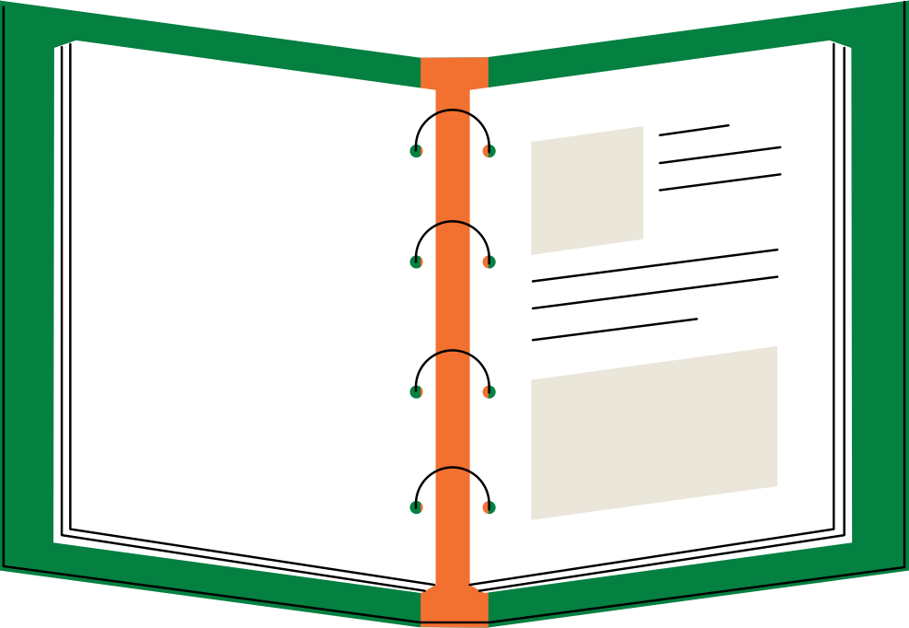
How CDE is Using the Survey Data
Shared survey results through a variety of channels with educator preparation programs
Discussed survey results with the internal Educator Talent Team
Built internal processes for incorporating this data into recommended evidence sources and conversations regarding data
Cross-State Convening

Slide 12
How EPPs are Using the Survey Data
The survey provides another data source—in addition to those already collected—to inform our continuous improvement efforts:
  Informs instructional changes and adaptations based on completers’ needs
  Allows EPPs to be student-centered and responsive to changing educational environment
  Guides discussions on curricular and professional dispositional needs
  Offers real-time, quick information to help EPPs provide guidance for mentors and college supervisors out in the field
Cross-State Convening

Slide 13
Final thoughts
Cross-State Convening
Final Thoughts
Continuous improvement efforts have traditionally been siloed between EPPs and state departments of education.
We create opportunities to strengthen policy AND practice when we work together!

Slide 14
Whole Group Discussion
Cross-State Convening
Reflect on Colorado’s example
  How do you get teacher candidate completer feedback regarding the effectiveness of your program(s)?
  What aspects of Colorado’s story resonate with you?
  What are your personal next steps for exploration and advocacy related to use of data to drive continuous improvement?

Slide 15
Arizona’s Parade of Progress
Cross-State Convening
Jennifer Gresko
Faculty Chair, Educator Preparation Programs
Rio Salado College
Tracey Sridharan
Director of Professional Learning & Sustainability
Arizona Department of Education
Kim Rice-Gentry
Lead Recruitment & Retention Specialist
Arizona Department of Education

Slide 16
Arizona Educator Preparation Programs
Traditional
Institutions of Higher Education
Community Colleges
Certificate Organizations
Alternative
Institutions of Higher Education
Community Colleges
Certificate Organizations
Classroom-Based
Cross-State Convening

Slide 17
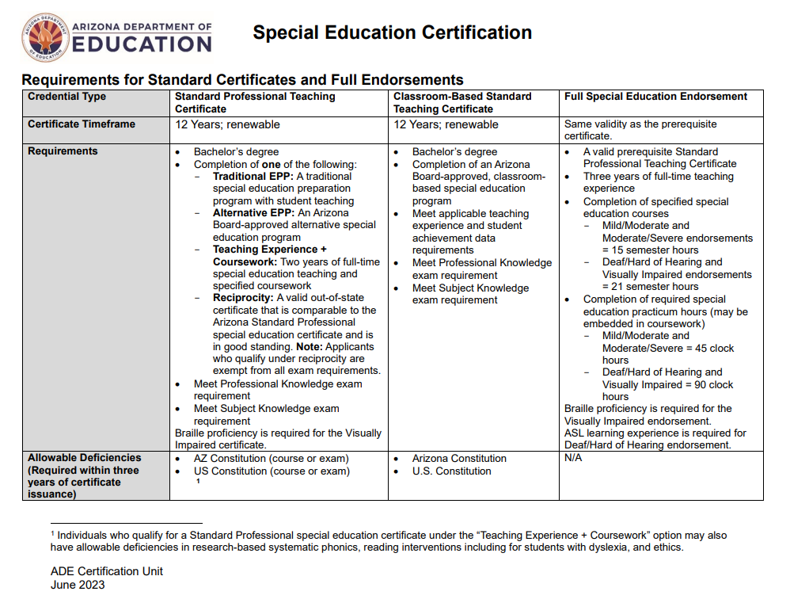
Arizona Special Education Teacher
Certification Pathways
Certification Pathways Document
Cross-State Convening

Slide 18



Many Paths in the Parade
Cross-State Convening
What is the impact of the varied pathways to special education teacher certification in Arizona?

Slide 19
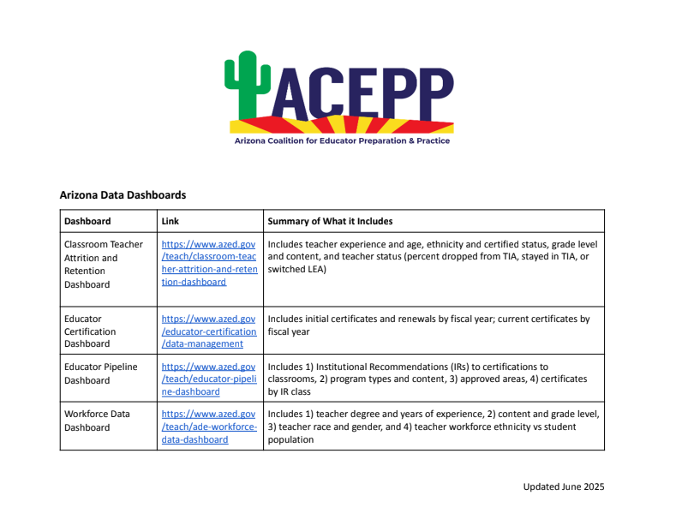
Data Resources
Cross-State Convening
ACEPP Data Sources Document

Slide 20
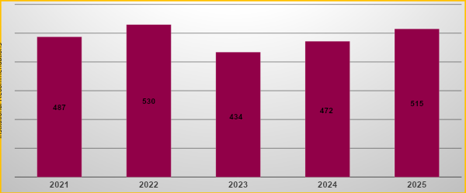
Arizona Special Education Institutional Recommendations by IR Year
Cross-State Convening
Note: Private university data is not included.

Slide 21
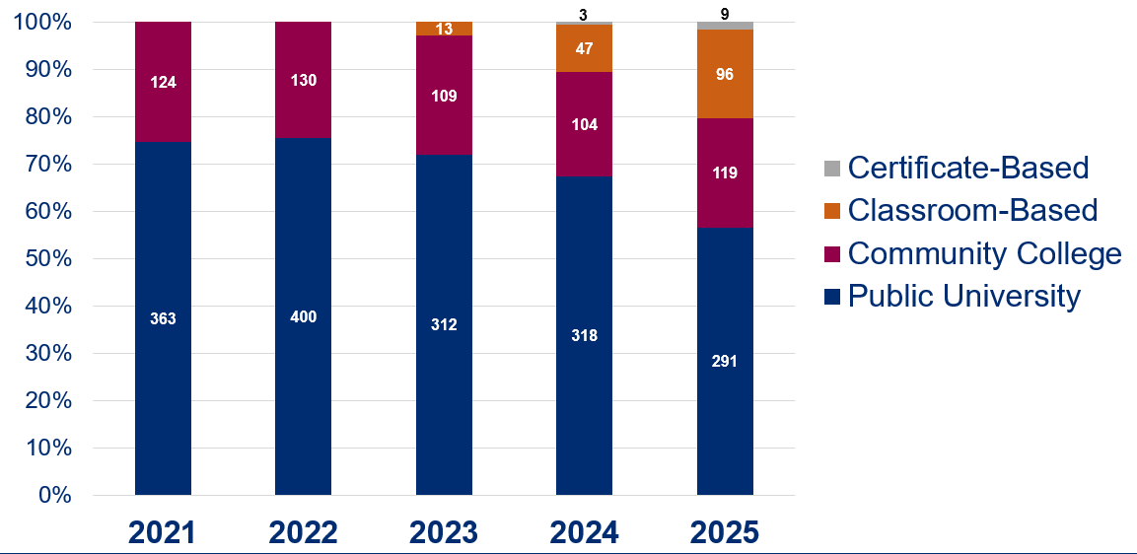
Special Education Institutional Recommendations by Preparation Type
Cross-State Convening
*Data as of 1/22/2026

Slide 22
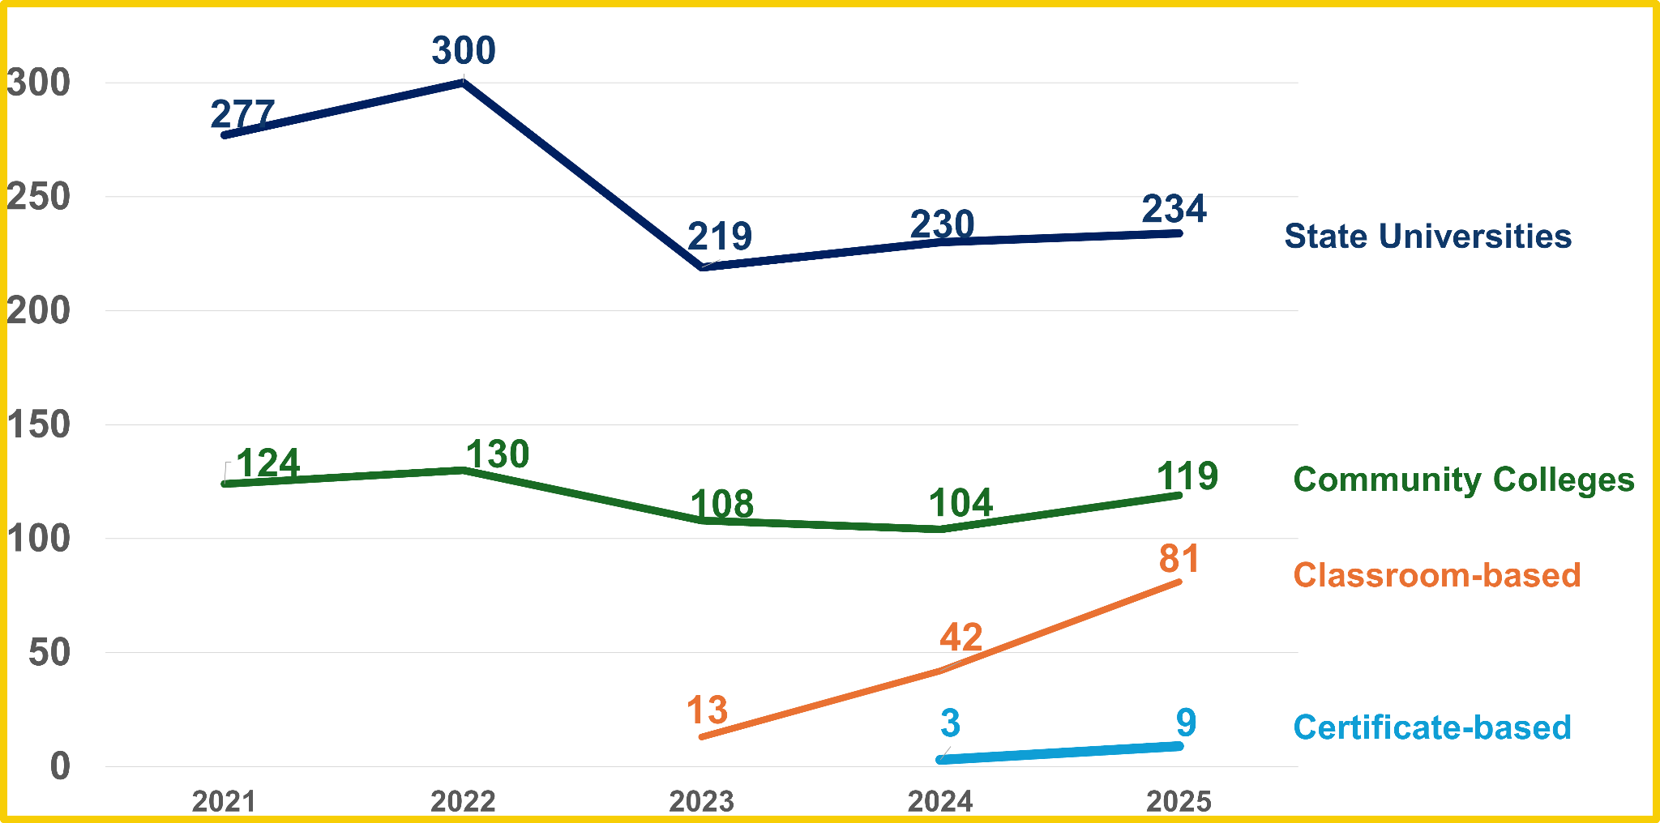
Standard Mild/Moderate Certificates by IR Year and Preparation Type

Slide 23
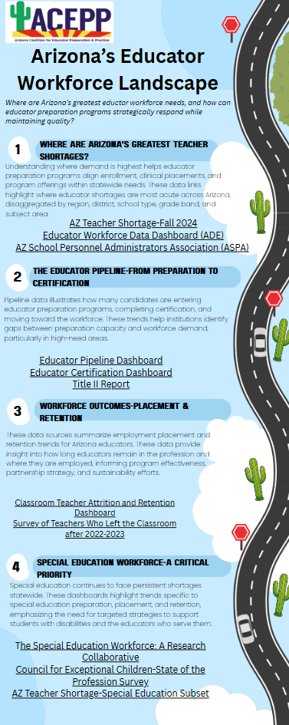

Progress Rolls On
Powered by Good Data
Current focus:
Support partners in accessing, understanding, and analyzing meaningful data to inform decisions.
Next steps:
Use data insights to drive actionable improvements and policy changes.
Cross-State Convening
click for infographic PDF

Slide 24

With an Eye Toward the Future
Cross-State Convening
Cross-State Convening
Enrollment in EPPs
School closures
Voucher program
Cuts to scholarship programs
Updating Professional Teaching Standards

Slide 25
Table Breakout Discussions
Cross-State Convening
Reflect on Arizona’s example
  What data do you have available to you?
  How do you use available data within your role?
  What are the implications on policy and practice?

Slide 26
Whole group debrief
Cross-State Convening
Whole Group Debrief
Session: The Parade of Progress is Paved with Good Data: Mapping the Route to Educator Outcomes and Accountability in Special Education; Goal #2 and Goal #3
What are your key takeaways?
What do you want to bring back to your team?

Slide 27
Fill in your state padlet
Cross-State Convening
Fill in your state padlet:
Session: The Parade of Progress is Paved with Good Data: Mapping the Route to Educator Outcomes and Accountability in Special Education; Goal #2 and Goal #3
Notes: Brief summary of the session, lessons learned, ideas that could support your context, potential pitfalls to avoid, etc.
Connections: How does this connect to your state’s current work? How could this connect to future work (use the future work column)? Are there follow-ups/additional networking needed with CEEDAR states or staff?

Slide 28


thanks
Cross-State Convening
THANK YOU!

Slide 29

Disclaimer
This content was produced under U.S. Department of Education, Office of Special Education Programs, Award No. H325A220002. David Guardino serves as the project officer. The views expressed herein do not necessarily represent the positions or policies of the U.S. Department of Education. No official endorsement by the U.S. Department of Education of any product, commodity, service, or enterprise mentioned in this website is intended or should be inferred.
Cross-State Convening

