Slide 1

Supporting Leadership Preparation
and Development:
Sharing Key Resources
Mónica Byrne-Jiménez, UCEA, Michigan State University
Shelby Cosner, LEAD-IDEA, University of Georgia
David DeMatthews, CEEDAR, University of Texas
February 11, 2026
New Orleans, LA

Slide 2
Supporting Leadership Preparation and Development: Sharing Key Resources
Policy Advocacy & Program Improvement (UCEA)
Educational Leader Preparation and Development (Lead-IDEA)
Inclusive Leadership (CEEDAR)

Slide 3
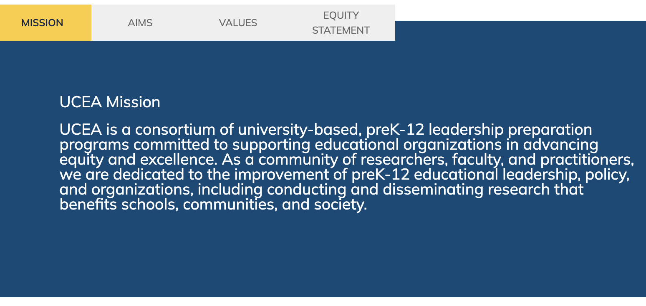




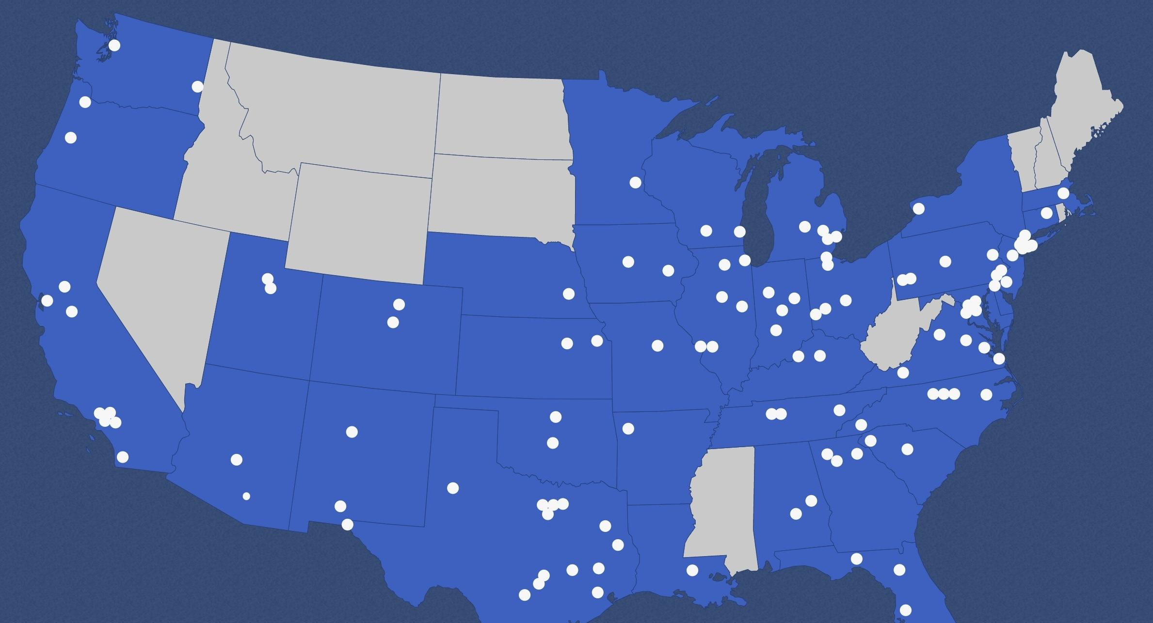
www.ucea.org

Slide 4
CEEDAR & UCEA Partnership
CEEDAR
UCEA
Engage systems, schools, and communities as active partners in research on authentic problems of practice
Generate new professional, academic, and community-based knowledges that advance the field of educational leadership
Improve the preparation and development of preK-12 educational leaders.
Goal 1: Offer high-quality instruction for teachers and leaders
Goal 2: Track and evaluate the impact of educator preparation policy
Goal 3: Use multiple data sources for continuous improvement of the educator workforce
Goal 4: Increased capacity of SEAs, EPPs, and LEAs to collaborate and implement plans that sustain and scale up reform efforts
UCEA works towards the transformation of schools and school communities to create equitable, ethical, and socially just outcomes for each child.

Slide 5
Policy & Advocacy Strategy
• Expand member capacity to advocate for policies supporting leadership preparation and practice
• Produce and disseminate research relevant to the field and its policy interests
• Bolster collaboration and grow interest in common policy challenges

Slide 6

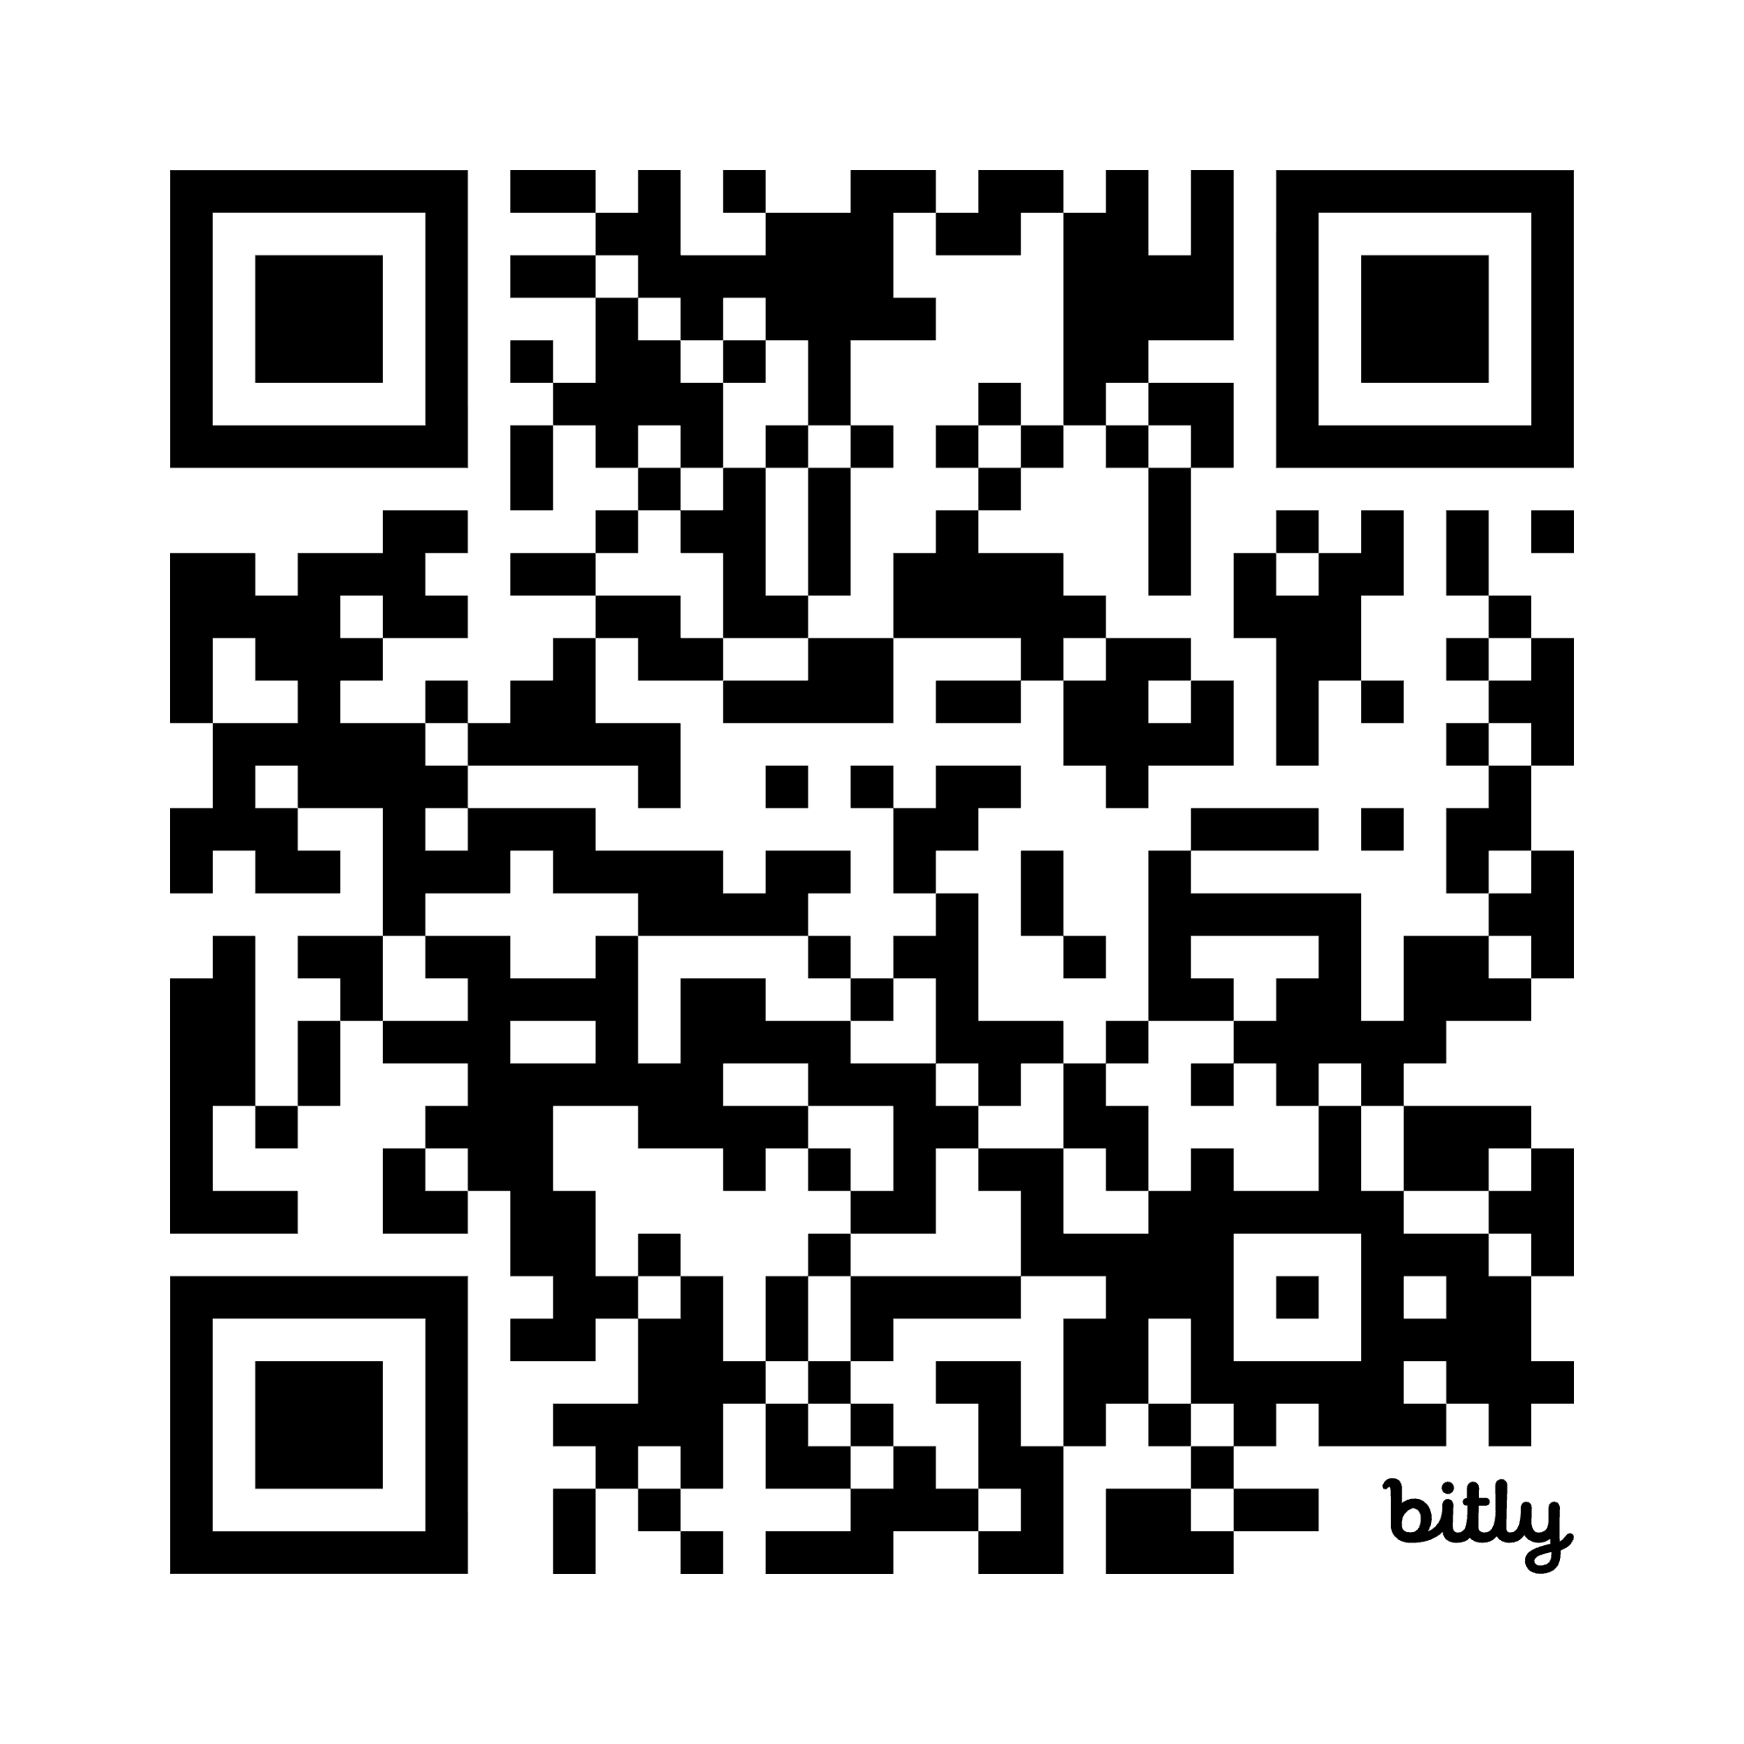
Advocacy Guidebook
  Understanding the Legislative Process
  Connecting with Elected Officials
  Effective Communication Strategies

Slide 7
Leadership Educational & Administration Prep Program (LEAPP)
Surveys
Align to (1) NELP standards, (2) UCEA Quality Criteria, & (3) Accreditation needs
Adaptable for local needs
Lowest cognitive load for survey takers
Data accessibility for local improvement
Provide important guidance as well as plug-and-play data for program improvement
Recruitment
Learning
Career
Program
LEAPP-I (Intake)
LEAPP - E (Exit)
LEAPP-P
(Professional)
LEAPP-Q
(Program)
Notes:
And also helps build evidence base for research and else?
Add timeline of program takes to visualize survey fit

Slide 8
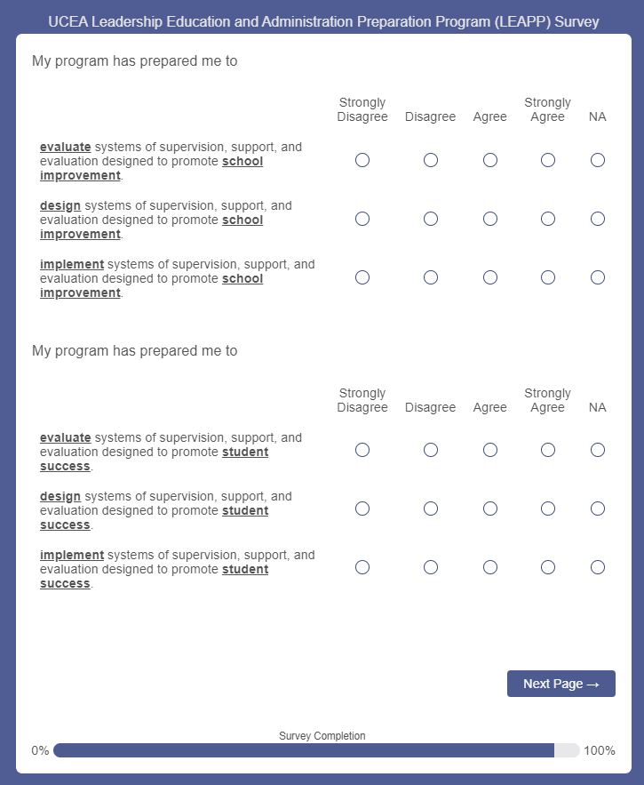
What does LEAPP look like?

Slide 9
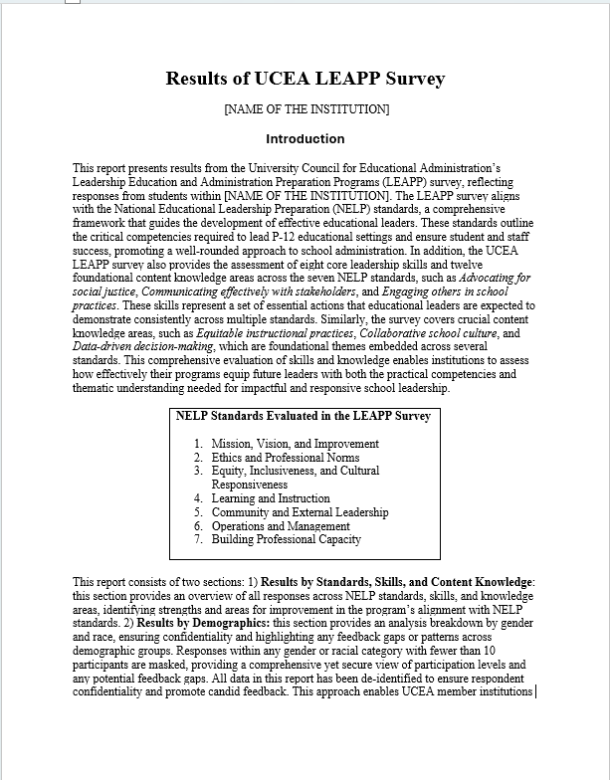
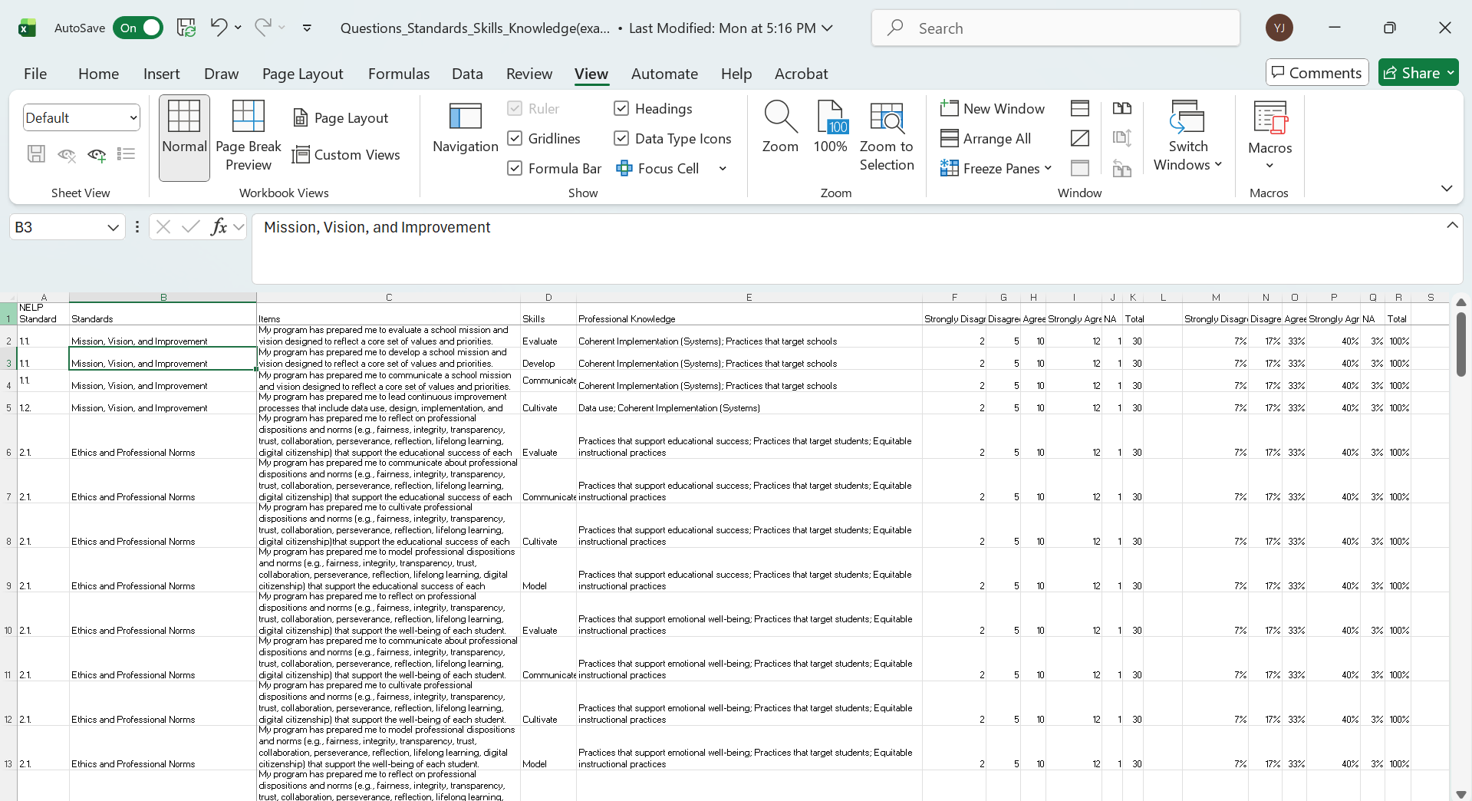
LEAPP Report & Data Worksheet

Slide 10
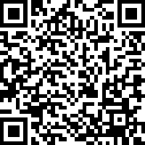
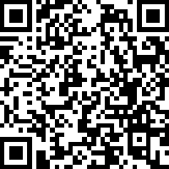
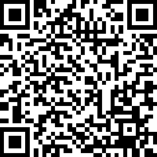
Take a Look!
LEAPP Intake (Demo)
LEAPP Exit (Demo)
LEAPP Professional (Demo)

Slide 11
Learning about the
Lead IDEA Center
Shelby Cosner, Knowledge Development Team Leader for Lead IDEA
Dr. Morrill M. Hall Endowed Chair of Educational Administration/University of Georgia
November 2025
This material was produced under the U.S. Department of Education, Office of Special Education Programs, Award No. H325Z230007. Anna Macedonia serves as the project officer. The views expressed herein do not necessarily represent the positions or policies of the U.S. Department of Education. No official endorsement by the U.S. Department of Education of any product, commodity, service, or enterprise mentioned on this website is intended or should be inferred.

Slide 12







Center Partners
Notes:
The Lead IDEA Center is a five-year technical assistance center funded by the U.S. Department of Education’s Office of Special Education and Rehabilitation Services (OSERS) and is part of the Office of Special Education Program (OSEP)’s Personnel Development Program. AIR manages Lead IDEA in partnership with the University of Connecticut (UConn), University of Georgia (UGA), Boston University (BU), True North Evaluation, the National Association of Elementary School Principals (NAESP), the National Association of Secondary School Principals (NASSP), as well as a group of distinguished consultants.

Slide 13


Our Mission
).
We work with leaders (and those who support, prepare, and develop leaders) to improve systems serving children with disabilities and their families through effective implementation of the Individuals with Disabilities Education Act (IDEA).IDEA
13

Slide 14
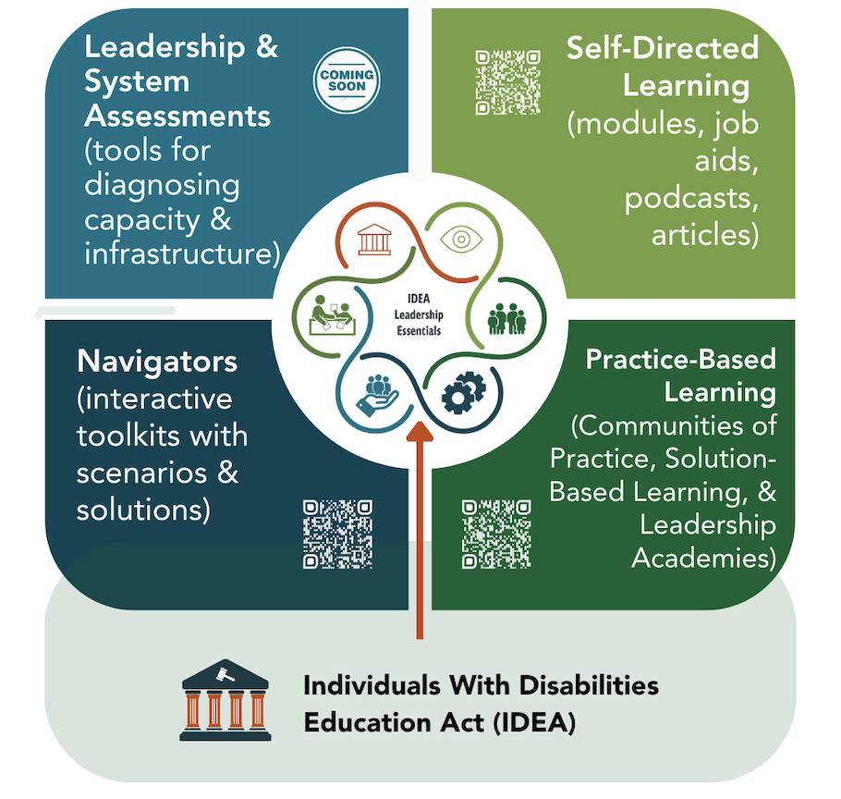
Key Types of Center Resources
Notes:
Abby
How do we rise to such a significant challenge and serve such a broad audience? In the first 3 years of Lead IDEA, we’ve been working to build, pilot, and refine a birth through grade 12 leadership development model and curriculum. This model reflects our data-driven approach – both in how we continuously needs sense to identify the most pressing resources and supports administrators need, as well as how they access information. We begin our TA with leadership & system assessments that diagnose administrators’ most pressing needs and skill gaps – and point them towards self-directed and facilitated learning that meets those needs. We’ve also leveraged research to understand the most impactful areas of learning that will lead to the greatest behavior and systems change. We are just now starting to work with districts and states to augment their existing leadership development with these Lead IDEA offerings – and will work hand-in-hand with states to scale and sustain them.

Slide 15
The IDEA Leadership Essentials describe the knowledge, skills, and mindsets early intervention (EI) and PreK—12 administrators need to effectively implement the Individuals with Disabilities Education Act (IDEA) in programs and schools.
Grounded in data and evidence, the Essentials specify the leaders' role in promoting an ecosystem that leads to progress for all children, including those with disabilities.
Each of the six IDEA Leadership Essentials is organized to include an action-oriented statement, a core mindset, and indicators of successful demonstration of the administrator's IDEA responsibilities.
Notes:
15 min

Slide 16
Components of the IDEA Leadership Self-Assessment
Review and Score knowledge, skills, and practices
View illustrated results in real-time
Identify areas of strength and develop goal(s) for growth
Develop an action plan
3
Notes:
Step 1: Start here tab (time is accounted for on previous slide).
Step 2: Read about the tool and minutes (3 minutes)
Step 3: Review how to use the tool/drop down using the demo and show how the gauges populate: (5 minutes)
Step 4: review and score each tab/indicator: (30 - 35 minutes). Encourage them to take their time.
Bring them back together and do a quick wrap up. Let them know that we will revisit this tool in the afternoon to review scores, identify areas of strength and areas for development.
Let them know that this is a living document that they will continue to work on with their coaches throughout sessions and in problem of practice.

Slide 17
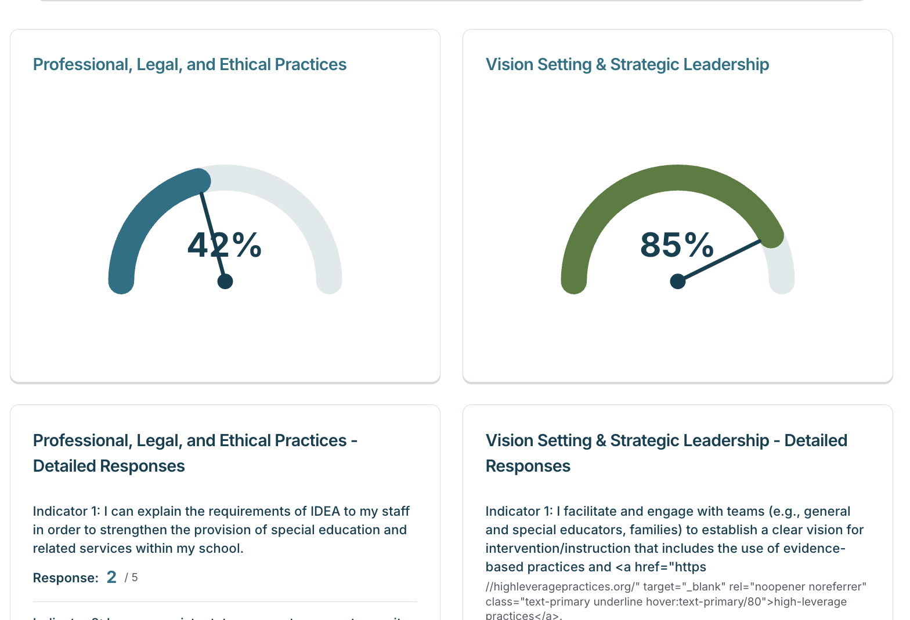
View Results in Real-Time

Slide 18


Assess Your IDEA Leadership
Measure your leadership capacity with the Lead IDEA Self-Assessment, a tool design to support reflection on the knowledge, skills, and practices essential to effective IDEA leadership.
Save & revisit your progress as you grow
Export your self-assessment results as a PDF
Access Lead IDEA resources to strengthen growth areas
Visit lead-idea.org/idea-essential or scan the QR code to get started!

Slide 19
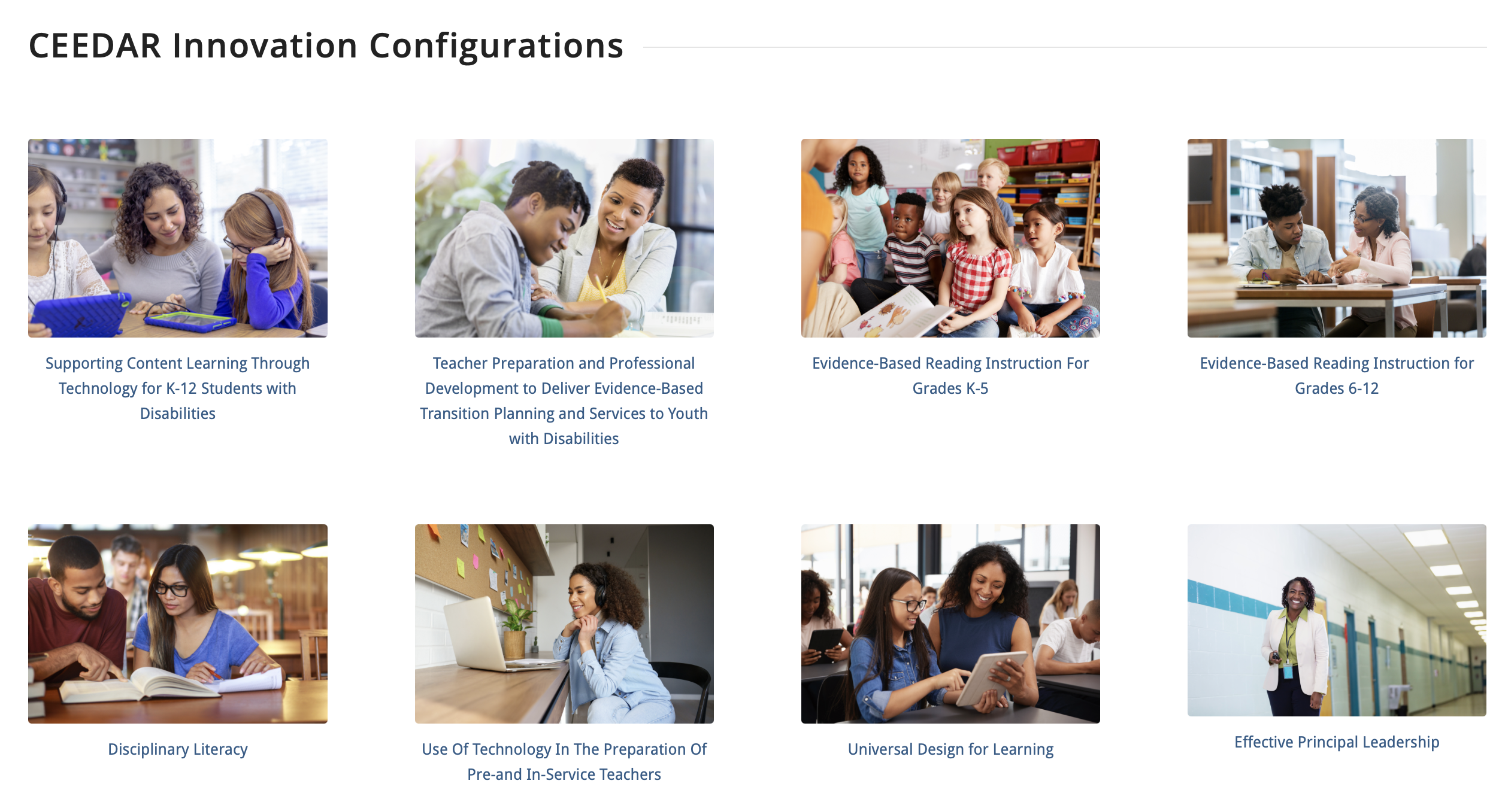

Innovation Configurations

Slide 20
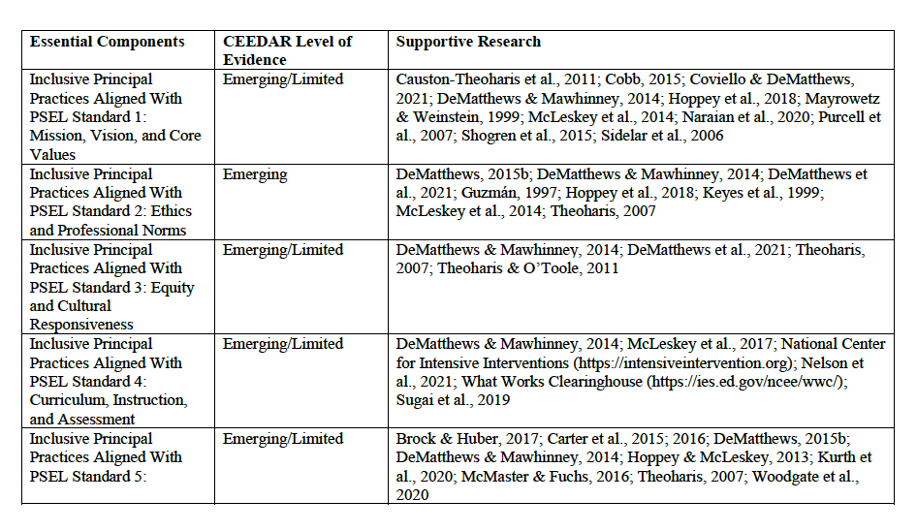
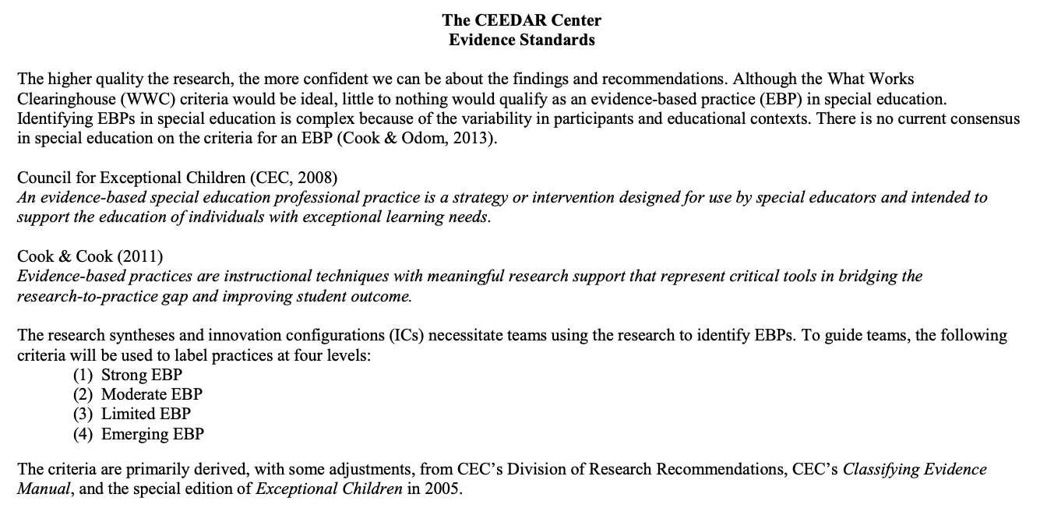
Evidence and Components

Slide 21
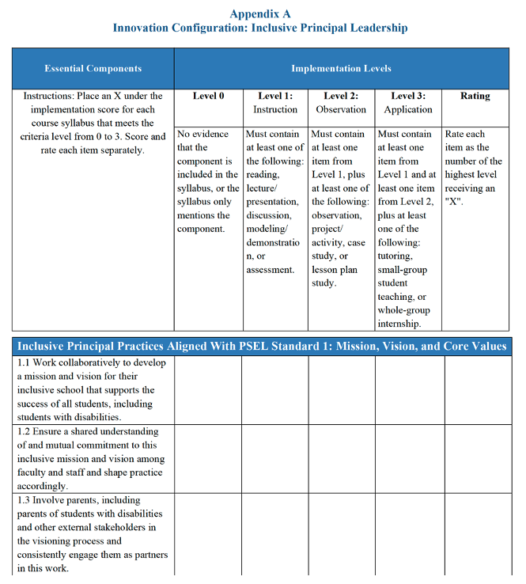
Appendix A

Slide 22
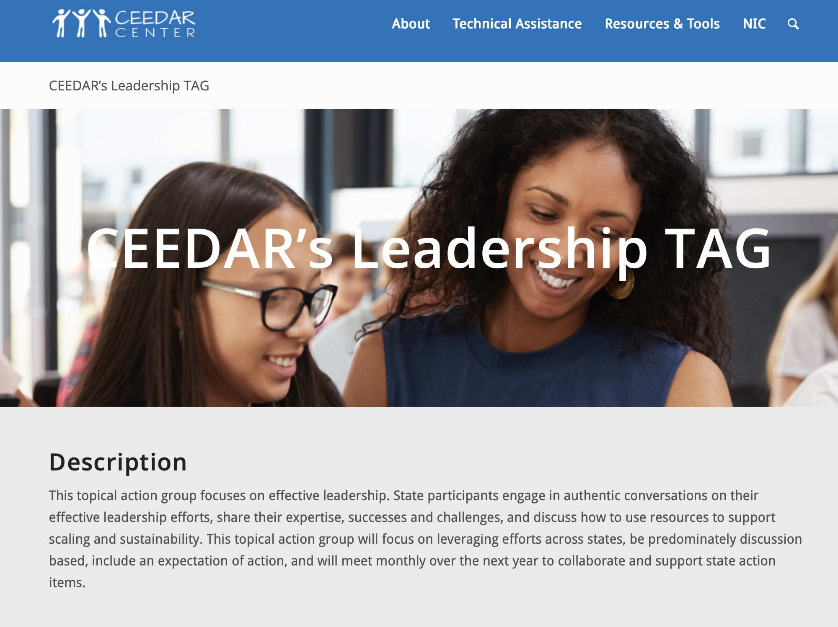
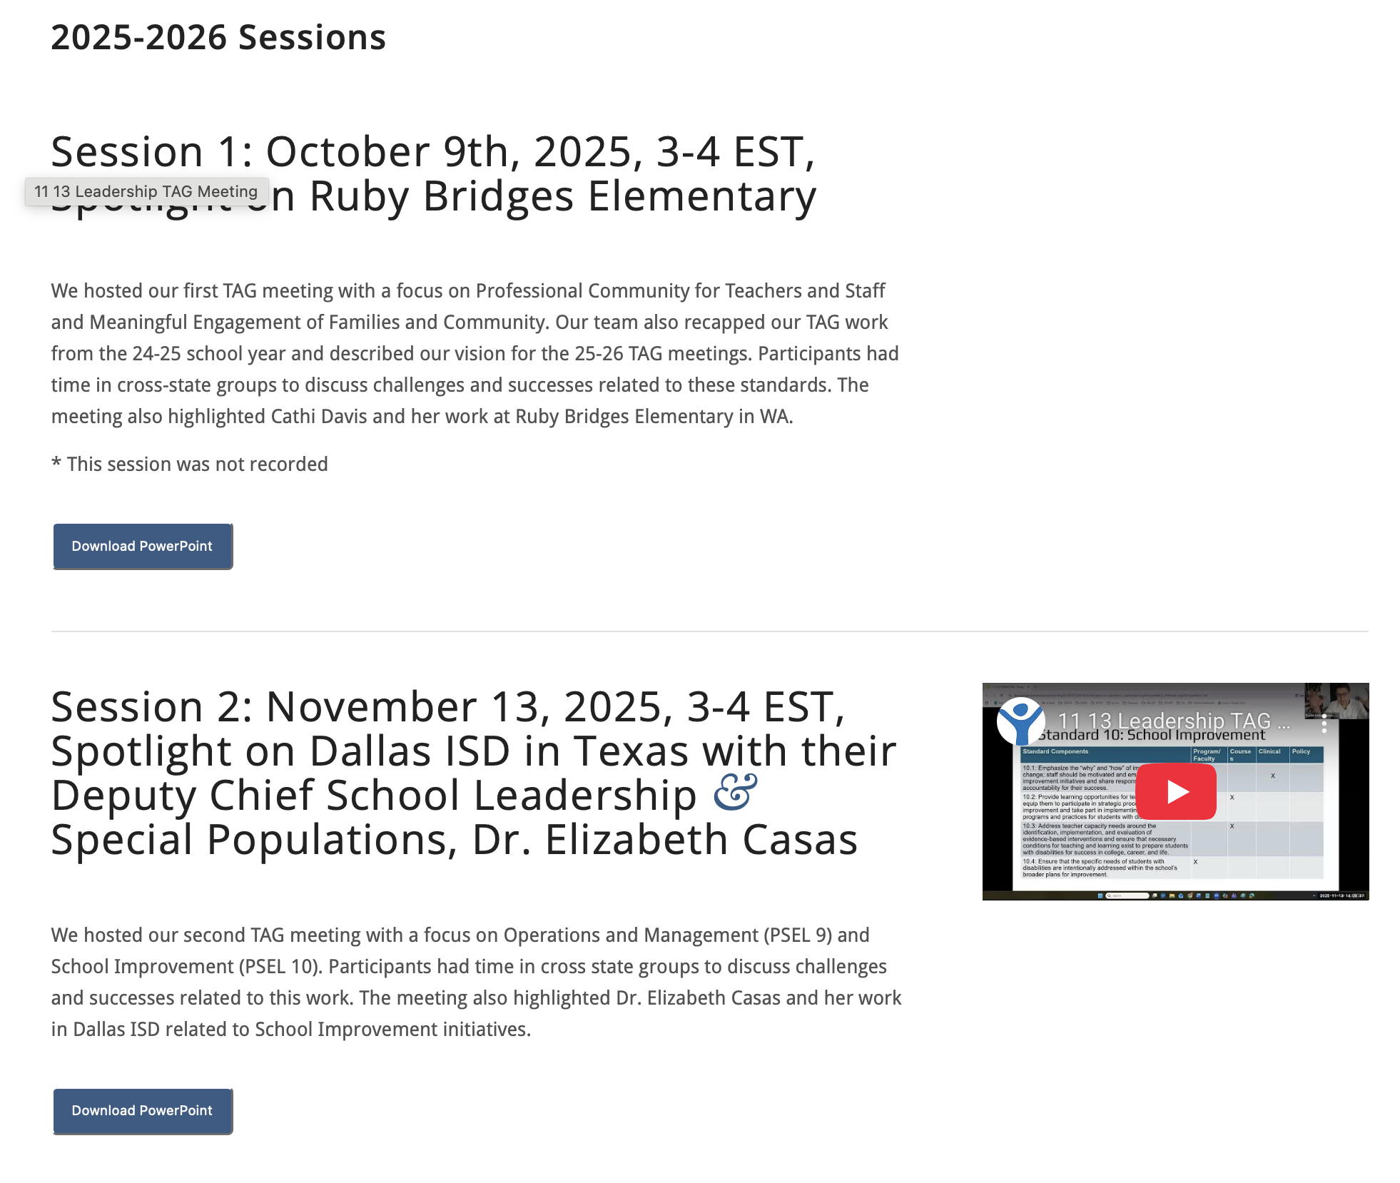
Effective Leadership TAG

Slide 23
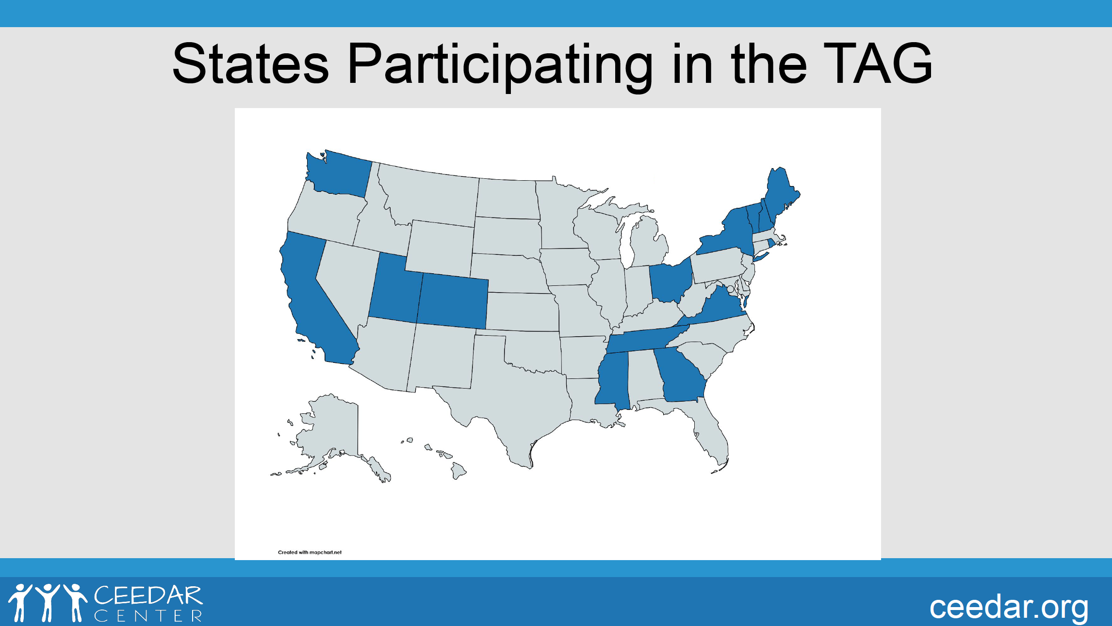
States participating in the TAG

Slide 24
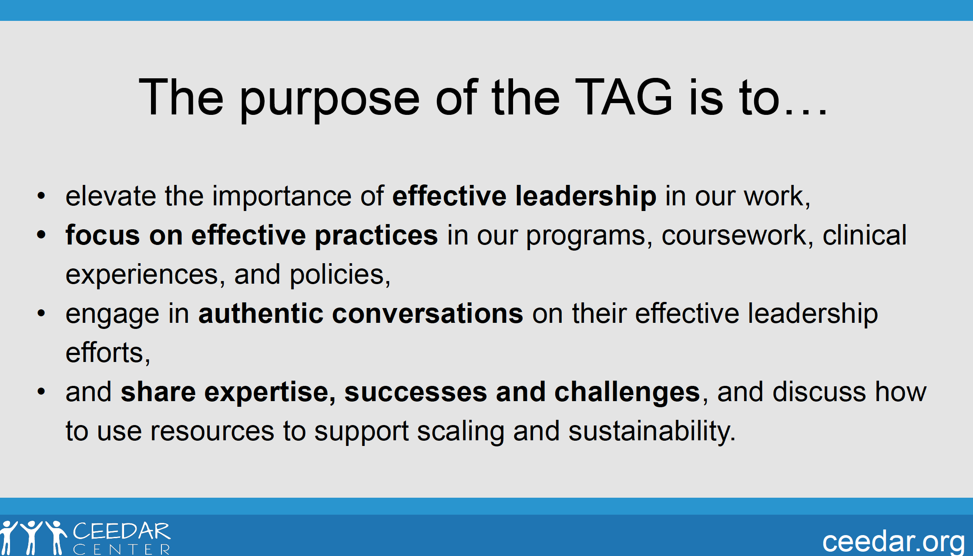
TAG purpose

Slide 25
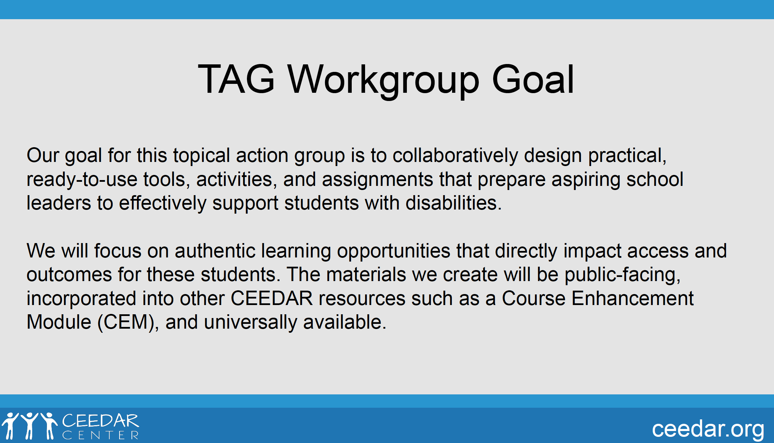
TAG Workgroup goal

Slide 26
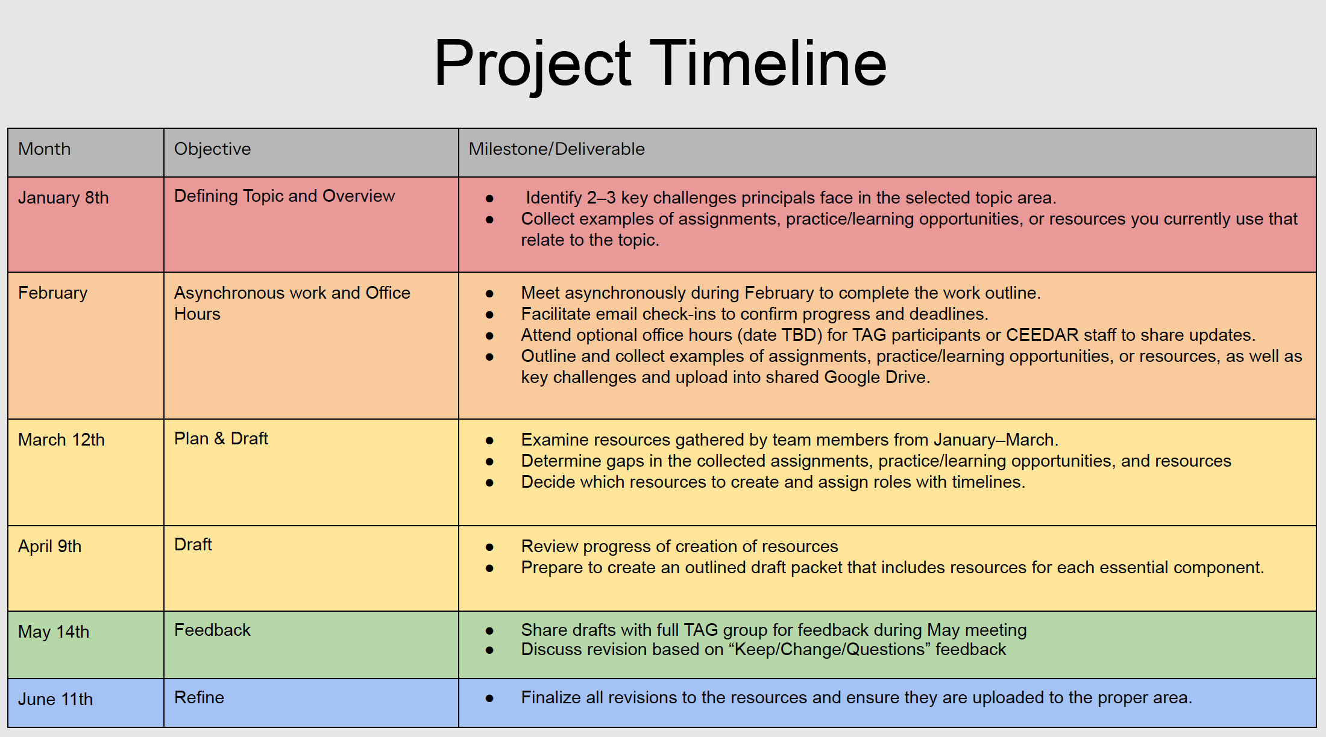
TAG TIMELINE

Slide 27
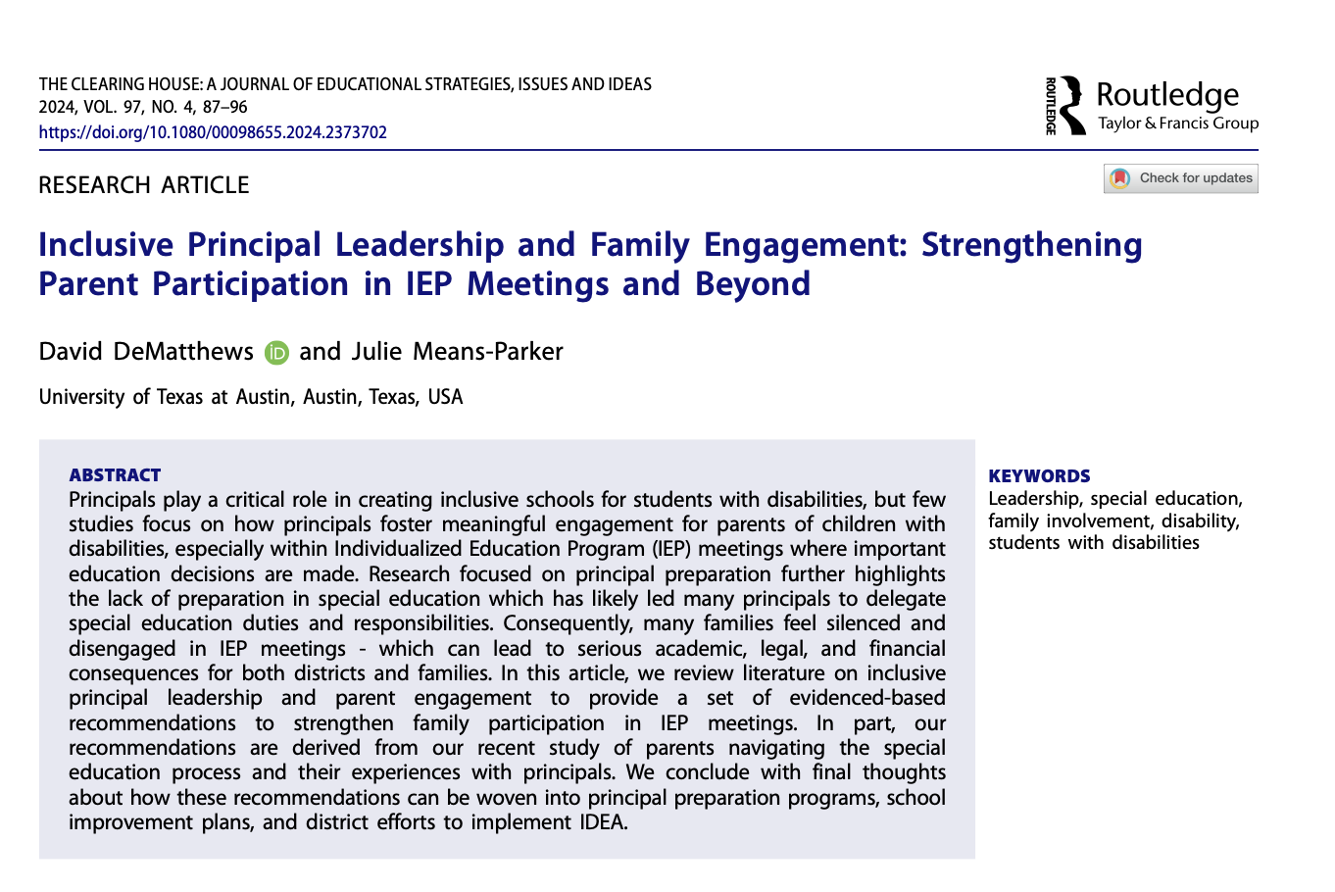
Recent Work

