Slide 1
Welcome to
CEEDAR’s Leadership
Topical Action Group (TAG)
Thursday, January 8th, 2026
3:00-4:00 Eastern Time
Welcome to our TAG!
Participants: please change your Zoom name to
your state and name
Ex: Florida, Agatha Trunchbull
CEEDAR staff: please change your Zoom name to
CEEDAR, Your name
Notes:
Abby: Make everyone co-hosts
Speaker: Abby
3:00-01

Slide 2

Check In
What is something you are looking forward to in 2026?
Notes:
Speaker: Abby
3:00-02

Slide 3
Virtual Meeting Recording Notice
This meeting is scheduled to be recorded by CEEDAR. Your consent to the recording is requested. Participation in the meeting without expressing an objection to recording will be treated as consent. Any participant who prefers to participate via audio only should disable their video camera so only their audio will be captured. External AI bots are prohibited unless specifically authorized.
Notes:
Speaker: Abby
3:02-3:10

Slide 4
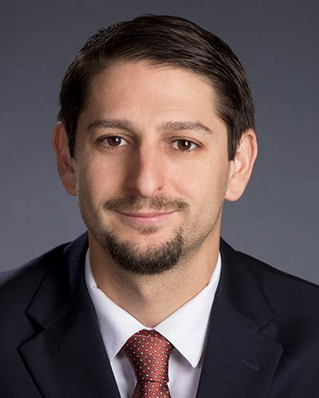
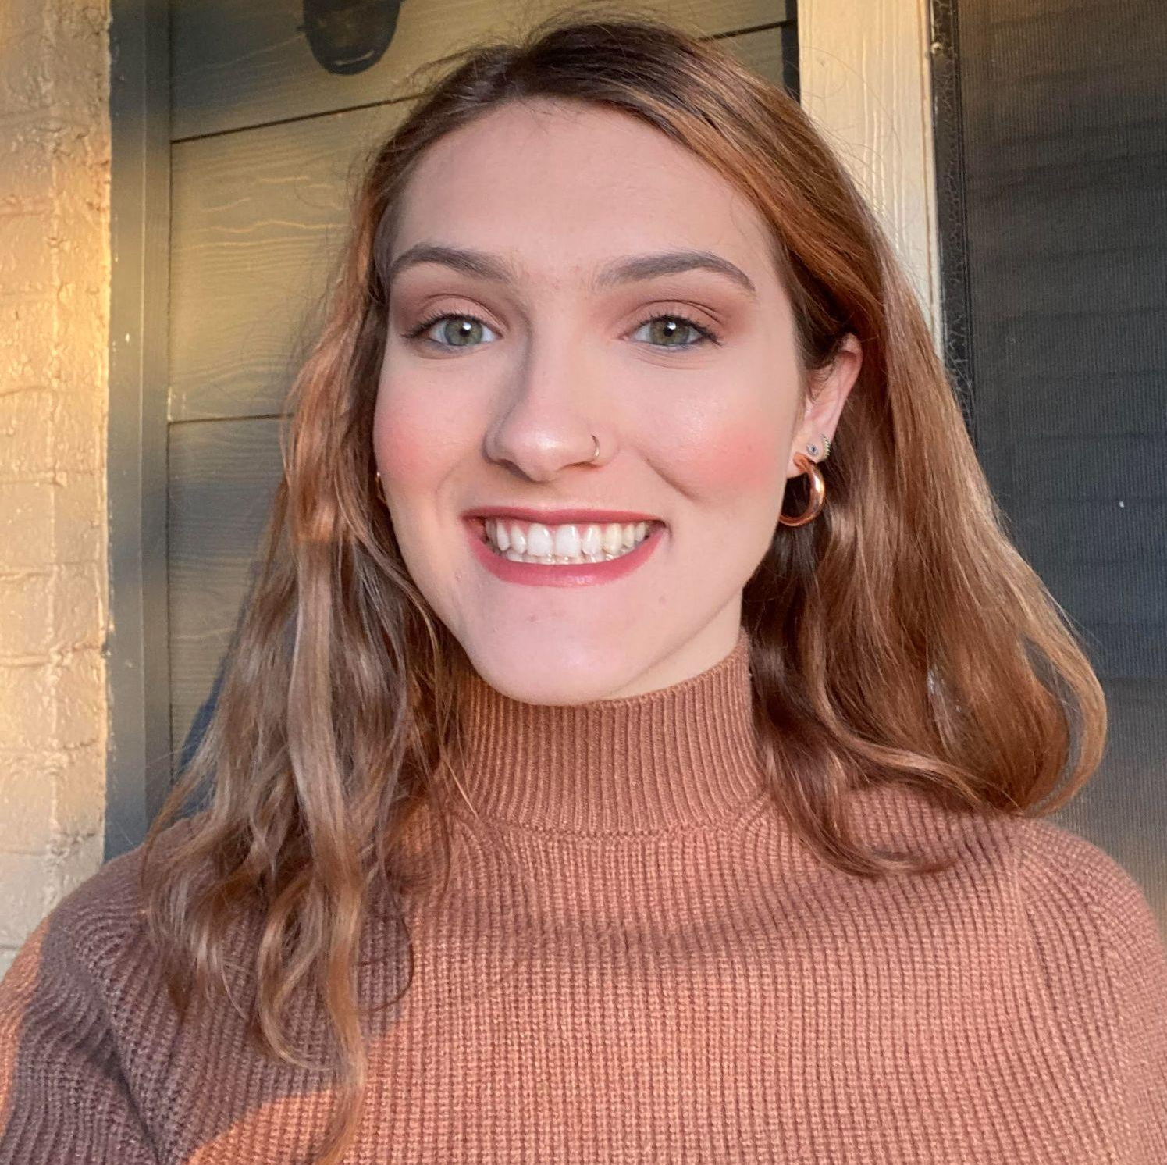
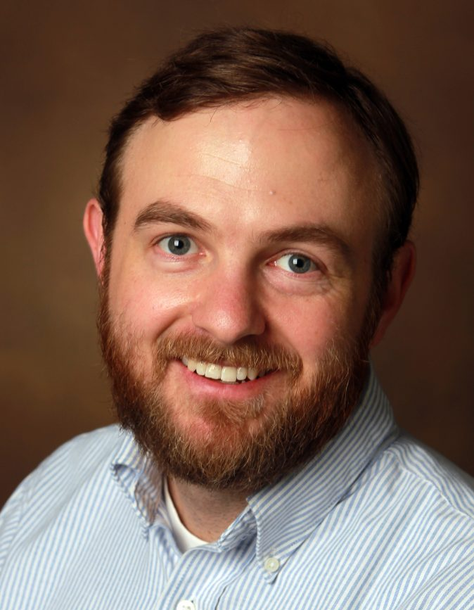
Welcome & Introductions
Dr. David DeMatthews
Professor, Department of Education Leadership and Policy,
The University of Texas at Austin
Abby Berner
Engagement Specialist, CEEDAR, Research Assistant, American Institute for Research (AIR)
Dr. Chris Redding
Associate Professor, Department of Educational Leadership and Policy, University of Florida
Notes:
Speaker: Abby
pause to let Chris intro himself
3:02-3:10

Slide 5





Our Partners
Notes:
Speaker: Abby
A warm thank you to our partners. Our partners are our liaisons and will share resources and can provide additional perspectives.
3:02-10

Slide 6
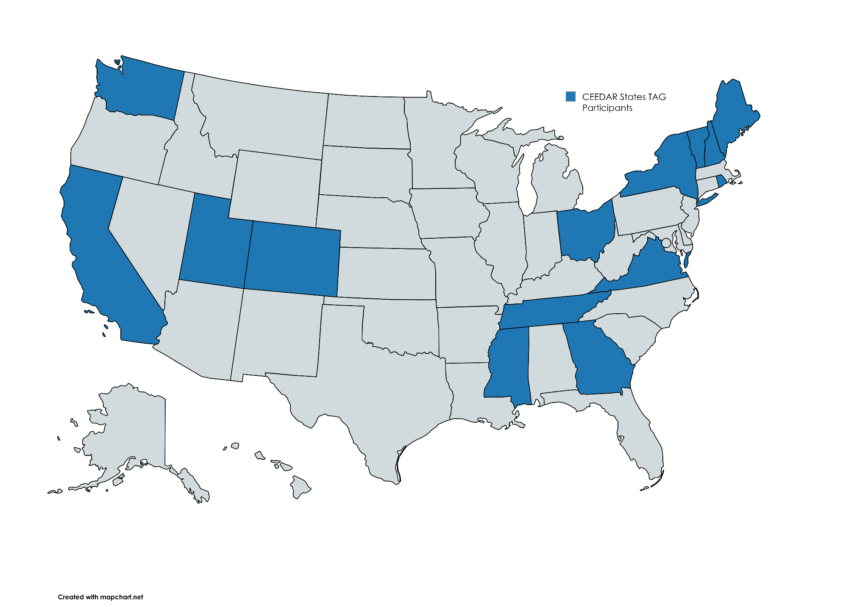
States Participating in the TAG
Notes:
Speaker: Abby
3:02-10

Slide 7
TAG Workgroup Goal
The Challenge:
Preparing future education leaders to cultivate inclusive schools for students with disabilities is a complex and demanding responsibility for leadership preparation programs.
Our Approach:
We leverage our TAG framework to design robust, practical learning activities that integrate seamlessly into our Course Enhancement Modules—giving you ready-to-use resources for your classes.
Notes:
Speaker: Abby
3:02-10

Slide 8
Leadership TAG Topics for Discussion
Date | Topic
October 9th, 3-4 EST | Professional Community for Teachers and Staff Meaningful Engagement of Families and Community
November 13th, 3-4 EST | Operations and Management School Improvement
December 11th, 3-4 EST | TAG Workgroups Session 0
January 8th, 3-4 EST | TAG Workgroups Session 1
February 12th, 3-4 EST | No meeting due to CEEDAR Convening
March 12th 3-4 EST | TAG Workgroups Session 2
April 9th, 3-4 EST | TAG Workgroups Session 3
May 14th, 3-4 EST | TAG Workgroups Session 4
June 11th, 3-4 EST | TAG Workgroups Session 5
Notes:
speaker: Abby
3:02-10

Slide 9
Today’s Agenda
Welcome and Introductions
Workgroup Goal & Approach
Project Timeline
  Session 1: Defining Topic and Overview
  February Asynchronous Tasks
Final Thoughts and Action Items
Workgroup Selection Results
Workgroup Meeting Time
Notes:
Speaker: Abby
3:02-10

Slide 10
Project Timeline
Month | Objective | Milestone/Deliverable
January 8th | Defining Topic and Overview | Identify 2–3 key challenges school leaders face in the selected topic area. Collect examples of assignments, practice/learning opportunities, or resources you currently use that relate to the topic.
February | Asynchronous work and Office Hours | Meet asynchronously during February to complete the work outline. Facilitate email check-ins to confirm progress and deadlines. Attend optional office hours (date TBD) for TAG participants or CEEDAR staff to share updates. Outline and collect examples of assignments, practice/learning opportunities, or resources, as well as key challenges and upload into shared Google Drive.
March 12th | Plan & Draft | Examine resources gathered by team members from January–March. Determine gaps in the collected assignments, practice/learning opportunities, and resources Decide which resources to create and assign roles with timelines.
April 9th | Draft | Review progress of creation of resources Prepare to create an outlined draft packet that includes resources for each essential component.
May 14th | Feedback | Share drafts with full TAG group for feedback during May meeting Discuss revision based on “Keep/Change/Questions” feedback
June 11th | Refine | Finalize all revisions to the resources and ensure they are uploaded to the proper area.
Notes:
Speaker: Abby
3:02-10

Slide 11
Principal Preparation Context
Numerous studies have documented that principals are inadequately prepared in their knowledge of special education policy.
A recent dissertation found that less than 25% of principals reported receiving necessary knowledge and skills for overseeing special education during preparation (Lovato, 2025).
Qualitative studies have found that principals often learn on the job (DeMatthews et al., 2020).
A 2021 Rand survey found that just 12% of 3,500 school principals felt completely prepared to support the needs of students with disabilities.
In a 2021 UCEA survey, few programs reported undertaking any recent programs improvements aimed at strengthening principal preparation to support students with disabilities.
Notes:
Speaker: David
3:10-18

Slide 12
Defining Topic and Overview (January 8th)
Objective: Understand the topic and define what school leaders need to do in alignment to professional standards.
In Meeting Tasks:
  Identify 2-3 key challenges school leaders confront in this topic area
  Gather existing examples of assignments, practice/learning opportunities, or resources that you created or currently use that relate to the topic your workgroup has selected.
Outputs and Deadline: By March 1, the workgroup should outline and collect product examples, learning outcomes, and key challenges in the shared Google Drive.
Notes:
Speaker: David
3:10-18

Slide 13
Asynchronous work and Office Hours (February)
Objective: Complete tasks and outputs from January’s meeting and include any documents or information in Google Drive by March 1st.
Asynchronous Monthly Tasks:
  meet asynchronously with workgroup to complete work outline on January 8th
  facilitate email correspondence to check on timelines
  attend an optional office hours session on February 23rd for TAG participants or CEEDAR staff to join and share updates
Outputs and Deadline: By March 1, the workgroup should outline and collect examples of assignments, practice/learning opportunities, or resources as well as key challenges in the shared Google Drive. Planning and drafting the assignment will begin on March 12.
Notes:
Speaker: David
3:10-18

Slide 14
Invitations and Next Steps
Next IC training: January 27th, 2-3:30 pm ET, sign up here
Our next TAG Session is Thursday, March 12th, 3-4 EST This meeting will serve as Session 2 for workgroup model.
Please note there is no February TAG Meeting. In February, you will receive detailed guidance via email outlining the tasks you can work on asynchronously. Additionally, you will be invited to join an optional office hours session, scheduled for February 23rd, where you can ask questions and receive further support.
Notes:
Speaker: Abby
3:18-20
IC Training Sign-Up

Slide 15
Workgroup Selection Results
Now it’s time to find out what workgroup you have been placed in. Please open this spreadsheet and search for your name!
Workgroup 1: Curriculum, Instruction, and Assessment (PSEL 4)
Workgroup 2: Operations and Management (PSEL 9)
Notes:
Speaker: Abby
3:20-22
CEEDAR TAG Workgroup Roster

Slide 16

Workgroup Time!
Notes:
Speaker: Abby
3:22-4:00

