Slide 1
Welcome to
CEEDAR’s Leadership
Topical Action Group (TAG)
Thursday, October 9th 2025
3:00-4:00 Eastern Time
Welcome to our TAG!
Participants: please change your Zoom name to
your state and name
Ex: Florida, Agatha Trunchbull
CEEDAR staff: please change your Zoom name to
CEEDAR, Your name
Notes:
Abby: Make everyone co-hosts
Speaker: Abby
3:00-01

Slide 2
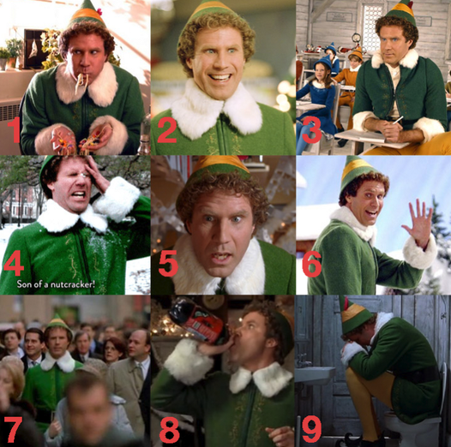
Check In
Which Elf are you today?
Notes:
Speaker: Abby
3:00-02

Slide 3
Virtual Meeting Recording Notice
This meeting is scheduled to be recorded by CEEDAR. Your consent to the recording is requested. Participation in the meeting without expressing an objection to recording will be treated as consent. Any participant who prefers to participate via audio only should disable their video camera so only their audio will be captured. External AI bots are prohibited unless specifically authorized.
Notes:
Speaker: David
3:02-3:12

Slide 4





Our Partners
Notes:
Speaker: David
A warm thank you to our partners
Our partners are Lead IDEA, NASSP, and CCSSO- they are our liaisons and will share resources, they can provide additional perspectives. If you are here from one of these partner organizations, please share who you are in the chat and feel free to share your expertise! We plan to highlight our partner CCSSO at our December meeting.
3:02-3:12

Slide 5
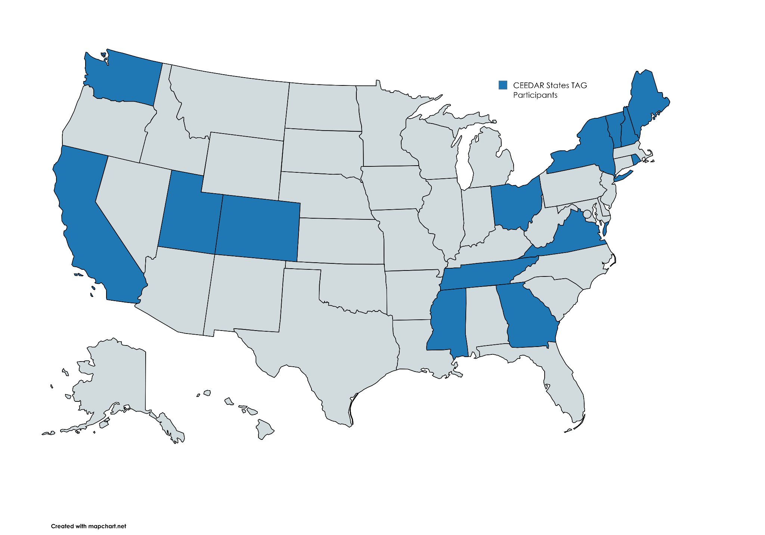
States Participating in the TAG
Notes:
Speaker: David
3:02-3:12

Slide 6
The purpose of the TAG is to…
elevate the importance of effective leadership in our work,
focus on effective practices in our programs, coursework, clinical experiences, and policies,
engage in authentic conversations on their effective leadership efforts,
and share expertise, successes and challenges, and discuss how to use resources to support scaling and sustainability.
Notes:
Speaker: David
Recognize that we have different roles as members of our TAG (SEA, IHE, associations, local) we want to be mindful of these roles as we talk in cross state and state team time
3:02-3:12

Slide 7
Leadership TAG Topics for Discussion
Date | Topic
October 9th, 3-4 EST | Professional Community for Teachers and Staff Meaningful Engagement of Families and Community
November 13th, 3-4 EST | Operations and Management School Improvement
December 11th, 3-4 EST | TAG Workgroups Session 0
January 8th, 3-4 EST | TAG Workgroups Session 1
February 12th, 3-4 EST | No meeting due to CEEDAR Convening
March 12th 3-4 EST | TAG Workgroups Session 2
April 9th, 3-4 EST | TAG Workgroups Session 3
May 14th, 3-4 EST | TAG Workgroups Session 4
June 11th, 3-4 EST | TAG Workgroups Session 5
Notes:
speaker: David
3:02-3:12

Slide 8
Today’s Agenda
Workgroup Goal & Approach
Overview of Course Enhancement Module (CEM)
Formation of Standards-Based Workgroups
Roles & Expectations
Survey Time
Project Timeline & Milestones
Virtual Collaboration Tools & Protocols
Questions
Notes:
Speaker: David
Abby put meeting norms in chat
Meeting norms:
Be present and prepared
Respect in the shared space and keep what is shared in confidence. We are creating a community.
We will record guest speakers and resources sharing, but nothing else. What happens in the TAG, stays in the TAG!
Breakout rooms could be mixed cross state or state specific depending on the work.
Group members should “believe the best” and lead with positive intentionality.
3:02-3:12

Slide 9
TAG Workgroup Goal
The Challenge:
Preparing future education leaders to cultivate inclusive schools for students with disabilities is a complex and demanding responsibility for leadership preparation programs.
Our Approach:
We leverage our TAG framework to design robust, practical learning activities that integrate seamlessly into our Course Enhancement Modules—giving you ready-to-use resources for your classes.
Notes:
Speaker: David
3:02-12

Slide 10
TAG Workgroup Goal 2
TAG Workgroup Goal
Our goal for this topical action group is to collaboratively design practical, ready-to-use tools, activities, and assignments that prepare aspiring school leaders to effectively support students with disabilities.
We will focus on authentic learning opportunities that directly impact access and outcomes for these students. The materials we create will be public-facing, incorporated into other CEEDAR resources such as a Course Enhancement Module (CEM), and universally available.
Notes:
Speaker: David
3:02-12

Slide 11
What is a CEM?
A Course Enhancement Module (CEM) provides resources for educator preparation and professional development providers specific topics, aligned with the innovation configurations.
The resources are meant to be readily available for EPPs and PD providers to adapt to their context.
Notes:
Speaker: Meg
3:12-20
meg will share screen
https://ceedar.education.ufl.edu/cems/high-leverage-practices/

Slide 12
Proposed Groups
These workgroups focus on the two standards that TAG participants identified as top priorities in the BOY survey. Our goal is to use these standards as a foundation for developing learning opportunities and activities that strengthen your preparation programs.
Each standard includes:
Associated sub-standards for deeper understanding
Example resources that a workgroup might create, helping you decide which standards align best with your goals
We’ll dive into these details together here and explore how they can support your work.
You can choose the workgroup that best aligns with your current scope and future goals. There’s no requirement to join the same group as other participants from your state. You will receive a survey momentarily that will help us create our two groups.
Notes:
Speaker: Dave
3:20-30
CEEDAR TAG Proposed Workgroups

Slide 13
Roles and Expectations in a Workgroup
(Co-Lead) Facilitator:
  Leads monthly meetings, keeps discussions focused on objectives
  Summarizes decisions and next steps at the end of each meeting
  Ensures voices are heard and tasks are distributed
(Co-Lead) Project Manager:
  Tracks progress, deadlines, and deliverables
  Maintains shared workspace and organizes files
  Sends weekly or bi-weekly reminders ahead of deadlines and upcoming meetings
Project Manager and Facilitator can be a CEEDAR staff member or a state participant.
Other Members:
  Attend monthly meetings and contribute asynchronously
  Complete assigned tasks before deadlines
  Used shared tools for co-creation and feedback
Notes:
Speaker: Dave
3:20-30

Slide 14
What we will not focus on:
A focus on any activity that does not prepare a principal to take action to support students with disabilities in their daily practice is not within the scope of our work.
  Broad lesson planning
  Deep dives into special education law
  Curating readings that don’t translate into practical tools
Notes:
Speaker: Dave
3:20-30

Slide 15

Survey Time!
Notes:
Speaker: Abby
3:30-40
CEEDAR TAG Workgroup Survey

Slide 16
Project Timeline
Month | Objective | Milestone/Deliverable
January 8th | Defining Topic and Overview | Identify 2–3 key challenges principals face in the selected topic area. Collect examples of assignments, practice/learning opportunities, or resources you currently use that relate to the topic.
February | Asynchronous work and Office Hours | Meet asynchronously during February to complete the work outline. Facilitate email check-ins to confirm progress and deadlines. Attend optional office hours (date TBD) for TAG participants or CEEDAR staff to share updates. Outline and collect examples of assignments, practice/learning opportunities, or resources, as well as key challenges and upload into shared Google Drive.
March 12th | Plan & Draft | Examine resources gathered by team members from January–March. Determine gaps in the collected assignments, practice/learning opportunities, and resources Decide which resources to create and assign roles with timelines.
April 9th | Draft | Review progress of creation of resources Prepare to create an outlined draft packet that includes resources for each essential component.
May 14th | Feedback | Share drafts with full TAG group for feedback during May meeting Discuss revision based on “Keep/Change/Questions” feedback
June 11th | Refine | Finalize all revisions to the resources and ensure they are uploaded to the proper area.
Notes:
Speaker: Abby
3:40-50

Slide 17
Virtual Collaboration
Utilize our central repository for drafts and final resources, Workgroup Google Drives
Track tasks and deadlines, Task Tracker
Record what is accomplished and next steps after each meeting, Workgroup Agenda
Adhere to feedback protocols for comments and revisions (more on this in future meetings)
Notes:
Speaker: Abby
3:40-50
CEEDAR Leadership TAG Public Resources

Slide 18
Invitations and Next Steps
Next IC training: January 27th, 2-3:30 pm ET, sign up here
Our next TAG Session is Thursday, January 8th, 2026, 3-4 EST. This meeting will serve as Session 1 for workgroup model. Your designated workgroup will be announced at this session!
You will have 45–50 minutes to collaborate with your workgroup to:
Gain a clear understanding of your topic and the related sub-standards.
Define the actions principals must take to be effective leaders in this area.
plan the next steps towards creating a applicable resource
Notes:
Speaker: Abby
3:40-50
IC Training Sign-Up

Slide 19

Questions?
Notes:
Speaker: Team
3:50-4:00

