Slide 1
Section 1:
Overview of
HLPs

Slide 2
Acronym Activity - HLPs
What does HLP stand for?
Hefty Language Plan
High Leverage Practice
Higher Learning Program
Huge Literacy Place
Notes:
We have a lot of acronyms in education, Let’s take a quick quiz. Which set of words represents HLPs?

Slide 3
What Are HLPs?
HLPs are practices that can be woven into core instruction in the general education setting to intentionally design, deliver, and assess instruction that leads to equitable learning outcomes for all students, including students with diverse learning needs.
“A set of practices that are fundamental to support K–12 student learning, and that can be taught, learned, and implemented by those entering the profession.”
—Windschitl et al., 2012, p. 880
Notes:
Explanation of Slide
HLPs are a set of fundamental practices—identified with research to support K–12 student learning—that can be taught to novice teachers and used to ensure equitable access to core instruction for all students. A “high-leverage practice” is an action or task that is central to teaching. HLPs specify what all teachers should know and define how they deliver instruction. Carried out skillfully, these practices increase the likelihood that teaching will be effective for students’ learning.

Slide 4
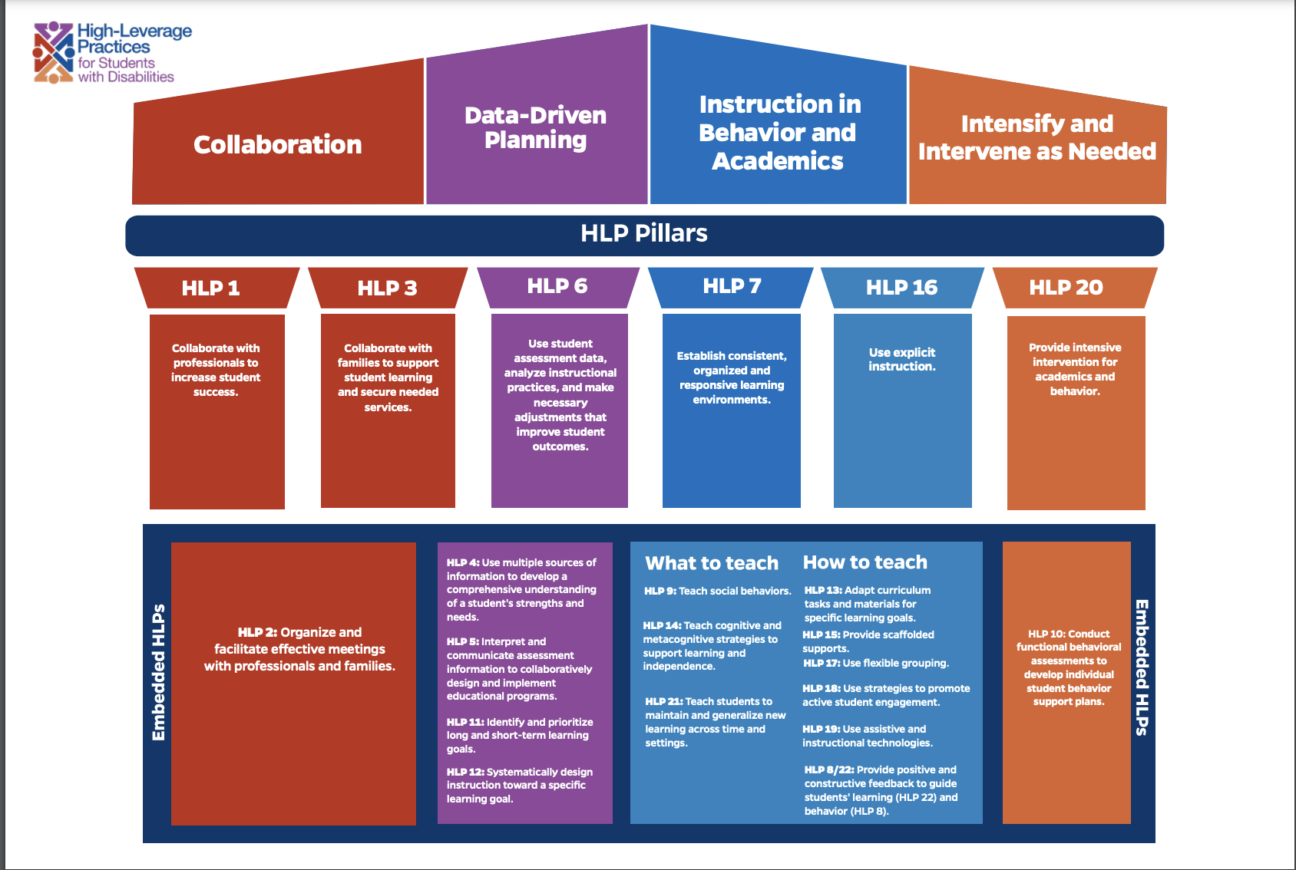
Notes:
The new visual for the HLPs is intended to show the interconnectedness of these practices. The top includes the 4 domains and 6 pillar practices are core HLPs, and embedded HLPs are practices that are often intertwined and support those HLP pillar practices. With that in mind, here are the practices... [Read visual]

Slide 5
Features of HLPs
Focus directly on instructional practice
Occur with high frequency in teaching
Research based and known to foster student engagement and learning
Broadly applicable and usable in any content area or approach to teaching
Fundamental to effective teaching when skillfully executed
Address needs of diverse students
McLeskey et al., 2017
Notes:
Explanation of Slide
HLPs are appealing for both general education and special education teachers because these practices are applicable to and can be used in any content area or grade level. Some might consider HLPs to be common-sense practices that are used widely—which is true.
That said, it is the intentionality with which HLPs are used to respond to specific learning tasks and student needs that makes them powerful. Although HLPs can enhance all students’ learning with increased intensity and intentionality, students with disabilities (SWDs), English learners (ELs), and students who struggle are provided better access to the curriculum through HLPs.

Slide 6




Why Should We Focus on HLPs?
We can define effective practice for teachers, assess it, and then improve it!
We can create a seamless system of support for teachers throughout their career.
HLPs are content agnostic and can be used across
all grades.
HLPs have been identified as practices that all novice teachers should know and be able to do.
Notes:
Explanation of Slide
Focusing on HLPs provides an opportunity to assess and improve specific practices. Understanding what we know about adult learning, teachers need practice with consistent feedback to implement instructional practices with fidelity, and we cannot expect teachers to master all instructional practices at one time. Targeting a consistent set of HLPs increases the likelihood of mastery among novice teachers.

Slide 7


A Few Caveats
HLPs do not replace the need to teach content using EBPs.
HLPs do not imply that learning to teach is simply a matter of mastering these HLPs.
Notes:
Explanation of Slide
It is important to note that HLPs do not replace the teaching of content using EBPs (e.g., teaching reading using an evidence-based phonics strategy). In addition, HLPs do not replace the need for intensive intervention in certain circumstances. HLPs are not the end-all of education practices. Instead, they are strategies that will increase student access to content and curriculum. Often, HLPs are used to teach evidence-based instruction. For example, explicit instruction, an HLP, often is used while providing evidence-based reading instruction. When teaching nonreaders, teachers also may employ coaching and feedback (another HLP) to ensure that students master phonetic concepts.

Slide 8

True or False?
HLPs are just for special education teachers.
  FALSE. HLPs are for all teachers!
When used effectively, HLPs can help promote equitable outcomes for SWDs and others with special learning needs.
  TRUE! HLPs can lead to improved student learning outcomes for all students in core instruction.
Notes:
Facilitation note: This slide has animation so that each question and answer appear one at a time. Read each statement aloud to the participants and have them guess the answer. Pause after each answer to read the explanations and discuss as a team.
Explanation of Slide
1. HLPs are just for special education teachers.
FALSE. HLPs are not just for special education teachers! All students, including SWDs, are general education students first and foremost. It is the responsibility of ALL teachers—general and special education—to know how to use HLPs in their instruction. Because HLPs provide a strong foundation for quality core instruction, HLPs are for both general and special education teachers.
2. When used effectively, HLPs can help promote equitable outcomes for SWDs.
TRUE! Ensuring equitable outcomes for SWDs means ensuring that each student receives high-quality core instruction with their general education peers. HLPs can be used to intentionally design, deliver, and assess core instruction in the general education setting, leading to equitable learning outcomes for each student, especially SWDs.

Slide 9

Activity: HLPs and Effective Teaching Practices
Using Handout 1: High-Leverage Practices and Effective Teaching Practices, fill out Column 1: List effective teaching practices you see in your classroom.
Review the Handout 2: High-Leverage Practices in Special Education.
Fill out Column 2 of Handout 1: High-Leverage Practices and Effective Teaching Practices, aligning the HLPs to your effective teaching practices.
Group share: Share one or two things you have noticed.
Notes:
Explanation of Slide
Now we will do an activity. Using the High-Leverage Practices and Effective Teaching Practices handout, fill out Column 1.
Column 1: List effective teaching practices you use in your classroom.
Let’s take a few minutes to fill this out. I will do a status check in 3 minutes and see if people need more time. Any questions before we begin?
Facilitation note: Give participants 2 – 3 minutes to list items in Column 1.
Explanation of Slide
Now review the High-Leverage Practices in Special Education handout and fill out Column 2 of the High-Leverage Practices and Effective Teaching Practices handout, aligning the HLPs to your effective teaching practices. Let’s take about 3 minutes to complete this. At that time, I will do a status check to see if people need more time. Any questions about this part?
Facilitation note: Give participants 2 – 3 minutes to list items to fill out Column 2.
Explanation of Slide
Let’s talk about what we discovered. What is an effective practice you use? Does that align with any of the HLPs? (wait for responses) Do the practices listed on the handout align with what you have experienced as areas of need for beginning teachers? (wait for responses) Which ones stood out to you as most important and why? (wait for responses).
Facilitation note: Have participants share in pairs, or ask for volunteers to respond. If the training is virtual, have participants share in the chat box.

Slide 10
Example of HLPs and Evidence-Based Practices (EBPs) Working Together at Tier 1
Explicit and systematic instruction (HLP)
EBPs are
Content specific
Subgroup specific
Taught using HLPs
Phonics-based instruction for decoding (EBP)
Notes:
Explanation of Slide
EBPs are practices supported by multiple, high-quality studies that use research designs from which causality can be inferred and demonstrate meaningful effects on students’ outcomes. These are identified by an evidence-based review process (Gersten et al., 2005; Horner et al., 2005). A few examples include the following:
Teaching phonological awareness
Decoding
Comprehension
Fluency
HLPs should be used in combination with EBPs. Both are necessary to provide students with an evidence-based education. Let’s use phonological awareness as an example. Phonological awareness is an evidence-based practice, which should be taught with a HLP, using explicit instruction. The HLP helps with the delivery of the EBP.
Another example is teaching comprehension. Using the HLP of providing specific feedback helps students know if they are comprehending reading content and using strategies appropriately.
If you want to read more about how EBP and HLP work together for effective instruction, this brief provides even more examples.
Facilitation note: For optional prework, have participants read High-Leverage Practices and Evidence-Based Practices: A Promising Pair.

Slide 11
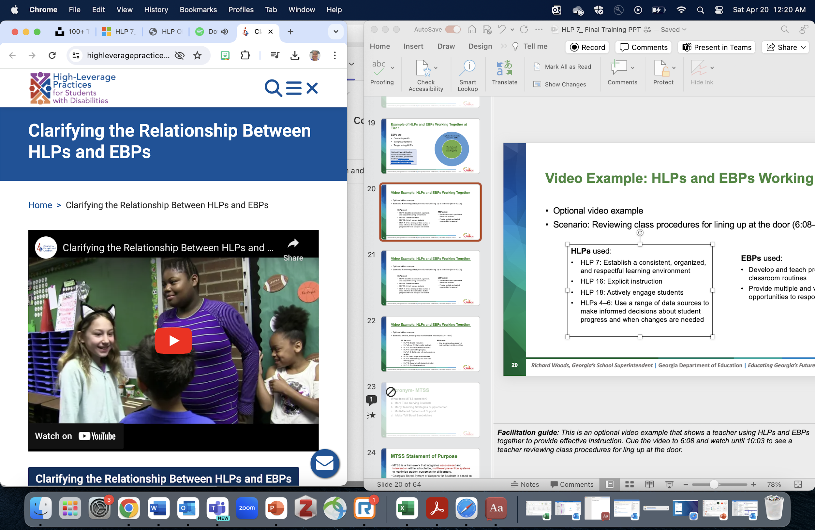
Optional Video Example 1: HLPs and EBPs Working Together
Scenario: Reviewing class procedures for lining up at the door (6:08–10:03)
Discussion: Which HLPs and EBPs are used?
Notes:
Facilitation guide: This is an optional video example that shows a teacher using HLPs and EBPs together to provide effective instruction. Cue the video to 6:08 and watch until 10:03 to see a teacher reviewing class procedures for lining up at the door.
https://highleveragepractices.org/clarifying-relationship-between-hlps-and-ebps
Discussion: Which HLPs and EBPs are used?
HLPs used:
HLP 7: Establish a consistent, organized, and responsive learning environment
HLP 16: Explicit instruction
HLP 18: Actively engage students
HLPs 4–6: Use a range of data sources to make informed decisions about student progress and when changes are needed
EBPs used:
Develop and teach predictable classroom routines
Provide multiple and varied opportunities to respond

Slide 12
Optional Video Example 2: HLPs and EBPs Working Together
Scenario: Reviewing class procedures for lining up at the door (10:04-16:55)
Discussion: Which HLPs and EBPs are used?
Notes:
Facilitation guide: This is another optional video example that shows a teacher using HLPs and EBPs together to provide effective instruction. Cue the video to 10:04 and watch until 16:55 to see an online, small-group mathematics lesson.
https://highleveragepractices.org/clarifying-relationship-between-hlps-and-ebps
Discussion: Which HLPs and EBPs were used?
HLPs used:
HLP 16: Explicit instruction
HLPs 8 and 22: High-quality feedback
HLP 15: Provide scaffolded supports
HLP 17: Use flexible grouping
HLPs 1–3: Collaborate with colleagues and families
HLP 4: Use a range of data sources
HLP 11: Address long- and short-term
learning goals
HLP 12: Systematically design instruction
HLP 13: Provide adaptations
EBP used:
Use of manipulatives as part of real-world story problem solving

Slide 13
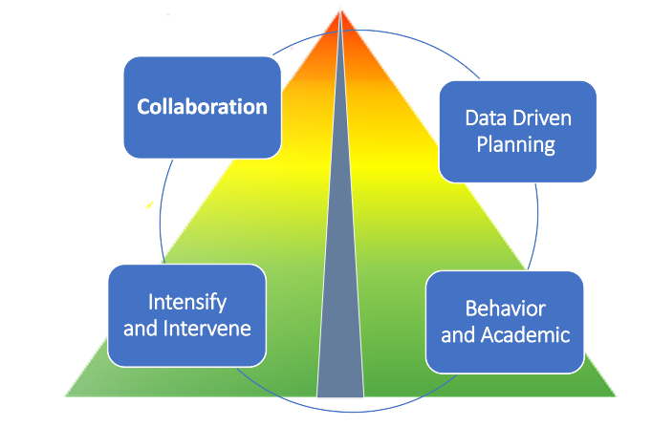
Multi-Tiered Systems of Support (MTSS) Statement of Purpose
MTSS is a framework that integrates assessment and intervention within schoolwide, multilevel prevention systems to maximize student outcomes for all learners.
Notes:
Explanation of Slide
Let’s review how MTSS and HLPs can work together to support student learning. What is MTSS? MTSS stands for multitiered system of support. It is a framework that integrates assessment and intervention within a schoolwide, multilevel prevention system to maximize student outcomes for all learners.

Slide 14
Components of MTSS
Considers the supports available within the system.
Provides infrastructure to support implementation of EBPs using HLPs.
Notes:
Explanation of Slide
MTSS helps educators to think about the supports and the systems in place to sustain their work. It provides a process for better understanding and implementing supports within the entire system that can support each child.

Slide 15

MTSS as a Multilevel Prevention System
3% to 5% of students
Students With Disabilities
Receive services
at all levels, depending on need
Tier 3: Intensive Level
of Prevention
Tier 2: Targeted Level
of Prevention
15% of students
Tier 1: Universal Level
of Prevention
80% of students
Notes:
Explanation of Slide
Many educators associate MTSS with the following triangle. It is intended to represent the three levels of prevention and the percentage of students who would be expected to benefit from these levels of prevention in an effective system. The first level, or Tier 1, is in green. It is expected that most students, at least 80%, benefit from core curriculum delivered through differentiation.
The next level, or Tier 2, supplements Tier 1. Even with good instruction, it is estimated that approximately 15% of students will need supplemental, small-group instruction to benefit from the core instruction and curriculum.
The top level, or intensive instruction or Tier 3, includes specialized, individualized systems for students with intensive needs. It typically involves small-group instruction of one to three students who are significantly behind their peers. It is estimated that approximately 3% to 5% of students will need intensive support.
If fewer than 80% of students are benefiting from the current primary prevention system, schools should consider focusing school improvement efforts on improving the core instruction and curriculum, which is where the HLPs can be instrumental. If a large percentage of students are in Tier 2 or Tier 3, consider implementing large-group instructional activities and system changes within Tier 1 to reduce the number of students requiring additional support.
Students with diverse learning needs, including ELs, SWDs, or students who are gifted, may receive supports throughout the levels of the system, depending on their individual needs.

Slide 16
MTSS and HLPs
Collaboration
Data Driven Planning
Intensify and Intervene
Behavior and Academic
Notes:
Explanation of Slide
You may be wondering how HLPs and MTSS fit together? HLPs are integral to this framework because these areas have been substantiated as having meaningful and enduring effects on student outcomes and learning environments. As stakeholders work to identify practices within collaboration, instruction, social-emotional learning, and assessment, the HLPs are established as practices that result in meaningful outcomes. The use of HLPs by general education teachers ensures that most students gain access to the general education curriculum. The result is that only those students who have more intensive needs will need to access support from Tier 2 and Tier 3.

