Slide 1
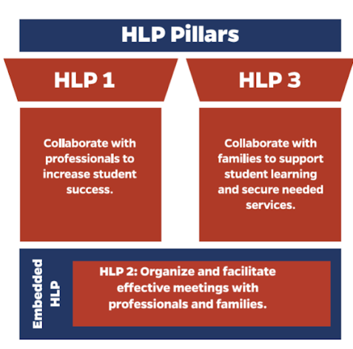
Collaboration HLPs
HLP 3
Collaboration with Families
Notes:
*Emphasize the connections to the HLPs.
Explanation of Slide
HLP 2 supports the collaboration pillars of the CEC high-leverage practices. [Read slide.] Because today we are specifically talking about IEP team meetings, we will focus on HLP 2, which is specific toward meetings.
HLP 2 full text: Teachers lead and participate in a range of meetings (e.g., meetings with families, individualized education program [IEP] teams, individualized family services plan [IFSP] teams, instructional planning) to identify clear, measurable student outcomes and develop instructional and behavioral plans that support these outcomes. They develop a meeting agenda, allocate time to meet the goals of the agenda, and lead in ways that encourage consensus building through positive verbal and nonverbal communication, encouraging the sharing of multiple perspectives, demonstrating active listening, and soliciting feedback.
Throughout this presentation, we’ll be sharing strategies to help support the implementation of this practice.

Slide 2



HLP 3: Key Elements of Collaboration with Families
Respectful Communication
Advocate
Encourage Students
Consider background, socioeconomic status, language, culture, and family priorities.
Educators should advocate for resources to help meet instructional, social, behavioral, or transition goals. Support families in self-advocacy.
Educators should encourage students to self-advocate and develop self-determination skills through the collaboration process.
Notes:
Explanation of slide.
[Read slide.]
HLP 3 full text: Teachers collaborate with families about individual children’s needs, goals, programs, and progress over time and ensure families are informed about their rights as well as about special education processes (e.g., IEPs, IFSPs). Teachers should respectfully and effectively communicate considering the background, socioeconomic status, language, culture, and priorities of the family. Teachers advocate for resources to help students meet instructional, behavioral, social, and transition goals. In building positive relationships with students, teachers encourage students to self-advocate, with the goal of fostering self-determination over time. Teachers also work with families to self-advocate and support their children’s learning.

Slide 3


Collaborating in your context
Who do you successfully collaborate with on a regular basis?
What is one thing that makes it successful?
Notes:
Explanation of Slide
On the chart paper in groups, or in a padlet…name who you collaborate with in a successful way. What is one thing that makes it successful?
Example: I work with the 4th grade teacher and we have dedicated time to talk about students.
Facilitation note:
Ask for volunteers for 4-5 people to give their example.

Slide 4
Strengthening Collaboration
What strategies can assist in collaborating with families?
  Ongoing communication
    Topics
    Modes
    Supports needed and resources available
Notes:
Explanation of Slide
We are going to talk today about strategies for strengthening collaboration with families.

Slide 5
Collaborating with families:
Ongoing communication topics
Happens when educators actively encourage families to participate in meaningful ways, and families support their children at home as well as at school.
This is a mutually beneficial relationship!
Ongoing communication topics:
  Student development and learning
  Challenges
  Successes
  High expectations
  Family experiences
Notes:
Explanation of Slide
Family engagement is a practice in which families and school personnel collaborate to support and improve the learning and development of children. Sometimes, this practice is referred to as parent engagement, parent involvement, or family-school partnership.
But family engagement means more than simply informing parents about their child’s progress or challenges, where communication is primarily one-way—that is, from the teacher to the parent. Rather, family engagement happens when educators actively encourage families to participate in meaningful ways, and families support their children at home as well as at school. This establishes a mutually beneficial relationship, one in which educators are committed to listening and collaborating with families and families are committed to prioritizing their children’s education. This relationship between schools and families can be focused on the following topics:
-Centered around student development and learning
-Challenges
-Successes
-High expectations
-Family experiences

Slide 6
Collaborating with families:
Communication opportunities
Scheduling
Scheduling events at times convenient for parents
Informing
Informing families of special events that foster connections (e.g., Meet the Teacher Night, Coffee and Conversations with the Principal, School Tours, Family Fun Night)
Hosting
Hosting parent nights that address parent concerns (e.g., Internet Safety for Children, Free Adult English Classes, Your Rights as a Parent of a Child with a Disability)
Notes:
Explanation of Slide
Creating an accepting and supportive environment is the first step in welcoming families. When families enter a school building, they should feel valued and included. This is especially true for the families of children with disabilities, who may already be grappling with a number of stressors. But a welcoming school environment is more than just a friendly front office staff. The interactions of everyone in the school—administrators, teachers, support staff, students, and visitors—should be caring and supportive. Educators can welcome families by creating opportunities for parents to make positive connections within the school.

Slide 7

Collaborating with families:
Communication opportunities
Offering volunteer opportunities for parents (e.g., read to a class, guest speaker, car rider line volunteer)
Providing a translator when necessary and making information available in families’ home language
Providing opportunities to families to share about their family experiences
Establishing regular communication about student/classroom (e.g., parent communication notebook, emails, phone calls)
Notes:
Explanation of Slide – Read slide

Slide 8

Collaborating with families:
Ongoing communication, supports needed and outside resources available
Communicate with families about supports needed at home
Provide families with resources that would be relevant to their situation or child
Notes:
Explanation of Slide
Educators should explicitly communicate with families about supports needed at home. Parents want to help their children and often appreciate knowing how they can provide supports at home. However, educators should involve families in a manner that is meaningful to them. The way in which a family gets involved in the education system is likely to be as unique as the family itself. A single mother working two jobs and struggling to make ends meet might find it difficult to allow her children to participate in after-school activities. On the other hand, she might make sure that her children read every day and complete their homework. She may appreciate other supports or resources that may help her situation or child.

