Slide 1
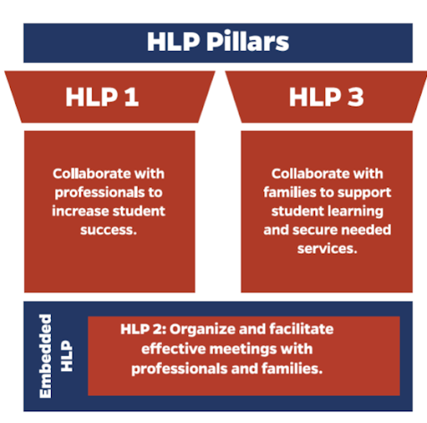
Collaboration HLPs
HLP 2: Facilitating Effective Meetings
Notes:
*Emphasize the connections to the HLPs.
Explanation of Slide
HLP 2 supports the collaboration pillars of the CEC high-leverage practices. [Read slide.] Because today we are specifically talking about IEP team meetings, we will focus on HLP 2, which is specific toward meetings.
HLP 2 full text: Teachers lead and participate in a range of meetings (e.g., meetings with families, individualized education program [IEP] teams, individualized family services plan [IFSP] teams, instructional planning) to identify clear, measurable student outcomes and develop instructional and behavioral plans that support these outcomes. They develop a meeting agenda, allocate time to meet the goals of the agenda, and lead in ways that encourage consensus building through positive verbal and nonverbal communication, encouraging the sharing of multiple perspectives, demonstrating active listening, and soliciting feedback.
Throughout this presentation, we’ll be sharing strategies to help support the implementation of this practice.

Slide 2



HLP 2: Key Elements of Facilitation
Lead and Participate
Identify Student Outcomes
Facilitate Effectively
Educators lead and participate in various meetings. Examples include IEP meetings, parent or family meetings, and instructional planning.
Educators develop a meeting agenda, allocate time, and encourage consensus.
Identified outcomes should be measurable. Instructional and behavioral plans should be aligned and support these goals.
Notes:
Explanation of Slide
[Read slide.]

Slide 3
IEP Meeting Facilitation-
As an Example
Notes:
For this content, we are going to use an IEP meeting as example of HLP 2, effective meeting facilitation.

Slide 4
Types of IEP Meetings
Initial
  Establish eligibility, develop the IEP, and make special education service and program recommendations.
Revision/Amendment
  Used when making minor changes to an existing IEP. **
  Revised copy will reflect the changes and modifications and will be labeled in the list of student documents as a revision.
Annual Review
  Review progress monitoring data, revise goals and objectives as needed, determine the student’s program.
Reevaluation
  Mandated every three years to discuss reevaluation and continued eligibility.
** An IEP meeting can be called at any time by any party.
Notes:
Explanation of Slide
There are several types of IEP meetings. At the initial meeting, the IEP team establishes eligibility, develops the IEP, and makes special education service and program recommendations.
A revision/amendment meeting can be called at any time by any party to make minor changes to an existing IEP. The revised copy will reflect the changes and modifications and be labeled in the list of student documents as a revision.
At the annual review, the IEP team reviews the student’s progress, revises goals and objectives, and determines the student’s program. An updated IEP is developed during this meeting.
A mandatory reevaluation must occur every three years. This meeting is used to discuss the need for reevaluation to determine continued eligibility for special education services. At this meeting, the team may decide that reevaluation or further testing is not necessary.
Note that an IEP meeting can be called at any time by any party.

Slide 5


Components of Effective IEP Meetings
Component 1: Prepare
Component 2: Facilitate
Notes:
Explanation of Slide
There are two components of effective IEP meetings: Prepare and facilitate.

Slide 6
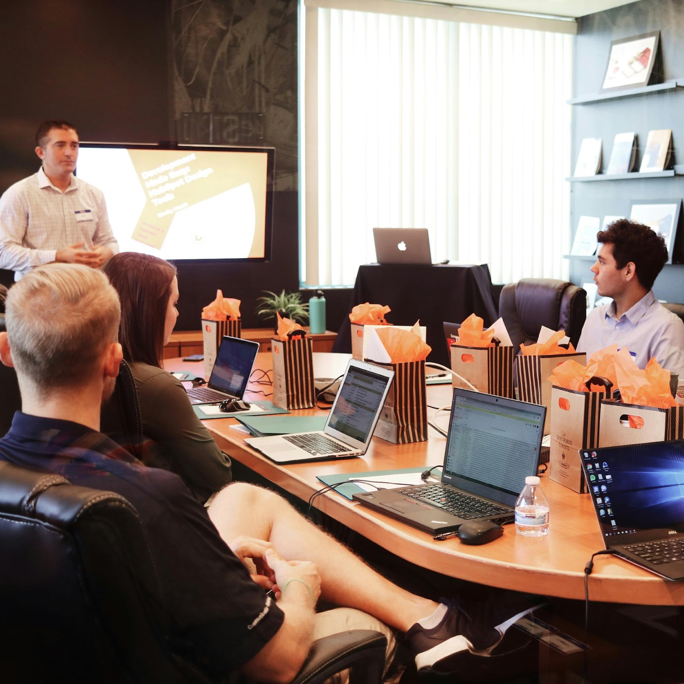
Component 1: Prepare for IEP Meetings
Set a clear goal for the meeting and prepare an agenda.
Determine required team members and their common availability.
Gather and organize key student assessment data.
Share the date, data, and expectations for preparation and participation with all team members.
Notes:
Explanation of Slide
Listed are the key tasks for preparing for an IEP meeting. We will be discussing each of these more in depth.
[Read slide.]

Slide 7
Prepare: Set a Clear Goal for the Meeting
Questions to consider:
Why are you having this meeting?
What do you and the participants hope to accomplish?
Example 1
Example 2
  The Goal for Student K’s upcoming IEP meeting is to review his progress and discuss the effectiveness of accommodations. We will adjust his IEP, as necessary.
  The Goal for Student K’s upcoming meeting is to discuss relevant data with the team to begin initial planning for Student K’s transition services.
Notes:
Explanation of Slide
When setting a goal for the IEP meeting, consider the following:
Why are you having this meeting?
What do you and the participants hope to accomplish?
[Read slide.]

Slide 8
Prepare: Determine Required Team Members and Common Availability
Required
Parent(s)
General education teacher(s)
Special education teacher(s)
Local education agency representative
Individual who can interpret implications of evaluation results (does not need to be a separate participant)
Others as Appropriate
Student (required if 16+ or if transition is discussed)
Interpreter
Related service personnel
People with other specialized knowledge or expertise regarding the student
Representatives of key agencies providing transition services
Notes:
Explanation of Slide
The LEA shall ensure that each IEP Team meeting includes the following participants: (a) The parents of the child; (b) Not less than one general education teacher of the child (if the child is, or may be, participating in the regular education environment); (c) Not less than one special education teacher of the child, or where appropriate, not less than one special education provider of the child; (d) A representative of the LEA (examples include, but are not limited to, a principal, supervisor, or counselor); (e) An individual who can interpret the instructional implications of evaluation results, [34 C.F.R. § 300.321(a)(5)] (f) At the discretion of the parent or the LEA, other individuals who have knowledge or special expertise regarding the child, including related services personnel as appropriate; [34 C.F.R. § 300.321(a)(6)] and; (g) Whenever appropriate, the child with a disability. The student must be required if aged 16 or older, or if transition is being discussed.
Note that the individual who can interpret the instructional implications of evaluation results does not need to be a separate person. (i.e. if the special education teacher can interpret evaluation results, they also count in this category.)
It is important to coordinate the date and time of the meeting with parents ahead of time to schedule during their availability. This is important for parent participation.

Slide 9
Prepare: Gather and Organize Key Student Assessment Data
Step 1: Gather assessment information and highlight main findings.
Step 2: Take into account considerations for culturally and linguistically diverse students.
Step 3: Identify the student’s strengths and needs.
Step 4: Consider how assessment information impacts accommodations, modifications, and fair grading practices.
Step 5: Be prepared to explain assessment data and/or create assessment communication documents based on audience.
Notes:
Step 1: Assessment data may come from a variety of sources, including state standardized assessments, interim district and school assessments, families, general educators, and other professionals (e.g., speech and language pathologists, behavior specialists). Often assessment data already come in reports, although the writing may be technical. Special education teachers should read all assessment information carefully and highlight/note the main findings. If an assessment is unfamiliar or the data need clarification, special education teachers should seek additional counsel to determine the main findings.
Step 2: Because culturally and linguistically diverse students are overrepresented in special education, having multiple measures is even more critical for this group of students. Several different types of assessments indicating similar results assist in the confidence that the results are accurate.
Step 3: The third step in interpreting data is to generate an initial list of student strengths and need areas across assessment findings. Using multiple assessments and viewpoints is beneficial in making determinations about student strengths and needs. Varying types of assessments provide different levels of data to use to create a student profile of strengths and needs.
Step 4: The special education teacher should review assessment findings, consider the identified strengths and needs, and generate potential implications. For example, a student who is having difficulty decoding may need an accommodation that allows for math questions to be read aloud. A student who is having difficulty answering multiple choice questions may need an accommodation to provide oral answers to in-class assessments.
Step 5: In addition to original reports, it may be helpful for special educators to make a guide or table that includes the different assessments, data results, interpretations, and considerations to assist in communicating assessment data. Because multiple assessments are necessary to provide a comprehensive and accurate view of student strengths and needs, it is difficult to communicate data with key stakeholders with seemingly endless pages of data and technical terms. Having a document will make communication more organized and less overwhelming for both the person relaying the information and the people receiving the information. A communication document is not required but may be helpful. Regardless of whether the special educator has an assessment communication document, they should always be prepared to explain assessment data.

Slide 10



Prepare:
Share the date, data, and expectations for preparation and participation with all team members (Notice of Meeting).
Share the date, location and participants
Share the relevant data tailored to specific audiences
Share the purpose of the meeting and expected participation with participants.
Notes:
Explanation of Slide
Special education teachers should give time for receivers of information to read and digest results before meeting in person. If an IEP team is meeting, providing assessment results a week in advance allows all key stakeholders time to review and think about the interpretation and implications of the data.
When the team meets together, the special education teacher can use the communication documents to review relevant results, considerations, and implications. This provides a starting point for conversations and input from the team about educational plans.

Slide 11
Legal Compliance
Each LEA shall take steps to ensure that one or both of the parents of a child with a disability are present at each IEP Team meeting or are afforded the opportunity to participate, including notifying parents of the meeting early enough to ensure that they will have an opportunity to attend, and scheduling the meeting at a mutually agreed upon time and place.
[ 34 C.F.R. § 300.322(a)(1) - (2) ]

Slide 12
Component 2:
Facilitate Effective IEP Meetings
Establish a welcoming and positive tone
Promote discussion, equal voice, and contributions.
Maintain efficiency by encouraging consensus building while ensuring that conversations stay on-task with the meeting purpose.
Ensure that all team members understand student data
Summarize what was accomplished
Discuss any follow-up activities that need to occur after the meeting’s conclusion.
Notes:
Explanation of Slide
We will be talking in detail about each of the following elements of facilitating effective IEP meetings.
Read elements.

Slide 13




Tips for Engaging Participants
Request and provide relevant assessment data to each team member based on their role.
Provide a data assessment summary sheet and comprehensive learner profile that will inform the educational plan.
Share appropriate background information and contextual considerations that emphasize students’ identified strengths and needs.
Develop a plan for future data collection and use.
Source: High Leverage Practices for Inclusive Classrooms, 2019.
13
Notes:
Explanation of Slide
[Read slide.]
This information and further details can be found in the book High Leverage Practices for Inclusive Classrooms, made available by the Council for Exceptional Children.

Slide 14
Facilitate:
Establish a welcoming and positive tone
Greet all participants with a positive tone.
Check in with front office individuals so they know someone is coming for a meeting and will provide a welcome.
“Mrs. Jones (mom) I am so glad you are here today. You are such an important part of our team.”
“Thanks for coming Mr. Lemstrom (general ed teacher). It is going to be really helpful to learn more about biology and the class expectations so we can ensure student K is successful.”
Notes:
Slide 16
Explanation of Slide
To establish a welcoming and positive tone, greet all participants with a positive tone and ensure all members are introduced with their names and roles.
Read examples.
It may be helpful to have older students do the introductions, as it improves self-advocacy and involvement in the process.
Facilitation note: If time allows, have students role play in pairs or small groups. Have them come up with their own examples to practice greeting and introducing participants.

Slide 15

Facilitate:
Establish a welcoming and positive tone
Ensure all members are introduced with name and role.
Start the meeting by explicitly saying something positive about the student.
For example, it is not enough to say, “This is Mrs. Smith.”
“Mrs. Smith is representing Publix where Student K has been learning job skills.”
“Student K has been a pleasure to have in class. He has made progress as a result of his effort and attitude.”
Notes:
Explanation of Slide
To establish a welcoming and positive tone, greet all participants with a positive tone and ensure all members are introduced with their names and roles.
Read examples.
It may be helpful to have older students do the introductions, as it improves self-advocacy and involvement in the process.
Facilitation note: If time allows, have students role play in pairs or small groups. Have them come up with their own examples to practice greeting and introducing participants.

Slide 16



Facilitate: Promote Discussion, Equal Voice, and Contributions
During the meeting, encourage each participant to contribute.
  Asking guiding questions to parents often solicits feedback as opposed to just an open call.
  “Mrs. Jones, could you tell us how Student K responds to multistep tasks at home?”
  “Ms. Reyes, can you share how Student K handles transitions between activities at home?”
  “Mrs. Jones, do you have anything to add?”
Example
Example
Non-Example
Notes:
Explanation of Slide
To promote discussion, equal voice, and contributions during the meeting, encourage each participant to contribute. Asking guiding questions to parents often solicits feedback as opposed to simply asking if they have any questions.
Read examples.

Slide 17
Maintain efficiency by encouraging consensus building while ensuring that conversations stay on-task with the meeting goal(s).
Ask questions to ensure agreement
  “Mrs. Jones, do you agree with the need we have established that Student K has difficulty following multi-step directions?”
Redirect when necessary
  Bring up the goal of the meeting
  Reserve questions unrelated to
  the IEP for after the meeting.
** Can you think of a time a meeting got derailed? Why? Did it get back on track? If so, how?
Notes:
Explanation of Slide
It is a good strategy when making decisions to get verbal agreement from different members of the team to build consensus and ensure participation from all members.
Sometimes meetings go in different directions. For example, the general education teacher may start telling a story about a situation with another student. “Did you know that I have another student who is also having a hard time in biology and he….”
In these circumstances, it is your job to bring the meeting back to the goal as quickly as possible. For example, you could say, “Mr. Lemstrom, you certainly have a record of assisting students, bringing us back to our goal today about Student K….”
Another strategy is to reserve questions unrelated to the IEP for after the meeting. This acknowledges a person’s contributions, but keeps the item for later.
For example, Mrs. Jones might start telling a story about Student K and his disagreement with the PE teacher, but the meeting is focused on biology and his use of accommodations to access the general education curriculum. You could say, “Mrs. Jones, can we come back to this information to discuss after our meeting? It is a really important need for student K, so I don’t want to lose this information, but I also want to make sure we reach our meeting goal today talking about biology and accommodations.”
We have all been in a meeting like this. Take a minute to talk to a partner about a meeting that was derailed. What happened? Did the meeting get back on track? If so, how?
Facilitation note:
Give 5 minutes for pairs to discuss. Call on 2 or three people to give their positive example of how a meeting was brought back on track.

Slide 18
Facilitate: Maintain Efficiency by Encouraging Consensus Building
Ask questions to ensure agreement.
  “Mrs. Jones, do you agree with the need we have established that Student K has difficulty following multistep directions?”
Redirect when necessary.
  Bring up the goal of the meeting.
  Reserve questions unrelated to the IEP for after the meeting.
Can you think of a time a meeting got off track? Why?
What strategies did you use to redirect the meeting?
Notes:
Explanation of Slide
It is a good strategy when making decisions to get verbal agreement from different members of the team to build consensus and ensure participation from all members.
Sometimes meetings go in different directions. For example, the general education teacher may start telling a story about a situation with another student. “Did you know that I have another student who is also having a hard time in biology and he….”
In these circumstances, it is your job to bring the meeting back to the goal as quickly as possible. For example, you could say, “Mr. Lemstrom, you certainly have a record of assisting students, bringing us back to our goal today about Student K….”
Another strategy is to reserve questions unrelated to the IEP for after the meeting. This acknowledges a person’s contributions, but keeps the item for later.
For example, Mrs. Jones might start telling a story about Student K and his disagreement with the PE teacher, but the meeting is focused on biology and his use of accommodations to access the general education curriculum. You could say, “Mrs. Jones, can we come back to this information to discuss after our meeting? It is a really important need for student K, so I don’t want to lose this information, but I also want to make sure we reach our meeting goal today talking about biology and accommodations.”
We have all been in a meeting like this. Take a minute to talk to a partner about a meeting that was derailed. What happened? Did the meeting get back on track? If so, how?
Facilitation note:
Give 5 minutes for pairs to discuss. Call on 2 or three people to give their positive example of how a meeting was brought back on track.

Slide 19
Facilitate: Ensure All Team Members Understand Student Data
Reinforce and double check understanding of data.
“Student K received a 215 on the state reading assessment. This indicates he is below grade level. Students in his grade level must score a 255 to be considered on level. In reviewing sections, Student K’s strengths were in locating main ideas, but he struggled with integrating key details. Does anyone have questions about this assessment or need more information?”
Notes:
Explanation of Slide
To ensure that all team members understand student data, reinforce and double check understanding of data. [Read example.]

Slide 20
Facilitate:
Summarize what was accomplished
Reference the purpose related to accomplishments
Mention key determinations, recommendations or services.
“For today’s meeting our purpose was…”
“After reviewing the data, we all agree that…”
Notes:
Read slide.

Slide 21
Facilitate: Summarize What Was Accomplished
Reference the purpose related to accomplishments.
Mention key determinations, recommendations, or services.
“For today’s meeting our purpose was . . .”
“After reviewing the data, we all agree that . . .”
Notes:
Explanation of Slide
[Read slide.]

Slide 22
Discuss any follow-up activities that need to occur after the meeting’s conclusion.
Create a “to do” of any follow up activities from the IEP meeting and who is responsible.
The special education teacher will follow up with Mrs. Smith about training in the new strategy.
Mrs. Smith will meet with student K’s supervisors to coordinate training in the new strategy that will be implemented at when student K is working at Publix.
Mrs. Jones will also start using this strategy at home to reinforce.
Notes:
Explanation of Slide
Before you end the meeting, discuss any follow-up activities that need to occur after the meeting’s conclusion. Create a “to do” of any follow-up activities and who is responsible.
Read examples.

Slide 23
Reflect and Discuss
How do I welcome people when they arrive?
Do the participants in my meetings equally participate?
How am I doing at keeping meetings on task and efficient?
Do I help all members understand data?
How do I typically summarize the meeting?
How do I document follow-up activities?
**Identify an aspect of facilitation for IEP meetings I can implement in my context.
Notes:
Facilitation note:
Have teachers break into groups to discuss individual contexts. Have them identify one aspect of facilitation for IEP meeting you can implement in your context.
Recommended time: 8 minutes

Slide 24
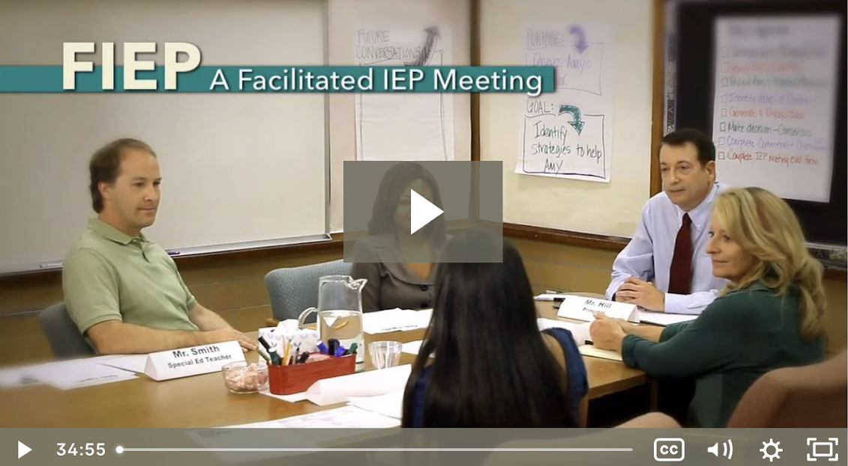
Practice
Break into groups to watch video clips of an IEP meeting.
Complete the “What Do You Notice” handout.
Notes:
Explanation of Slide
Take out the “What Do You Notice” handout. We are going to watch some clips together and I want you to fill in the boxes and we will discuss what you saw after.
Facilitation notes:
After you watch clips, go though every part and have people identify what they saw, positives, improvements. Any aspects related to the meeting.
Watch these clips: https://esc13.net/resources/a-facilitated-iep-meeting
4:40-6:55
9:09-12:37
14:27-17:04
28:05-30:41
31:47- 32:41

