Slide 1
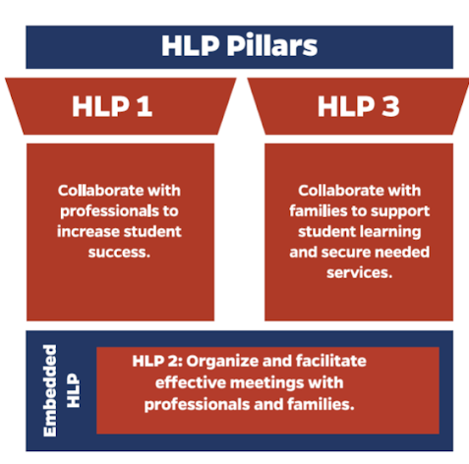
Collaboration HLPs
Notes:
*Emphasize the connections to the HLPs.
Explanation of Slide
HLP 2 supports the collaboration pillars of the CEC high-leverage practices. [Read slide.] Because today we are specifically talking about IEP team meetings, we will focus on HLP 2, which is specific toward meetings.
HLP 2 full text: Teachers lead and participate in a range of meetings (e.g., meetings with families, individualized education program [IEP] teams, individualized family services plan [IFSP] teams, instructional planning) to identify clear, measurable student outcomes and develop instructional and behavioral plans that support these outcomes. They develop a meeting agenda, allocate time to meet the goals of the agenda, and lead in ways that encourage consensus building through positive verbal and nonverbal communication, encouraging the sharing of multiple perspectives, demonstrating active listening, and soliciting feedback.
Throughout this presentation, we’ll be sharing strategies to help support the implementation of this practice.

Slide 2



HLP 1: Key Elements of Collaboration with Professionals
Include a Variety of Stakeholders
Effective Communication
Develop or Adjust Plans
General education teachers, paraprofessionals, and support staff should all be part of the collaboration process.
Share ideas, engage in active listening, questioning, planning, problem
solving, etc.
Use student data to
inform instructional or behavioral plan adaptations.
Notes:
Explanation of slide.
[Read slide.]
HLP 1 full text: Collaboration with general education teachers, paraprofessionals, and support staff is necessary to support students’ learning toward measurable outcomes and to facilitate students’ social and emotional wellbeing across all school environments and instructional settings (e.g., cotaught). Collaboration with individuals or teams requires the use of effective collaboration behaviors (e.g., sharing ideas, active listening, questioning, planning, problem solving, negotiating) to develop and adjust instructional or behavioral plans based on student data, and the coordination of expectations, responsibilities, and resources to maximize student learning.

Slide 3


Collaborating in your context
Who do you successfully collaborate with on a regular basis?
What is one thing that makes it successful?
Notes:
Explanation of Slide
On the chart paper in groups, or in a padlet…name who you collaborate with in a successful way. What is one thing that makes it successful?
Example: I work with the 4th grade teacher and we have dedicated time to talk about students.
Facilitation note:
Ask for volunteers for 4-5 people to give their example.

Slide 4
Strengthening Collaboration
What strategies can assist in collaborating with other professionals?
  Cultivating positive relationships
  Shared problem solving
  Co-teaching considerations
Notes:
Explanation of Slide
We are going to talk today about strategies for strengthening collaboration with other professionals

Slide 5
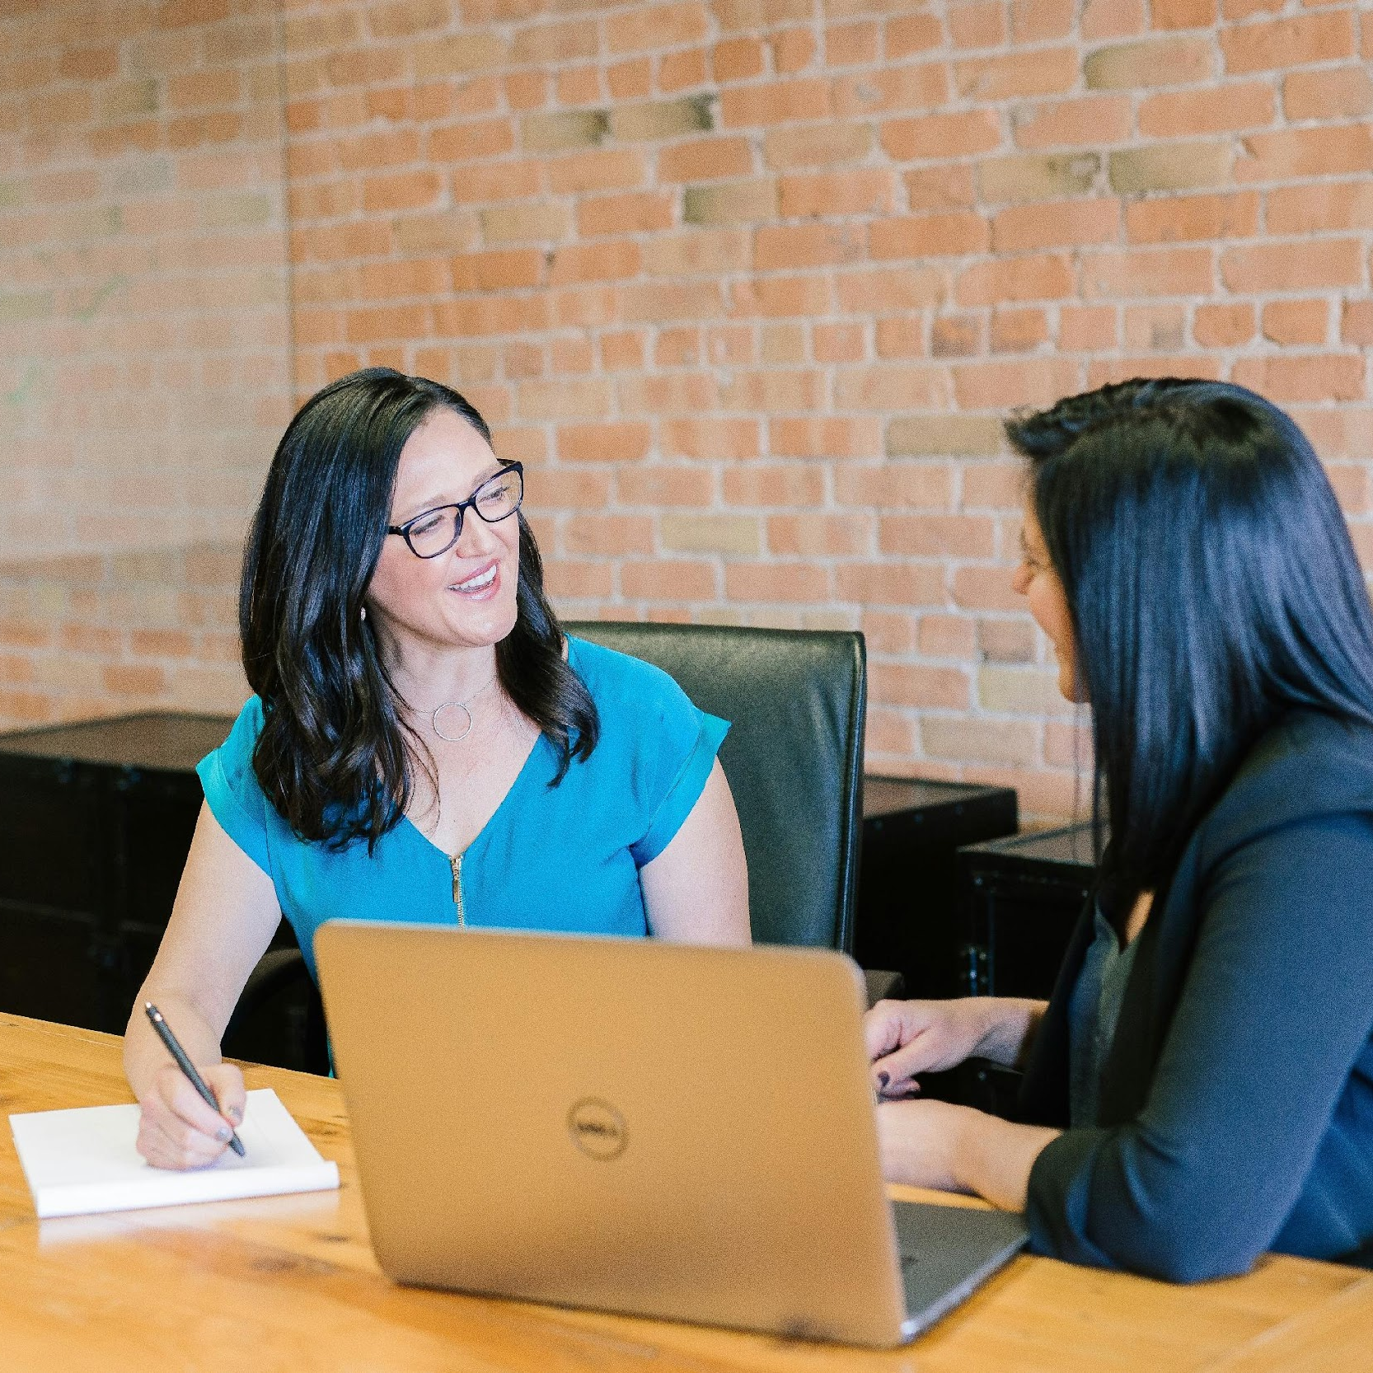
Collaborating with professionals: Cultivating positive relationships
Use non-verbal listening skills that include smiling, nodding and making eye contact
Share resources
Find supportive statements to reinforce
Find common/shared connections and experiences
Communicate in a timely manner
Notes:
Explanation of Slide
Building positive relationships sometimes takes some direct action on your part. There are some simple strategies that can help to build a positive relationship with other colleagues. The first is paying attention to your non-verbal language. Smile and make eye contact with your colleagues. Sometimes you may be stressed out about a classroom situation, but take a moment to reset and smile at your colleagues. If you have resources that might be helpful to a colleague, share them. Look for something positive to reinforce in your colleagues. Everyone likes positive feedback. Finally, look for any shared connections or experiences. It is easier to build relationships when you can help others see what you have in common. Reinforce the common! And finally, communicating in a timely manner is crucial. Best practice is to respond to emails within one business day.

Slide 6


Collaborating with Professionals:
Shared Problem Solving
Use active listening skills, paraphrase, and ask clarifying questions.
Focus on data for challenging discussions.
Have a “working together” perspective.
Notes:
Explanation of Slide
When dealing with challenges, professionals often feel frustration. You can help to create a collaborative problem-solving environment by using active listening skills, paraphrasing, and asking clarifying questions. When things get heated, look at the data; this will take the focus away from people and onto the data to help make solutions. It is good to reinforce that we are in this together to solve problems. This creates a culture of collaboration.

Slide 7


Collaborating with Professionals:
Shared Problem Solving
  “What I hear you saying, Judy, is you are frustrated with Student K because he is disturbing other students during group work. Let’s take a look at last week’s observation data together so we can work together to come up with some strategies.”
  “Judy, I am pretty sure if you implement the strategies we discussed at the last IEP meeting, Student K would not be distracted. You just need to follow through.”
Non-Example
Example
7
Notes:
Explanation of Slide
[Read example and non-example.]

