Slide 1
Domain 1
Collaboration
Notes:
Collaboration is essential in special education, focusing on the collective efforts of professionals and families to support students with disabilities. It ensures that each student's Individualized Education Program (IEP) is implemented effectively, promoting student success in academic and social settings.
This domain emphasizes the need for shared expertise among general and special educators, paraeducators, and family members. Effective collaboration fosters better communication, planning, and implementation of instructional strategies, ultimately enhancing students' learning experiences.

Slide 2
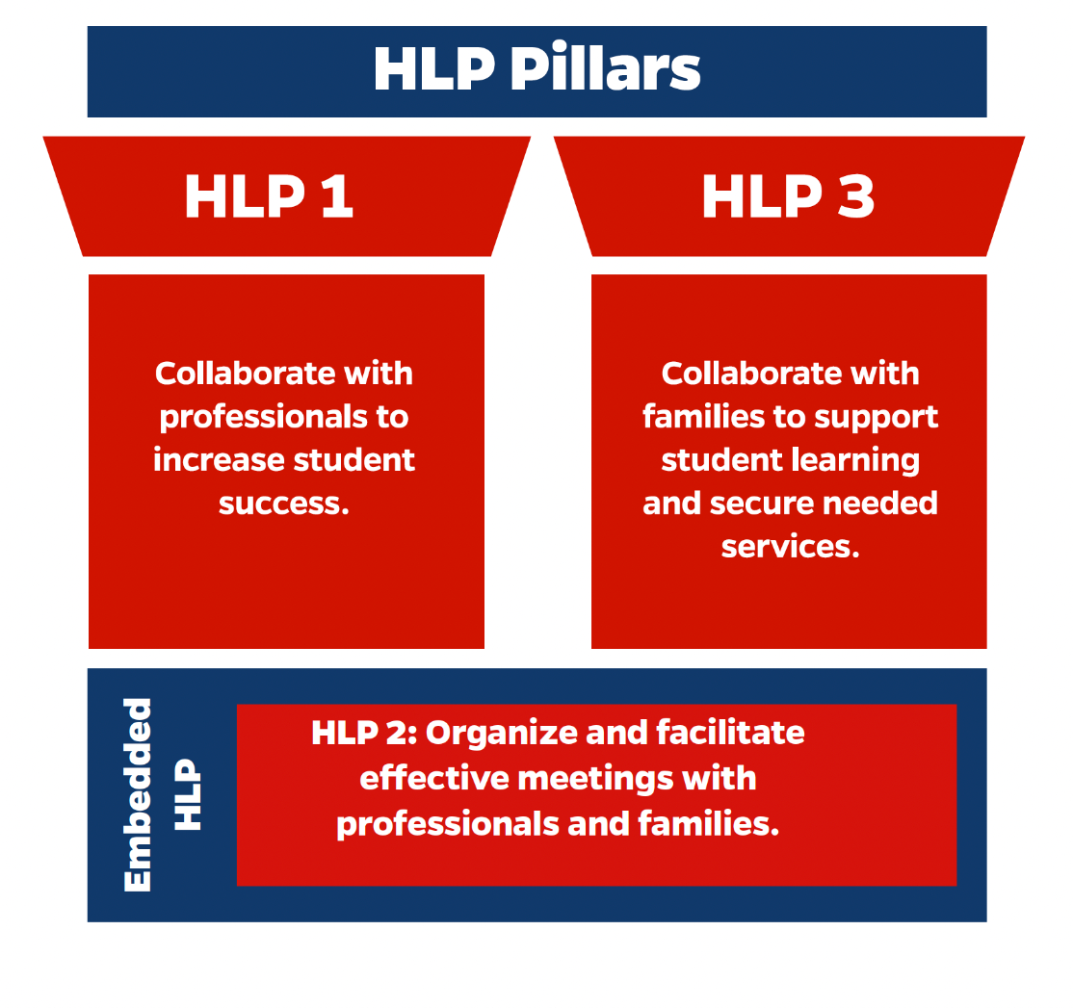
Notes:
These are the pillar practices and embedded HLP for the collaboration domain.

Slide 3
Key Components of Collaboration
Understanding student's holistic needs
Planning and implementing IEPs
Monitoring student progress
Adjusting instruction as needed
Notes:
Let's break down the essential components of effective collaboration. First, we must understand each student's holistic needs—not just academic, but contextualizing the entire child. Second, IEP planning and implementation require input from all team members. Third, we continuously monitor progress to ensure our interventions are working. Fourth, we adjust instruction based on data. Finally, we reflect on our practices to ensure we're meeting the needs of all students.

Slide 4
Key Stakeholders in Collaboration
General Educators: Curriculum and instruction knowledge.
Special Educators: Specially designed instruction and progress monitoring.
Support Personnel: Speech therapists, counselors, etc.
Families: Provide insight into students' needs and help build trust.
Notes:
Four key groups make collaboration work. General educators bring curriculum expertise. Special educators contribute specialized instructional knowledge. Support personnel provide specific expertise like speech therapy or counseling. And critically, families offer invaluable insights into their children's needs and help build trust across the educational team.

Slide 5
Pillar Practice HLP 1
Collaborate with Professionals to Increase Student Success

Slide 6
Pillar Practice HLP 1
Collaborate with Professionals to Increase Student Success.
Focus: Using effective collaboration behaviors like active listening, problem-solving, and planning.
Outcome: Enhanced learning and social-emotional well-being for students.
Notes:
Collaboration among special educators, general educators, paraeducators, support personnel, and family members is crucial for the success and well-being of students with disabilities. The primary goal is to combine the expertise of all team members to create, implement, and adjust instruction to meet the needs of students, often through an Individualized Education Programs (IEPs). This process ensures that instruction is tailored to each student's needs, fostering their learning and development. Effective collaboration improves communication and relationships, allowing team members to achieve shared goals that might not be possible individually. It involves systematic planning and decision-making, where professionals work together to address the diverse needs of students.
Successful collaboration is built on open communication, mutual respect, and a recognition of each team member's strengths. It is essential to consider the intersectional experiences, identities, and backgrounds of both students and their families, ensuring that cultural preferences and perspectives are respected during discussions. Educators must also be aware that families may have different experiences and feelings about school environments, which can impact their engagement. Therefore, ongoing efforts to check biases and assumptions are vital. Despite its complexity and the many factors that influence its quality, collaboration remains a key component in providing effective, inclusive education for students with disabilities.

Slide 7
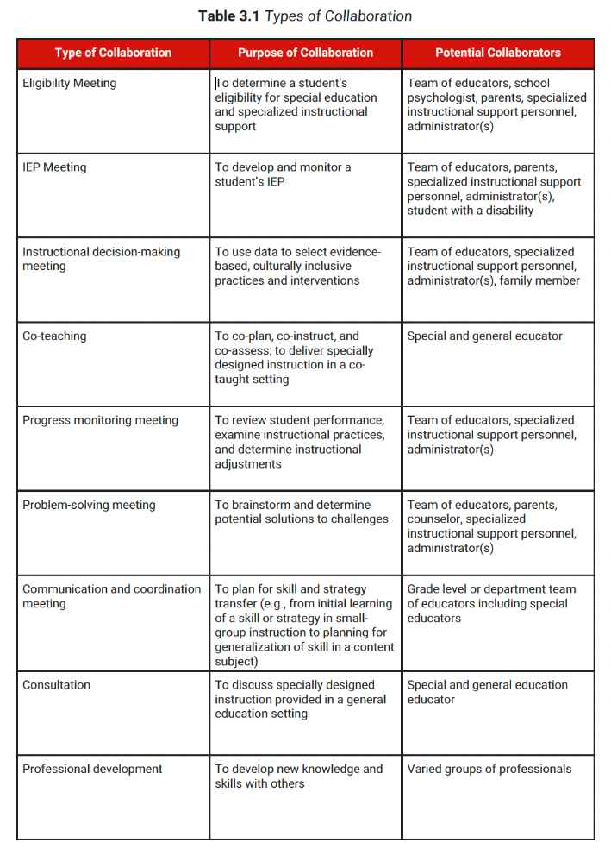
Notes:
Collaboration can come in many forms across a school. Here are some of the ways that collaboration can come into play as well as the purpose and potential collaborators Including paraprofessionals, general, special education, specialized instructors, and administrators as well as students when collaborating gives a much stronger sense of collaboration across the board.

Slide 8
Pillar Practice HLP 3
Collaborate with Families to Support Student Learning and Secure Needed Services.
Focus: Building trust, open communication, and sharing information between school and home.
Notes:
Educator-family collaboration is a crucial aspect of supporting students with disabilities, combining the expertise and perspectives of both educators and families. Federal laws like the Every Student Succeeds Act (ESSA) and the Individuals with Disabilities Education Act (IDEA) mandate such collaboration, emphasizing the role of parents as active members of their child's educational team. These laws ensure parents can participate in annual meetings, request evaluations, and provide input on their child's Individualized Education Program (IEP). This collaborative approach ensures that a student's strengths, needs, and background are fully considered when planning instruction and services, helping to tailor educational experiences more effectively.
Beyond legal requirements, effective collaboration is characterized by trust, respect, and open communication, as educators intentionally engage with families to better understand students' cultural and social contexts. By valuing family insights, educators can better design and implement educational programs that reflect students' lived experiences and needs. Successful collaboration extends across various aspects of a student’s development, such as academic progress, social-emotional growth, behavior, assessment, and transitions. This partnership between educators and families is critical for ensuring students with disabilities have access to meaningful learning opportunities, appropriate behavior support, and smooth transitions throughout their educational journey.

Slide 9
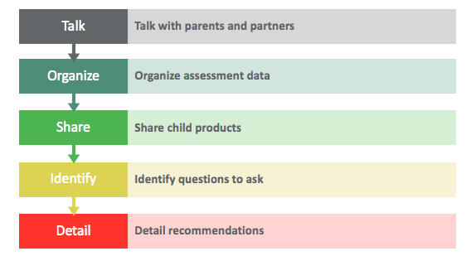
Notes:
This graphic displays some of the ways we as educators collaborate with families.

Slide 10
Embedded Practice HLP 2
Organize and Facilitate Effective Meetings
Purpose: Identifying student outcomes and developing behavioral plans.
Strategies: Creating meeting agendas, encouraging multiple perspectives, and active listening.
Notes:
Organizing effective meetings is an embedded practice that supports all our collaborative efforts. A clear agenda ensures we stay focused and accomplish our goals. Proper time allocation respects everyone's schedules. Consensus building means everyone's voice matters. Active listening shows we value each perspective. Remember, the success of our collaboration often depends on how well we structure these interactions.

Slide 11
Regular Team Meetings
Collaborative planning and role clarity
Effective Collaboration Techniques
In-class collaboration between educators and paraeducators
Professional development opportunities
Notes:
There are so many meetings! Who wants to attend a meeting that is not effective? We have all been to them? Using our collaboration skills, we can facilitate effective meetings that help to accomplish our shared goals.,

Slide 12
Benefits of Effective Collaboration
Improved student achievement
Enhanced educator effectiveness
Better family engagement
Increased student well-being
Stronger educational programs
Notes:
Effective collaboration yields significant benefits. Student achievement improves when we work together cohesively. Educator effectiveness increases through shared expertise. Family engagement strengthens when we truly partner with parents. Student well-being improves with coordinated support. Educational programs become more comprehensive and effective through collaborative effort

Slide 13
Barriers to Collaboration
Limited time
Scheduling conflicts
Communication challenges
Cultural misunderstandings
Limited knowledge of collaboration strategies
Notes:
Let's acknowledge common barriers to collaboration. Time constraints often challenge us. Scheduling conflicts can make meetings difficult. Communication challenges arise, especially across languages or cultures. Limited knowledge of collaboration strategies can hinder effectiveness. But recognizing these barriers is the first step to overcoming them.

Slide 14
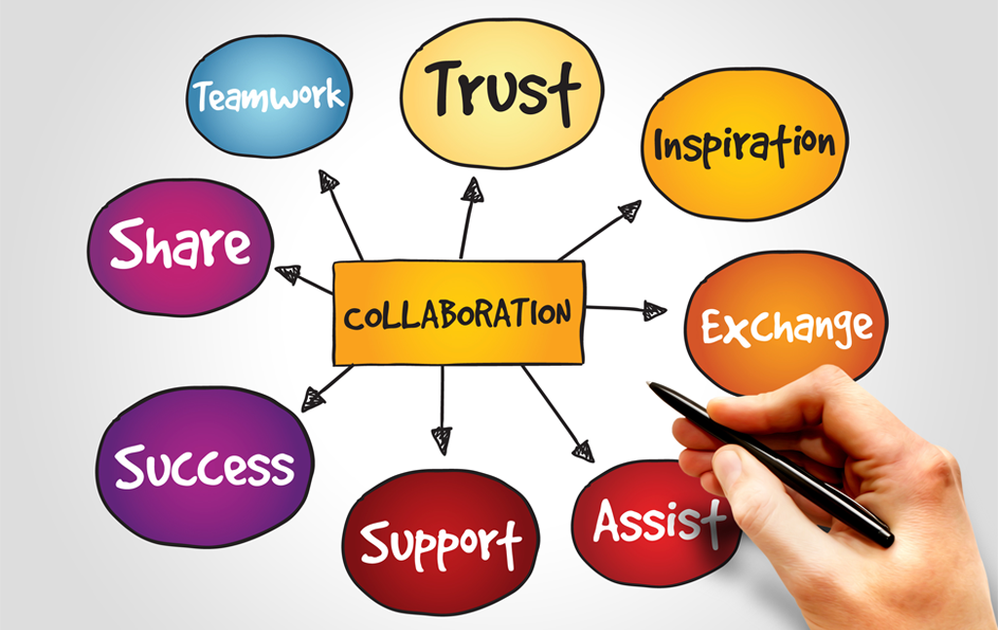
Building Trust in Collaboration
Active listening
Regular communication
Respecting different perspectives
Following through on commitments
Maintaining confidentiality
Notes:
Trust is the foundation of effective collaboration. Active listening shows we value others' input. Regular communication keeps everyone informed and involved. Following through on commitments builds reliability. Maintaining confidentiality ensures professional integrity.

Slide 15
Data-Driven Collaboration
Using assessment data
Progress monitoring
Adjusting instruction
Making informed decisions
Sharing results with stakeholders
Notes:
Data drives our collaborative decisions. We use assessment data to understand student needs. Progress monitoring helps us track effectiveness. This information guides instructional adjustments. When sharing results with stakeholders, we ensure the data tells a clear story about student progress and needs

Slide 16
Family Engagement Strategies
Regular communication
Multiple communication channels
Considering Context
Translation services when needed
Flexible meeting times
Notes:
Effective family engagement requires multiple approaches. We use various communication channels to reach families. Cultural sensitivity guides our interactions. Translation services ensure language isn't a barrier. Flexible meeting times accommodate family schedules. The goal is making families feel valued and included.

Slide 17

Technology in Collaboration
Digital communication tools
Virtual meetings
Online progress monitoring
Shared documents
Accessibility features
Notes:
Technology enhances our collaborative efforts. Digital tools facilitate communication. Virtual meetings increase accessibility. Online progress monitoring simplifies data sharing. Shared documents improve coordination. Accessibility features ensure everyone can participate fully

Slide 18
Measuring Collaborative Success
Student outcomes
Family satisfaction
Team effectiveness
Goal achievement
Program improvement
Notes:
We measure collaborative success through multiple indicators. Student outcomes show program effectiveness. Family satisfaction reflects engagement quality. Team effectiveness indicates collaborative strength. Goal achievement demonstrates progress. Program improvement shows systemic growth.

Slide 19
Best Practices Summary
Maintain regular communication
Focus on student success
Respect different perspectives
Use data to drive decisions
Foster collaborative environments where everyone belongs
Build strong relationships
Notes:
Let's conclude with key best practices. Regular communication keeps everyone aligned. Student success remains our focus. Diverse perspectives enrich our work. Data drives our decisions. Inclusive environments support all students. Strong relationships sustain our efforts. Together, these practices create effective collaboration that benefits every student.

