Slide 1
Welcome to
CEEDAR’s Leadership
Topical Action Group (TAG)
Thursday, October 9th 2025
3:00-4:00 Eastern Time
Welcome to our TAG!
Participants: please change your Zoom name to
your state and name
Ex: Florida, Agatha Trunchbull
CEEDAR staff: please change your Zoom name to
CEEDAR, Your name
Notes:
Abby: Make everyone co-hosts
Speaker: Abby
3:00-01

Slide 2

Check In
What is your favorite fall or holiday dish?
Notes:
Speaker: Abby
3:00-02

Slide 3
Virtual Meeting Recording Notice
This meeting is scheduled to be recorded by CEEDAR. Your consent to the recording is requested. Participation in the meeting without expressing an objection to recording will be treated as consent. Any participant who prefers to participate via audio only should disable their video camera so only their audio will be captured. External AI bots are prohibited unless specifically authorized.
Notes:
Speaker: Bobbi
3:02-3:10

Slide 4
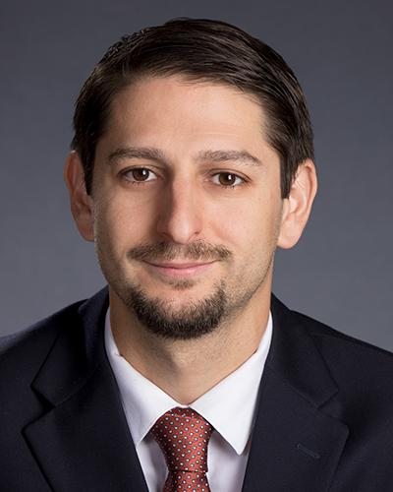
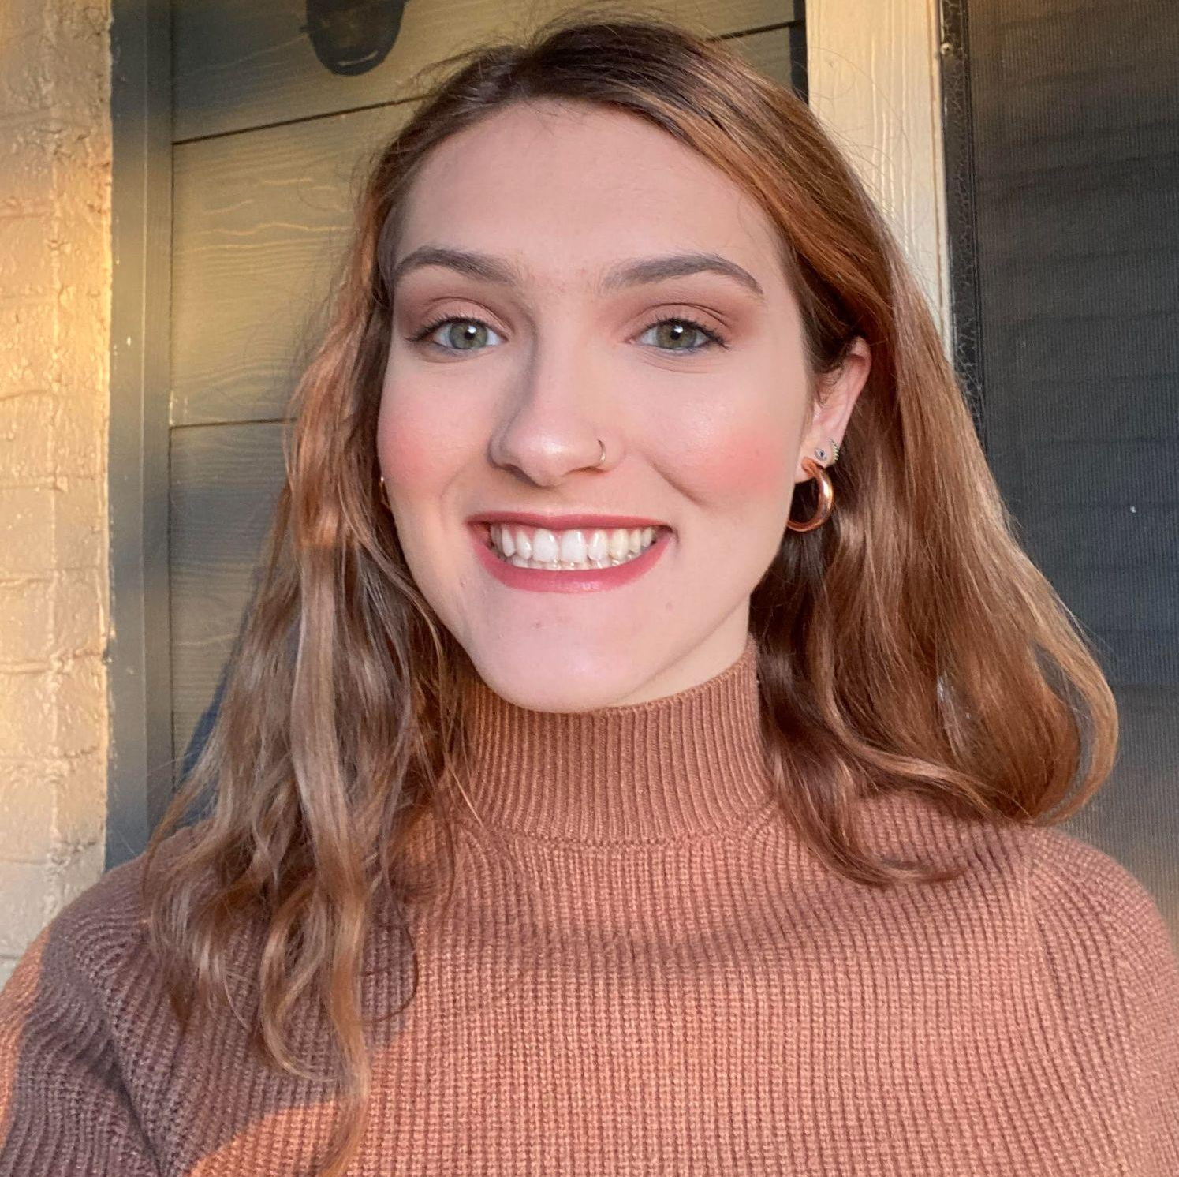
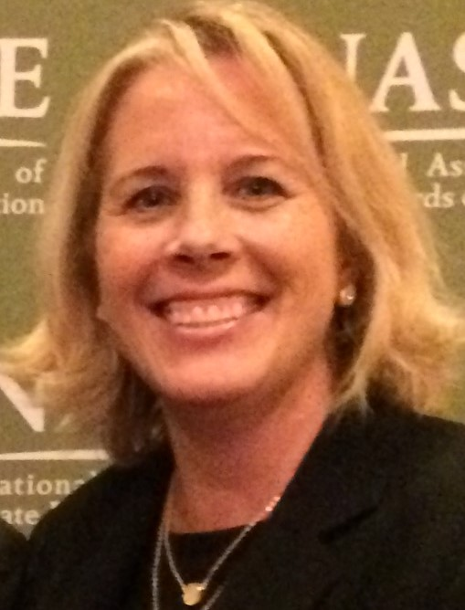
Welcome & Introductions
Dr. David DeMatthews
Professor, Department of Education Leadership and Policy,
The University of Texas at Austin
Abby Berner
Engagement Specialist, CEEDAR, Research Assistant, American Institute for Research (AIR)
Dr. Bobbi Newman
State Lead for CEEDAR Center, Principal Researcher, American Institute for Research (AIR)
Notes:
Speaker: Bobbi
3:02-3:10

Slide 5





Our Partners
Notes:
Speaker: Bobbi
A warm thank you to our partners
Our partners are Lead IDEA, NASSP, and CCSSO- they are our liaisons and will share resources, they can provide additional perspectives. If you are here from one of these partner organizations, please share who you are in the chat and feel free to share your expertise! We plan to highlight our partner CCSSO at our December meeting.
3:02-3:10

Slide 6
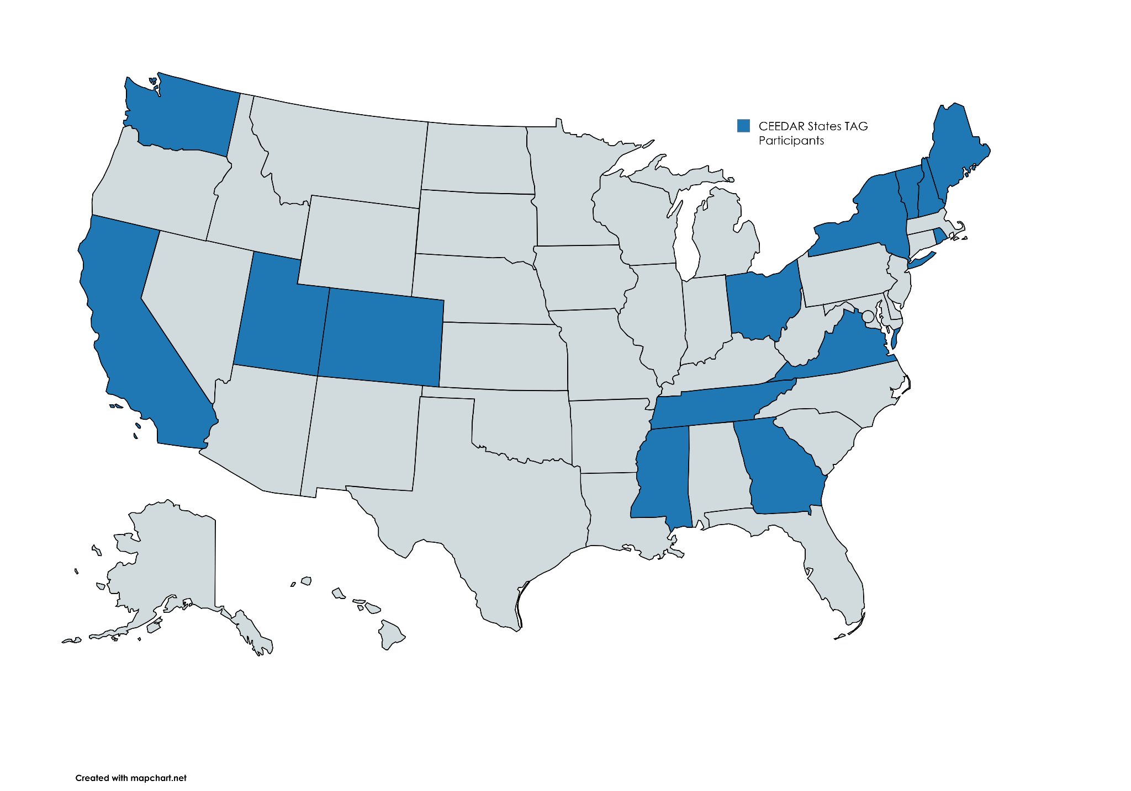
States Participating in the TAG
Notes:
Speaker: Bobbi
3:02-3:10

Slide 7
The purpose of the TAG is to…
elevate the importance of effective leadership in our work,
focus on effective practices in our programs, coursework, clinical experiences, and policies,
engage in authentic conversations on their effective leadership efforts,
and share expertise, successes and challenges, and discuss how to use resources to support scaling and sustainability.
Notes:
Speaker: Bobbi
Recognize that we have different roles as members of our TAG (SEA, IHE, associations, local) we want to be mindful of these roles as we talk in cross state and state team time
3:02-3:10

Slide 8
Leadership TAG Topics for Discussion
Date | Topic
October 9th, 3-4 EST | Professional Community for Teachers and Staff Meaningful Engagement of Families and Community
November 13th, 3-4 EST | Operations and Management School Improvement
December 11th, 3-4 EST | TAG Workgroups Session 0
January 8th, 3-4 EST | TAG Workgroups Session 1
February 12th, 3-4 EST | No meeting due to CEEDAR Convening
March 12th 3-4 EST | TAG Workgroups Session 2
April 9th, 3-4 EST | TAG Workgroups Session 3
May 14th, 3-4 EST | TAG Workgroups Session 4
June 11th, 3-4 EST | TAG Workgroups Session 5
Notes:
speaker: Bobbi
3:02-3:10

Slide 9
Today’s Agenda
Welcome and Introductions
PSEL Standards 9 and 10
Cross State Breakout Groups
Spotlight on Dallas ISD’s School Improvement Initiatives
Dallas ISD Q&A
Final Thoughts and Action Items
Notes:
Speaker: Bobbi
Abby put meeting norms in chat
Meeting norms:
Be present and prepared
Respect in the shared space and keep what is shared in confidence. We are creating a community.
We will record guest speakers and resources sharing, but nothing else. What happens in the TAG, stays in the TAG!
Breakout rooms could be mixed cross state or state specific depending on the work.
Group members should “believe the best” and lead with positive intentionality.
3:02-3:10

Slide 10
Standard 9: Operations and Management
Standard Components | Program/ Faculty | Courses | Clinical | Policy
9.1: Manage budgets and develop strong relationships with central offices to ensure the effective and efficient use of resources and ensure that students with disabilities have the access to appropriate transportation, classroom services, accommodations, and extracurricular activities. |  | X
9.2: Ensure that external resources are aligned with their schools’ goals and support core programs and services for each student. |  |  | X
9.3: Assign roles and responsibilities to optimize staff capacity to address each student’s learning needs, especially students w/ disabilities. |  |  |  | X
9.4: Develop and effectively manage school structures, schedules, operations, and administrative systems that support students with disabilities. | X
Notes:
Speaker: Dave
3:10-20

Slide 11
Standard 10: School Improvement
Standard Components | Program/ Faculty | Courses | Clinical | Policy
10.1: Emphasize the “why” and “how” of improvement and change; staff should be motivated and empowered to own improvement initiatives and share responsibilities and accountability for their success. |  |  | X
10.2: Provide learning opportunities for teachers and staff to equip them to participate in strategic processes of improvement and take part in implementing effective programs and practices for students with disabilities. |  | X
10.3: Address teacher capacity needs around the identification, implementation, and evaluation of evidence-based interventions and ensure that necessary conditions for teaching and learning exist to prepare students with disabilities for success in college, career, and life. |  | X
10.4: Ensure that the specific needs of students with disabilities are intentionally addressed within the school’s broader plans for improvement. | X
Notes:
Speaker: Dave
3:10-20

Slide 12
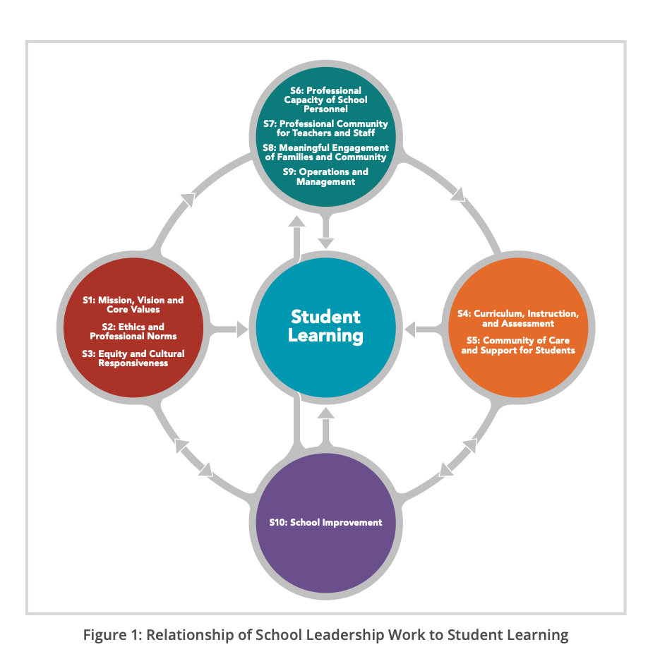
Relationship of School Leadership Work to Student Learning (NPBEA, 2015)
Notes:
Speaker: Dave
3:10-20

Slide 13
Cross State Breakout Room Guiding Question
Share an example of how your SEA/EPP is supporting evidence-based inquiry and evaluation to make school leaders more effective for all students, staff, families, and the community.
CEEDAR staff, please help participants engage with the discussion questions as well as facilitate introductions.
We will stay in these breakout rooms until 3:33 ET.
Notes:
Speaker: Bobbi
groups till 3:33 ET
3:20-33
Mix of state and CEEDAR facilitators
Abby will put in chat: slide screenshot

Slide 14
Takeaways from Cross State Discussion
Welcome back! Feel free to share 1-2 sentences in the chat that summarize your group’s discussion.
Notes:
Speaker: David
intro DISD folks

Slide 15

Dallas ISD - School Improvement
Dr. Elizabeth Casas
Deputy Chief School Leadership & Special Populations
Notes:
Speaker: Elizabeth
3:34-49

Slide 16


OUR VISION
Dallas ISD seeks to be a premier urban school district.
OUR MISSION
Educating all students for success.
Notes:
Speaker: Elizabeth
3:34-49

Slide 17

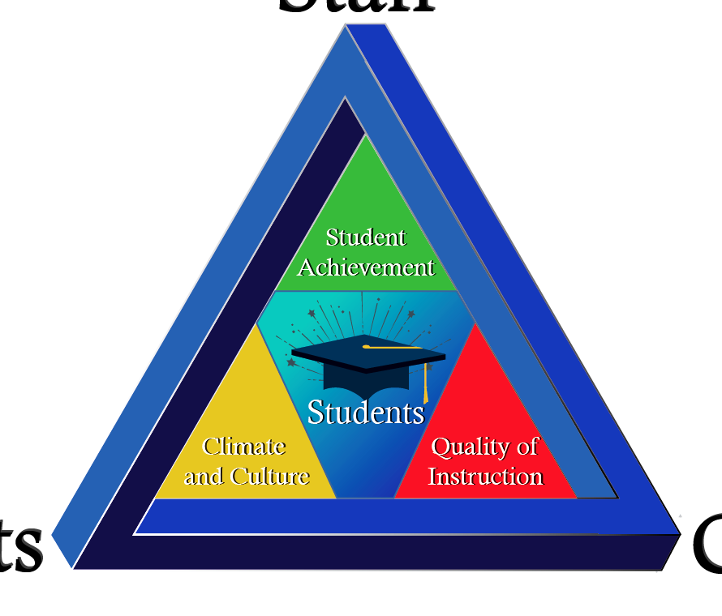
Our Plan
STAFF
PARENTS
COMMUNITY
Notes:
Speaker: Elizabeth
3:34-49

Slide 18
Our Beliefs
EFFECTIVE INSTRUCTION
On grade level Tier I instruction results in student academic achievement.
ACCESS & OUTCOMES
At-risk students will succeed with access and opportunity.
EXCELLENCE
The team is committed to excellence for every student.
Notes:
Speaker: Elizabeth
3:34-49

Slide 19

OBJECTIVES
 | Highlight Dallas ISD School Improvement Practices (PSEL 10)
 | Identify District level systems for improvement and campus practices
 | Reflect on Principal Leadership Knowledge and Skills
Notes:
Speaker: Elizabeth
3:34-49

Slide 20

Accountability Rating
Dallas Independent School District (DISD) earned a B
rating from the Texas Education Agency (TEA) for the 2024-2025 school year.
Overall Score: 83
Previous Year Rating: C (79)
Increase in A and B-rated schools: Over 70% of schools received an A or B rating.
Decrease in D and F-rated schools: The number of D and F-rated schools decreased from 65 to 14.
Specific improvements: 60 schools earned an A, and 97 earned a B.
Notes:
Speaker: Elizabeth
3:34-49

Slide 21

School
Improvement
PSEL
Standard
10
Mission and Vision
High Expectations
Accountability Systems
(a)
Continuous Improvement
Structured Data Cycles
Reflection/Instructional adjustments
(b)
Improvement through readiness
and shared accountability
MTSS & Goal Setting
(c)
Notes:
Speaker: Elizabeth
3:34-49

Slide 22


Leveraging the MTSS Process to Differentiate Learning Gaps
from Learning Disabilities
Notes:
Casas
Speaker: Elizabeth
3:34-49

Slide 23

Executive Summary
Background: The District has been under corrective actions by the Texas Education Agency due to a failure to establish eligibility determination within timelines due to the high volume of new referrals compounded by a national shortage of evaluators.
Student Impact: Delays in completing evaluations and conducting ARD meetings means that students with disabilities are not receiving the necessary services that will assist them in achieving academic success.
Solution: Collaboration between Special Education, MTSS, and School Leadership the district launched the MTSS Verification Process where all parties are accountable for ensuring that timelines are met and that there are no delays in students receiving needed programs and services.
Notes:
Speaker: Elizabeth
3:34-49

Slide 24
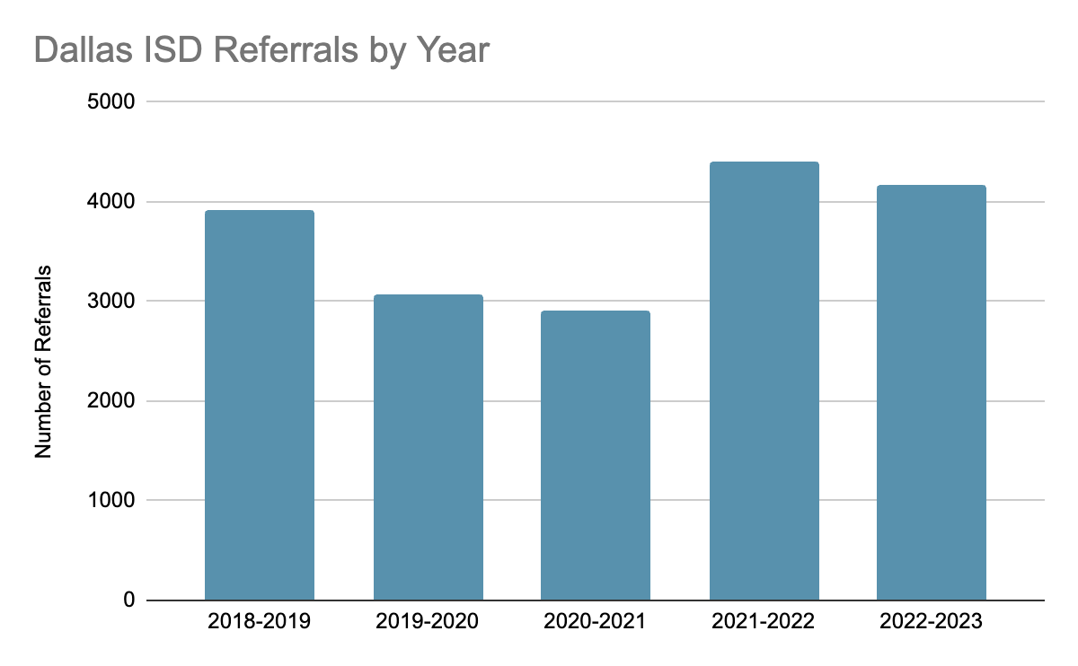
Problem of Practice: Referral Trends
The chart below represents the number of students who have been referred for Special Education evaluation since the 2018-2019 SY. For 2022-2023, these referrals were made from August 1, 2022 to April 28, 2023.
4,405
28%
Referred students with intervention plans
*19.9%
of referred students have active intervention plans
3,914
4,165
3,074
2,900
Notes:
Speaker: Elizabeth
3:34-49

Slide 25
Problem Statement:
Learning Gaps vs. Disabilities: Some students are misidentified due to temporary learning gaps rather than actual disabilities.
Root Cause Analysis:
Lower academic expectations
Low implementation of MTSS
Missed opportunities for appropriate interventions (MTSS)
Notes:
Speaker: Elizabeth
3:34-49

Slide 26

What is the Law?
Texas State Regulations: 19 TAC§89.1011 Full Individual and Initial Evaluation
Referral of students for a full individual and initial evaluation for possible special education services must be a part of the district's overall, general education referral or screening system. Prior to referral, students experiencing difficulty in the general classroom should be considered for all support services available to all students, such as tutorial; remedial; compensatory; response to evidence-based intervention; and other academic or behavior support services. If the student continues to experience difficulty in the general classroom after the provision of interventions, district personnel must refer the student for a full individual and initial evaluation. This referral for a full individual and initial evaluation may be initiated by school personnel, the student's parents or legal guardian, or another person involved in the education or care of the student.
* An LEA may not deny a referral or delay an initial evaluation because pre-referral interventions have not been implemented with a student.
Notes:
Speaker: Elizabeth
3:34-49

Slide 27

LINE OF DELINEATION
STEP 1
STEP 3
STEP 5
Special Services Referral Consideration
Initiate MTSS by conducting Student Support Team (SST) meeting to identify gap, consider movement between the tiers, and appropriate intervention.
SST reconvenes to discuss student progress and next steps, if MTSS has been exhausted.
SST Chair completes MTSS Verification Process.
INTERVENTION
INTERVENTION
INTERVENTION
INTERVENTION
INTERVENTION
INTERVENTION
STEP 2
STEP 4
STEP 6
Interventions are implemented to support closing the engagement or instructional gap.
If the SST determines that the student may benefit from Special Services,
begin MTSS Verification Process.
Once the principal and ED have verified the MTSS process Special Services is notified.
START the MTSS
PROCESS
*Until IEP services are initiated, MTSS intervention is required.
Notes:
Let’s stamp what to do when students are struggling. First Initiate the MTSS by conducting student Support Team Meeting.Step 2 - Implement the interventions to support closing the gap. this will include capturing student’s attendance in intervention services and collecting frequent progress monitoring data points to see if the intervention is closing the gap. Step 3 - SST reconvenes to review student data, including attendance in intervention and makes changes to intervention focus if needed. Step 4 - If the SST determines the student may benefit from Special Services then begin the MTSS verification process and student continues to receive interventions. Step 5 complete the MTSS verification process and student continues interventions. Step 6 the principal and ED verify the MTSS process and Special services is notified, and the student continues to receive interventions.
Speaker: Elizabeth
3:34-49

Slide 28
Data Meetings &
Student Goal Setting
Notes:
Speaker: Elizabeth
3:34-49

Slide 29
Data Meeting Cycle Process
Data Meeting Cycle Windows
(1.5 - 2.5 hours Meeting)
September 17, 2025
November 19, 2025
February 11, 2026
Principal Meetings/Regional Time
Step 1
Data templates sent two days in advance
Step 3
Data discussion protocol with the region/vertical.
Step 2
Principal collaborates with A-Team on responses and action steps.
Notes:
Speaker: Elizabeth
3:34-49

Slide 30
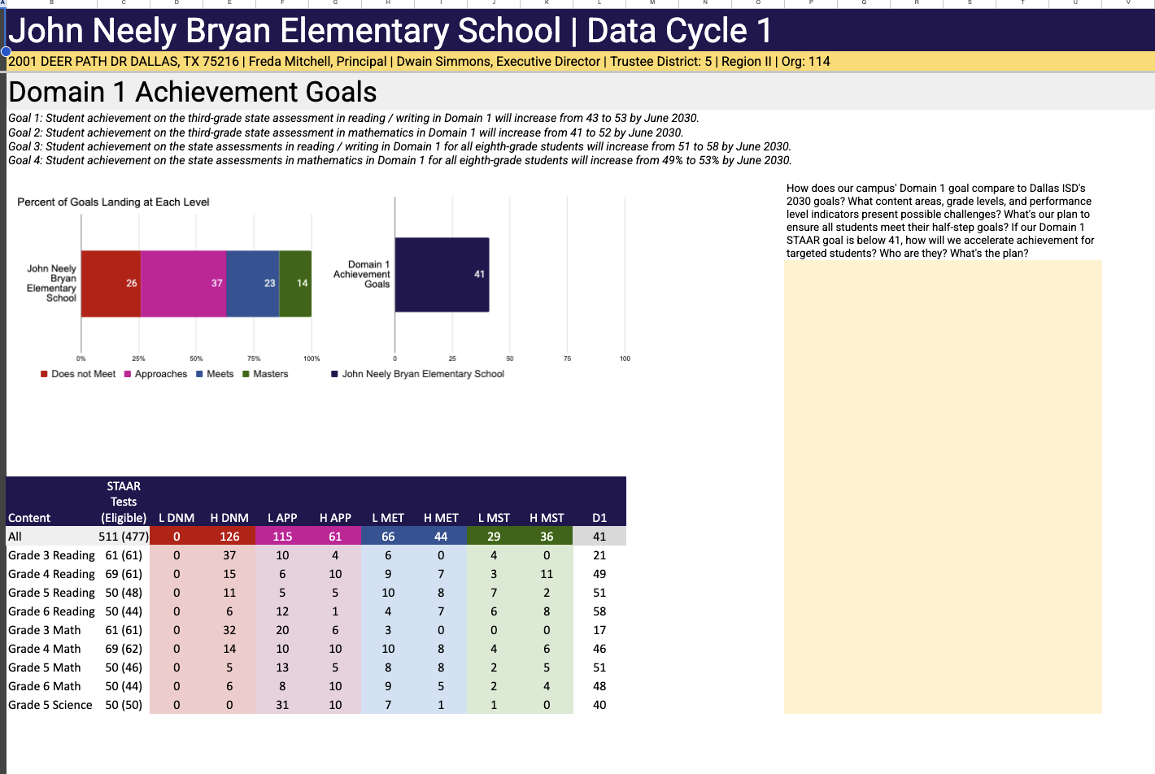
Data Template Review
Reflection:
1. How does our campus’ Domain 1 goal compare to Dallas ISD’s 2026 goal?
2. What content areas, grade levels, and performance level indicators present possible challenges?
3. What’s our plan to ensure all students meet their half-step goals?
4. If our Domain 1 goal is below 41, how will we accelerate achievement for targeted students?
5. Who are they?
6. What is the plan?
Notes:
Speaker: Elizabeth
3:34-49

Slide 31
“When students can answer -
Where am I going? How am I doing? What’s next? -
they are empowered to own their learning journey.”
- John Hattie
Notes:
Speaker: Elizabeth
3:34-49

Slide 32
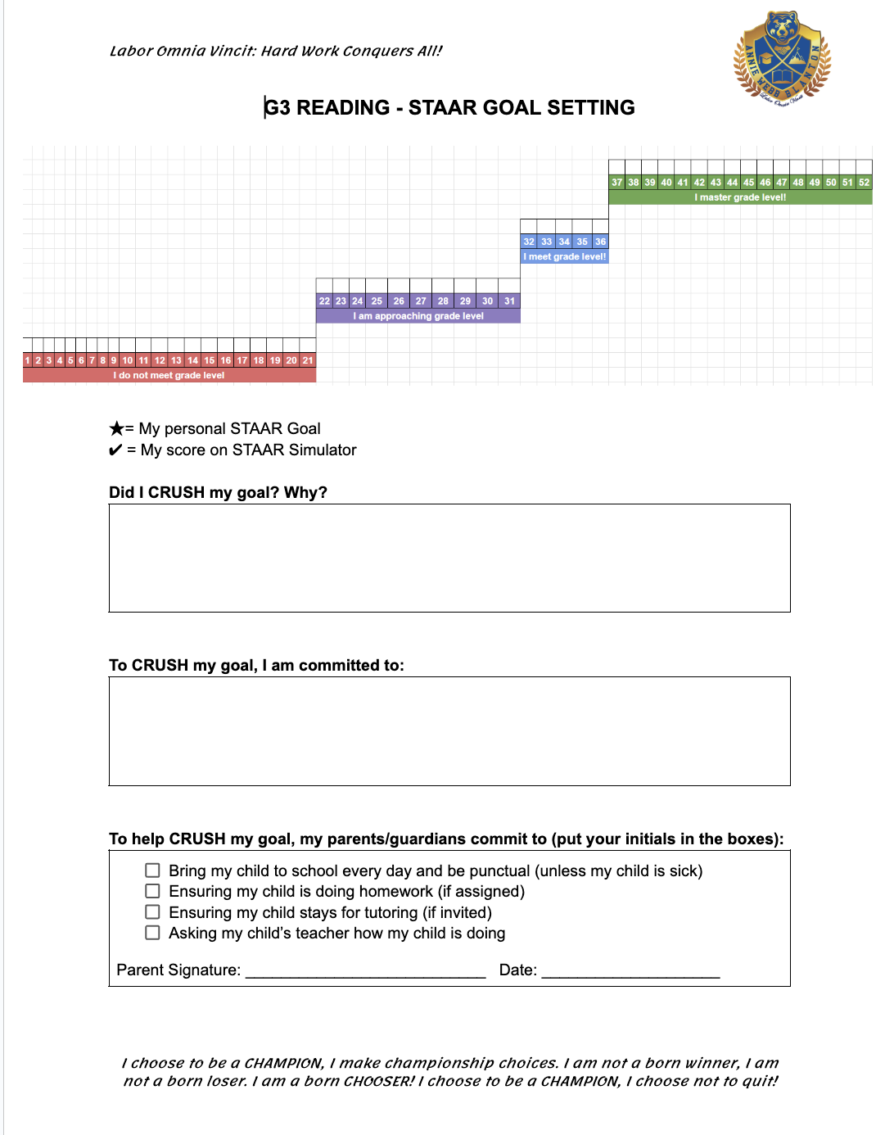
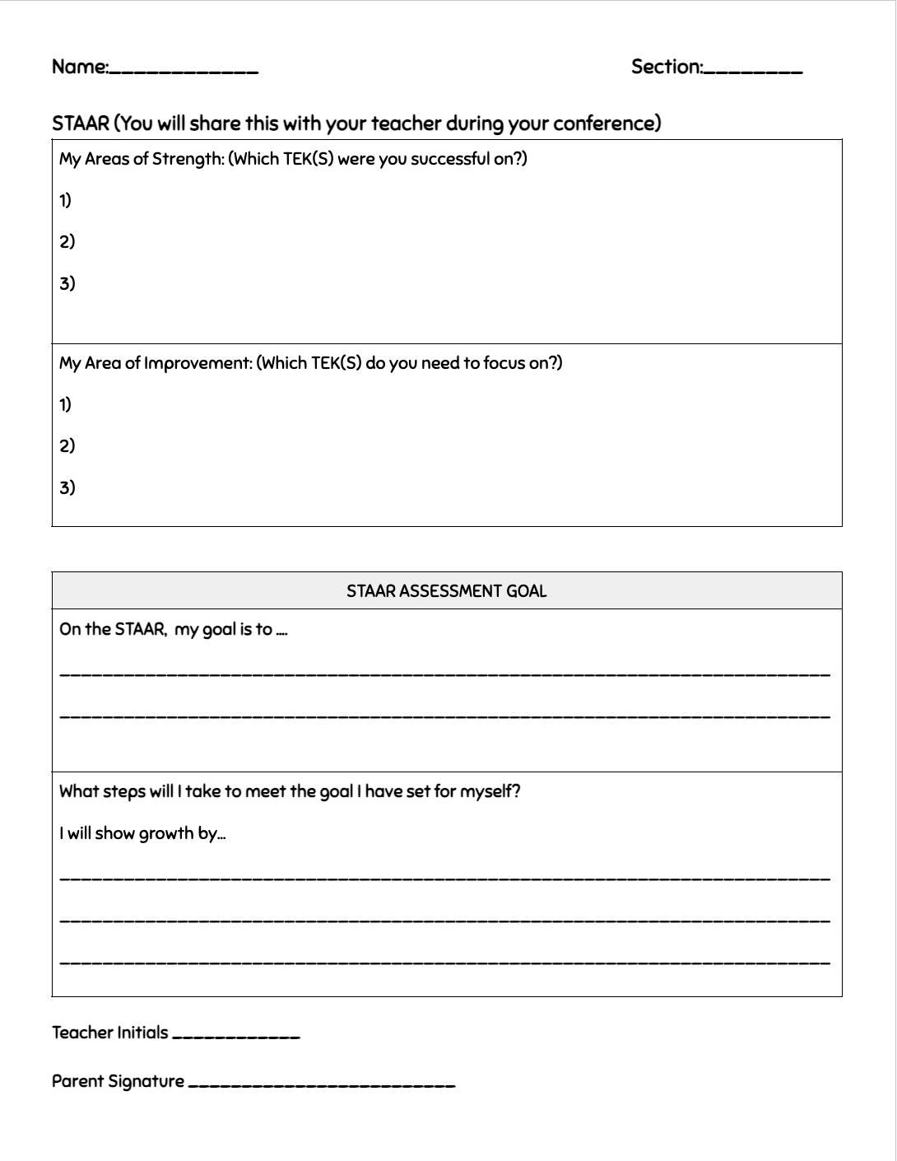
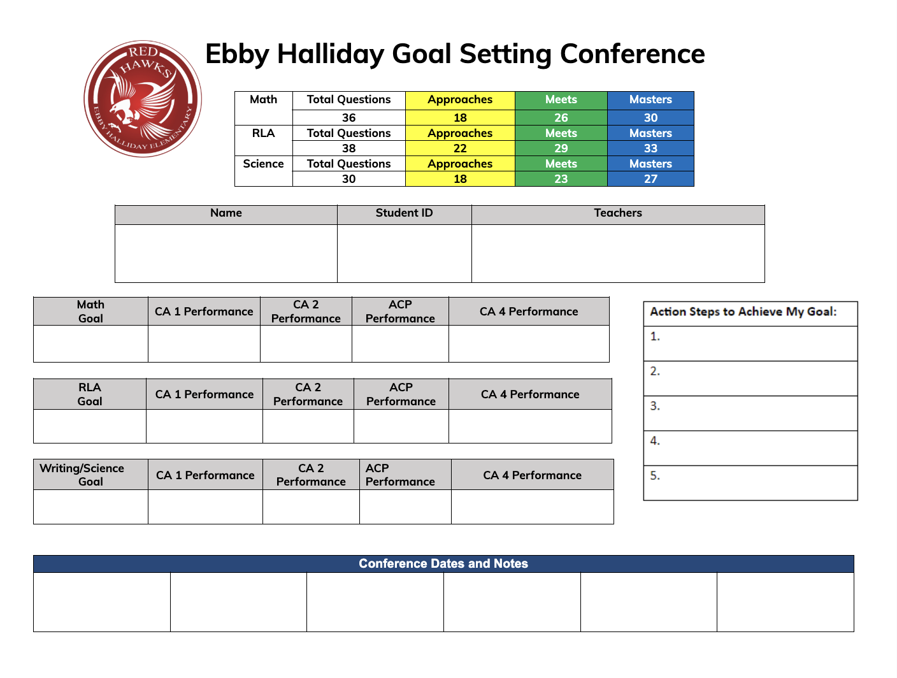
STUDENT GOAL SHEET SAMPLES
bit.ly/SampSTgoals
Notes:
Speaker: Elizabeth
3:34-49

Slide 33
STUDENT GOAL SETTING EXPECTATIONS
Teacher-Student Conferences
Student Goal Sheets
Organization of Goal Sheets
Evidence of Tracking
Notes:
Speaker: Elizabeth
3:34-49

Slide 34
KEY LEADERSHIP TAKE AWAYS
PSEL STANDARD 10 | ORGANIZATIONAL STRUCTURES | PRINCIPAL KNOWLEDGE AND SKILLS
(a) Mission and Vision High Expectations Accountability Systems | Clearly articulated mission and vision statements that are visible, discussed, and used as a filter for decisions. Campus Improvement Plan (CIP) tied to measurable outcomes. Visibility and Instructional feedback systems (e.g., classroom walk-throughs, coaching cycles). | Strategic communication and storytelling to link daily actions to long-term purpose. Systems thinking: seeing connections between initiatives. Ability to model empathy while holding high expectations. Deep pedagogical content knowledge across subjects.
(b) Continuous Improvement Structured Data Cycles Reflection/Instructional adjustments | Campus Instructional Leadership Team (CILT) with defined roles (instructional lead, data lead, PD coordinator). Meeting protocols (agendas, norms, minutes, next steps) to sustain momentum. Shared decision-making committees (e.g., SBDM, safety, attendance). | Team facilitation, conflict resolution, and distributed leadership. Data literacy to guide team decisions. Talent identification and leadership coaching skills. Skill in building shared ownership and collective efficacy.
(c) Improvement through readiness and shared accountability MTSS & Goal Setting | Tiered intervention structures (academic, behavior, attendance) with clear entry/exit criteria. Data meetings every 4–6 weeks to review progress-monitoring data. Documentation systems for interventions (e.g., MTSS tracker, IEP progress monitoring). | Understanding of special education law and MTSS design. Ability to use formative and diagnostic data to drive individualized supports. Knowledge of universal design for learning (UDL) and inclusion frameworks.
Notes:
Speaker: Elizabeth
3:34-49

Slide 35
Dallas ISD Q&A
Sample questions:
What collaborative practices between Special Education, MTSS, and School Leadership have proven most effective in reducing delays for students needing services?
Based on your experience, what principal leadership skills are most critical for driving school improvement?
What guidance do you have for leaders to ensure the use of data for campus improvement?
What are essential learning experiences in an EPP program that will support aspiring leaders to drive continuous improvement?
Notes:
speaker: Team
monitor the chat for additional questions
3:49-57

Slide 36
Invitations and Next Steps
Next IC training: November 20th, 1-2:30pm ET, sign up here
Our next TAG Session is Thursday, December 11th, 3-4 EST. This meeting will serve as Session 0 for workgroup model.
What you can expect:
workgroup topic selection
TAG project timeline for the remainder of the academic year
helpful resources to support workgroup creation of meaningful products related to supporting effective principal leadership
You will receive additional guidance from your TAG state lead before 12/11, so be on the lookout for that!
Notes:
speaker: Bobbi
thank the presenters from DISD and share out final thoughts
3:57-4:00
IC Training Sign-Up

