Slide 1
Welcome to
CEEDAR’s Leadership
Topical Action Group (TAG)
Thursday, June 5th 2025
3:00-4:00 Eastern Time
Welcome to our TAG!
Participants: please change your Zoom name to
your state and name
Ex: Florida, Agatha Trunchbull
CEEDAR staff: please change your Zoom name to
CEEDAR, Your name
Notes:
Abby: Make everyone co-hosts
Speaker: Abby
3:00-3:01

Slide 2

Check in:
What are you looking forward to this summer? This can be professionally or personally.
Notes:
Speaker: Abby Please change your name to Your state abbreviation and your first and last name
3:00-3:02

Slide 3
Virtual Meeting Recording Notice
This meeting is scheduled to be recorded by CEEDAR. Your consent to the recording is requested. Participation in the meeting without expressing an objection to recording will be treated as consent. Any participant who prefers to participate via audio only should disable their video camera so only their audio will be captured. External AI bots are prohibited unless specifically authorized.
Notes:
Speaker: Bobbi
3:02-3:03

Slide 4
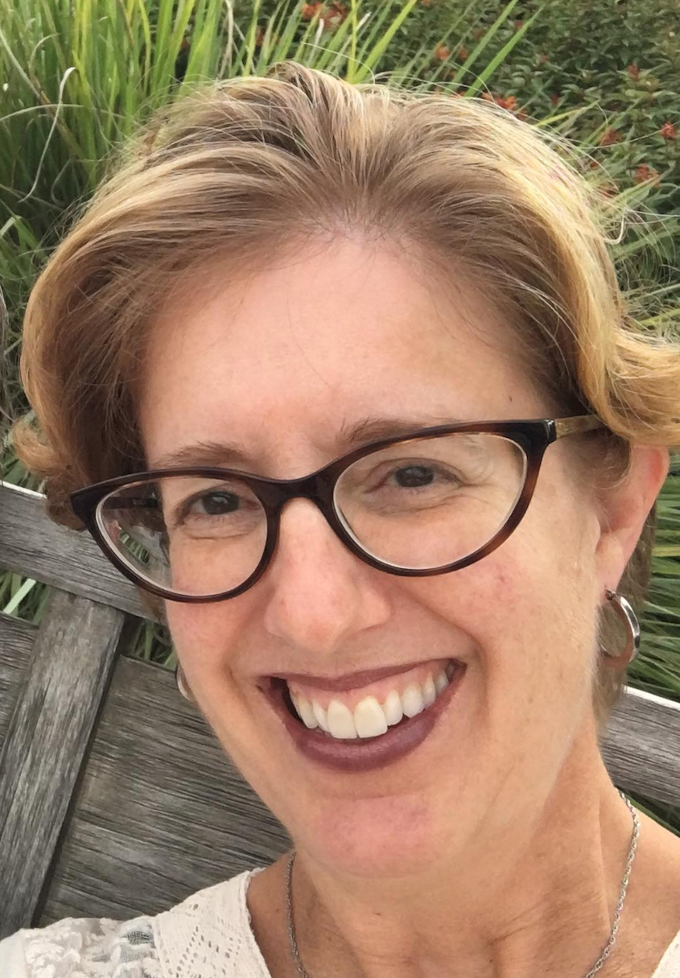
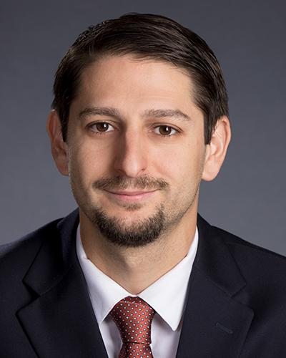
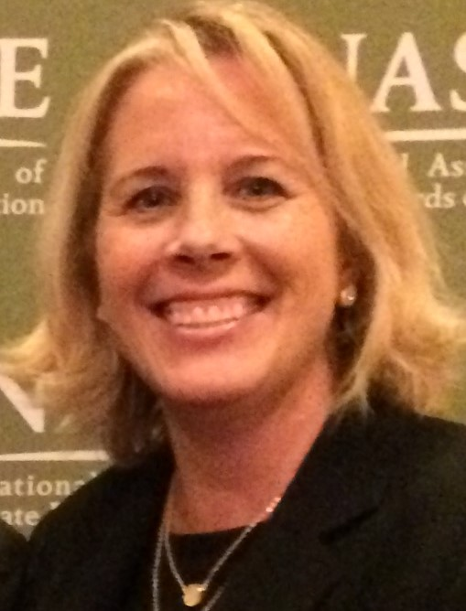
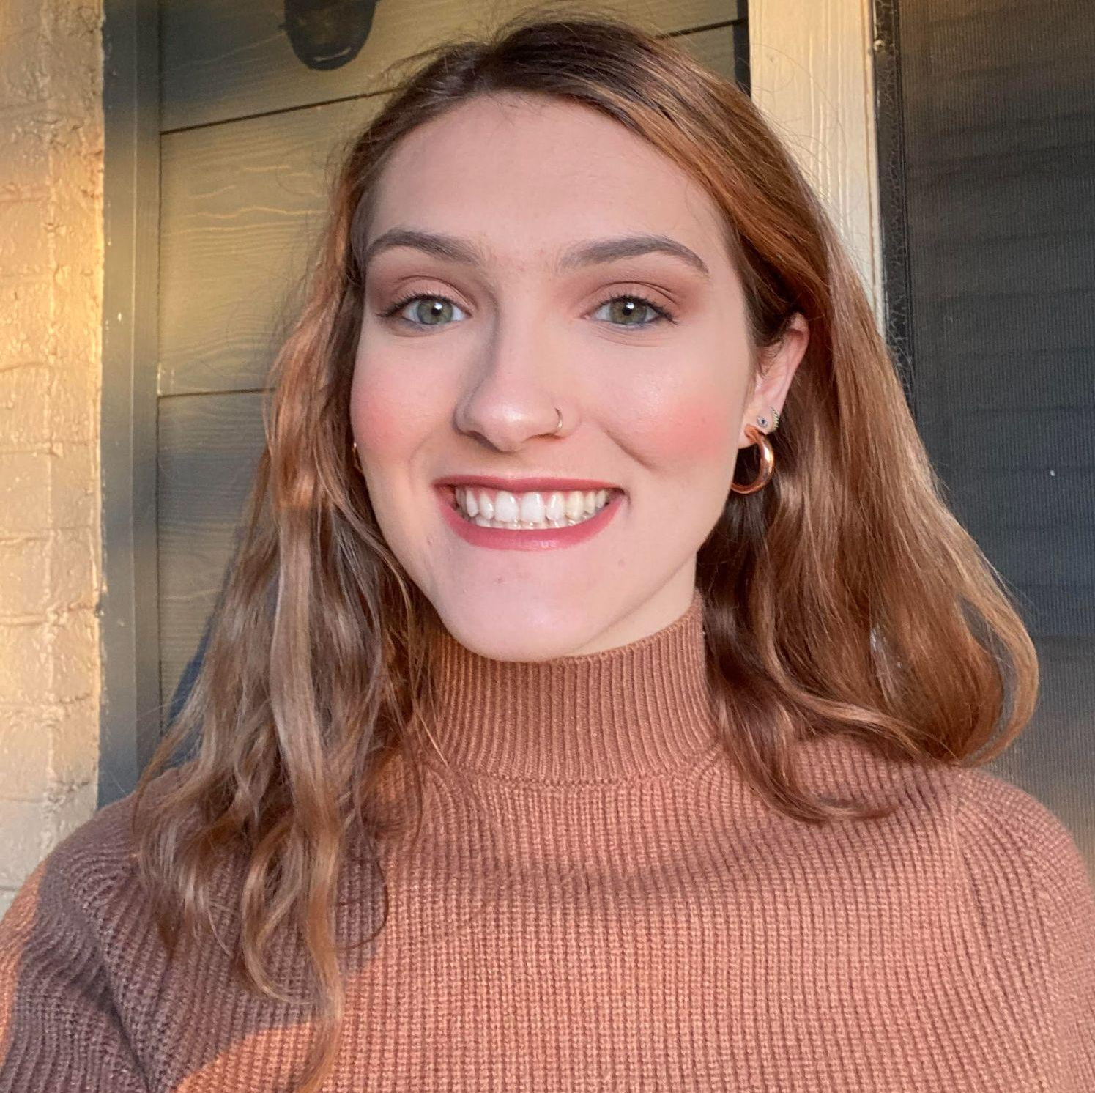
Welcome & Introductions
Dr. David DeMatthews
Professor, Department of Education Leadership and Policy,
The University of Texas at Austin
Nichole Spalding
Technical Assistance Specialist,
CEEDAR, University of Florida
Abby Berner
Engagement Specialist, CEEDAR, Research Assistant, American Institute for Research (AIR)
Dr. Bobbi Newman
State Lead for CEEDAR Center, Principal Researcher, American Institute for Research (AIR)
Notes:
Speaker: Bobbi
3:02-3:03

Slide 5





Our Partners
Notes:
Speaker: Bobbi
A warm thank you to our partners
Our partners are Lead IDEA, NASSP, and CCSSO- they are our liaisons and will share resources, they can provide additional perspectives. If you are here from one of these partner organizations, please share who you are in the chat and feel free to share your expertise!
3:02-3:03

Slide 6
The purpose of the TAG is to…
elevate the importance of effective leadership in our work,
focus on effective practices in our programs, coursework, clinical experiences, and policies,
engage in authentic conversations on their effective leadership efforts,
and share expertise, successes and challenges, and discuss how to use resources to support scaling and sustainability.
Notes:
Speaker: Bobbi
Recognize that we have different roles as members of our TAG (SEA, IHE, associations, local) we want to be mindful of these roles as we talk in cross state and state team time
3:02-3:03

Slide 7
Leadership TAG
Potential Topics for Discussion
This is our last meeting of the academic year. We will start again September 2025. The cadence (1st Thursday) and time (3 EST) will stay the same.
Date | Topic
January 9 | Curriculum, Instruction and Assessment
February 6 | Curriculum, Instruction and Assessment
March 6 | Communities of Student Care and Support
April 3 | Communities of Student Care and Support
May 1 | Professional Capacity and School Personnel
June 5 | Professional Capacity and School Personnel and Teacher Retention Support
Notes:
speaker: Bobbi
3:03-3:04

Slide 8
Today’s Agenda
Welcome and Introductions
Resource Sharing - Standard 6
Cross State Breakout Groups
Spotlight on Los Angeles Unified School District
Final Thoughts and Action Items
Dismiss from State Breakout Groups
Notes:
Speaker: Bobbi
Abby put meeting norms in chat
Meeting norms:
Be present and prepared
Respect in the shared space and keep what is shared in confidence. We are creating a community.
We will record guest speakers and resources sharing, but nothing else. What happens in the TAG, stays in the TAG!
Breakout rooms could be mixed cross state or state specific depending on the work.
Group members should “believe the best” and lead with positive intentionality.
3:04-3:05

Slide 9

Overview of the Principal Navigator for Special Educator Retention
Addressing Key Issues in Special Educator Retention
9
Notes:
Title Slide
Title: Overview of the Lead IDEA Center's Principal Navigator for Special Educator Retention
Subtitle: Addressing Key Issues in Special Educator Retention
Slides 2 - 5: Introduction
Lead IDEA Center: A brief introduction to the Lead IDEA Center and its mission.
Principal Navigator Tool: An overview of the Principal Navigator tool and its purpose.
Importance of Special Educator Retention: Why retaining special educators is crucial for student success.
Slide 6: Key Retention Issues
Overview: Introduction to the six pressing retention issues highlighted by the Navigator.
Role Ambiguity
Feeling Isolated
Untapped Expertise
Overloaded and Overextended
Differing Expectations: School and Home
Feeling Unsupported
Slides 7 - 9: Role Ambiguity
Description: Explanation of role ambiguity and its impact on special educators.
Example: Principal Lee's story from the Navigator.
Strategies: Toolkit strategies for clarifying roles and responsibilities.
Slides 10 - 12: Feeling Isolated
Description: Explanation of the feeling of isolation among special educators.
Example: Example from the Navigator.
Strategies: Toolkit strategies for fostering collaboration and shared ownership.
Slides 13 - 15: Untapped Expertise
Description: Explanation of how special educators' expertise is often untapped.
Example: Principal Kassem's story from the Navigator.
Strategies: Toolkit strategies for utilizing special educators' expertise.
Slides 16 - 18: Overloaded and Overextended
Description: Explanation of the issue of being overloaded and overextended.
Example: Example from the Navigator.
Strategies: Toolkit strategies for managing workload and preventing burnout.
Slides 19 - 21: Differing Expectations: School and Home
Description: Explanation of the differing expectations between school and home.
Example: Example from the Navigator.
Strategies: Toolkit strategies for engaging families as partners.
Slides 22 - 24: Feeling Unsupported
Description: Explanation of the feeling of being unsupported, especially for early career special educators.
Example: Example from the Navigator.
Strategies: Toolkit strategies for supporting early career special educators.
Slide 25: Conclusion
Summary: Recap of the key points discussed.
Importance: Emphasis on the importance of addressing these issues for special educator retention.
Call to Action: Encouragement for principals and school leaders to take action.

Slide 10
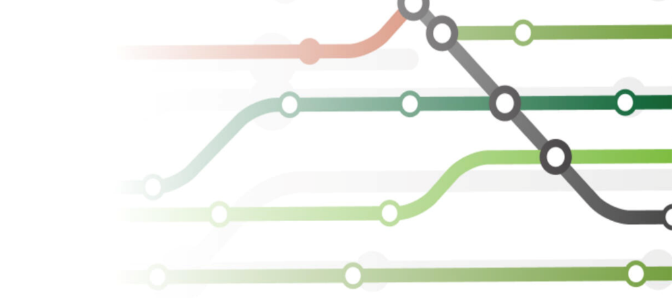
Navigator Tool
School Stories
  Relatable, application-based scenarios
  Provide clear action steps to address issues
Toolkits
  Strategies to address issues
  Short-, medium-, and
  long-term solutions
  Possible actions
  Resources to implement strategies
  Videos
  Related IDEA considerations
Interactive resource
Customizable to your needs and resource preferences
Notes:
Strategies = bigger picture conceptual ways in which an issue can be addressed
Solutions are HOW strategies are implemented, and include actions and point to resources

Slide 11



Why retaining special educators is crucial for student success.
Increased hiring of unqualified or inexperienced teachers (just trying to fill the position!)
In March 2024, 51% of public schools nationwide reported they would need to fill positions in special education before the start of the next school year, the most of any specialty.
Increased demands on remaining staff
Negative impacts on students
Bettini & Gilmour, 2024 Source

Slide 12
Key Retention Issues
1. Role Ambiguity
2. Feeling Isolated
3. Untapped Expertise
4. Overloaded and Overworked
5. Differing Expectations: School and Home
6. Feeling Unsupported
Notes:
Slide 2: Key Retention Issues
Overview: Introduction to the six pressing retention issues highlighted by the Navigator.
Role Ambiguity
Feeling Isolated
Untapped Expertise
Overloaded and Overextended
Differing Expectations: School and Home
Feeling Unsupported

Slide 13
Role Ambiguity
1. Role Ambiguity
Special educator roles are not clearly defined and effectively managed.
General educators do not fully understand the contributions special educators can make in their classrooms.
Leaders must work closely with special educators to coordinate services, clearly define their roles, and set expectations for inclusive practices to create more positive learning environments.
Leads to lack of collaboration and support among educators.
Negatively impacts all educators and the quality of services provided to students with disabilities (SWDs).
Notes:
Slide 3: Role Ambiguity
Description: Explanation of role ambiguity and its impact on special educators.
Example: Principal Lee's story from the Navigator.
Strategies: Toolkit strategies for clarifying roles and responsibilities.

Slide 14

Resources: School Stories
Resources: School Stories
Scenario
  Principal Lee notices that the roles of special educators are often unclear and misunderstood among staff, including the teachers themselves.
Principal Lee’s Action Steps
  Creates job descriptions and expectations to clarify roles.
  Uses a recognition and rewards system to highlight teachers going above and beyond.
  Establishes communities of practice.
  Creates leadership roles for educators.

Slide 15
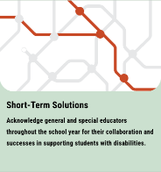

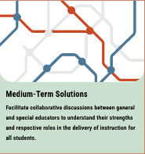
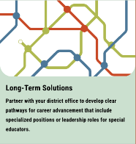
Resources: Toolkit
Resources: Toolkit
Strategy A
Recognize and use the specialized skills and knowledge of special educators.
Strategy B
Understand and support IDEA implementation.

Slide 16

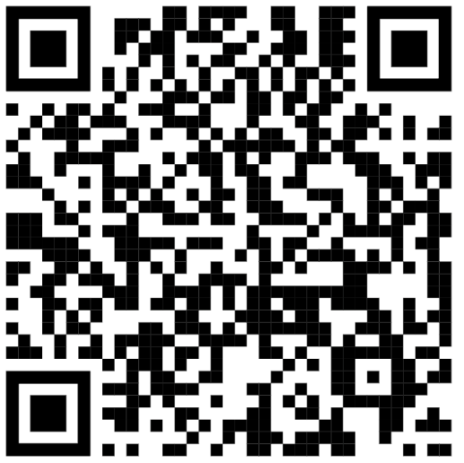
Activity: Explore the Toolkit
Activity: Explore the Toolkit
Access the Clarifying Roles and Responsibilities Toolkit.
Explore the strategies and connected resources.
Reflect on how you can apply these strategies.
  How can you ensure roles and responsibilities are clearly defined in your context?
  What are the barriers to implementing these strategies?
Notes:
https://lead-idea.org/resources/toolkit-1-clarifying-roles-and-responsibilities

Slide 17
Feeling Isolated
Feeling Isolated
Special educators often feel isolated.
They lack collaborative opportunities with general education colleagues.
They feel the sole responsibility for SWD success.
Leaders must promote mutual accountability for every student by facilitating regular collaboration opportunities and promoting each educator's expertise.
Without dedicated collaboration and planning time with general educators, there will be gaps in the services outlined in students’ individualized education programs (IEPs).
This can lead to teacher burnout and attrition.
Notes:
Feeling Isolated
Description: Explanation of the feeling of isolation among special educators.
Example: Example from the Navigator.
Strategies: Toolkit strategies for fostering collaboration and shared ownership.

Slide 18

Resources: School Stories 2
Resources: School Stories
Scenario
  Principal Martinez notices a growing disconnect between general and special educators, which impacts the supports provided to SWDs.
Principal Martinez’s Action Steps
  Creates a shared staff vision for inclusion.
  Surveys staff and reviews existing collaborative structures.
  Provides protected planning time for educators to collaborate.
  Establishes a Special Education Task Force.
  Provides ongoing professional development (PD) on effective collaborative strategies.

Slide 19

Resources: Toolkit 2
Resources: Toolkit
Strategy A
Establish and protect planning and collaboration time between special educators and their general education peers.
Strategy B
Build trusting, positive relationships by being visible and available to staff.
Strategy C
Cultivate, model, and maintain an inclusive learning environment with shared ownership and accountability.

Slide 20

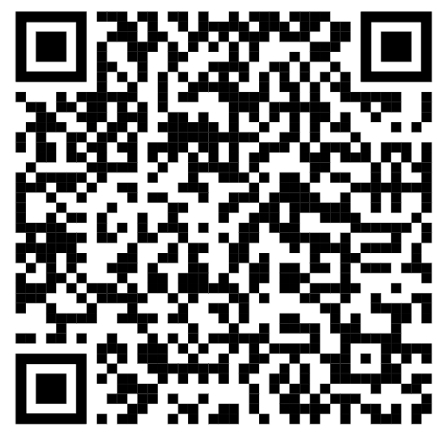
Activity: Explore the Toolkit 2
Activity: Explore the Toolkit
Access the Promoting Shared Ownership and Collaboration Toolkit.
Explore the strategies and connected resources.
Reflect on how you can apply these strategies.
  How can you establish and protect planning and collaboration time between special and general education teachers?
  What do principals need from their district leadership to implement these strategies?
Notes:
Presenters can customize the activity based on the audience
https://lead-idea.org/resources/toolkit-2-promoting-shared-ownership-and-collaboration

Slide 21
Untapped Expertise
Untapped Expertise
Special educators report feeling undervalued and not recognized for their contributions.
They are often used in roles that are not aligned with their training.
Their expertise in specially designed instruction (SDI) is often overlooked.
Leaders should actively collaborate with all teachers, offer ongoing PD for all staff on effective practices, closely monitor classroom instruction, and ensure the proper implementation of IEPs.
This hinders collaboration among educators.
This can lead to teacher burnout and attrition.
Notes:
Untapped Expertise
Description: Explanation of how special educators' expertise is often untapped.
Example: Principal Kassem's story from the Navigator.
Strategies: Toolkit strategies for utilizing special educators' expertise.

Slide 22

Resources: School Stories 3
Resources: School Stories
Scenario
  Principal Kassem observes that her special educators are exhibiting low levels of engagement and job satisfaction.
Principal Kassem’s Action Steps
  Conducts a survey and discovers that these teachers feel underused and undervalued on account of systems.
  Makes an effort to understand her special educators’ strengths, skills, and areas of interest.
  Provides them with PD and continual feedback to enhance their expertise.
  Practices distributed leadership by creating leadership roles for special educators.

Slide 23


Resources: Toolkit 3
Resources: Toolkit
Strategy A
Encourage and reinforce the autonomy of special educators.

Slide 24
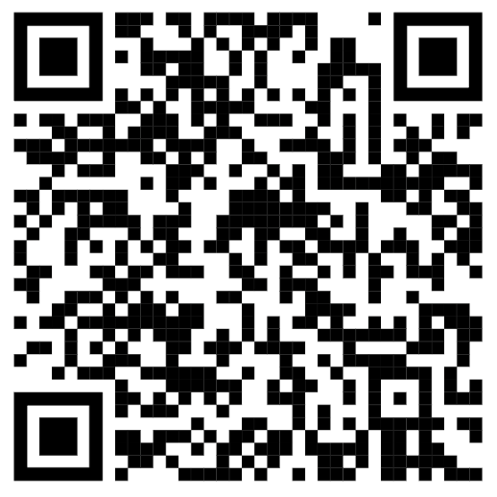
Resources Toolkit 3
Resources: Toolkit
Access the Empower and Utilize Expertise.
Explore the strategies and connected resources.
Reflect on how you can apply these strategies.
  How can you encourage the autonomy of special educators?
  What are the barriers to implementing these strategies?
Notes:
https://lead-idea.org/resources/toolkit-3-empower-and-utilize-expertise

Slide 25
Key Takeaways
Special educator retention is a key issue in the field that has major impacts on the school environment and success of SWDs.
District and school leadership can play an important role in increasing special educator retention.
LEAD IDEA seeks to support leaders with this issue through the Navigator Tool.
Take some time to familiarize yourself with this tool and the resources it provides!
Check back for new Navigators addressing other common IDEA leadership challenges.
Notes:
Slide 9: Conclusion
Summary: Recap of the key points discussed.
Importance: Emphasis on the importance of addressing these issues for special educator retention.
Call to Action: Encouragement for principals and school leaders to take action.

Slide 26

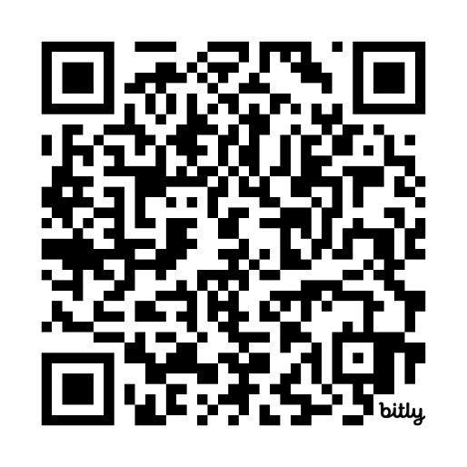
Access the Navigator and Other Resources on Our Website
Visit Our Website:
https://lead-idea.org
Notes:
Can sign-up for newsletter & submit a form sharing IDEA challenge

Slide 27
Cross State Breakout Room Guiding Question
Share an example of how your SEA/EPP/APP is addressing special education teacher retention and/or working conditions.
CEEDAR facilitators, be prepared to come back from breakouts and share 1-2 sentences that summarize the discussion.
We will stay in these breakout rooms until 3:30 ET.
Notes:
Speaker: Bobbi
groups till 3:30 ET
Mix of state and CEEDAR facilitators
Abby will put in chat: slide screenshot
3:15-3:16

Slide 28
Takeaways from Cross State Discussion
Welcome back! CEEDAR facilitators, share 1-2 sentences in the chat that summarize your group’s discussion.
Notes:
Speaker: David
intro LAUSD folks
3:27-3:30

Slide 29


Los Angeles Unified School District (LAUSD) and CEEDAR Center: Our Partnership Story
June 5, 2025
Notes:
Adrienne

Slide 30
Students with Disabilities: 66,115
2024-2025
Special Day Class- Modified Core Curriculum |  | Special Day Class- Core |  | Resource Specialist Program |  | Designated Instructional Services only (ie Speech) |  | Total SWDs
# | % | # | % | # | % | # | % | #
6,989 | 11% | 17,722 | 27% | 31,921 | 48% | 9,483 | 14% | 66,115
Notes:
Let’s take a look at where students with disabilities are served in LAUSD. You will note there are three types of programs delineated here- students in special day classes, students in the resource program, and students who receive designated services only, such as speech.
Students served in a special day class program spend the majority of the day, without general education peers. The norm of the classroom is lower and the class is taught by a special education teacher rather than a content area teacher. You will notice that there are two types of special day classes listed- those for students on the modified core curriculum and those for students on the core or general education curriculum. Modified Core was previously referred to as alternate curriculum, but modified core is a more precise term since all students are required to have access to the core curriculum, and some require modifications.
Students receiving resource services spend most of their day in the general education classroom and may receive push in support, pull out support, or both.

Slide 31
Partnership with CEEDAR
History of partnership between LAUSD and IHEs to support inclusive practices
Mutual benefit:
  Alignment between LEA and IHEs related to inclusive practices in teacher/admin prep programs
  Partnership in teacher training: Expanding use of evidence-based inclusive practices provides increased opportunities for student teachers and interns
Alignment with innovation configuration on Inclusive Principal Leadership
Alignment with work of other technical assistance centers (e.g. SWIFT and TIES Center)

Slide 32


LAUSD’s Position Paper
The position of LAUSD is to bring more students into inclusive settings commensurate with national standards while upholding the federal law as stated in IDEA.
While students with disabilities have had opportunities to be included for many years in our district, we are now pushing for a systemic shift in mindset to be better aligned with the spirit of the law.
Notes:
https://media.edlio.net/47280ab3/3347b876/618edfe4/39292de541f64afc9da8902cf2367c4f?_=Position%20Paper%20Equity%20and%20Access%20for%20Students%20with%20Disabilities_11_19_2021_2_1_2022.pdf

Slide 33

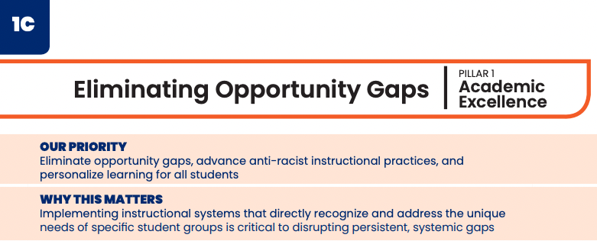
LAUSD’s Strategic Plan
Measure of Success: Increase the percentage of students with disabilities who are in the general education program at least 80% of the school day (from 58.8% in 2020-21)
Notes:
We also monitor this on a District level. Superintendent Carvalho has been a strong advocate for this work and as such has included it in the strategic plan.
While the state has a goal of 70% of students served 80% of the day or more in GE, LAUSD aimed higher, for 80% of our students in GE 80% or more of the day by 2026.
It is important to note here that this goal does not indicate all students for all of the day. IEP teams continue to make recommendations that are appropriate for students.

Slide 34
Intention in Working with Higher Education
Support for the Position Paper from Educational Authorities
Additional Partners Who Could Provide Professional Development
Alignment of New Teachers Recruited by LAUSD

Slide 35

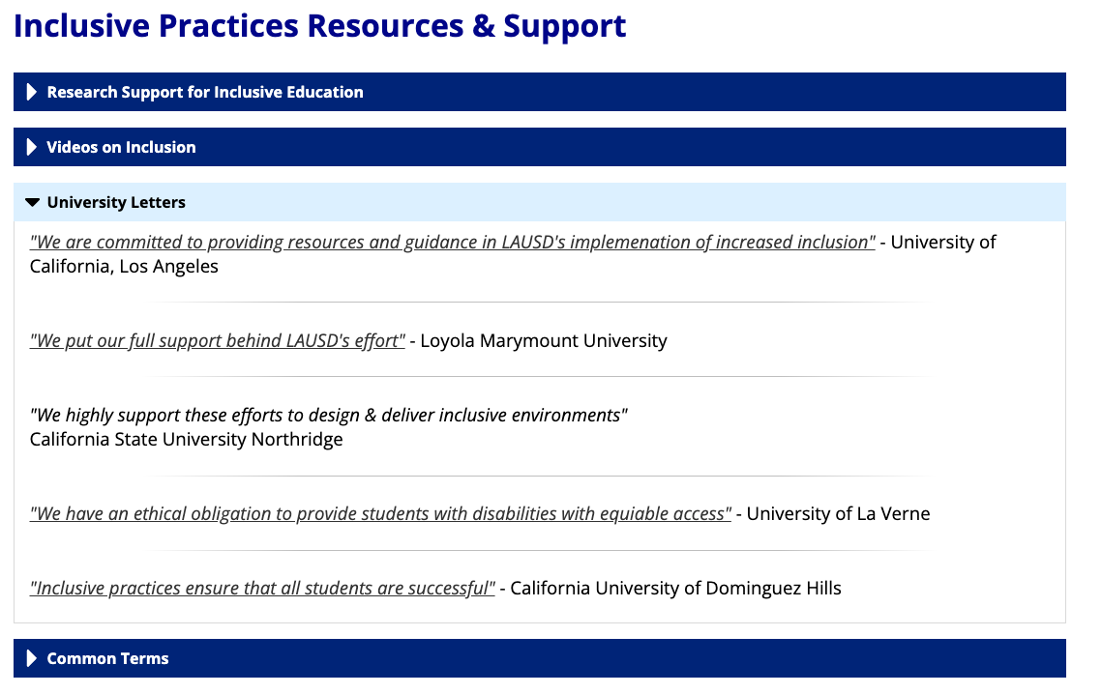
Meetings with Institutes of Higher Education
Notes:
Joyce
Read objectives

Slide 36

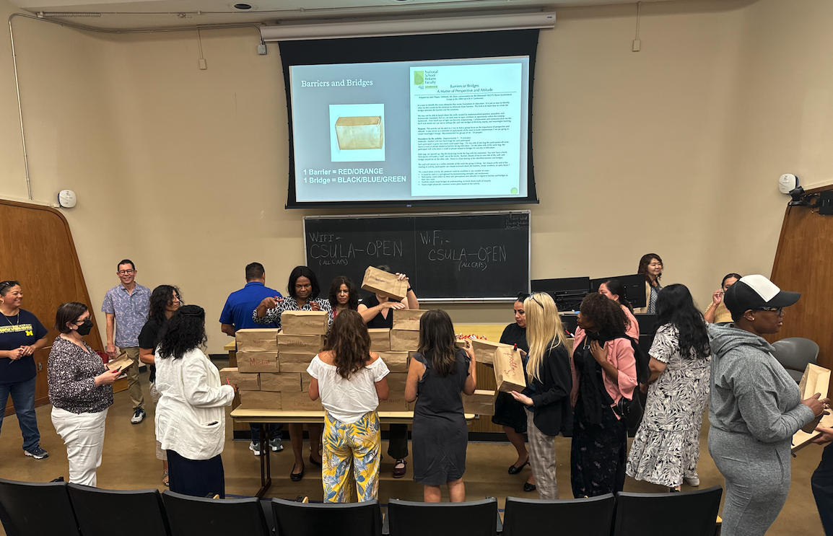
Elementary Principal Academy
Elementary Principals
3 Saturday Sessions
Co-Presented by CEEDAR and LAUSD
Emphasis on membership and belonging, challenging behavior, students with extensive support needs, and using school site data to set goals
Notes:
Jack

Slide 37
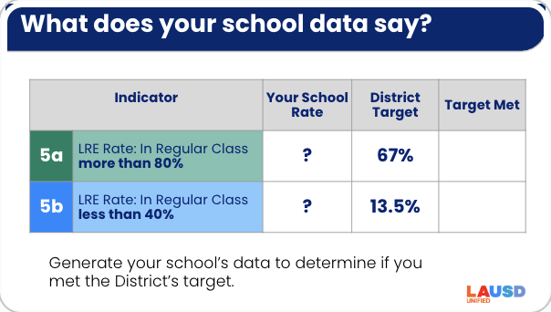

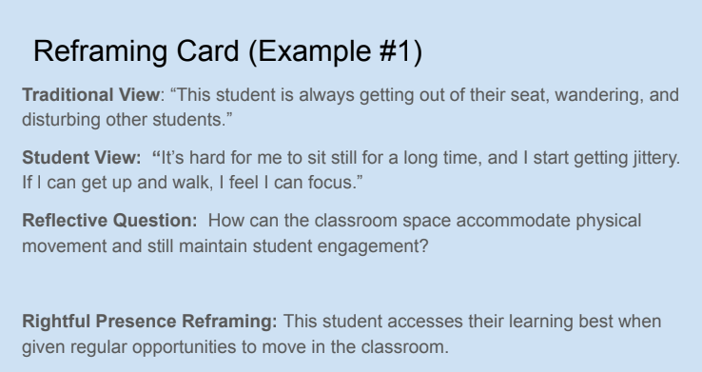
Slides from the Academy
Participation, Membership, and Belonging
Notes:
Chuck

Slide 38
Results
What did you find most valuable about this professional learning series?
“The videos and discussions were inspiring. This professional development helped me reaffirm the importance of the work.”
“Sharing with colleagues, providing a safe space to discuss hard questions, and the reframing cards.”
“It was powerful to hear from the guest speaker, Alison, learning about her experience and perspective.”
*96% participant satisfaction rate with the Elementary Principal Institute series
Notes:
Jack

Slide 39

Next Steps
Four of the Principals from the first set of schools have asked for additional optional support in the form of a walkthrough with SIP
(Supporting Innovative Practices)
Offering Principal Institute for a new set of schools
Providing ongoing coaching and PD support to
LAUSD coaches working with demonstration sites
(supported by SIP)

Slide 40
Recommendations
Clearly establish mutual goals for inclusive practices for LEA and IHE
Include key LEA decision makers whenever possible
Leverage existing partnerships in teacher and admin preparation
Include voices of individuals directly impacted when possible - teachers, parents, and individuals with disabilities

Slide 41
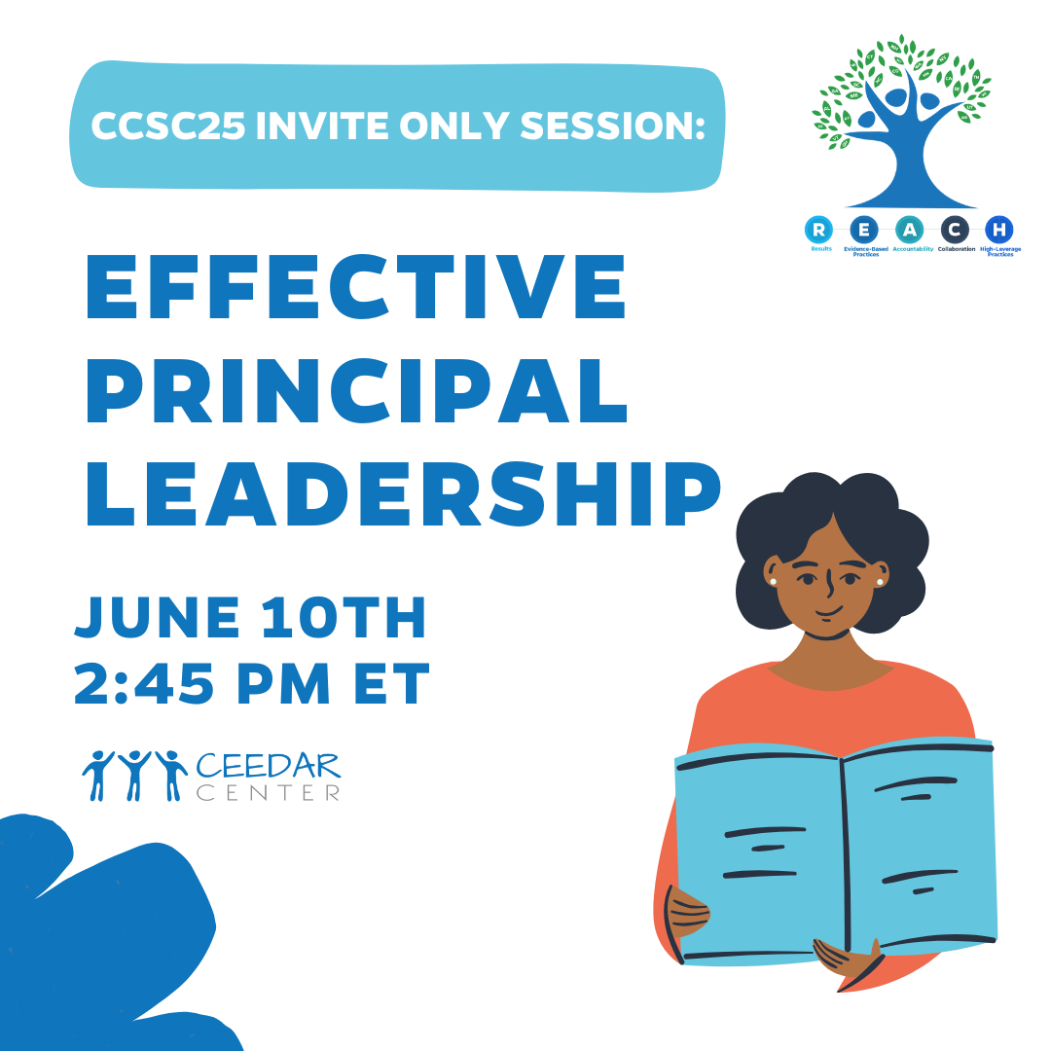
Invitations
You are invited to a special session during our CEEDAR Cross State Convening! Join us June 10th 2:45 EST for an interactive session:
reflecting on our content from the academic year
a Q&A with our partners from Lead IDEA and UCEA
an opportunity for you to connect with other participating states
Notes:
speaker: Bobbi
thank the presenters from LAUSD and share out final thoughts before our break out rooms
3:45-46

Slide 42
End of Year Survey
Please use the first 5 minutes of your state team time to complete this end of year survey. This will help collect feedback on your experience as well as plan for next year’s TAG topics.
Notes:
speaker: Bobbi
3:46-48
Abby send link
https://www.surveymonkey.com/r/T7LCCLC

Slide 43
State Team Reflection
Please access your blueprint from your state notes page to help with these questions. This also provides you a space to record your thinking during discussion.
  What ideas did you hear today that resonated with you?
  How might what you learned today impact your state plan or the work in your organization?
After these breakout rooms, we will not return to the main room, you will be free to leave.
Notes:
speaker: Abby
Now with your state team in breakout rooms, please reflect on LAUSD’s presentation and how it relates to your state’s work.
each breakout room will have a CEEDAR staff member or SLT member to help guide your conversations, you will have until the end of the hour. After these breakout rooms, we will not return to the main room, you will be free to leave. Do we have any questions?
Nichole sends questions in the chat and
state notes page
In your state time discuss:
What ideas did you hear today that resonated with you?
How might what you learned today impact your state plan or the work in your organization?

