Slide 1

Teacher Preparation and Professional Development to Deliver Evidence-Based Transition Planning and Services for Youth with Disabilities
CEEDAR Lunch-and-Learn
Mary Morningstar, Valerie Mazzotti, Janie Claywell
May 28, 2025

Slide 2
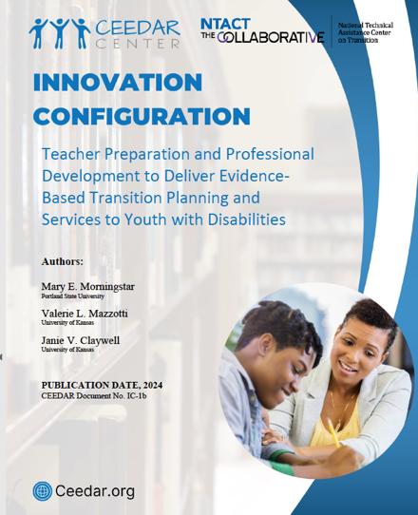
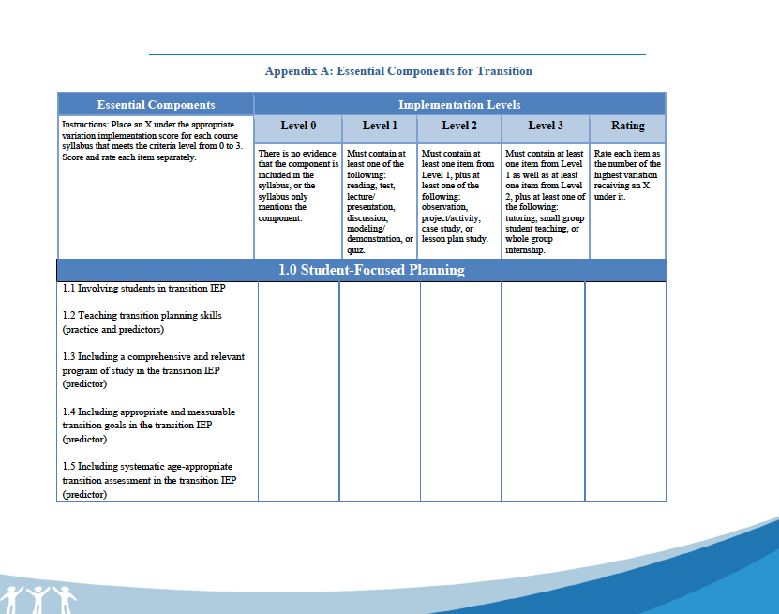
IC Overview
Notes:
This innovation configuration (IC) serves as a foundation for enhancing current practices in preparing special educators to provide transition services. As such, this paper examines: (a) the current state of identified transition evidence-based practices (EBPs) and predictors of postschool success to support students with disabilities as they transition into postschool life; (b) a review of critical programmatic structures and services that predict improved postschool outcomes; and (c) implications for future practice and research, including how state educational agencies (SEAs) and institutions of higher education (IHEs) can utilize the IC to identify areas of strengths and necessary changes to improve transition education, planning, and services.

Slide 3

What do you think transition educators need know & should be able to do to support successful student outcomes?
Notes:
Since 1990, and subsequent amendments in 1997 and 2004, the secondary transition provisions of the Individuals with Disabilities Education Act (IDEA) have required special educators to plan, coordinate, and deliver transition services for transition-aged students with disabilities. Section 300.43 of IDEA (2004) defines transition services as a coordinated set of activities for a child with a disability that (a) is designed to be within a results-oriented process focused on improving the academic and functional achievement of the child with a disability to facilitate the child’s movement from school to postschool activities, including postsecondary education, vocational education, integrated employment (including supported employment), continuing and adult education, adult services, independent living, or community participation and (b) is based on the individual child’s needs, taking into account the child’s strengths, preferences, and interests, including instruction; related services; community experiences; the development of employment and other postschool adult living objectives; and if appropriate, acquisition of daily living skills and provision of a functional vocational evaluation (U.S. Department of Education, 2011).
Despite these requirements, students with disabilities still experience less favorable postschool outcomes compared to their peers without disabilities (Lipscomb et al., 2017). This discrepancy may be due, in part, to secondary special educators feeling unprepared to plan for and deliver transition services (Simonsen et al., 2020). Studies have maintained secondary special educators report a lack knowledge and skills that hinder their abilities to implement effective transition practices (Benitez et al., 2009; Taylor et al., 2016). Consequently, educators who are unprepared to plan and deliver transition services may be inadvertently contributing to the poor outcomes of students with disabilities (Morningstar & Clavenna-Deane, 2018).

Slide 4


Who “does” Transition mean??
Secondary Educators
Transition Personnel
Notes:
Secondary Educators
Individual case management & transition planning
Teach specific skills (academic & non-academic; EBP)
Evaluate student growth & progress
Collaborate with general educators & school supports
Transition Coordinator
Systems and programs (transition predictors; advocacy)
Support and professional development
Interagency collaboration and outreach to families/community at large
Program evaluation

Slide 5
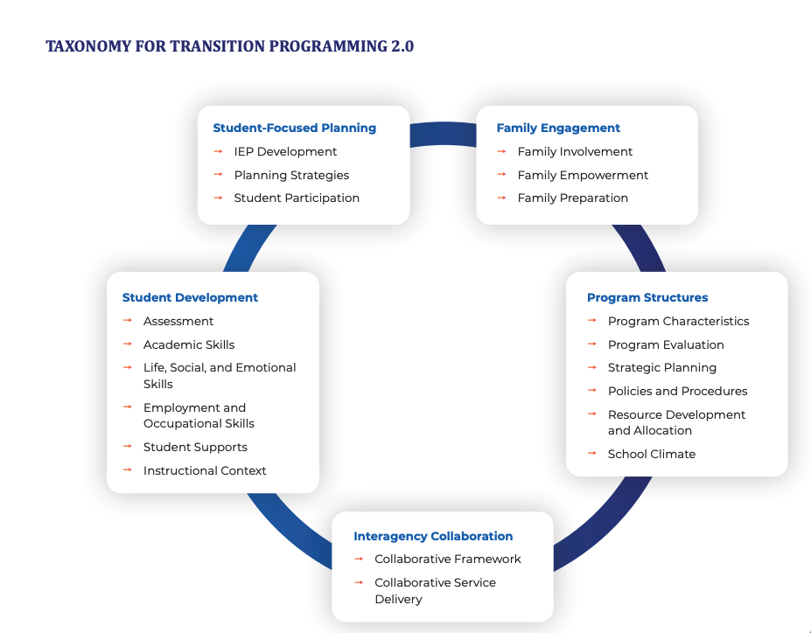
Taxonomy

Slide 6




Does Training Matter?
Secondary Educators are Prepared to Plan but not Act
Are not Sufficiently Prepared with EBPP’s
Formal Training (EPP & PD) Matters the Most
Morningstar, M. E., & Benitez, D. T. (2013). Teacher training matters: The results of a multistate survey of secondary special educators regarding transition from school to adulthood. Teacher Education and Special Education, 36, 51–64.
Notes:
Given the changing roles of secondary special educators, it stands to reason that teacher education and professional development (PD) should be geared toward increasing pre-service content targeting transition planning and services. Almost two decades since Anderson et al. (2003), relatively little change has occurred in educator preparation of transition competencies. Morningstar and colleagues (2018) reported from a national survey of 140 special education teacher preparation programs that less than half of the programs (i.e., 46.2%) offered a stand-alone course devoted to secondary transition. This finding is supported by Williams and colleagues (2018) who found transition content was not sufficiently addressed in coursework. Transition personnel development (i.e., pre-service and in-service) has been recognized as a cornerstone of improving transition services (Holzberg et al., 2018); however, clear guidance is limited toward establishing high-quality approaches that prepare secondary transition educators with the knowledge and skills to improve in-school and postschool outcomes for students with disabilities.
Predictors
•Number of transition courses
•Number of transition professional development
•Certification/licensure

Slide 7

What about Educator Preparation Programs & Transition?
46% reported a Stand-alone Transition Course
Most focus on Transition & Instructional Planning
Least Prepared in Implementing Transition Practices
Learning was Mostly Didactic & Application was Limited
Morningstar, M. E., Hirano, K. A., et al., (2017). Examining the status of transition-focused content within educator preparation programs. Career Development and Transition for Exceptional Individuals, 41(1), 4-15.
Notes:
Least Prepared:
Limited courses and sufficient depth of knowledge
Critical Role of faculty specializing in transition
Instructional Modalities
Infusing content across existing courses
Case studies using assessment data to develop PSGoals
Investigating how districts implement transition practices
Action planning and advocating for changes
Personnel Development is recognized as central strategy for systems change and improvement
Single transition course offers greater levels of preparation among program graduates
Lack of growth toward purposeful preparation of teachers over the past 15 years impacting transition

Slide 8
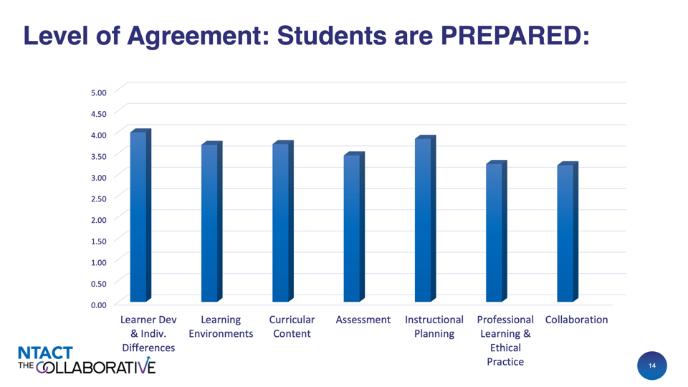
Level of Agreement

Slide 9
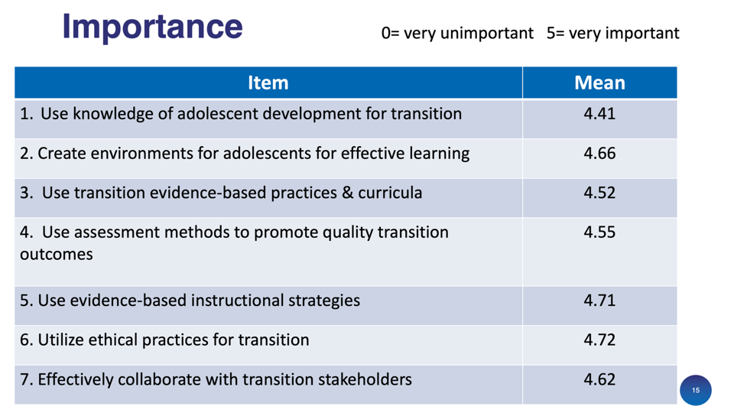
Importance

Slide 10
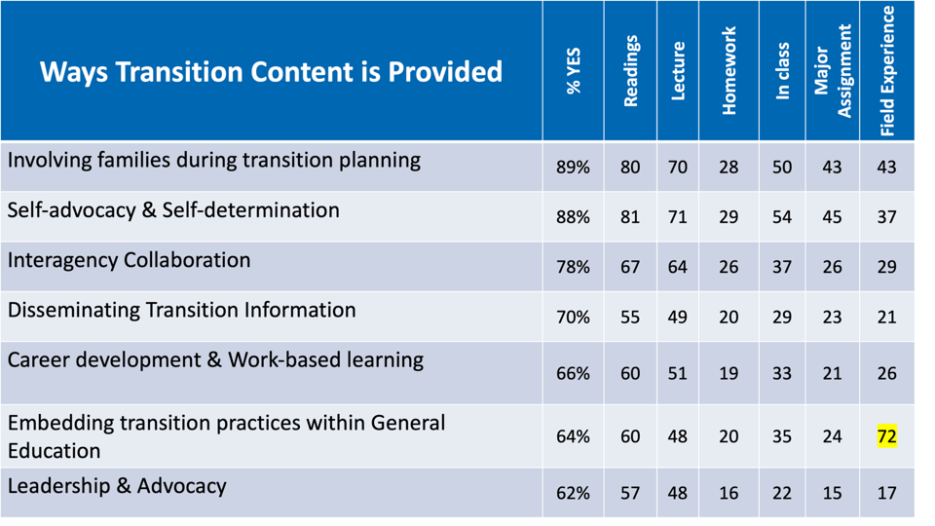
Ways Transition Content is Provided

Slide 11

What can we do to ensure professional development is effective?

Slide 12
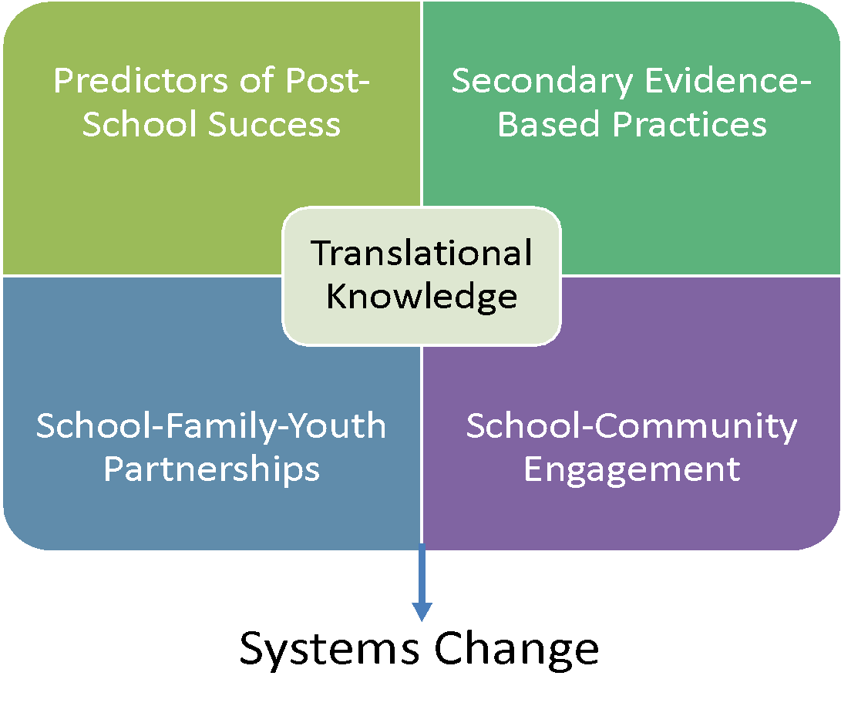
Improving PD
Improving PD through
Evaluation of Secondary Transition Programs & Practices

Slide 13




What Predicted Post-Secondary School Success?
23 Predictors organized alphabetically
EDUCATION
  8 Research-based
  9 Promising
EMPLOYMENT
  1 Evidence-based
  11 Research-based
  10 Promising
A predictor is defined as an in-school experience, typically a program (e.g., a work-based learning experience) that correlated with improved post-school outcomes.
INDEPENDENT LIVING
  3 Research-based
  6 Promising
Mazzotti, V. L., Rowe, D. A., Kwiatek, S. M., Voggt, A., Chang, W. H., Fowler, C. H., Poppen, M., Sinclair, J., & Test, D. W. (2021). Secondary transition predictors of post-school success: An update for the field. Career Development and Transition for Exceptional Individuals, 44(1), 47-64.
https://doi.org/10.1177/2165143420959793
Notes:
Definition: A predictor was defined as an in-school experience, typically a program (e.g., a work-based learning experience) that correlated with improved post-school outcomes.
Findings include 23 PREDICTORS organized alphabetically
Education: 8 research-based, 9 promising
Employment: 1 evidence-based, 11 research-based, 10 promising
Independent Living: 3 research-based, 6 promising

Slide 14
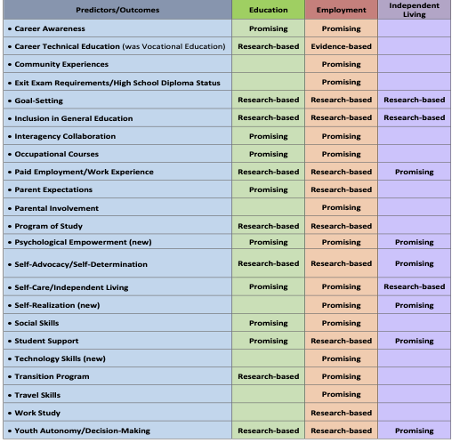
23 Predictors
23 Predictors of
Postschool
Success

Slide 15

Why Implement
Predictors of Postschool Success?
Predictors provide:
  Evidence-based information to inform practices
  A framework to:
    Evaluate, develop, and improve secondary transition programs and practices
    Determine if programs, instruction, or services reflect effective practices
    Foster conversations with partners (including families and students/ youth)

Slide 16
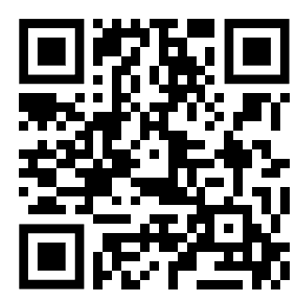
Predictor School/District
Implementation Self-Assessment
Operationalizes the predictors by listing programmatic characteristics useful for implementation
Helps programs assess if a predictor is being implemented (with fidelity)
Provides common language across disciplines and agencies focused on improved outcomes for individuals with disabilities
Located here:
https://transitionta.org/pisa-self-assessment/

Slide 17
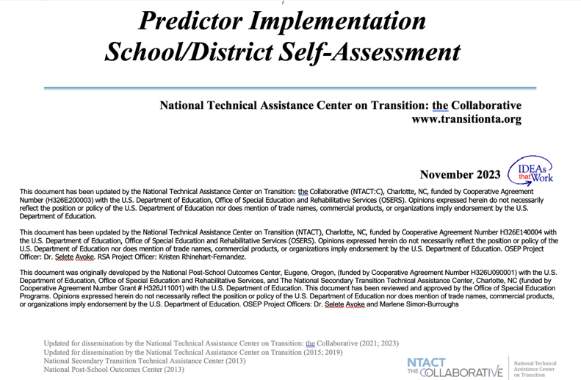
Predictor Implementation

Slide 18
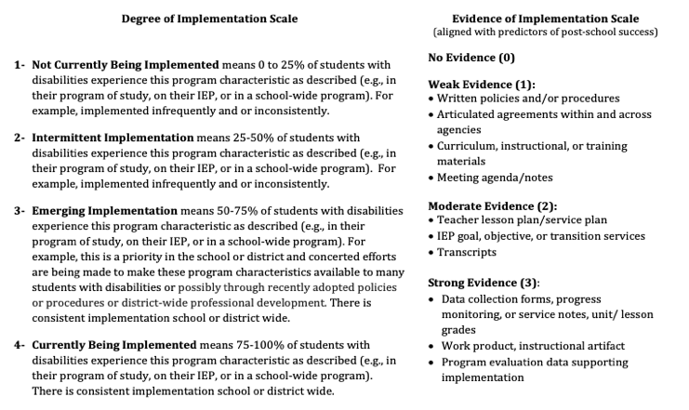
Using/Scoring the PISA

Slide 19

Interagency Collaboration
Operational Definition:
a clear, purposeful, and carefully designed process that promotes cross agency, cross program, and cross disciplinary collaborative efforts leading to tangible transition outcomes for youth.
(Rowe et al., 2015)

Slide 20

Interagency Collaboration:
Program Characteristics
Develop wide reaching state interagency teams that include disability related and non-disability related agencies (e.g., Developmental Disabilities, Vocational Rehabilitation, Department of Labor, Social Security Administration) with a common interest in transition service delivery.
Develop an agreed upon vision and mission of transition services and programs.
Coordinate the development of policies and procedures for service delivery and sharing of resources by both school and community agencies.

Slide 21
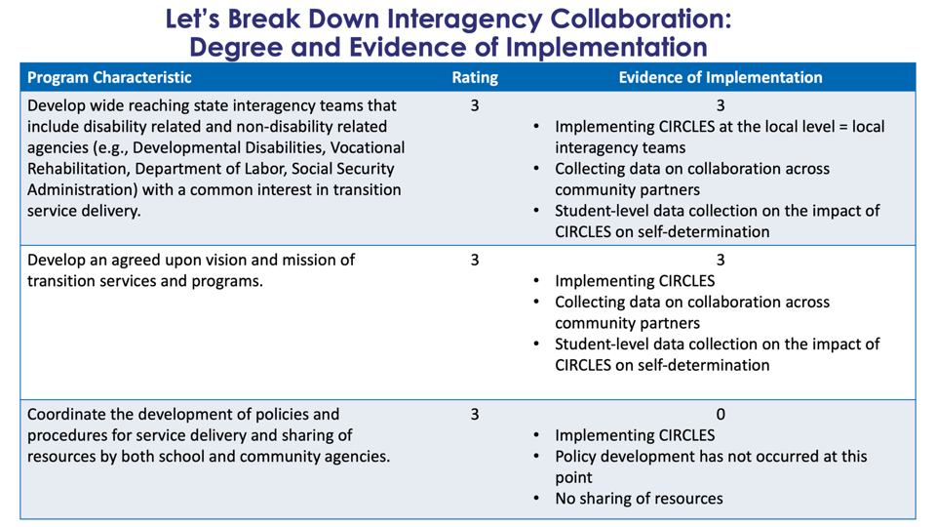
Degree and Evidence of Implementation

Slide 22
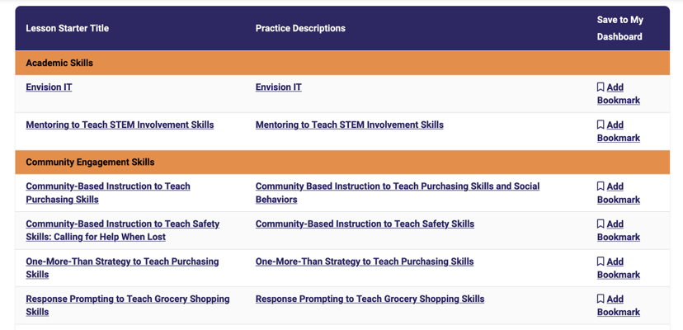
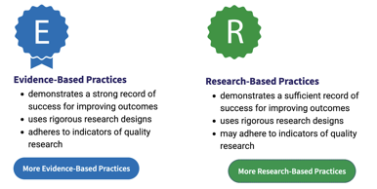
Evidence-Based & Research-Based Practices

Slide 23
What Can You Do?
Keeping up with the Research
  NTACT:C Resources
Focus on Practices (student level skills) AND Predictors (program level change)
EBP and PD: consistently embed transition instruction
  Use the Innovation Configuration!

Slide 24

Find us on:  
#transitionTA | transitionTA.org | ntact-collab@uncc.edu
The contents of this presentation were developed under a grant (H326E200003) from the Department of Education. However, those contents do not necessarily represent the policy of the Department of Education, and you should not assume endorsement by the Federal Government.

Slide 25
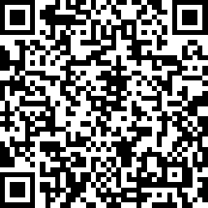

We value your feedback!
www.research.net/r/CEEDAR-IC-5-25

