Slide 1
Welcome to
CEEDAR’s Leadership
Topical Action Group (TAG)
Thursday, May 1st 2025
3:00-4:00 Eastern Time
Welcome to our TAG!
Participants: please change your Zoom name to
your state and name
Ex: Florida, Agatha Trunchbull
CEEDAR staff: please change your Zoom name to
CEEDAR, Your name
Notes:
Abby: Make everyone co-hosts
Speaker: Abby
3:00-3:01

Slide 2

Check in:
What do you look for in terms of support from your professional community?
Notes:
Speaker: Abby Please change your name to Your state abbreviation and your first and last name
3:00-3:02

Slide 3
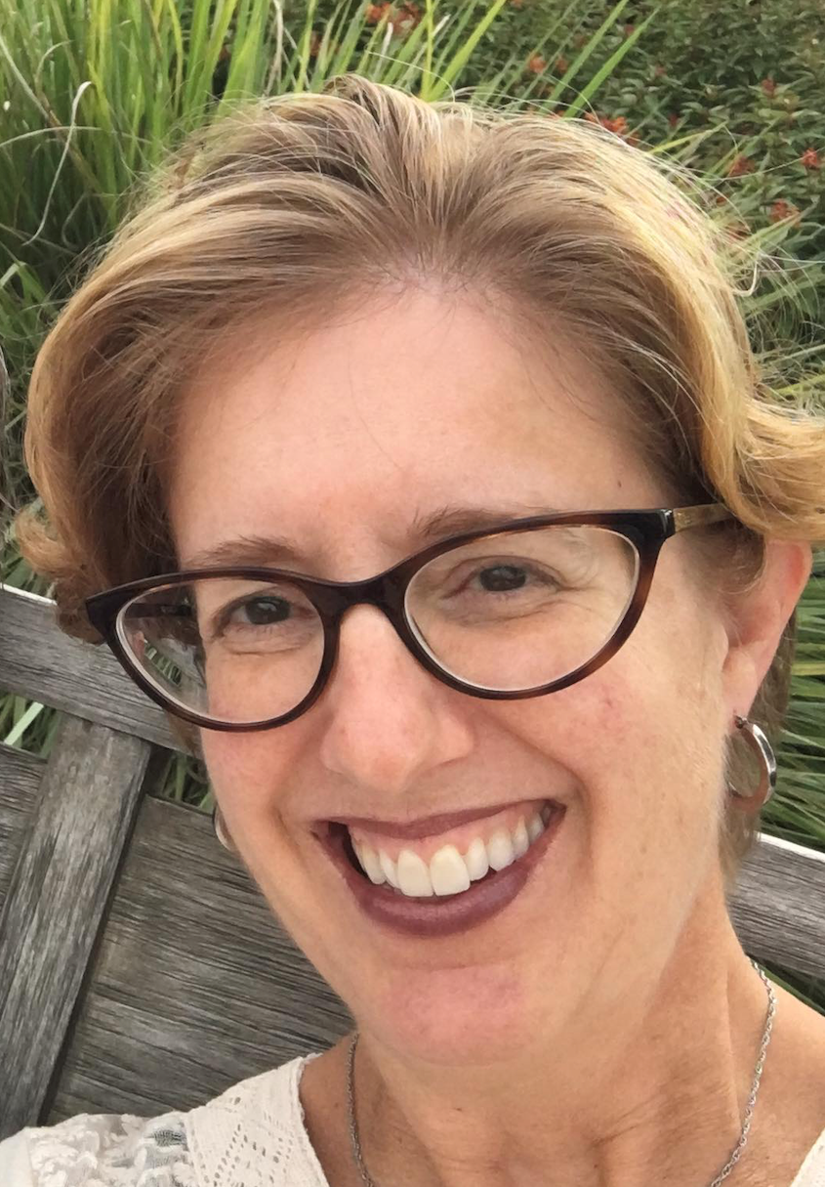
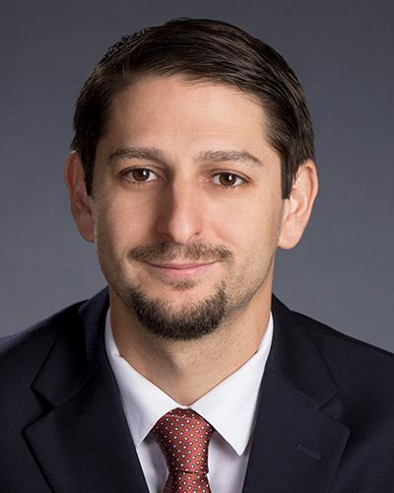
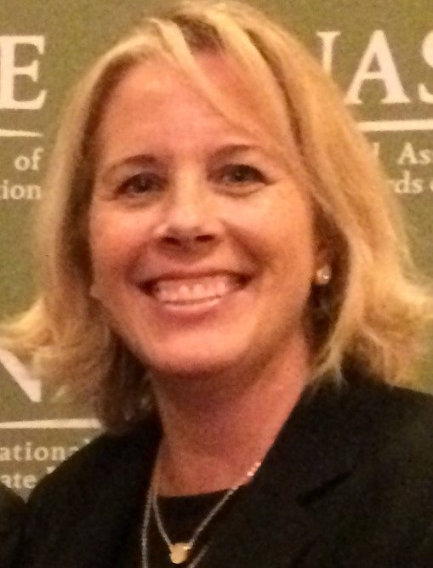
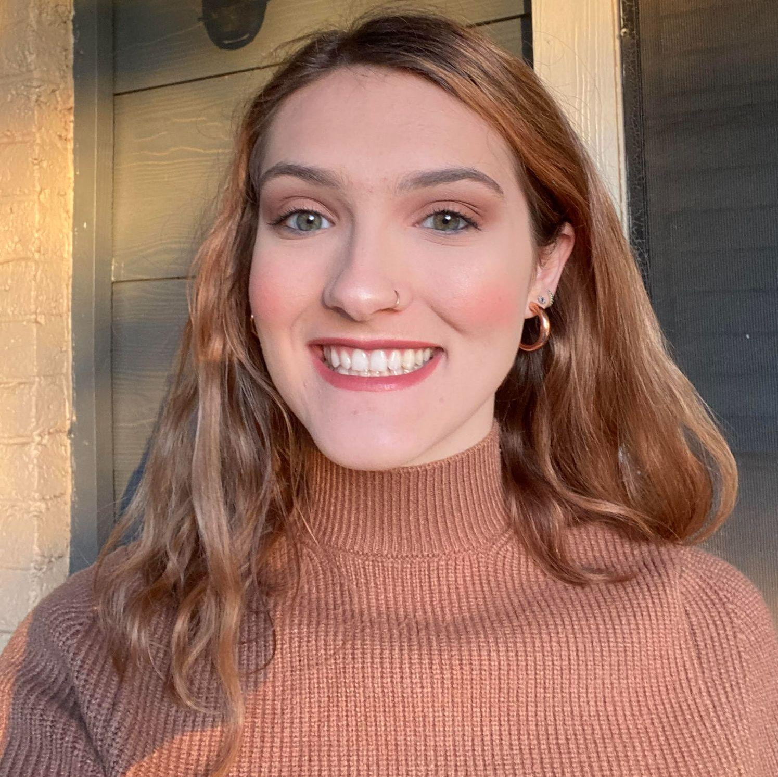
Welcome & Introductions
Dr. David DeMatthews
Professor, Department of Education Leadership and Policy,
The University of Texas at Austin
Nichole Spalding
Technical Assistance Specialist,
CEEDAR, University of Florida
Abby Berner
Engagement Specialist, CEEDAR, Research Assistant, American Institute for Research (AIR)
Dr. Bobbi Newman
State Lead for CEEDAR Center, Principal Researcher, American Institute for Research (AIR)
Notes:
Speaker: Nichole
3:02-3:03

Slide 4





Our Partners
Notes:
Speaker: Nichole
A warm thank you to our partners
Our partners are Lead IDEA, NASSP, and CCSSO- they are our liaisons and will share resources, they can provide additional perspectives. If you are here from one of these partner organizations, please share who you are in the chat and feel free to share your expertise!
3:02-3:03

Slide 5
The purpose of the TAG is to…
elevate the importance of effective leadership in our work,
focus on effective practices in our programs, coursework, clinical experiences, and policies,
engage in authentic conversations on their effective leadership efforts,
and share expertise, successes and challenges, and discuss how to use resources to support scaling and sustainability.
Notes:
Speaker: Nichole
Recognize that we have different roles as members of our TAG (SEA, IHE, associations, local) we want to be mindful of these roles as we talk in cross state and state team time
3:02-3:03

Slide 6
Leadership TAG
Potential Topics for Discussion
Date | Topic
January 9 | Curriculum, Instruction and Assessment
February 6 | Curriculum, Instruction and Assessment
March 6 | Communities of Student Care and Support
April 3 | Communities of Student Care and Support
May 1 | Professional Capacity and School Personnel
June 5 | Professional Capacity and School Personnel
Notes:
speaker: Nichole
3:03-3:04

Slide 7
Today’s Agenda
Welcome and Introductions
Resource Sharing - Standard 6
Cross State Breakout Groups
Spotlight on James Madison University
Final Thoughts and Action Items
Dismiss from State Breakout Groups
Notes:
Speaker: Nichole
Abby put meeting norms in chat
Meeting norms:
Be present and prepared
Respect in the shared space and keep what is shared in confidence. We are creating a community.
We will record guest speakers and resources sharing, but nothing else. What happens in the TAG, stays in the TAG!
Breakout rooms could be mixed cross state or state specific depending on the work.
Group members should “believe the best” and lead with positive intentionality.
3:04-3:05

Slide 8
Standard 6: Professional Capacity of School Personnel
“Research has shown that the capacity of special education teachers to deliver effective instruction may be
substantially impeded by working conditions that are not supportive (Billingsley et al., 2020;
Fisher et al., 2000)” (DeMatthews et al., 2024, p. 40).
Standard Components | Program/ Faculty | Courses | Clinical | Policy
6.1: Hire and retain highly effective special and general education teachers with a schoolwide vision and a set of core values that support improving achievement and outcomes for all students, including students with disabilities. | X
6.2: Provide multiple sources of high-quality, meaningful professional learning and development opportunities and participate alongside staff. |  |  | X
Notes:
Speaker: David
3:05-15

Slide 9
Standard 6: Professional Capacity of School Personnel (continued)
Working conditions include both the roles and responsibilities of special education teachers, as well as different types of supports (e.g., class or group size, schedules, technology) that help or hinder their ability to deliver effective instruction (Billingsley et al., 2020).
Standard Components | Program/ Faculty | Courses | Clinical | Policy
6.3: Identify strategies to motivate their staff and encourage, recognize, and facilitate leadership opportunities for teachers and staff who effectively educate students with disabilities. |  | X
Notes:
Speaker: David
3:05-15

Slide 10
Interconnected: Standards 6,7,8,9
Standard 6: Professional Capacity
Standard 9: Operations and Management
Standard 7: Professional Community
Standard 8: Meaningful Engagement with Family and Community
Notes:
Speaker: David
3:05-15

Slide 11
Cross State Breakout Room Guiding Question
Share an example of how your SEA/EPP is strengthening program implementation of Professional Capacity and School Personnel for aspiring and current school leaders.
CEEDAR facilitators, be prepared to come back from breakouts and share 1-2 sentences that summarize the discussion.
We will stay in these breakout rooms until 3:30 ET.
Notes:
Speaker: Bobbi
groups till 3:30 ET
Mix of state and CEEDAR facilitators
Abby will put in chat: slide screenshot
3:15-3:16

Slide 12
Takeaways from Cross State Discussion
Welcome back! CEEDAR facilitators, share 1-2 sentences in the chat that summarize your group’s discussion.
Notes:
Speaker: David
intro JMU folks
3:27-3:30

Slide 13

Increasing Special Education Teacher Retention Through Targeted Coaching: Focusing on High Leverage Practices (HLPs)
Dr. Katrina Maynard, James Madison University​
Dr. John McNaught, James Madison University
Dr Dannette Murray, James Madison University

Slide 14

What We Know About Teacher Retention
The Problem:
30-50% of new teachers leave the field within the first 5 years.
Special education teacher attrition rate is closer to 50%.
Attrition rate of special education teachers is almost double that of general education teachers.
High burnout rate.
Insufficient support.
Lack of financial Compensation
The Solution:
Professional Development Opportunities​
Collaboration and Mentoring
Supportive Administration
Positive School Culture

Slide 15

Principal and Leader Preparation & Virginia Principal Support Program (VPSP)
One of the facets of the Virginia Principal Support Program (VPSP) is leading special education instruction. TTAC and Faculty experts on HLPs provide training on HLPs
  Things discussed during the program include:
  - the importance of HLPs in meeting the needs of IPE goals
    - provide attendees with the HLP Leadership guides
Faculty leaders in VPSP can discuss the importance of HLPs in courses they teach as they prepare future principals
Discuss the importance of providing feedback to teachers on the implementation of HLPs during classroom observations

Slide 16
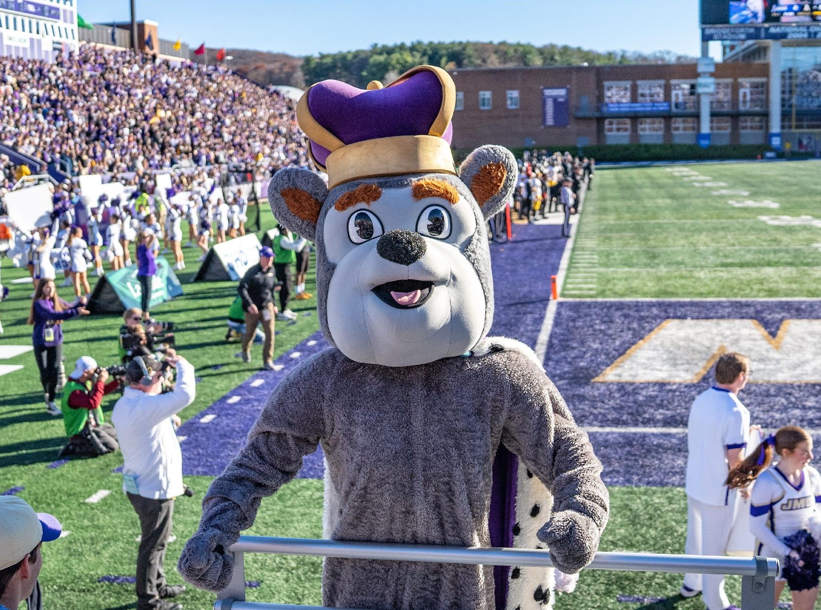
Accomplishments
Participate in CEEDAR Trainings yearly.
Complete and continually update the CEEDAR blueprint.
Provide PD on HLPS for all Faculty (Fall 2023).
SPED and IECE Program discussed how and where HLPs were
covered within coursework (Spring 2024-present).
    What HLPs are covered in specific courses?
    Determined whether it was at the introduction, developing, and mastered/applying level.
Programs discussed and decided on their top 5-7 HLPs to highlight (Summer 2023).
Added HLPs to all program courses (Fall 2024)
Aligned all HLPs, VDOE competencies and course key assessments/assignments (Fall 2024).
Programs utilized Innovation Configuration (IC) (Fall 2023-present).
    Where are our holes?
    How do we ensure all identified HLPs are being adequately covered?
TTAC provided multiple trainings with paraprofessionals on HLPs in Region 5 within the local school divisions.

Slide 17
CEEDAR/VDOE Study: Purpose
    Assess pre-service candidates’ effectiveness in implementing select HLPs with fidelity during student teaching placement.
    Assess effectiveness of University Supervisors (USs) and Cooperating Teachers (CTs) feedback during post-observation debrief conferences.
    By using HLPs and How to Give Effective Feedback, as a framework for training USs and CTs, our Teacher Preparation Program can provide a research-based and structured approach to preparing USs and CTs for their vital role in guiding and mentoring future educators.
    Improving the quality of teacher preparation and ultimately the effectiveness of K-12 education.

Slide 18
Content Covered in the Trainings
    High Leverage Practices (HLPs)
    Effective Questioning
    Use of Explicit Instruction
    Quality of Feedback (Specific, Statement Focused and Connection Making)
    Levels of Feedback (Specific, General and behavioral
    Importance of Opportunities to Respond (OTRs-Deep, Rote, Choral)

Slide 19

Observation Procedure/Steps:
Student teacher teaches a lesson (30-45 minute minimum in duration) and will be observed by either the US or the CT individually. A total of 12 observations must be completed-six by US and six by CT.​
Student teacher records themselves while teaching the observed lesson. A total of 12 video recordings.
US/CT MUST use the Classroom Observation Form while observing the lesson.
US/CT will conduct a debrief session that focuses on the use and implementation of HLPs.
  Student teacher audio records debrief session (12 total).
  US/CT must provide feedback on HLPs used by the student teacher using the Classroom Observation Form.
  Student Teacher uploads audio recording to Canvas.
Student teachers will watch their video and write a reflection referencing the information from the debrief (on HLPs) and performance from lesson video.
Student teacher will upload the following to Canvas: 1) Classroom Observation Form from US/CT, 2) audio recording of debrief session focused on HLPs, and 3) lesson reflection.

Slide 20
Procedures Review
Twelve total lessons across a semester. Taught out in the field during practicum and student teaching.
Six of these are observed by the USs and six are observed by the CTs (both participated in the trainings) using a research developed observation tool.
Students debrief with the US or CT. This debriefing is audiotaped for later scoring by the research team.
Students will watch a video of their teaching and answer five reflection questions (to be reviewed by the research team).

Slide 21
Reflection Questions:
Things that went well in my lesson- Be sure to explain why they went well. How did your teaching and/or instructional strategy impact student learning? Was there K-12 Student mastery of lesson objective? Be sure to include supporting data referenced (progress monitoring data).
Things you might do differently next time- Be sure to explain why. What didn’t go as planned? How might you do it differently next time (your teaching, your class structure and/or lesson components)? Why would you do it differently next time? How will it impact student learning differently?
How you utilized HLPs in your lessons- Be sure to discuss the impact utilizing HLPs had on your teaching and student achievement.
How did the US and CT feedback influence your teaching?- During your observation debrief, what feedback/comments were made that forced you to think about your students or your instruction?
Overall impressions on the taught lesson. Were your students engaged, on task, and/or using active learning? Be sure to use pseudo names when referring to students.

Slide 22
Preliminary Findings
US and CT provided general feedback.
US and CT did not provide specific examples with feedback.
US and CT do not always give clear feedback on HLPs
  Tend to give general feedback related to an HLP.
    Even with specific training on providing HLP specific feedback US and CT often times resorted to traditional ways of providing feedback.
Feedback lacked constructive feedback and goals for improvement.
US and CT need more training and coaching on how to give effective feedback.

Slide 23

Thank you
Thank you!
Questions?
Contact Information:
Dr. Katrina L. Maynard
James Madison University
maynarkl@jmu.edu
Dr. John McNaught
James Madison University
mcnaugjt@jmu.edu
Dr. Dannette Y. Murray
James Madison University
murraydy@jmu.edu

Slide 24
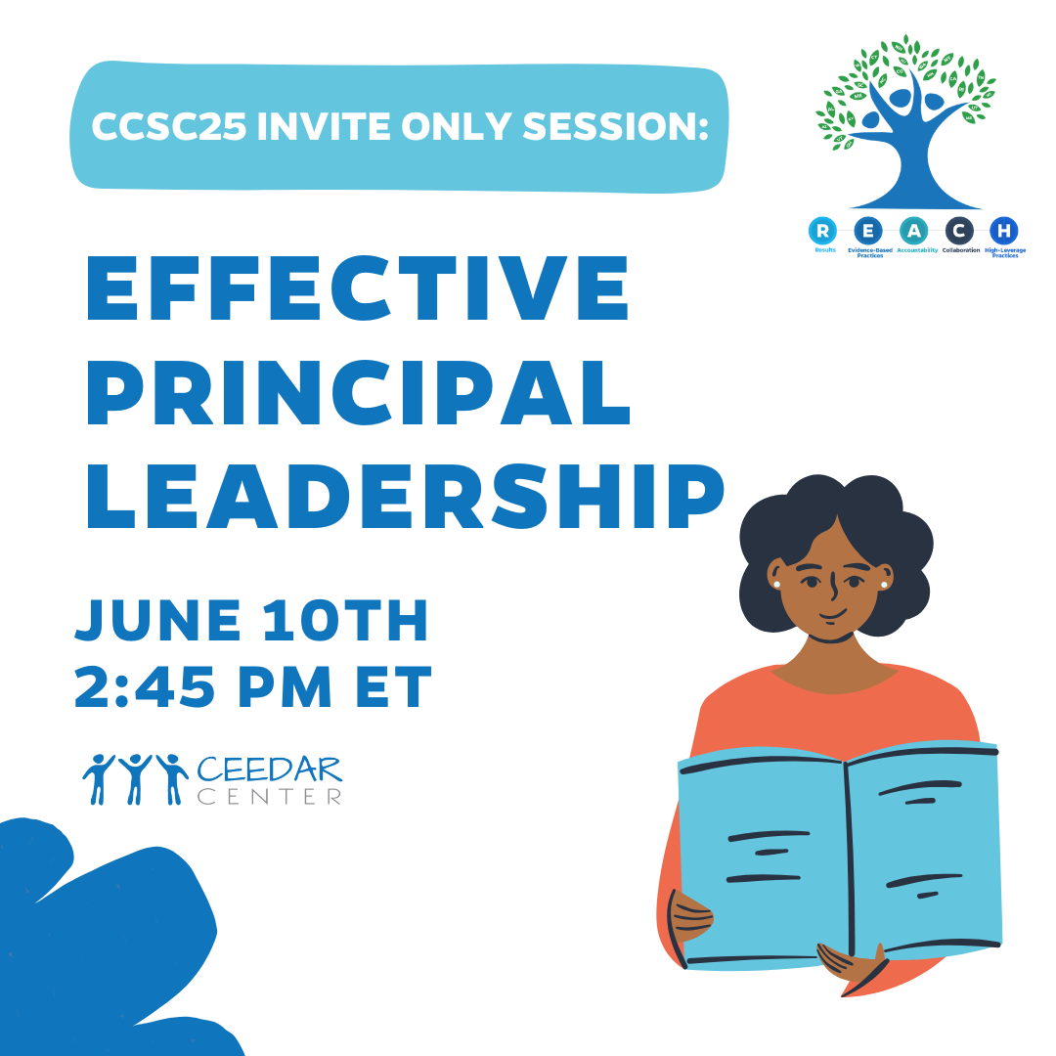
Invitations
Our last TAG meeting for the school year is June 5th, we are revisiting Professional Capacity and School Personnel
    Please review pages 38-41 in the IC document to help orient you to our meeting topic.
  Next IC trainings are May 13th and June 26th, sign up here
Also, you are invited to a special session during our CEEDAR Virtual Convening, save this date and time! ➡️
Notes:
speaker: Abby
thank the presenters from JMU and share out final thoughts before our break out rooms
Nichole send links to IC document and IC training sign-up and CEEDAR Convening Registration
3:40-42
IC Document https://ceedar.education.ufl.edu/wp-content/uploads/2025/02/Inclusive-Principal-Leadership-IC.pdf
IC training sign-up https://docs.google.com/forms/d/e/1FAIpQLSdMFYUHSfGdE-ED6YvObvUCKy4rZjfvibQGjo-rR9JrvAWI8w/viewform
CEEDAR Convening Registration https://www.ccsc2025.com/

Slide 25
State Team Reflection
Please access your blueprint from your state notes page to help with these questions. This also provides you a space to record your thinking during discussion.
  What ideas did you hear today that resonated with you?
  How might what you learned today impact your state plan or the work in your organization?
After these breakout rooms, we will not return to the main room, you will be free to leave.
Notes:
speaker: Abby
Now with your state team in breakout rooms, please reflect on JMU’s presentation and how it relates to your state’s work.
each breakout room will have a CEEDAR staff member or SLT member to help guide your conversations, you will have until the end of the hour. After these breakout rooms, we will not return to the main room, you will be free to leave. Do we have any questions?
Nichole sends questions in the chat and
state notes page
In your state time discuss:
What ideas did you hear today that resonated with you?
How might what you learned today impact your state plan or the work in your organization?

