Slide 1
Welcome to
CEEDAR’s Leadership
Topical Action Group (TAG)
Thursday, April 3rd 2024
3:00-4:00 Eastern Time
Welcome to our TAG!
Participants: please change your Zoom name to
your state and name
Ex: Florida, Agatha Trunchbull
CEEDAR staff: please change your Zoom name to
CEEDAR, Your name
Notes:
Abby: Make everyone co-hosts
Speaker: Abby
3:00-3:01

Slide 2

Check in:
Notes:
Speaker: Abby Please change your name to Your state abbreviation and your first and last name
3:00-3:02

Slide 3
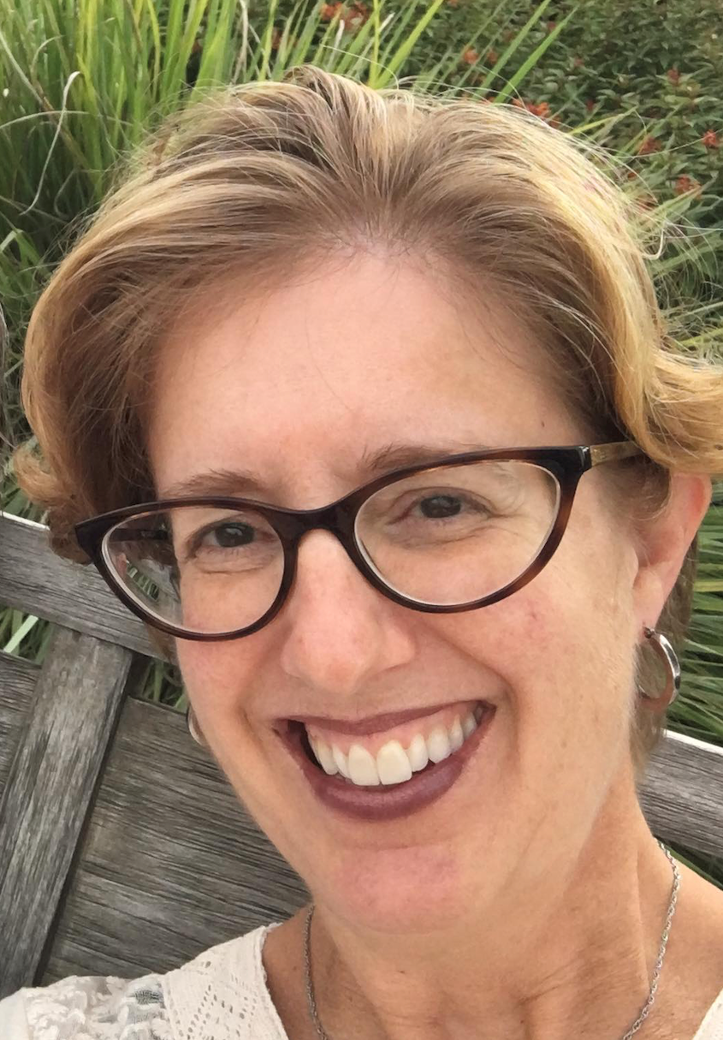
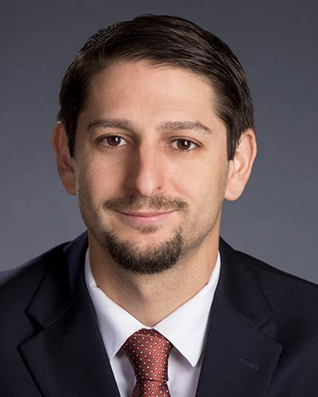
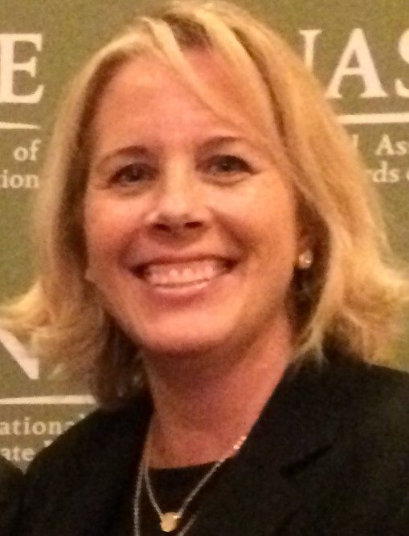
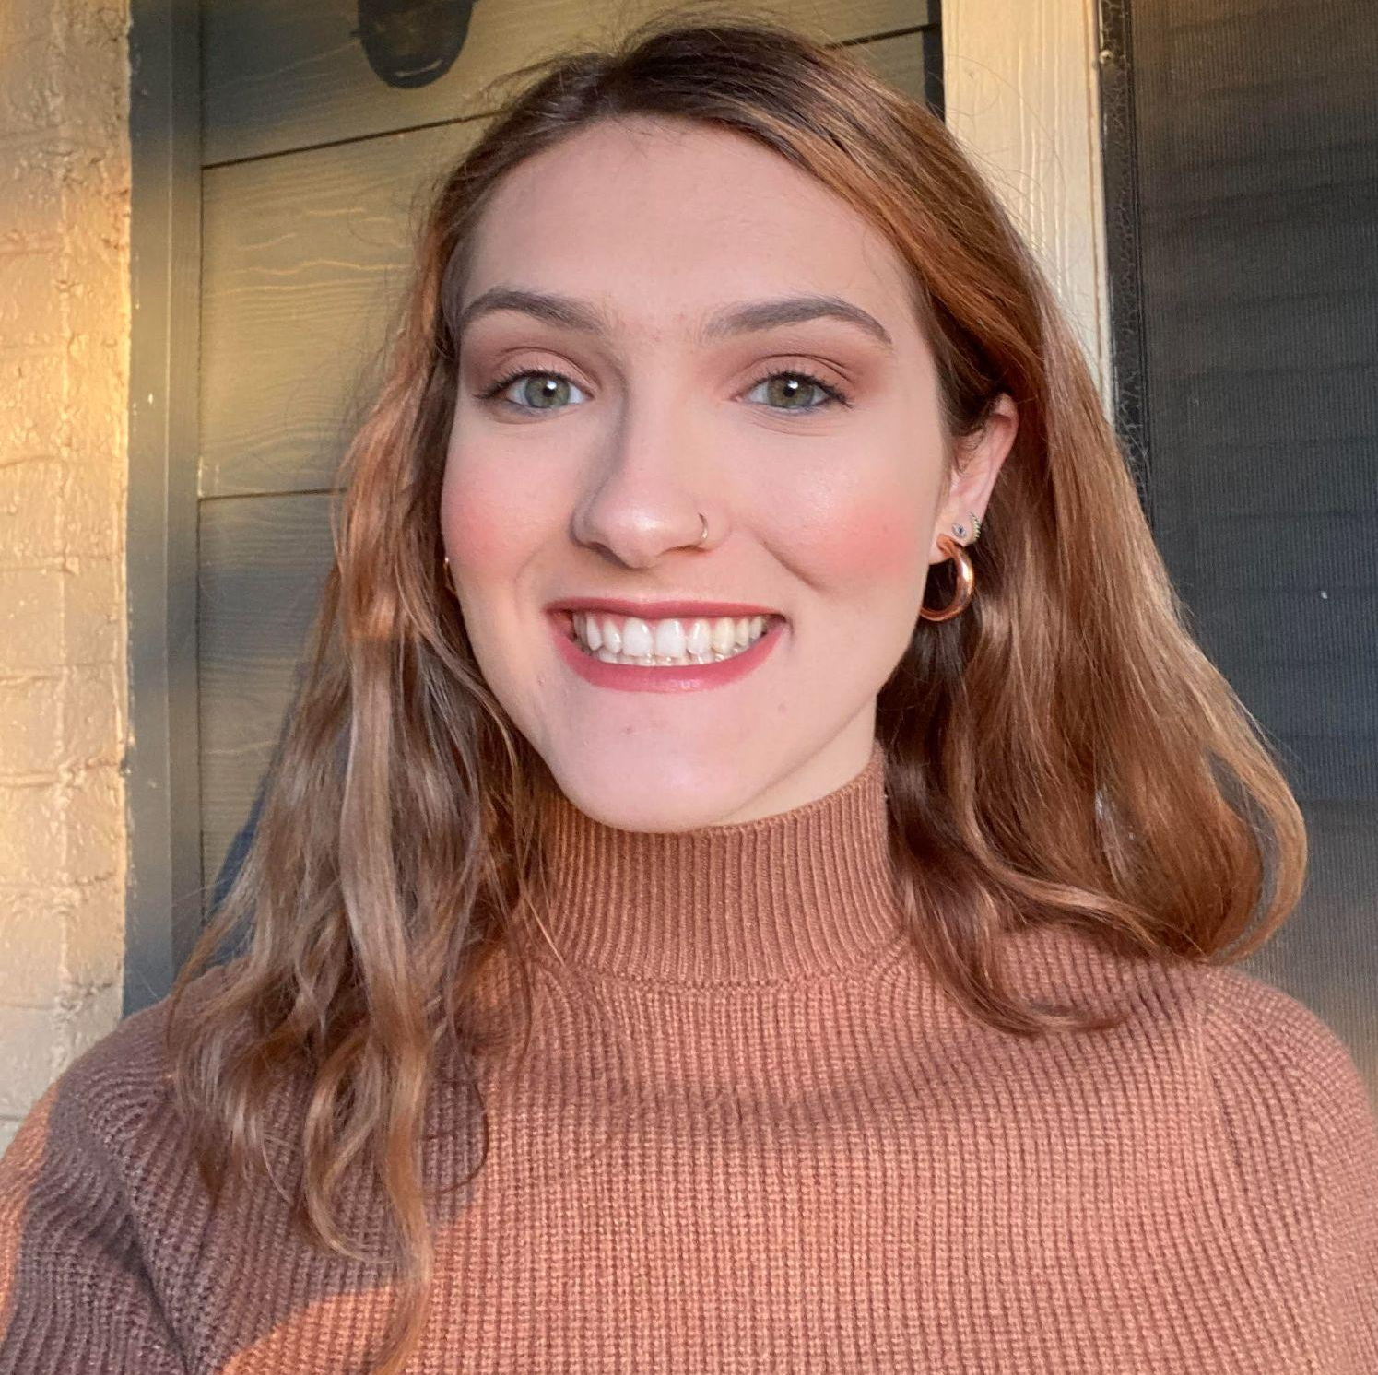
Welcome & Introductions
Dr. David DeMatthews
Professor, Department of Education Leadership and Policy,
The University of Texas at Austin
Nichole Spalding
Technical Assistance Specialist,
CEEDAR, University of Florida
Abby Berner
Engagement Specialist, CEEDAR, Research Assistant, American Institute for Research (AIR)
Dr. Bobbi Newman
State Lead for CEEDAR Center, Principal Researcher, American Institute for Research (AIR)
Notes:
Speaker: Bobbi
3:02-3:03

Slide 4





Our Partners
Notes:
Speaker: Bobbi
A warm thank you to our partners
Our partners are Lead IDEA, NASSP, and CCSSO- they are our liaisons and will share resources, they can provide additional perspectives. If you are here from one of these partner organizations, please share who you are in the chat and feel free to share your expertise!
3:02-3:03

Slide 5
The purpose of the TAG is to…
elevate the importance of effective leadership in our work,
focus on effective practices in our programs, coursework, clinical experiences, and policies,
engage in authentic conversations on their effective leadership efforts,
and share expertise, successes and challenges, and discuss how to use resources to support scaling and sustainability.
Notes:
Speaker: Bobbi
Recognize that we have different roles as members of our TAG (SEA, IHE, associations, local) we want to be mindful of these roles as we talk in cross state and state team time
3:02-3:03

Slide 6
Leadership TAG
Potential Topics for Discussion
Date | Topic
January 9 | Curriculum, Instruction and Assessment
February 6 | Curriculum, Instruction and Assessment
March 6 | Communities of Student Care and Support
April 3 | Communities of Student Care and Support
May 1 | Professional Community for Teachers and Staff
June 5 | Meaningful Engagement of Families and Community
Notes:
speaker: Bobbi
3:03-3:04

Slide 7
Today’s Agenda
Welcome and Introductions
Resource Sharing - Standard 5
Cross State Breakout Groups
Spotlight on North-Grand Early College STEAM High School in Chicago
Final Thoughts and Action Items
Dismiss from State Breakout Groups
Notes:
Speaker: Bobbi
Abby put meeting norms in chat
Meeting norms:
Be present and prepared
Respect in the shared space and keep what is shared in confidence. We are creating a community.
We will record guest speakers and resources sharing, but nothing else. What happens in the TAG, stays in the TAG!
Breakout rooms could be mixed cross state or state specific depending on the work.
Group members should “believe the best” and lead with positive intentionality.
3:04-3:05

Slide 8
Standard 5: Communities of Student Care and Support
Principals can help ensure that students with disabilities “participate in school life as they engage with others in general education classrooms and participate in non-classroom activities such as assemblies, field trips, playgrounds, lunch, and school-sponsored extracurricular activities…” (p. 35).
Standard Components | Program/ Faculty | Courses | Clinical | Policy
5.1: Build and maintain a safe, caring, and healthy environment that meets the needs of each student, including students with disabilities, and encourages them to be active, responsible members of their community |  | X
5.2: Ensure that students with disabilities have opportunities to learn with their non-disabled peer to the greatest extent appropriate. |  | X
Notes:
Speaker: David
3:05-3:15

Slide 9
Standard 5: Communities of Student Care and Support(continued)
“Principals can also ensure special and general education teachers have adequate time and structure for the planning necessary to build caring environments” (e.g., participation plans, schedule changes) (p. 36).
Standard Components | Program/ Faculty | Courses | Clinical | Policy
5.3: Promote inclusive environments that foster acceptance, care, and a sense of value and belonging in adult-student and student-peer relationships. | X
5.4: Support teachers as they create productive and inclusive environments in their classrooms and throughout the school. |  |  | X
Notes:
Speaker: David
3:05-3:15

Slide 10
Interconnected: Standards 4-5
Standard 4 Curriculum, Instruction, and Assessment
Standard 5
Community of Care and Support for Students
Notes:
Speaker: David
3:05-3:15

Slide 11
Cross State Breakout Room Guiding Question
Share an example of how your SEA/EPP is strengthening program implementation of Communities of Student Care and Support for aspiring and current school leaders.
CEEDAR facilitators, be prepared to come back from breakouts and share 1-2 sentences that summarize the discussion.
We will stay in these breakout rooms until 3:30 ET.
Notes:
Speaker: Bobbi
groups till 3:30 ET
Mix of state and CEEDAR facilitators
Abby will put in chat: slide screenshot
3:15-3:16

Slide 12
Takeaways from Cross State Discussion
Welcome back! CEEDAR facilitators, share 1-2 sentences in the chat that summarize your group’s discussion.
Notes:
Speaker: David
intro Chicago folks
3:27-3:30

Slide 13
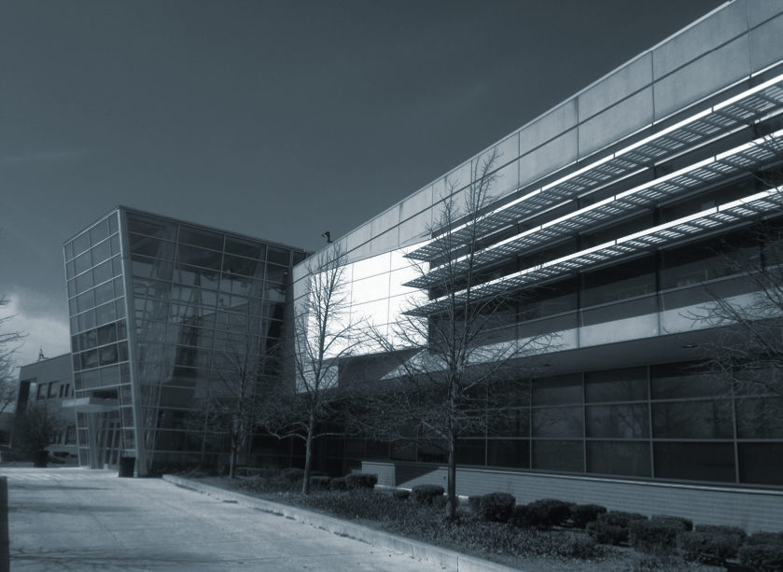

Welcome!
Communities of Care
NORTH-GRAND
EARLY COLLEGE STEAM
HIGH SCHOOL
www.northgrandhs.org
@northgrandhs

Slide 14

Rightful Presence in Chicago Public Schools
CPS Priority: “Ensure the rightful presence of every student with disabilities so they can fully engage in rigorous instruction at their grade level, in the general education classroom to the greatest extent possible, and accessing the same opportunities as their non-disabled peers.”
  Personalized learning experiences
  Rigorous instruction
  Access to opportunities, including post-secondary preparation
This cannot be done without creating a community of care!
https://www.cps.edu/sites/five-year-plan/priorities/student/students-with-disabilities/

Slide 15
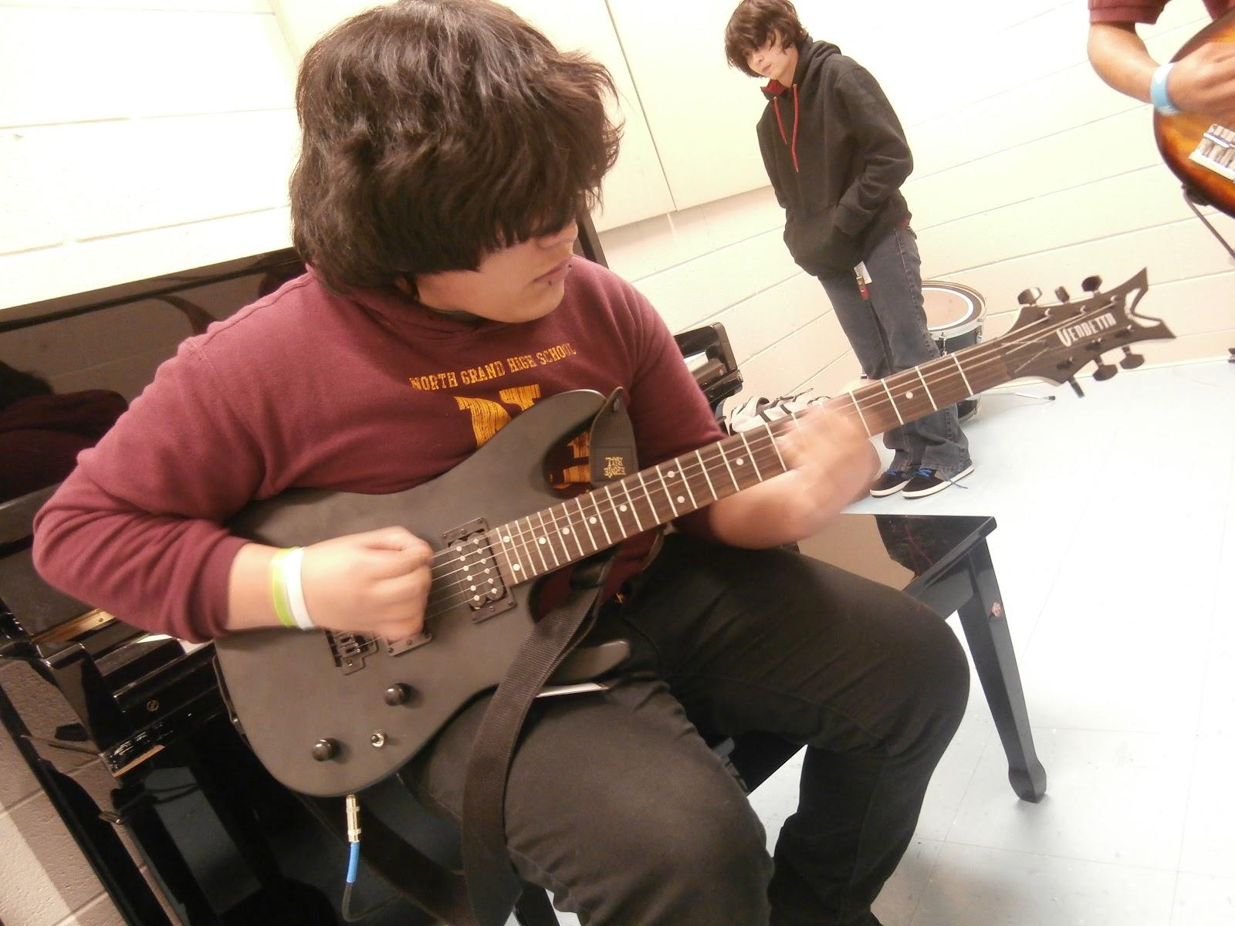
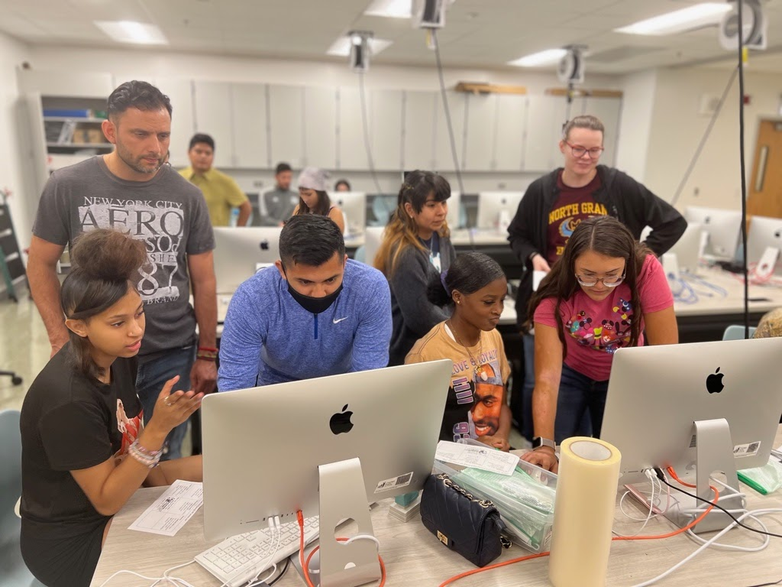
Community of Care - Inside the School
Student self-course selection
  Trusted adult conversations
  Student-led
  Specific to students’ needs
Co-Generative Dialogues
Full access to classrooms that provide
  Continuum of Services
  Flexible Scheduling

Slide 16
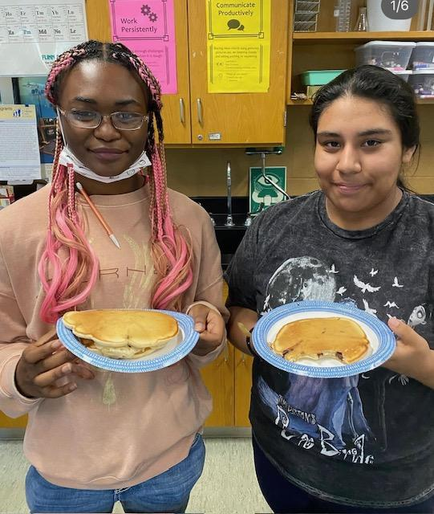
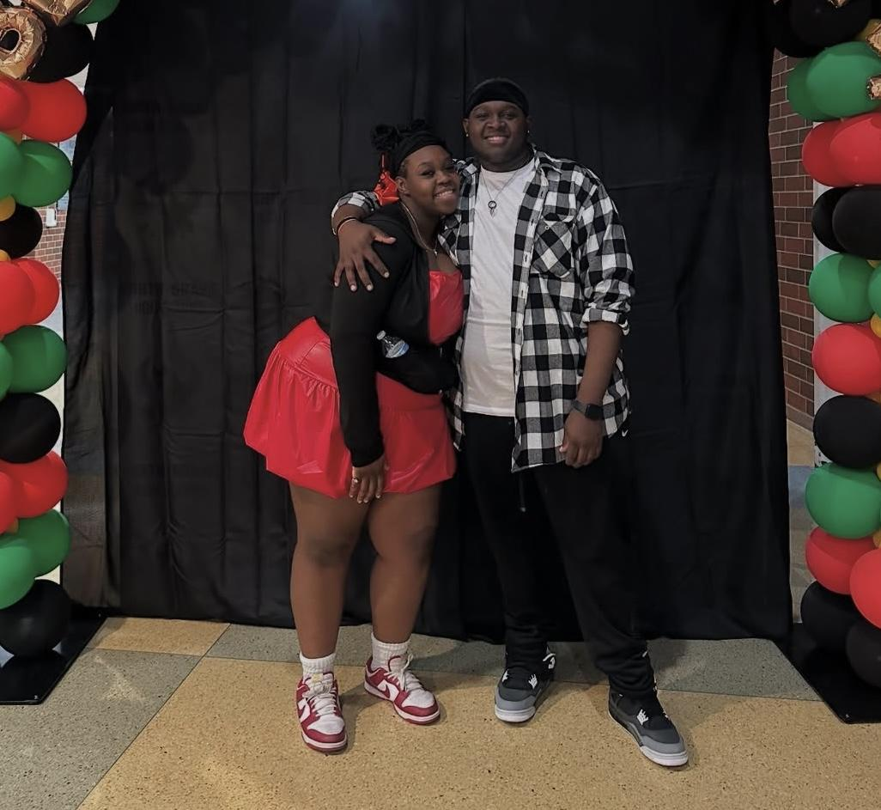
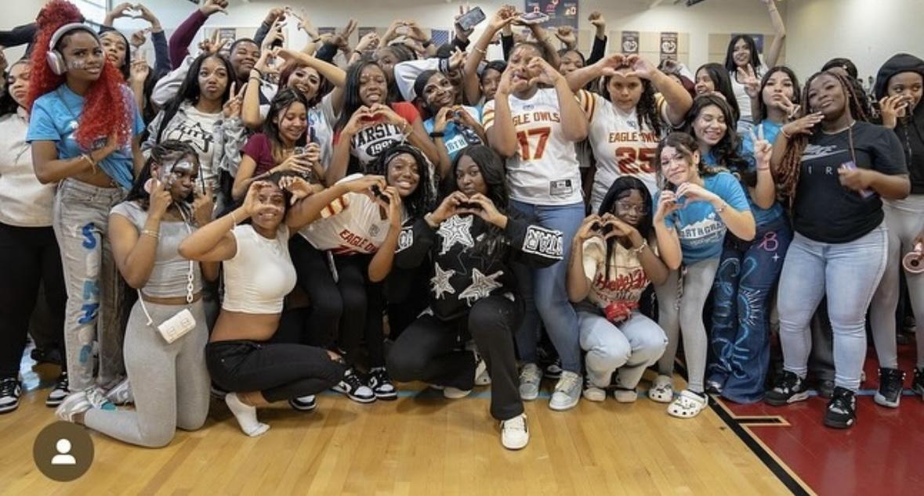
Community of Care - Outside the School Day
Athletics
  Special Olympics
  Full access to robust sports programming
Out of School Time Programming
  Cluster-specific programs
  Targeted supports for students with disabilities, including access to tutoring
  High level of participation in after-school clubs

Slide 17

Key Leadership Moves to Leverage Communities of Care
Build relational trust with both staff and students
Bring issues to the forefront of conversations with key stakeholder groups and challenge biases when they arise
  Senior Leadership Team
  Instructional Leadership Team
  Course teams and departments
  Students and parents
Develop an intentional, specific plan with action steps
  Promotes accountability

Slide 18
High Value Clinical Experiences (Work Tasks) to Prepare Future Leaders
Establish Work Tasks During the Clinical Experience that Provide Developmental Opportunity:
Look at data that reveals how students are experiencing the school; surveys (5 Essentials or Cultivate) and engage in listening tours with students, parents, staff, and community members; emphasize students with disability; what are you learning from these data and is there a plan of action that the aspirant might lead that acts on these findings?
Regularly engage in learning walks in classrooms throughout the school that focus on looking for the nature of adult/student relationships and high leverage practices (HLPs) - both formally (done with with mentor principal including debrief) and informally
  Aspirants must sharpen their lens for what to “look for” in an all access classroom
  Ground your work in research (HLP and elements of these practices)!
Develop and enact a plan of radical self-care
  Focus on adult SEL and student SEL

Slide 19
High Value Clinical Activities
Identify settings that have strong practices for creating a community of care for students with disabilities and ensure that aspirants have an opportunity to interact with those leaders
CPS does this through aspirant cohort visitation to schools on a monthly basis for a full day exploration
This could be done through taped interviews or Zoom

Slide 20
Invitations
Our next TAG meeting is May 1st, we are discussing:
  Professional Capacity and School Personnel (IC Standard 6)
    Please review pages 38-41 in the IC document to help orient you to our next meeting topic.
  Next IC training is May 13th, 1-2:30 ET, sign up here
Notes:
speaker: Bobbi
thank the presenters from Chicago and share out final thoughts before our break out rooms
Abby send links to IC document and IC training sign-up
3:40-42

Slide 21
State Team Reflection
Please access your blueprint from your state notes page to help with these questions. This also provides you a space to record your thinking during discussion.
  What ideas did you hear today that resonated with you?
  How might what you learned today impact your state plan or the work in your organization?
After these breakout rooms, we will not return to the main room, you will be free to leave.
Notes:
speaker: Abby
Now with your state team in breakout rooms, please reflect on Chicago’s presentation and how it relates to your state’s work.
each breakout room will have a CEEDAR staff member or SLT member to help guide your conversations, you will have until the end of the hour. After these breakout rooms, we will not return to the main room, you will be free to leave. Do we have any questions?
Abby sends questions in the chat and
state notes page
In your state time discuss:
What ideas did you hear today that resonated with you?
How might what you learned today impact your state plan or the work in your organization?

