Slide 1
Welcome to
CEEDAR’s Leadership
Topical Action Group (TAG)
Thursday, March 6th 2024
3:00-4:00 Eastern Time
Welcome to our TAG!
Participants: please change your Zoom name to
your state and name
Ex: Florida, Agatha Trunchbull
CEEDAR staff: please change your Zoom name to
CEEDAR, Your name
Notes:
Abby: Make everyone co-hosts
Speaker: Abby
3:00-3:01

Slide 2

Check in:
Check in:
When you are having a tough day, what kind of care and support do you look for?
Notes:
Speaker: Abby Please change your name to Your state abbreviation and your first and last name
3:00-3:02

Slide 3
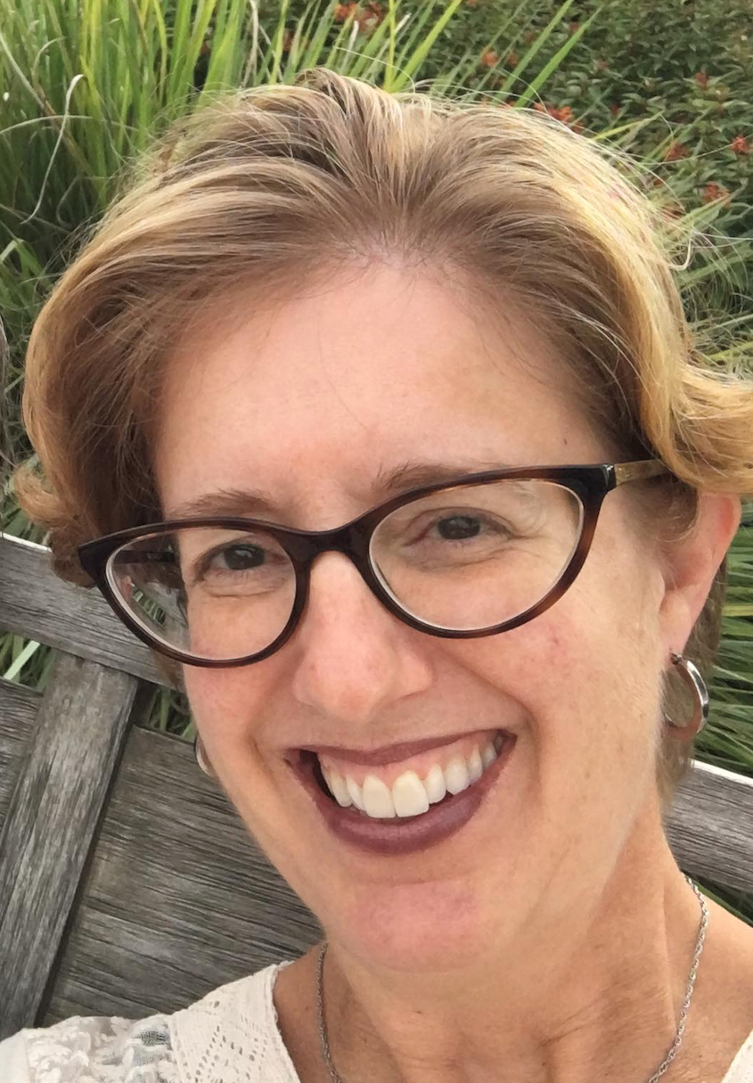
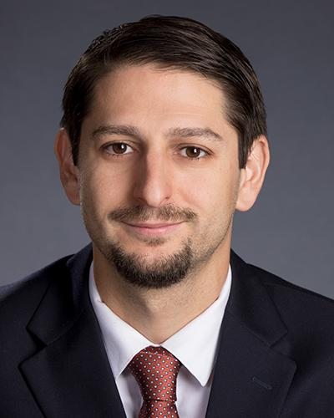
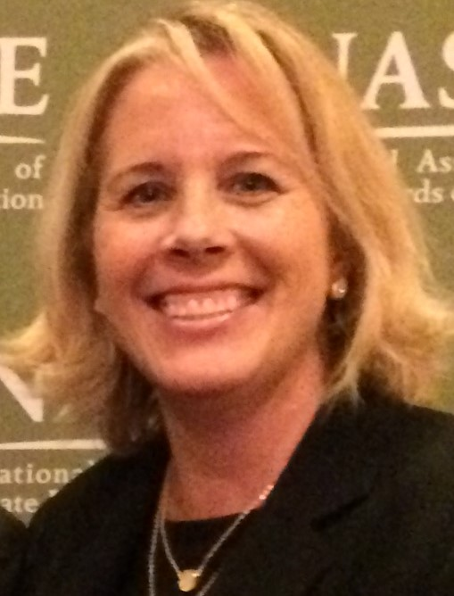
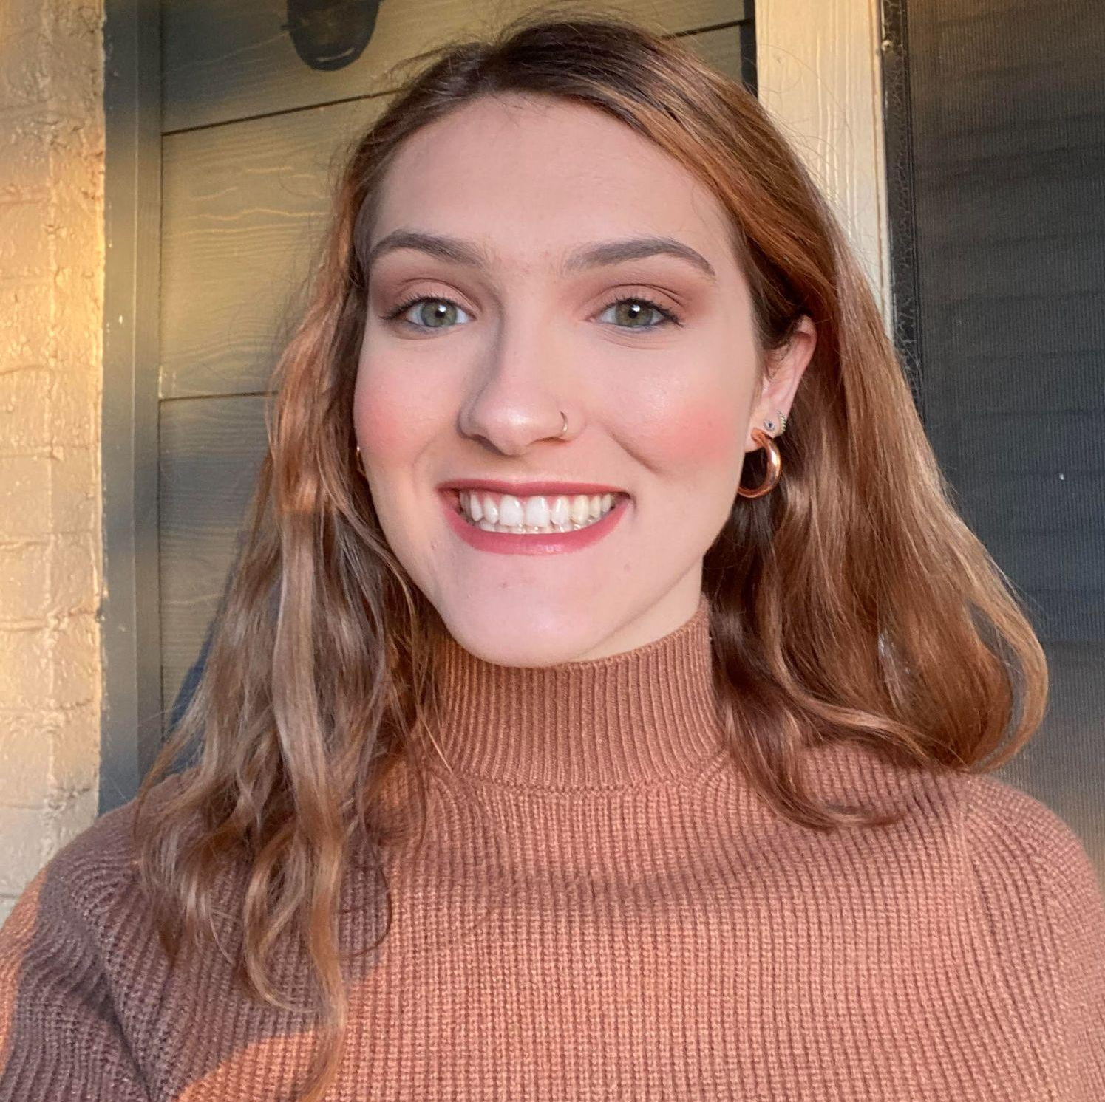
Welcome & Introductions
Dr. David DeMatthews
Professor, Department of Education Leadership and Policy,
The University of Texas at Austin
Nichole Spalding
Technical Assistance Specialist,
CEEDAR, University of Florida
Abby Berner
Engagement Specialist, CEEDAR, Research Assistant, American Institute for Research (AIR)
Dr. Bobbi Newman
State Lead for CEEDAR Center, Principal Researcher, American Institute for Research (AIR)
Notes:
Speaker: Nichole
3:02-3:03

Slide 4





Our Partners
Notes:
Speaker: Nichole
A warm thank you to our partners
Our partners are Lead IDEA, NASSP, and CCSSO- they are our liaisons and will share resources, they can provide additional perspectives. If you are here from one of these partner organizations, please share who you are in the chat and feel free to share your expertise!
3:02-3:03

Slide 5
The purpose of the TAG is to…
elevate the importance of effective leadership in our work,
focus on effective practices in our programs, coursework, clinical experiences, and policies,
engage in authentic conversations on their effective leadership efforts,
and share expertise, successes and challenges, and discuss how to use resources to support scaling and sustainability.
Notes:
Speaker: Nichole
Recognize that we have different roles as members of our TAG (SEA, IHE, associations, local) we want to be mindful of these roles as we talk in cross state and state team time
3:02-3:03

Slide 6
Leadership TAG
Potential Topics for Discussion
Date | Topic
January 9 | Curriculum, Instruction and Assessment
February 6 | Curriculum, Instruction and Assessment
March 6 | Communities of Student Care and Support
April 3 | Communities of Student Care and Support
May 1 | Professional Community for Teachers and Staff
June 5 | Meaningful Engagement of Families and Community
July 10 | Operations and Management, School Improvement
Notes:
speaker: Nichole
3:03-3:04

Slide 7
Today’s Agenda
Welcome and Introductions
Resource Sharing - Standard 5
Cross State Breakout Groups
Spotlight on Greeley-Evans School District 6 in Colorado
Final Thoughts and Action Items
Dismiss from State Breakout Groups
Notes:
Speaker: Nichole
Abby put meeting norms in chat
Meeting norms:
Be present and prepared
Respect in the shared space and keep what is shared in confidence. We are creating a community.
We will record guest speakers and resources sharing, but nothing else. What happens in the TAG, stays in the TAG!
Breakout rooms could be mixed cross state or state specific depending on the work.
Group members should “believe the best” and lead with positive intentionality.
3:04-3:05

Slide 8
Standard 5: Communities of Student Care and Support
Principals can help ensure that students with disabilities “participate in school life as they engage with others in general education classrooms and participate in non-classroom activities such as assemblies, field trips, playgrounds, lunch, and school-sponsored extracurricular activities…” (p. 35).
Standard Components | Program/ Faculty | Courses | Clinical | Policy
5.1: Build and maintain a safe, caring, and healthy environment that meets the needs of each student, including students with disabilities, and encourages them to be active, responsible members of their community |  | X
5.2: Ensure that students with disabilities have opportunities to learn with their non-disabled peer to the greatest extent appropriate. |  | X
Notes:
Speaker: David
3:05-3:15

Slide 9
Standard 5: Communities of Student Care and Support(continued)
“Principals can also ensure special and general education teachers have adequate time and structure for the planning necessary to build caring environments” (e.g., participation plans, schedule changes) (p. 36).
Standard Components | Program/ Faculty | Courses | Clinical | Policy
5.3: Promote inclusive environments that foster acceptance, care, and a sense of value and belonging in adult-student and student-peer relationships. | X
5.4: Support teachers as they create productive and inclusive environments in their classrooms and throughout the school. |  |  | X
Notes:
Speaker: David
3:05-3:15

Slide 10
Interconnected: Standards 4-5
Standard 4 Curriculum, Instruction, and Assessment
Standard 5
Community of Care and Support for Students
Notes:
Speaker: David
3:05-3:15

Slide 11
Cross State Breakout Room Guiding Question
Share an example of how your SEA/EPP is strengthening program implementation of Communities of Student Care and Support for aspiring and current school leaders.
CEEDAR facilitators, be prepared to come back from breakouts and share 1-2 sentences that summarize the discussion.
We will stay in these breakout rooms until 3:30 ET.
Notes:
Speaker: Bobbi
groups till 3:30 ET
Mix of state and CEEDAR facilitators
Abby will put in chat: slide screenshot
3:15-3:16

Slide 12
Takeaways from Cross State Discussion
Welcome back! CEEDAR facilitators, share 1-2 sentences in the chat that summarize your group’s discussion.
Notes:
Speaker: David
intro Colorado folks
3:27-3:30

Slide 13

How a School District Increased Inclusion for Students with Disabilities
Inclusive Principal Practices Aligned With PSEL Standard 5: Communities of Student Care and Support
Notes:
5.1 Build and maintain a safe, caring, and healthy environment that meets the needs of each student, including students with disabilities, and encourages them to be active, responsible members of their community.
5.2 Ensure that students with disabilities have opportunities to learn with their non-disabled peers to the greatest extent appropriate.
5.3 Promote inclusive social environments that foster acceptance, care, and a sense of value and belonging in adult-student and student-peer relationships.
5.4 Support teachers (and other employees) as they create productive and inclusive environments in their classrooms and throughout the school.
Amie Cieminski, UNC
Long-standing partnership between the College of Education and the local school district for teacher education and principal preparation. In the last ten years, we have graduated 140 educators with principal licenses and today educational leaders have gone through UNC’s leadership programs.
We know that becoming more inclusive as a building is challenging and principals cannot do it alone. Today, I want to introduce you to school district leaders who took the lead for students with disabilities to be in more inclusive environments and to be more successful academically and socially through system-wide efforts.
Tom Gribble, Executive Director of Student Services
Danielle Bock, Director of Nutrition Services

Slide 14
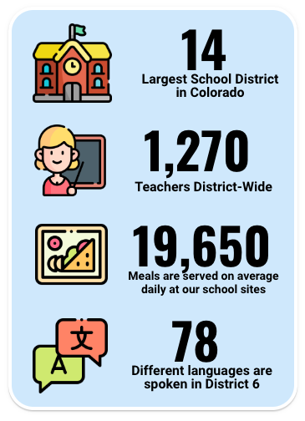
D6 by the numbers
Enrollment - 23,000 in 31 schools
Ethnicity by % of Students
  63.8% Hispanic or Latino
  28.8% White
Students with IEP - 3230

Slide 15
Problem
Too many students in pull-out support with alternate (below grade level) curriculum
Not equitable and accessible grade-level (Tier 1) instruction
Students not meeting grade level expectations and not graduating at the same rate as their peers
Led to identification on State and Federal Accountability Systems
  Every Student Succeeds Act (ESSA) Identified
  Empowering Action for School Improvement (EASI) Grants (+$5M)

Slide 16
Vision for Students with Disabilities Success
District 6 will ensure all students graduate college and career ready by providing an inclusive environment for students with disabilities where they have access to high-quality, evidence-based, grade-level instruction and are valued for their assets.

Slide 17
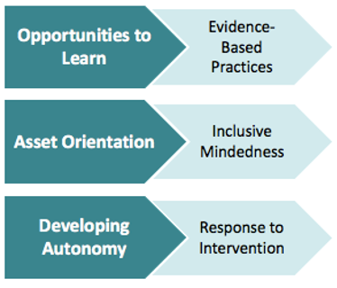
3 Focus Domains in Special Education Action Plan based on Self-Study
“Based on this analysis, the team determined that intentional and explicit focus on Inclusive Mindedness, Evidence-based Practices, and Response to Intervention would yield the most gains toward improving outcomes for students with disabilities.” pg.24

Slide 18
Implementation of the plan
Clear expectations from Superintendent
Professional development for building administrators and educators
Dr. Richard Villa - Co-Teaching
Toby King - Inclusive Practices and Student-Centered Scheduling
10 Co-Teaching Instructional Coaches to lead and model the approach
Start small and focus on identified schools

Slide 19
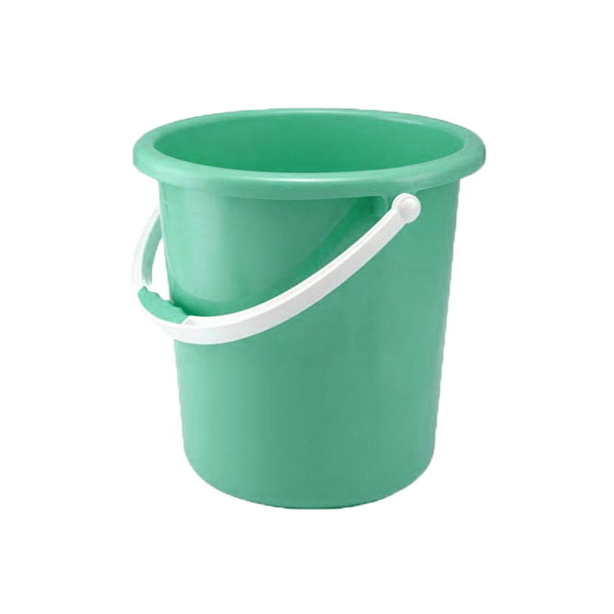
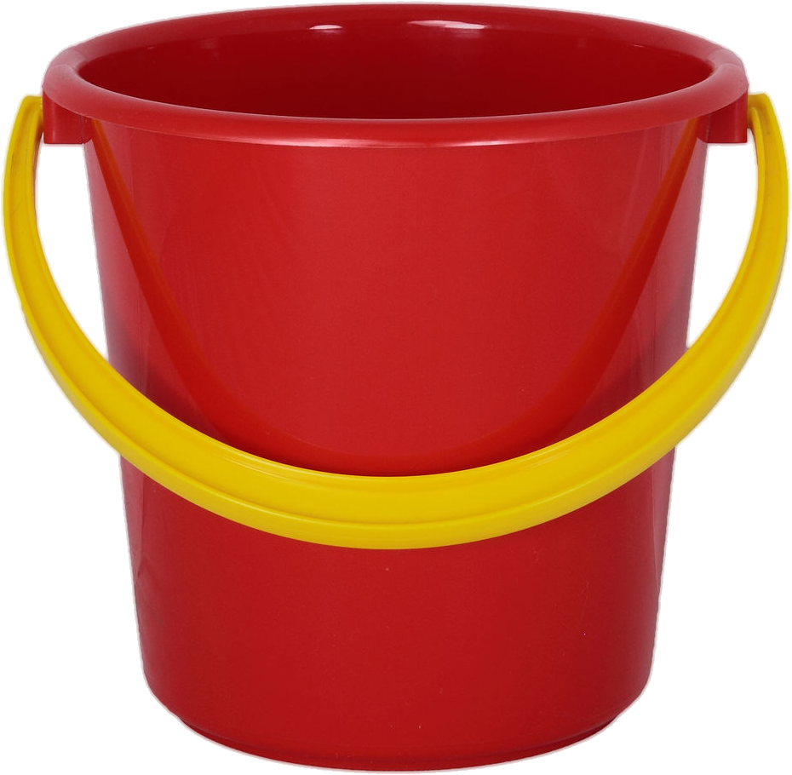
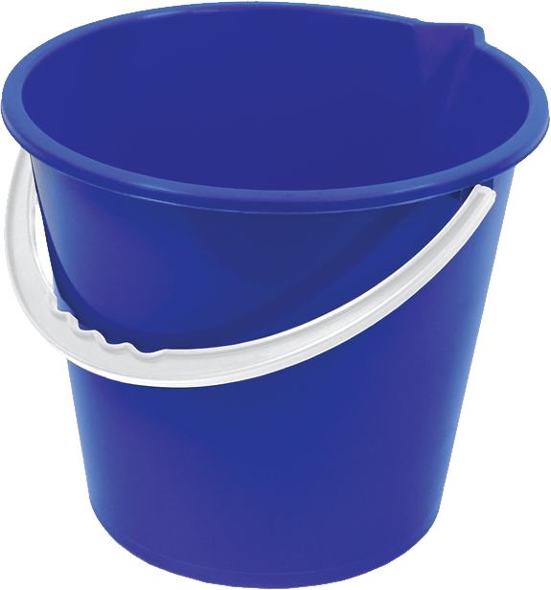
Least Restrictive Environment (LRE)/Most Inclusive Environment (MIE) “Buckets”
Least Restrictive Environment (LRE)/Most Inclusive Environment (MIE) “Buckets”
0-39% | 40-79% | 80-100%
Notes:
The Individuals with Disabilities Education Act (IDEA) is founded on the basic principle that students with disabilities should attend the school in their neighborhood and be integrated, to the maximum extent possible, with students without disabilities…Least Restrictive Environment (LRE) data is one way to measure how inclusive a school/district is for students with disabilities
The data is pulled directly from each Individualized Education Program (IEP) for students
When IDEIA is reauthorized, join us in advocating to change LRE to MIE
Most Inclusive Environment
Federal and State agencies sort LRE Data into 3 buckets.
0-39% of the student’s day in the general education environment.
40-79% of the student’s day in the general education environment.
80-100% of the student’s day in the general education environment.
It’s this last green bucket - that gets the most attention as it’s expected that MOST students spend MOST of their time in general education.
Infact, CDE has identified TARGETS for Districts regarding the 80-100% bucket. The target is for ______ of students with IEPs to spend 80% or more of their time in the general education environment.

Slide 20
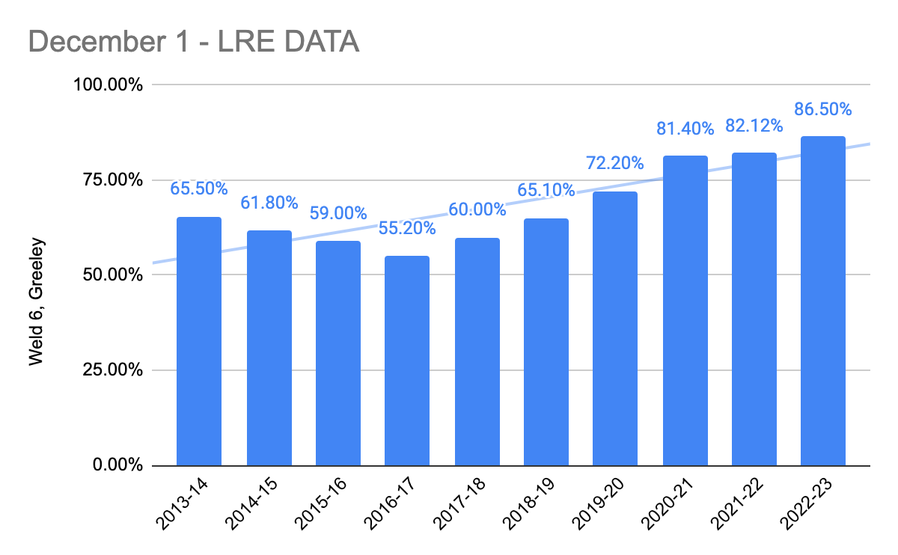
Decemer 1-LRE Data
Notes:
Orient you to this graph
% of time in general education on left
Dec 1 LRE data for each year along bottom
Orange line represents the 78.3% target from CDE
You can see a steady upwards trend from 2016-2017 school year to our current Dec 1 data
We exceed the state target last year and again this year.
More students with IEPs are accessing the general education environment/curriculum
Not only is the percentage growing but so is the total numbers of students with IEP
We are creating more inclusive environment for even more students.
Dec 1 2016/17 - 2384
Dec 1 2019/20- 2688 (more than 300 additional students)
The increase of inclusive environments is affecting student with IEPs of all races!

Slide 21
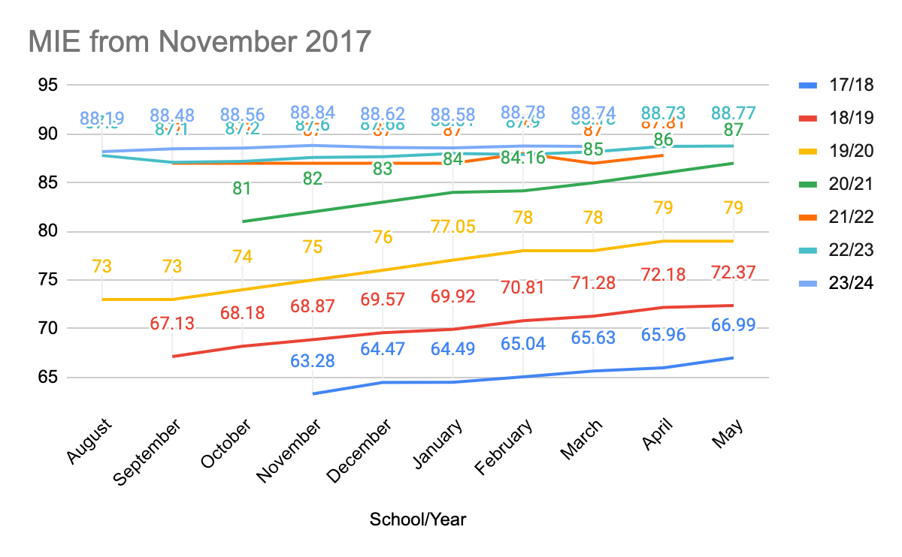
MIE from November 2017

Slide 22
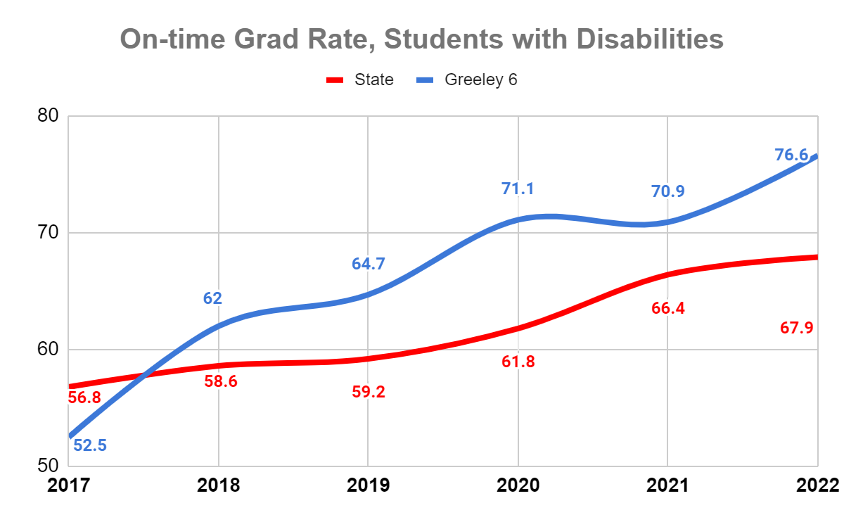
On-time Grad Rate, Students with Disabilities

Slide 23
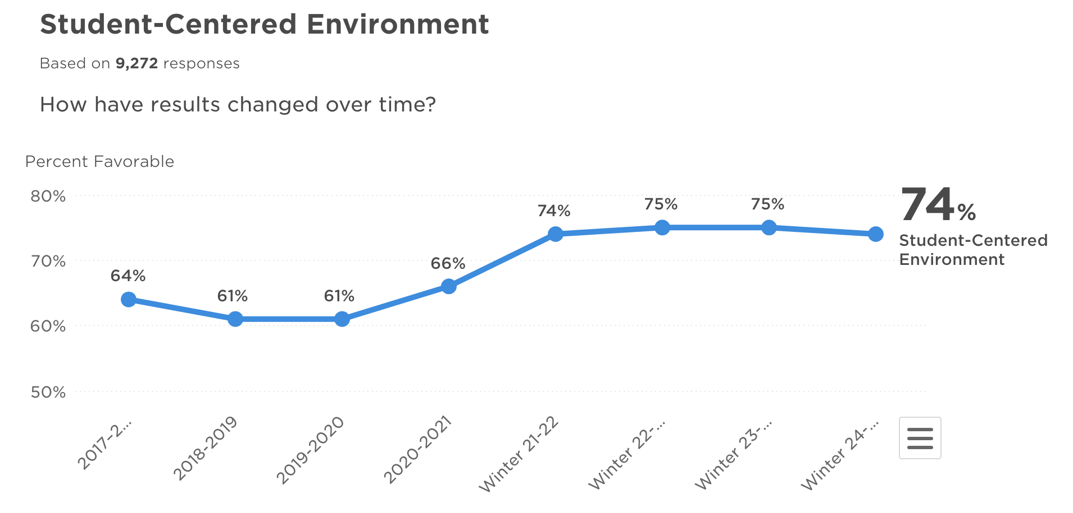
Student-centered Environment
Notes:
Student Perception Data using Panorama Survey
Elementary-I feel like I fit in 66%-72%
Secondary students-I fell like an important part of my classroom community. 58-68%

Slide 24
Quotes
“My child/student…
was invited to their first birthday party”
was invited to their first sleepover”
has friends to text with”
has better school behavior than ever before”
has a friend to hang out with at lunch”
has a real friend…for the first time…ever”

Slide 25


Workplace Opportunities

Slide 26

Workplace Partnership with local hospital system
LINK TO VIDEO

Slide 27
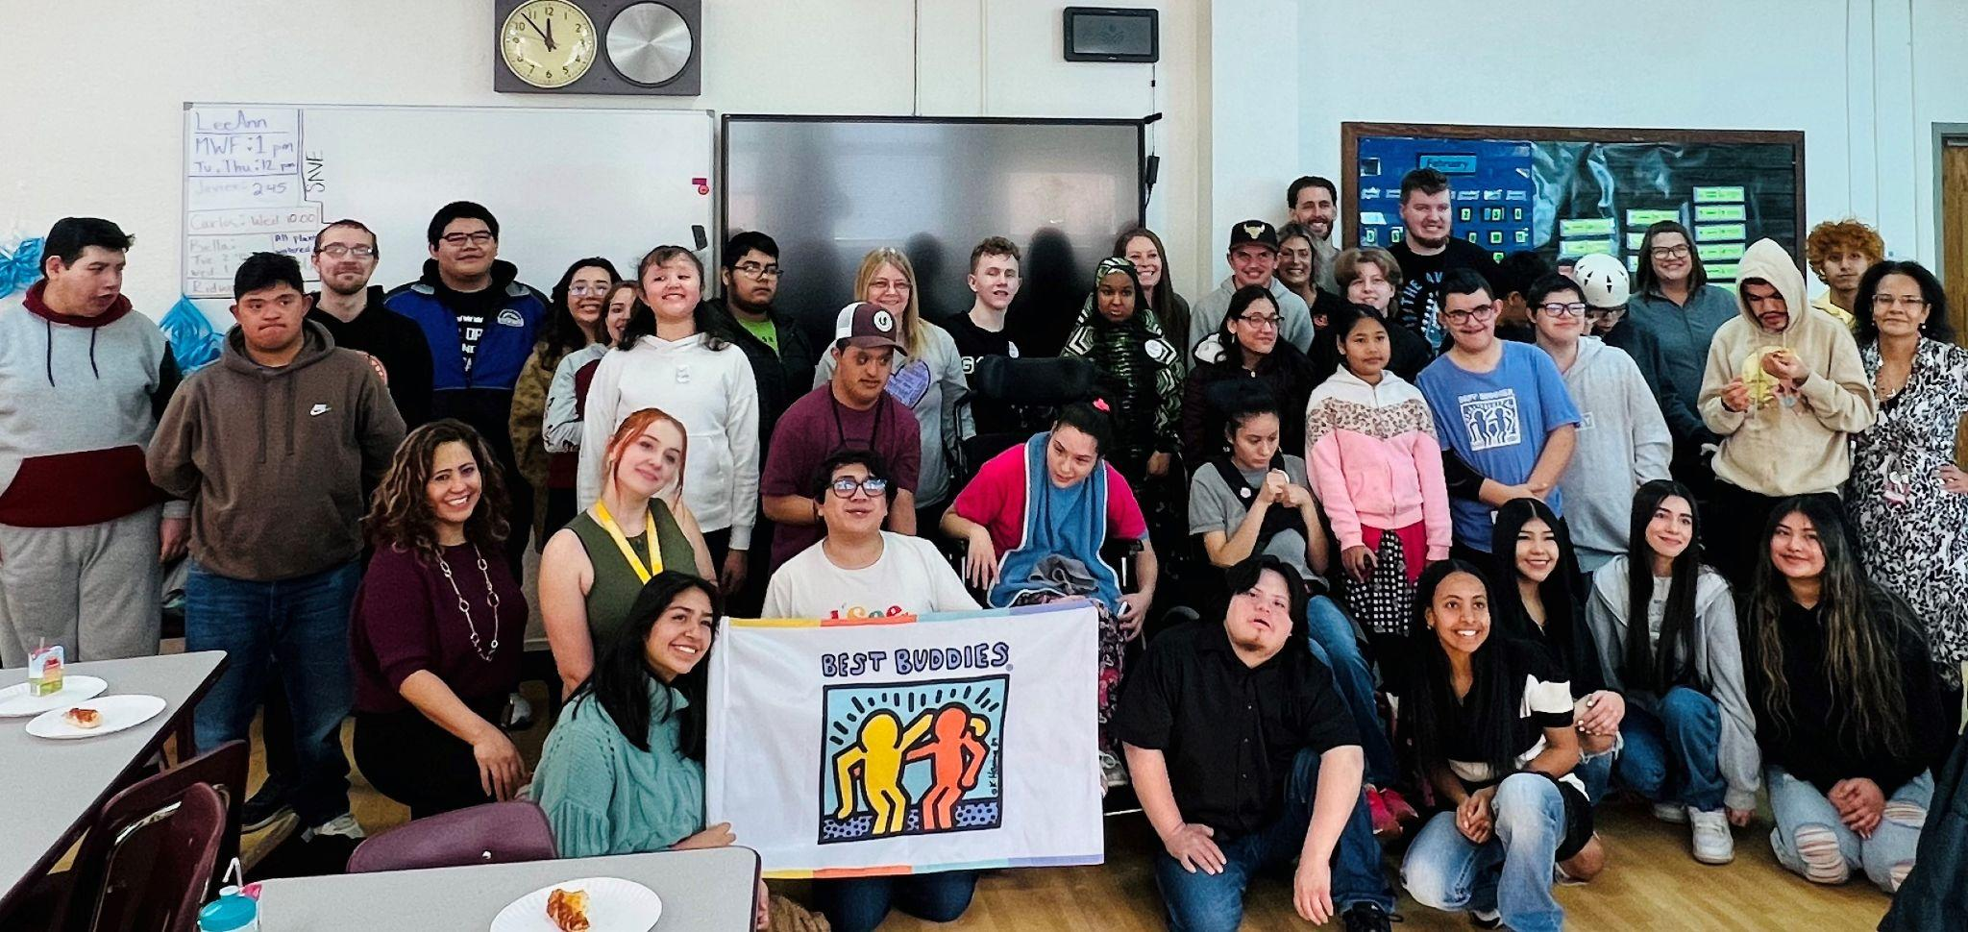
Inclusiveness Outside the Classroom
Growth in Unified Sports
Clubs such as Best Buddies
Junior Special Education Advisory Council (SEAC) with 30 + Students
Notes:
Big Hairy Audacious Goal (5:40)

Slide 28
Ongoing Challenges
A building can only be as inclusive as the principal allows
Student-centered scheduling
Educator planning time
Inclusive mindset
Ongoing inclusion of all students in high-quality instruction and assessment practices
Working toward MIE!

Slide 29

Contact Information
Tom Gribble - Greeley-Evans School District 6
tgribble@greeleyschools.org
Danielle Bock - Greeley-Evans School District 6
dbock@greeleyschools.org
Amie Cieminski - University of Northern Colorado
amie.cieminski@unco.edu

Slide 30
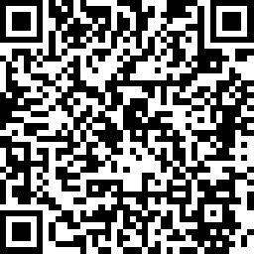
Invitations
Our next TAG meeting is April 3rd, we are discussing:
  Communities of Student Care and Support (IC Standard 5) again.
    Please review pages 35-37 in the IC document to help orient you to our next meeting topic.
  Next IC training is March 7th 12-1:30 ET, sign up here
Please use the first 5 minutes of your state team reflection time to complete the CEEDAR Topical Action Group survey. This will provide us with helpful and critical feedback to report back to our funders as well as help us strengthen our TAG.
Scan QR code for survey or use the link in the chat
Notes:
speaker: Abby
thank the presenters from Colorado and share out final thoughts before our break out rooms, HAVE FOLKS COMPLETE THE SURVEY
Nichole send CEEDAR Topical Action Group Survey
3:40-42

Slide 31
State Team Reflection
Please access your blueprint from your state notes page to help with these questions. This also provides you a space to record your thinking during discussion.
  What ideas did you hear today that resonated with you?
  How might what you learned today impact your state plan or the work in your organization?
After these breakout rooms, we will not return to the main room, you will be free to leave. Don’t forget to complete the CEEDAR Topical Action Group survey!
Notes:
speaker: Abby
Now with your state team in breakout rooms, please reflect on Colorado’s presentation and how it relates to your state’s work.
each breakout room will have a CEEDAR staff member or SLT member to help guide your conversations, you will have until the end of the hour. After these breakout rooms, we will not return to the main room, you will be free to leave. Do we have any questions?
Nichole sends questions in the chat and state notes page
In your state time discuss:
What ideas did you hear today that resonated with you?
How might what you learned today impact your state plan or the work in your organization?

