Slide 1
Welcome to
CEEDAR’s Leadership
Topical Action Group (TAG)
Thursday, February 6th 2024
3:00-4:00 Eastern Time
Welcome to our TAG!
Participants: please change your Zoom name to
your state and name
Ex: Florida, Agatha Trunchbull
CEEDAR staff: please change your Zoom name to
CEEDAR, Your name
Notes:
Abby: Make everyone co-hosts
Speaker: Abby
3:00-3:01

Slide 2

Check in:
Did you ever have a “good luck charm” or go-to study study strategy to use before an assessment? Share your response in the chat.
Notes:
Speaker: Abby Please change your name to Your state abbreviation and your first and last name
3:00-3:02

Slide 3
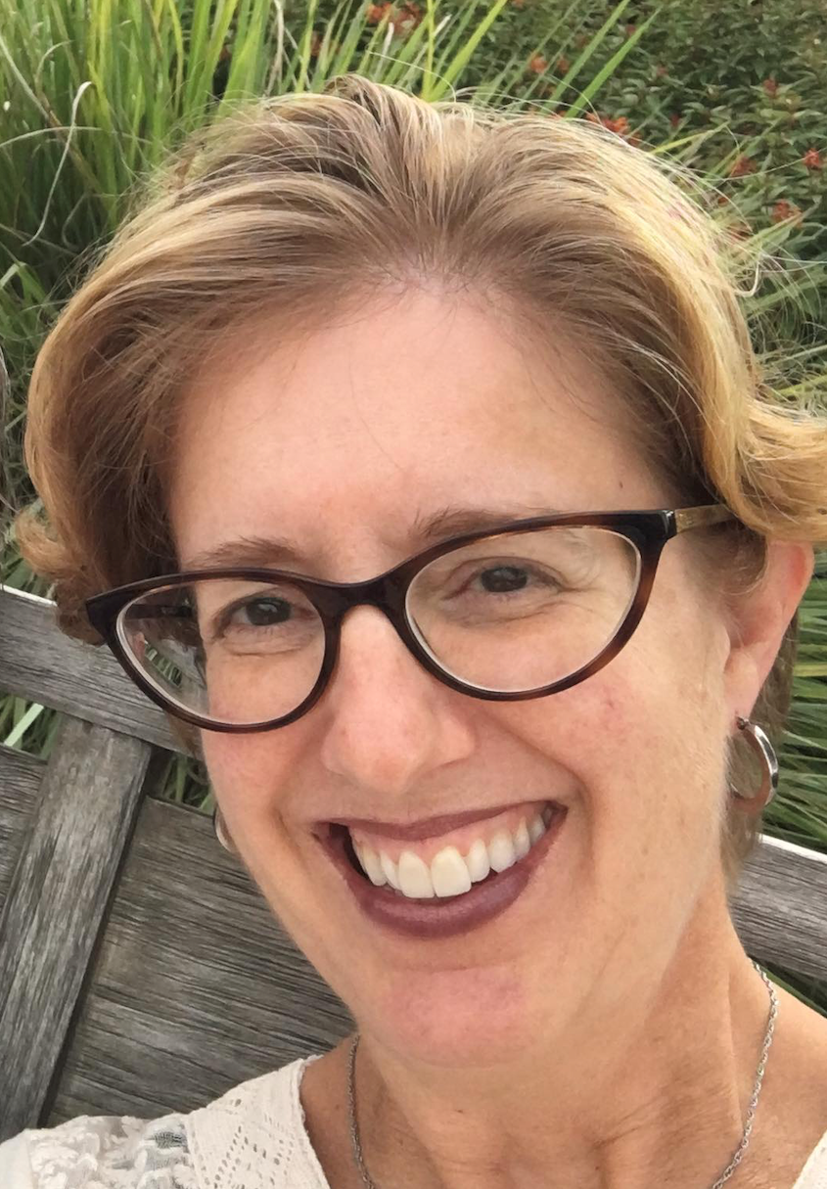
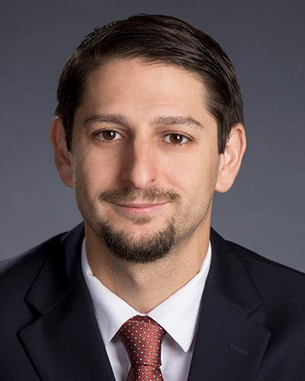
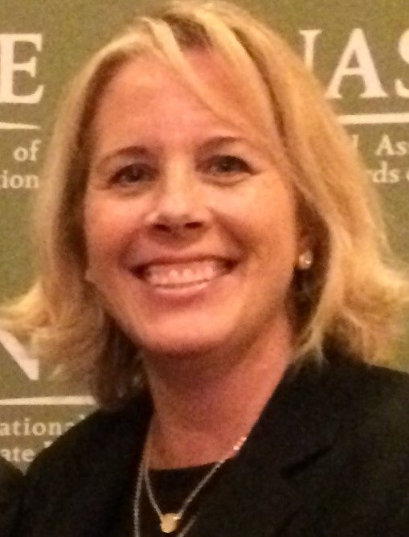
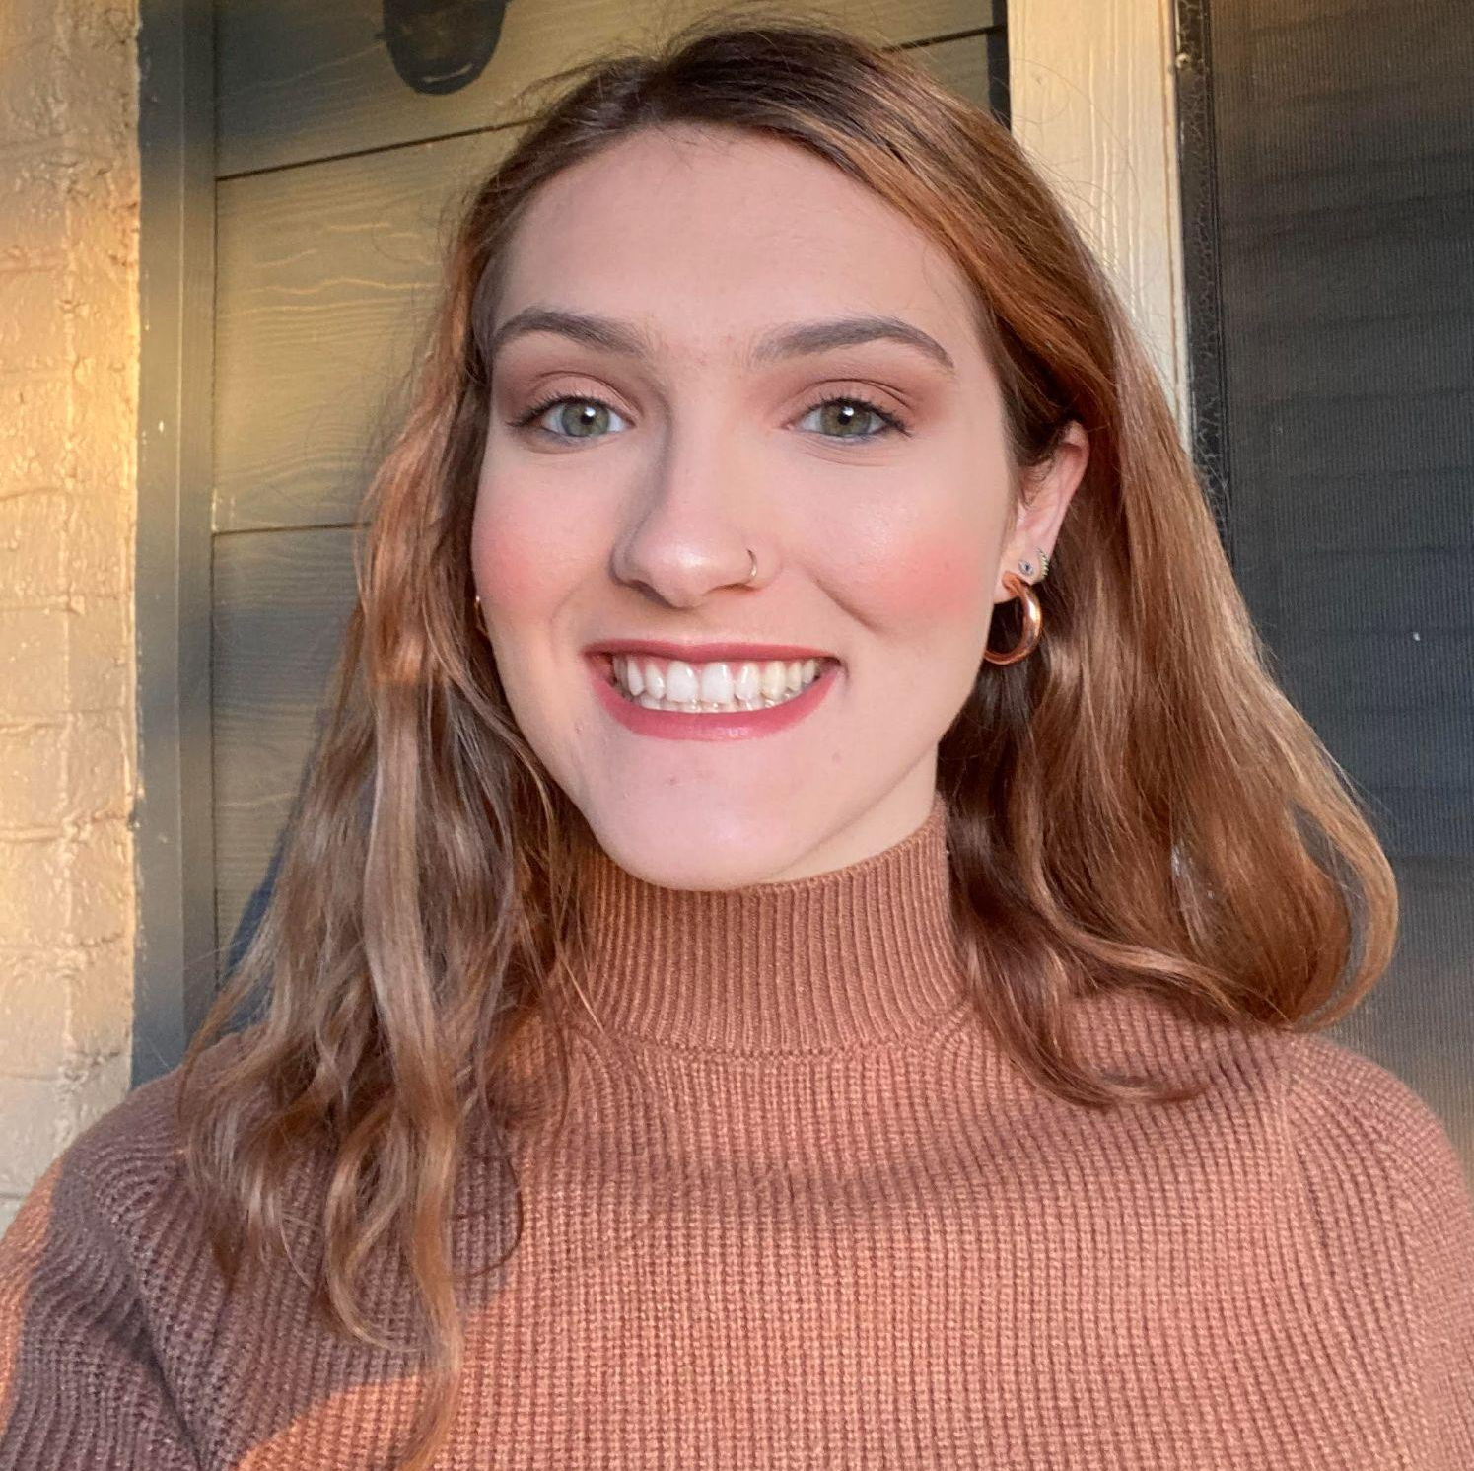
Welcome & Introductions
Dr. David DeMatthews
Professor, Department of Education Leadership and Policy,
The University of Texas at Austin
Nichole Spalding
Technical Assistance Specialist,
CEEDAR, University of Florida
Abby Berner
Engagement Specialist, CEEDAR, Research Assistant, American Institute for Research (AIR)
Dr. Bobbi Newman
State Lead for CEEDAR Center, Principal Researcher, American Institute for Research (AIR)
Notes:
Speaker: Bobbi
3:02-3:03

Slide 4





Our Partners
Notes:
Speaker: Bobbi
A warm thank you to our partners
Our partners are Lead IDEA, NASSP, and CCSSO- they are our liaisons and will share resources, they can provide additional perspectives. If you are here from one of these partner organizations, please share who you are in the chat and feel free to share your expertise!
3:02-3:03

Slide 5
The purpose of the TAG is to…
elevate the importance of effective leadership in our work,
focus on effective practices in our programs, coursework, clinical experiences, and policies,
engage in authentic conversations on their effective leadership efforts,
and share expertise, successes and challenges, and discuss how to use resources to support scaling and sustainability.
Notes:
Speaker: Bobbi
Recognize that we have different roles as members of our TAG (SEA, IHE, associations, local) we want to be mindful of these roles as we talk in cross state and state team time
3:02-3:03

Slide 6
Leadership TAG
Potential Topics for Discussion
Date | Topic
January 9 | Curriculum, Instruction and Assessment
February 6 | Curriculum, Instruction and Assessment
March 6 | Communities of Student Care and Support
April 3 | Professional Capacity and School Personnel;
May 1 | Professional Community for Teachers and Staff
June 5 | Meaningful Engagement of Families and Community
July 10 | Operations and Management, School Improvement
Notes:
speaker: Bobbi
3:03-3:04
mention that the july 10th date was added, make sure you have accepted the invite

Slide 7
Today’s Agenda
Welcome and Introductions
Resource Sharing - Standard 4
Cross State Breakout Groups
Spotlight on Georgia
Final Thoughts and Action Items
Dismiss from State Breakout Groups
Notes:
Speaker: Bobbi
Nichole put meeting norms in chat
Meeting norms:
Be present and prepared
Respect in the shared space and keep what is shared in confidence. We are creating a community.
We will record guest speakers and resources sharing, but nothing else. What happens in the TAG, stays in the TAG!
Breakout rooms could be mixed cross state or state specific depending on the work.
Group members should “believe the best” and lead with positive intentionality.
3:04-3:05

Slide 8
Standard 4: Curriculum, Instruction, and Assessment
“Principals have the responsibility to support intellectually rigorous and coherent systems of curriculum, instruction, and assessment to foster student achievement…” (p. 25).
Standard Components | Program/ Faculty | Courses | Clinical | Policy
4.1: Communicate high academic expectations for all students, including students with disabilities; promote high-quality, intellectually challenging curricula and instruction; and provide opportunities for students with disabilities to achieve within the general education curriculum using multi-tiered systems of support (MTSS). |  | X
4.2: Work collaboratively with classroom teachers to help them develop their capacity for effective instruction for each student |  | X

Slide 9
Standard 4: Curriculum, Instruction, and Assessment (continued)
“… many principals lack the pre-service and in-service preparation to identify or support high-quality instruction for students with disabilities; thus, they need to proactively seek guidance and support for this work (p. 26).
Standard Components | Program/ Faculty | Courses | Clinical | Policy
4.3: Ensure that evidence-based practices (EBPs) and high-leverage practices (HLPs) are implemented. | X
4.4: Promote appropriate, clear, and valid monitoring and assessment systems in which teachers receive meaningful information about how students respond to instruction and where information is relevant to instructional improvement |  |  | X

Slide 10
Interconnected: Standards 4-5
Standard 4 Curriculum, Instruction, and Assessment
Standard 5
Community of Care and Support for Students

Slide 11
Cross State Breakout Room Guiding Question
Share an example of how your SEA/EPP is strengthening program implementation of curriculum, instruction, and assessment for aspiring and current school leaders.
CEEDAR facilitators, be prepared to come back from breakouts and share 1-2 sentences that summarize the discussion.
We will stay in these breakout rooms until 3:30 ET.
Notes:
Speaker: Bobbi
groups till 3:30 ET
Mix of state and CEEDAR facilitators
Abby will put in chat: slide screenshot
3:15-3:16

Slide 12
Takeaways from Cross State Discussion
Welcome back! CEEDAR facilitators, share 1-2 sentences in the chat that summarize your group’s discussion.
Notes:
Speaker: David
intro NH folks
3:27-3:30

Slide 13

Georgia Educational Leadership Faculty Association
Karen Bryant, Nick Sauers, Jami Berry, Kaneshia Dorsan
Notes:
Karen will introduce colleagues and the agenda on the next slide. Total three minutes for first three slides.

Slide 14
Agenda
GELFA Overview
GELFA/CEEDAR Collaboration
UGA Inclusive Leadership Protocol
Notes:
Karen

Slide 15
GELFA Overview
Our mission is to support personal and
professional growth for improving the teaching
and learning of educational leadership in
Georgia.
2024-2025 VPLC Focus: Innovative Programmatic Improvement
Notes:
Karen will provide a brief history of GELFA and how ed leadership preparation programs in Georgia have collaborated on curriculum development. One example: Development of Tier I and Tier II programs

Slide 16
GELFA/CEEDAR Collaboration
Identify program needs and alignment to HLPs. Share in GELFA meeting at Summer GAEL focused on reading/ literacy instruction.
Revisit high-leverage practices, their implementation, and review the new HLP Guide.
Identify HLPs that align with and support reading/literacy instruction.
HLPs 13, 16, &20
Notes:
Nick will share (3 min.) how CEEDAR has collaborated with GELFA to ensure that leaders are prepared to meet the needs of each and every student. Examples from Blueprint: presentations at GELFA meetings. Meg presented at Winter GAEL on HLPs.Jami presented at Summer GAEL on connections to reading and literacy instruction. A graphic depicting identified HLPs is in the works.Identified HLPs listed below.
HLP 13. Adapt curriculum tasks and materials for specific learning goals.
Related PSEL Standards
PSEL 4. Curriculum, Instruction, and Assessment
HLP 16. Use explicit instruction.
PSEL 4. Curriculum, Instruction, and Assessment
HLP 20. Provide intensive instruction.
PSEL 3. Equity and Cultural Responsiveness

Slide 17

Inclusive Principal Leadership Se
Se
Leadershi
Notes:
Jami and Kaneshia will share (4 min) how the inclusive leadership self-assessment and reflection protocol is used in Ed Leadership classes at UGA.

Slide 18
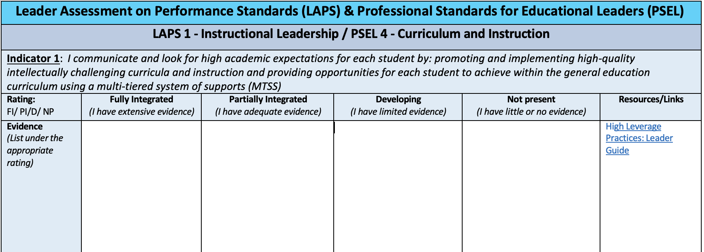
Leader Assessment on Performance Standards (LAPS) & Professional Standards for Educational Leaders (PSEL)
LAPS 1 - Instructional Leadership / PSEL 4 - Curriculum and Instruction
Indicator 1: I communicate and look for high academic expectations for each student by: promoting and implementing high-quality intellectually challenging curricula and instruction and providing opportunities for each student to achieve within the general education
curriculum using a multi-tiered system of supports (MTSS)
Rating:
FI/ PI/D/ NP
Fully Integrated
(I have extensive evidence)
Partially Integrated
(I have adequate evidence)
Developing
(I have limited evidence)
Not present
(I have little or no evidence)
Resources/Links
Evidence
(List under the appropriate rating)
High Leverage
Practices: Leader Guide
Leader Assessment on Performance Standards (LAPS) & Professional Standards for Educational Leaders (PSEL)
LAPS 1 - Instructional Leadership / PSEL 4 - Curriculum and Instruction
Indicator 1: I communicate and look for high academic expectations for each student by: promoting and implementing high-quality intellectually challenging curricula and instruction and providing opportunities for each student to achieve within the general education
curriculum using a multi-tiered system of supports (MTSS)
Rating:
FI/ PI/D/ NP
Fully Integrated
(I have extensive evidence)
Partially Integrated
(I have adequate evidence)
Developing
(I have limited evidence)
Not present
(I have little or no evidence)
Resources/Links
Evidence
(List under the appropriate rating)
High Leverage
Practices: Leader Guide
Notes:
Jami and Kaneshia: Highlight alignment to state and national leader standards and the link to the high leverage practices guide as a resource.Leadership candidates rate themselves based on artifacts and evidence.

Slide 19
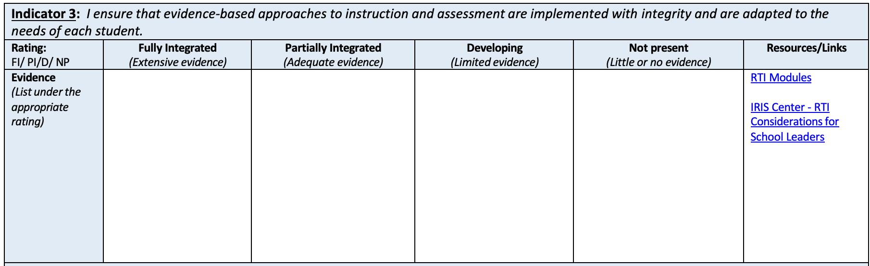
Notes:
Highlight the emphasis in Indicator 3 on meeting the needs of each student and the IRIS Center resources.

Slide 20
Nick Sauers, Georgia State University
nsauers@gsu.edu
Jami Berry, University of Georgia
JamiBerry@uga.edu
Kaneshia Dorsan, University of Georgia
kdorsan@uga.edu
Karen Bryant, University of Georgia
bryantkc@uga.edu
Notes:
Thank you! We will be happy to answer any questions.

Slide 21
Invitations
Our next TAG meeting is March 6th, we are discussing:
  Communities of Student Care and Support (IC Standard 5).
    Please review pages 35-37 in the IC document to help orient you to our next meeting topic.
  We are looking for a state to highlight in this March meeting.
    If you have a connection within your state work that connects to IC Standard 5, please reach out to aberner@air.org
  We will be updating some of our meetings to help with scheduling a virtual CEEDAR convening, more info to come!
Notes:
speaker: Bobbi
thank the presenters from GA and share out final thoughts before our break out rooms
Abby send IC document
3:40-42

Slide 22
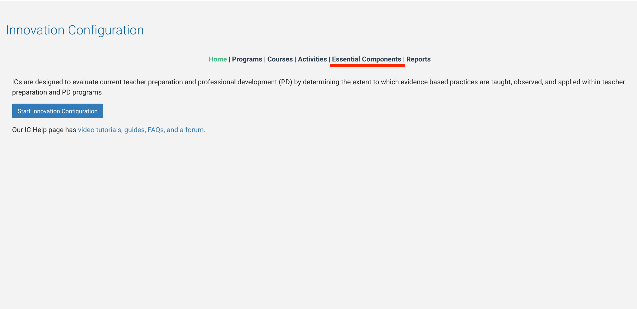
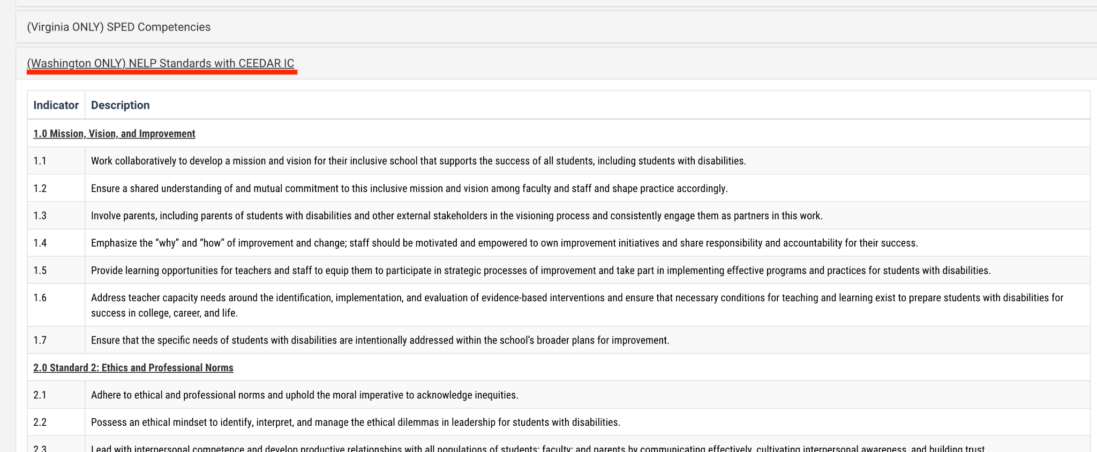
Helpful Resource
Within our Networked Improvement Community (NIC), CEEDAR has added a component to help crosswalk the NELP standards to the PSEL standards. PSEL are the standards that are used in our Principal Leadership IC.
Notes:
speaker: Bobbi
share resource and Abby share link https://ceedarnic.org/
3:42-43

Slide 23
State Team Reflection
Please access your blueprint from your state notes page to help with these questions. This also provides you a space to record your thinking during discussion.
  What ideas did you hear today that resonated with you?
  How might what you learned today impact your state plan or the work in your organization?
After these breakout rooms, we will not return to the main room, you will be free to leave.
Notes:
speaker: Abby
Now with your state team in breakout rooms, please reflect on GA’s presentation and how it relates to your state’s work.
each breakout room will have a CEEDAR staff member or SLT member to help guide your conversations, you will have until the end of the hour. After these breakout rooms, we will not return to the main room, you will be free to leave. Do we have any questions?
Nichole sends questions in the chat and state notes page
In your state time discuss:
What ideas did you hear today that resonated with you?
How might what you learned today impact your state plan or the work in your organization?

